Slide 1
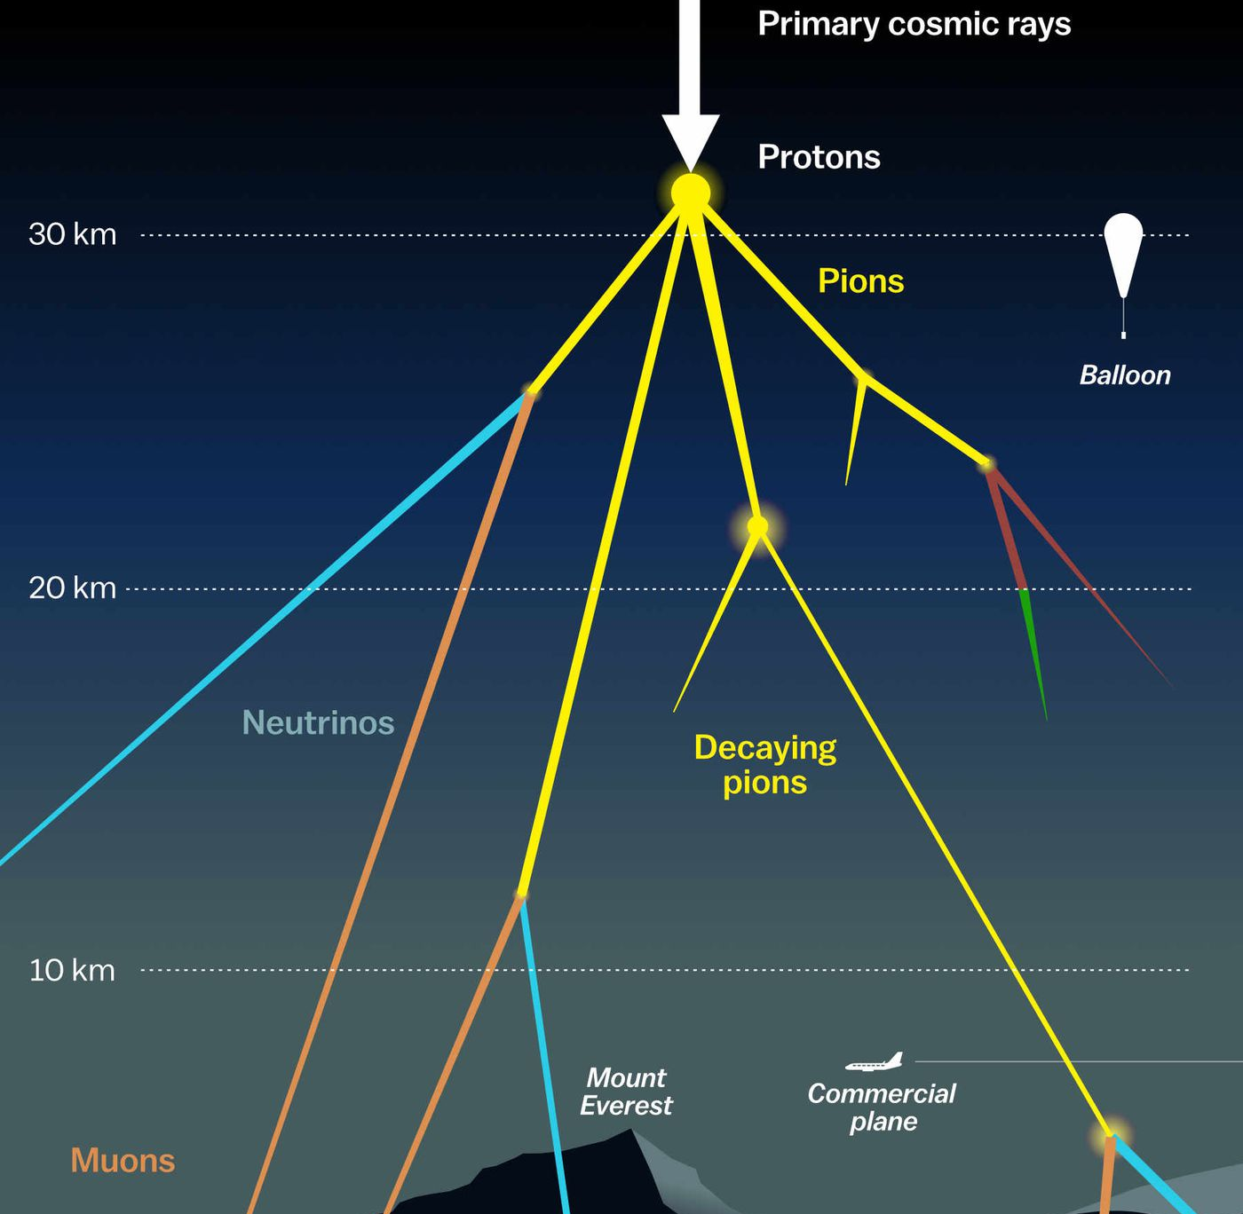

Update Plots - Data-MC mis-match fixed Pascal Gutjahr ICRC 2025 Plot Approval June 15, 2025
WG reviewer: Dennis Soldin
Coll. reviewer: Anatoli Fedynitch
Technical reviewer: Karolin Hymon
Wiki: prompt wiki
Last update: Uppsala May 14
Plot approval: wiki
Source: NASA

Slide 2

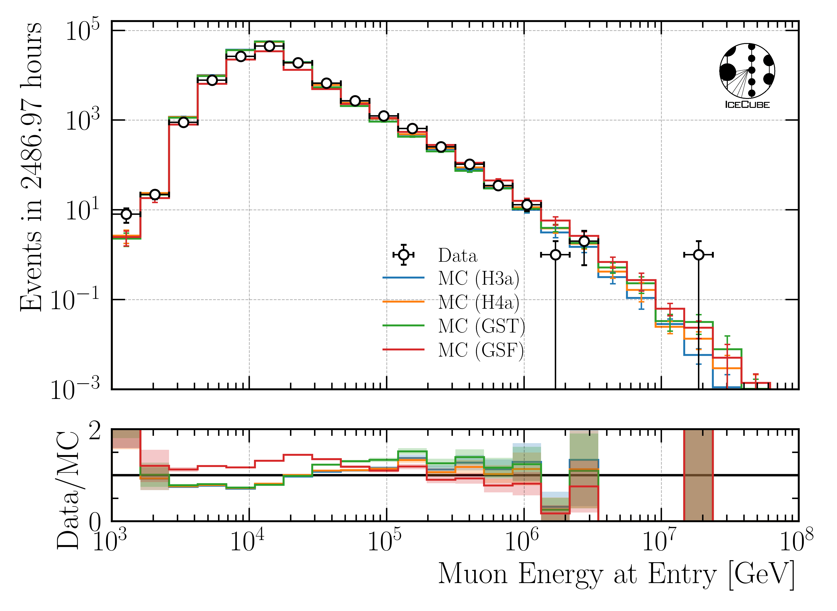
Data-MC: Leading Muon Energy (no cut)
Mis-match for all 4 primary models
Different shape for GSF and the other 3 models

Slide 3
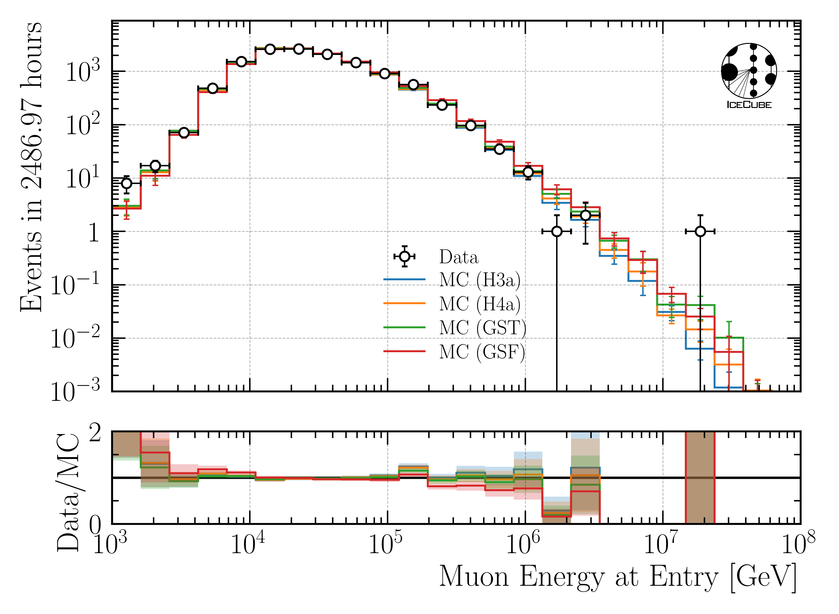
Data-MC: Leading Muon Energy (leadingness cut of 0.4)
leadingness: leading muon energy divided by total bundle energy (at entry)

Slide 4
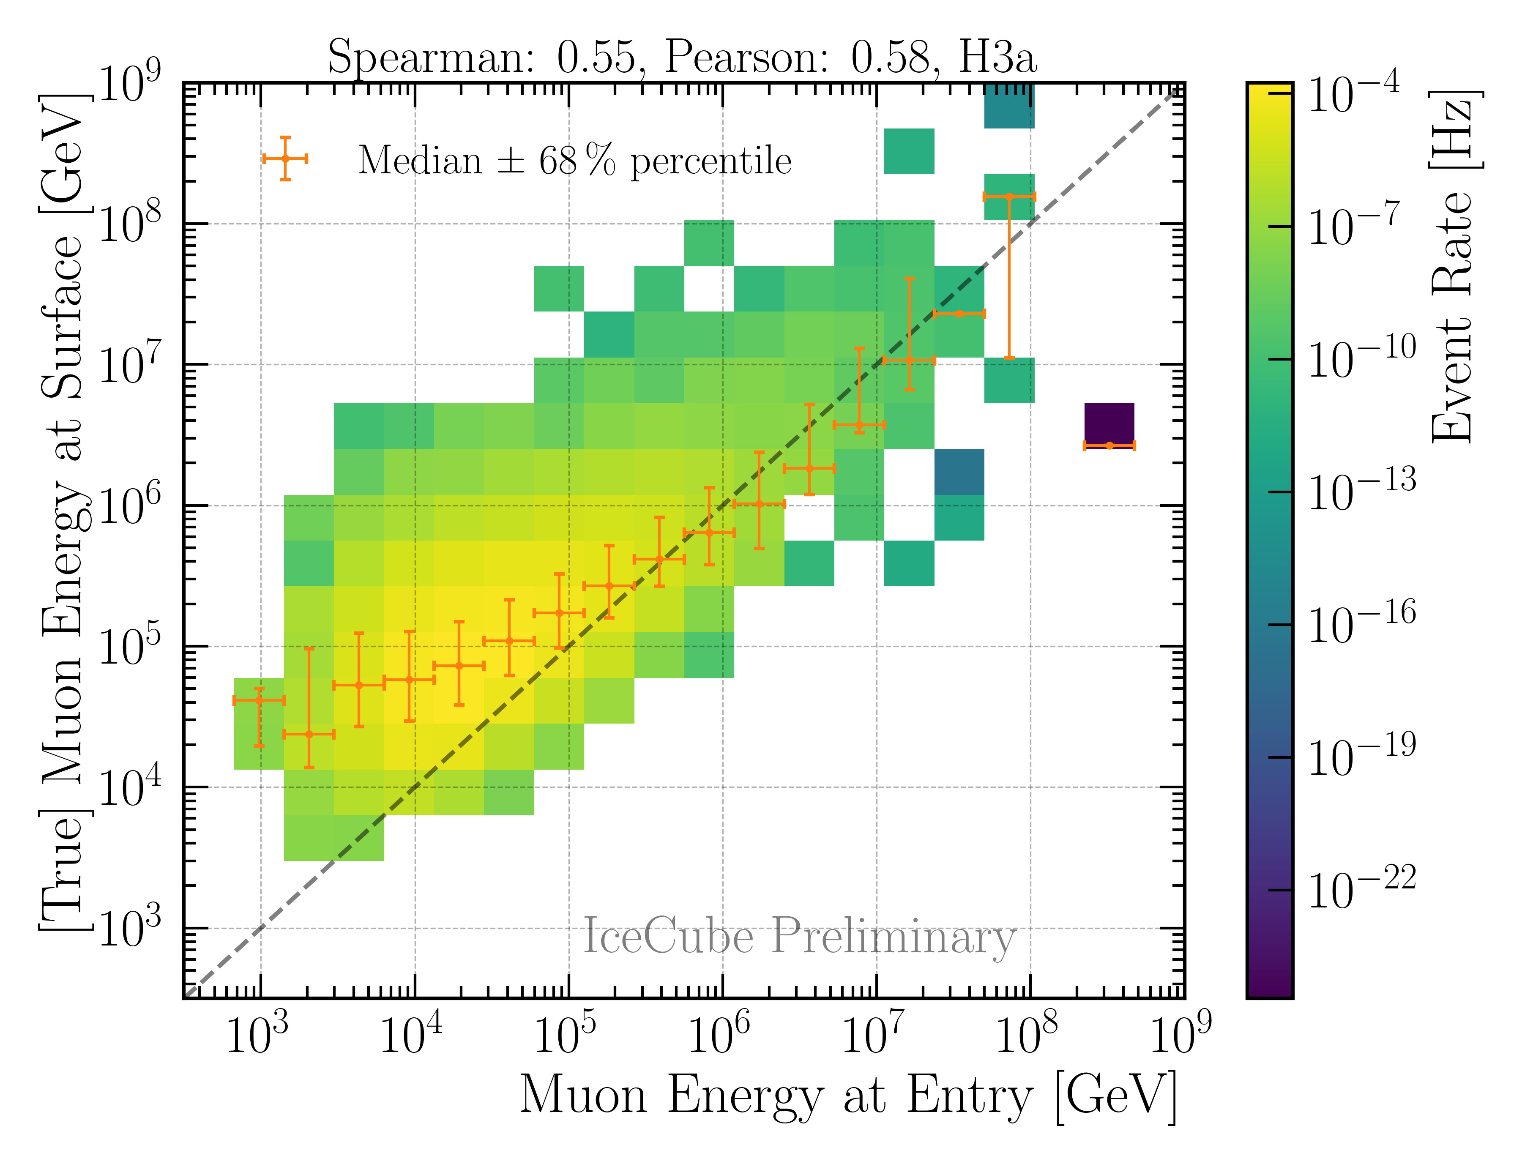
Correlation
better correlation than before

Slide 5
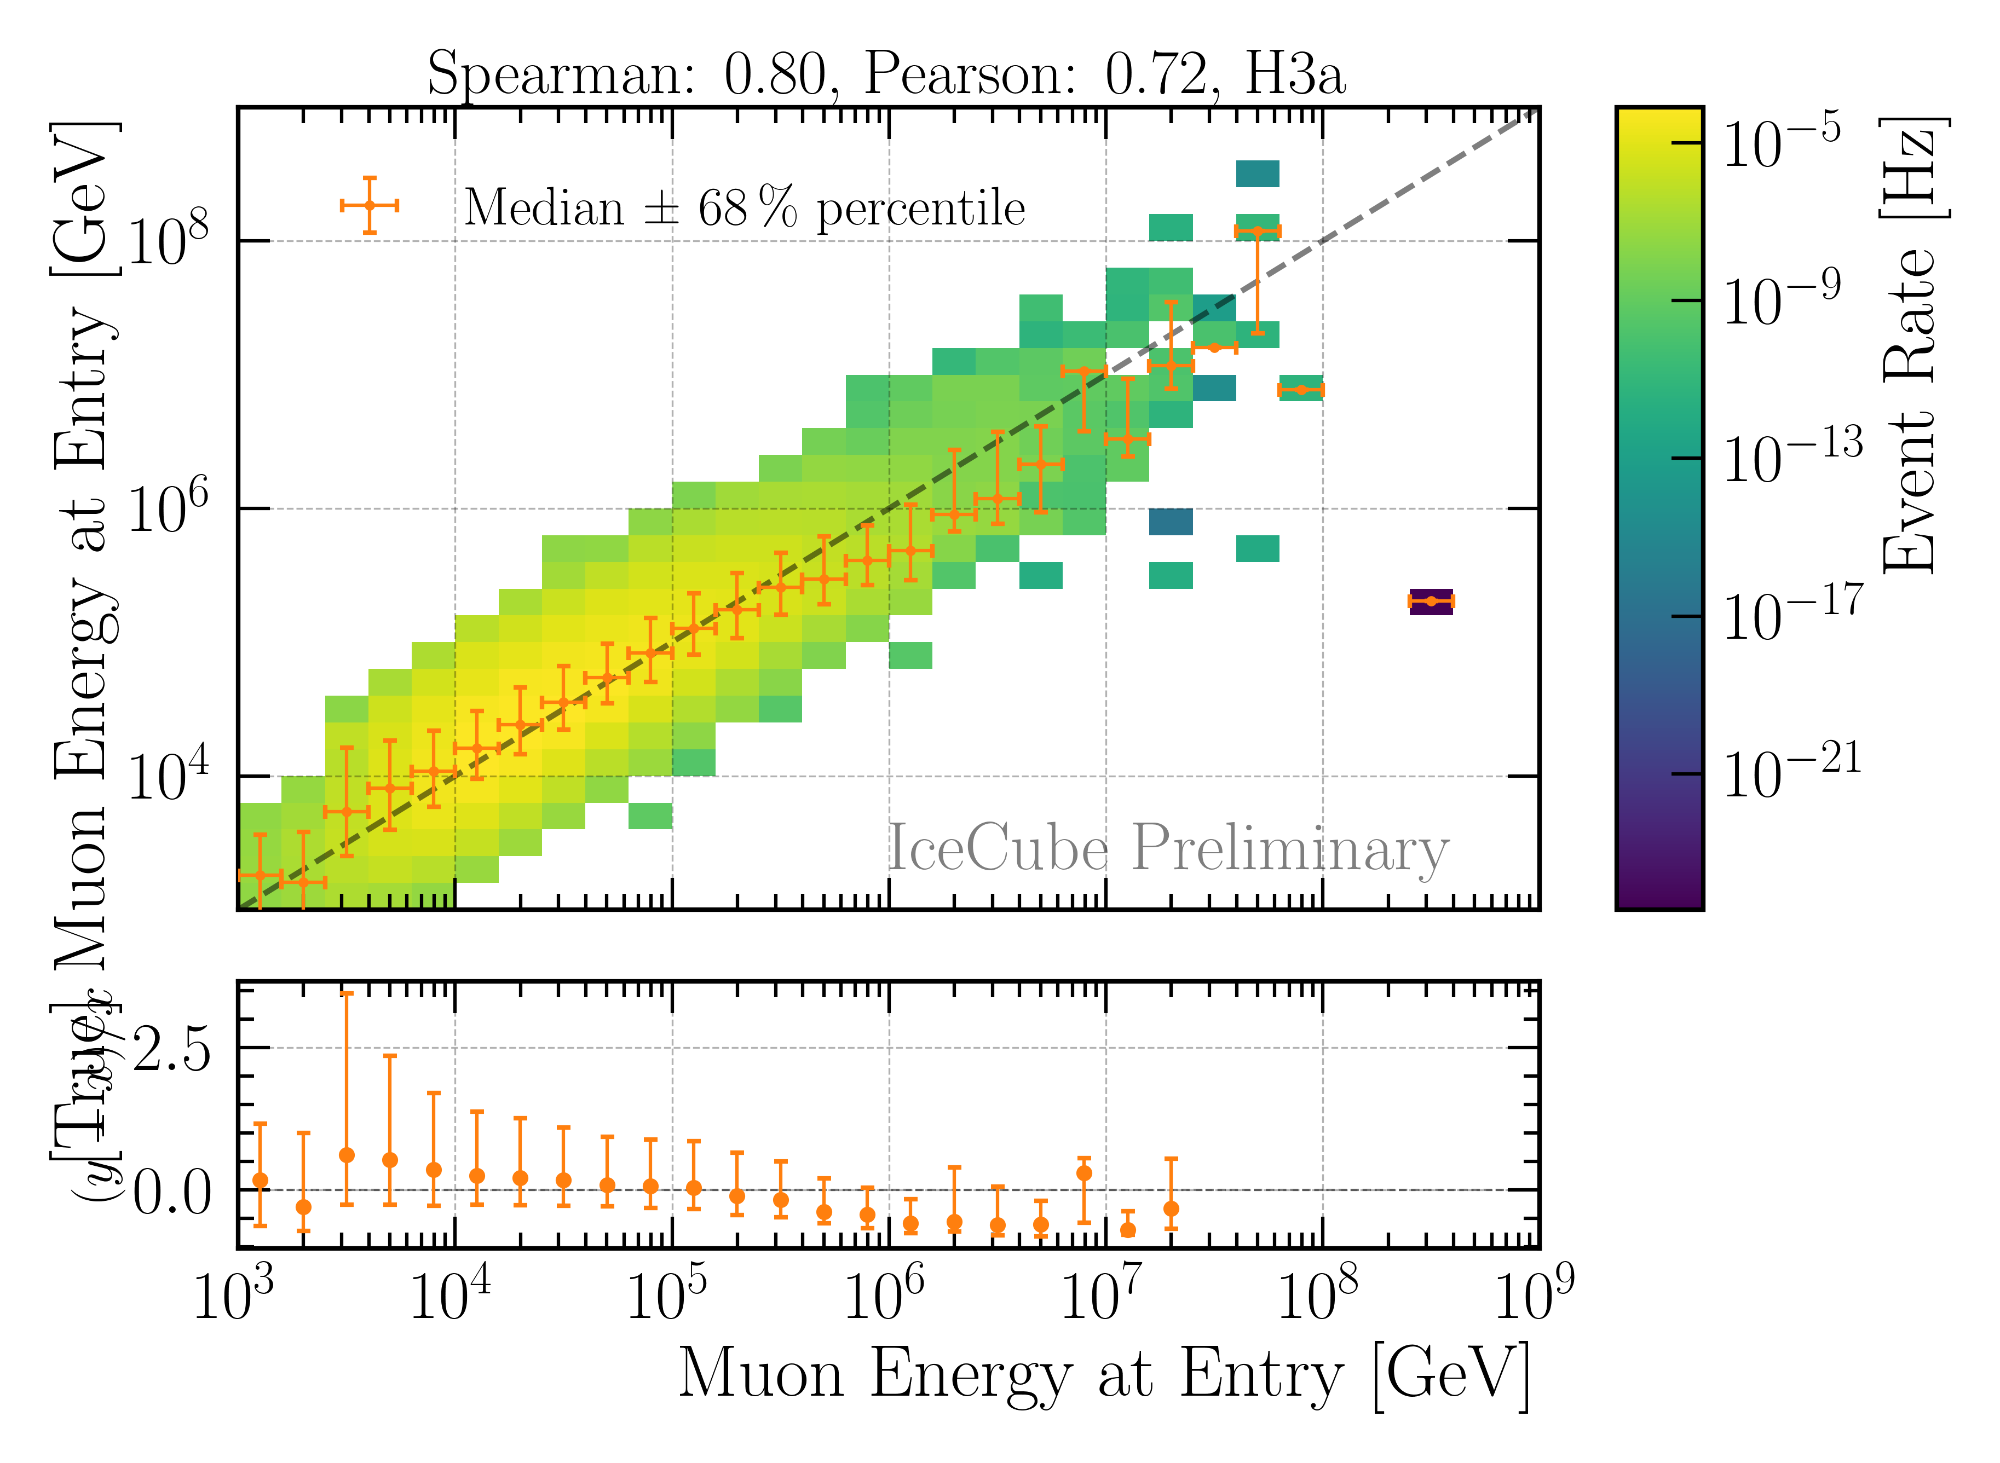
Reconstruction: True vs Pred
better resolution than before
label will be fixed

Slide 6
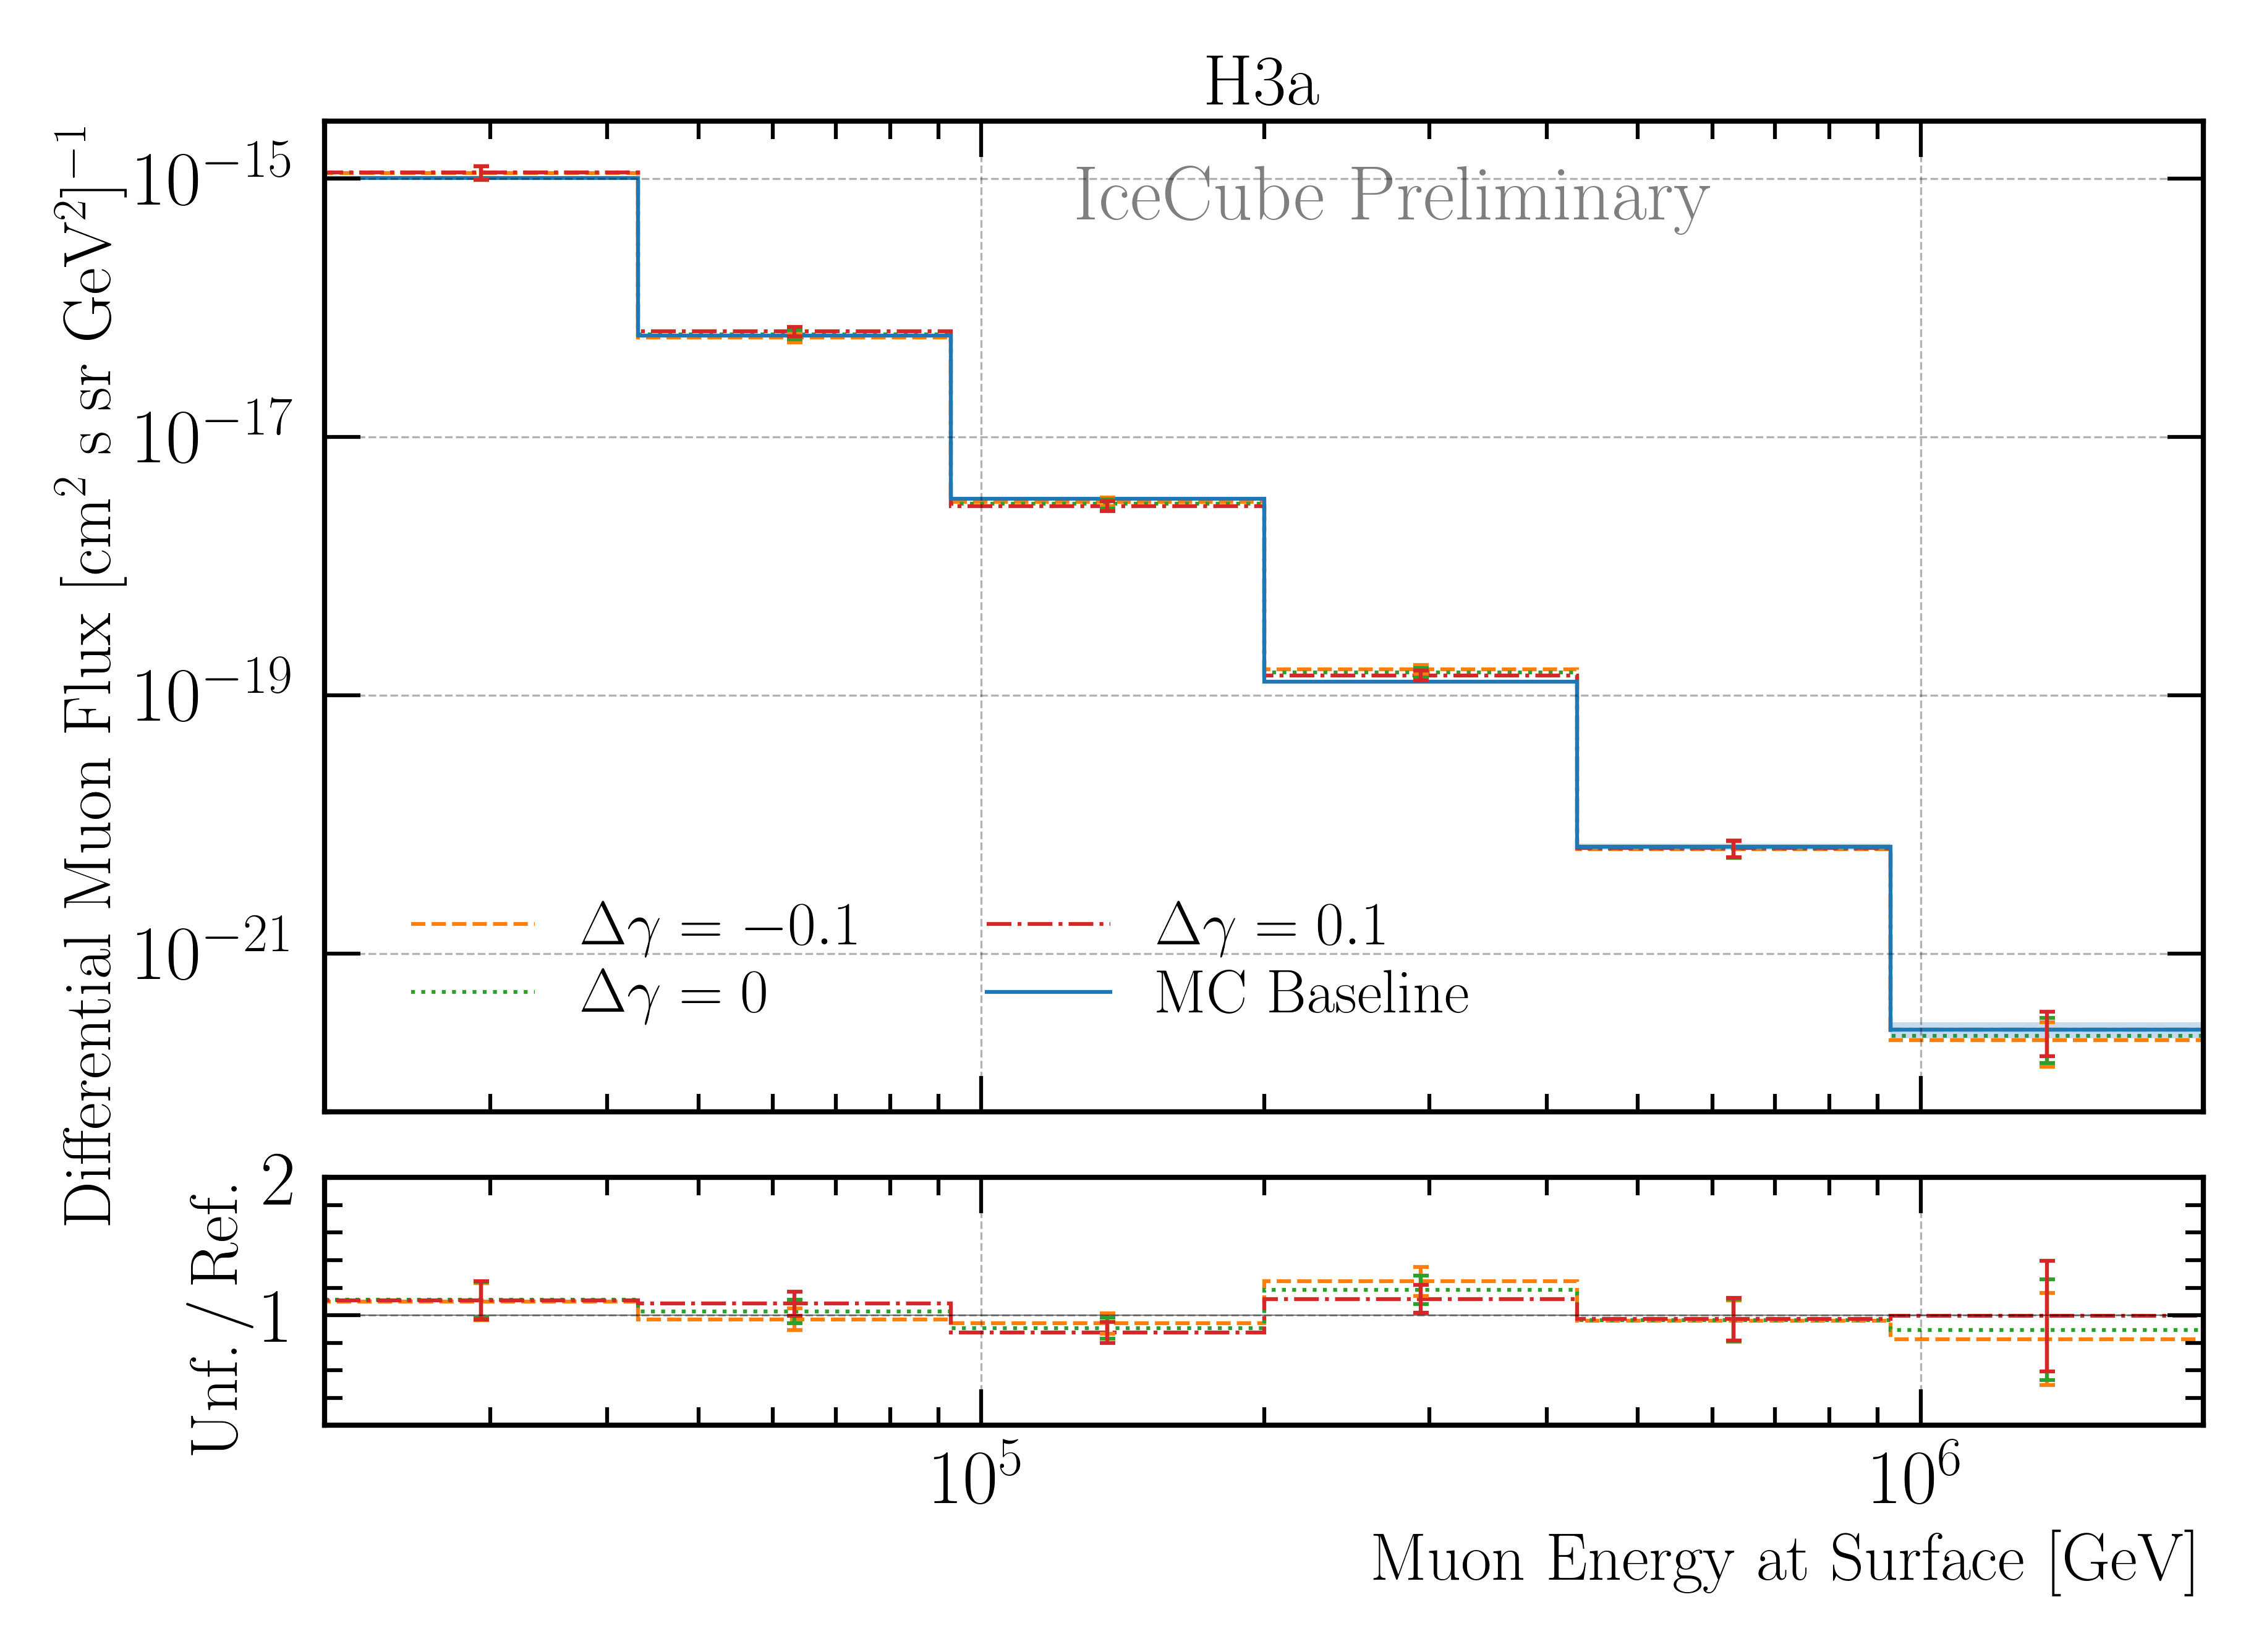
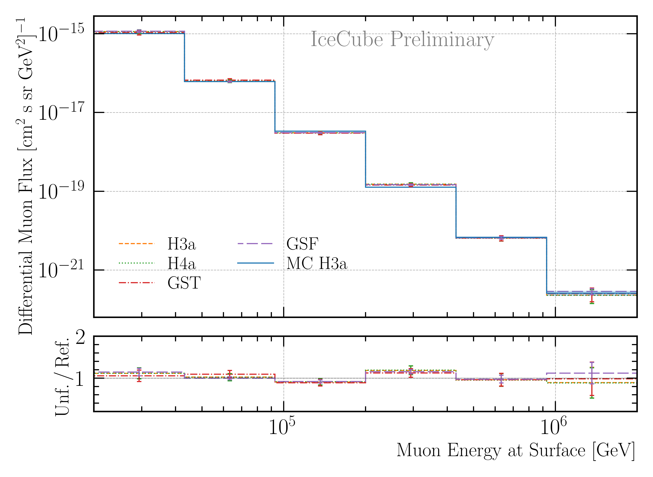
Robustness Tests
more robust

Slide 7
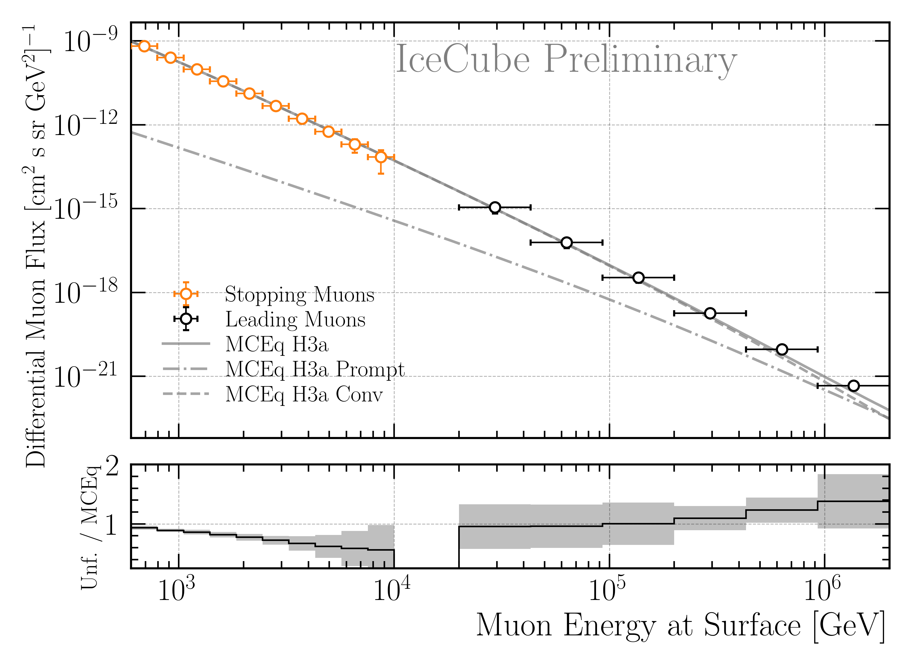
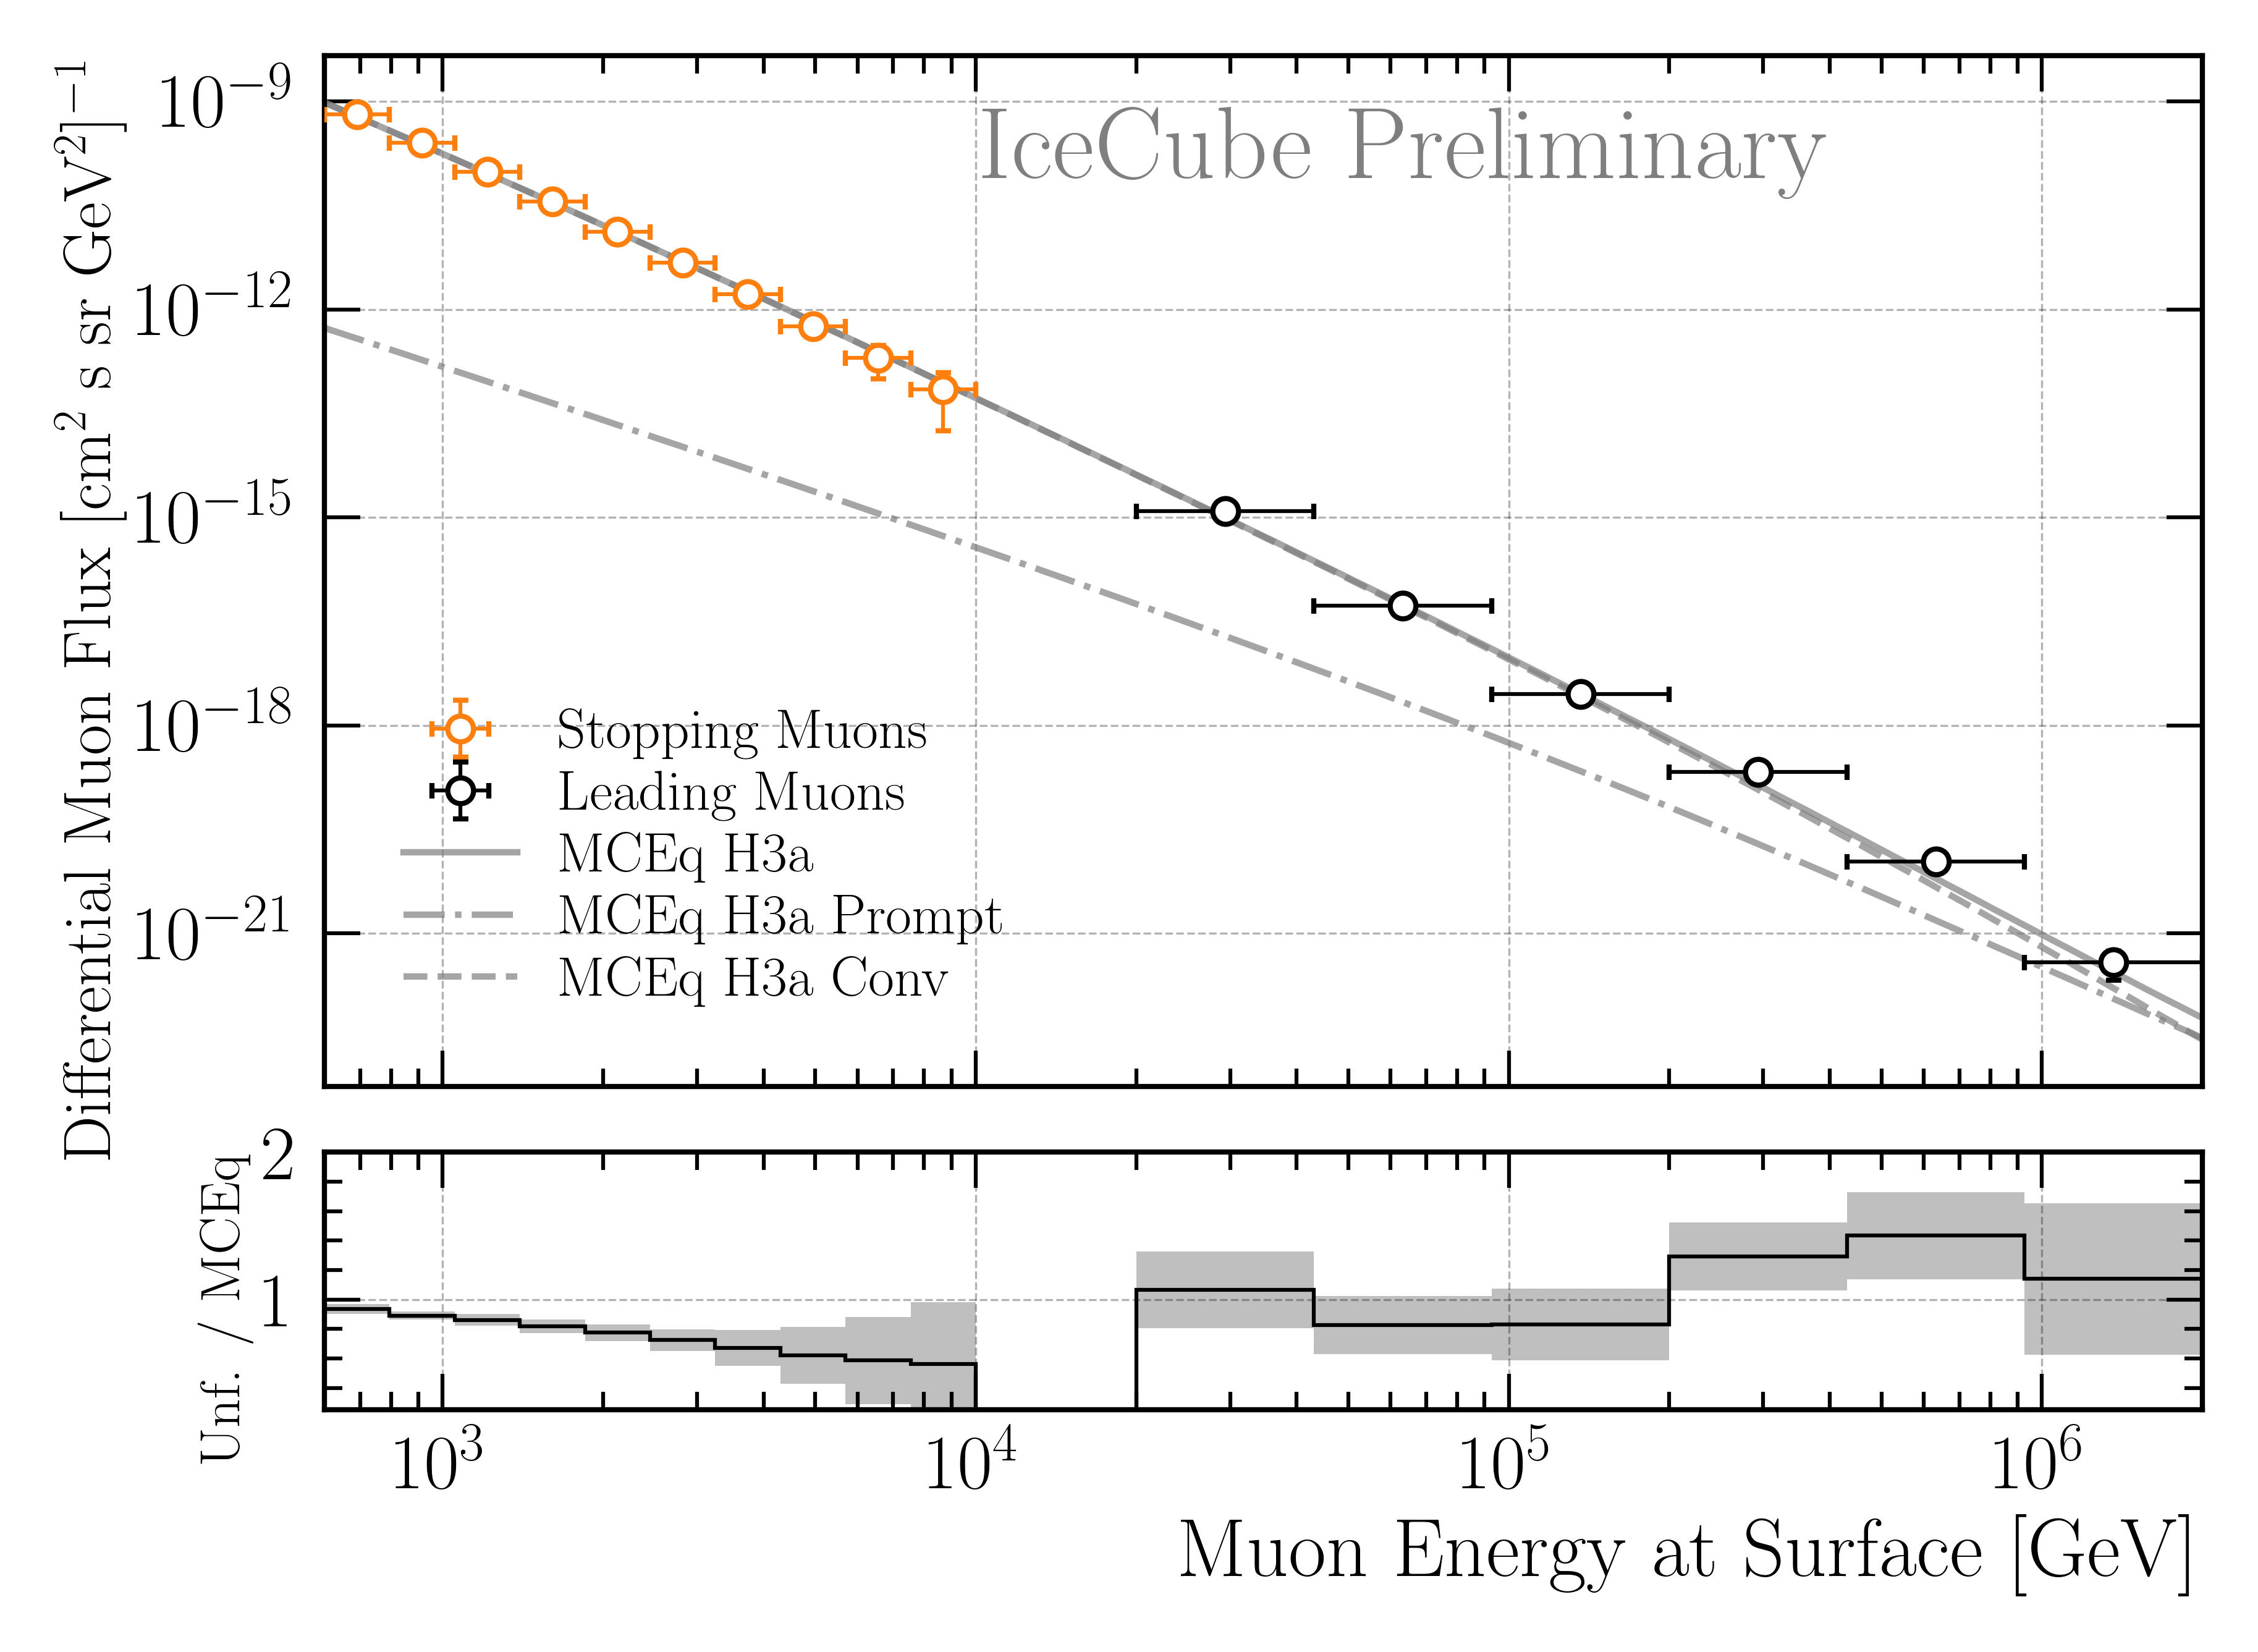
Muon Flux Unfolding
unfolding result is within the uncertainties the same as before
New result
Old result

