Slide 1
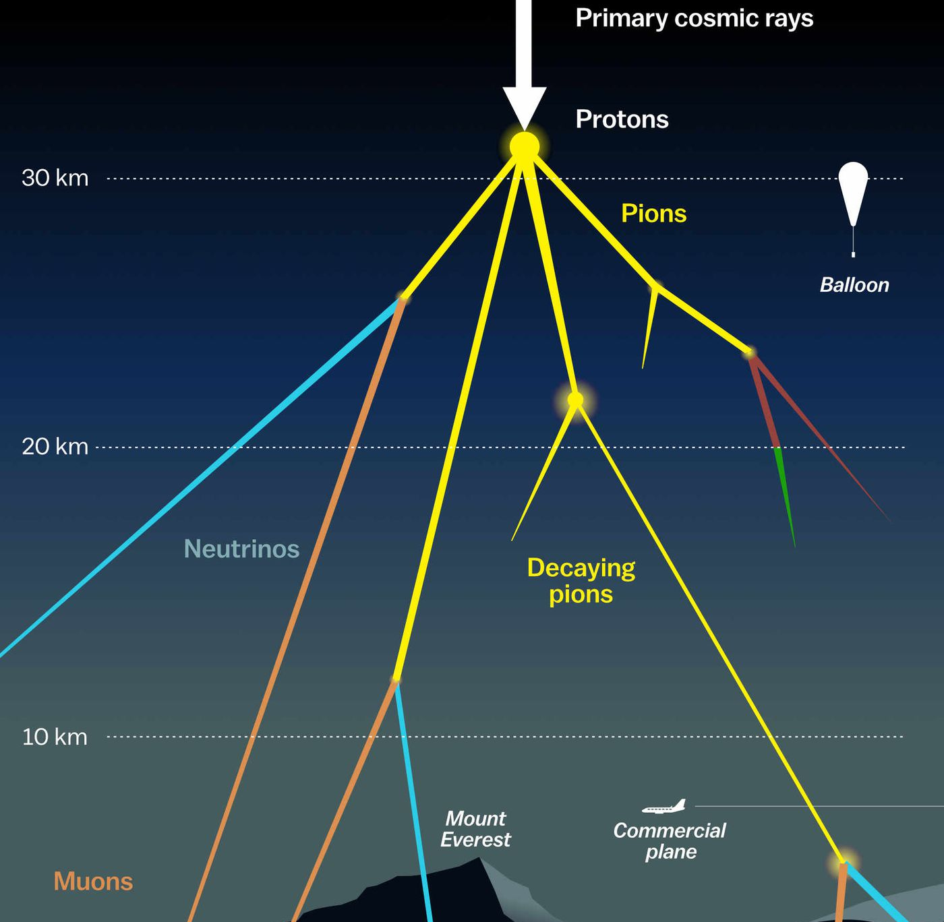

Measuring the prompt component of the atmospheric muon flux Pascal Gutjahr
March 5, 2024
Source: NASA

