Slide 1
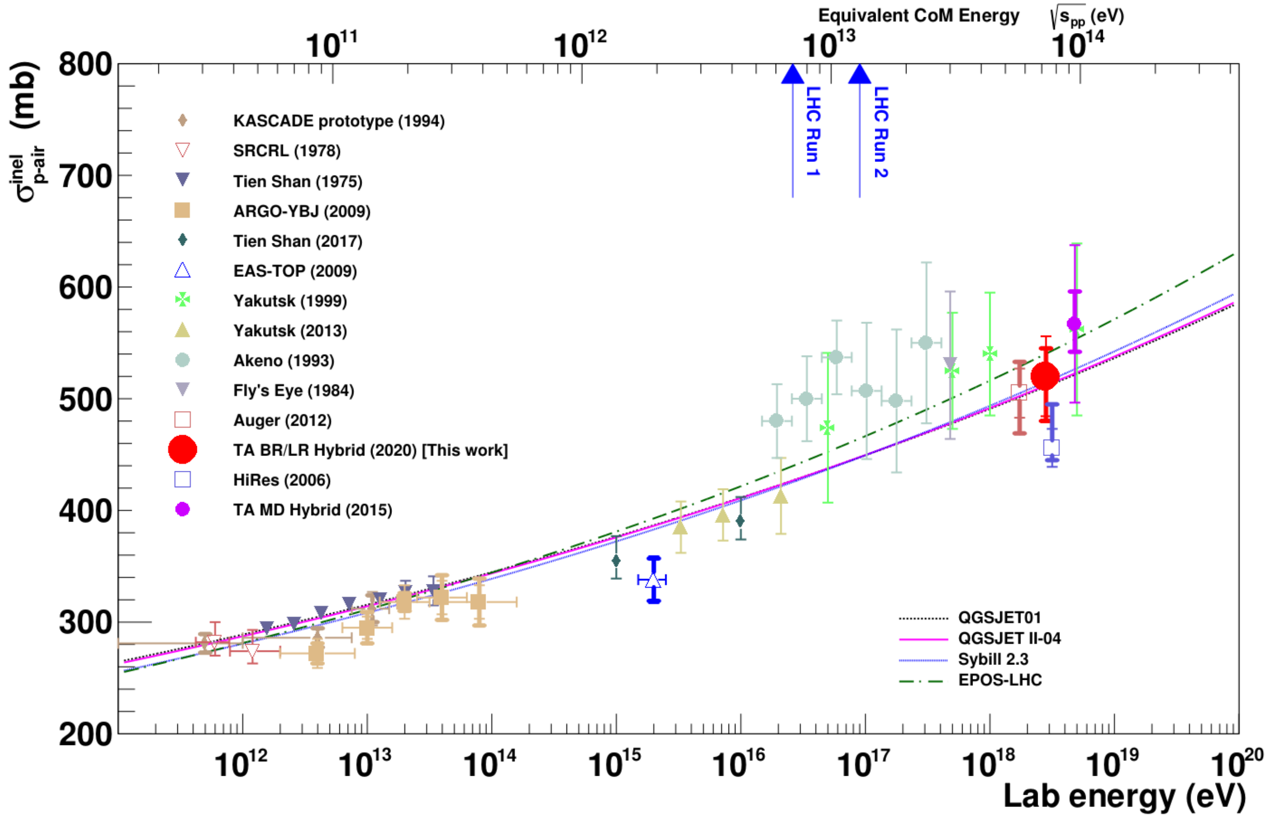
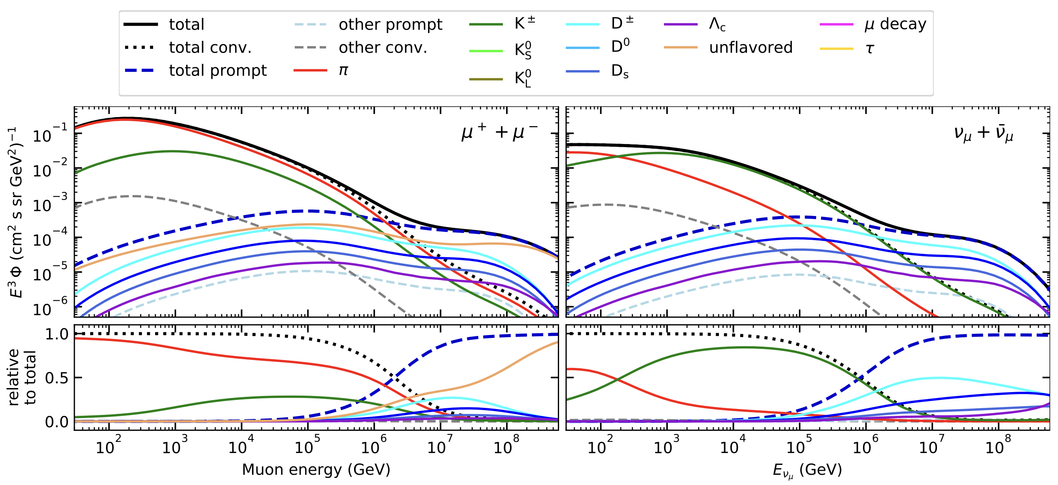
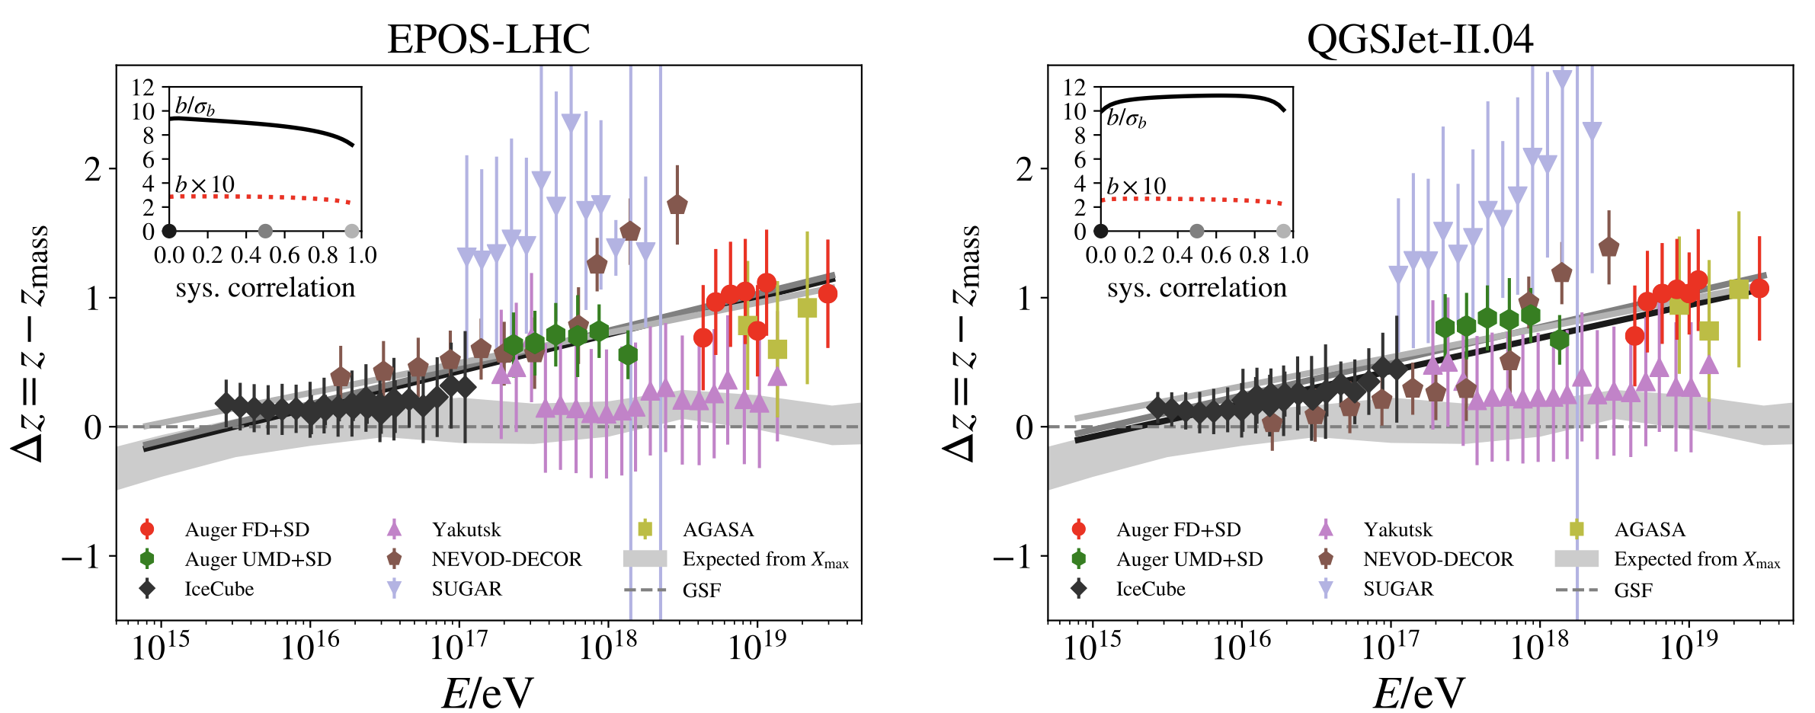
ICRC: Measuring the Prompt Component of the Atmospheric Muon Flux using IceCube
Motivation
fine-tune hadronic interaction models
muon puzzle
Analysis goals
measure normalization of prompt muon flux
unfold atmospheric muon flux
Uncertainties at E > 10 PeV
2006.05012
2108.08341
More muons measured than simulated for E > 40 PeV ~ cms 8 TeV

Slide 2
Overview
Analysis
Simulation
Reconstruction
Selection
Forward fit
Dataset
CORSIKA 77500 Ehist
SIBYLL 2.3d
10 TeV – 100 EeV
DNN reconstructions
Muon energies
Muon direction
Track geometry
Level 3
L2 muon filter
500 TeV bundle energy cut at surface
Add labels
Fit prompt normalization
Poisson LLH fit
Validation
Tag prompt / conv particles
MCEq comparisons
Unfolding
Level 4
Add DNN reconstructions
Muon spectrum
Unfold muon flux
Level 5
Data-MC quality cuts

Slide 3
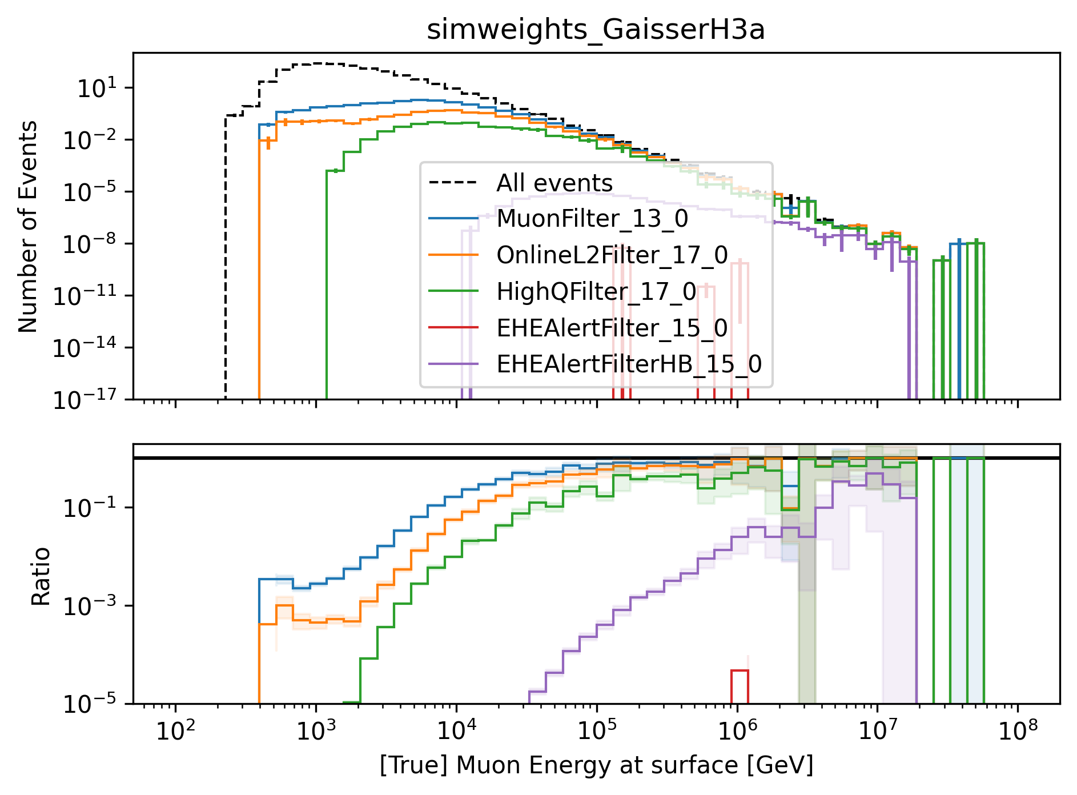
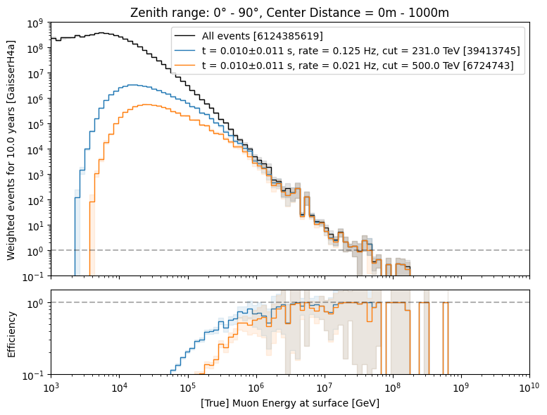
Simulation, Reconstruction and Selection
new CORSIKA 7 extended history simulations compared to MCEq
selection: muon filter, energy cut, data-MC quality cuts
DNN reconstructions
Most energetic muon in bundle
Muon parent:
pion or kaon
yes
no
conventional
prompt

Slide 4
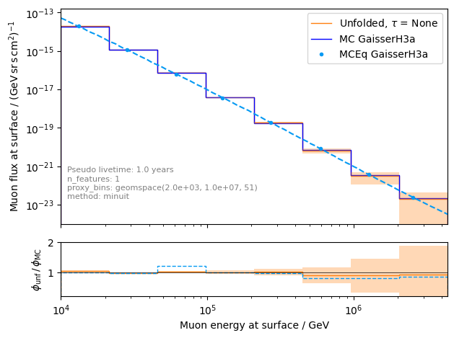
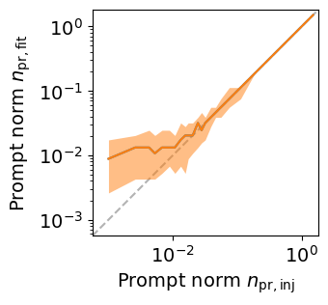
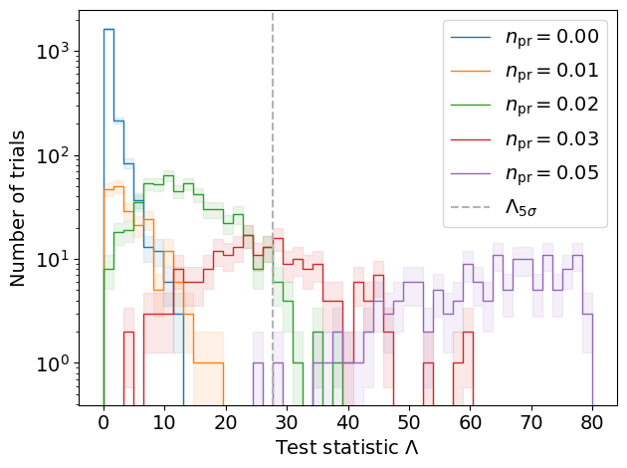
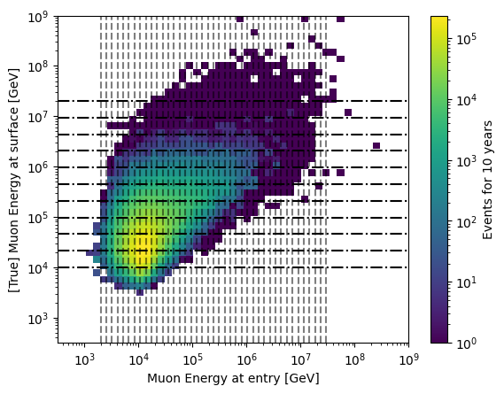
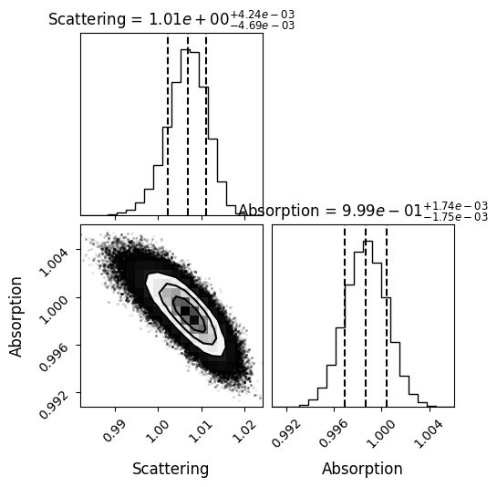
Forward Fit and Unfolding
unfolded muon flux at surface
Test bias
trials for forward fit
proxy variable
systematics

