Slide 1
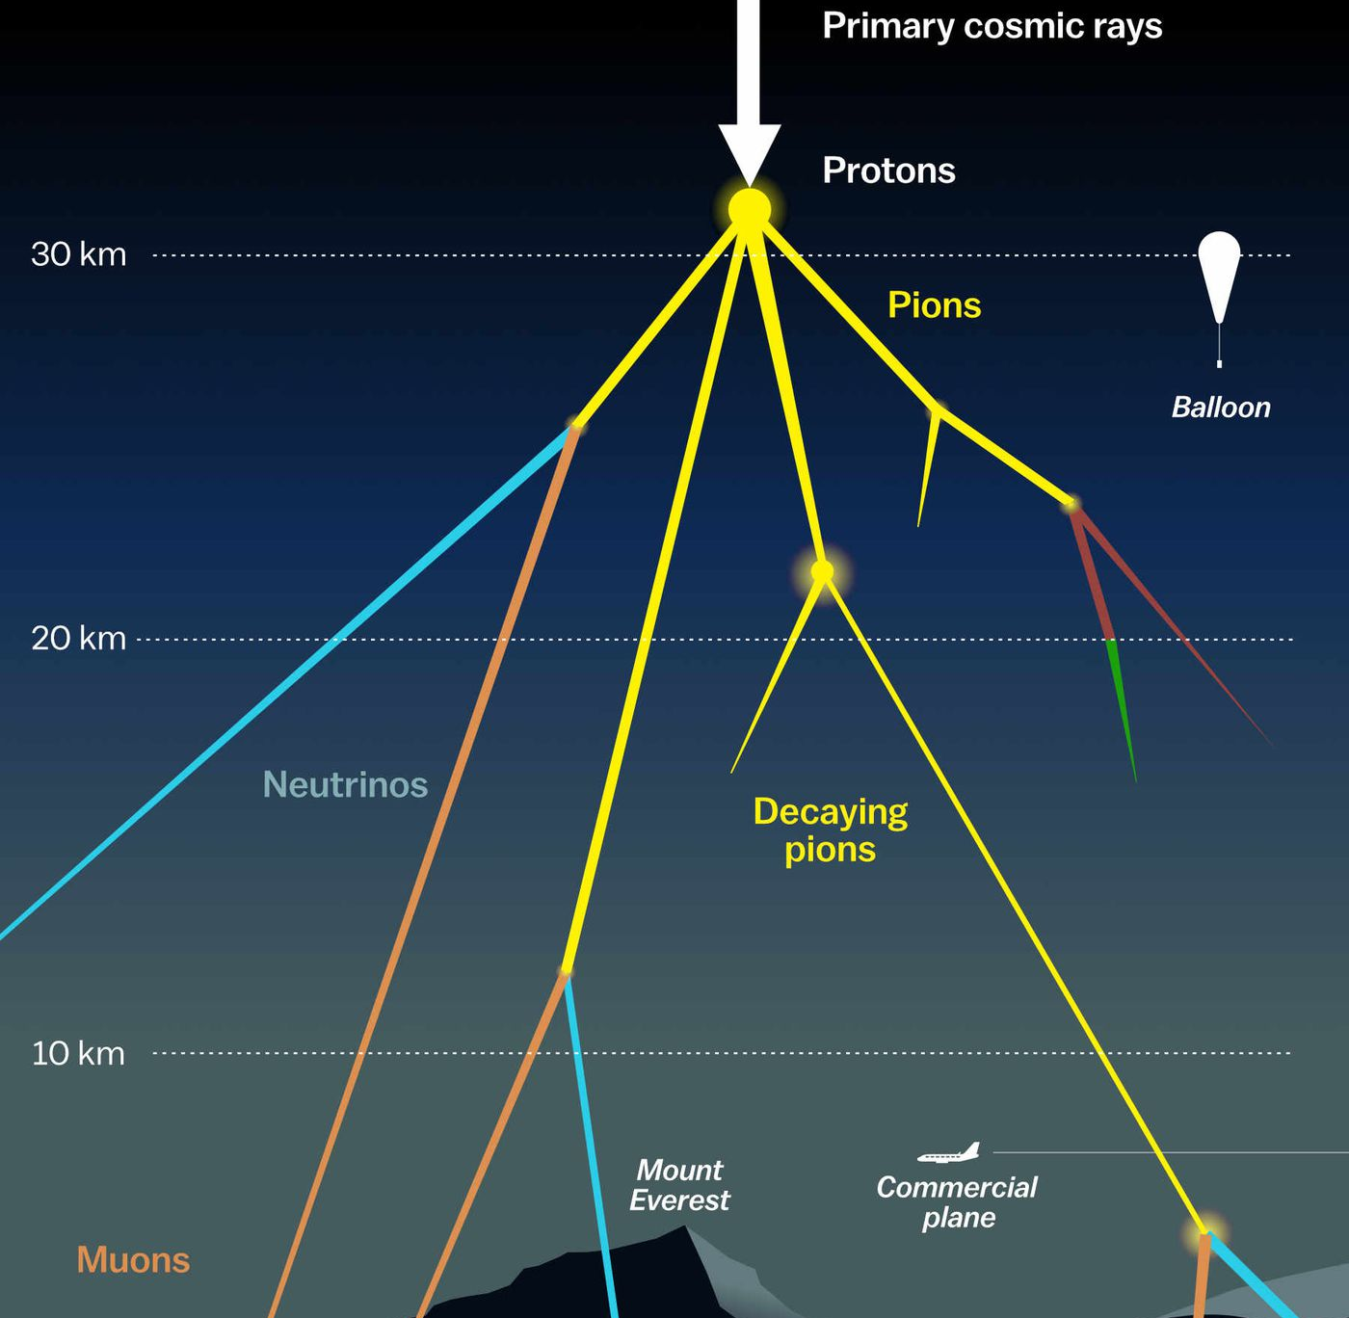
Updates on prompt atmospheric muon analysis Ludwig Neste and Pascal Gutjahr
CR-Call September 29, 2023
Source: NASA

Slide 2

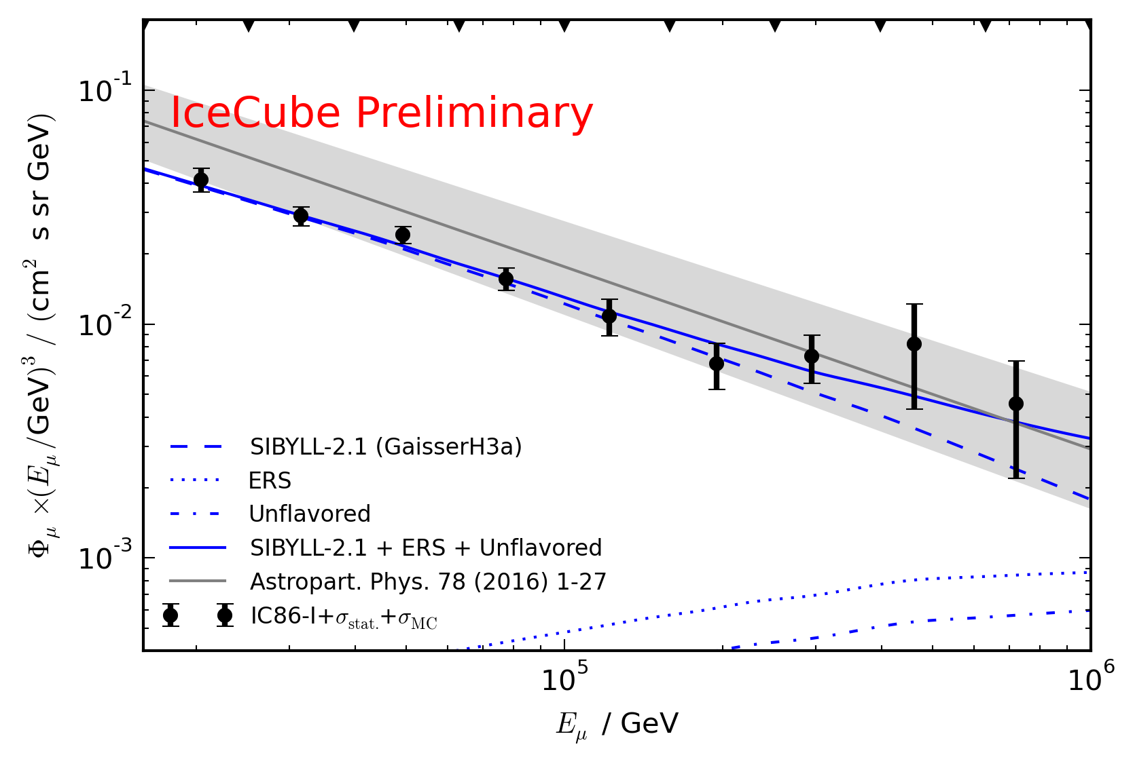
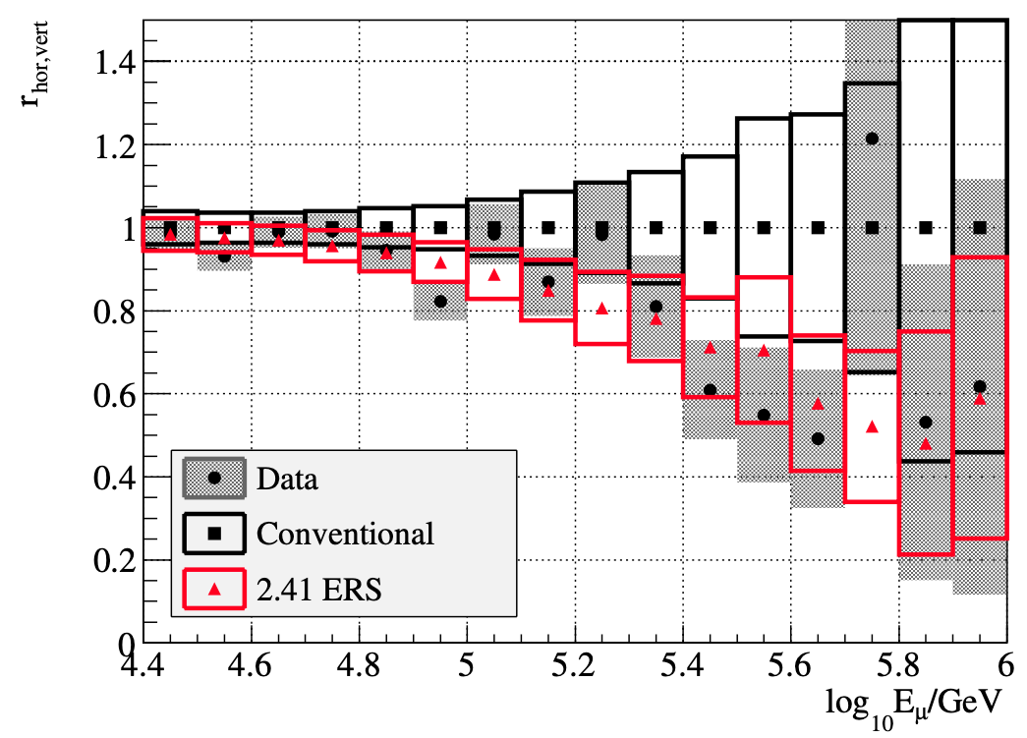
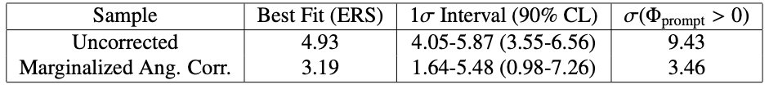
Motivation
Goal
Measure prompt normalization
Unfold energy spectrum
Prompt atmospheric muons have never been significantly measured
Old analyses:
Leading muon analysis: limited MC statistics (by Tomasz Fuchs, https://wiki.icecube.wisc.edu/index.php/Analysis_of_Leading_Muons)
Characterization of the muon flux: zenith problem (by Patrick Berghaus, https://arxiv.org/abs/1506.07981)

Slide 3
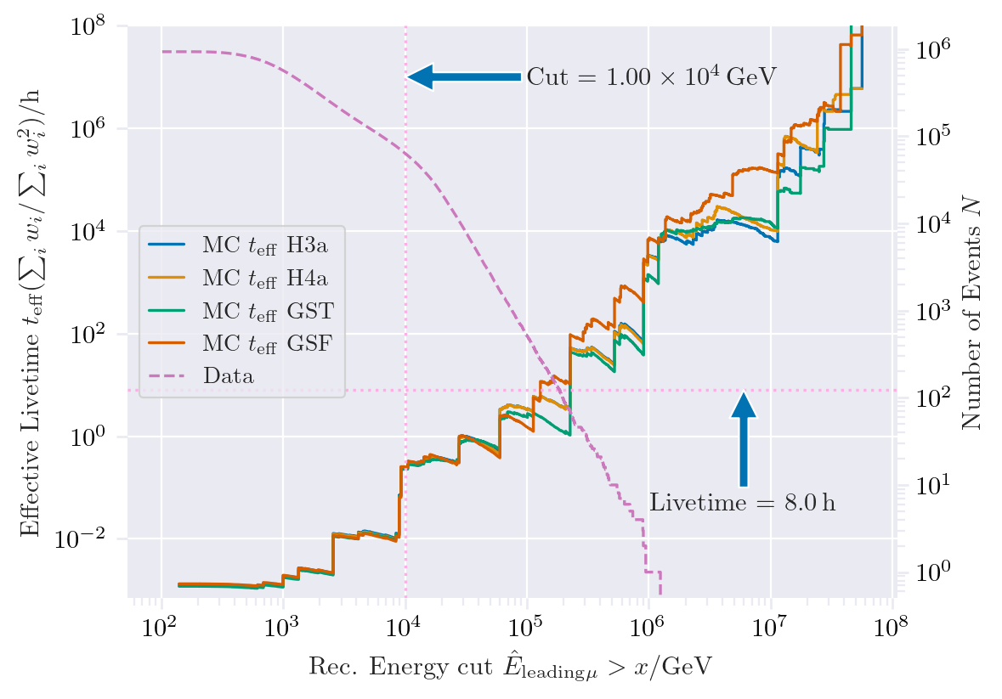
New CORSIKA extended history simulations
CORSIKA 77420
SIBYLL 2.3d
Icetray 1.5.1
5 components (p, He, N, Al, Fe)
Polyplopia: True
Trimshower: True
Ecuts1: 273 GeV (hadron min energy)
Ecuts2: 273 GeV (muon min energy)
Ecuts3: 10²⁰ GeV (electron min energy)
Ecuts4: 10²⁰ GeV (photon min energy)
4 datasets:
30010: 600 GeV – 1 PeV
30011: 1 PeV – 100 PeV
30012: 100 PeV – 1 EeV
30013: 1 EeV – 50 EeV
/data/sim/IceCube/2023/generated/CORSIKA_EHISTORY/
Please go ahead and test the datasets

Slide 4
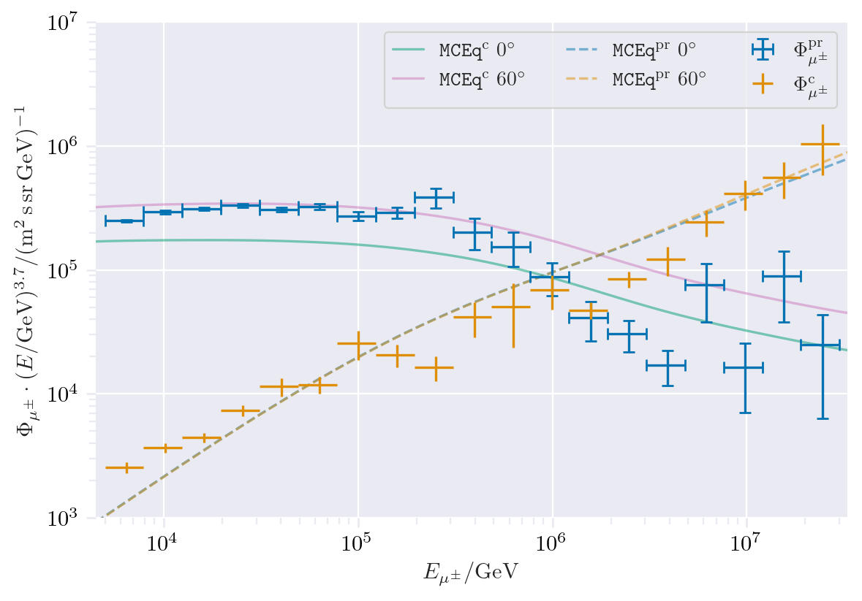
CORSIKA vs. MCEq
Most energetic muon inside
Muon parent:
pion or kaon
no
yes
conventional
prompt
CORSIKA standalone
IceCube CORSIKA step 0
For detailed information, see the talk by Ludwig Neste at the upcoming collaboration meeting

Slide 5
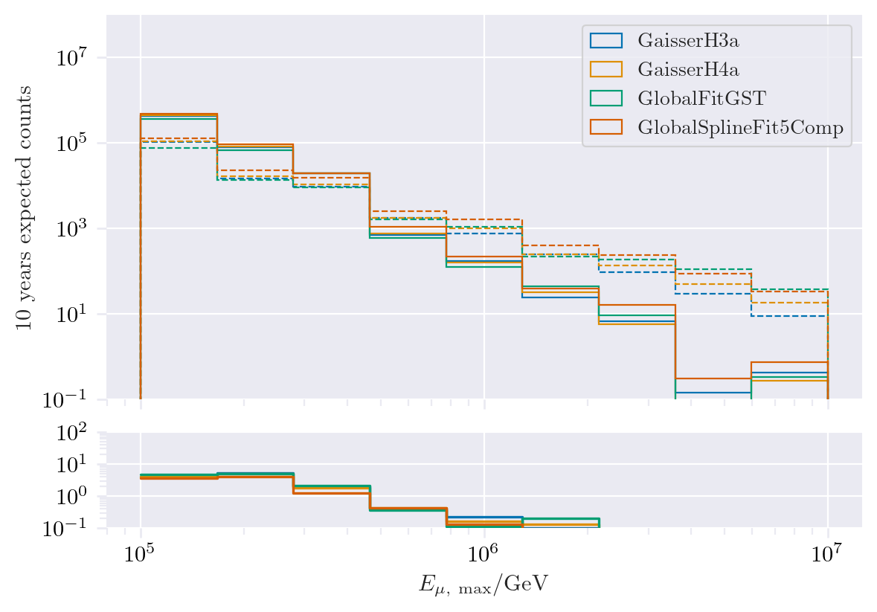
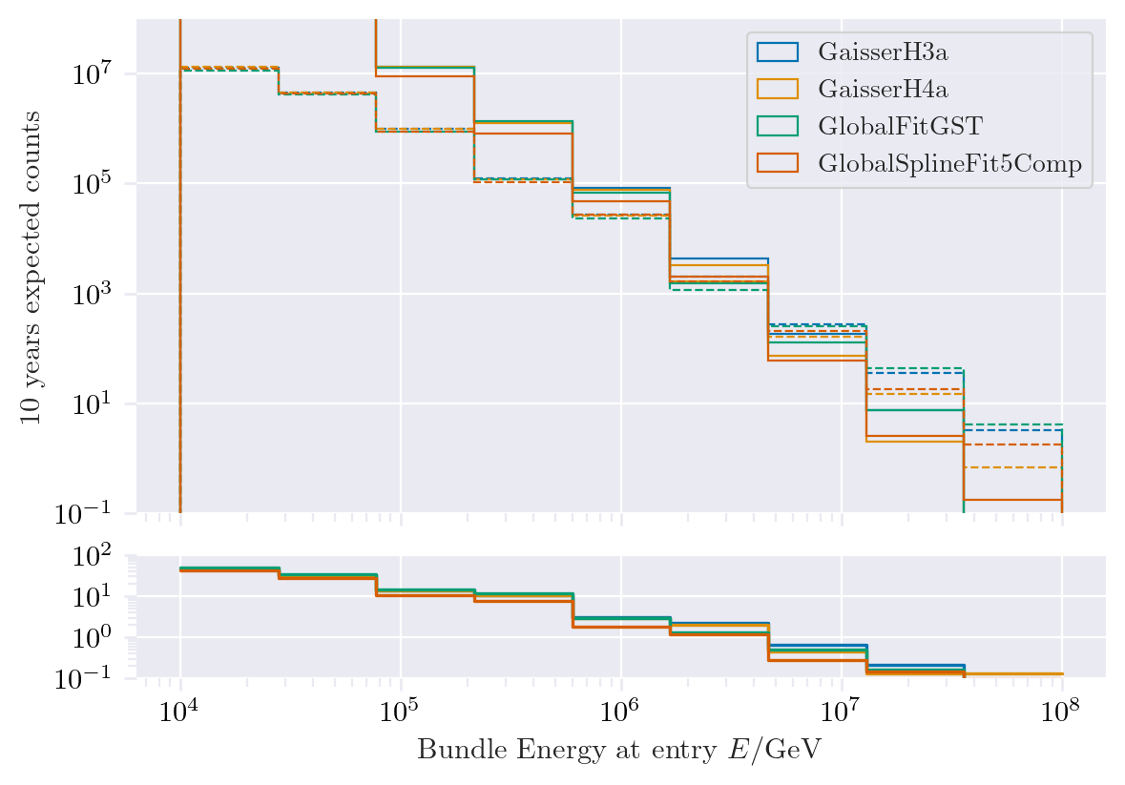
Expected muons for 10 years: leading vs. bundle energy
Solid: conventional
Dashed: prompt

Slide 6
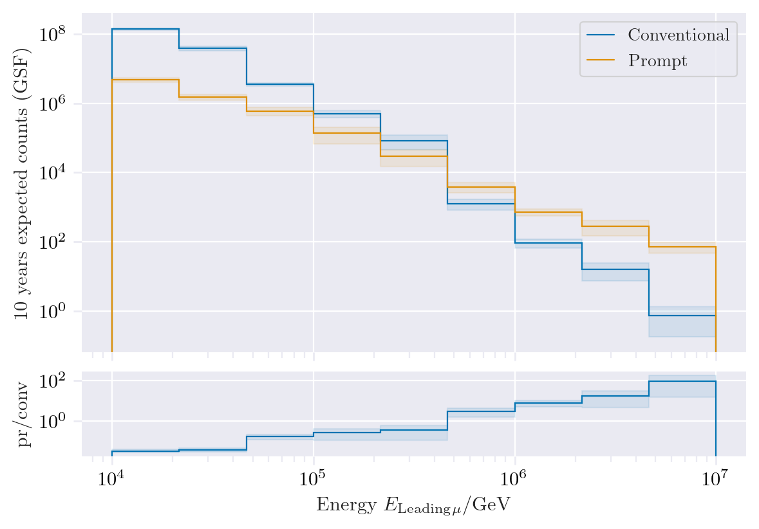
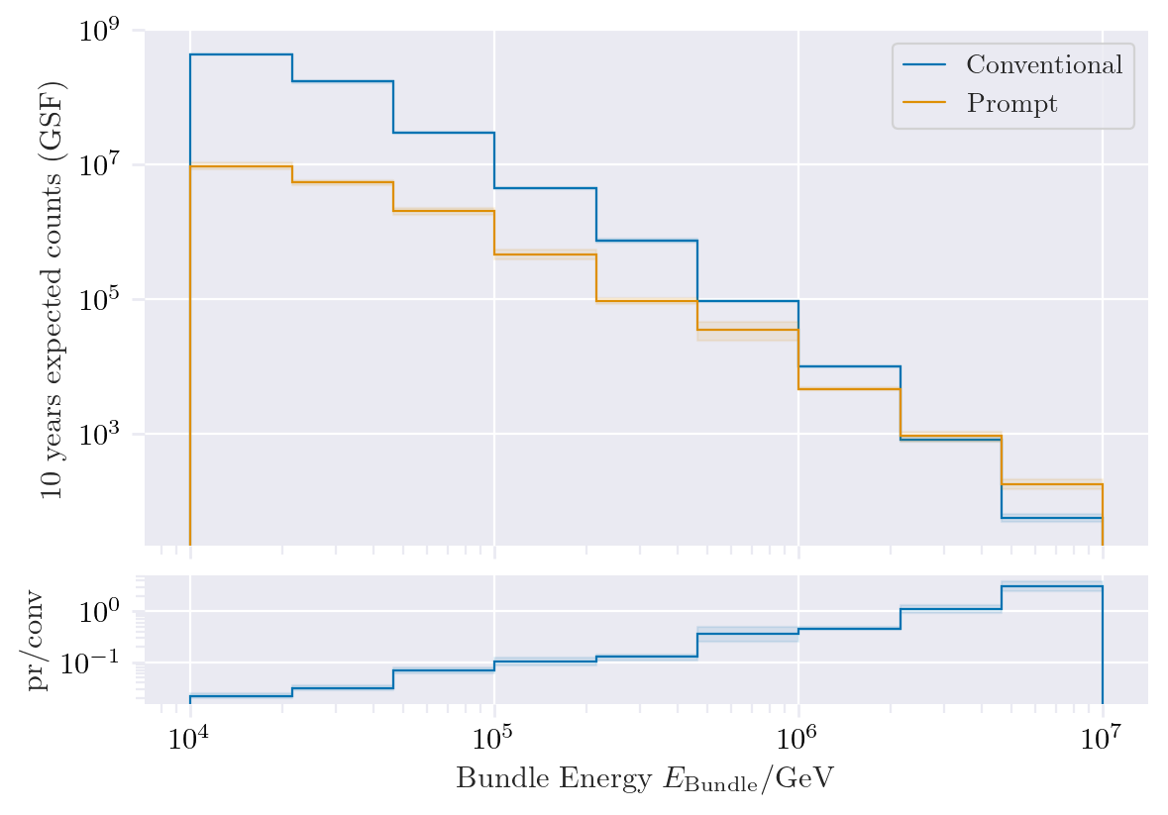
Expected muons for 10 years: leading vs. bundle energy (GSF)
Leading muon energy is more sensitive to detect prompt

Slide 7
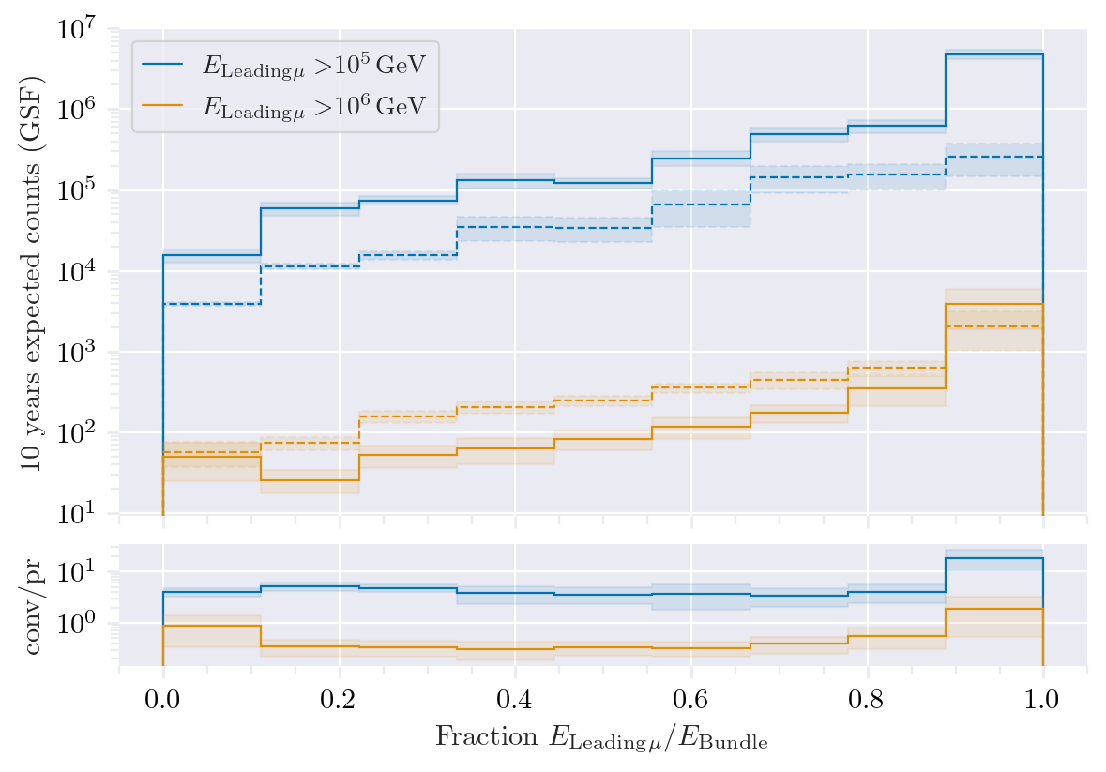
Leading muon energy fraction
Prompt dominates for energies > 1 PeV
Leading energy sweet spot: 0.1 – 0.9
Solid: conventional
Dashed: prompt

Slide 8
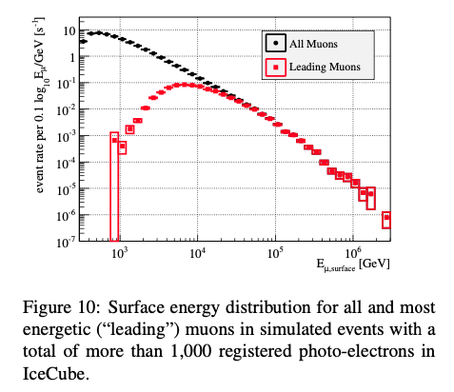
Leading muon contribution
Muons with energies between 100 TeV and 10 PeV dominate the bundle by more than 90%
Conventional muons are more dominant than prompt
High leading energy fraction does not lead to more sensitivity to detect prompt

Slide 9
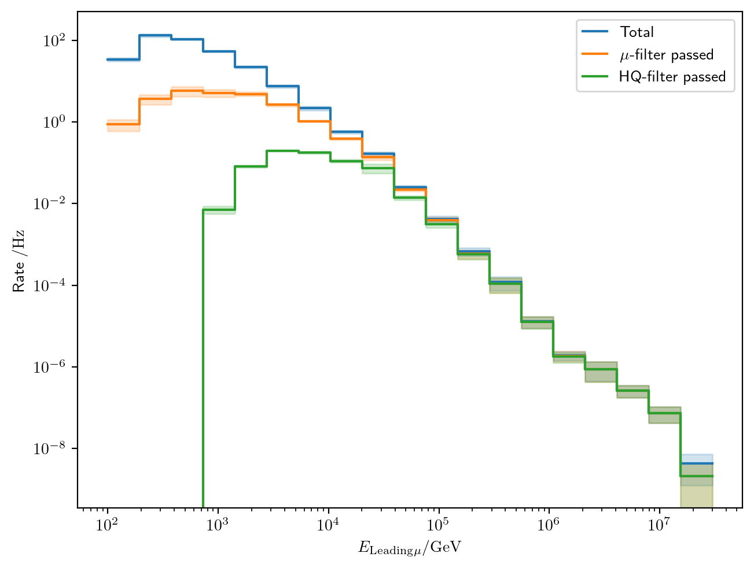
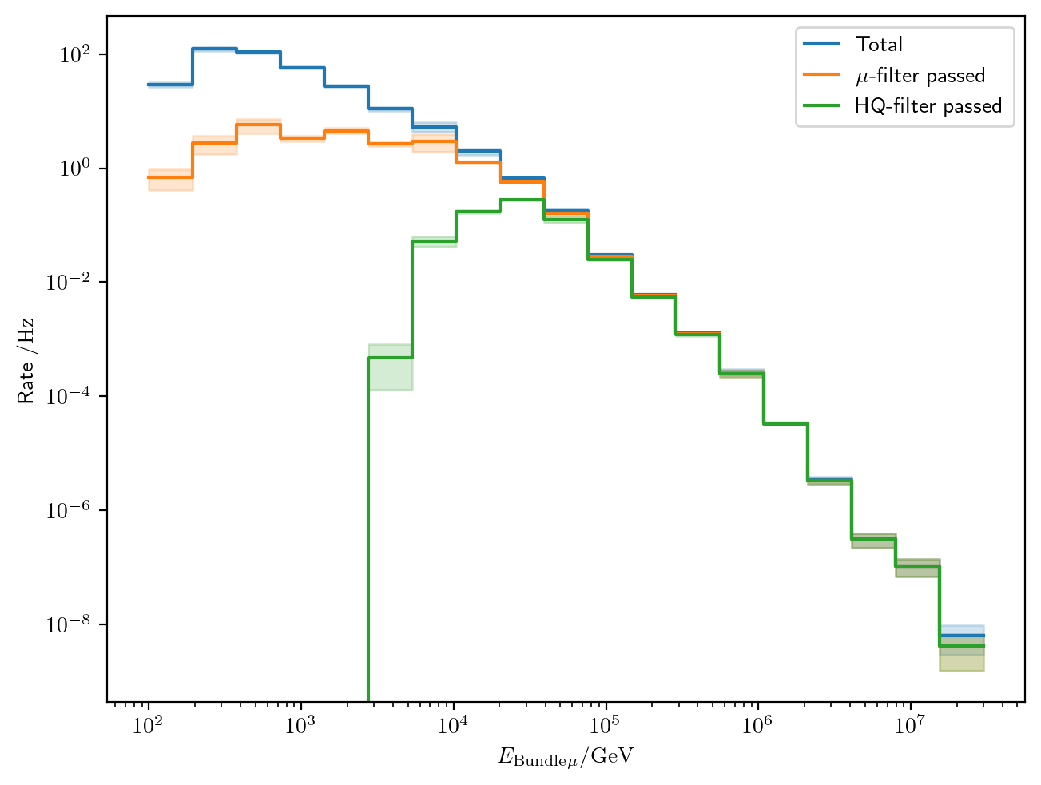
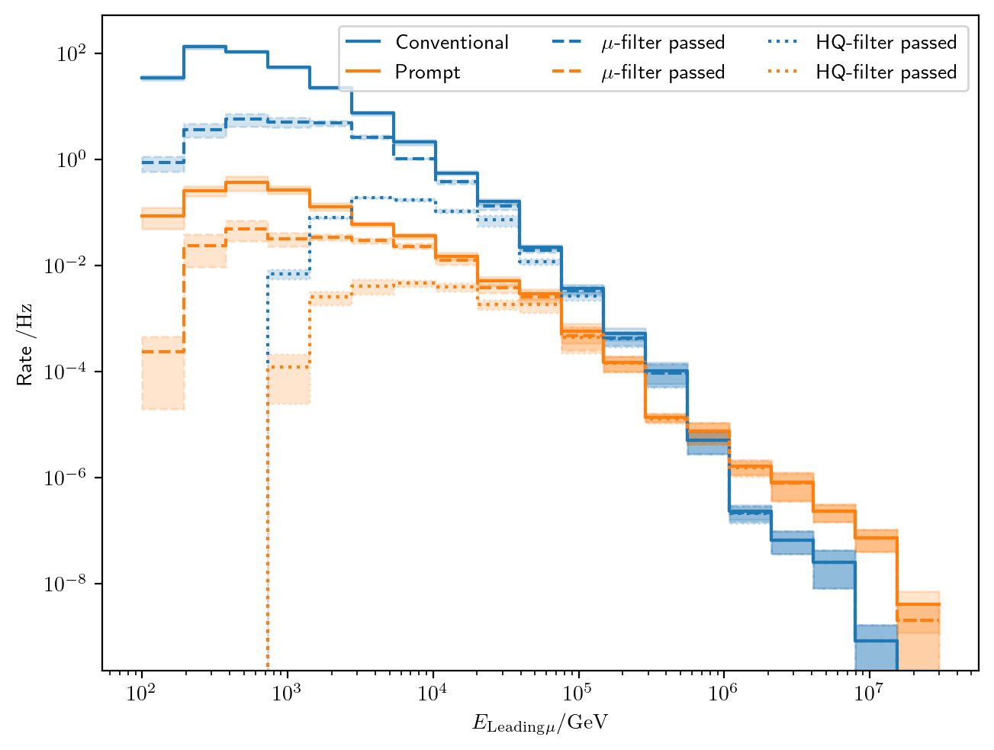
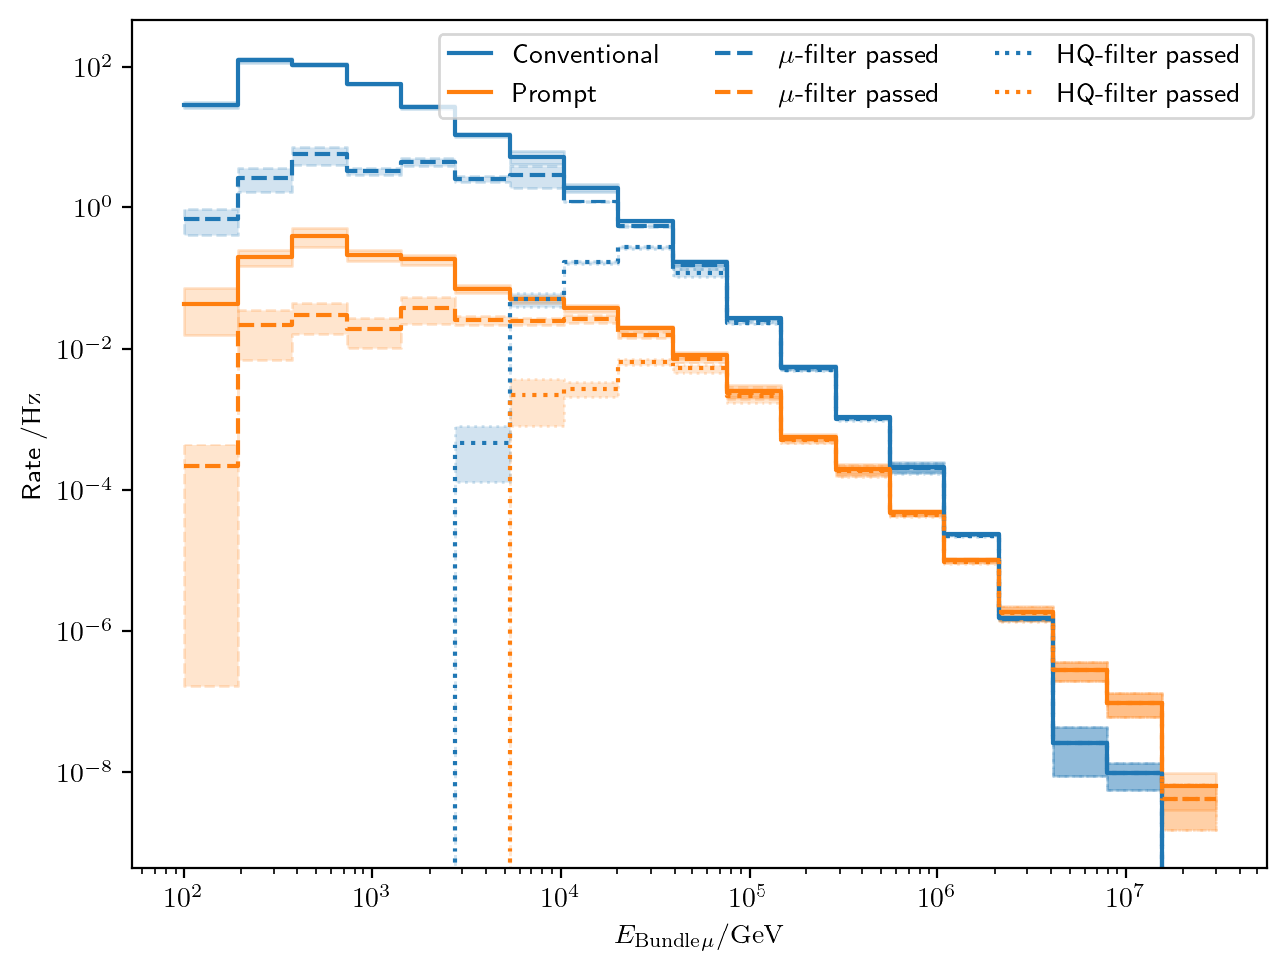
Filters
Choose muon filter,
larger statistics at 10 TeV

Slide 10
Data-MC agreements
Two bachelor students worked on reconstructions using the dnn_reco framework:
Leander Flottau
Benjamin Brandt
Reconstructions:
Leading energy
Leading fraction
Bundle energy
Multiplicity
Azimuth
Zenith
General:
Trained on uncleaned and 6µs cleaned muon pulses
Processed 1 day of experimental data (July 4th, 2020)
Work in progress

Slide 11
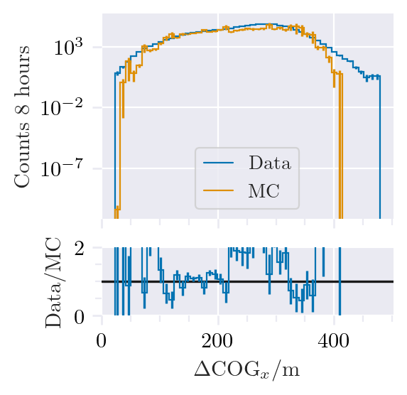
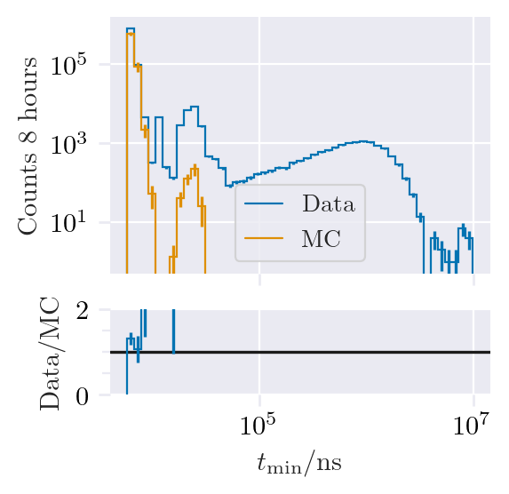
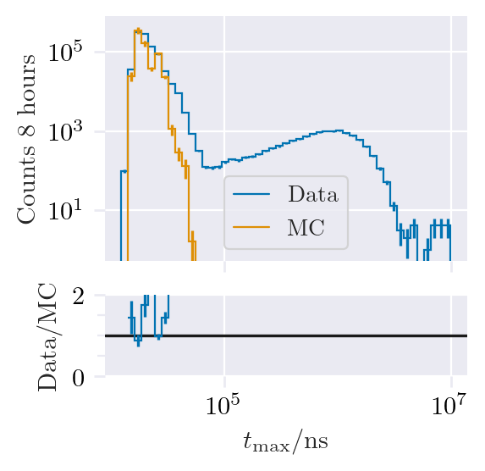
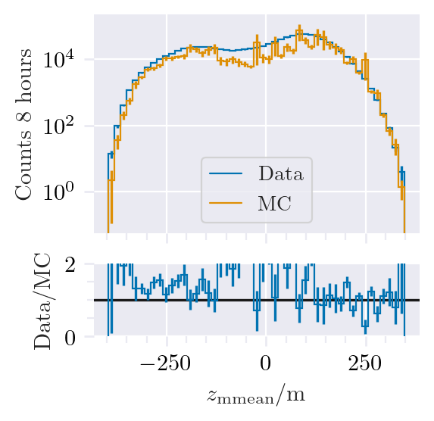
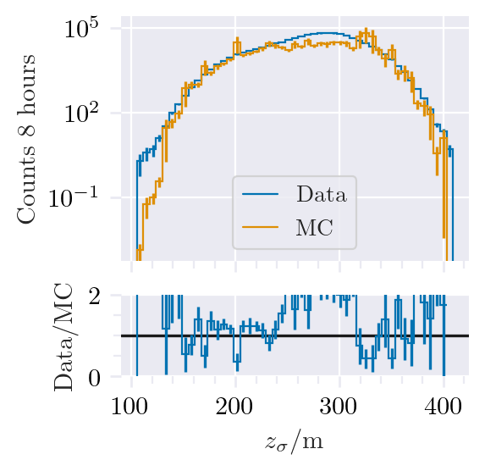
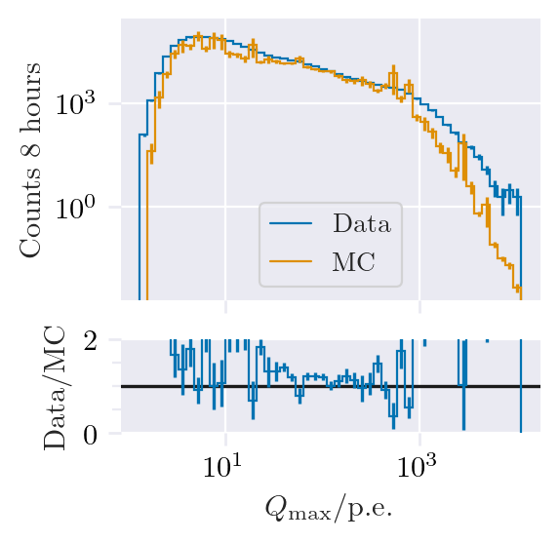
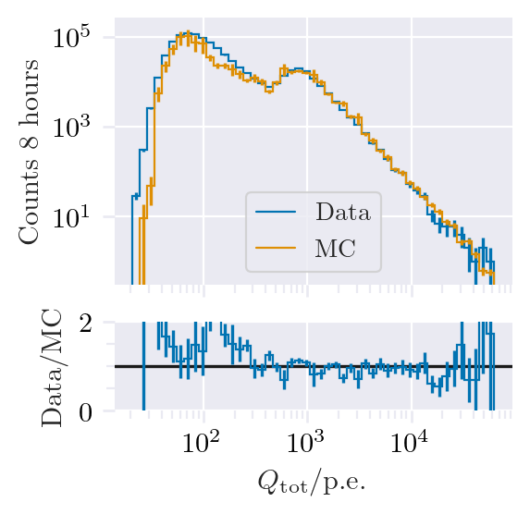
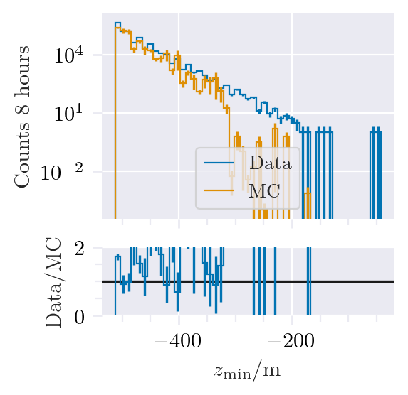
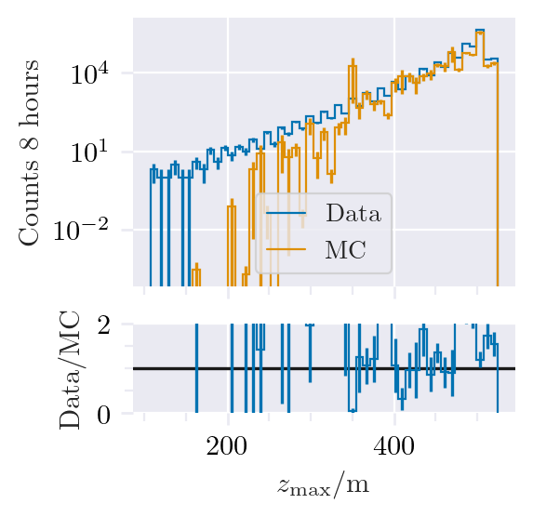
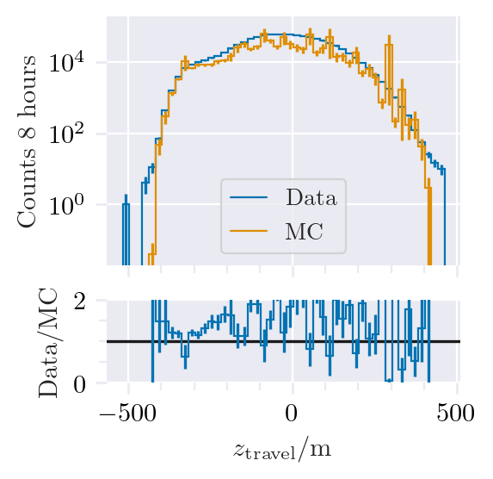
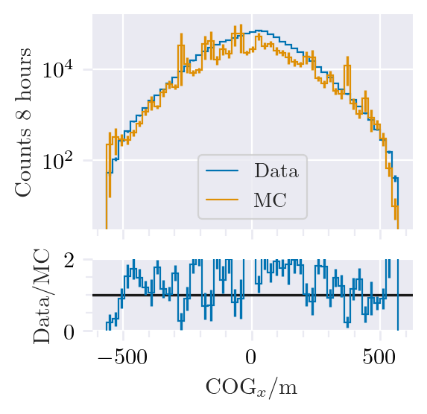
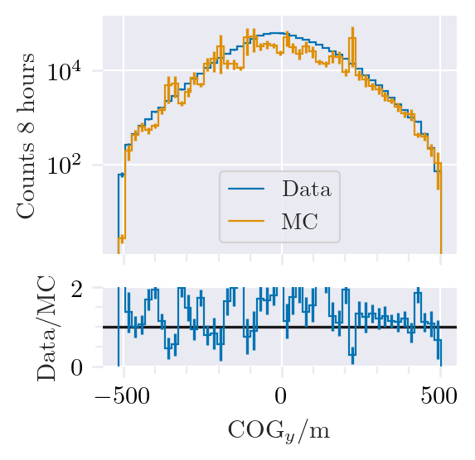
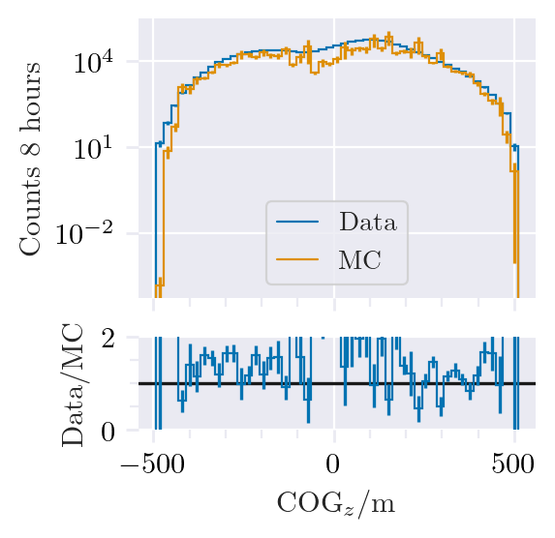
Data-MC: HitStatistics - SplitInIceDSTPulses

Slide 12
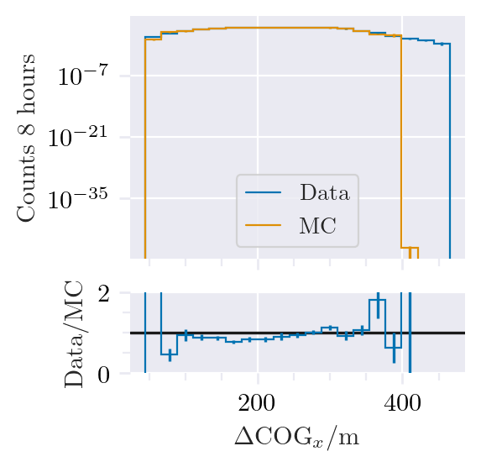
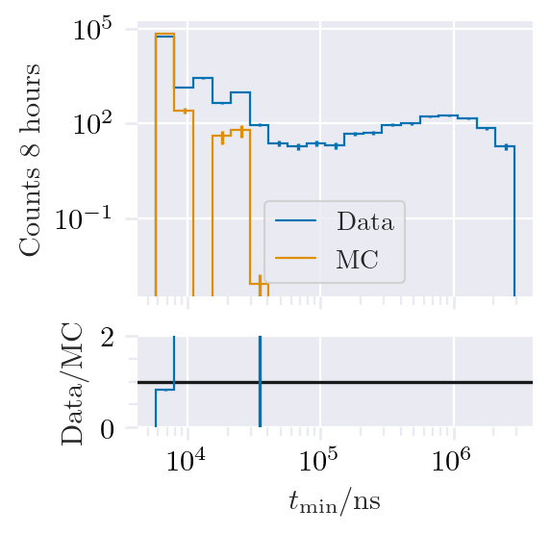
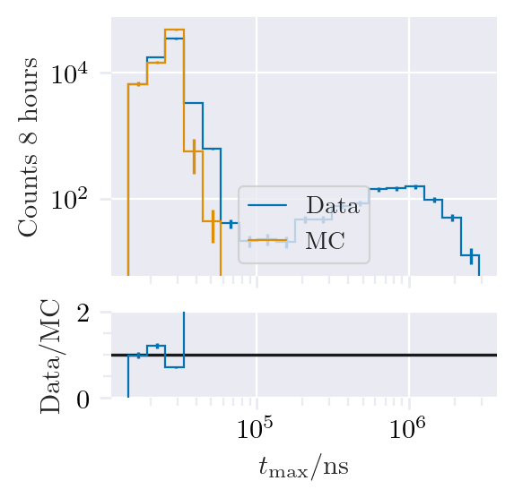
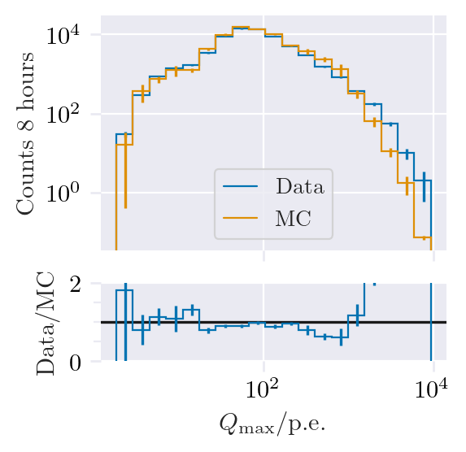
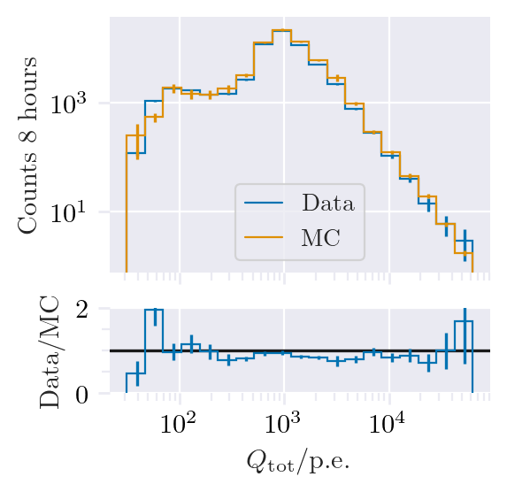
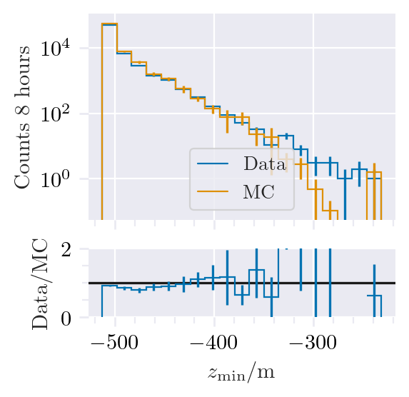
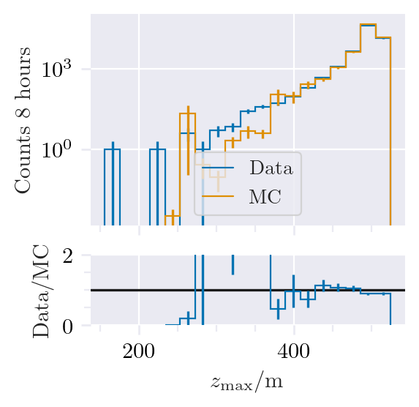
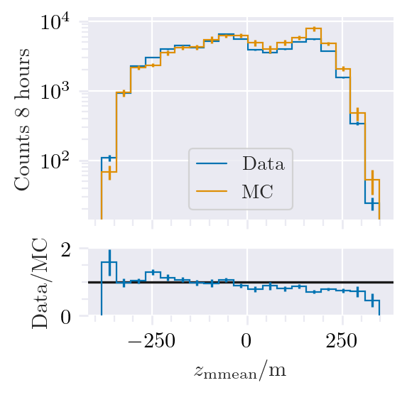
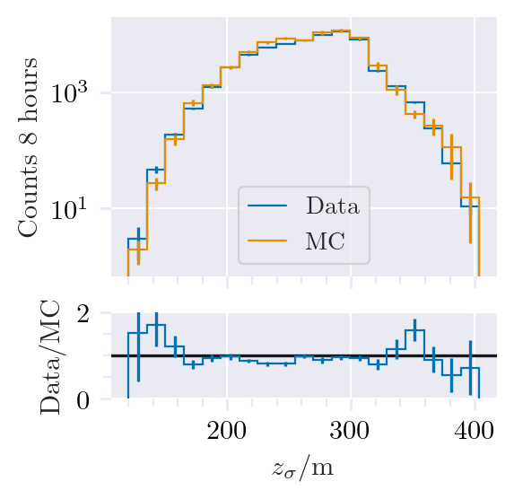
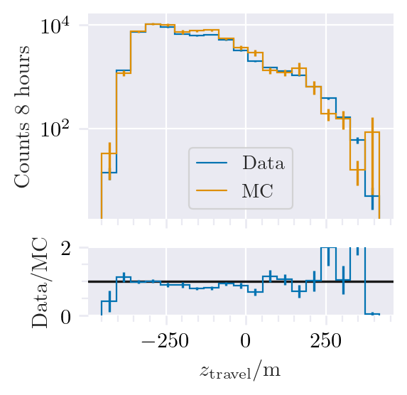
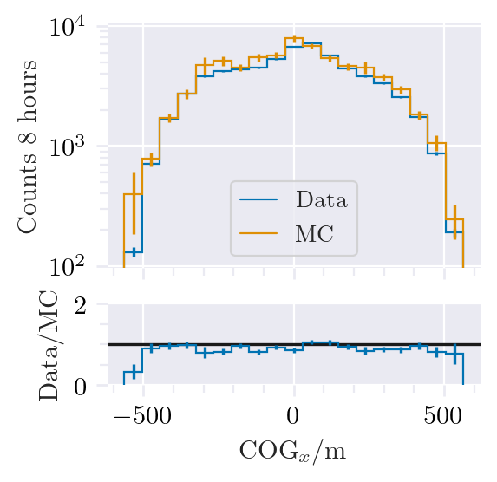
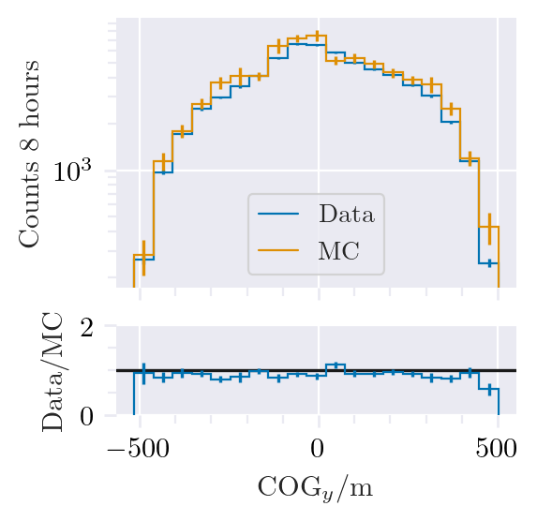
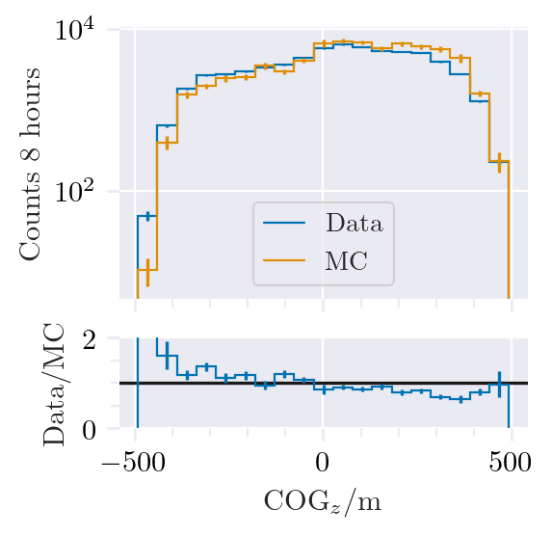
Data-MC: HitStatistics - SplitInIceDSTPulses
Reconstructed bundle energy > 10 TeV
Good agreement for pulses

Slide 13
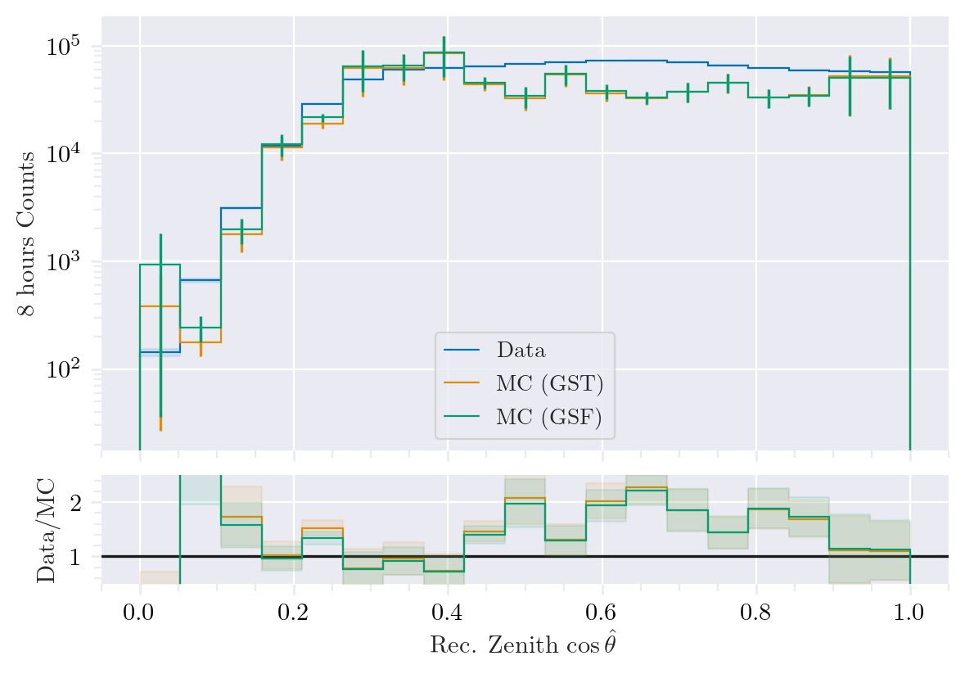
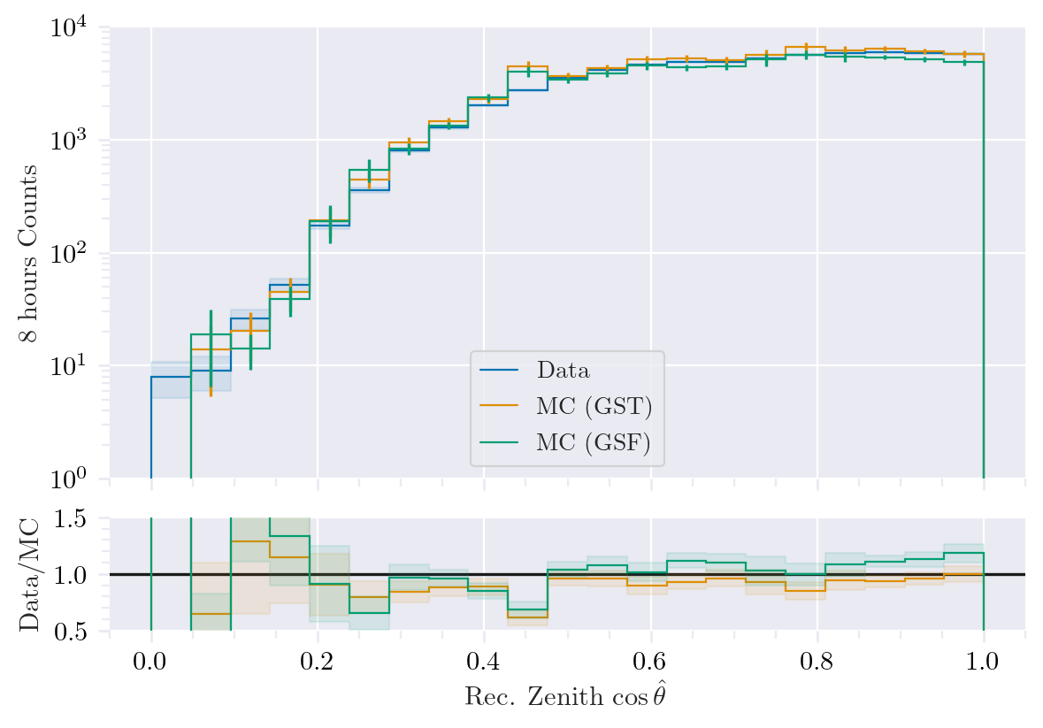
Data-MC: cos(zenith)
Reconstructed bundle energy > 10 TeV
Deviations at low cos(zenith), but very small statistics

Slide 14
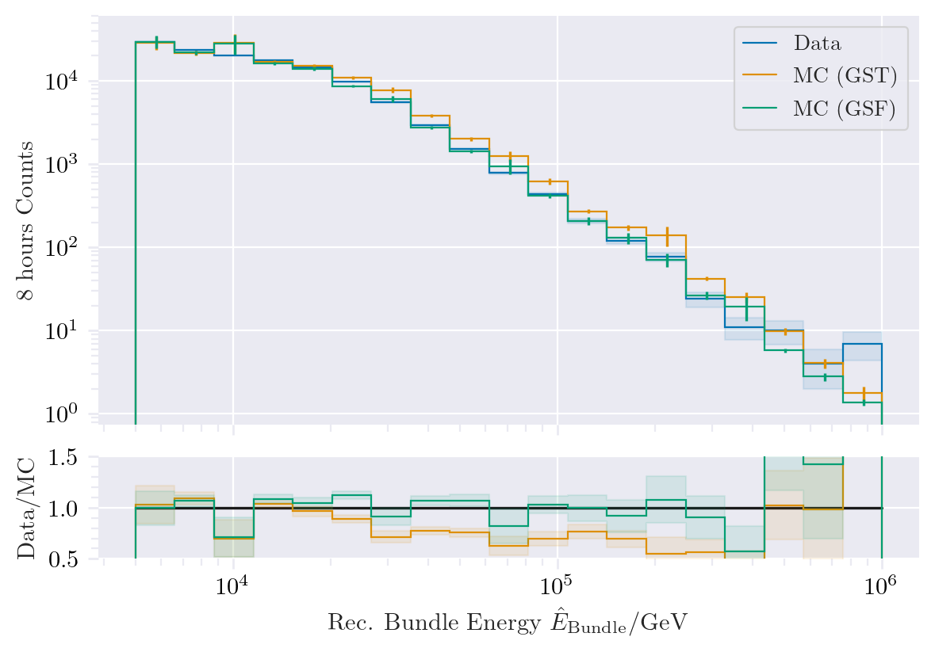
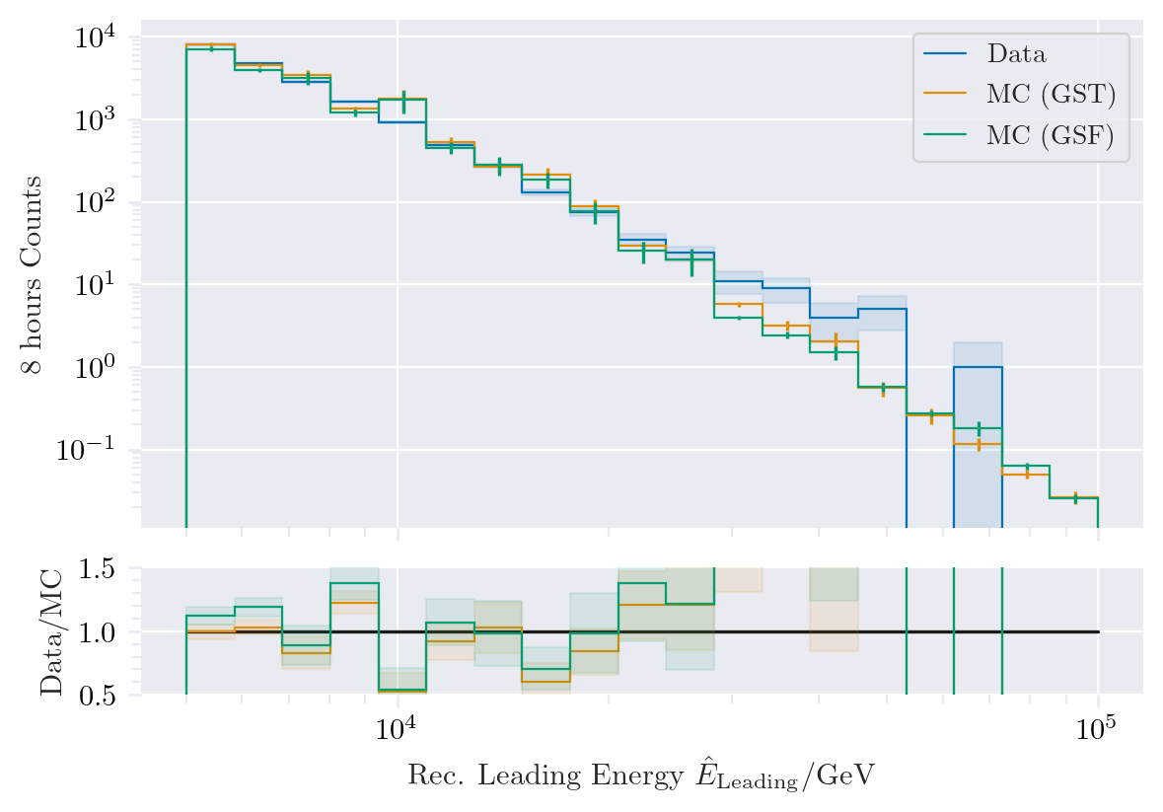
Data-MC: energy spectrum
Prompt?
Bundle energy: good agreement with GSF

Slide 15
Pseudo analysis

Slide 16
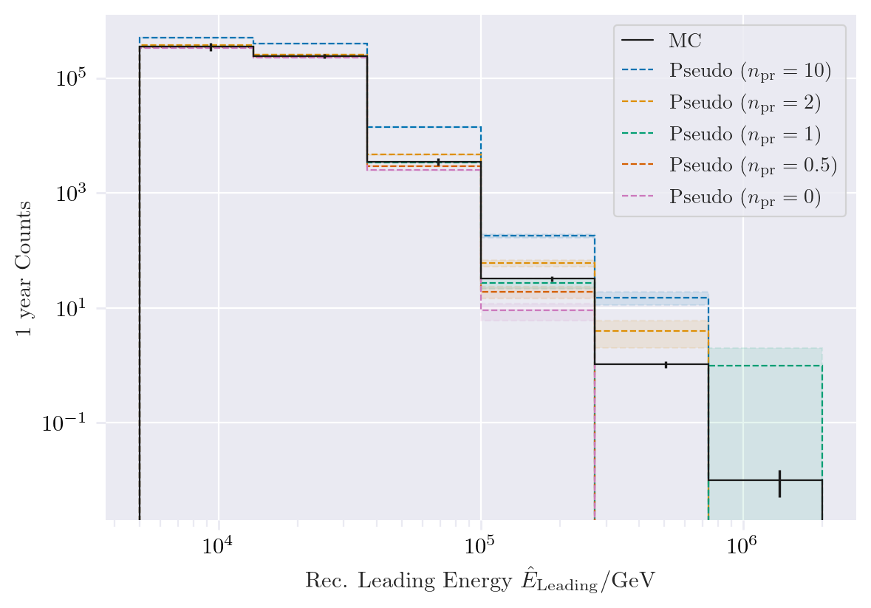
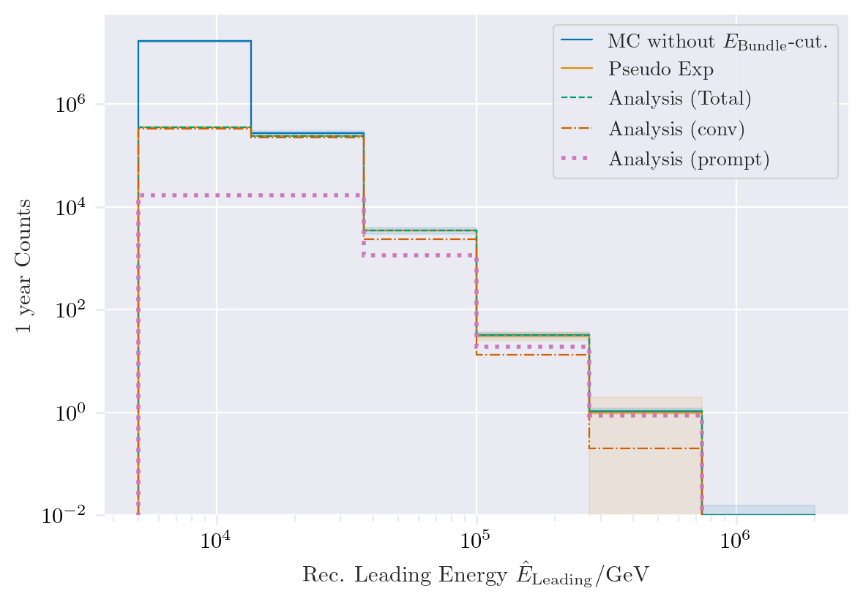
Pseudo data sampling
Tagging alows scaling of prompt by factor n_{pr}

Slide 17
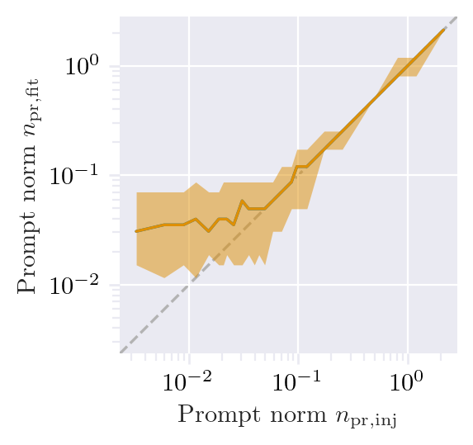
Test bias
Bias starts below a prompt normalization of 0.1

Slide 18
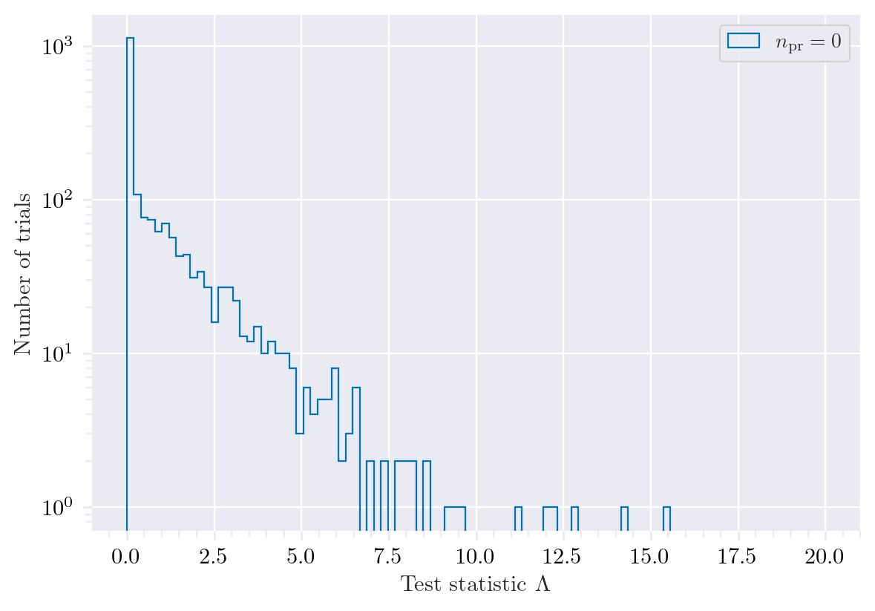

Test background statistics

Slide 19

Discovery potential and sensitivity
5 sigma discovery potential: 0.102 ± 0.005
Sensitivity: 0.024 ± 0.001

Slide 20
Conclusion and outlook
New CORSIKA EHIST simulations
CORSIKA vs. MCEq agreement
DNN angular and energy reconstructions
First data-MC comparisons
Pseudo analysis set up
Wiki page
Data-MC agreement of dnn input
Optimize DNN reconstructions
Include systematics (snowstorm)
Scattering
Absorption
Anisotropy
Hole ice 1
Hole ice 2
Dom efficiency
Conventional normalization
We do not include systematics of the primary fluxes, instead we perform the analysis several times for different flux models
Entire analysis is based on CORSIKA 7 and SIBYLL 2.3d, perform “minor” simulation with another hadronic model?

Slide 21
Backup

Slide 22

Definition of the muon flux
$φ_{tot}=φ_{conventional}+φ_{prompt}$
$π, Κ$ ∝ E^{-3.7}
“not” $π, Κ \text{∝ }\text{E}\text{−}\text{2}\text{.7}$

Slide 23

Muon flux
0°: perpendicular to Earth’s surface
$$φ_{tot}=φ_{conv}+φ_{prompt}$$
Prompt dominates at energies larger than PeV
Conventional particle flux depends on zenith angle
conventional
prompt
We can measure prompt muon energies from ~1 PeV to ~100 PeV

Slide 24

Muon production – different weightings
GST predicts most prompt
MCLabelsLeadingMuons_entry_energy

Slide 25


Solution to zenith problem?
No complete solution, but a step in the right direction

Slide 26

Simulated events
Passed muon filter

Slide 27
Evaluation of models used in pseudo analysis
Note: the DNN reconstruction models are still investigated! The models used here are in an early stage. So far, the two bachelor students have trained models with better performance.
Updates on the models and reconstructions are provided in the near future

Slide 28

Zenith reconstructions

Slide 29

Azimuth reconstructions

Slide 30

Angular resolution

Slide 31

Bundle energy reconstruction

Slide 32

Leading energy reconstruction

