Slide 1
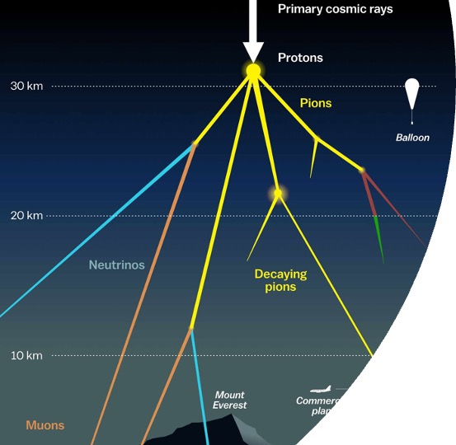
Prompt 31.08.2023
Evaluation of Ludwig’s, Ben’s and Leander’s results

Slide 2
Outline
How many events do we expect? –> Which label shall we use for this?
Show effect of filters
What is our prompt definition? –> Why?

Slide 3
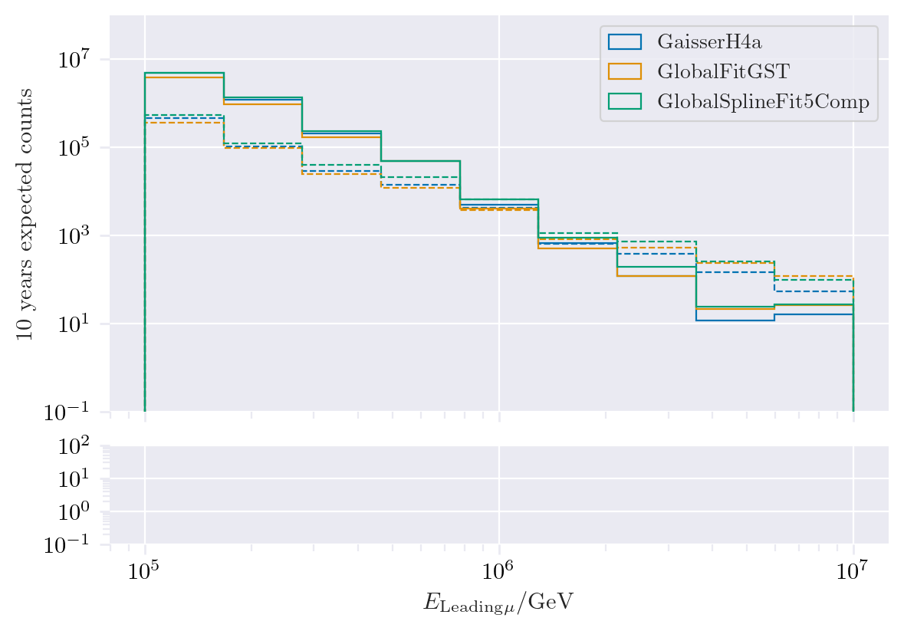
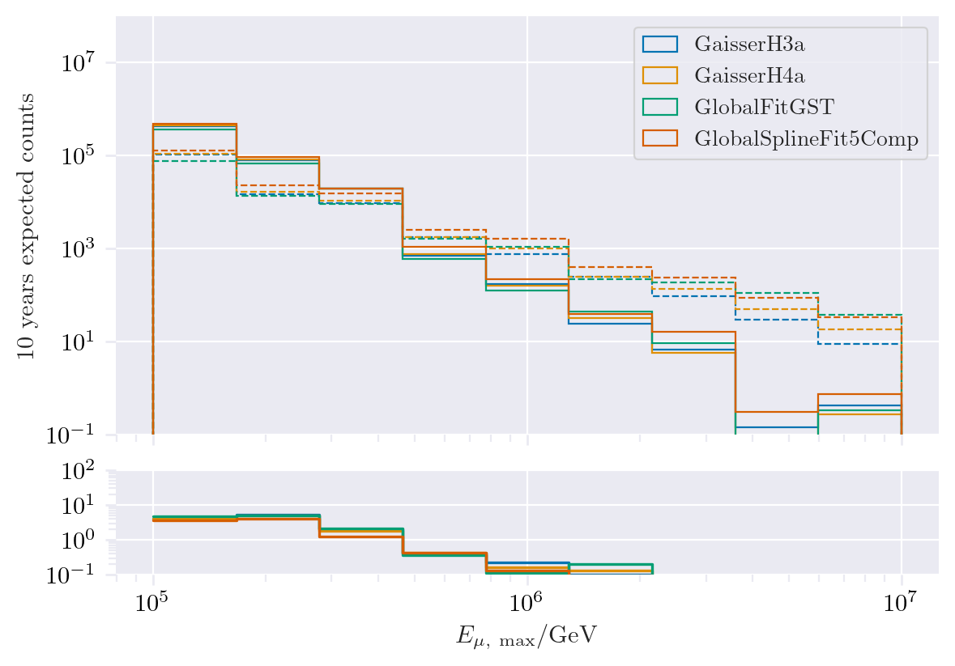
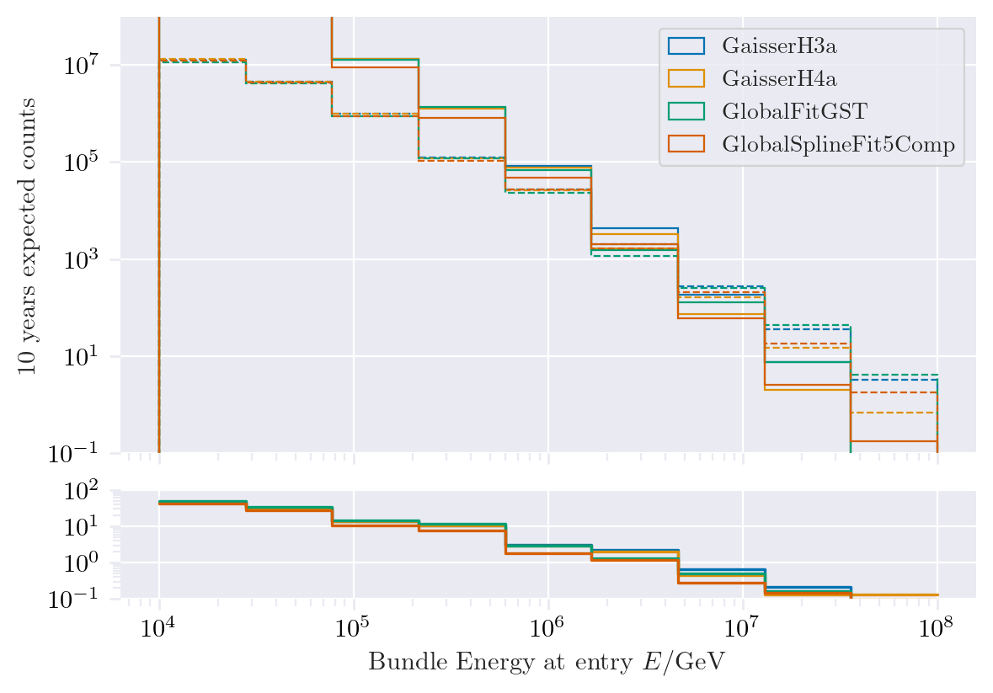
Expected muons for 10 years
dashed: conv
dotted: prompt
MostEnergeticMuonInside_energy
MCLabelsLeadingMuons_entry_energy
MCLabelsLeadingMuons_bundle_energy_at_entry

Slide 4
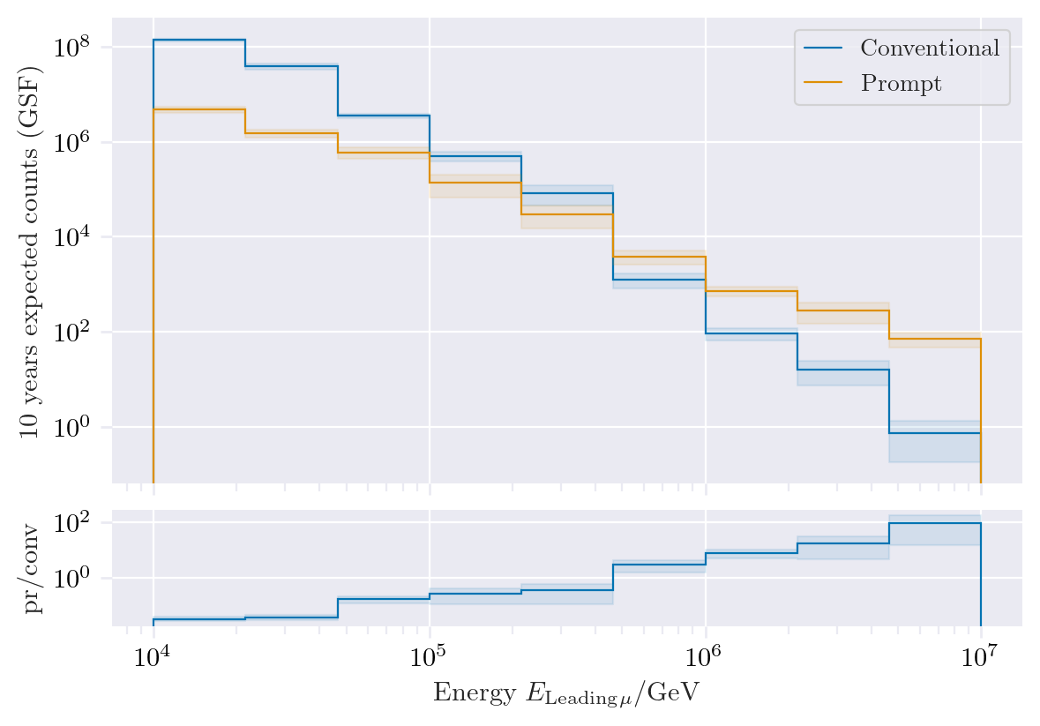
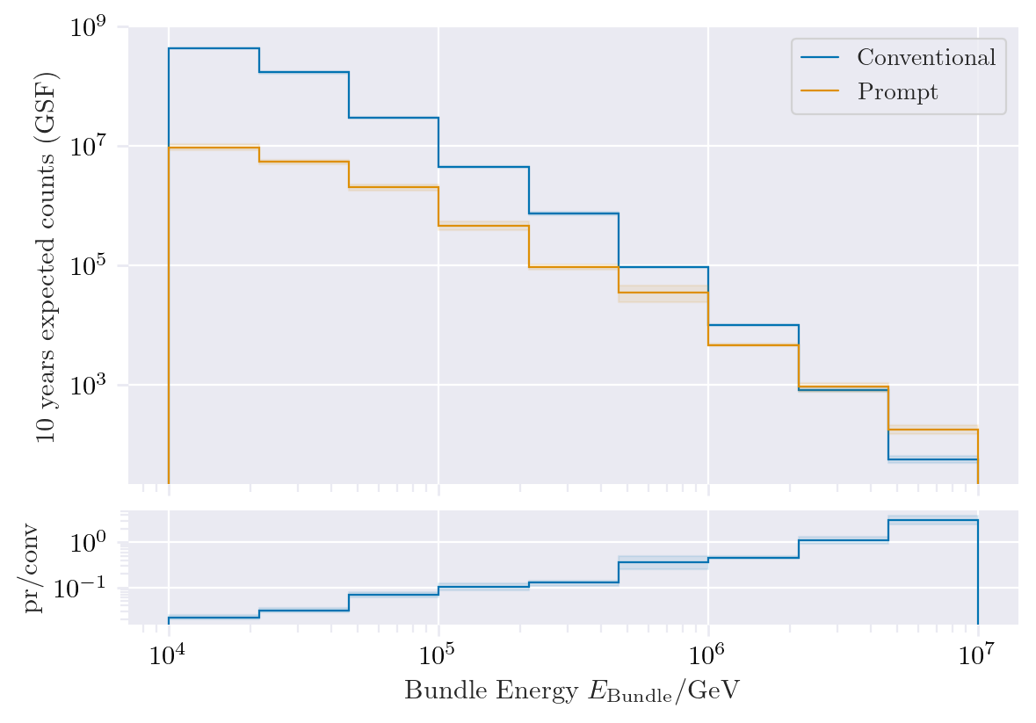
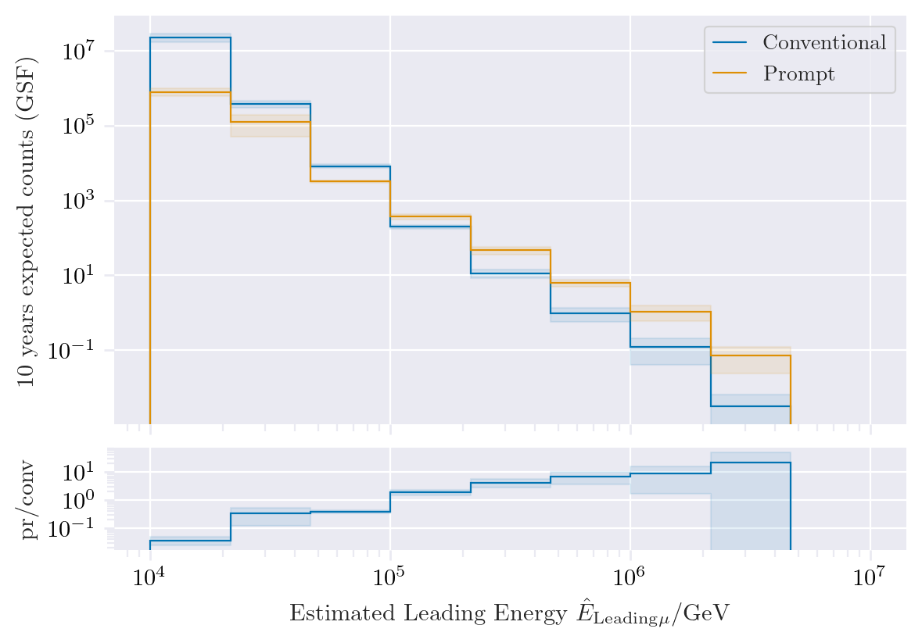
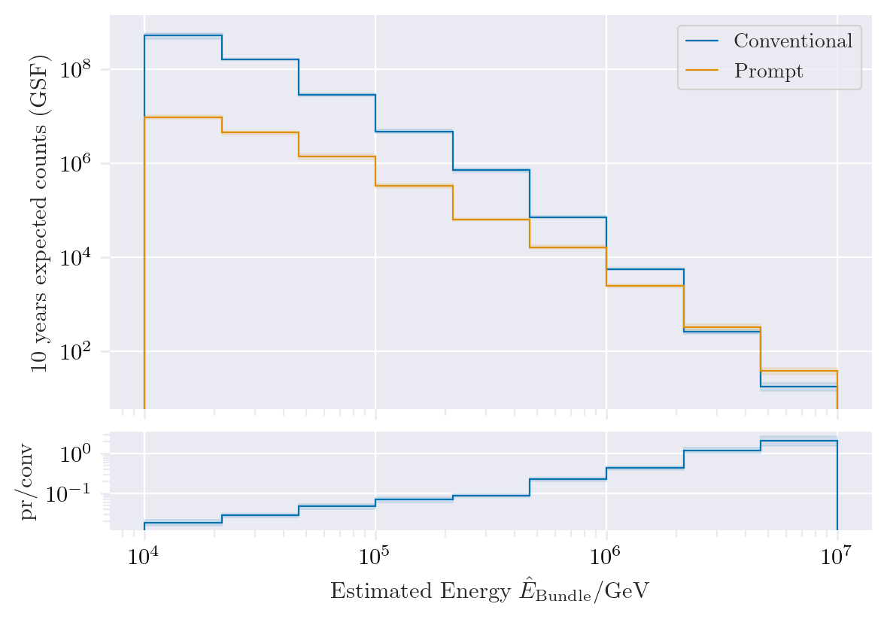
Leading vs. bundle energy
MCLabelsLeadingMuons_entry_energy
MCLabelsLeadingMuons_bundle_energy_at_entry
Leading muon energy is more sensitive to measure prompt
But it is more difficult to reconstruct the leading muon energy accurately
DeepLearningReco_energy_bigger_model_bundle
Issues in leading energy reconstruction

Slide 5
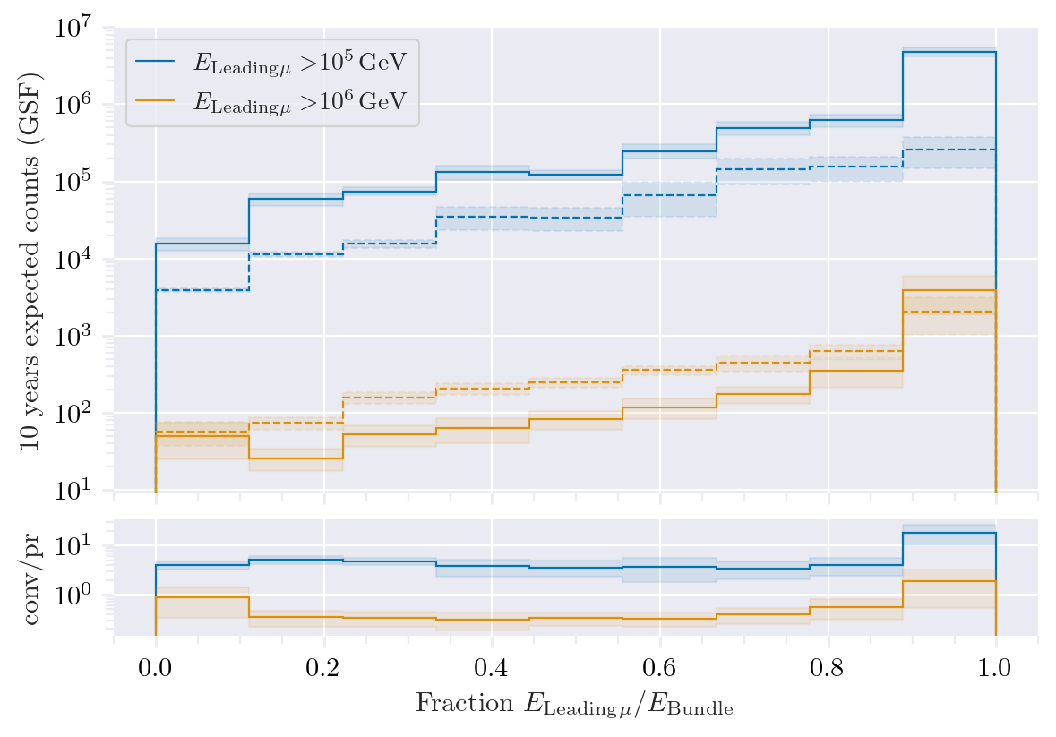
Leading energy fraction
Solid: conventional
Dashed: prompt
Prompt dominates for energies > 1 PeV
Leading energy fraction sweetspot between 0.1 – 0.9

Slide 6
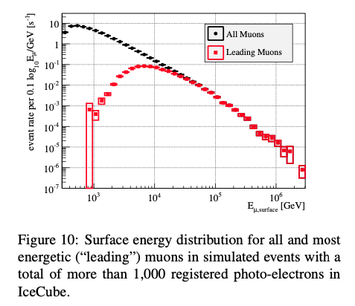
Leading muon fraction
What happens at energies < 1e5 GeV?

Slide 7
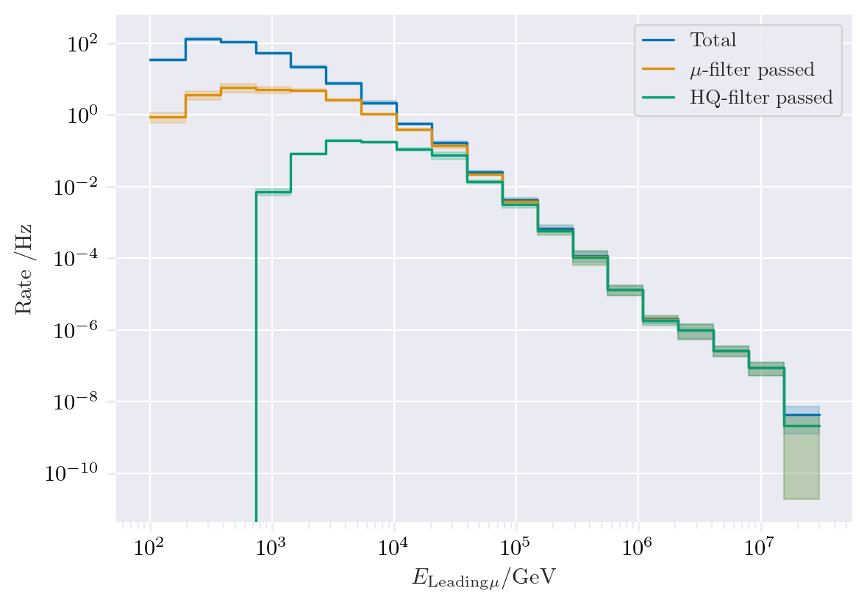
Filter – total flux
MCLabelsLeadingMuons_entry_energy

Slide 8
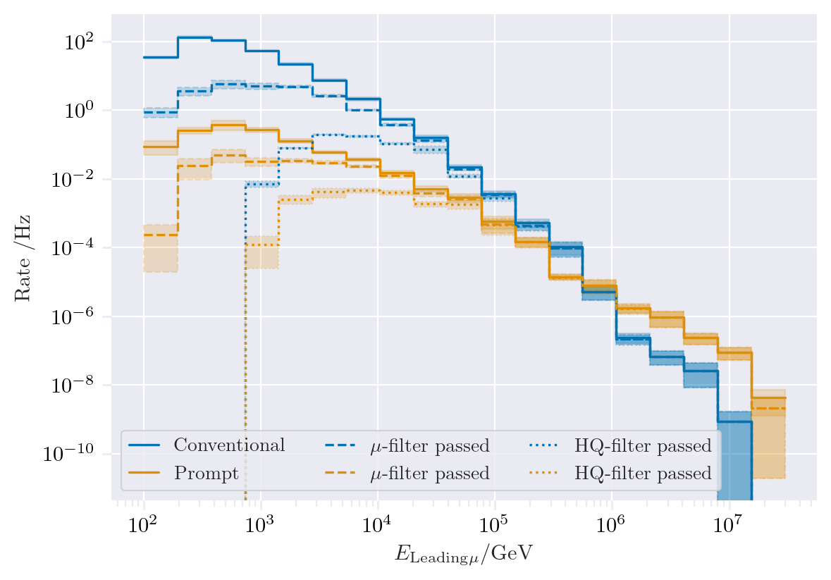
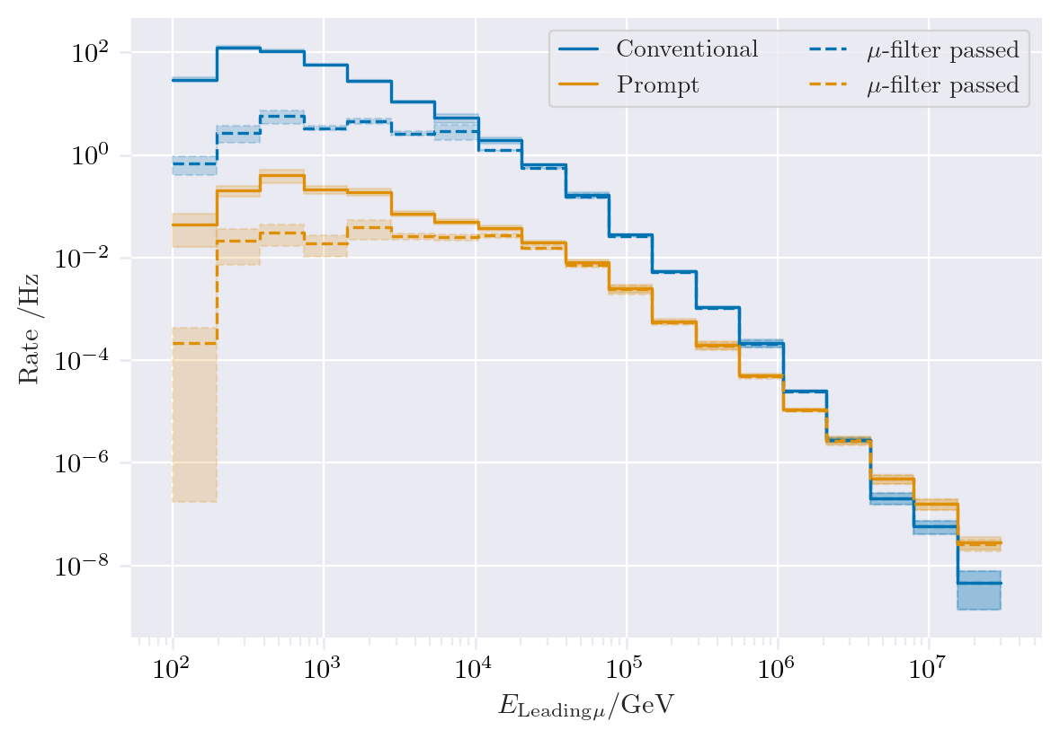
Filter Muon filter if E > 1e4 GeV HQ filter similar to muon filter for E > 1e5 GeV
MCLabelsLeadingMuons_entry_energy
MCLabelsLeadingMuons_bundle_energy_at_entry

Slide 9
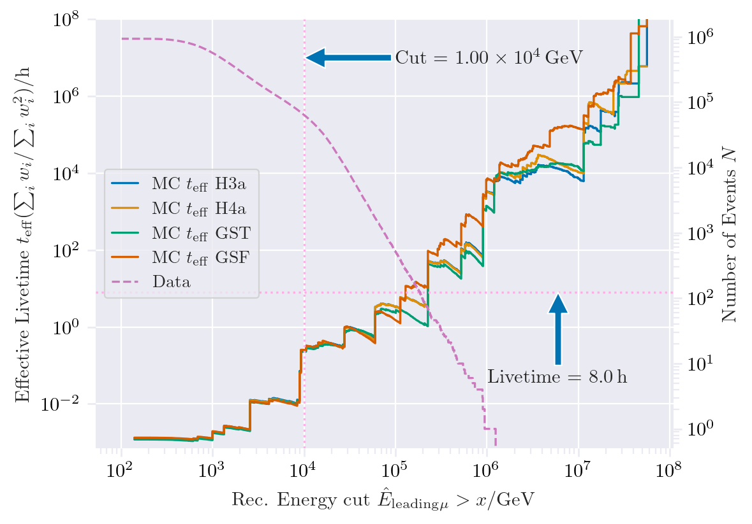
How many events do we need to simulate?
Enough events at high energies
-> More events at energies lower 1 PeV needed
Which primary energy leads to which leading energy?

Slide 10
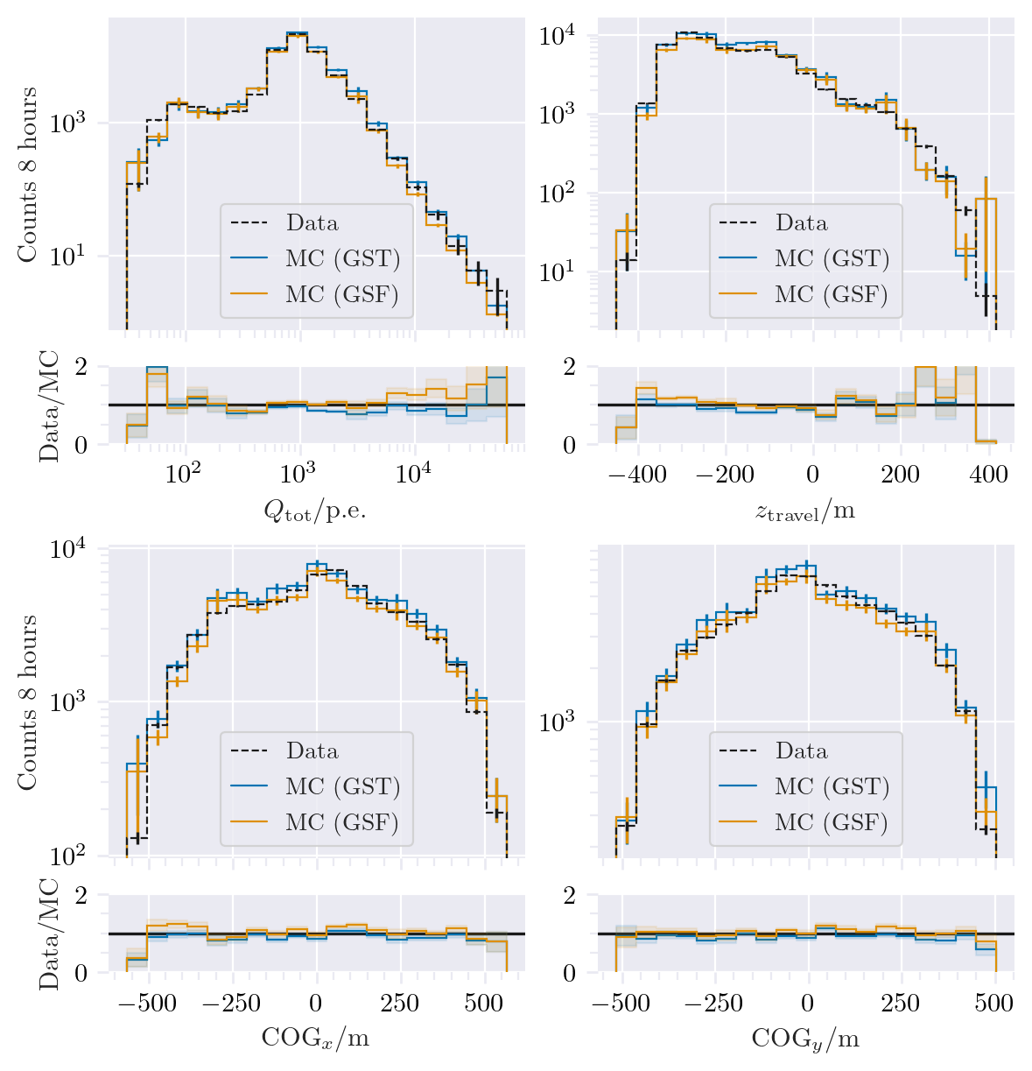
Data-MC (charge)
Cut: DeepLearningReco_exported_model_PromptMu_L2_energy_bundle_energy_at_entry > 1e4 GeV

Slide 11
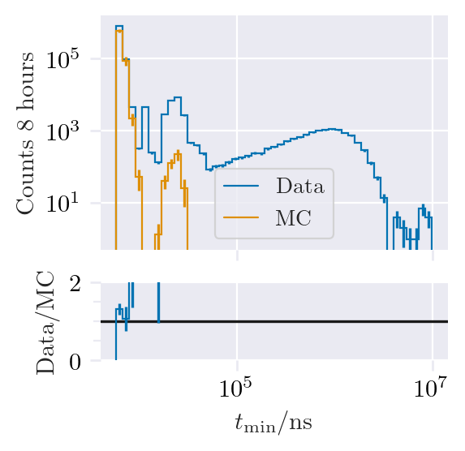
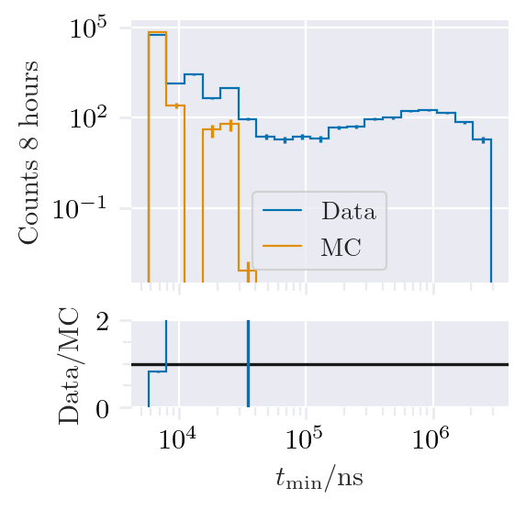
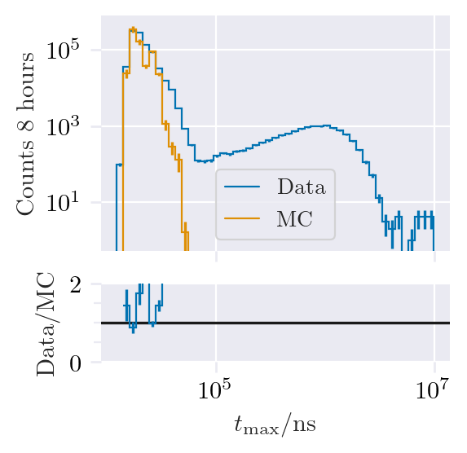
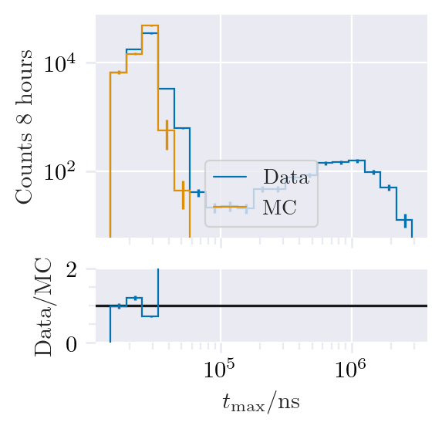
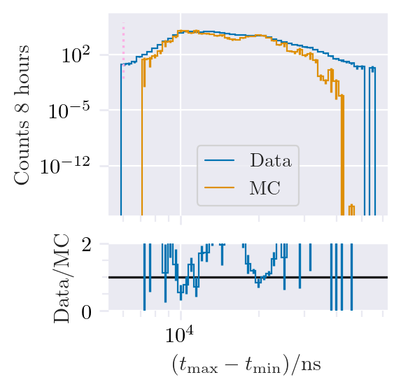
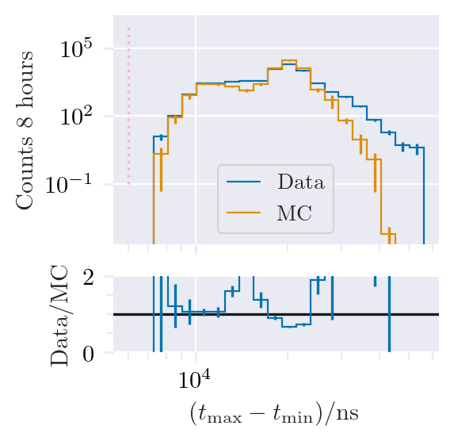
Data-MC (pulses)
No cut
Cut E > 1e4 GeV
Other events
Pulse cleaning needed
Pulse cleaning: 6000 ns

Slide 12
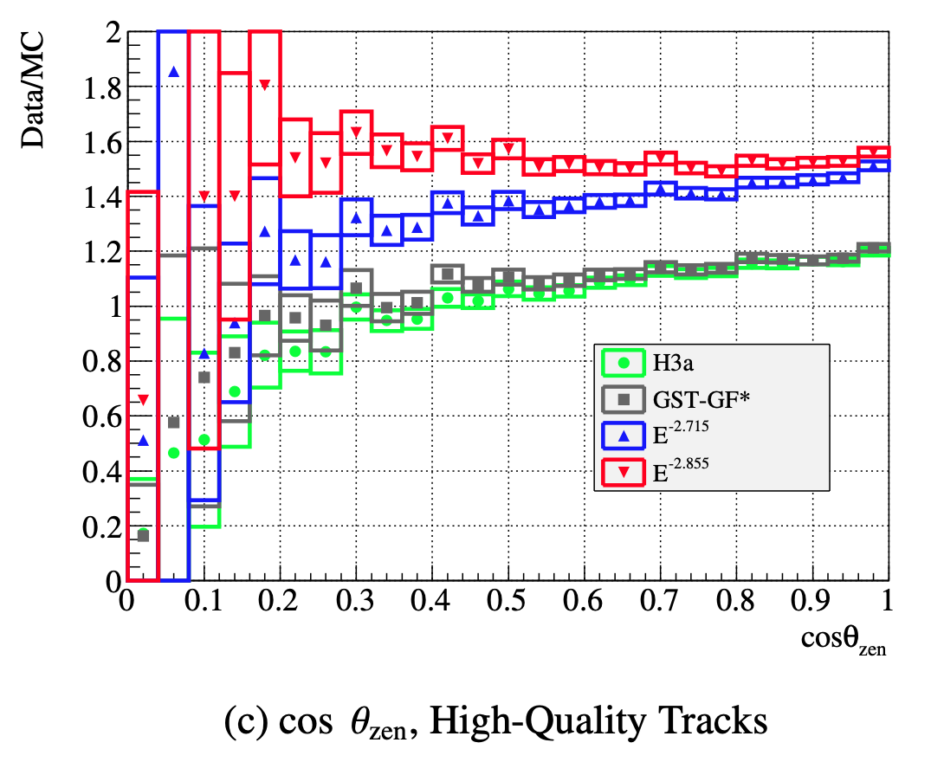
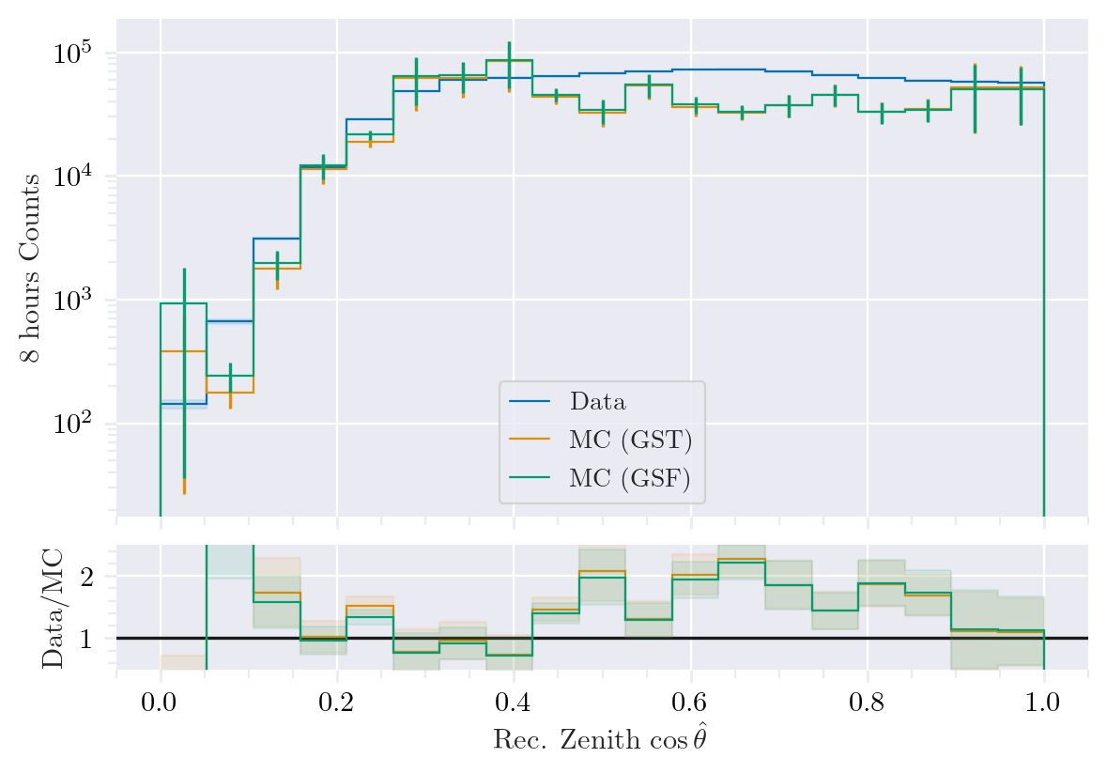
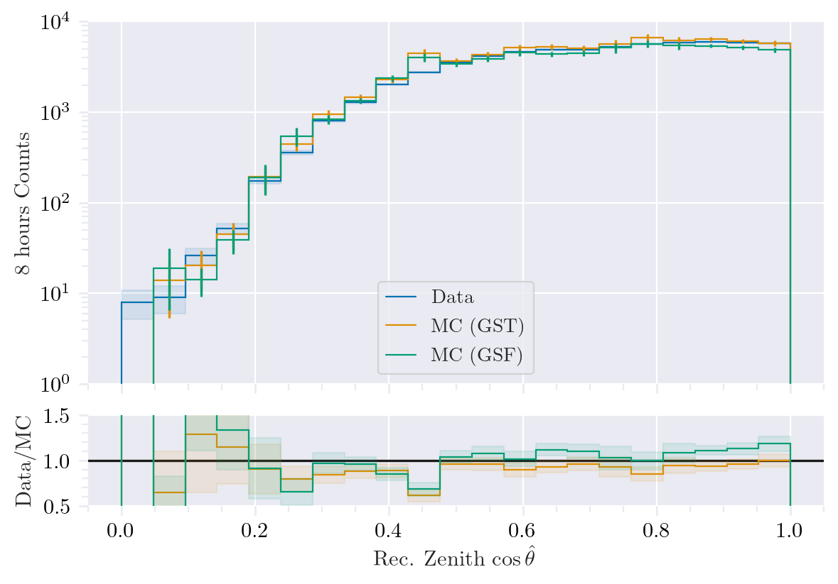
Data-MC (cos zenith)
No cut
Cut E > 1e4 GeV
Mismatch, but low statistics!

Slide 13
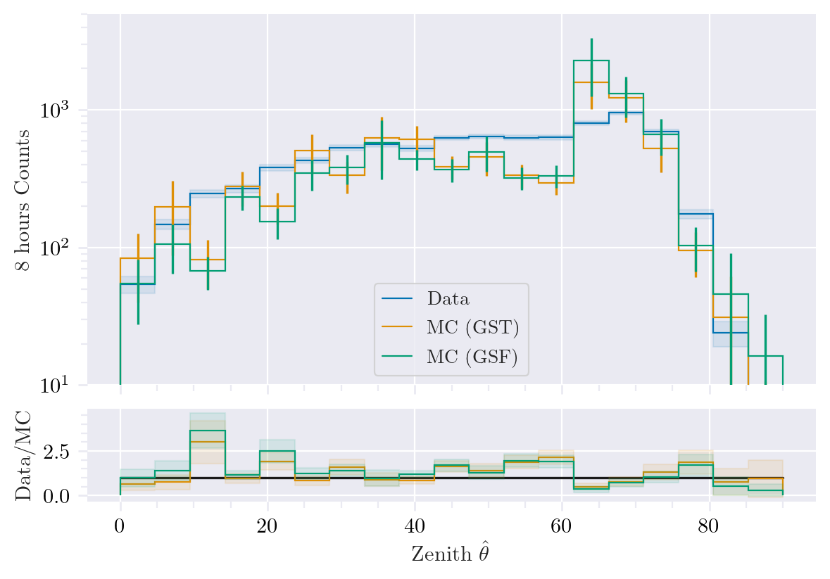
Data-MC (zenith)
Energy cut??
Excess?
DNN uncertainty cut: < 3.14/180
DeepLearningReco_direction_big_PrimaryZenith

Slide 14
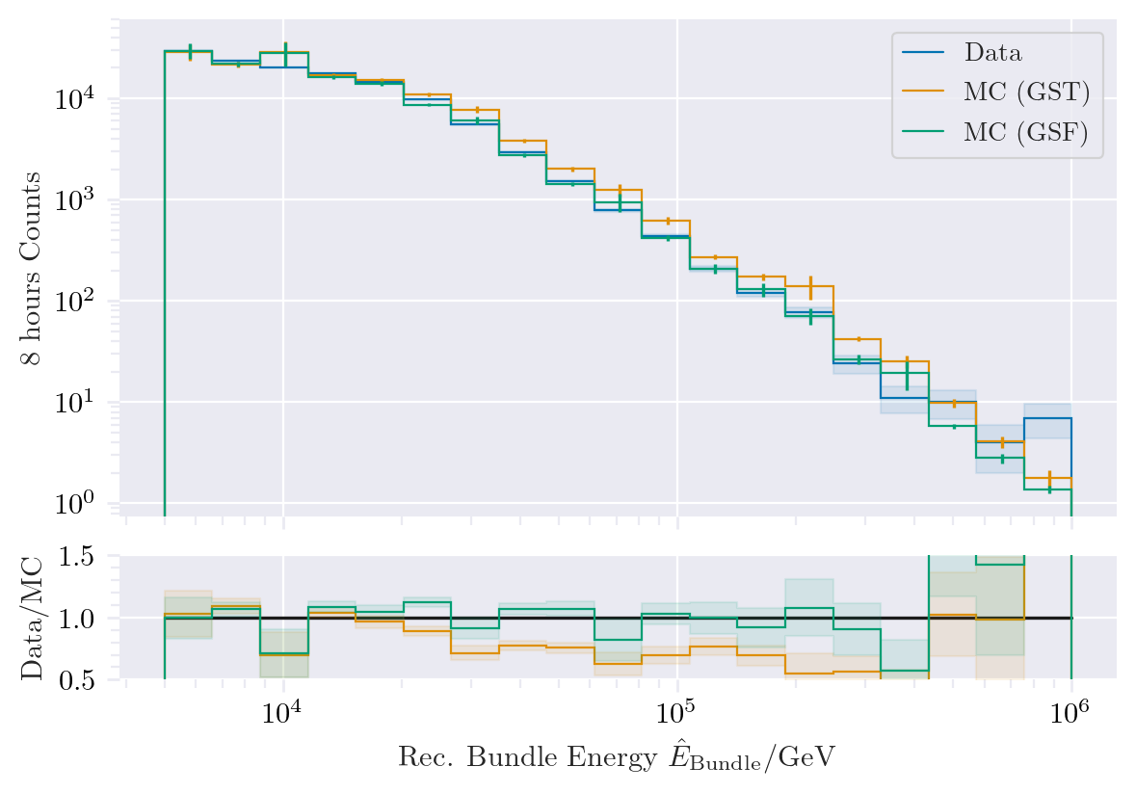
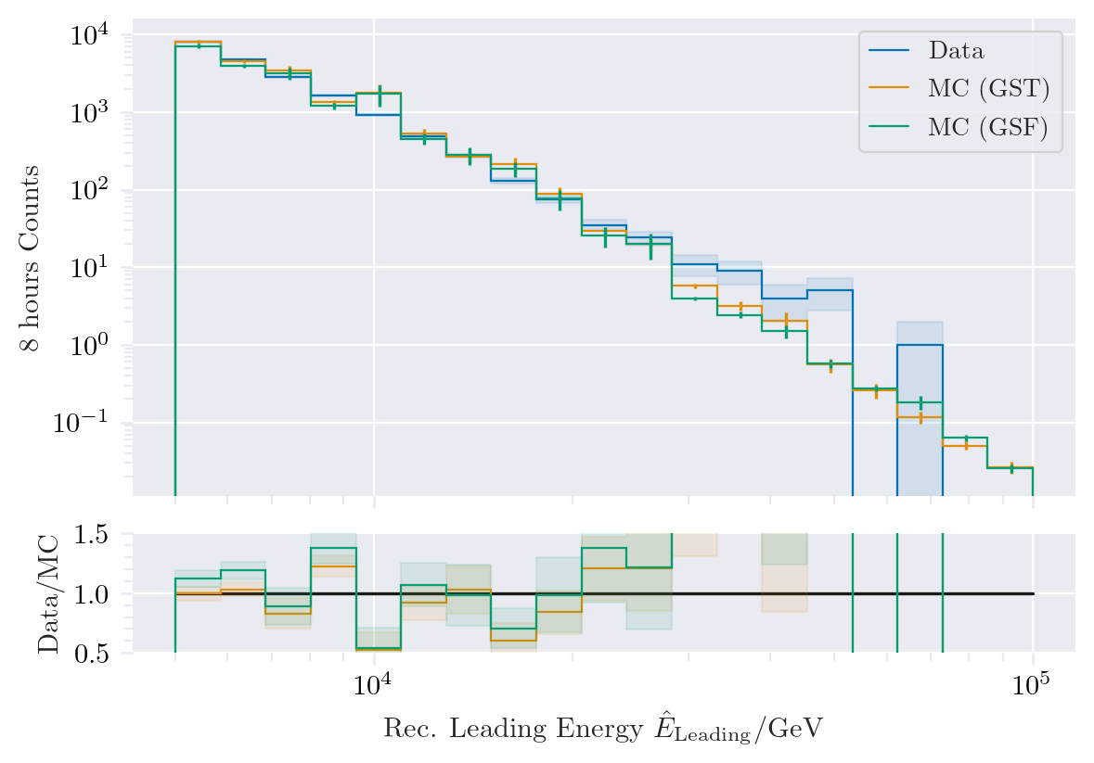
Data-MC (energy spectrum)
Only low statistics?
Bundle: GSF better than GST

Slide 15
First analysis chain

Slide 16
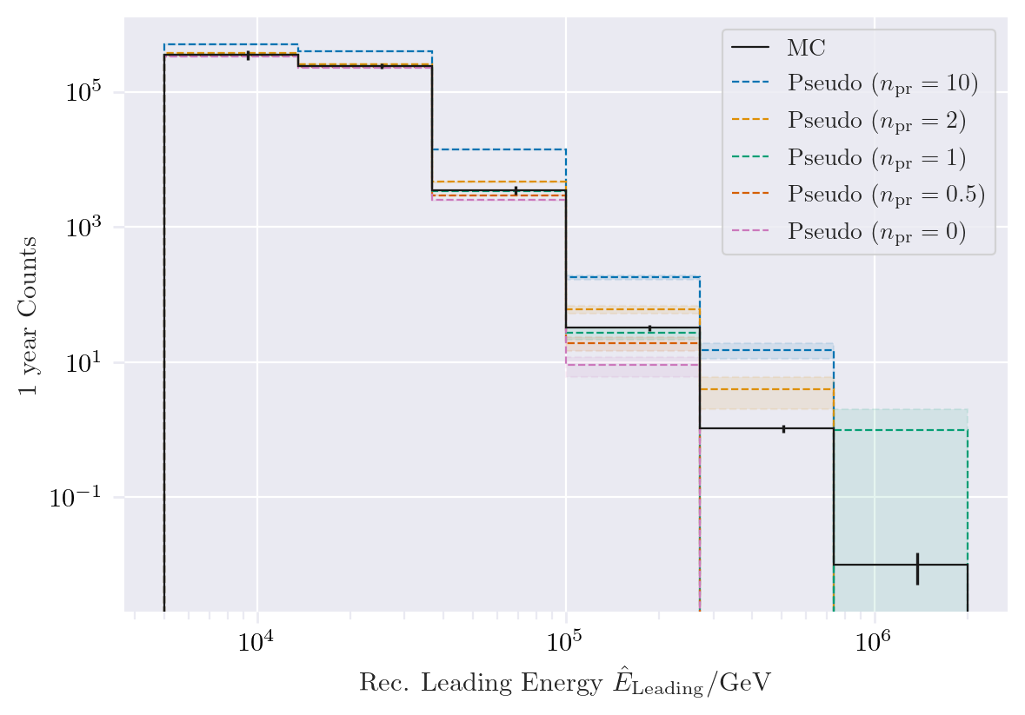
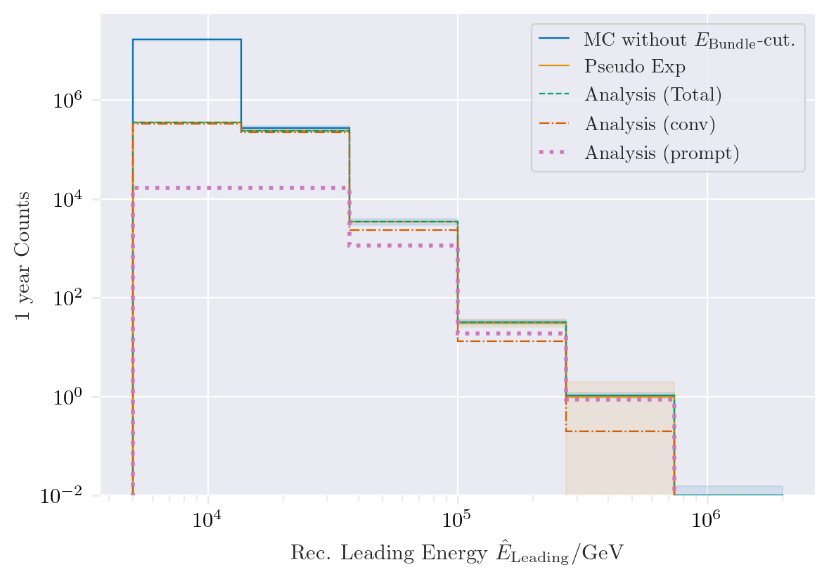
Pseudo data sampling
Check sampling method

Slide 17
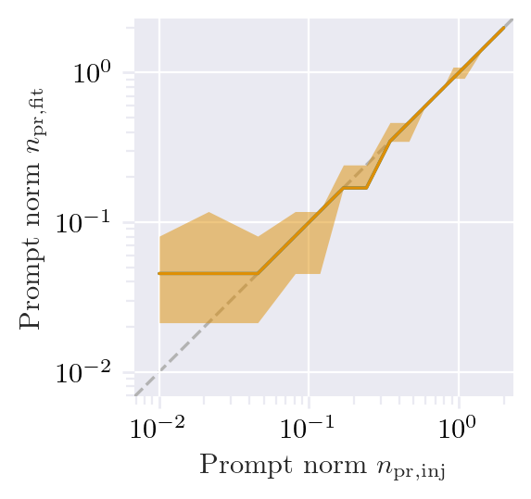
Test bias

Slide 18
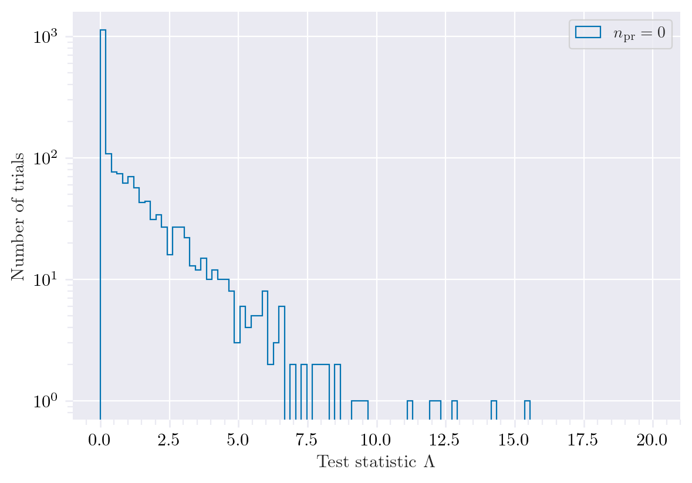
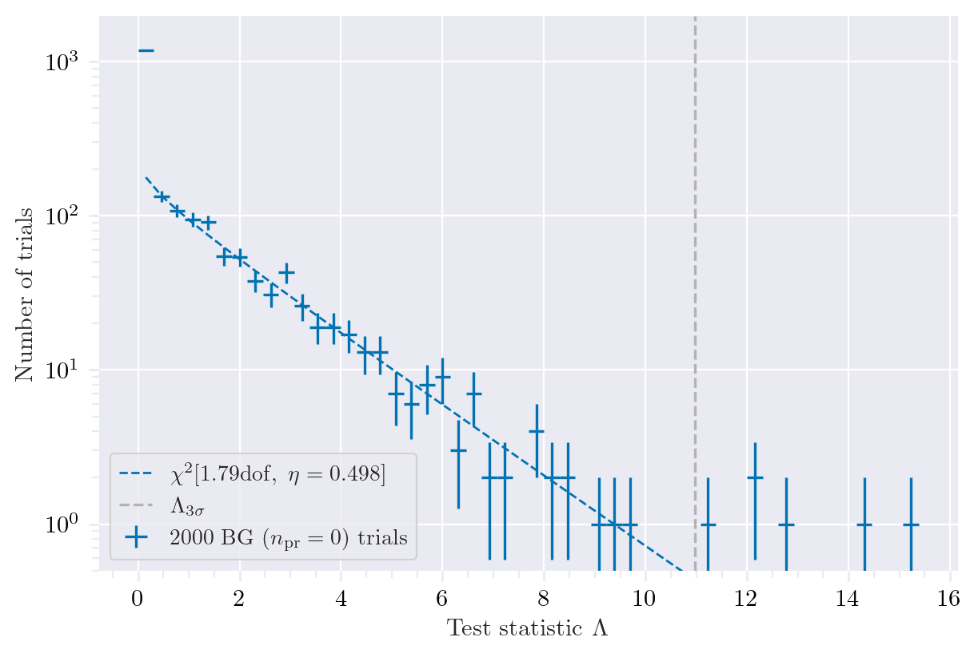
Test background statistics

Slide 19
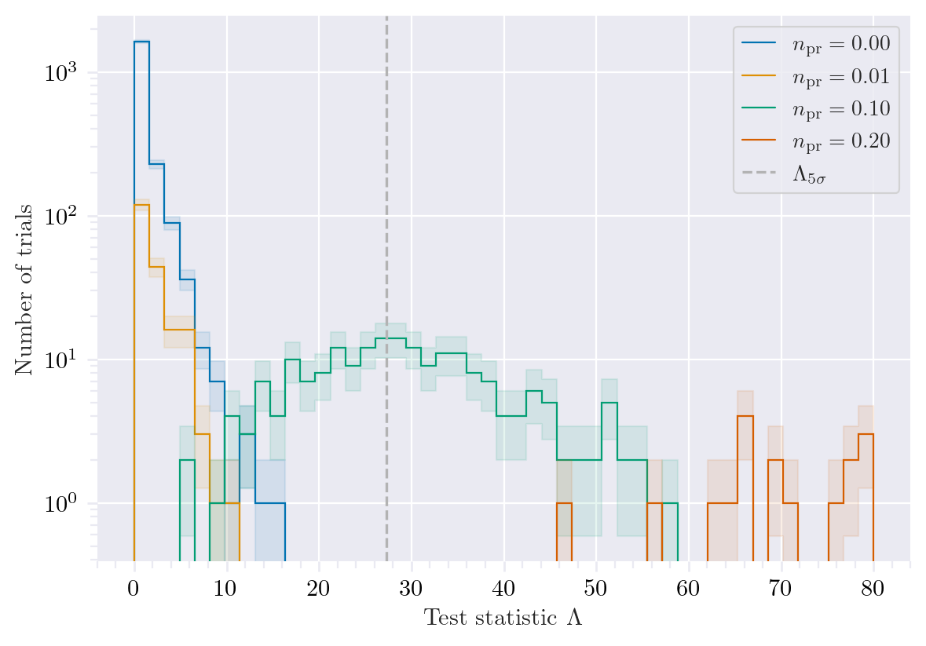
Discovery potential and sensitivity
Discovery potential: 0.102 +- 0.004
(50% of all trials result in a significance > 5 sigma)
Sensitivity: 0.024 +- 0.001
(90% of all trials result in a test statistic that is as least as large as the
median of the background test statistic value for the null hypothesis)
Analysis performed only in energy bins -> extend to zenith
DeepLearningReco_exported_model_PromptMu_L2_energy_entry_energy

Slide 20
Backup

Slide 21
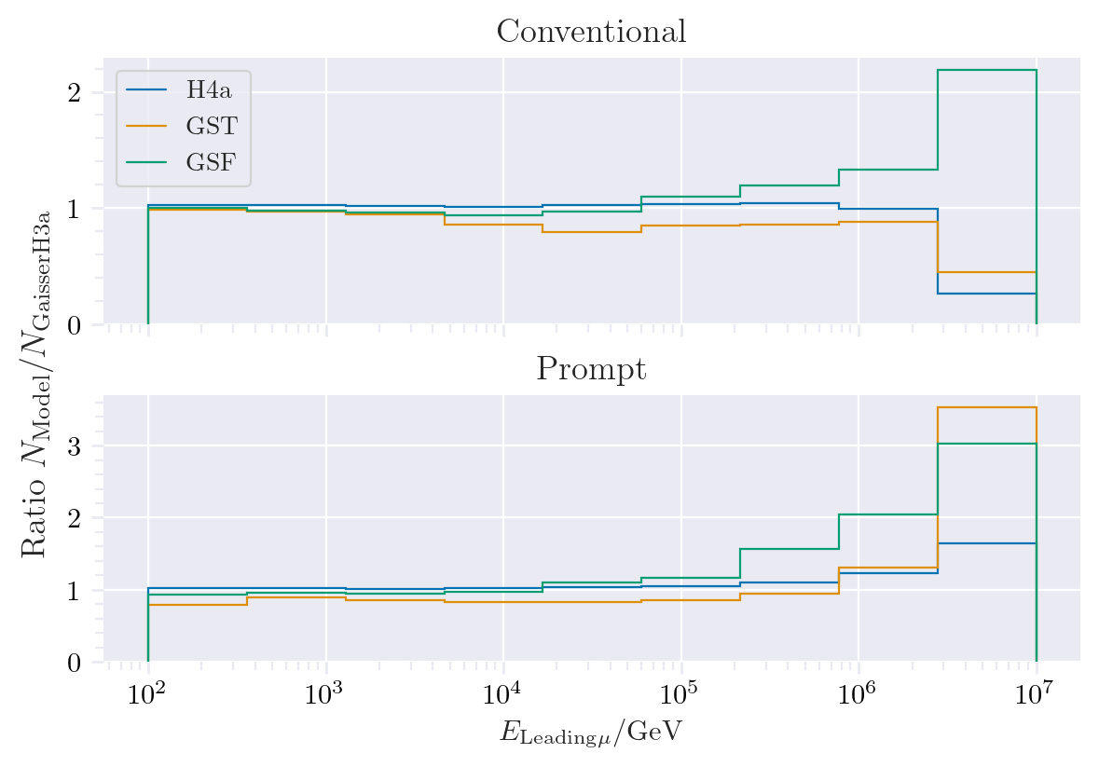
Muon production – different weightings
GST predicts most prompt
MCLabelsLeadingMuons_entry_energy

Slide 22



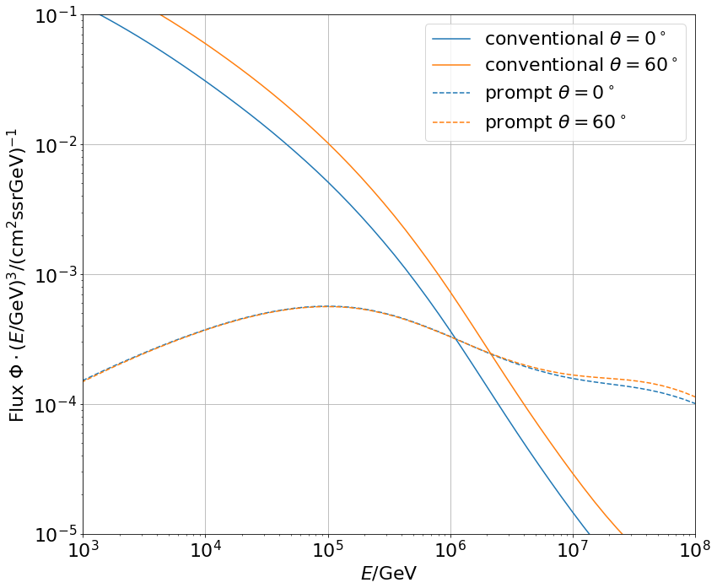
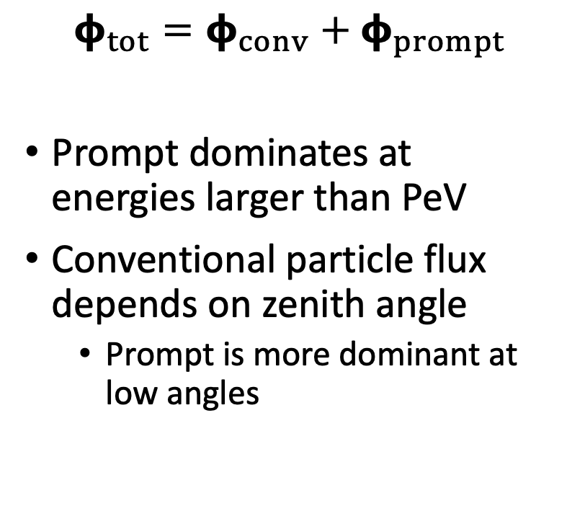
Muon flux
0°: perpendicular to Earth’s surface
$$φ_{tot}=φ_{conv}+φ_{prompt}$$
Prompt dominates at energies larger than PeV
Conventional particle flux depends on zenith angle
Prompt is more dominant at low angles
conventional
prompt
We can measure prompt muon energies from ~1 PeV to ~100 PeV

Slide 23
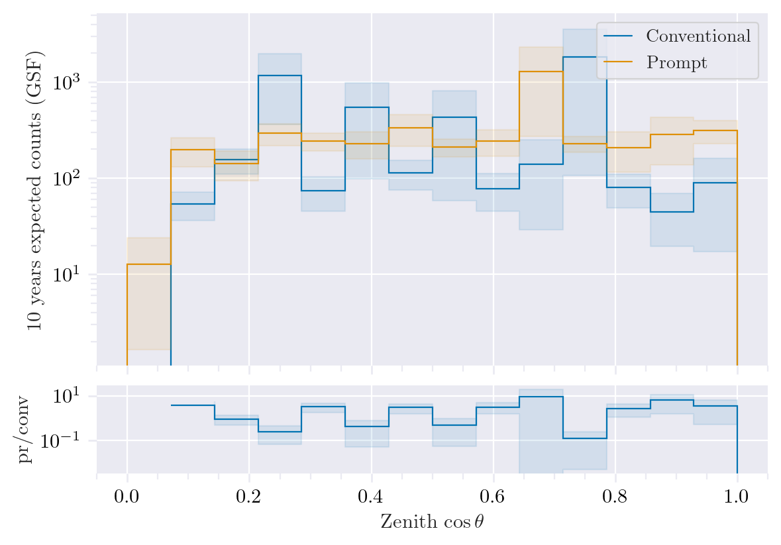
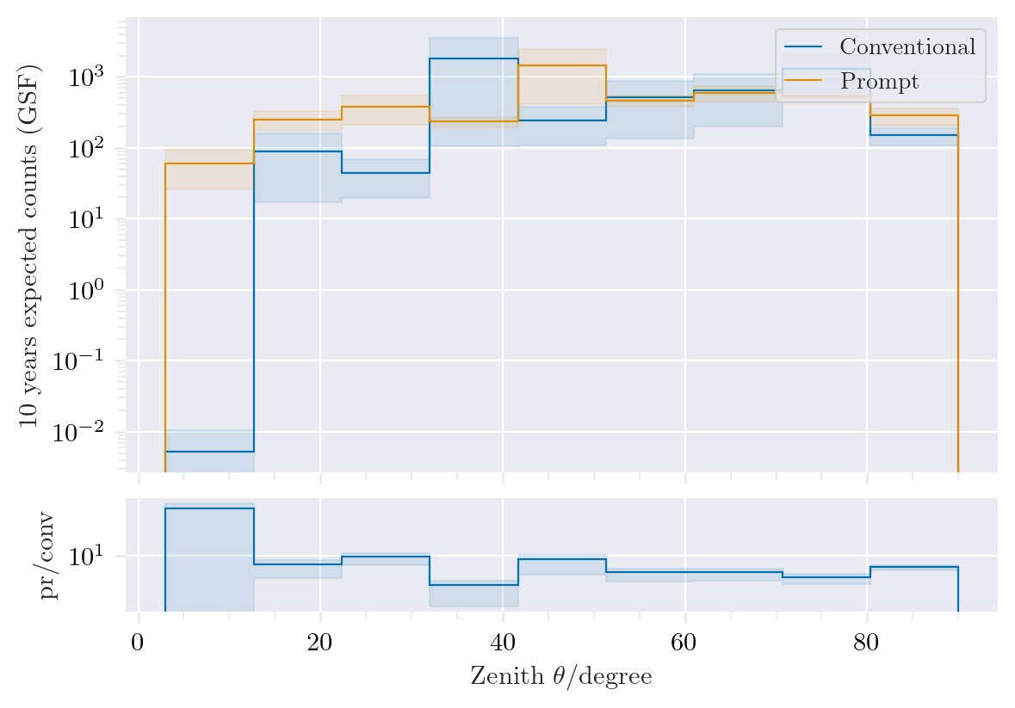
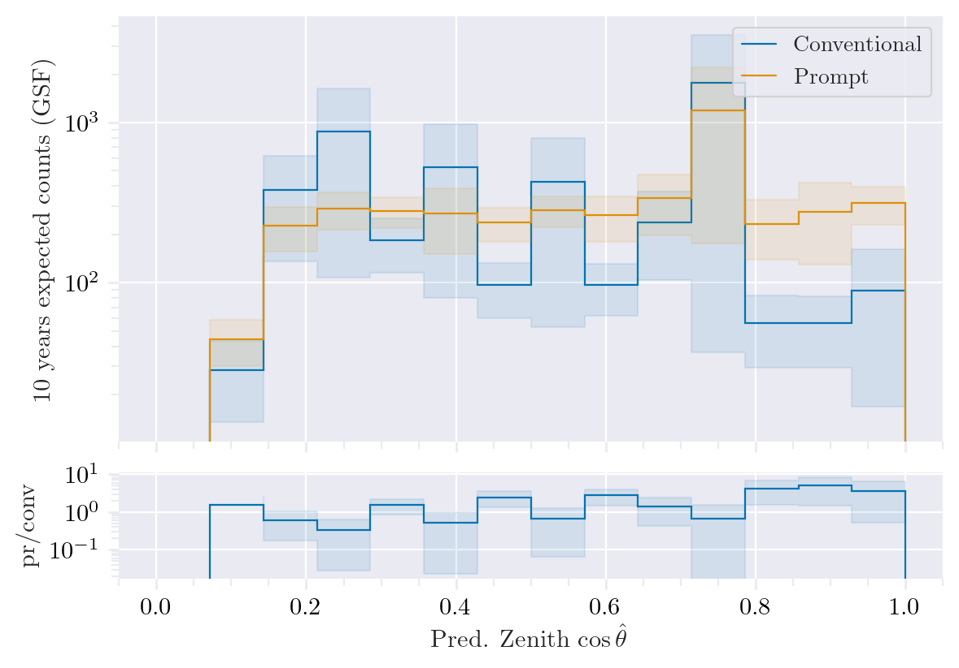
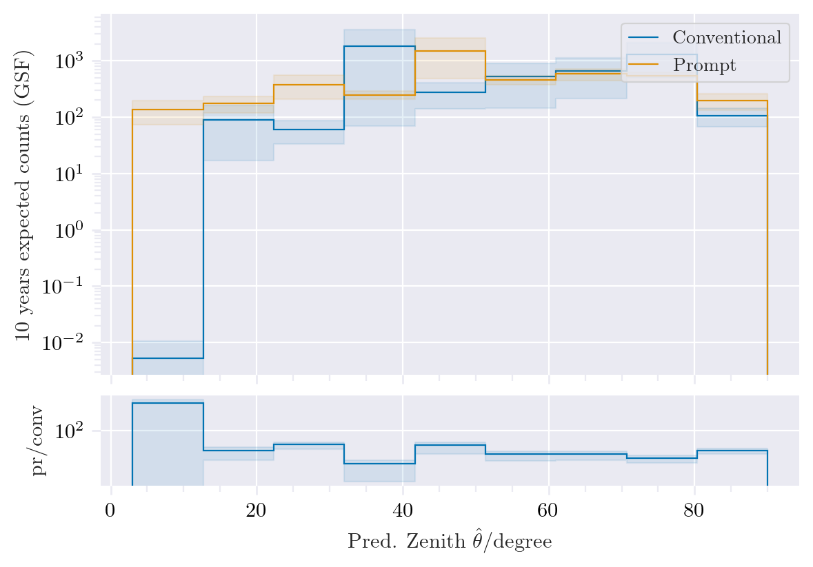
Zenith Cut: MostEnergeticMuonInside_energy > 1 PeV
Prompt dominates at low zenith angles
Same plots?
MostEnergeticMuonInside_zenith
DeepLearningReco_direction_even_bigger_PrimaryZenith

Slide 24
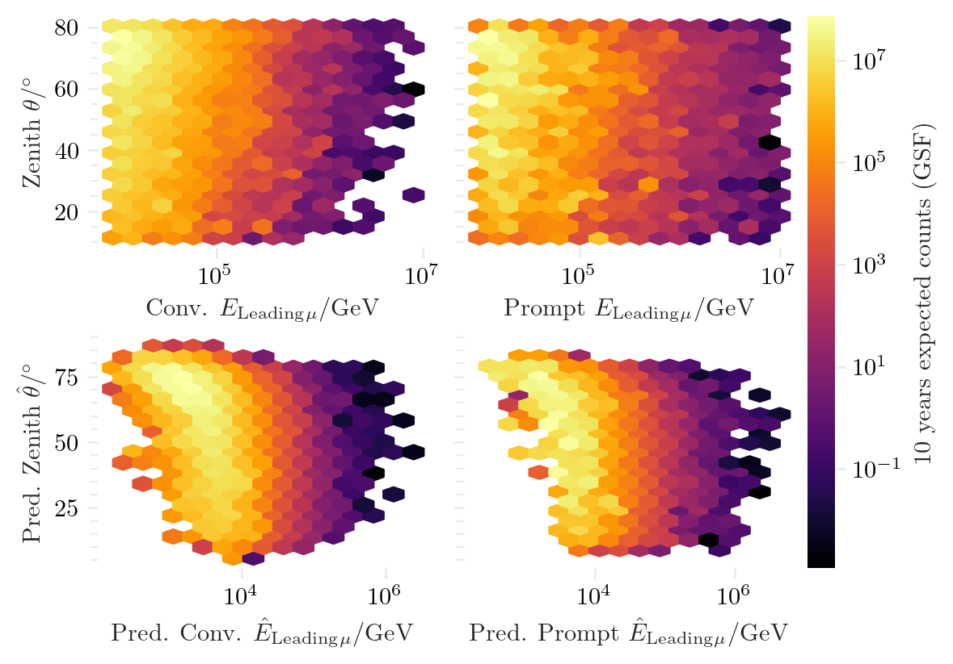
Zenith in dependence of leading muon energy
Cuts: 1e4 < MostEnergeticMuonInside_energy < 1e7
11° < MostEnergeticMuonInside_zenith < 80°

Slide 25
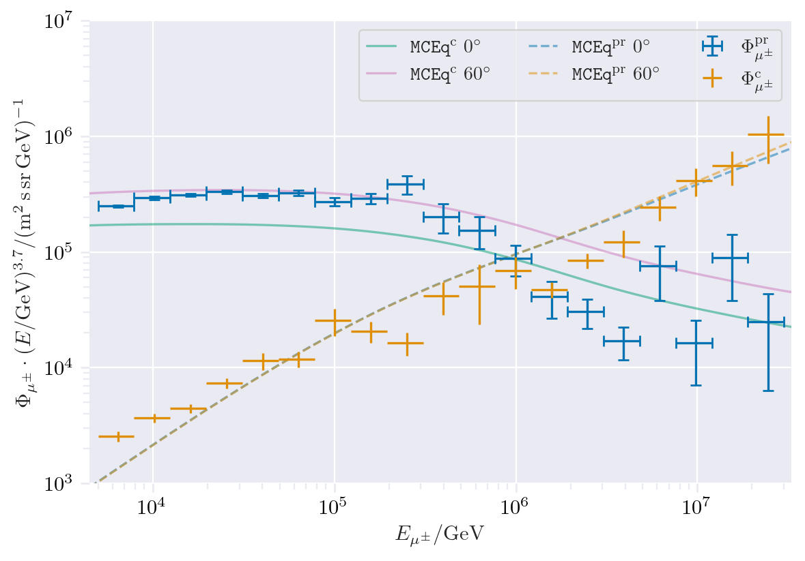
CORSIKA tagging roundtrip
Compare MCEq vs. tagging of IceCube CORSIKA step 0

Slide 26
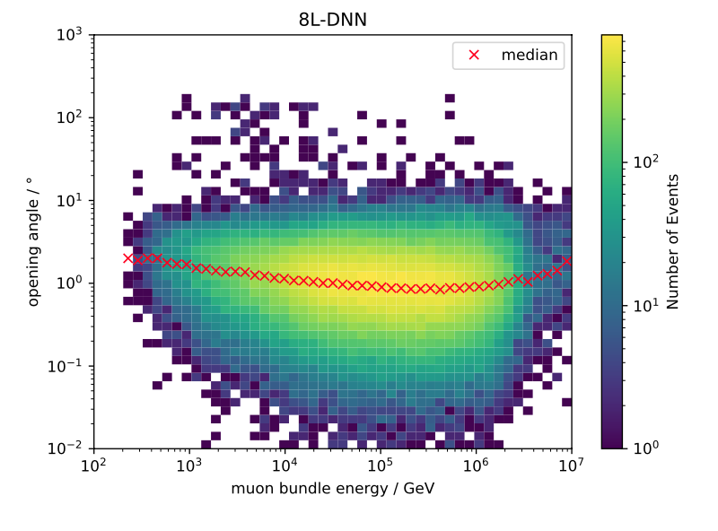
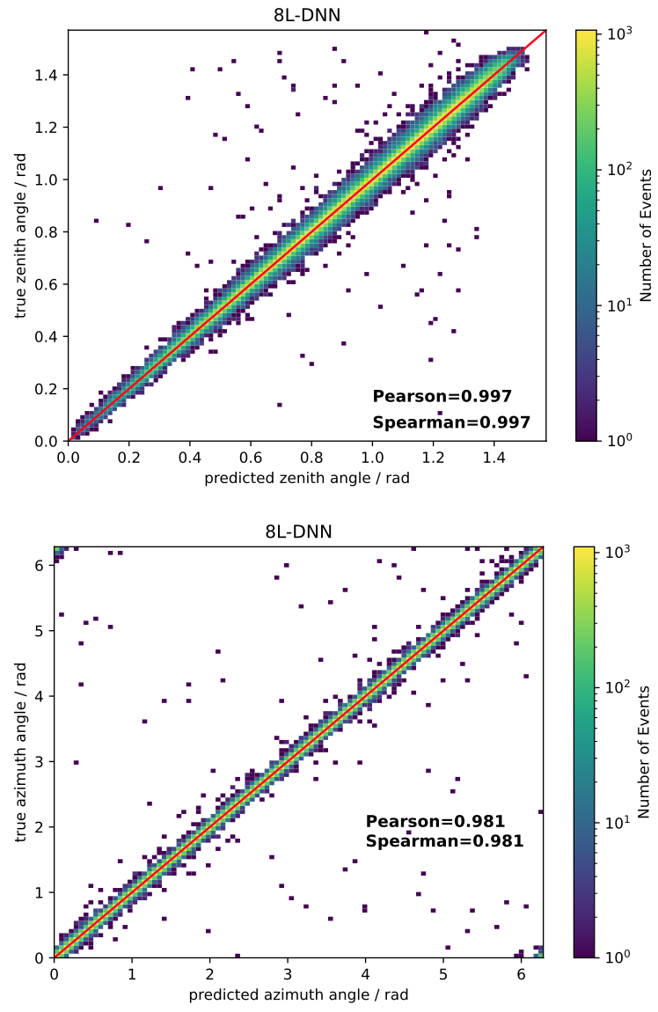
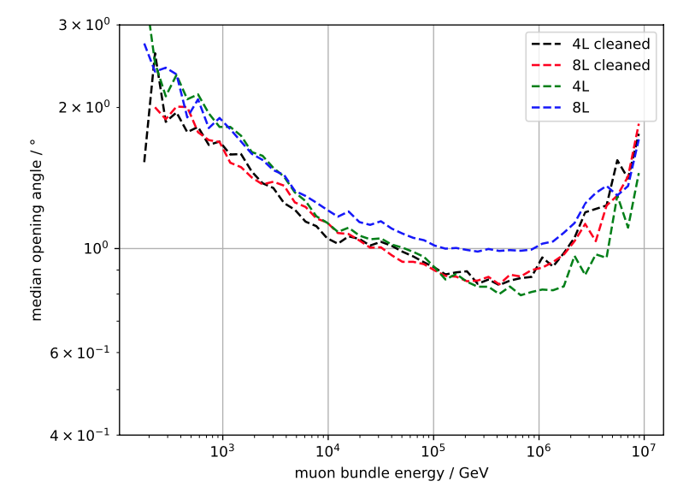
Angular reconstruction - DNN
Cleaned pulses: 6µs

Slide 27
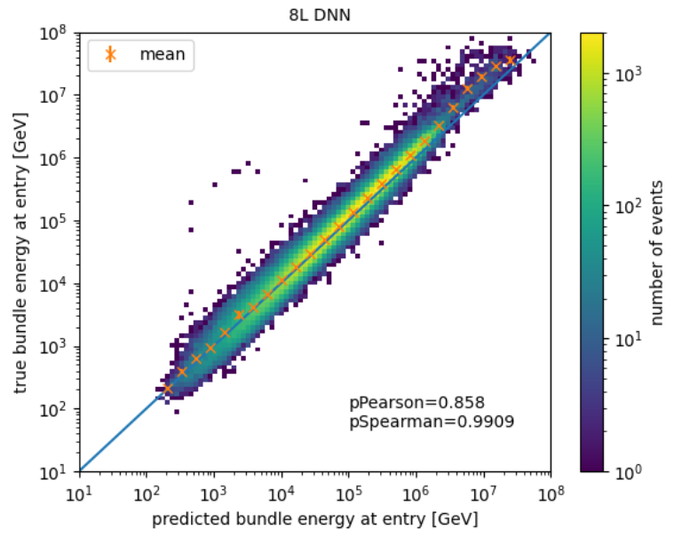
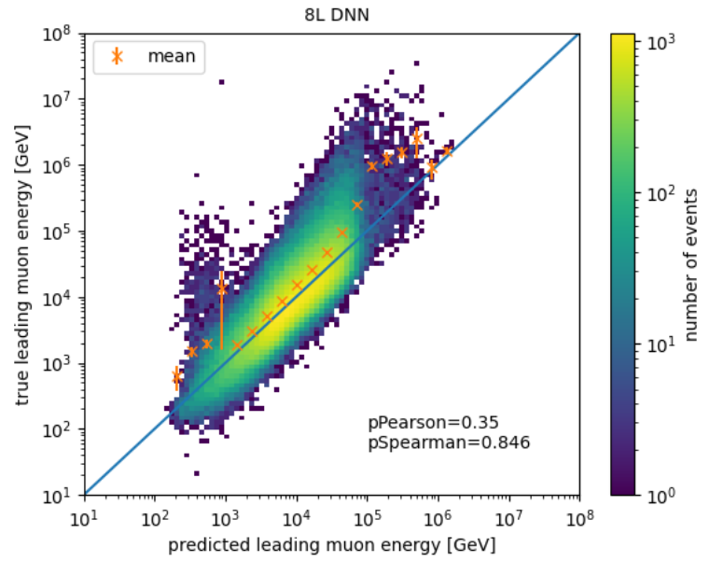
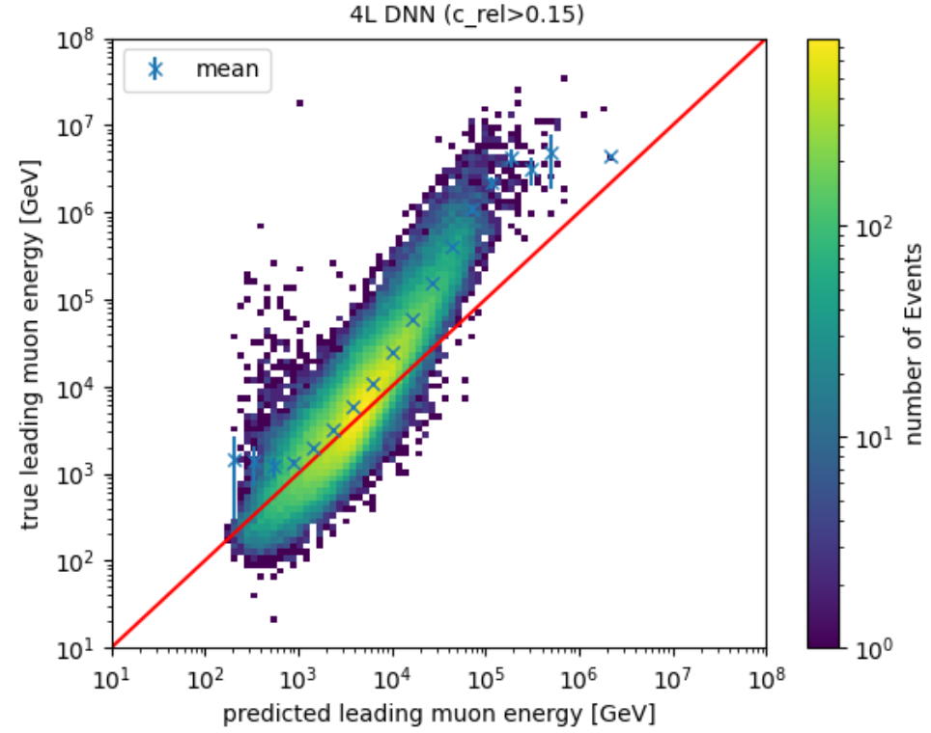
Energy reconstruction - DNN
Uncertainty cut: < 0.5
No cut
leading fraction cut
Test: train on leading muon energy only

