Slide 1
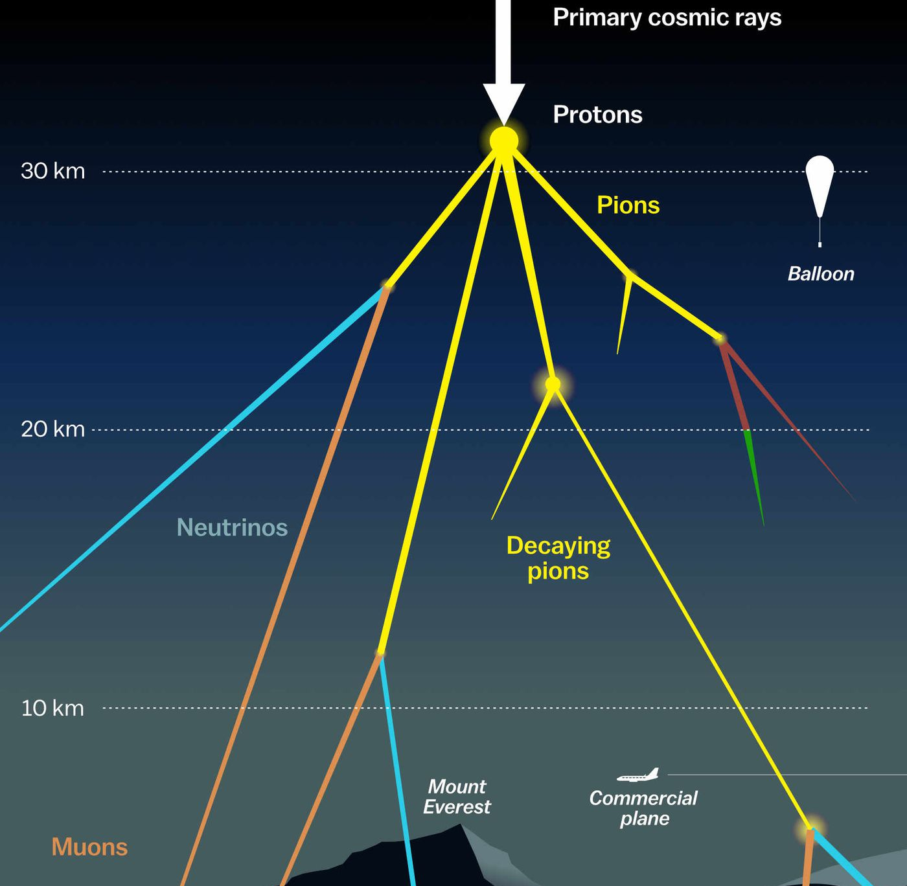

Measuring the prompt component of the atmospheric muon flux Pascal Gutjahr
July 26, 2024
Source: NASA

Slide 2
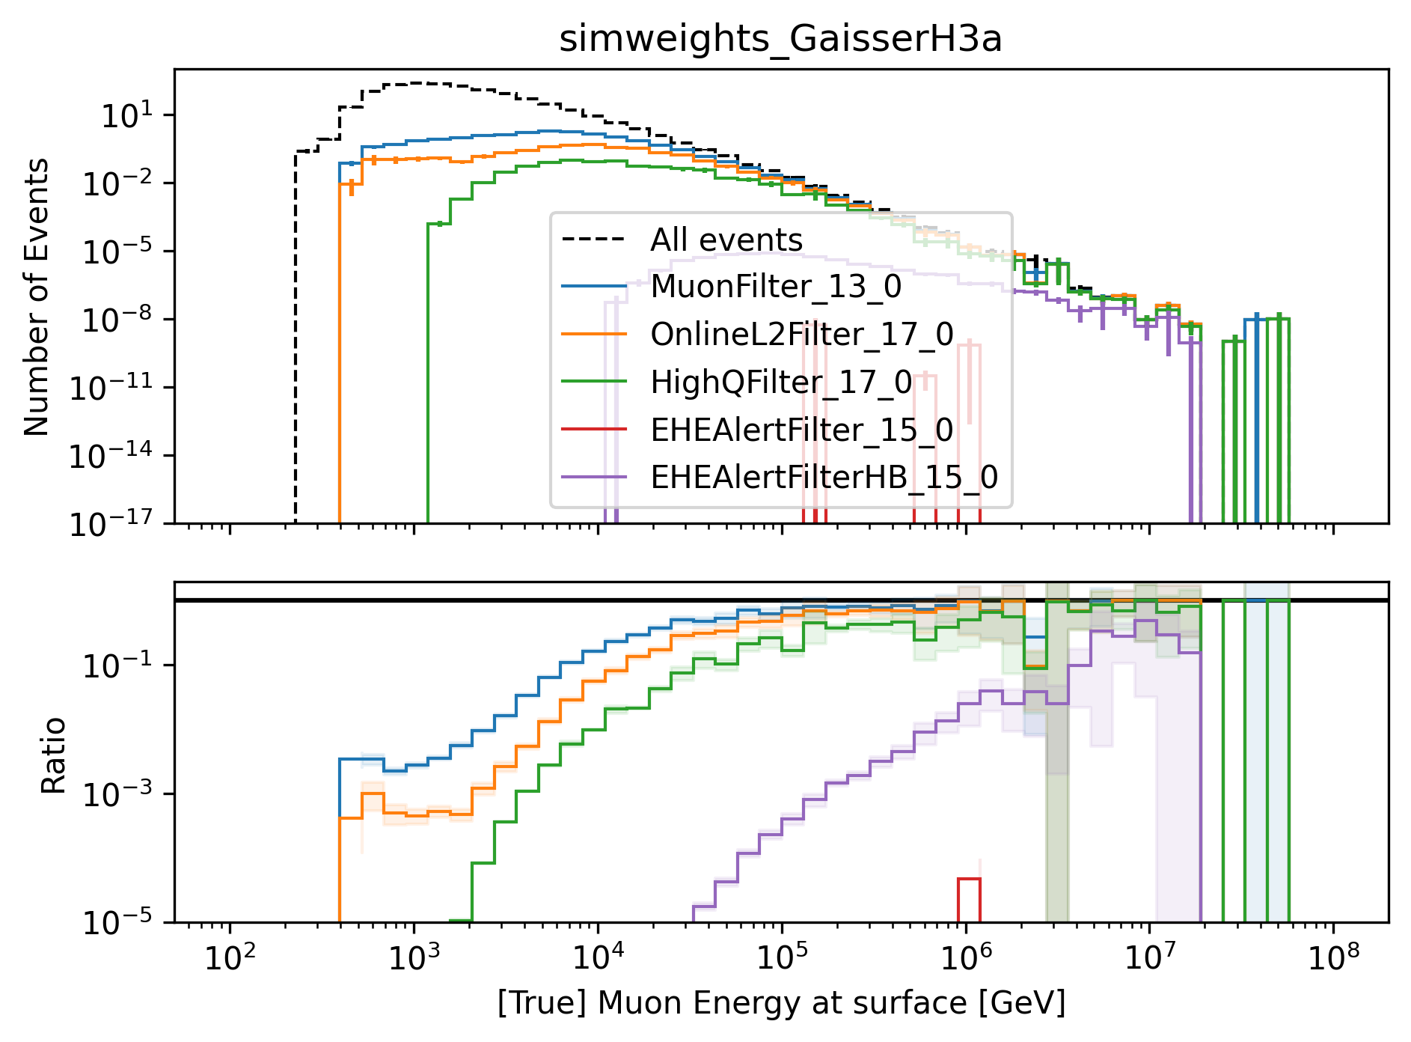
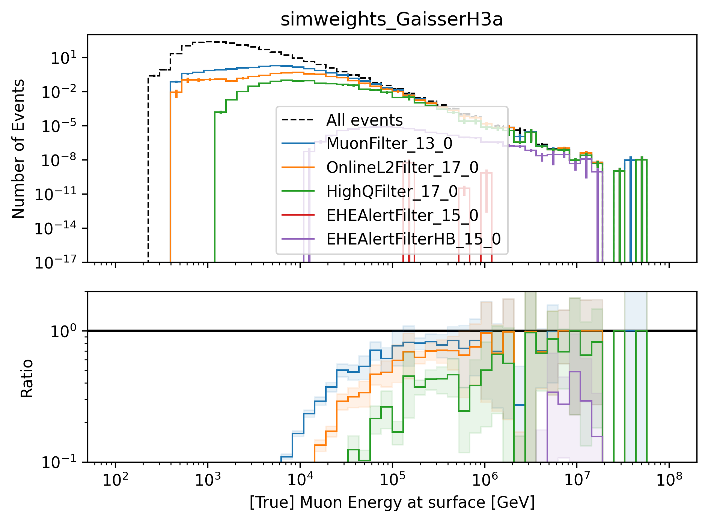
Check level 2 filters – muon energy at surface
zoom

Slide 3
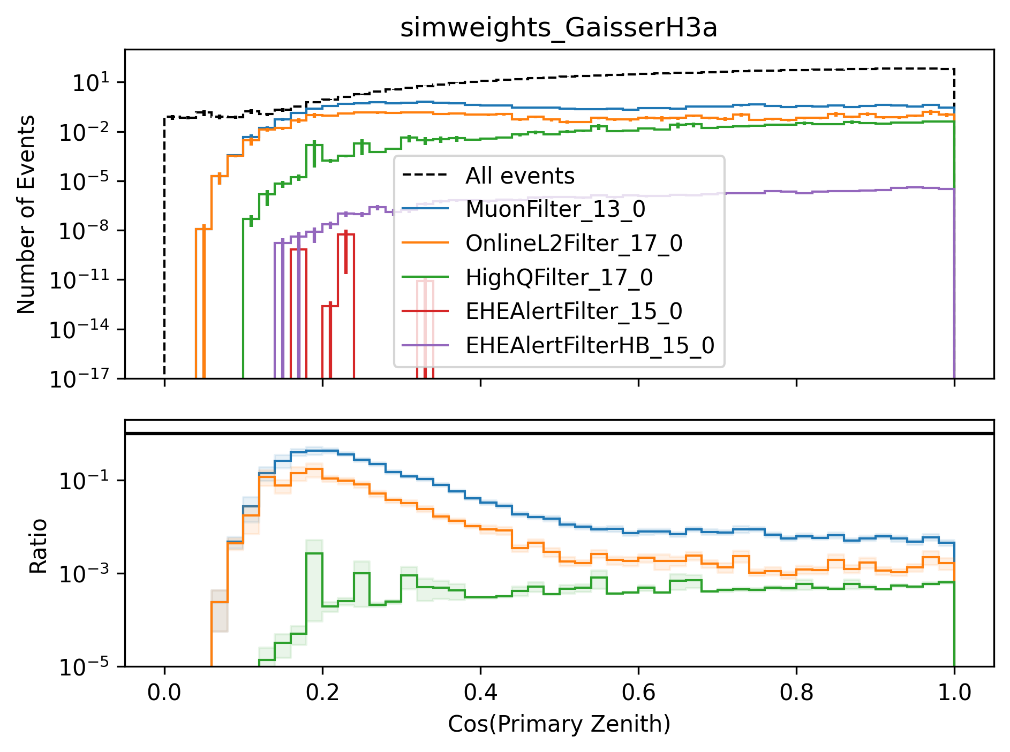
Check level 2 filters – cos(zenith)
HighQ filter removes more horizontal events
horizontal high-energetic muons at surface travel long distances through ice → lose a lot of energy → not enough energy left to pass the high-charge filter
in principle, we want to keep those events, but I could check data-MC agreement for cos(zenith) for the HighQ and OnlineL2 filter

Slide 4
Mismatch in rate on level 2
Rates / Hz | 20904 | Ehist 2023 | Ehist 2024
Level 2 | 315 | 370 | 1300
Level 2 - MuonFilter | 22 | 24 | 15
Primary energy | 600 GeV – 100 PeV (per nucleon) | 600 GeV – 50 Eev | 10 TeV – 100 EeV
Ehist 2024 simulation has the largest rate, but low energy events are not simulated
Ehist 2024: larger cylinder
r = 700m [600m]
l = 1400m [1200m]
Which rate is expected at level 2? (without any filter)

Slide 5
On-going to-dos
Restructure entire wiki
Move all plots using my former Ehist CORSIKA simulation to appendix
Process level 2: MC, NuGen and experimental data
Process level 4: MC, NuGen and experimental data
Check rate on level 2
Simulate small dataset for 500 GeV – 10 TeV
Check calculation of weighting (area calculation, cylinder radius, length, …)
Check zenith distribution for OnlineL2Filter and HighQFilter
WG review
Selection → explanations / update plots
Data-MC → show only final plots (move others to appendix) / update plots
Forward fit → clarifications
Muon flux at surface comparison
Zenith distribution
Glashow resonance?
Atmospheric muons and their variations with temperature (https://arxiv.org/pdf/2405.08926)

