Slide 1
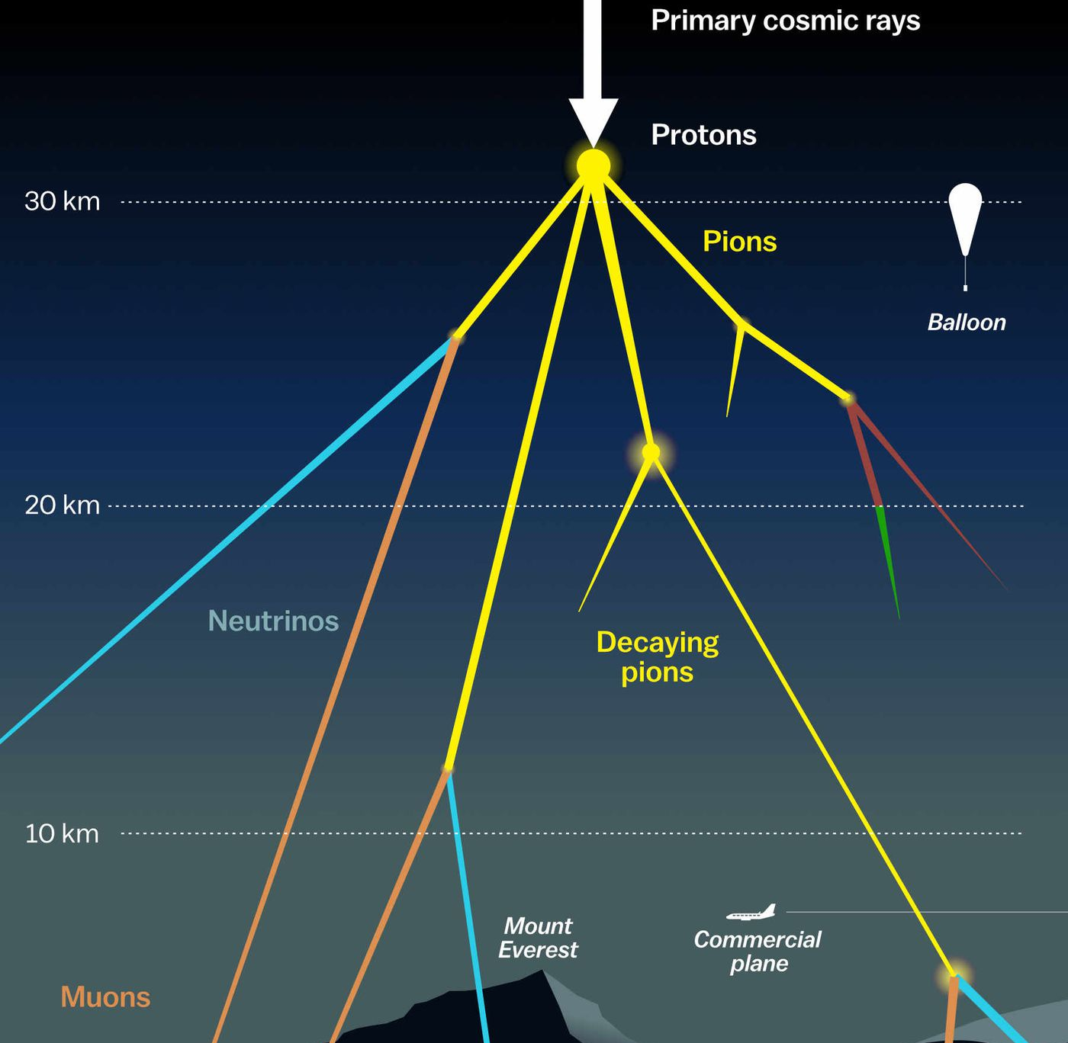

Measuring the prompt component of the atmospheric muon flux Pascal Gutjahr
Commercial plane flight altitudes: 9km – 12km
July 30, 2024
Source: NASA

Slide 2
Rates on level 2
Rates are based on Gaisser H3a
Rates / Hz | 20904 | Ehist 2023 | Ehist 2024 | Exp 2012 – 28h | Ehist 2024
Level 2 | 315 | 370 | 1300 | 430 | 2888
Level 2 - MuonFilter | 22 | 24 | 15 | 32 | 18
Primary energy | 600 GeV – 100 PeV (per nucleon) | 600 GeV – 50 EeV | 10 TeV – 100 EeV | * | 500 GeV – 100 EeV
no coincident events simulated
273 GeV cut
no neutrino rates
10 TeV cut
Rates / Hz | 20904 | Ehist 2023 | Ehist 2024 | Exp 2012 – 28h
Level 2 | 203 |  | 1300 | *
Level 2 - MuonFilter | 18 |  | 15 | *
Primary energy | 10 TeV – 100 PeV (per nucleon) | 600 GeV – 50 Eev | 10 TeV – 100 EeV | *
Ratio projected area: 0.73

Slide 3
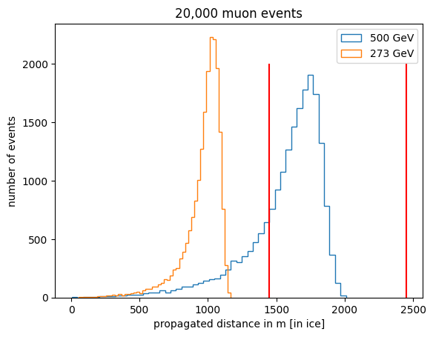
Check 273 GeV cut using PROPOSAL
propagate until decay or final muon energy of 200 MeV
no muons with 273 GeV reach the detector

Slide 4
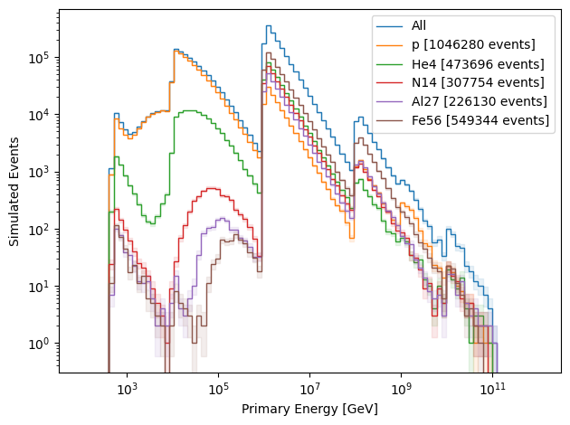
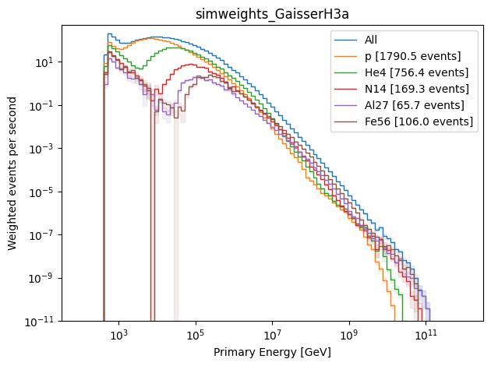
Simulated Primaries

Slide 5
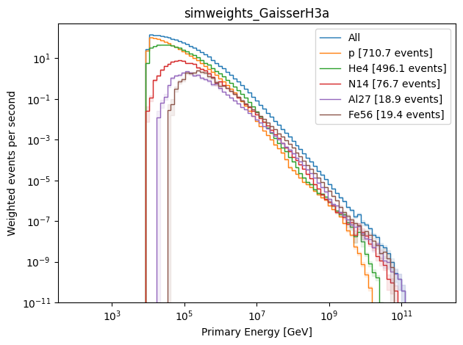
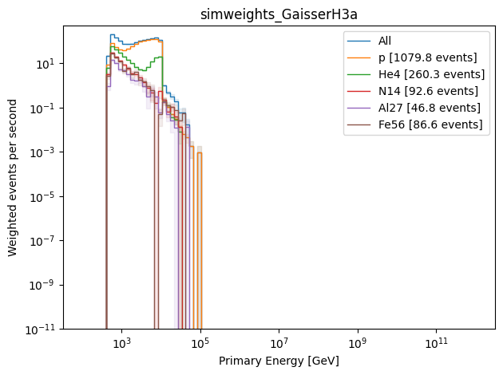
Simulated Primaries
number muons at surface > 0
number muons at surface = 0

Slide 6
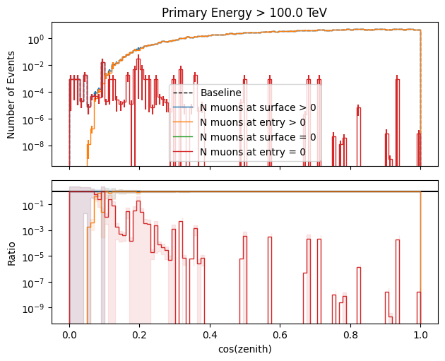
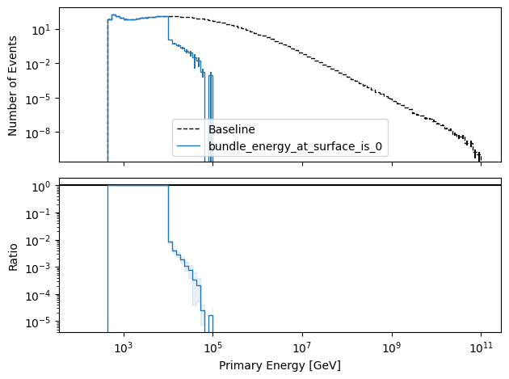
Simulated Primaries

Slide 7
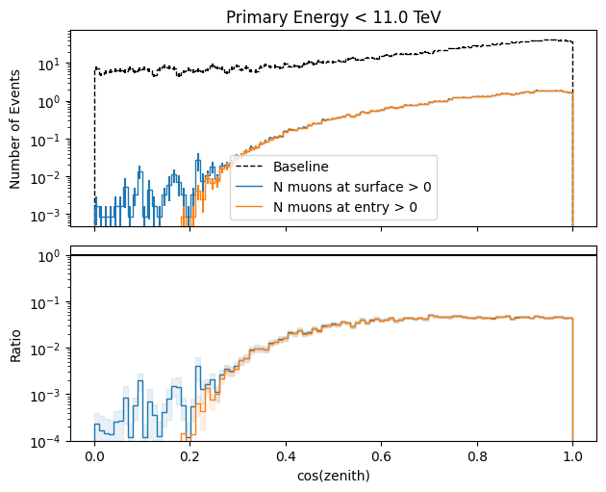
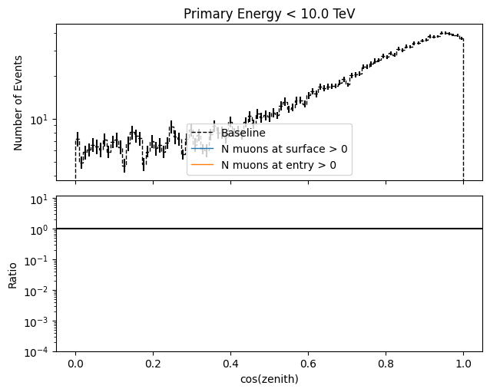
Simulated Primaries
Why are there no muons below 10 TeV primary energy?
→ issue in labels?!
Number of events with primary energy < 10 TeV: 111461
Number of events with primary energy < 10 TeV and muon filter passed: 239

Slide 8
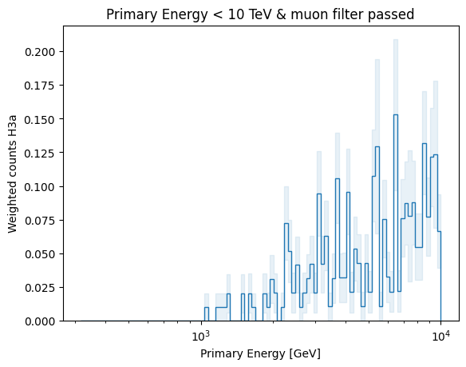
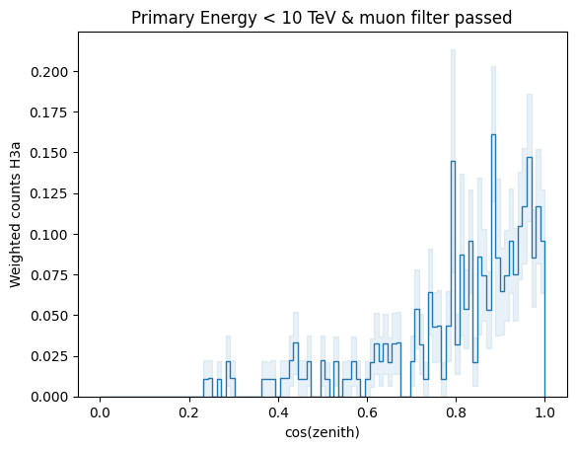
Simulated Primaries

Slide 9
Summary
Exp rate on level 2 is lower than Ehist 2024, but after muon filter exp rate is higher
273 GeV cut is not responsible
Investigate NuGen impact → currently processed
What happens below 10 TeV?
Dataset was created last week, but config is the same as for the other datasets
Issue in labels?
General issue below 10 TeV?
Mistake in processing?
Currently simulating test dataset for r = 600m and l = 1200m
Currently processing level 4 (MC, NuGen, Exp) for further MC comparisons…(due too high priority this takes forever…)

