Slide 1
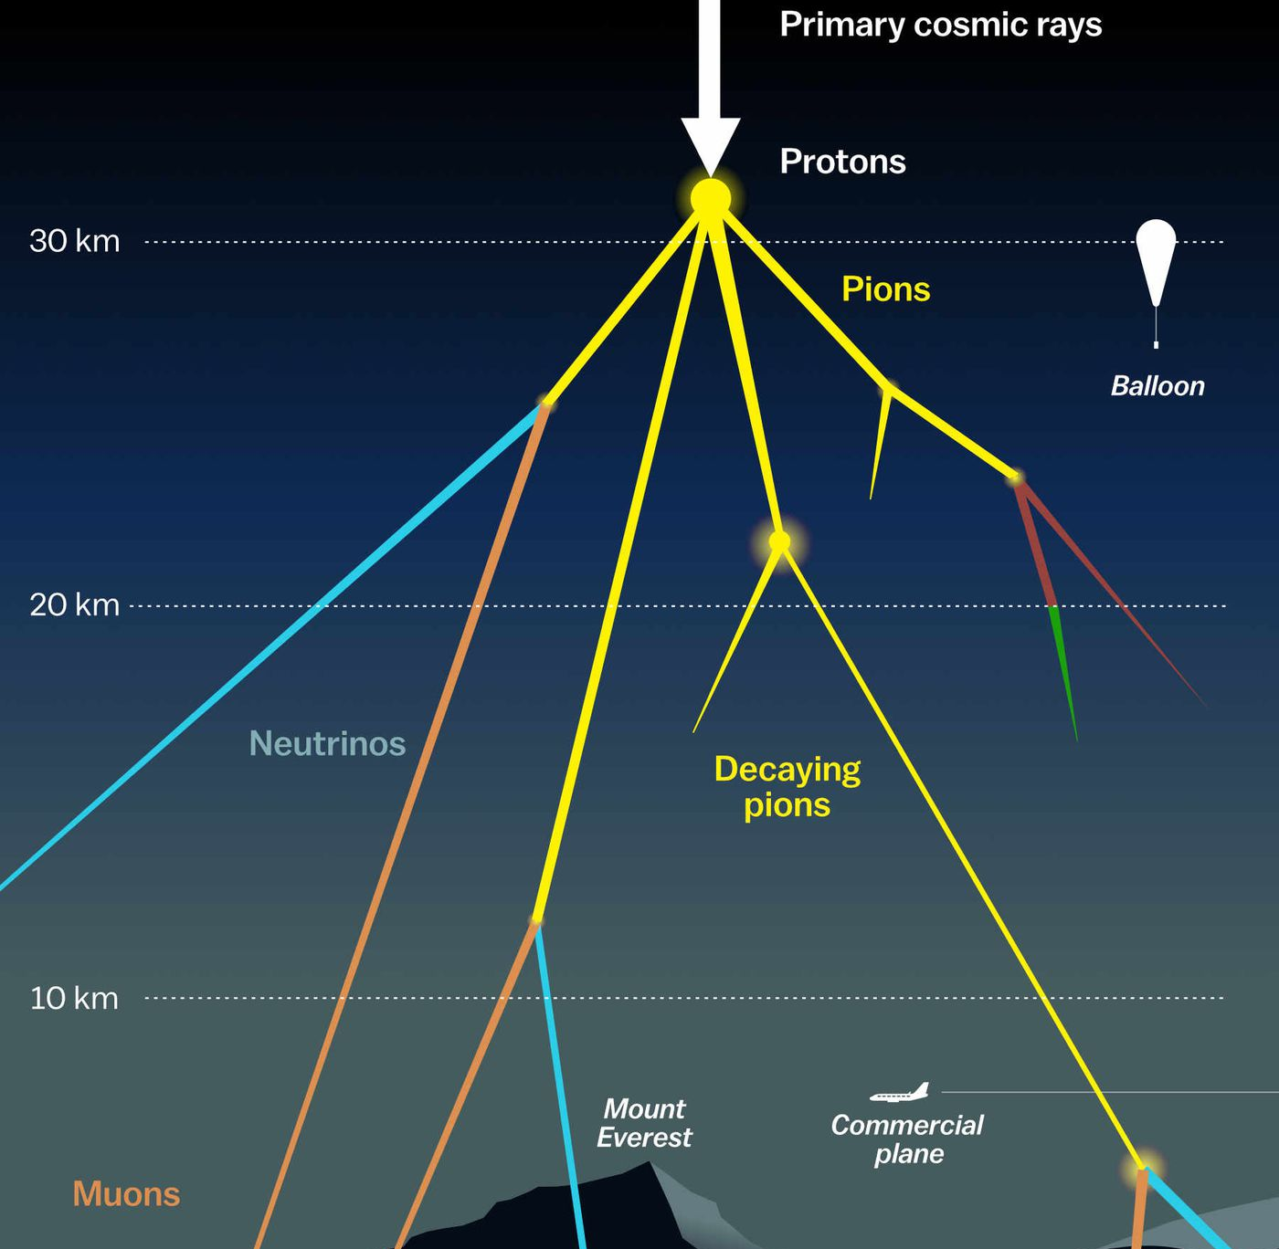

Measuring the prompt component of the atmospheric muon flux Pascal Gutjahr
August 2, 2024
Source: NASA

Slide 2
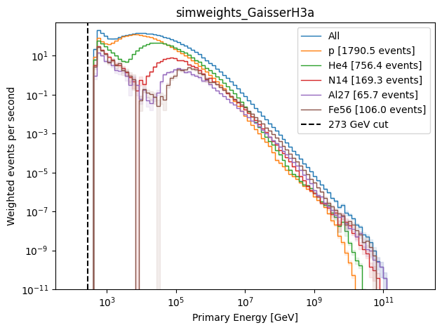
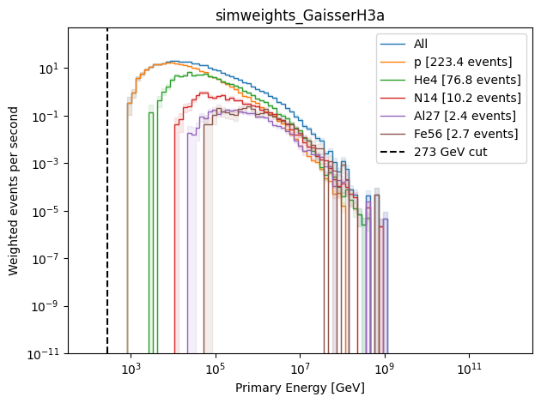
Primary Energy
Ehist 2024
20904

Slide 3
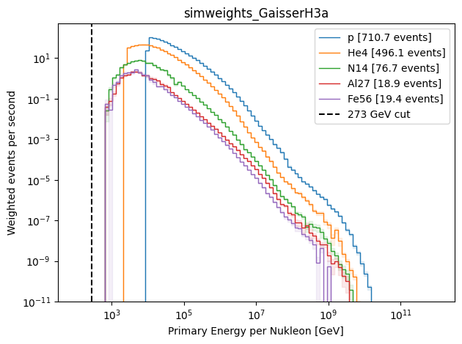
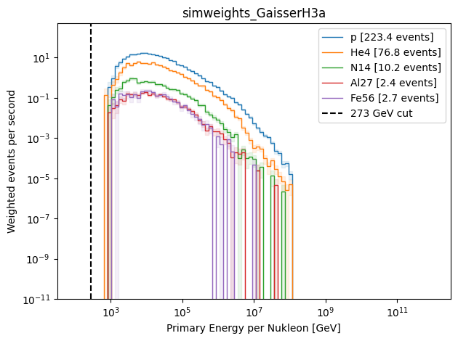
Primary Energy per Nucleon
Ehist 2024 (bundle energy at surface > 0)
20904

