Slide 1
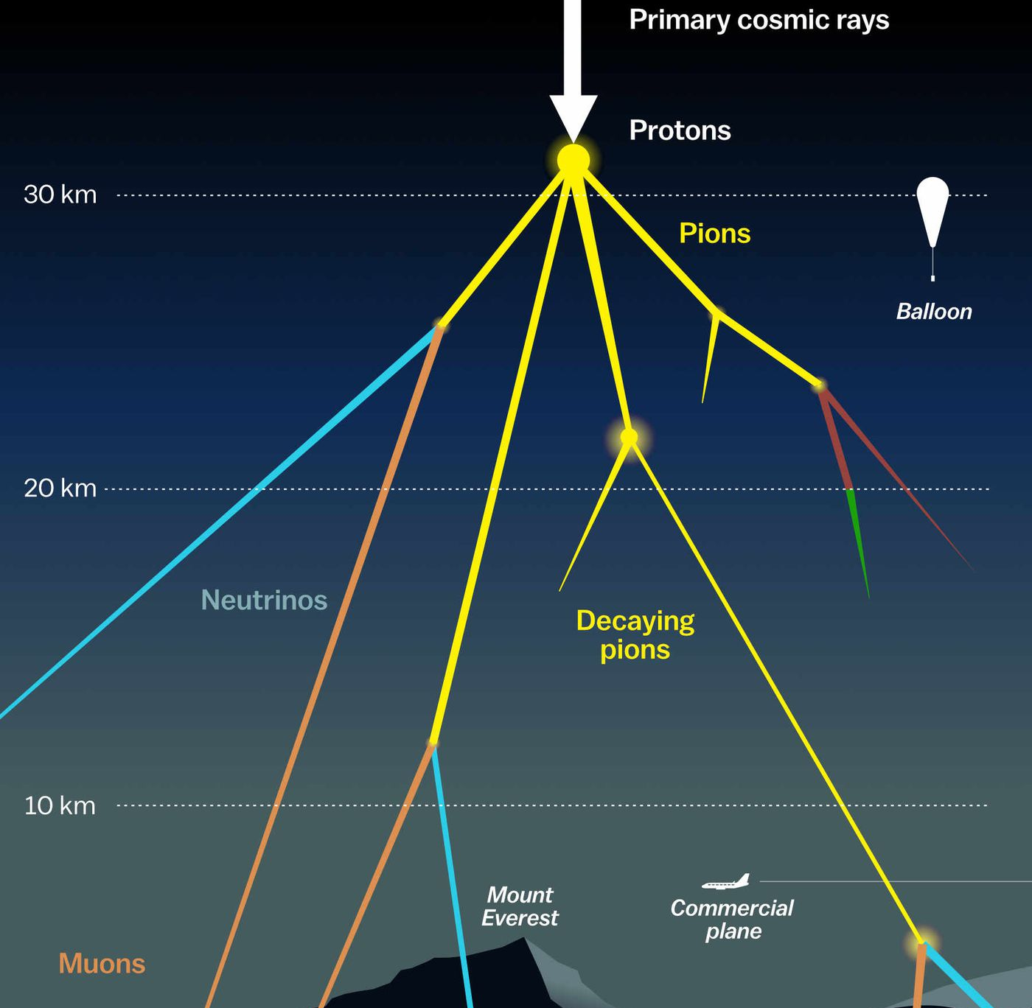

Measuring the prompt component of the atmospheric muon flux Pascal Gutjahr
August 6, 2024
Source: NASA

Slide 2
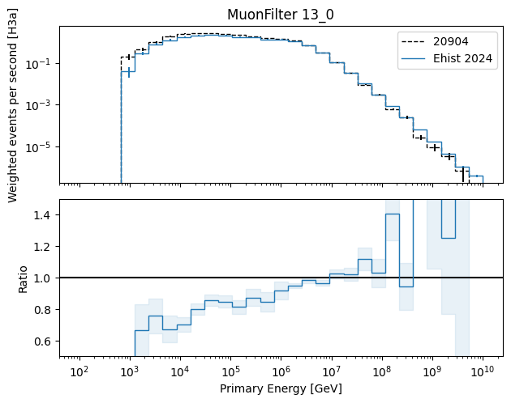
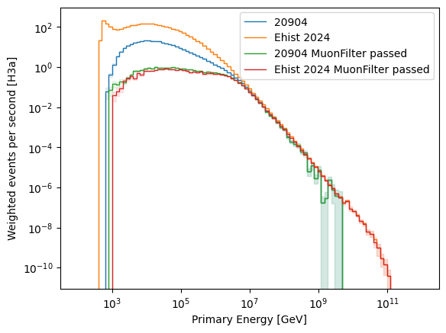
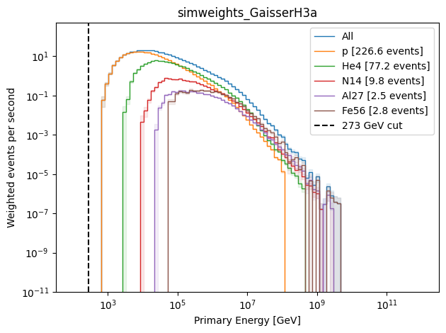
Primary Energies – apply muon filter
Differences: 20904
uses trimshower (zenith dependent 273 GeV cut)
removes primaries, when I3MCTree is empty
SIBYLL 2.3c
E_max = 1e8 GeV (per nukleon)
coincident events are simulated
high-energy component of particles
lighter than iron is missing in 20904
20904
low-energy component of heavy
particles is missing in 20904 → this should lead to an overshoot in the ratio?!

Slide 3
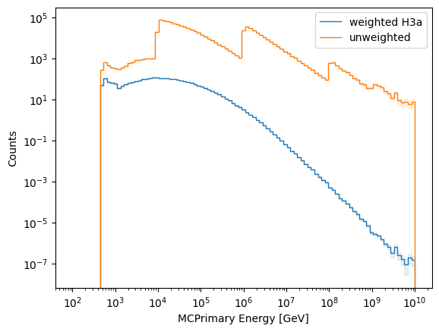
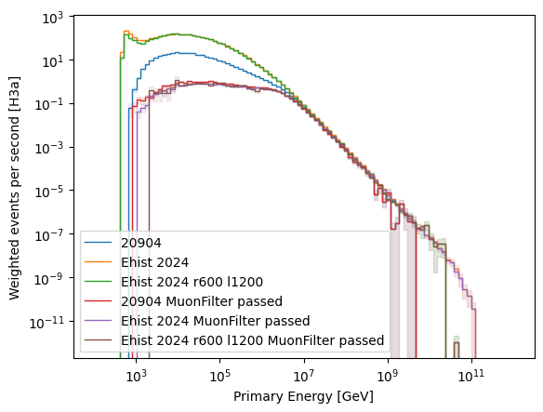
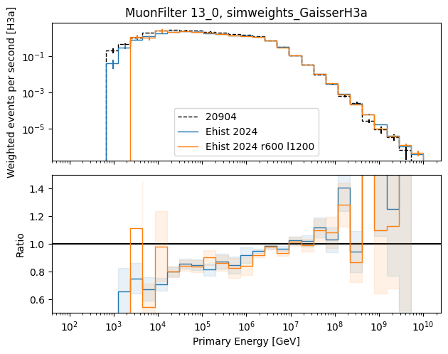
Check simulation: r = 600m , l = 1200m
statistics??
1/10 of statistics of r=700m and l=1400m
dataset
 | 20904 | Ehist r=700 | Ehist r=600
L2 | 319 | 2888 | 2632
L2 - MuonFilter | 22.6 | 18.4 | 18.8

Slide 4
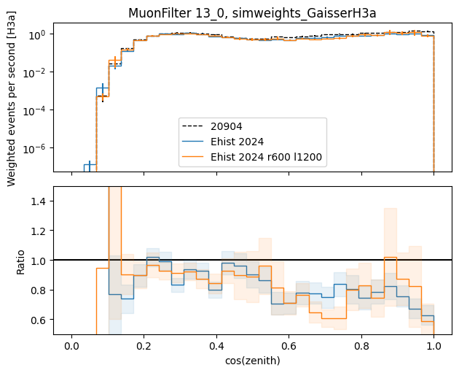

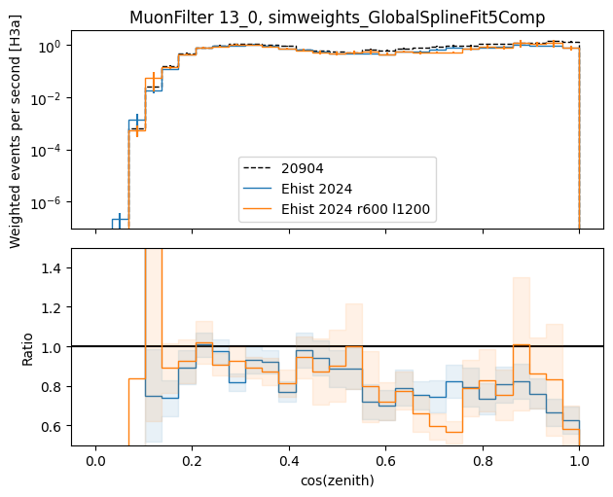
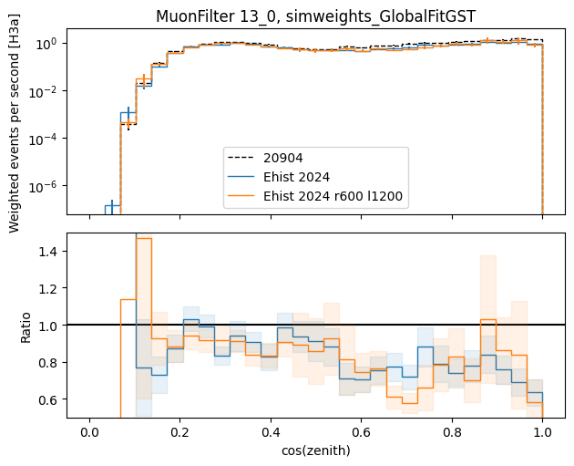
Check cos(zenith) distribution

Slide 5
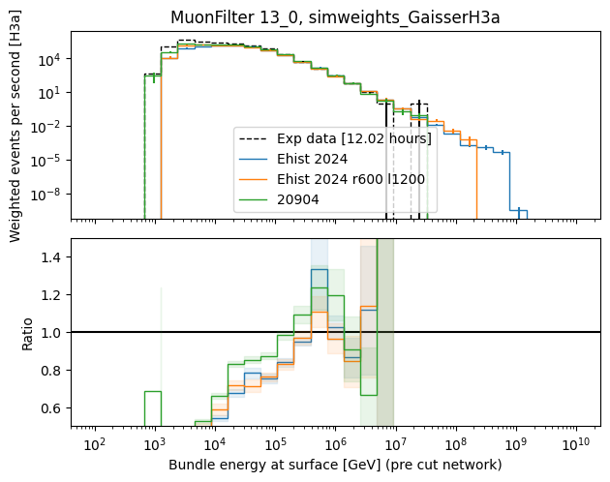
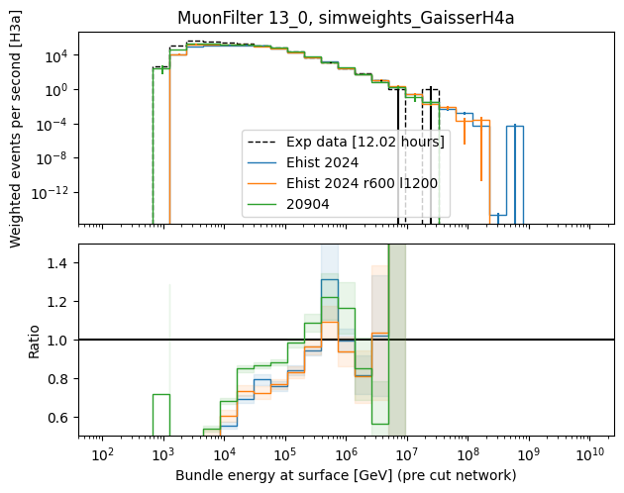
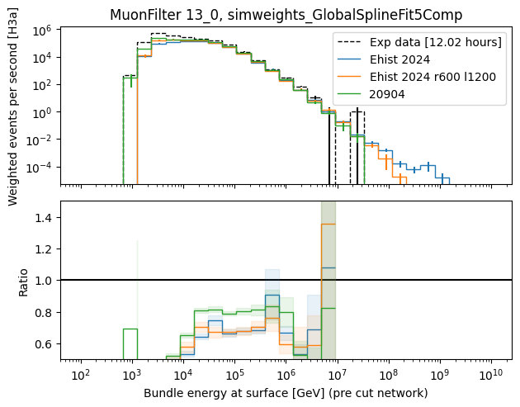
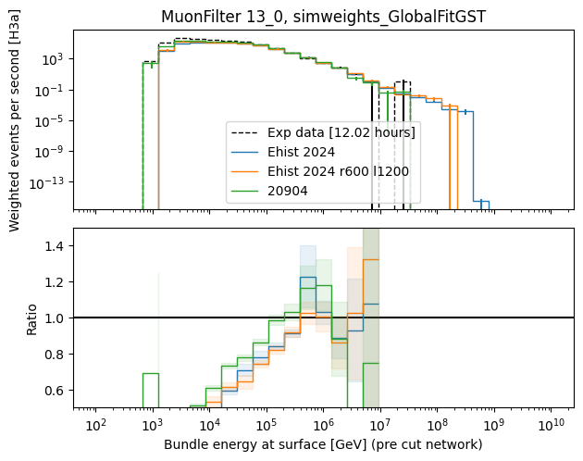
Data-MC: bundle energy at surface level 2 after muon filter

Slide 6
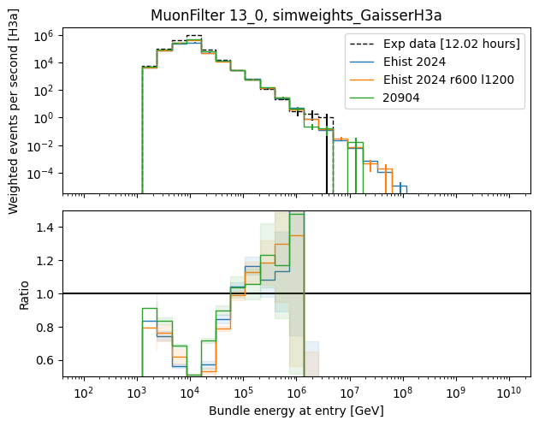
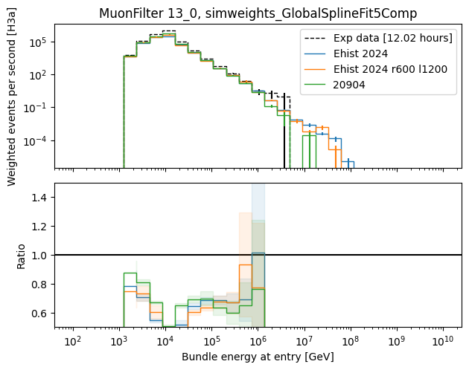
Data-MC: bundle energy at entry level 2 after muon filter

Slide 7
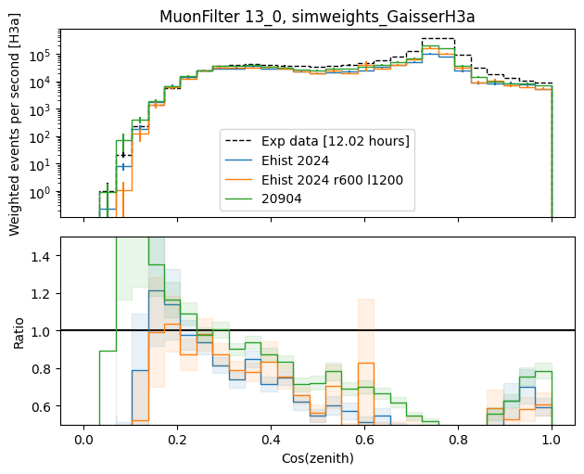
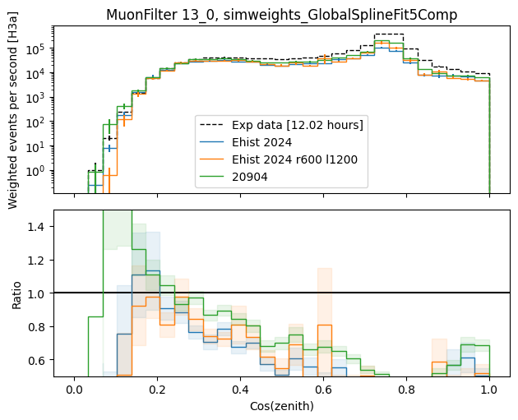
Data-MC: cos(zenith) level 2 after muon filter

Slide 8
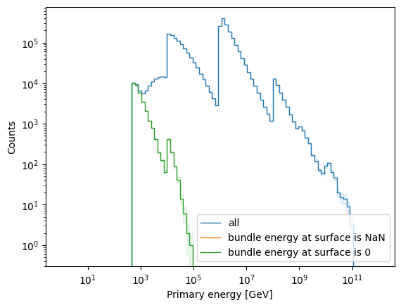
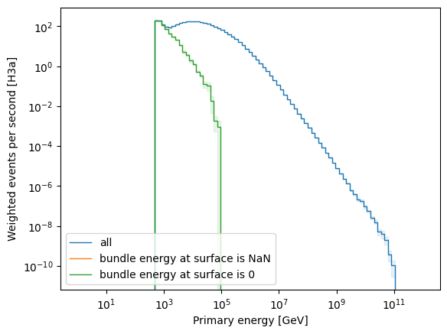
Labels issue below 10 TeV fixed → mistake in config
No NaNs any more
But bundle energy at surface can be 0 → why?

Slide 9
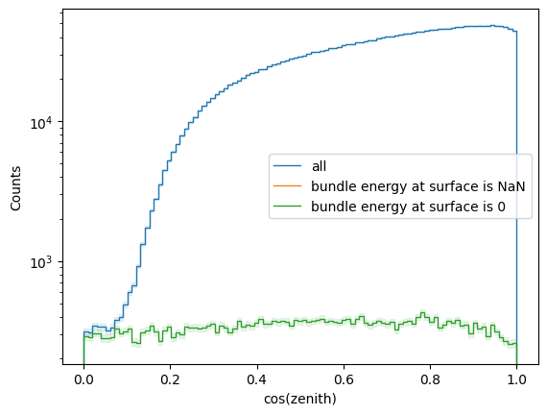
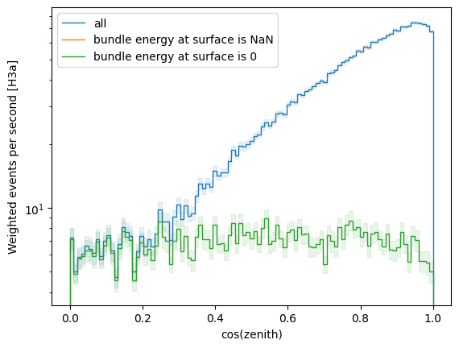
Check cos(zenith) – surface bundle energy is 0
Happens for all directions

Slide 10
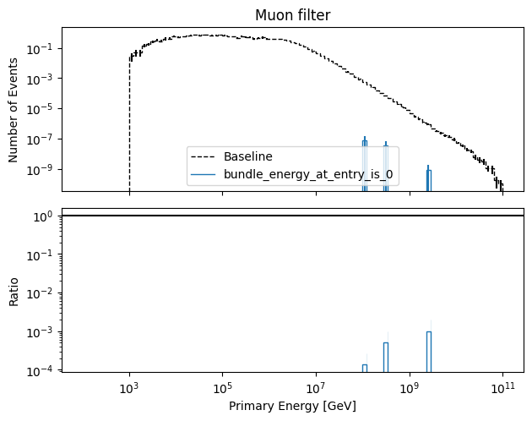
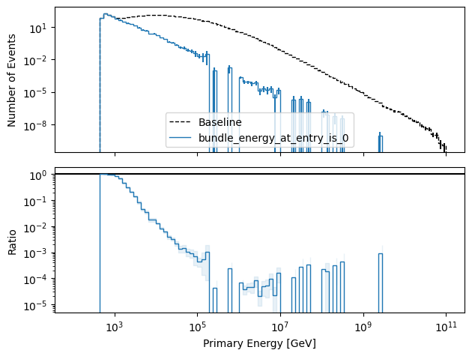
Primary Energy – detector entry bundle energy is 0
for 3 events, the bundle energy at detector entry is 0, although the event passed the muon filter

Slide 11
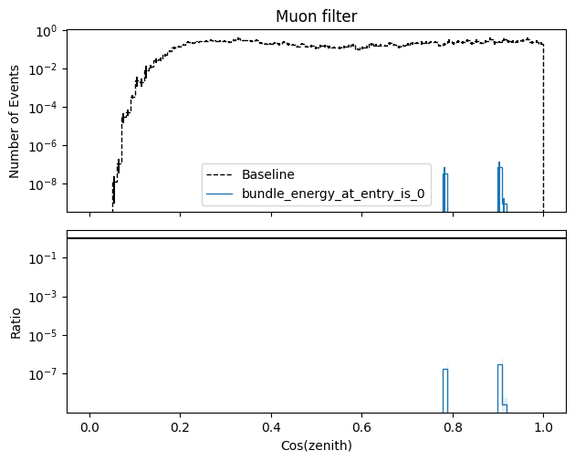
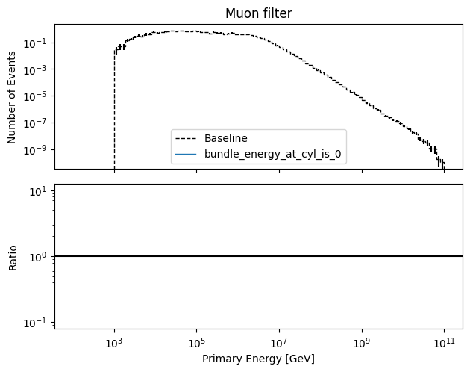
Cos(zenith) – detector entry bundle energy is 0
in total, there are 3 simulated events with a bundle energy at entry = 0
at entry means: intersection with convex hull extended by 200m
if the hull is extended by 220m, the muon hits the detector
It’s also checked, if the muon has an intersection with a cylinder around IceCube, with r = 700m and l = 1400, there are intersections → this is why the event passes the muon filter
This happened for 3 of 502365 events
Effect should be negligible
at cylinder entry,
no bundle energy is 0

Slide 12
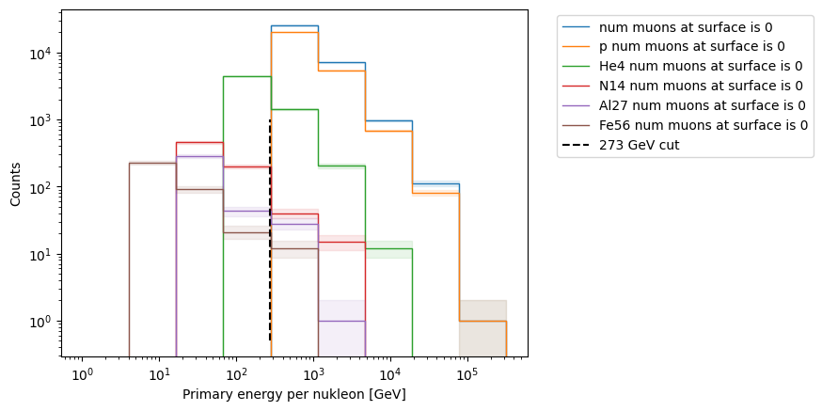
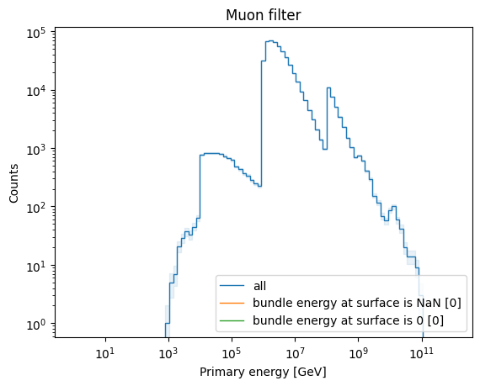
Primary energy per nukleon – no muons at surface
maximum energy is 90 TeV
since there is no muon → none of these events pass the muon filter
These events don’t produce any muon at surface with an energy above 273 GeV
For 50 Tev < E < 90 TeV, this happens 5 times out ouf 110,511 simulated events

Slide 13
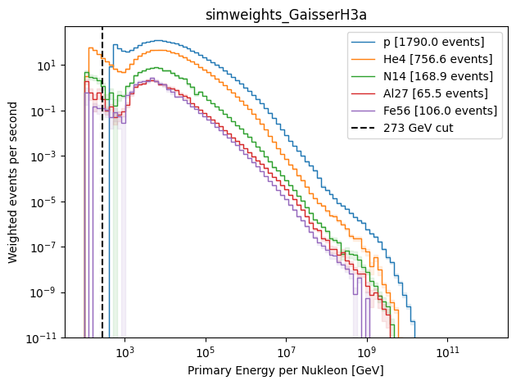
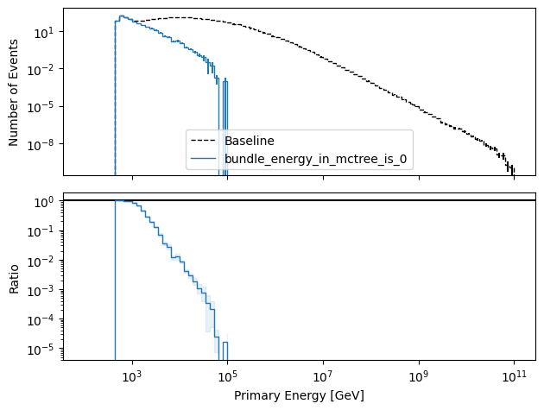
Where is the flattening/minimum coming from?
no muons at surface (below 273 GeV)
Level 2: detector simulation / trigger → removes events
We added option to keep empty primaries (no muons at surface)
→ these events are never further simulated / checked for trigger (never removed)
→ that’s why these events are kept until level 2

Slide 14
Summary
20904: highest rate after muon filter: 22 Hz va. 18 Hz
Small differences between 20904 and Ehist2024
Changing the cylinder size doesn’t have a negative impact
Data-MC after muon filter is not very good for energy and zenith (for all 3 datasets)
Labels issue below 10 TeV fixed → mistake in config
After applying the muon filter, 3 of 500k events have a bundle energy of 0
Because of no intersection point with convex hull ext. by 200m, but intersection with cylinder around IceCube, which leads to passing the muon filter
Some primaries don’t produce a muon above the ecuts of 273 GeV
For 50 TeV < E < 90 TeV, this happens for 5 of 110k events
Where is the flattening in the primary spectrum around 1 TeV coming from?

