Slide 1
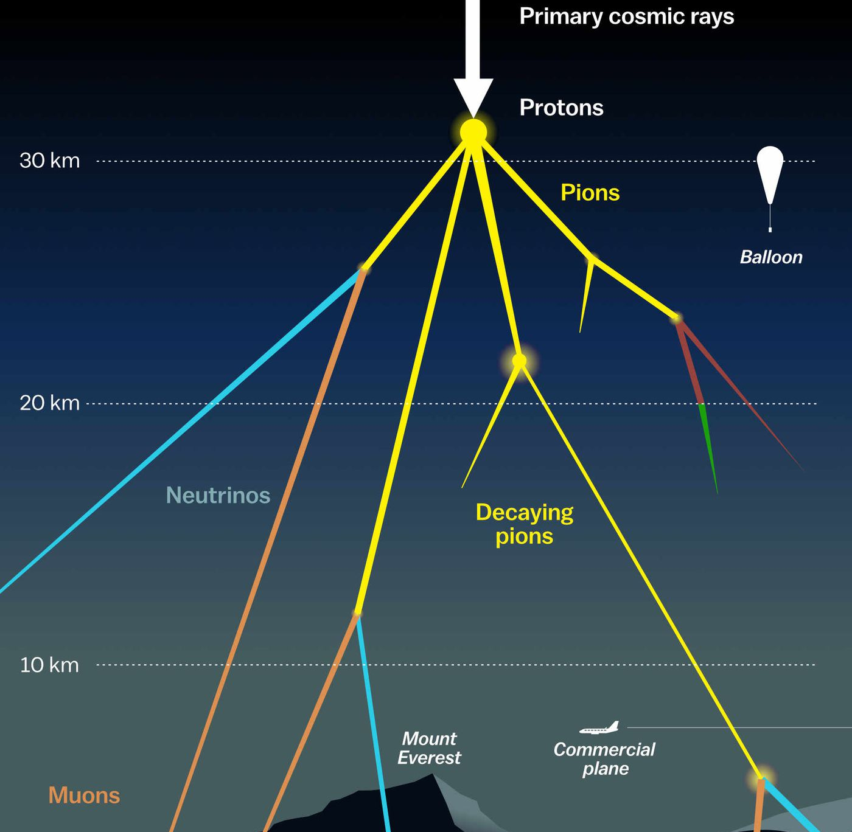

Measuring the prompt component of the atmospheric muon flux Pascal Gutjahr
August 16 , 2024
Source: NASA

Slide 2
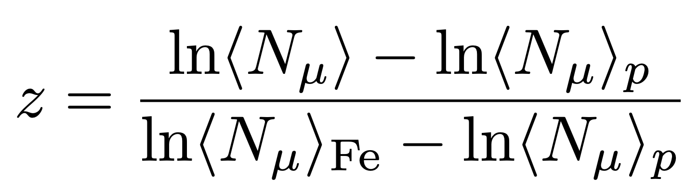
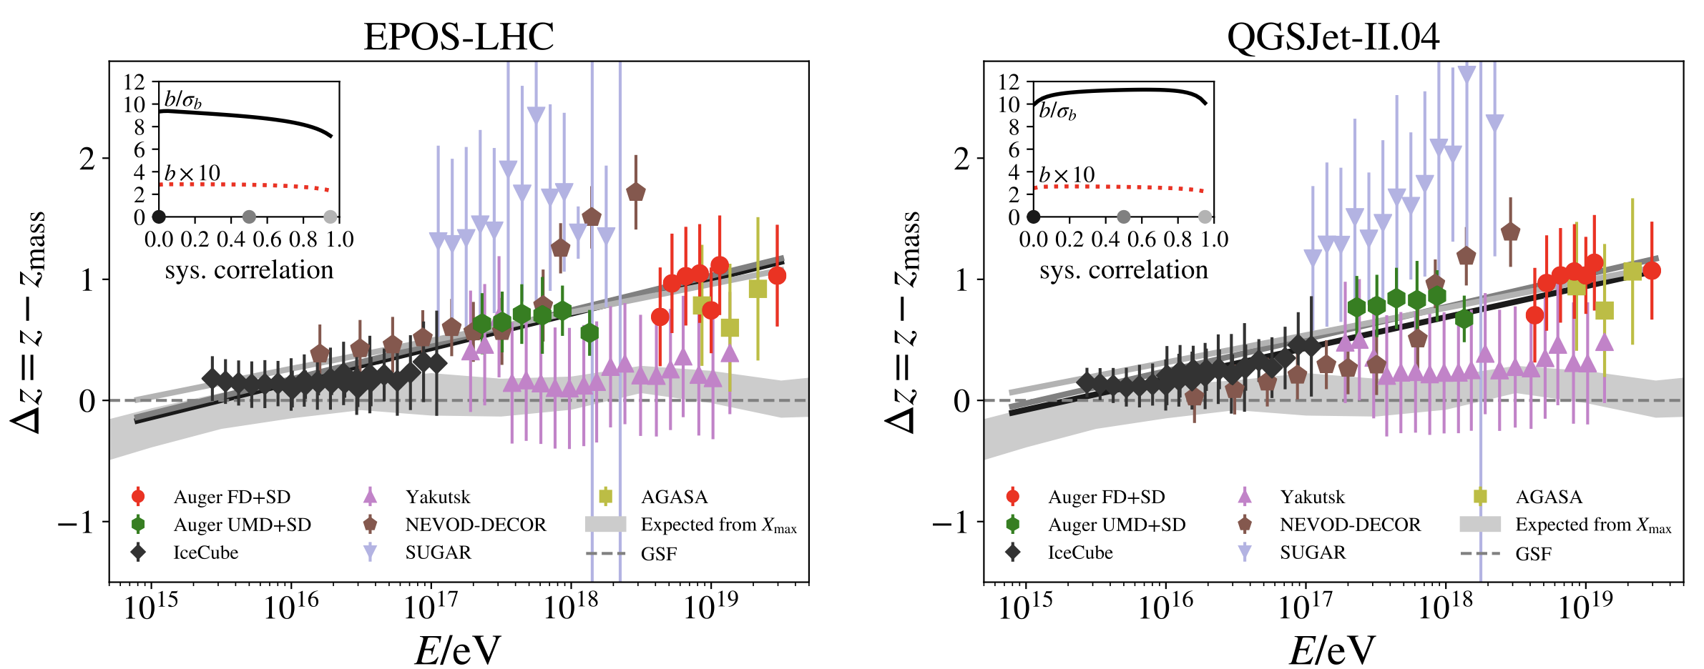
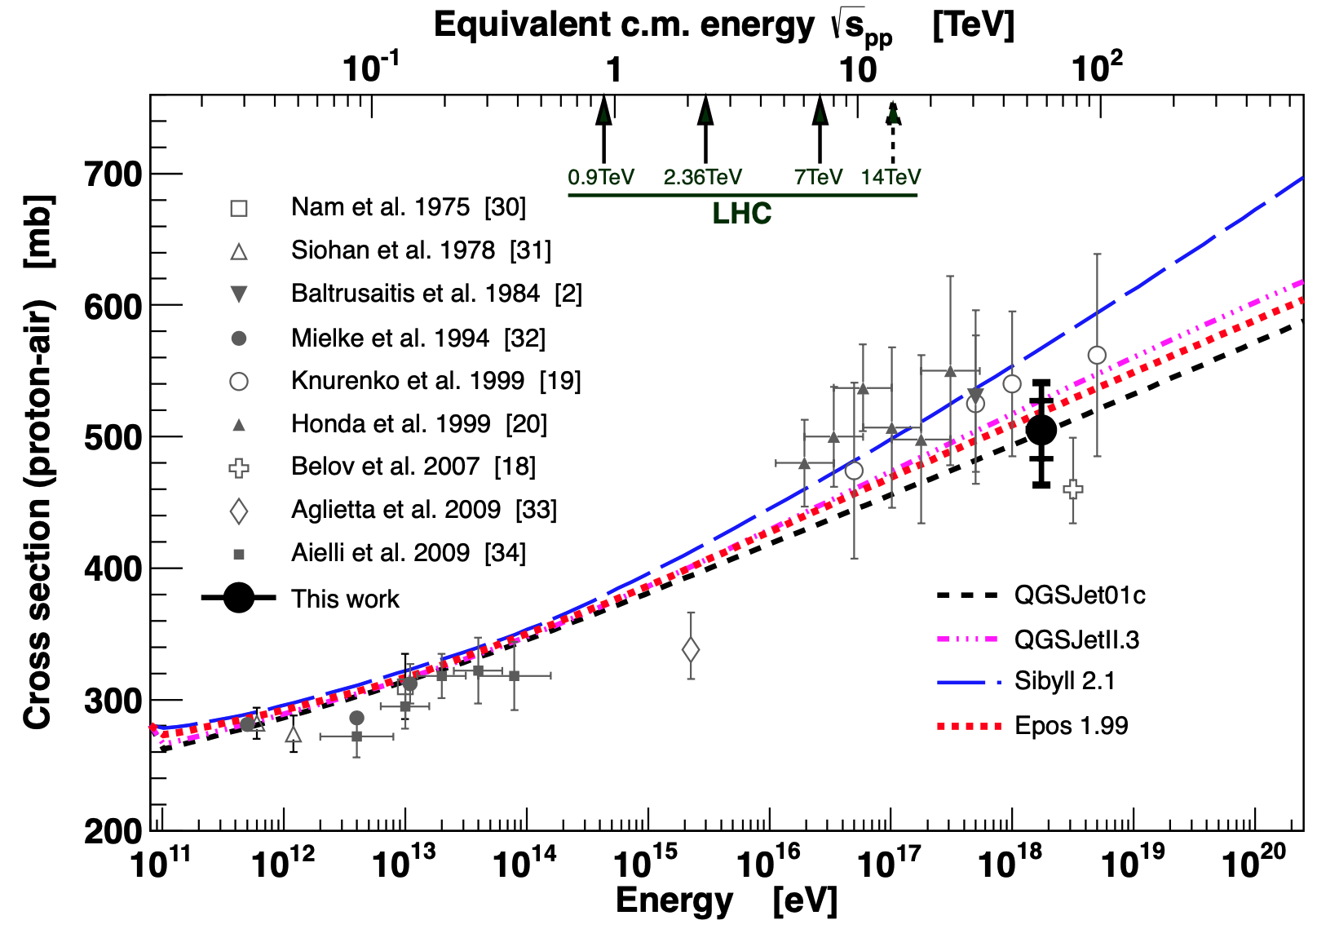
Motivation: muon Puzzle and model uncertainties
”muon number”
Expected z
(“muon number”)
2108.08341
1208.1520
More muons measured than simulated for E > 40 PeV ~ cms 8 TeV
Precise pion/kaon ratio measurement needed
Large uncertainties at E > 10 PeV

Slide 3
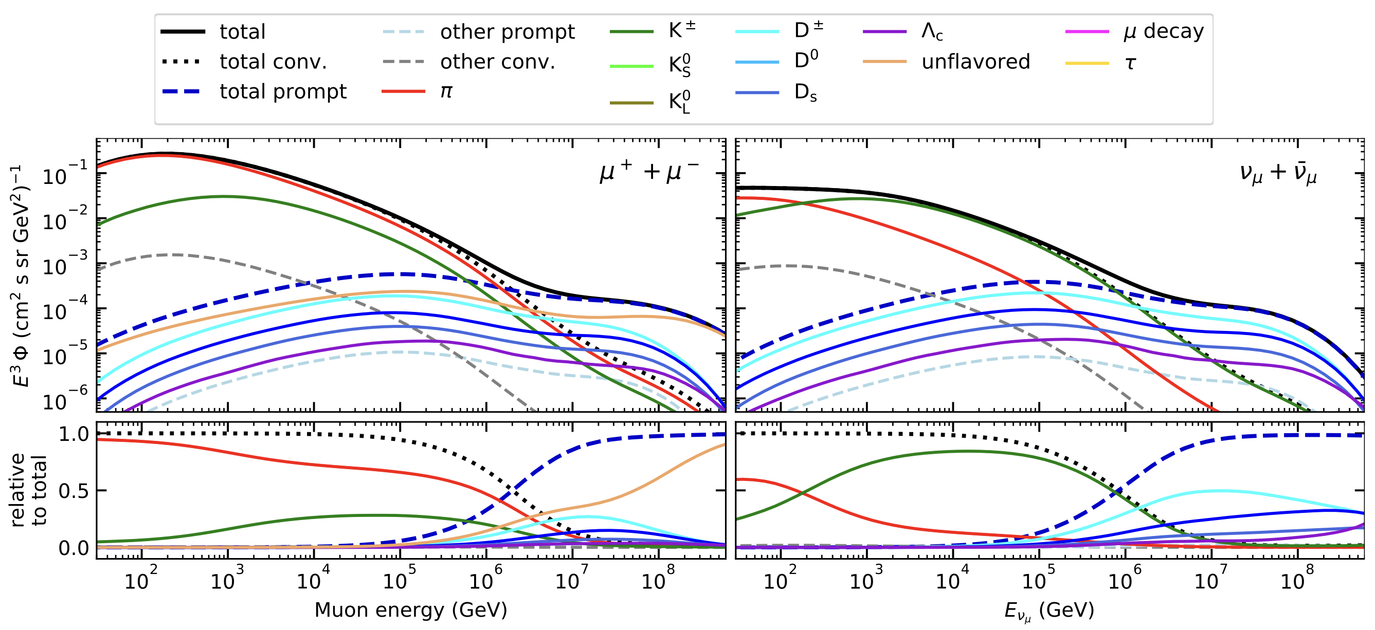
The origin of atmospheric muons and neutrinos
10.1103/PhysRevD.100.103018
no unflavored
dominated by pions
dominated by kaons
Combined fit:
handle on pion/kaon ratio
handle on charmed mesons

Slide 4
Analysis goals
Unfolding of an atmospheric muon spectrum
No prior / model independent
Measuring the normalization of the prompt component of the atmospheric muon flux
Forward fit for a specific model
Future goals
Measure normalization of atmospheric prompt neutrino flux
Combined muon + neutrino fit
Most energetic muon inside
Muon parent:
pion or kaon
yes
no
conventional
prompt
requires new simulation

Slide 5
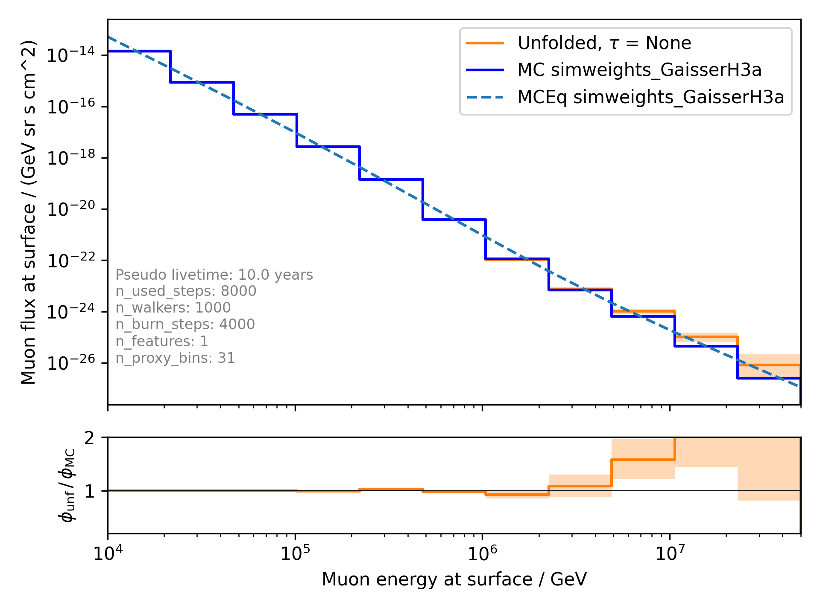
Unfold muon flux

Slide 6
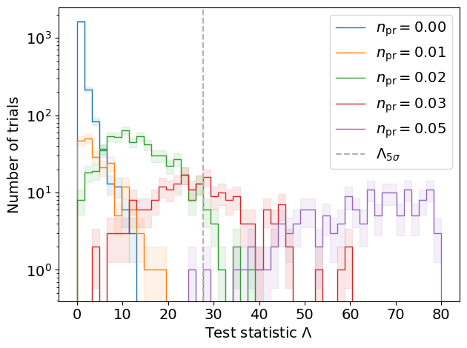
Discovery potential and sensitivity
Cuts:
L2 MuonFilter
Bundle energy at entry > 100 TeV
Expectation for 1 year:
5 sigma discovery potential: 0.102 ± 0.005
Sensitivity: 0.024 ± 0.001
Expectation for 10 years:
5 sigma discovery potential: 0.032 ± 0.001
Sensitivity: 0.007 ± 0.000
Caution:
Limited MC statistics -> events are oversampled in pseudo dataset
No systematics
Tested NNMFit
presented in Grand Rapids

Slide 7
On-going investigations

Slide 8
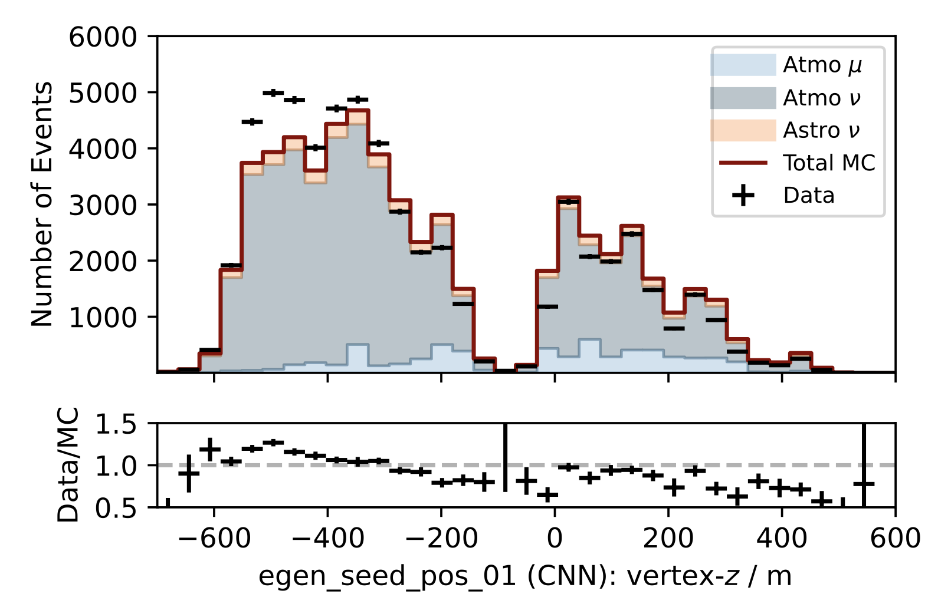
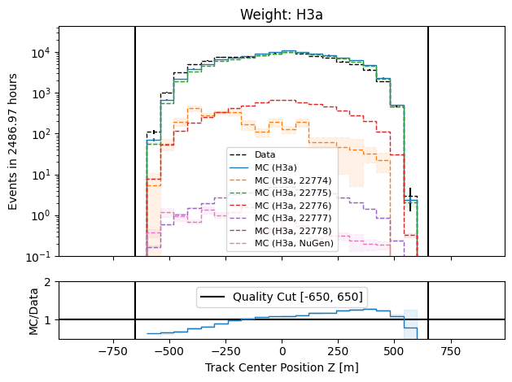
Neutrino: z-vertex
Dissertation Mirco
Same shape mismatch for neutrinos as for muons

