Slide 1
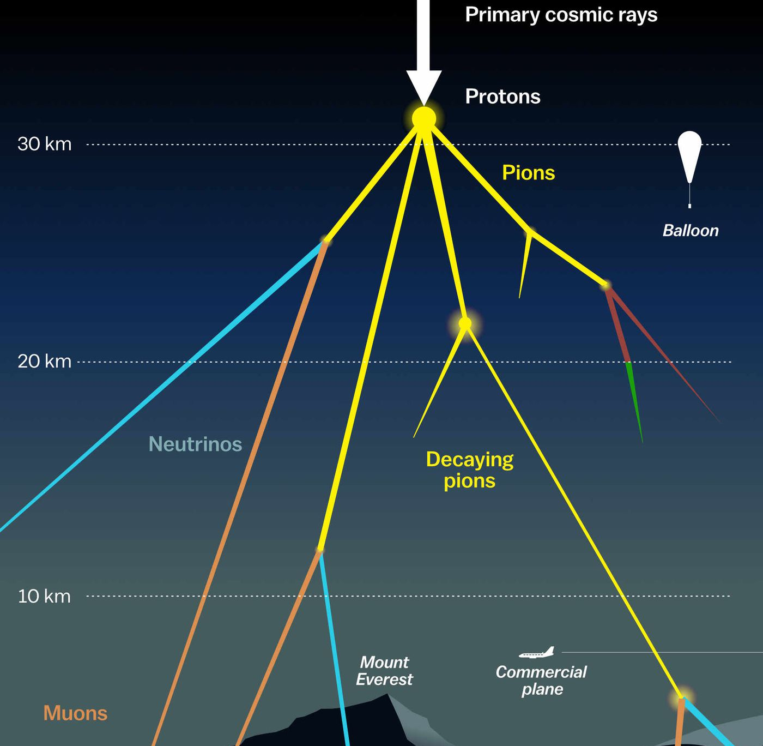

Measuring the prompt component of the atmospheric muon flux Pascal Gutjahr
August 27, 2024
Source: NASA

Slide 2
General information
22774 -- 22778: datasets using CORSIKA extended history, simulated with IceProd
NuGen: includes astro and atmospheric component
astro: gamma = 2.6, n = 1.5
atmospheric: MCEq (H3a, H4a, GST, GSF)
Weights for different primary models are scaled to the number of experimental data to compare the shapes → at the end of these slides, there are the rates shown for each month to see the difference of the overall normalization

Slide 3
level4: muon filter and 500 TeV bundle energy cut at surface

Slide 4
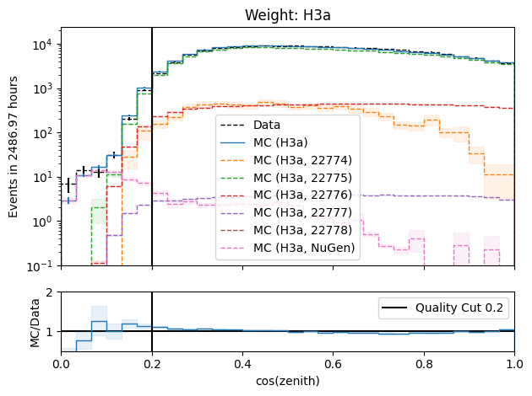
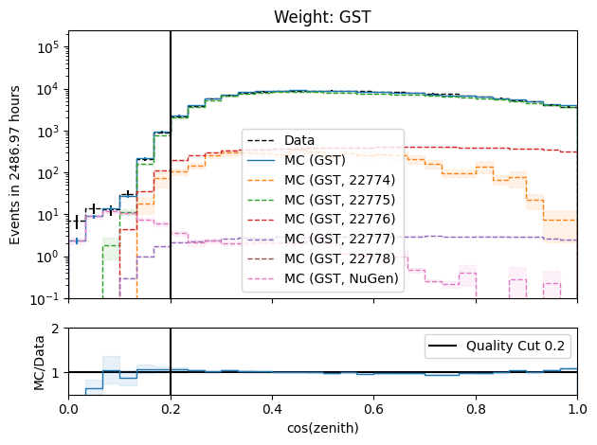
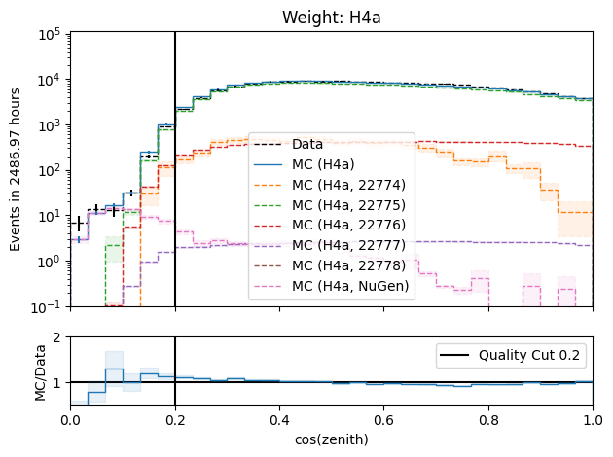
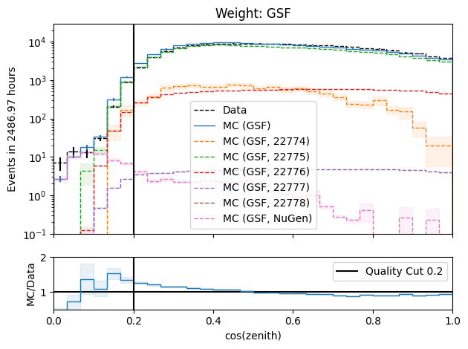
level4: cos(zenith)

Slide 5
level5: level4 + quality cuts to improve data-mc

Slide 6
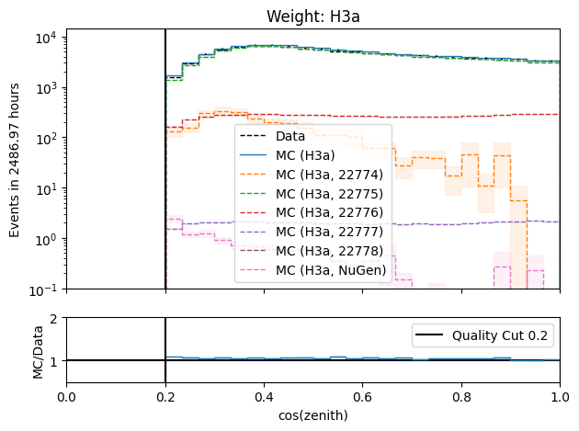
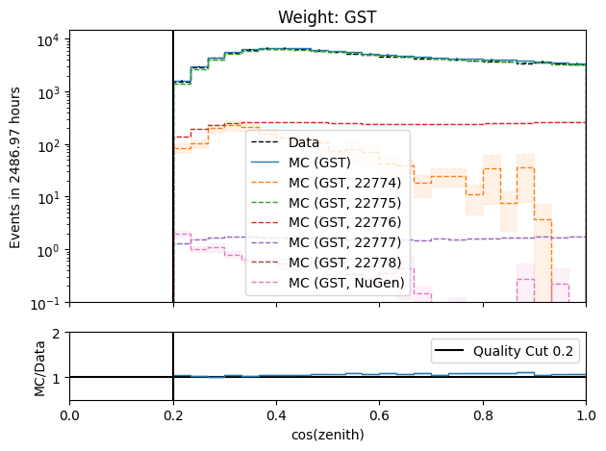
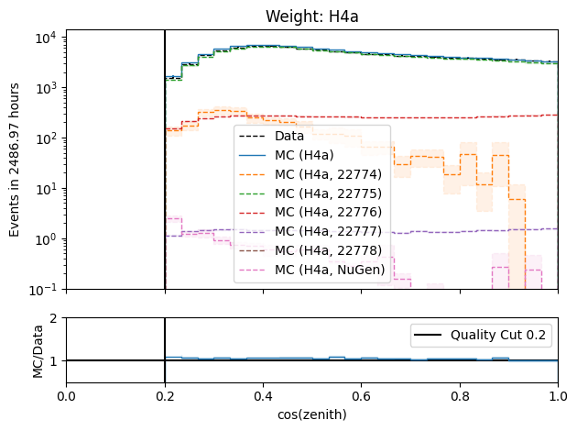
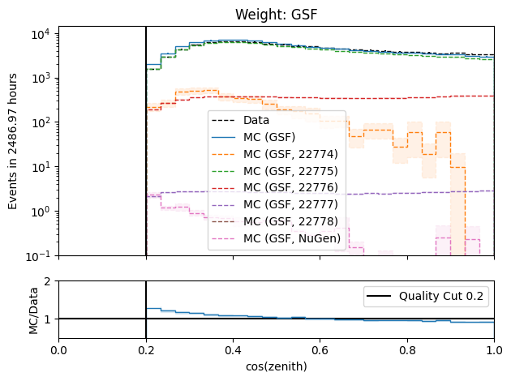
level5: cos(zenith)

Slide 7
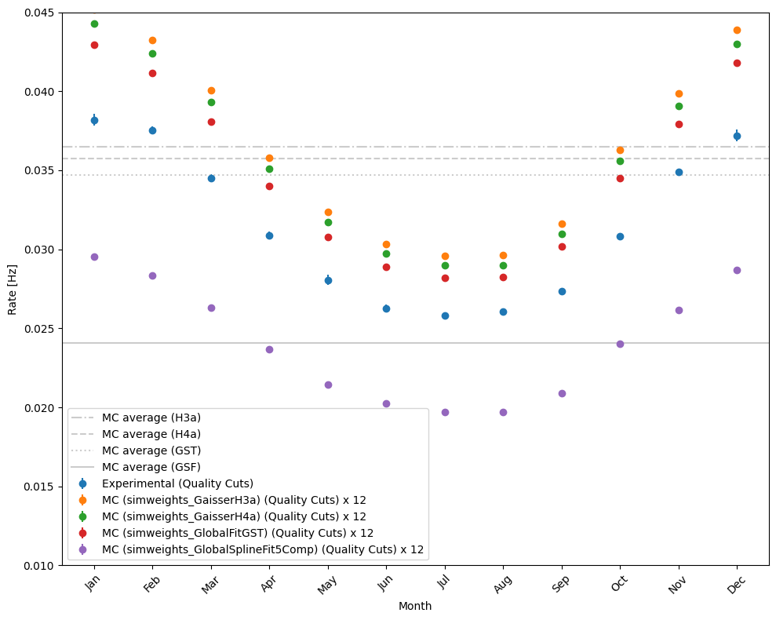
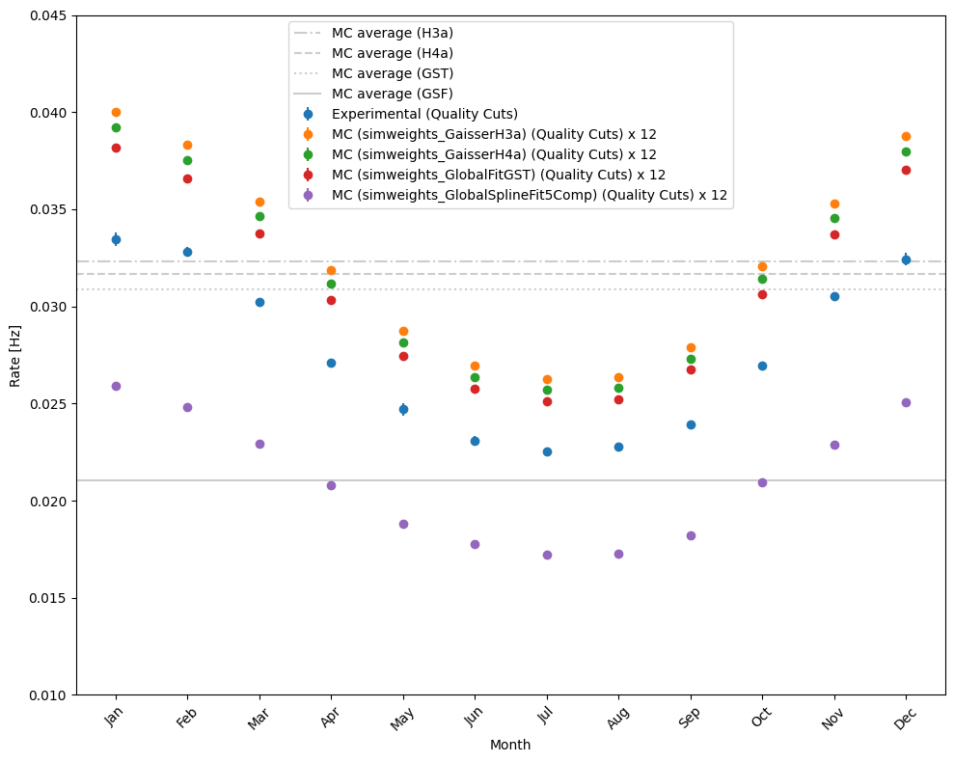
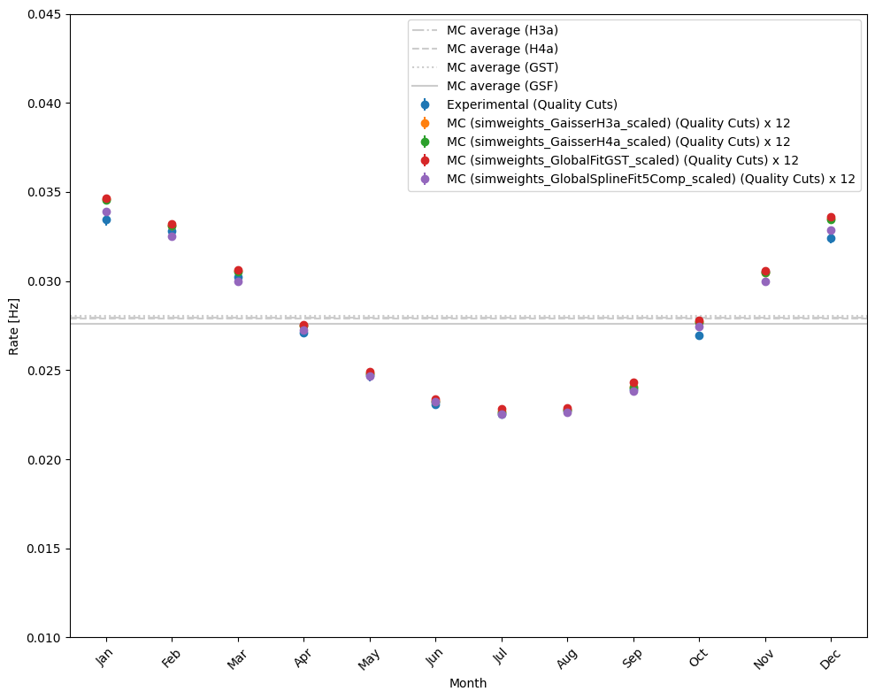
Rates per month
level4 (no quality cuts)
level5 (quality cuts)
level5 (quality cuts) – scaled weights

