Slide 1
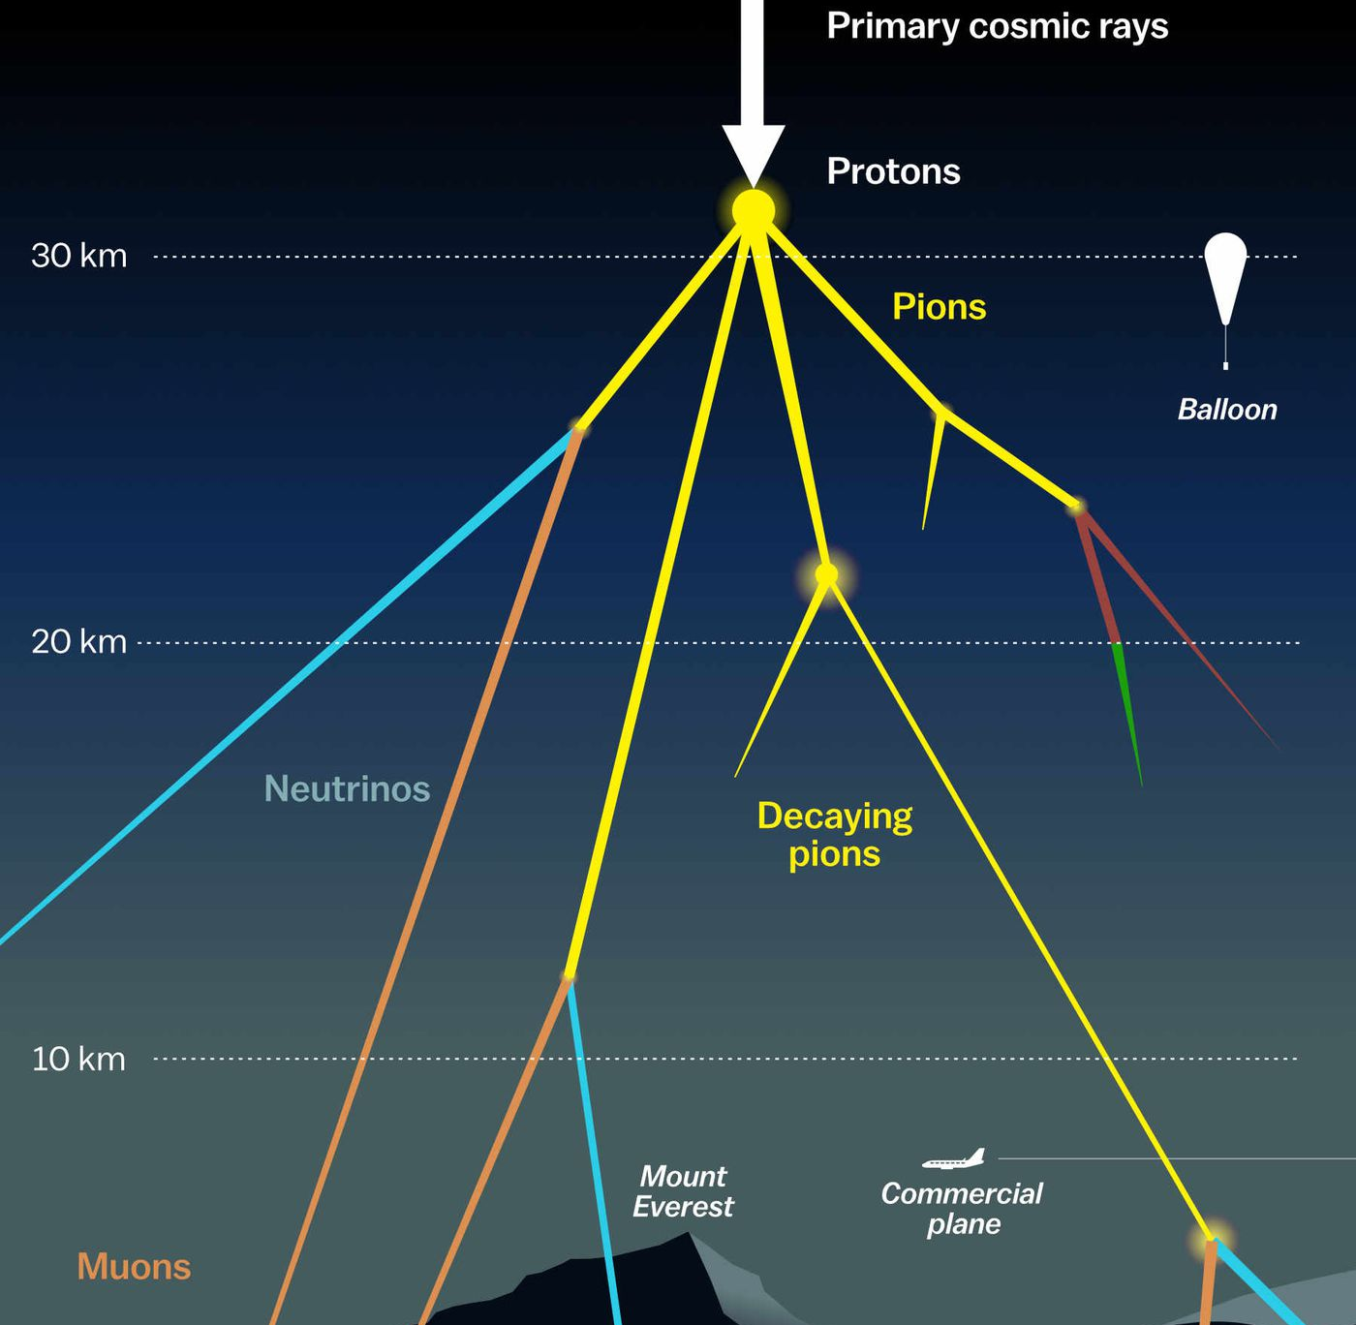

Prompt muons Pascal Gutjahr
April 9, 2024
Source: NASA

Slide 2
Unfolding – only energy proxy
old plot – binning too large

Slide 3
Unfolding – tree binning
overshoots at high energies
too little statistics?
Next steps
plot binning

Slide 4
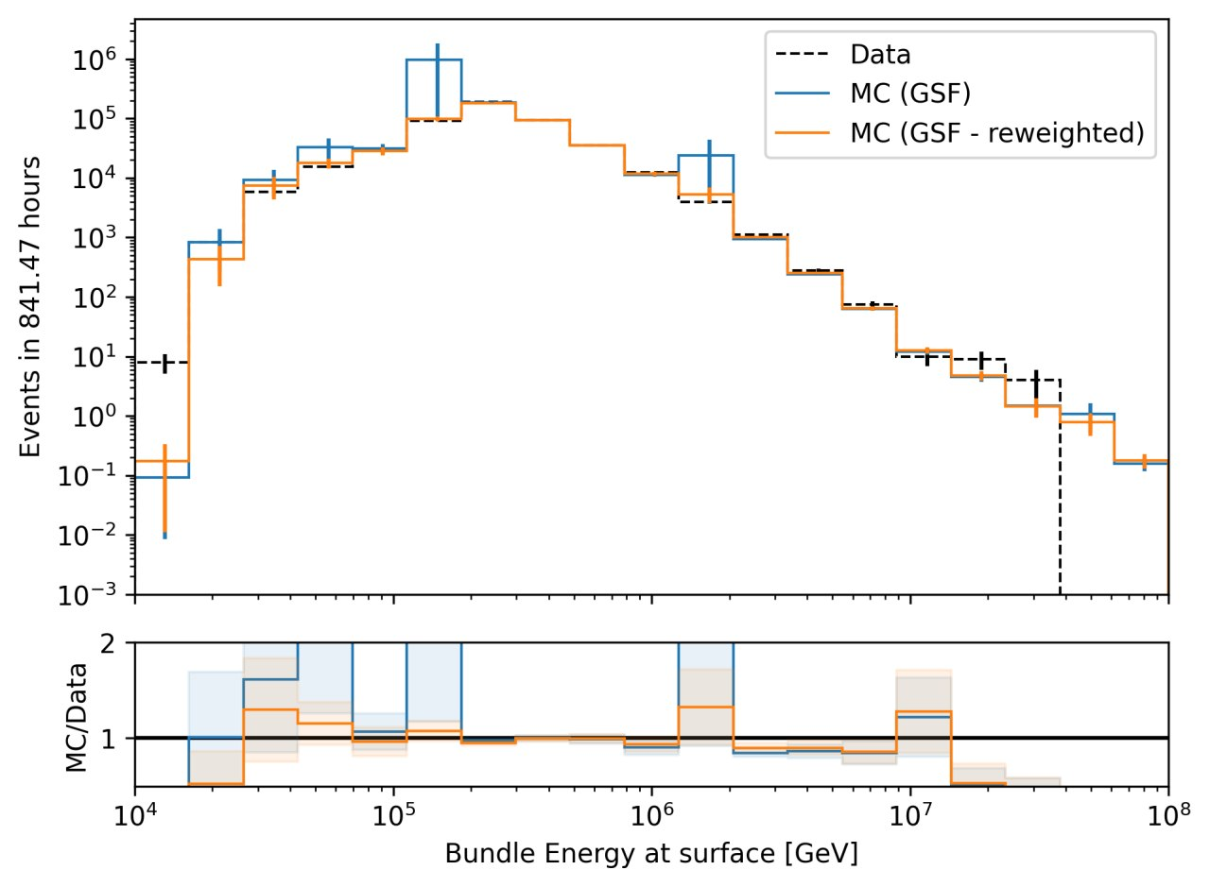
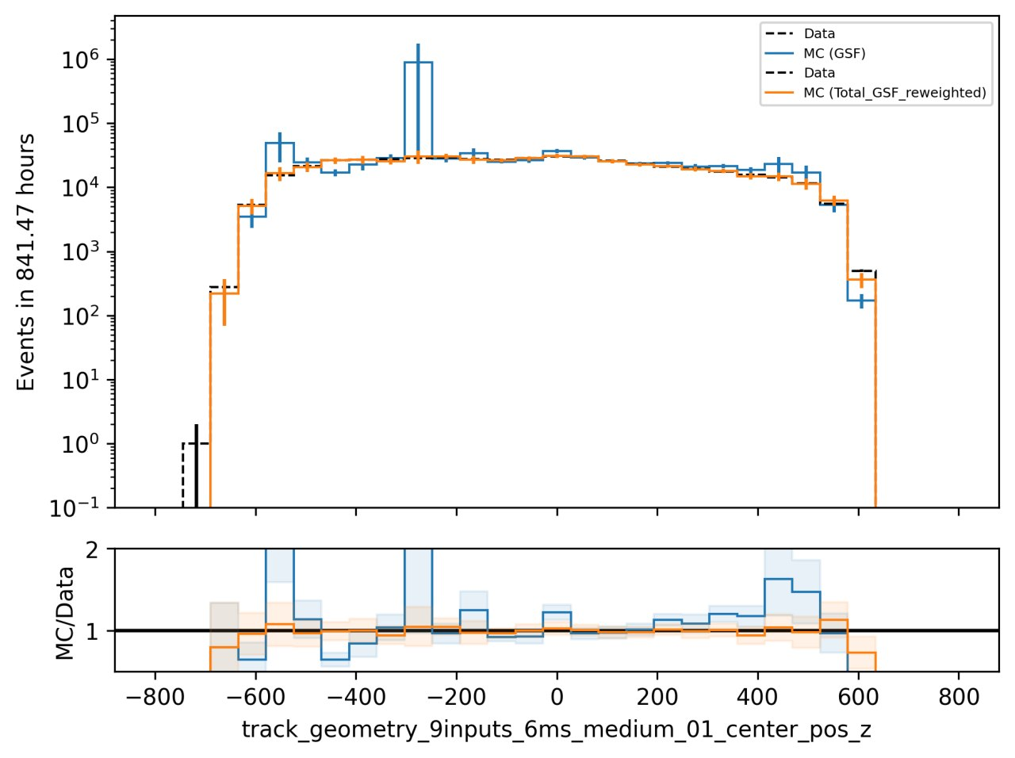
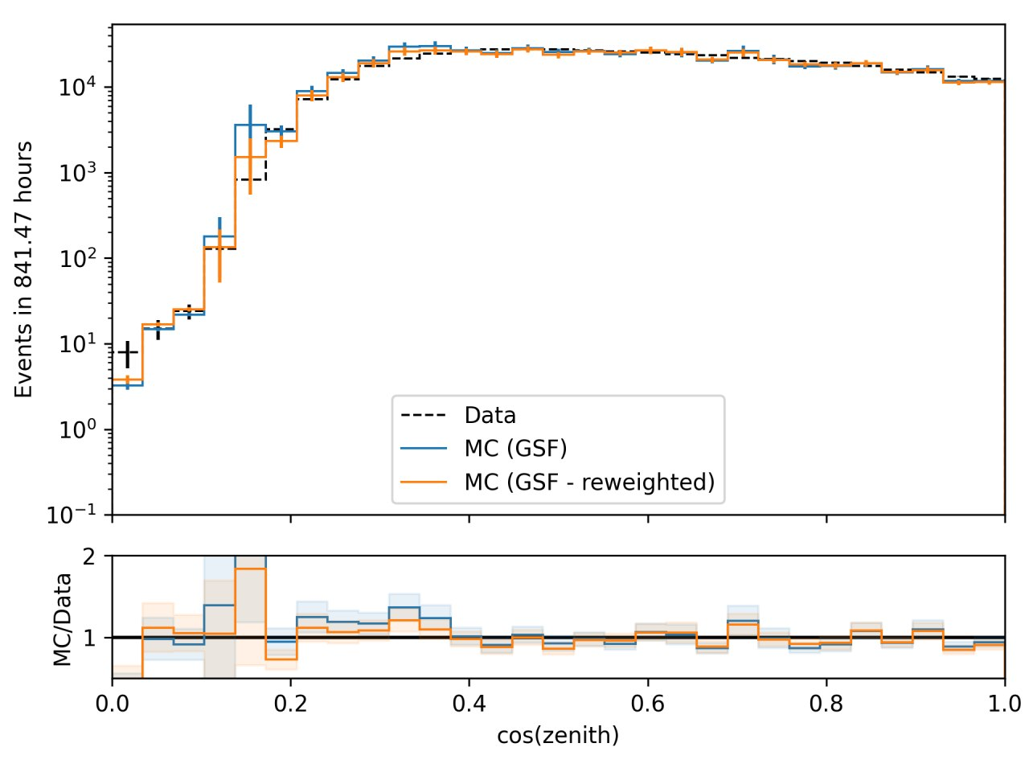
Data-MC: z-mismatch
re-weight z-position
fixes z-mismatch
no impact on energy/zenith (small improvement)

Slide 5
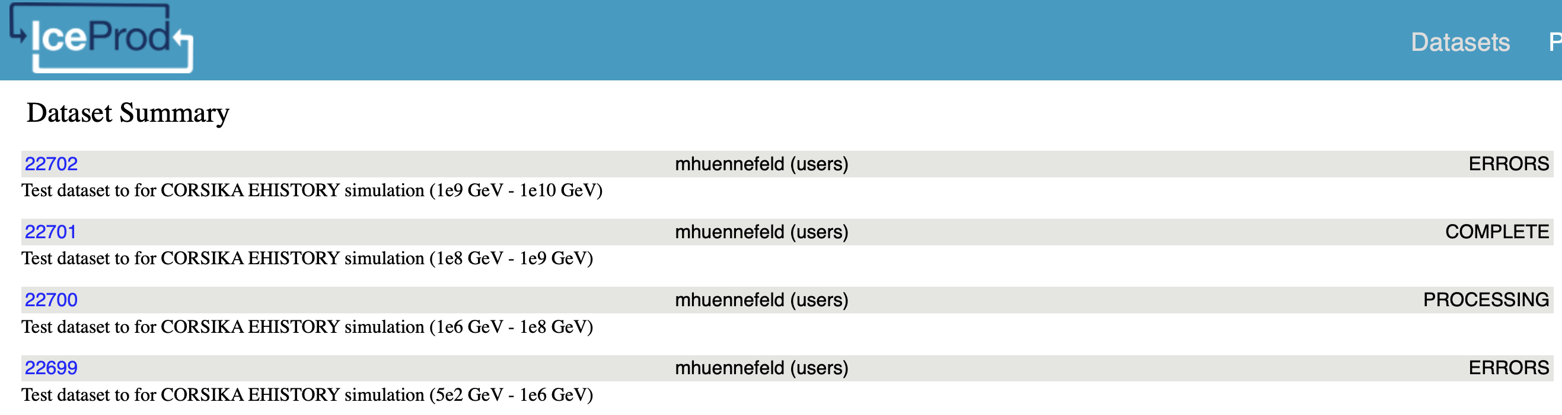
Simulation
started first iceprod tests
investigate errors
check configs for latest recommendations / software / settings
Polyplopia: MuonGun vs CORSIKA ?

Slide 6
Misc / ToDos
Investigate decision tree binning
Investigate iceprod errors
Check produced iceprod datasets
Analyze impact of CORSIKA as polyplopia
Finalize configs
Estimate muon multiplicity for neutrino datasets using DNN (asked by Dave)
Compare multiplicity charm/unflavored (asked by Lu)
Train DNN to estimate neutrino energy (ESTES)?
LBL Meetings: Google drive to store meeting slides?

