Slide 1
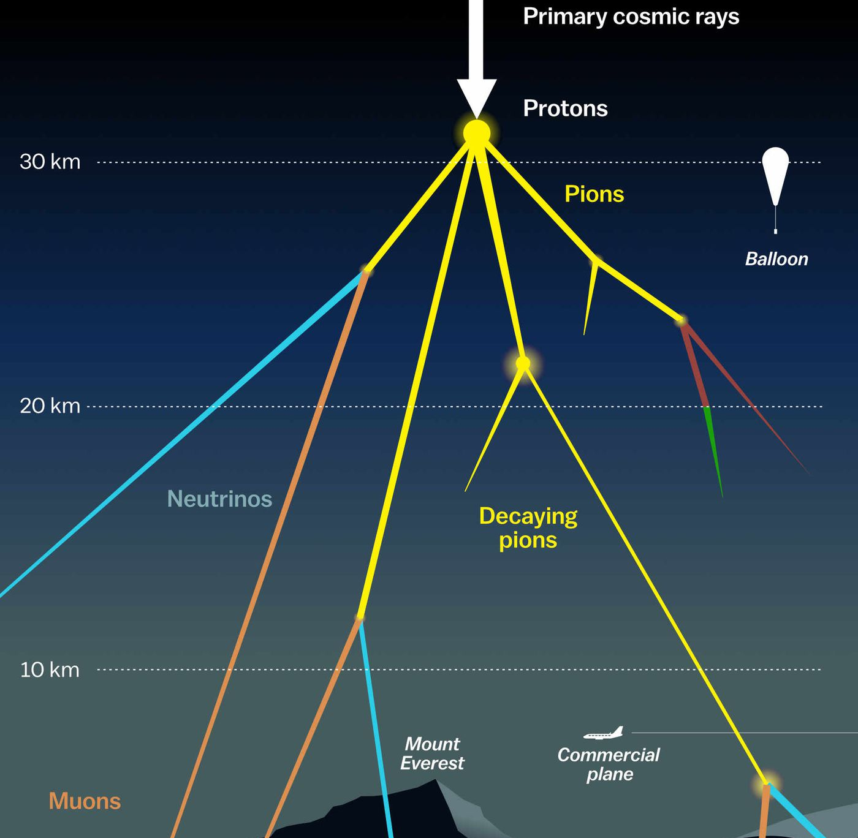
Updates on prompt atmospheric muon analysis Ludwig Neste and Pascal Gutjahr
CR-Call September 22, 2023
Source: NASA

Slide 2

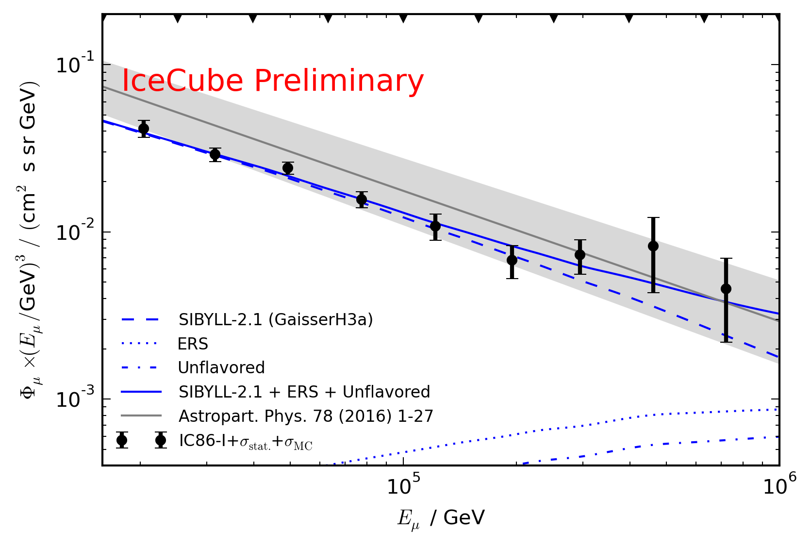
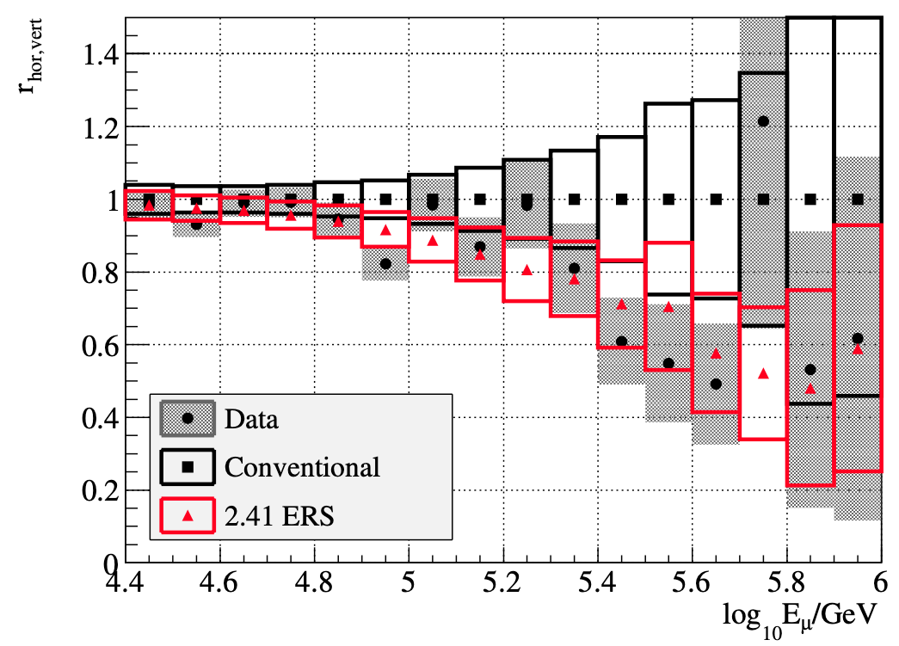
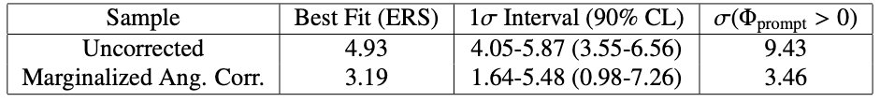
Motivation
Goal
Measure prompt normalization
Unfold energy spectrum
Prompt atmospheric muons have never been significantly measured
Old analyses:
Leading muon analysis: limited MC statistics (by Tomasz Fuchs, https://wiki.icecube.wisc.edu/index.php/Analysis_of_Leading_Muons)
Characterization of the muon flux: zenith problem (by Patrick Berghaus, https://arxiv.org/abs/1506.07981)

Slide 3
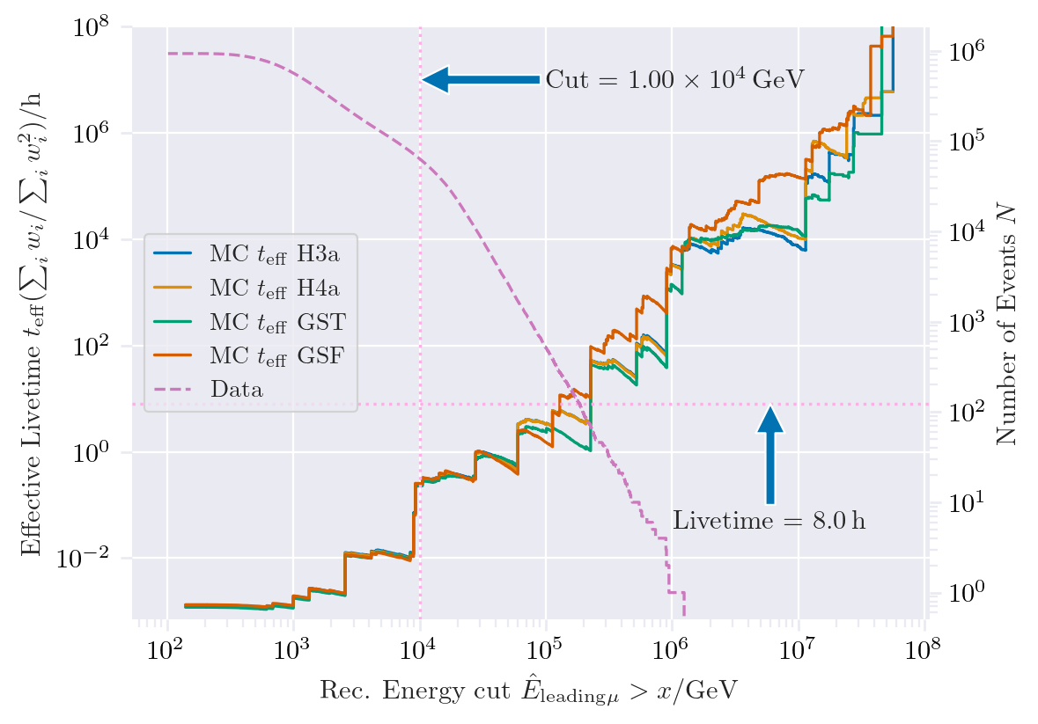
New CORSIKA extended history simulations
CORSIKA 77420
SIBYLL 2.3d
Icetray 1.5.1
5 components (p, He, N, Al, Fe)
Polyplopia: True
Trimshower: True
Ecuts1: 273 GeV (hadron min energy)
Ecuts2: 273 GeV (muon min energy)
Ecuts3: 10²⁰ GeV (electron min energy)
Ecuts4: 10²⁰ GeV (photon min energy)
4 datasets:
30010: 600 GeV – 1 PeV
30011: 1 PeV – 100 PeV
30012: 100 PeV – 1 EeV
30013: 1 EeV – 50 EeV
/data/sim/IceCube/2023/generated/CORSIKA_EHISTORY/
Please go ahead and test the datasets

Slide 4
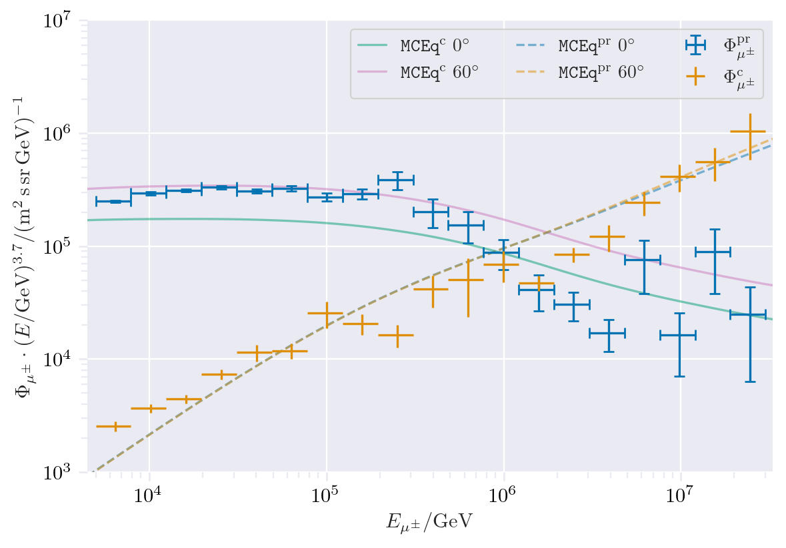
CORSIKA vs. MCEq
Prompt definition: not pion and kaon
IceCube CORSIKA step 0
For detailed information, see the talk by Ludwig Neste at the upcoming collaboration meeting

Slide 5
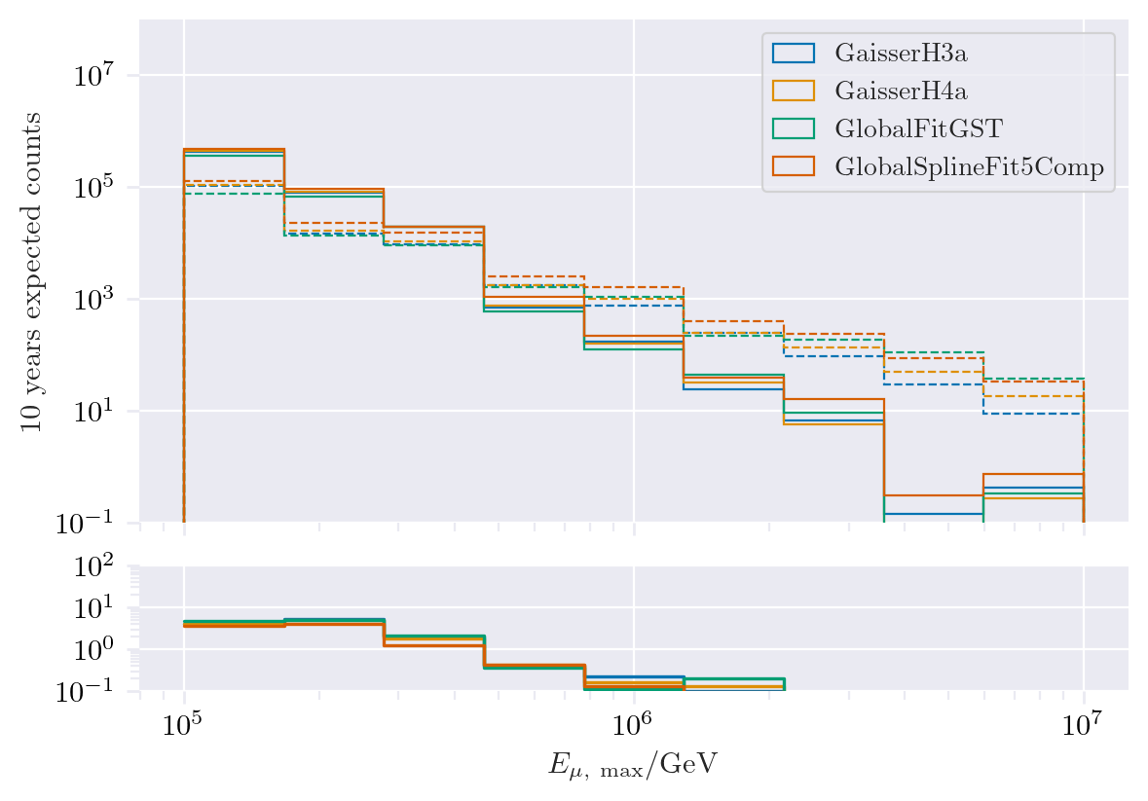
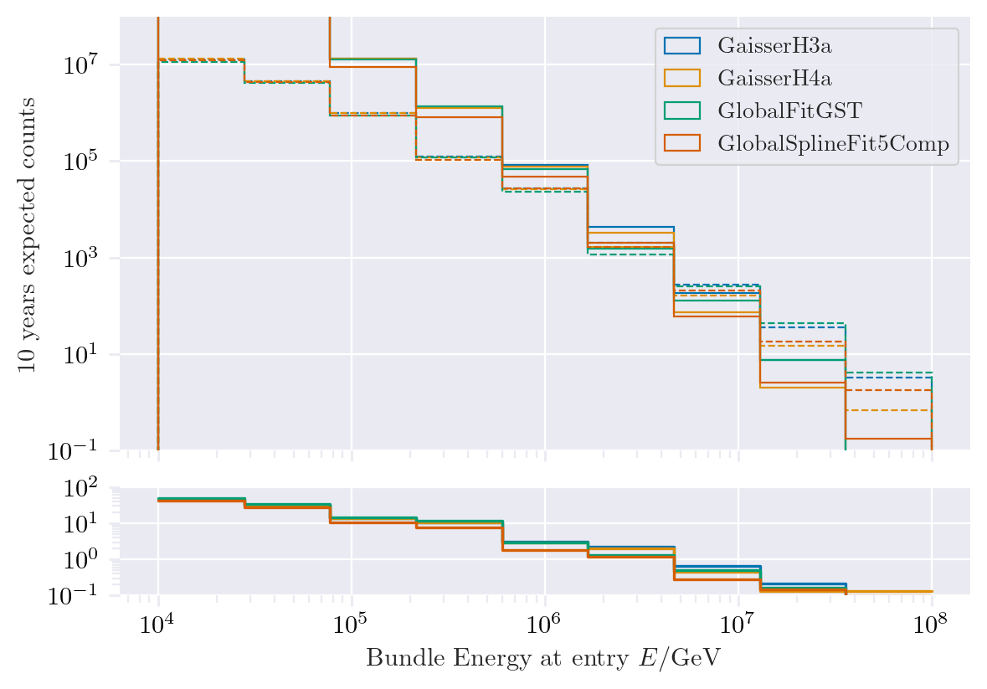
Expected muons for 10 years: leading vs. bundle energy

Slide 6
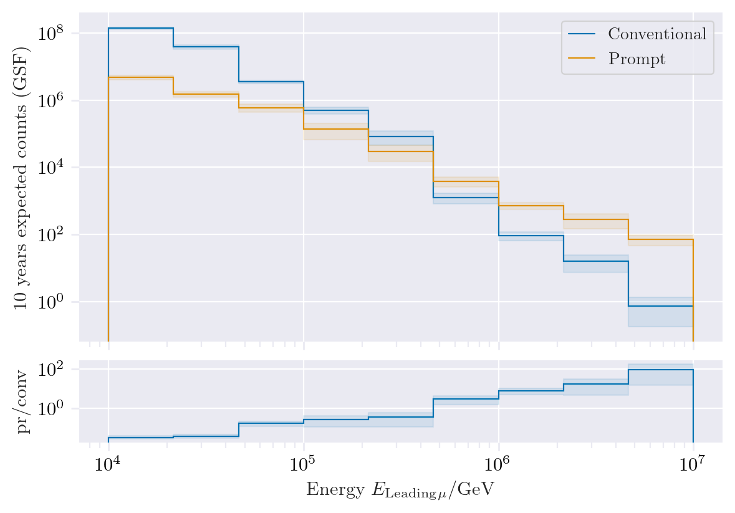
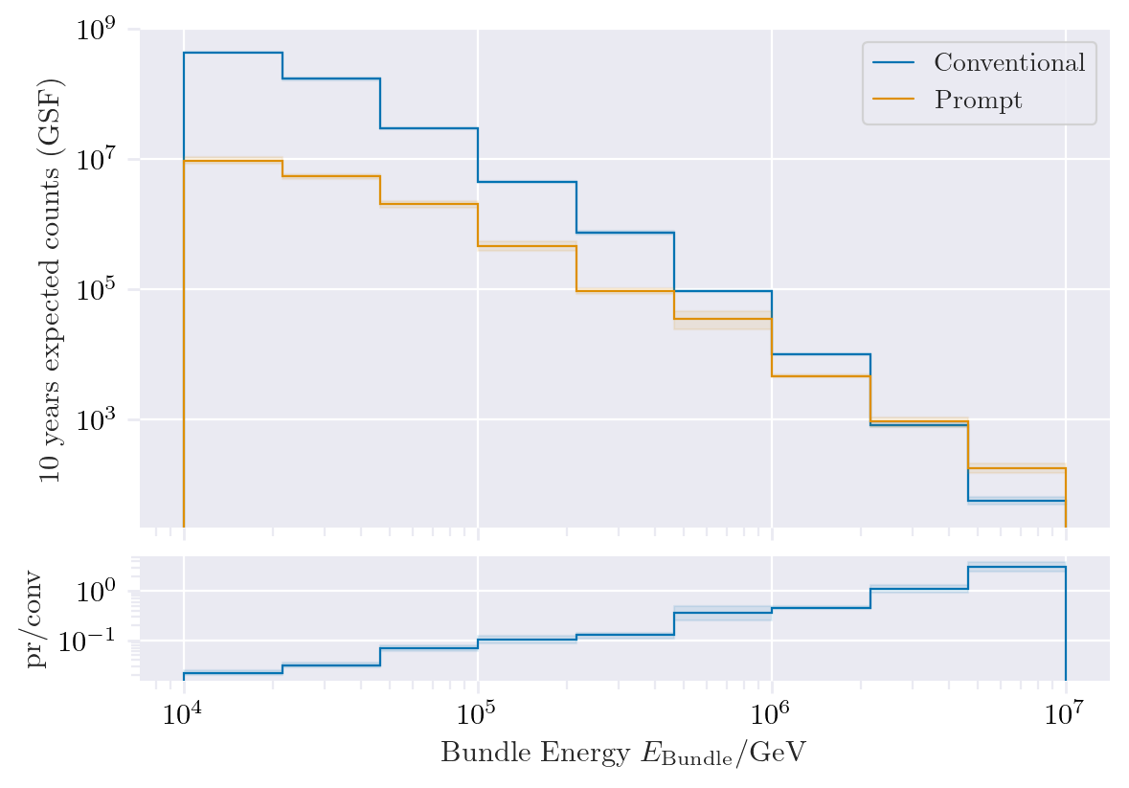
Expected muons for 10 years: leading vs. bundle energy
Leading muon energy is more sensitive to detect prompt

Slide 7
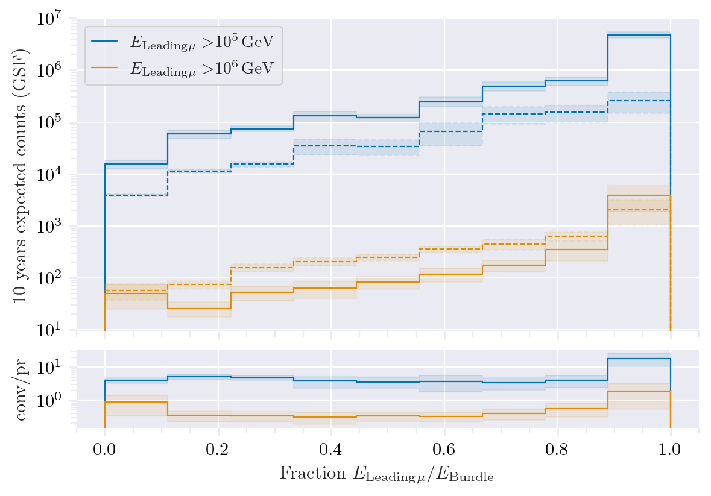
Leading muon energy fraction
Prompt dominates for energies > 1 PeV
Leading energy sweet spot: 0.1 – 0.9
Solid: conventional
Dashed: prompt

Slide 8
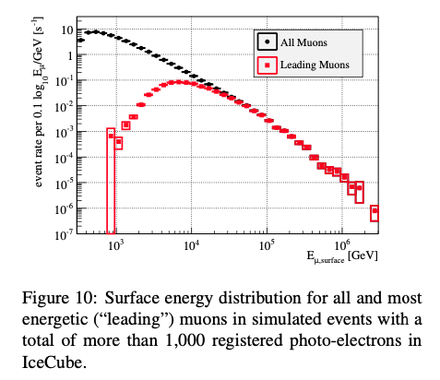
Leading muon contribution
Muons with energies between 100 TeV and 10 PeV dominate the bundle by more than 90%
Conventional muons are more dominant than prompt
High leading energy fraction does not lead to more sensitivity to detect prompt

Slide 9
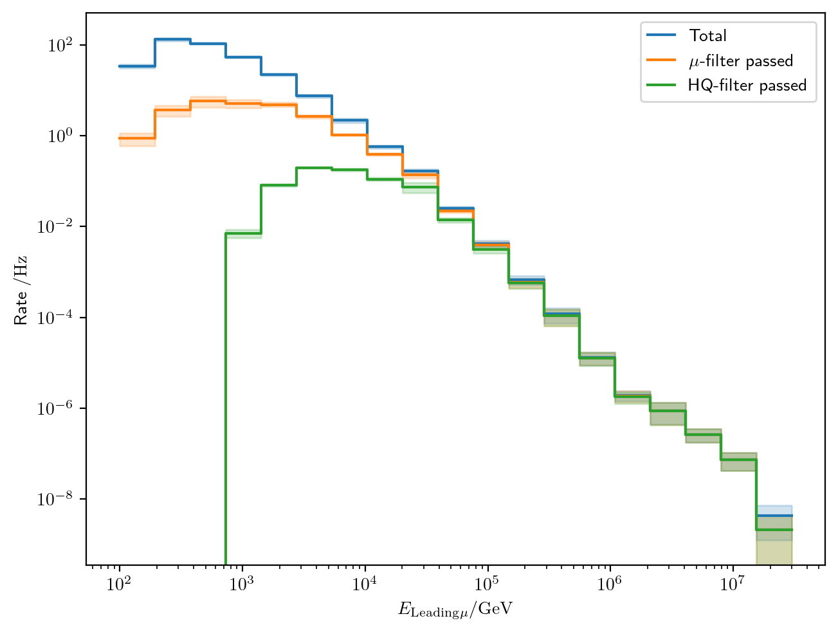
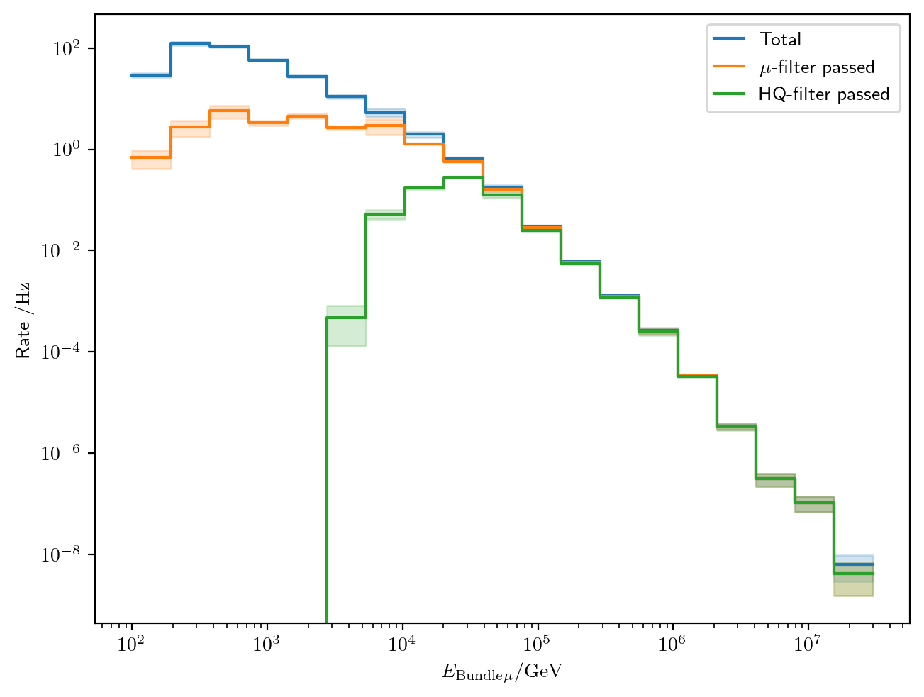
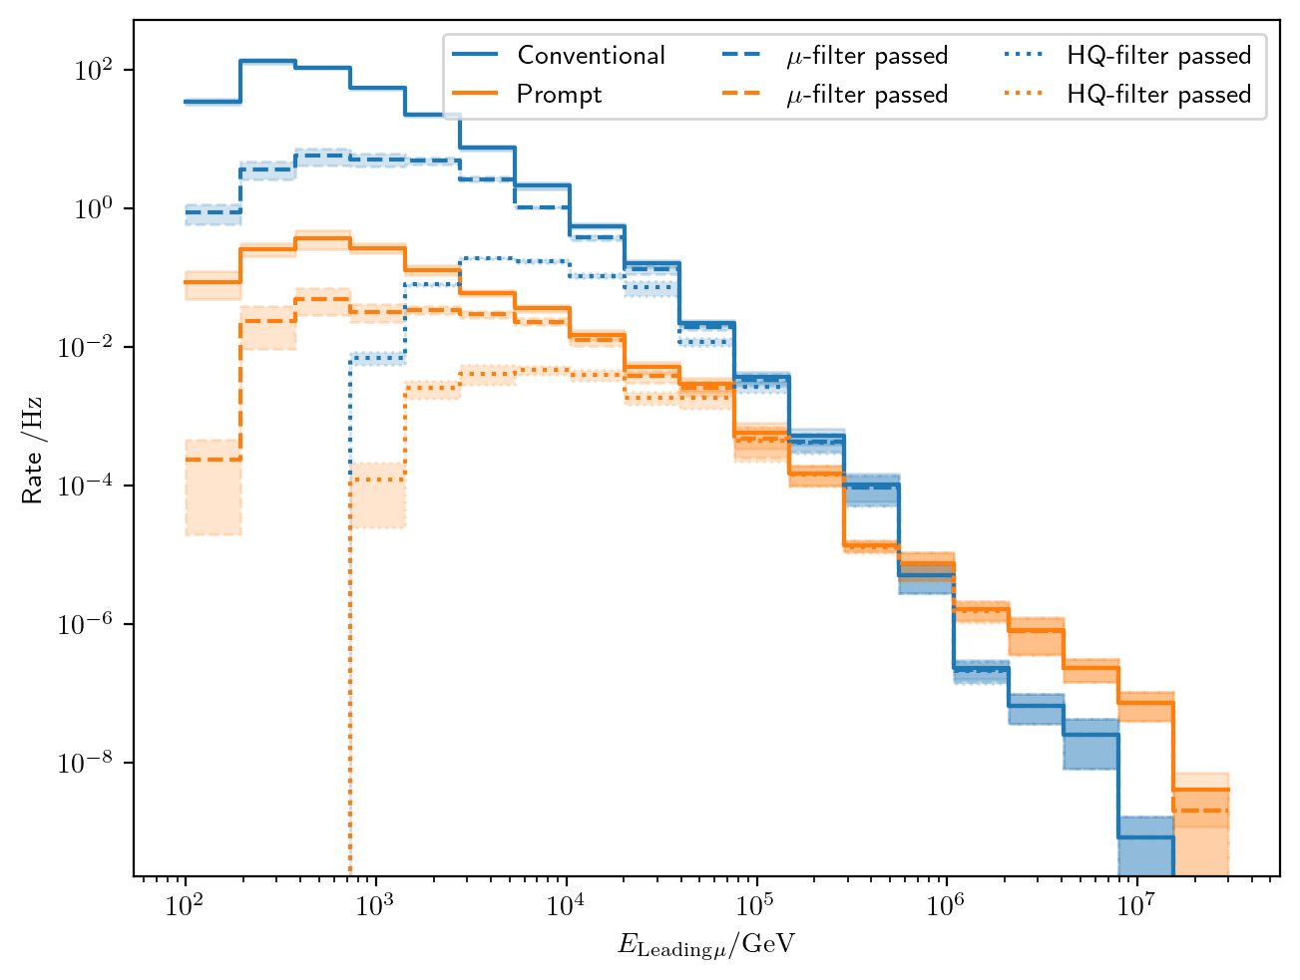
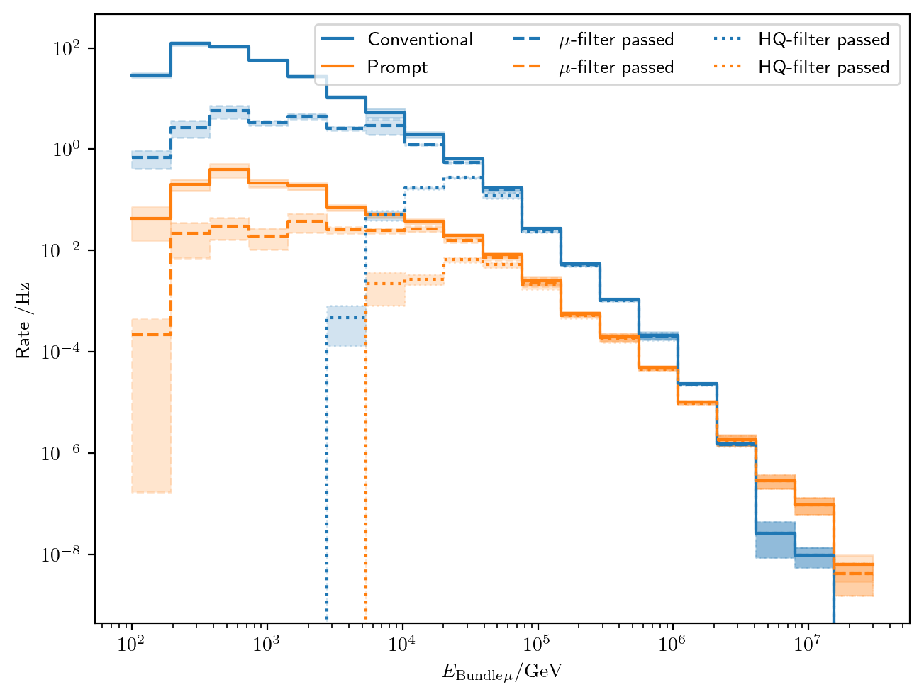
Filters
Choose muon filter,
larger statistics at 10 TeV

Slide 10
Data-MC agreements
Two bachelor students worked on reconstructions using the dnn_reco framework:
Leander Flottau
Benjamin Brandt
Reconstructions:
Leading energy
Leading fraction
Bundle energy
Multiplicity
Azimuth
Zenith
General:
Trained on uncleaned and 6µs cleaned muon pulses
Processed 1 day of experimental data from 2011 to 2020 (July 4th)
Work in progress

Slide 11
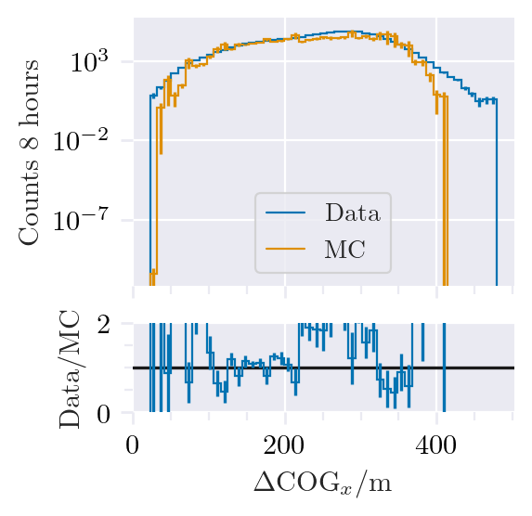
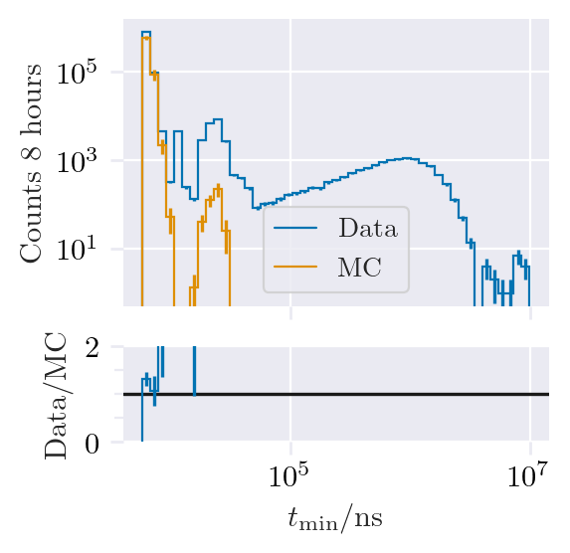
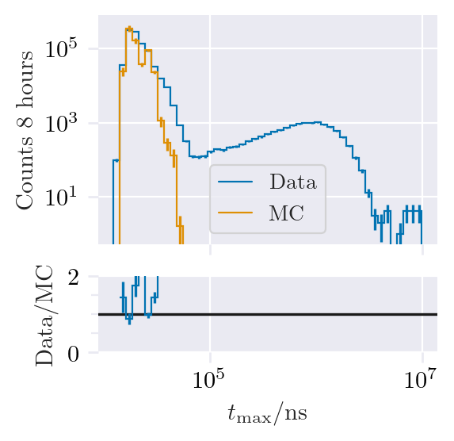
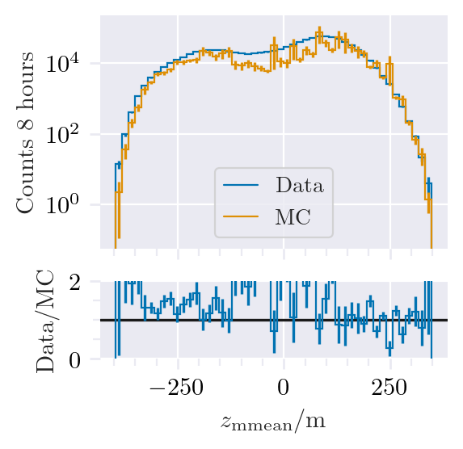
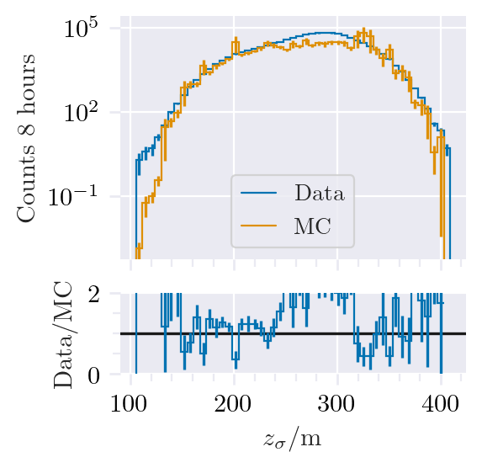
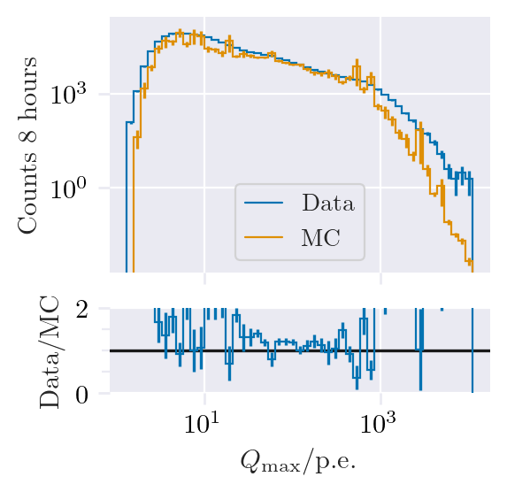
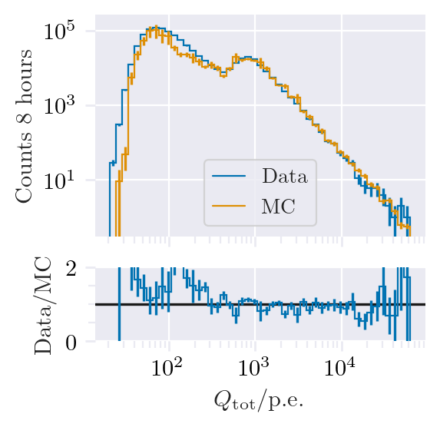
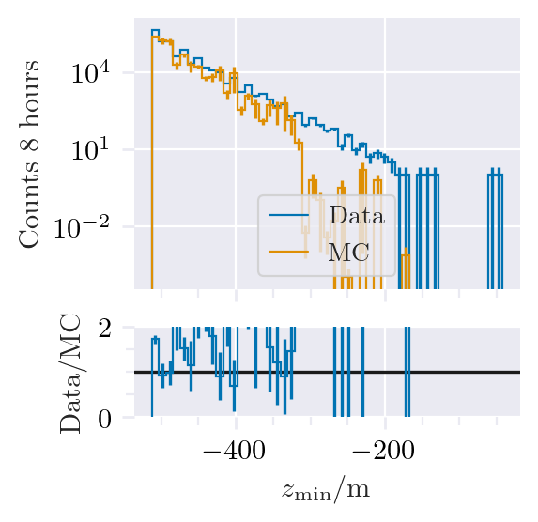
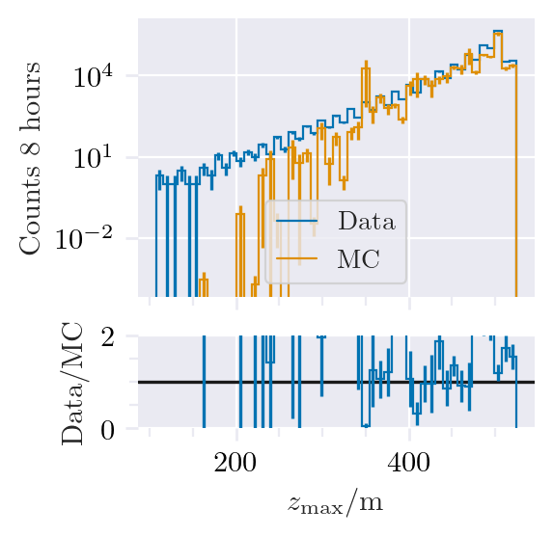
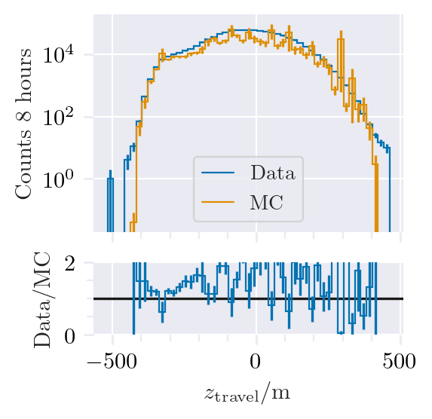
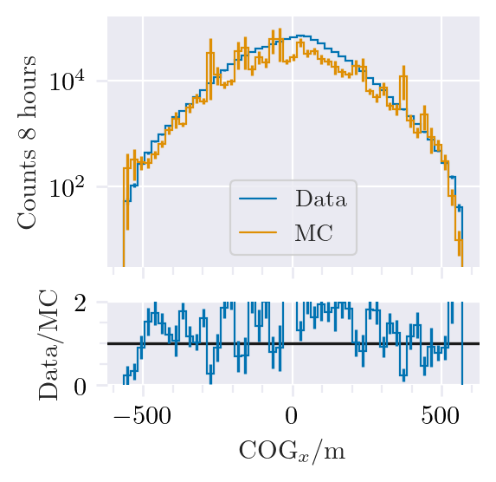
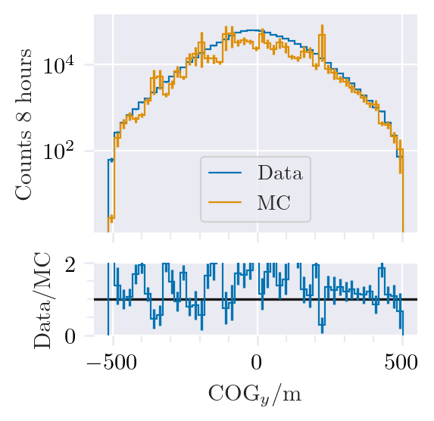
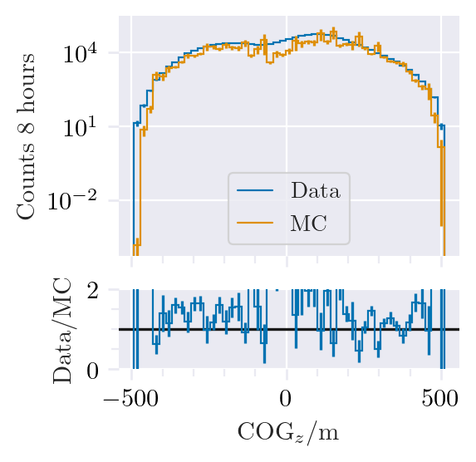
Data-MC: HitStatistics - SplitInIceDSTPulses

Slide 12
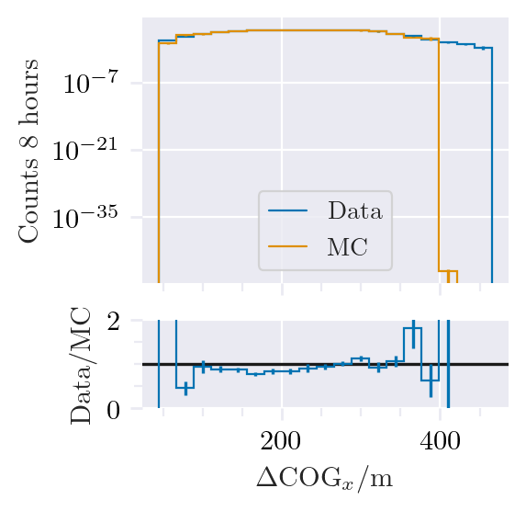
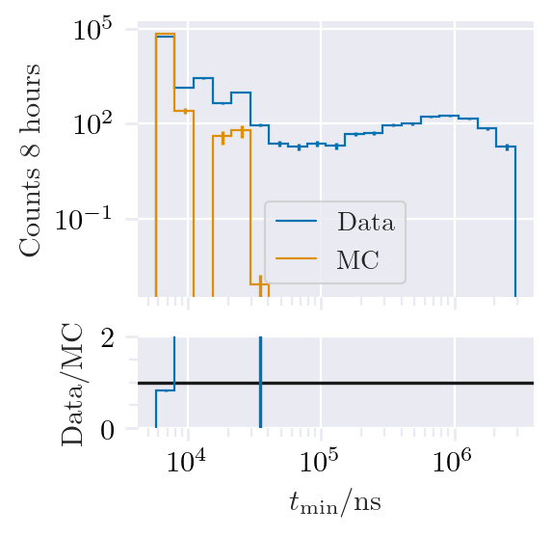
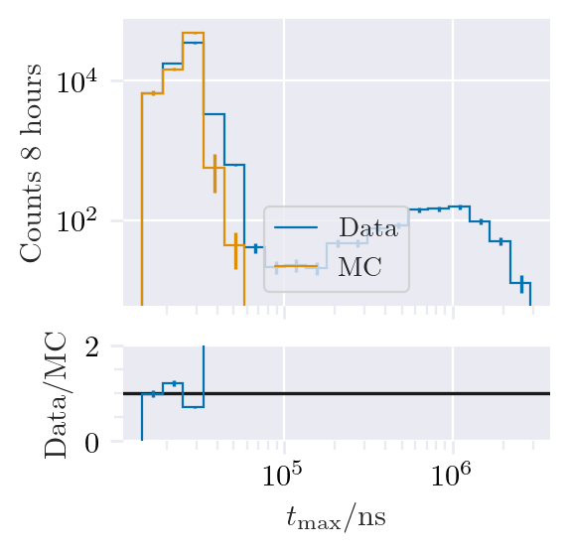
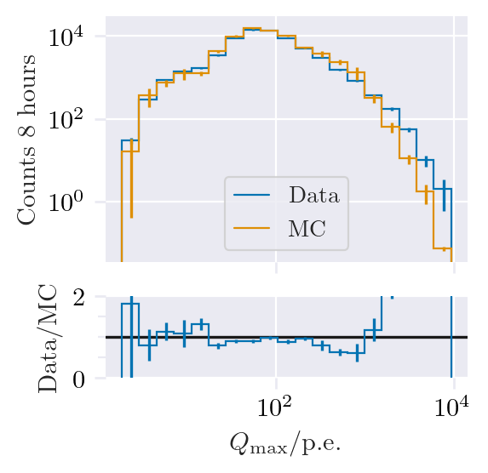
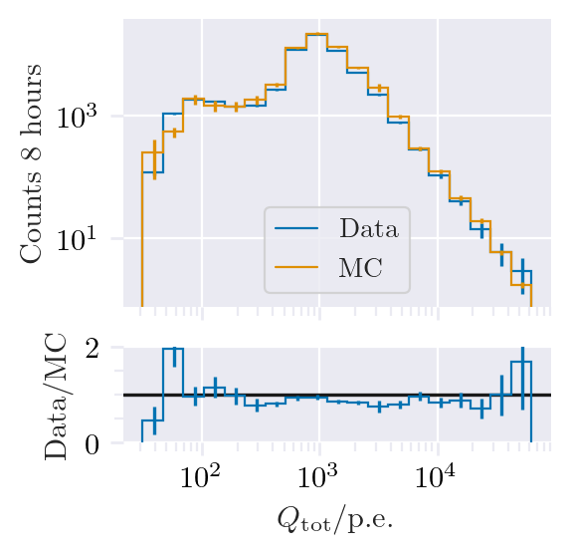
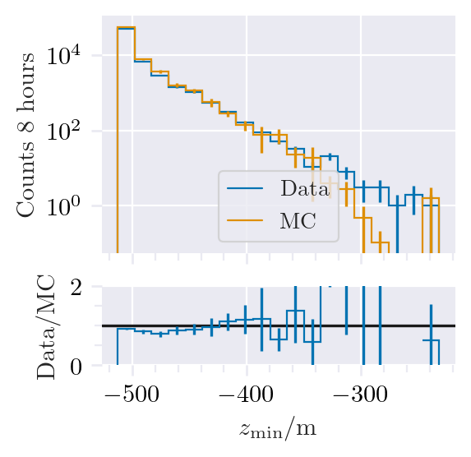
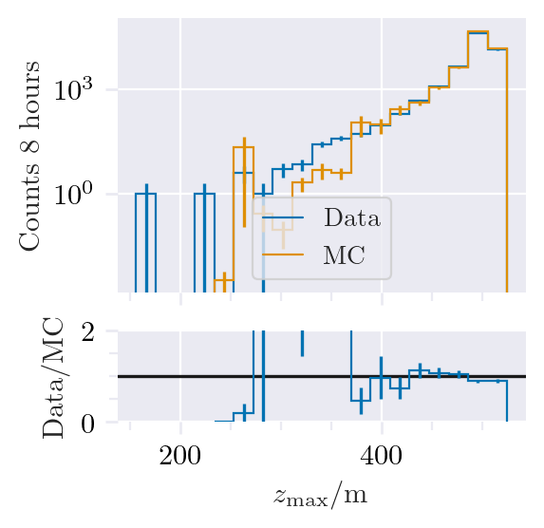
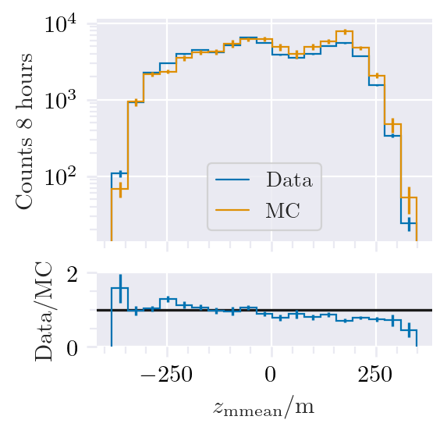
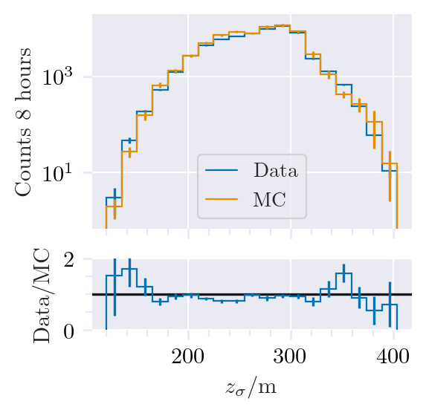
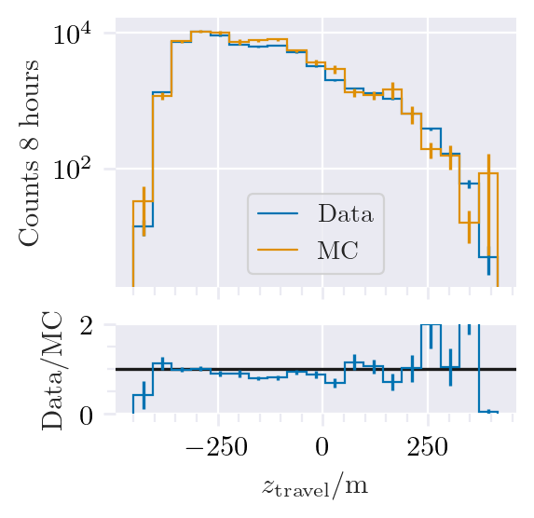
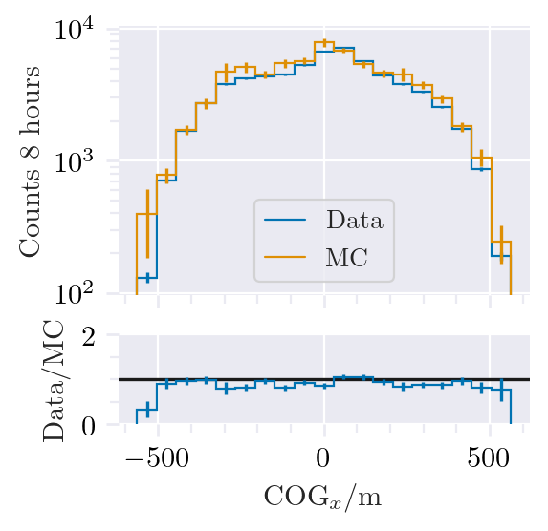
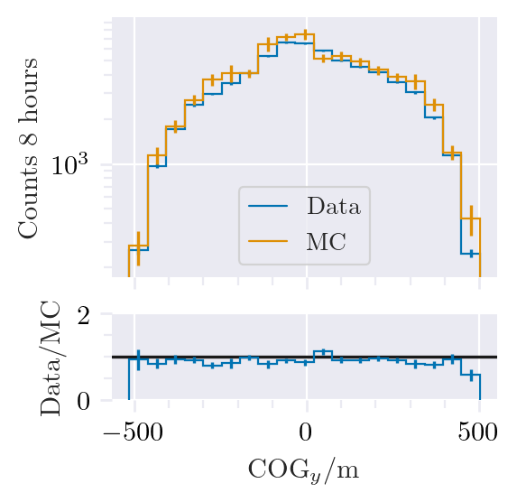
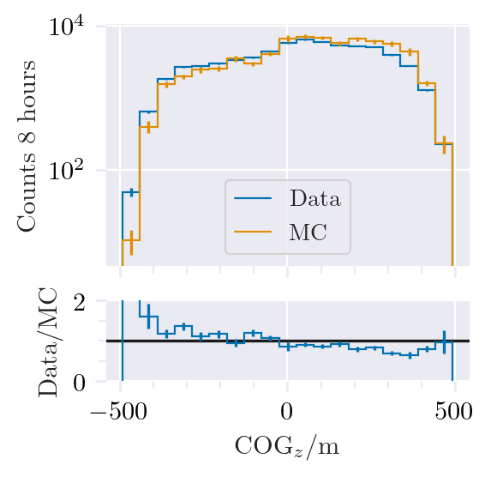
Data-MC: HitStatistics - SplitInIceDSTPulses
Reconstructed bundle energy > 10 TeV

Slide 13
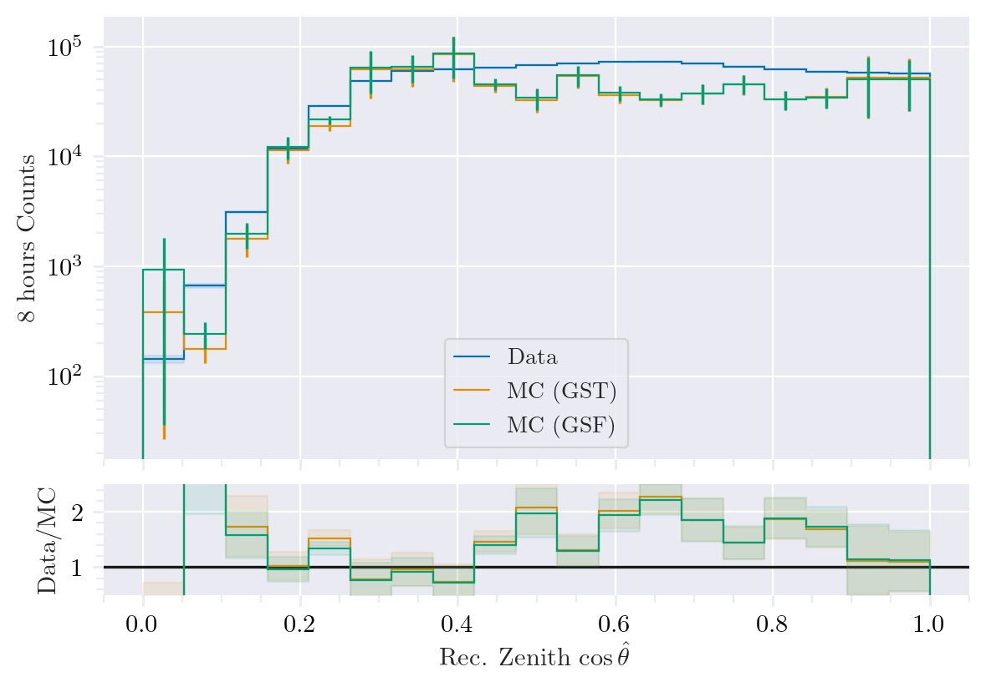
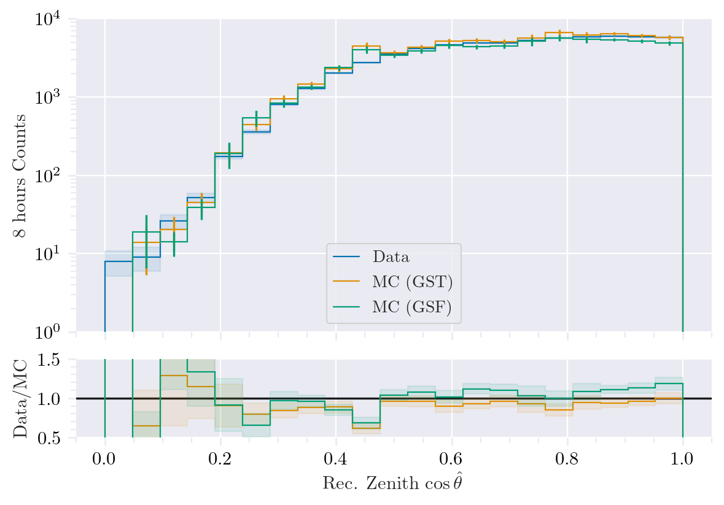
Data-MC: cos(zenith)
Reconstructed bundle energy > 10 TeV

Slide 14
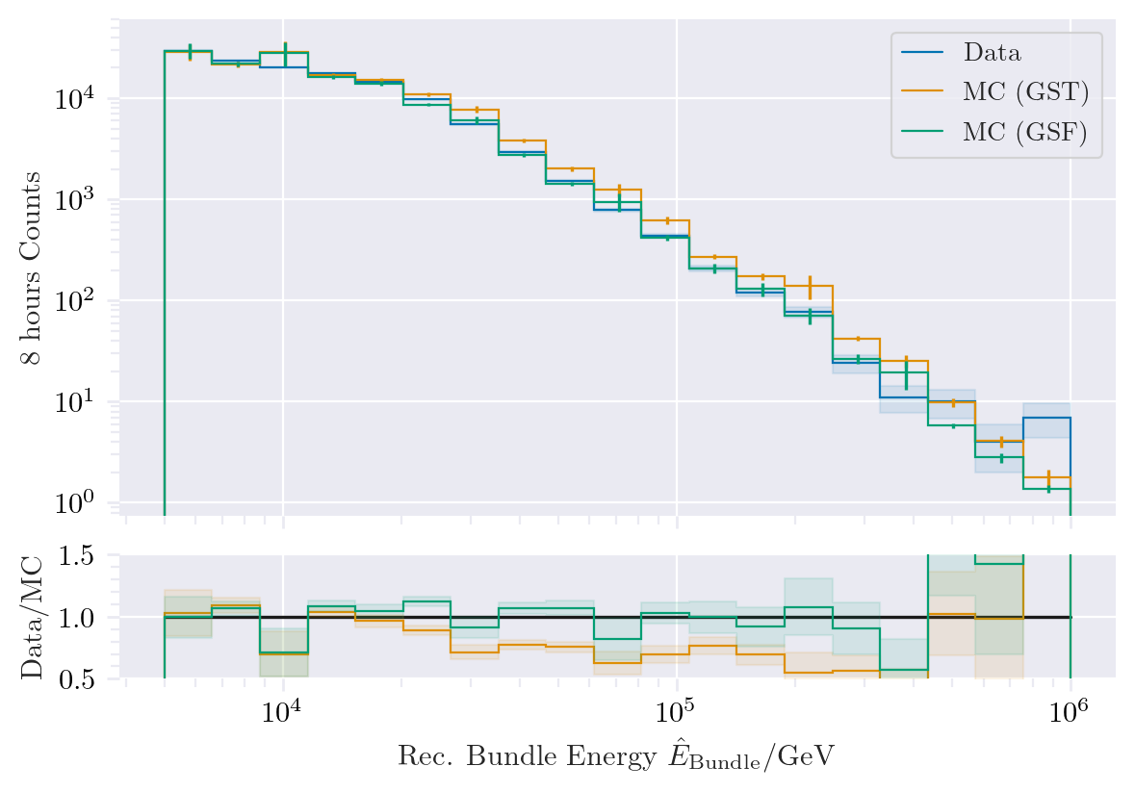
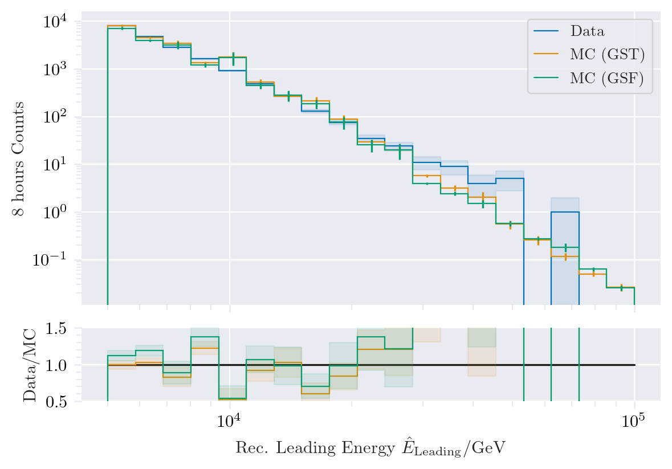
Data-MC: energy spectrum

Slide 15
Pseudo analysis

Slide 16
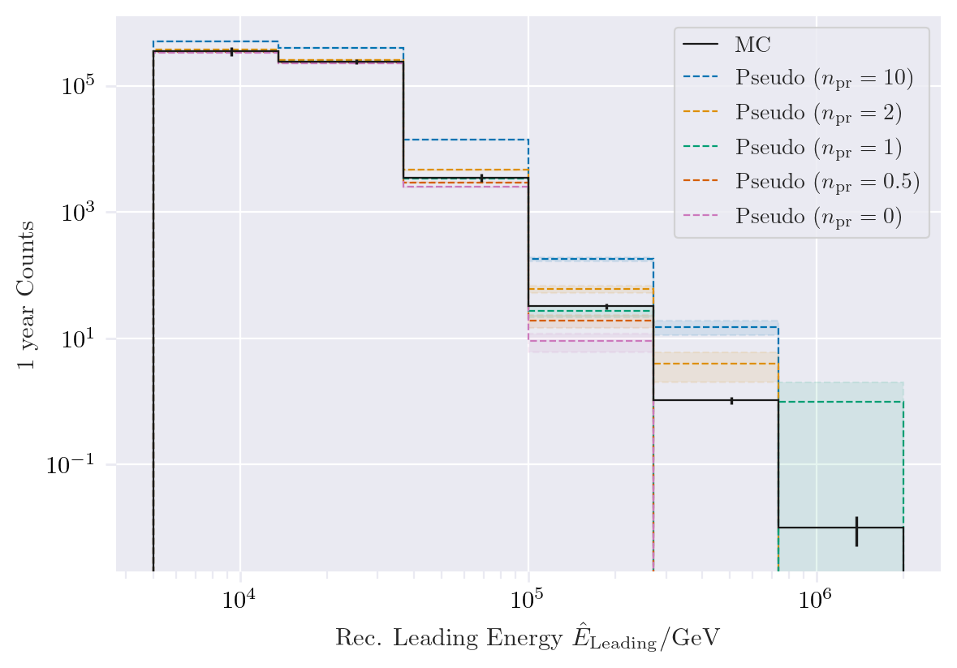
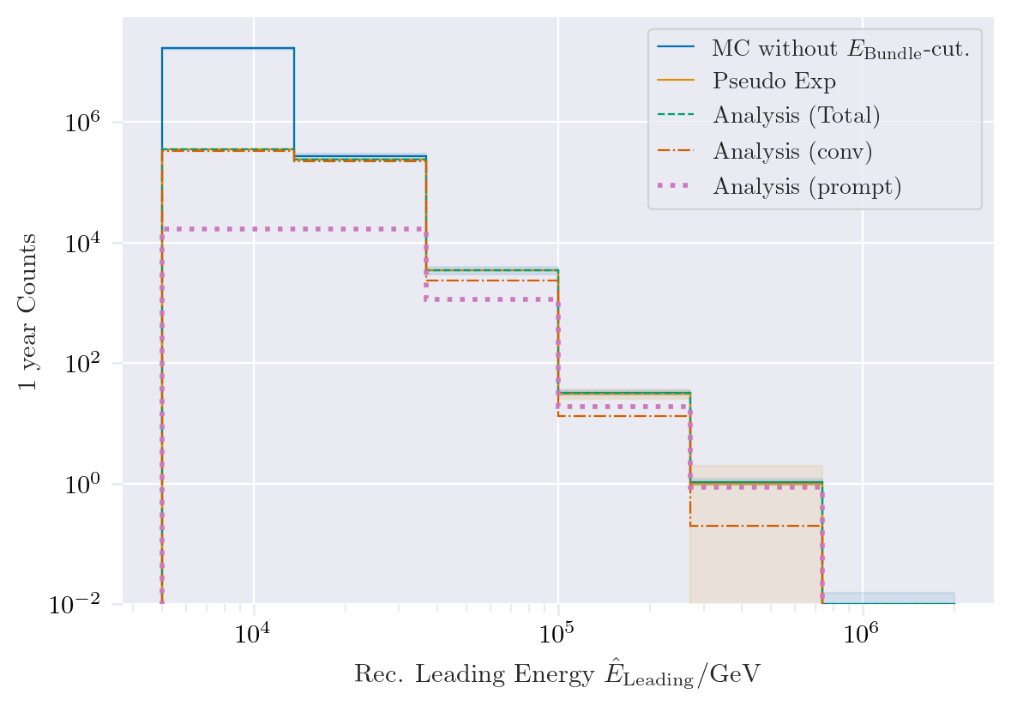
Pseudo data sampling

Slide 17
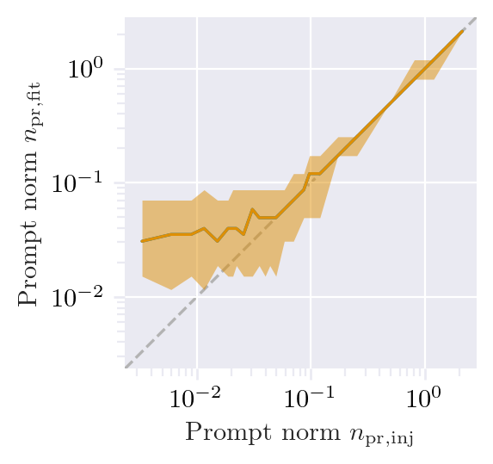
Test bias

Slide 18
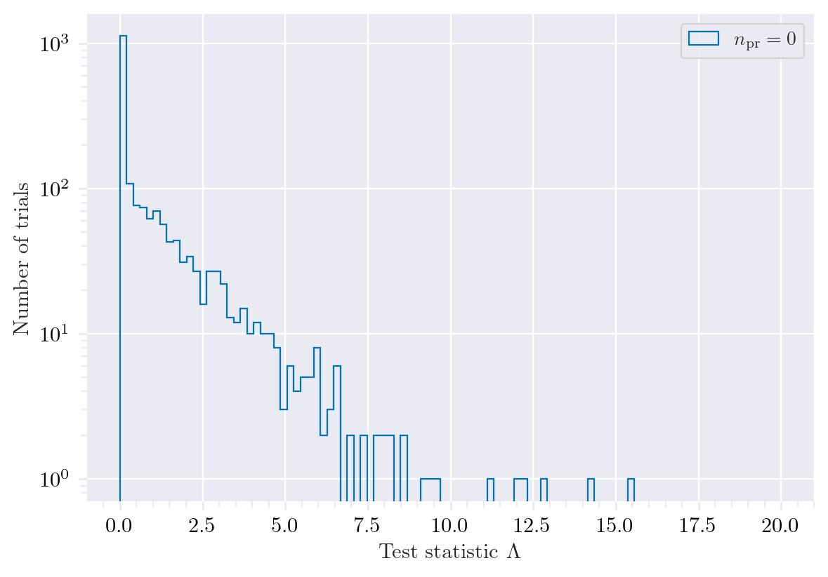

Test background statistics

Slide 19

Discovery potential and sensitivity
5 sigma discovery potential: 0.102 ± 0.005
Sensitivity: 0.024 ± 0.001

Slide 20
Conclusion and outlook
New CORSIKA EHIST simulations
CORSIKA vs. MCEq agreement
DNN angular and energy reconstructions
First data-MC comparisons
Pseudo analysis set up
Wiki page
Data-MC agreement of dnn input
Optimize DNN reconstructions
Include systematics (snowstorm)
Scattering
Absorption
Anisotropy
Hole ice 1
Hole ice 2
Dom efficiency
Conventional normalization
We do not include systematics of the primary fluxes, instead we perform the analysis several times for different flux models
Entire analysis is based on CORSIKA 7 and SIBYLL 2.3d, perform “minor” simulation with another hadronic model?

Slide 21
Backup

Slide 22
Add backup slides:
Evluation of models used for this talk

Slide 23

Definition of the muon flux
$φ_{tot}=φ_{conventional}+φ_{prompt}$
$π, Κ$ ∝ E^{-3.7}
“not” $π, Κ \text{∝ }\text{E}\text{−}\text{2}\text{.7}$

Slide 24

Muon flux
0°: perpendicular to Earth’s surface
$$φ_{tot}=φ_{conv}+φ_{prompt}$$
Prompt dominates at energies larger than PeV
Conventional particle flux depends on zenith angle
conventional
prompt
We can measure prompt muon energies from ~1 PeV to ~100 PeV

Slide 25

Muon production – different weightings
GST predicts most prompt
MCLabelsLeadingMuons_entry_energy

Slide 26


Solution to zenith problem?
No complete solution, but a step in the right direction

Slide 27

Simulated events
Passed muon filter

