Slide 1
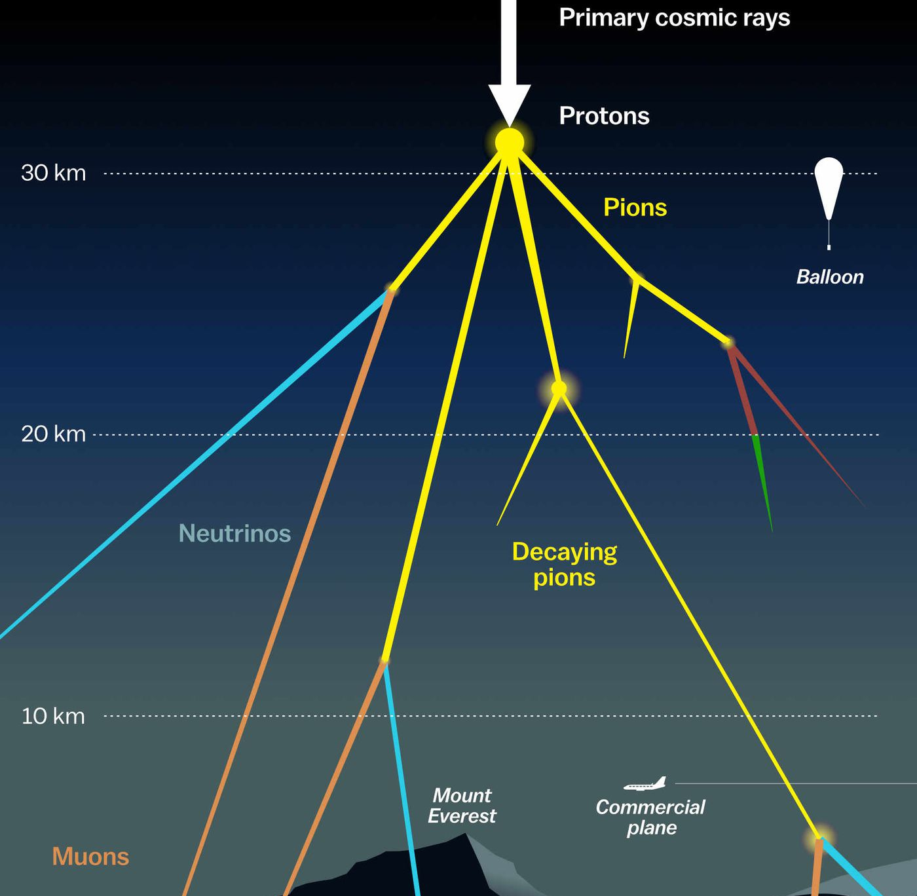

Measuring the prompt component of the atmospheric muon flux Pascal Gutjahr
May 7, 2024
Source: NASA

Slide 2
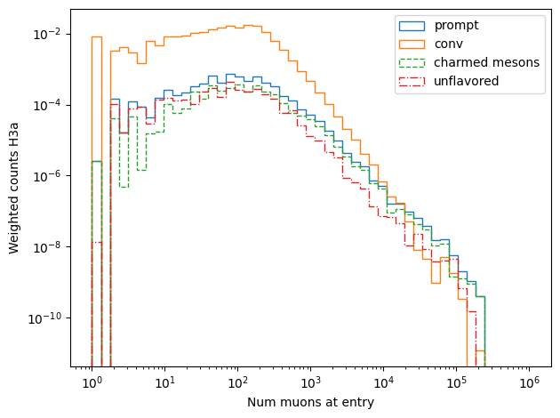
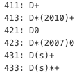
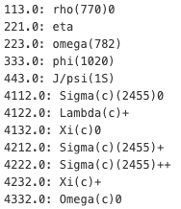

Multiplicity: charm vs unflavored
Charm
Unflavored
Conv

Slide 3
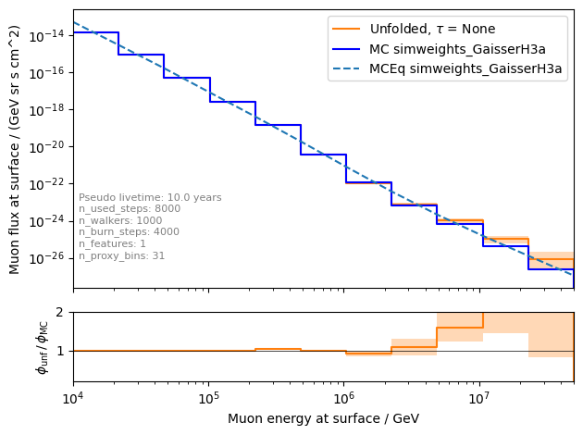
Unfolded muon flux at surface
unfolding of the high energy region above ~1 PeV depends on the flux model
several orders of magnitude are reconstructed → too less statistics at high energies
reweight events to get more statistics at high energies for training

Slide 4
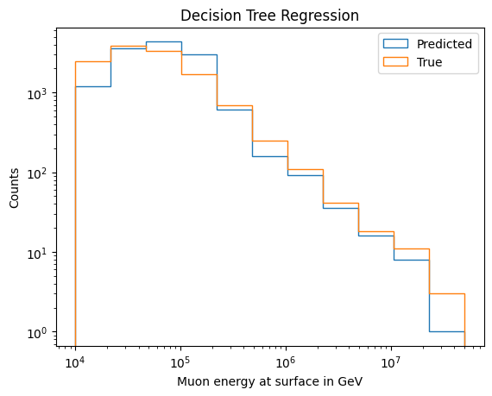
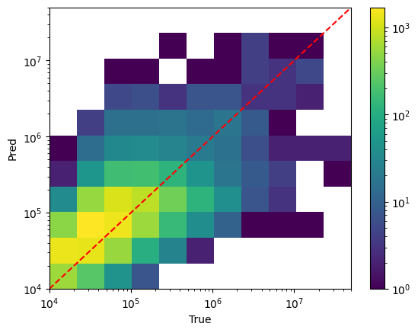
Tree binning – check tree prediction

Slide 5
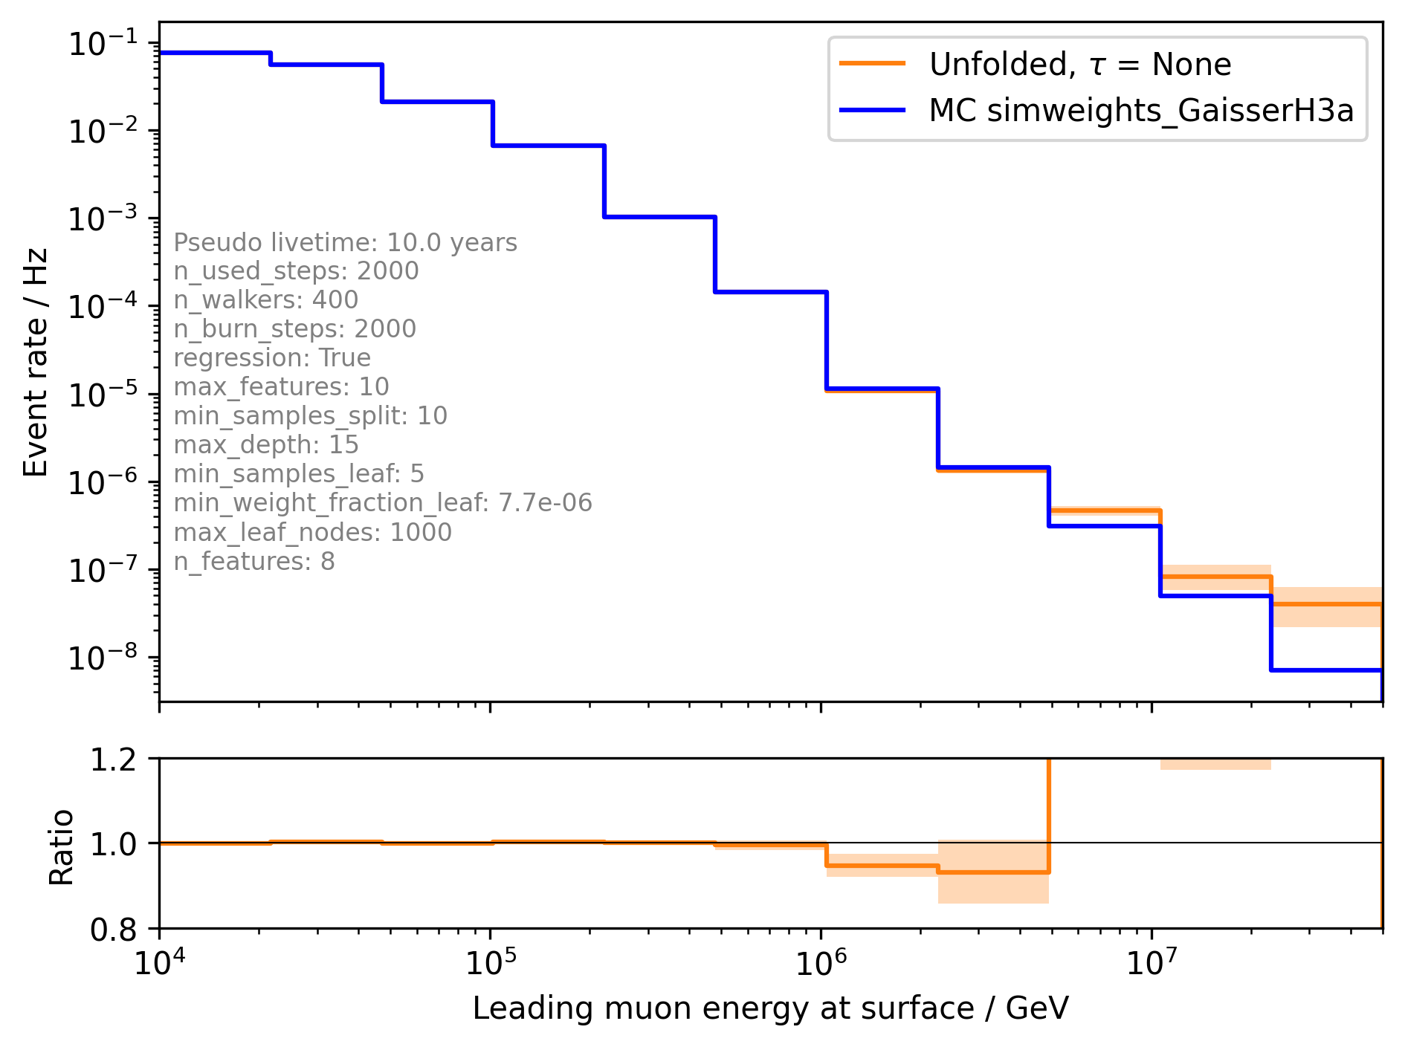
Event rate using tree binning

Slide 6
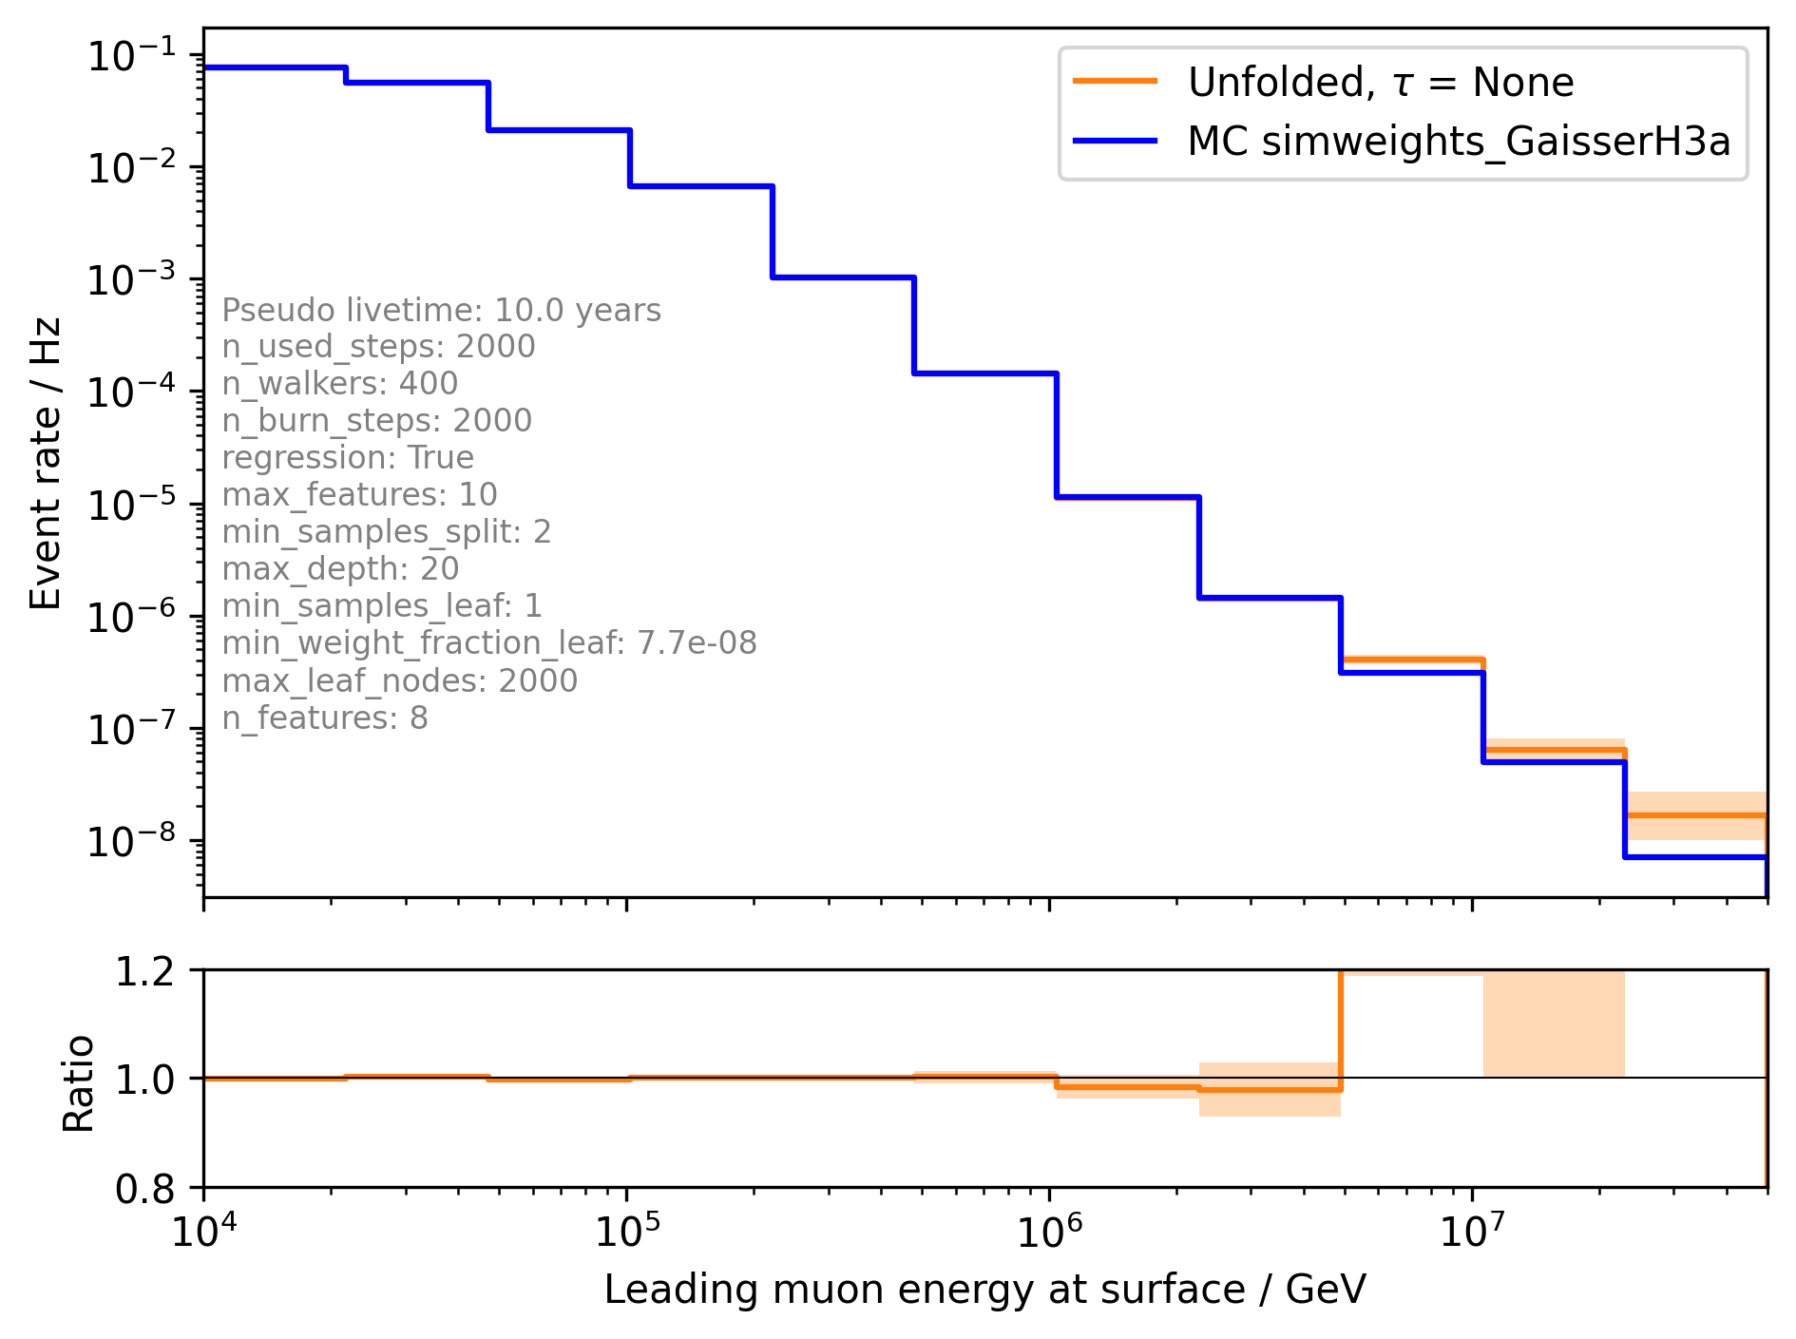
Event rate using tree binning

