Slide 1
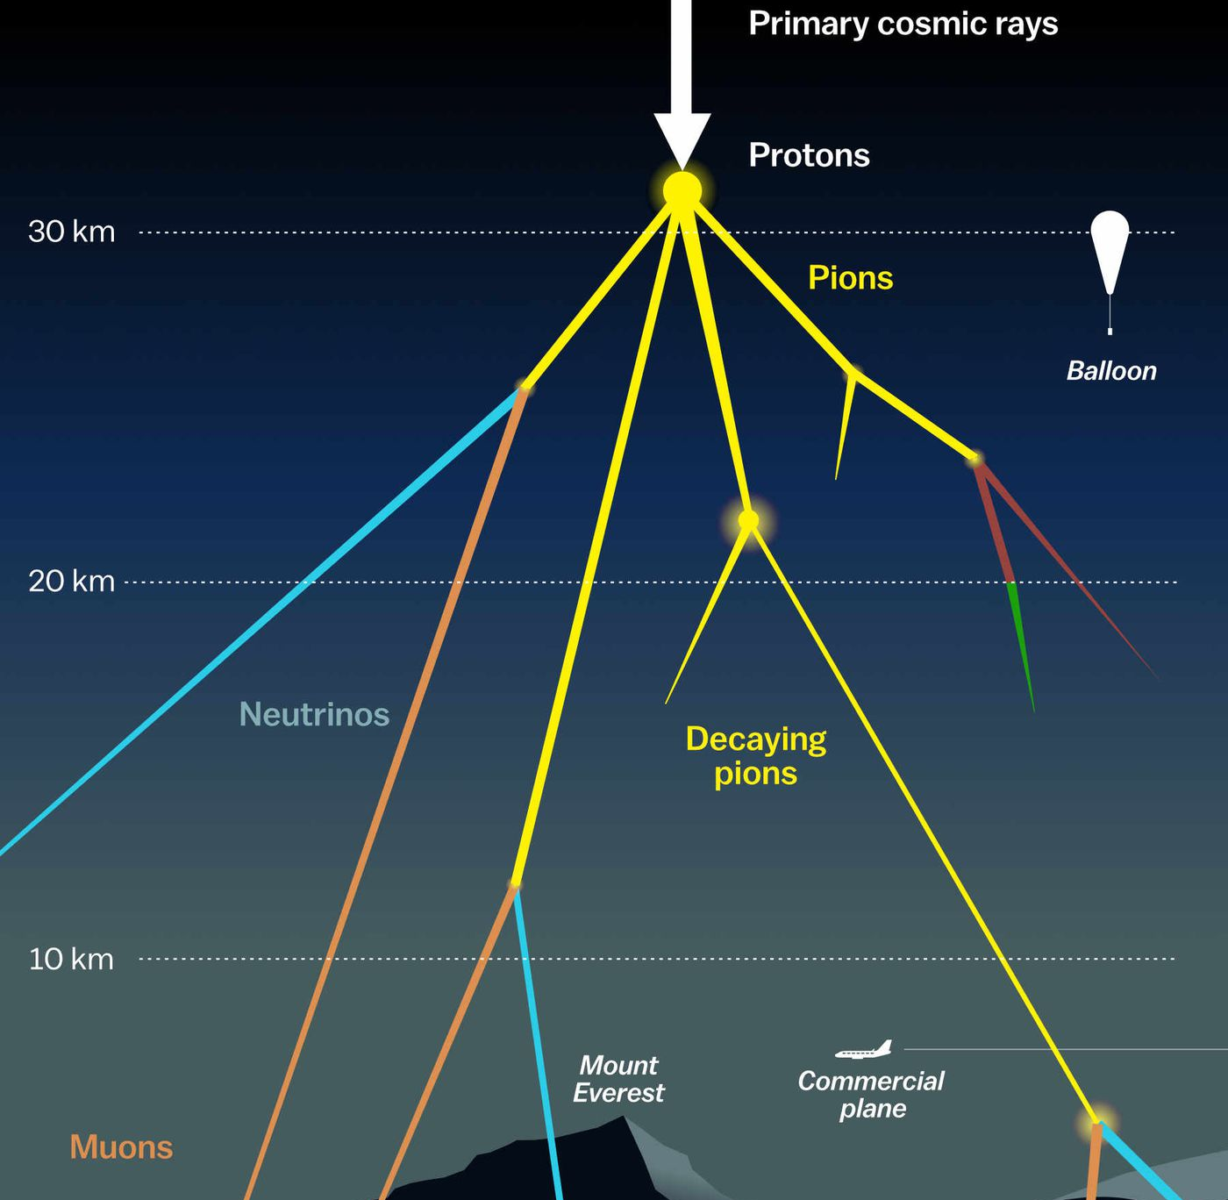

Measuring the prompt component of the atmospheric muon flux Pascal Gutjahr
July 9, 2024
Source: NASA

Slide 2
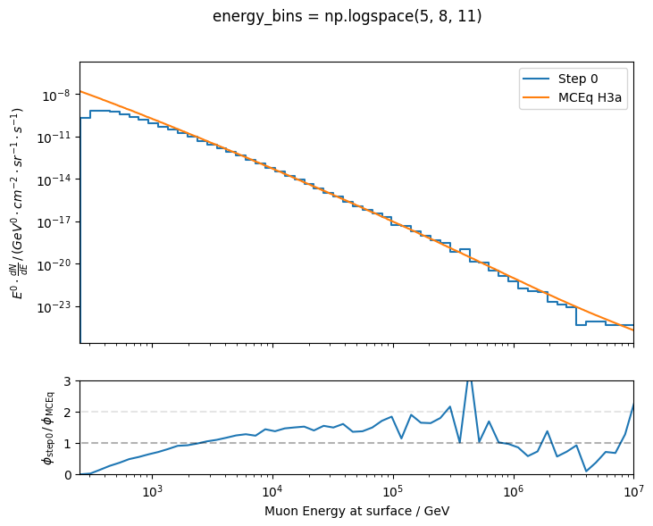
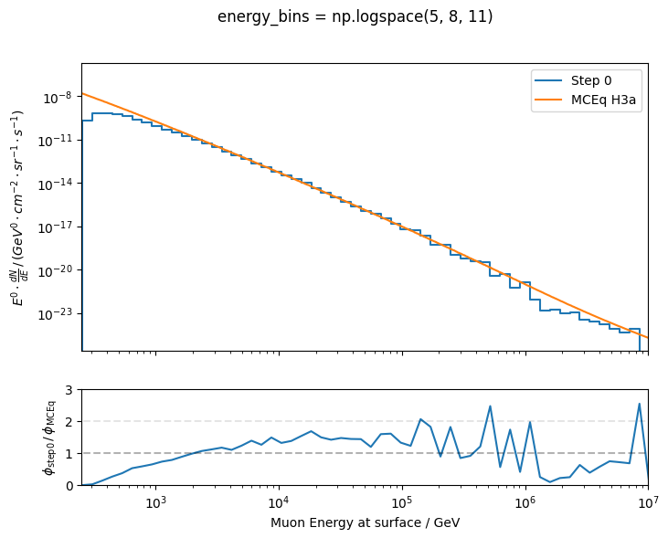
Muon flux at surface – old dataset
full high-energy statistics
plot from last week
statistics?

Slide 3
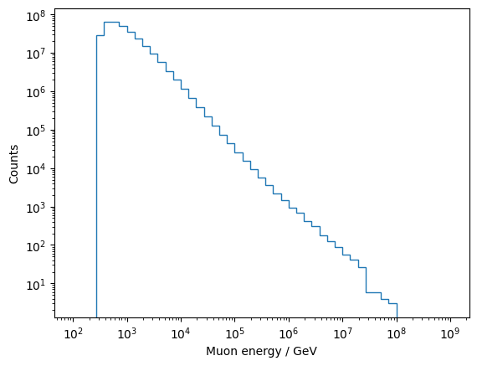
Muon flux at surface – old dataset
full high-energy statistics
statistics?
273 GeV (ecuts)
not enough high-energy showers simulated

Slide 4
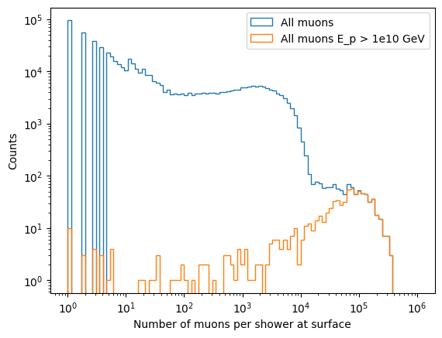
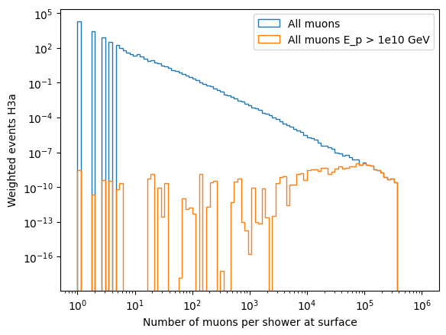
Number of muons per shower at surface – old dataset
10 events with primary energy > 1e10 GeV have only one muon at surface?! (15 events have 0 muons at surface)

Slide 5
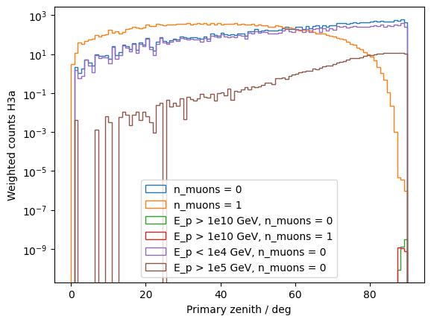
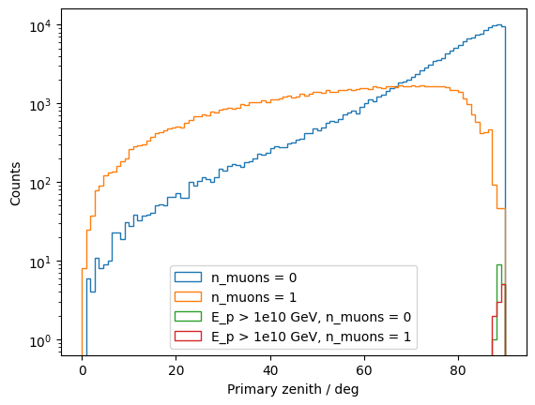
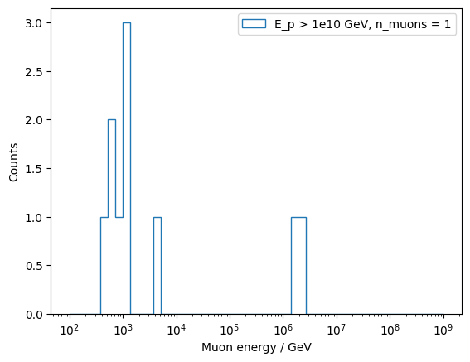
No muons at surface – old dataset
most events without any muon at surface
are low-energetic (E_primary < 1e4 GeV) → muons are removed by ecuts
no muons for very horizontal showers
at high energies
single muons of high-energetic
primary showers are low-energetic

Slide 6
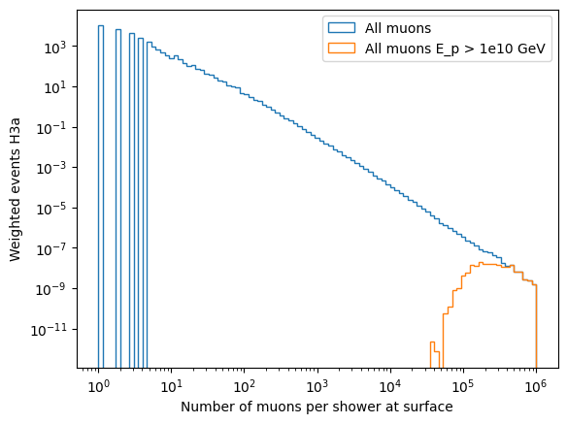
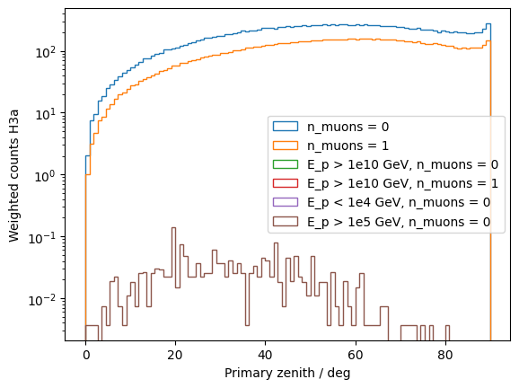
Number of muons per shower – new dataset
all muons E < 1e4 GeV are
removed while processing

Slide 7
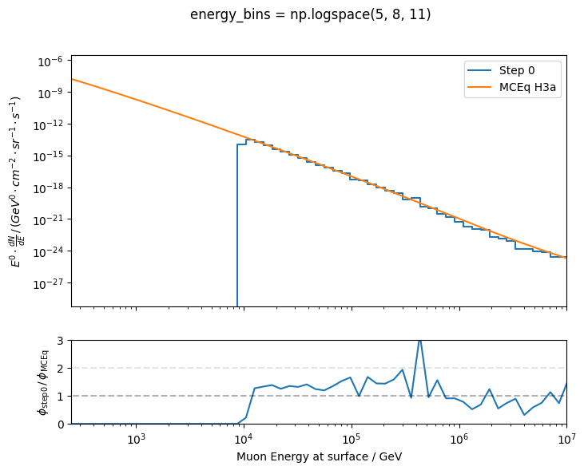
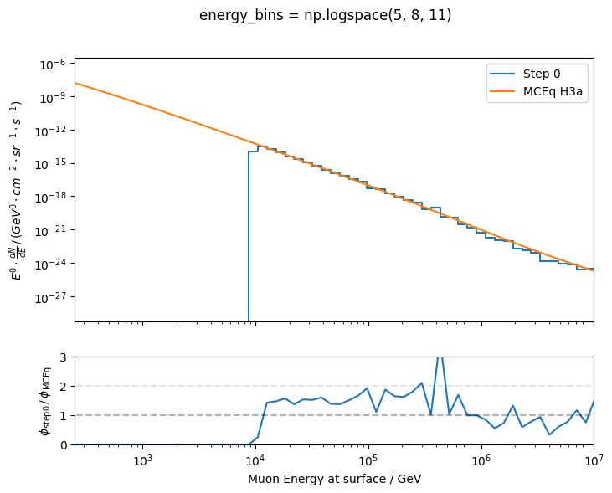
Different seasons – old dataset
January
Full year
maybe there is an offset between MCEq and CORSIKA?!

Slide 8
…I’m so stupid…

Slide 9
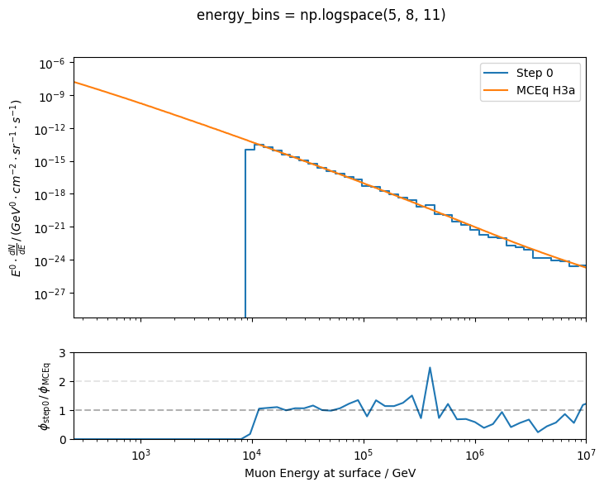
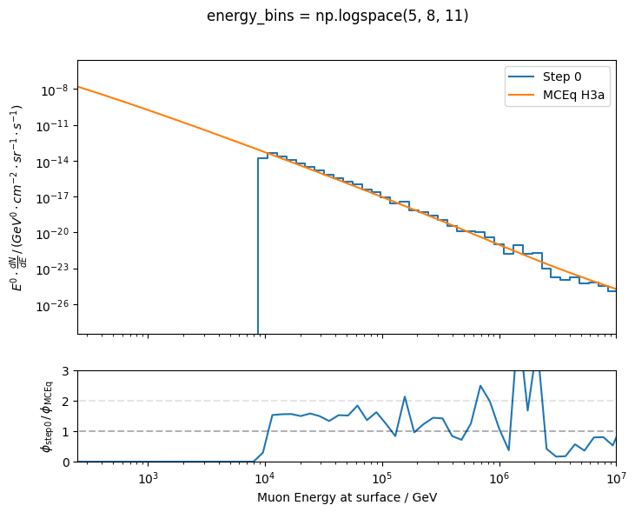
For the calculation, I used the bin edges and not the bin mids
old dataset
new dataset
✓
x

