Slide 1
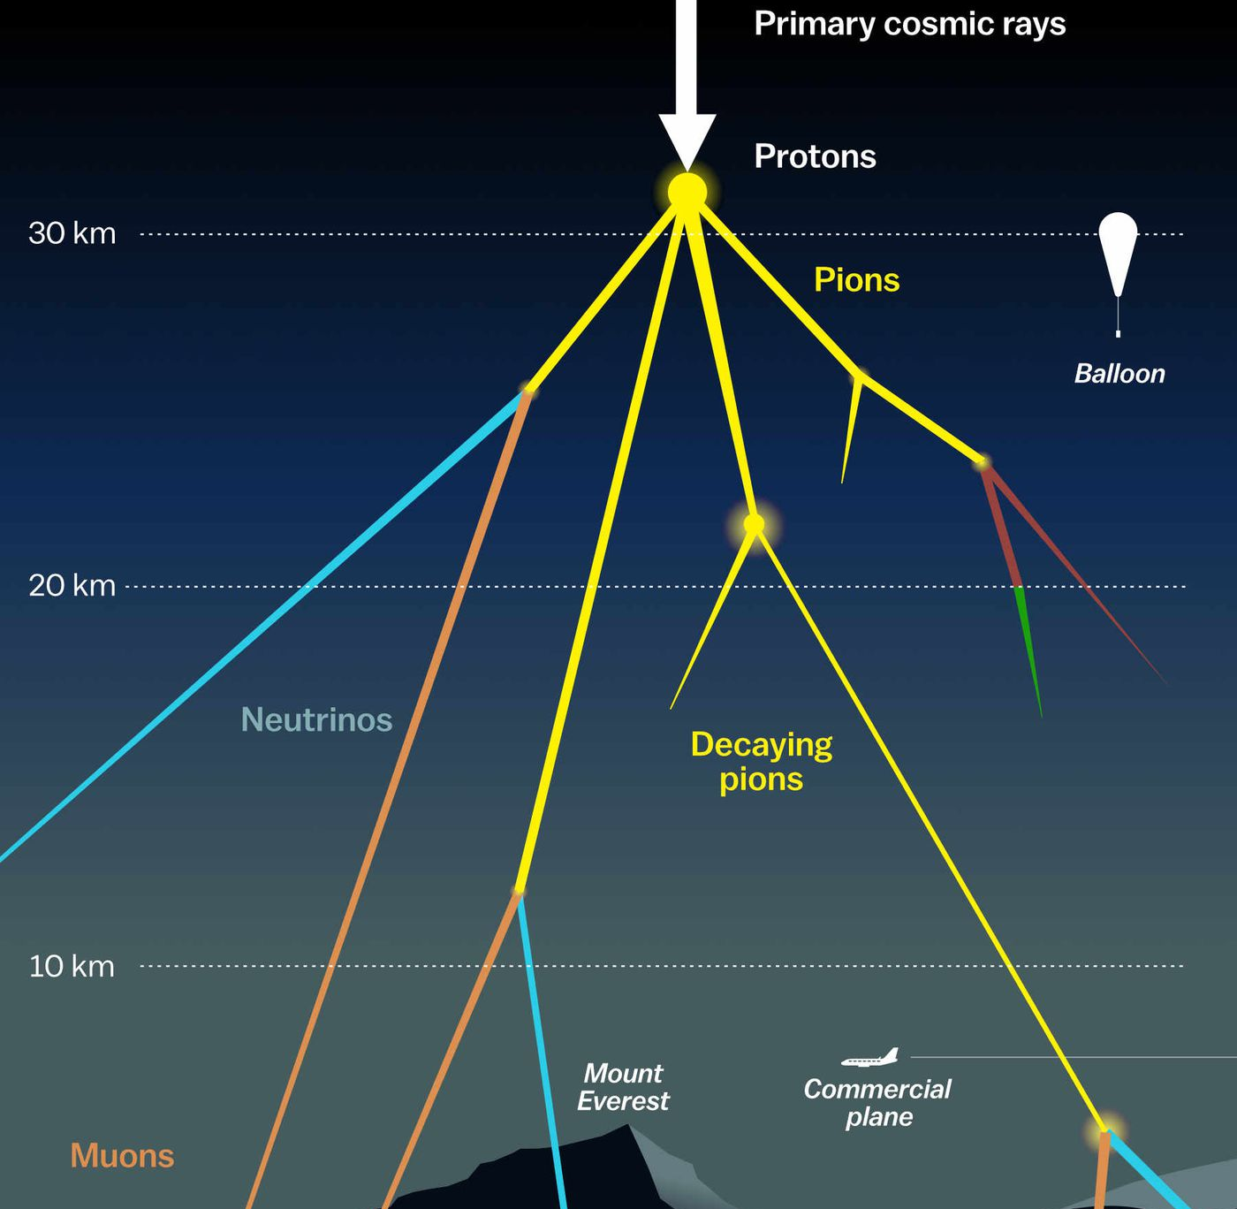

Measuring the prompt component of the atmospheric muon flux Pascal Gutjahr
July 12, 2024
Source: NASA

Slide 2
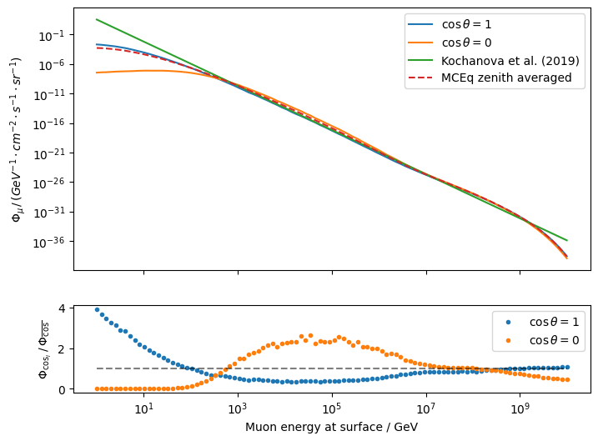
MCEq zenith averaged

Slide 3
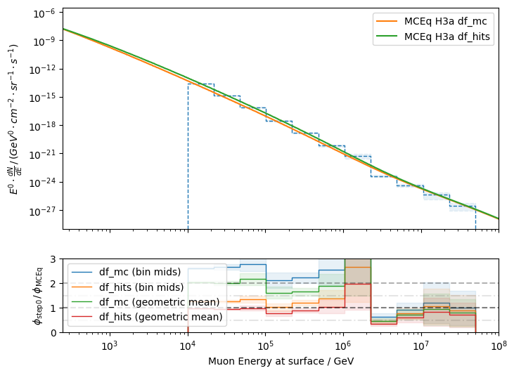
MCEq flux average calculation – new simulation

Slide 4
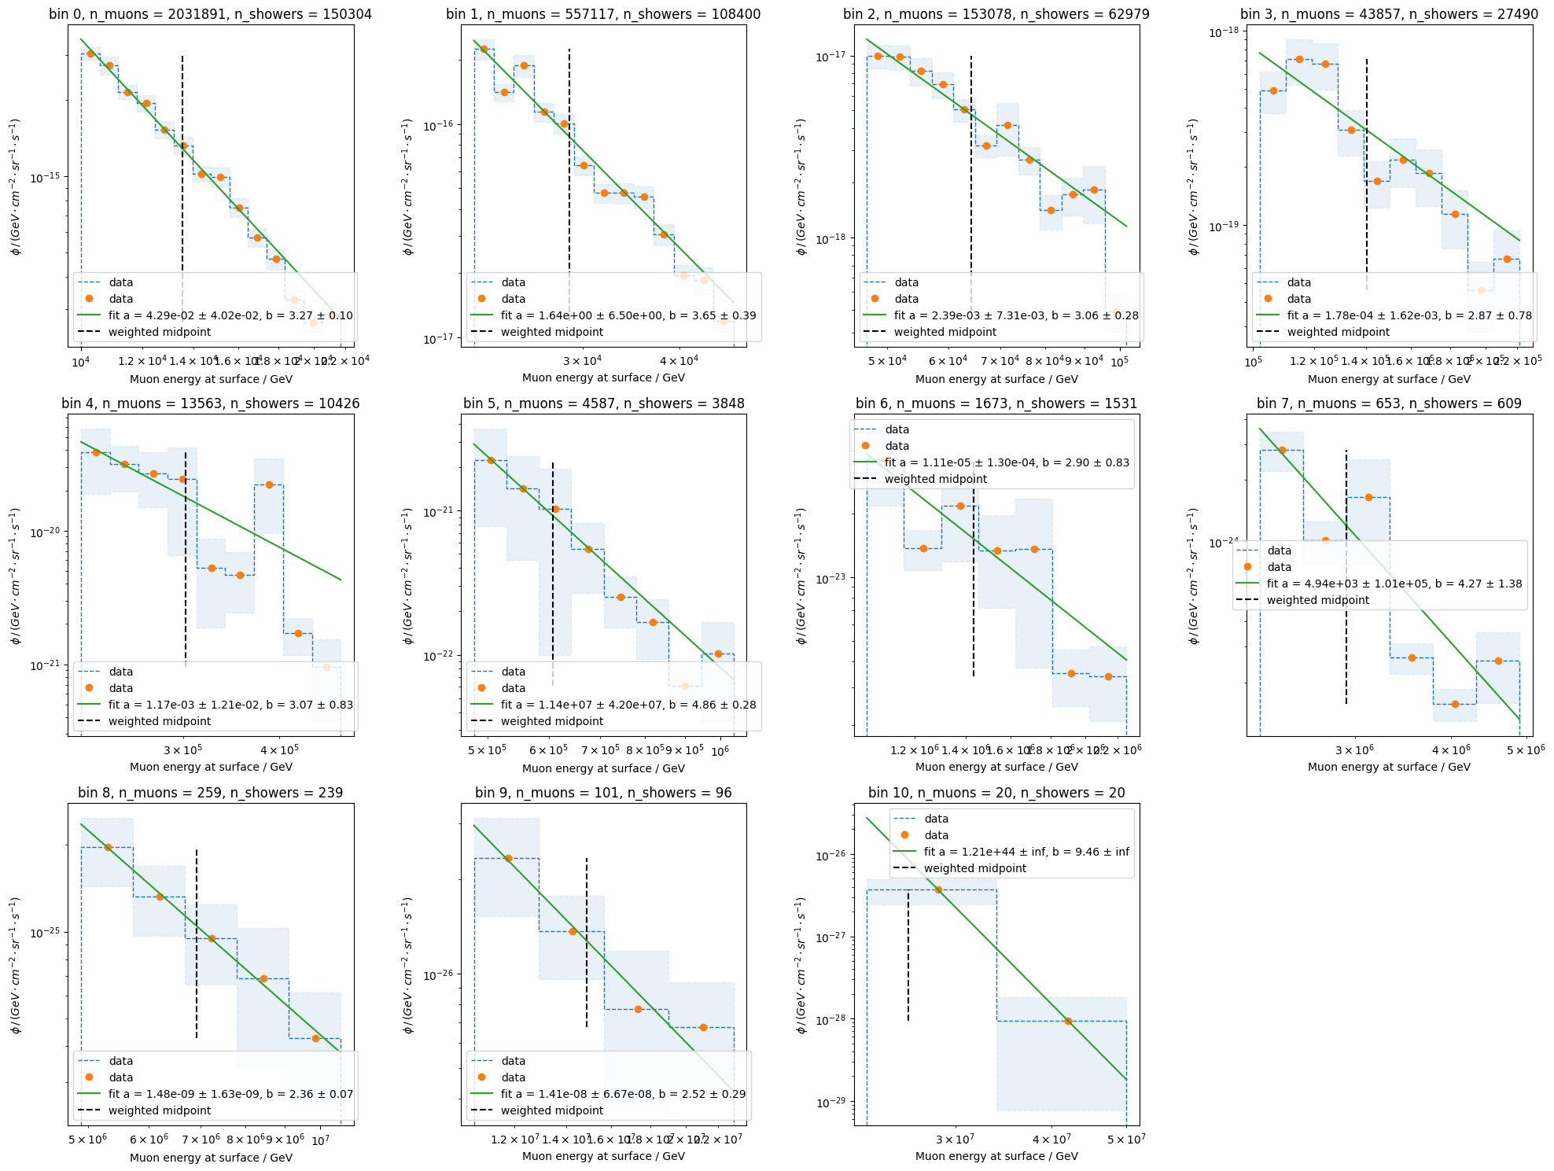
Fit spectral index of each bin – old simulation

Slide 5
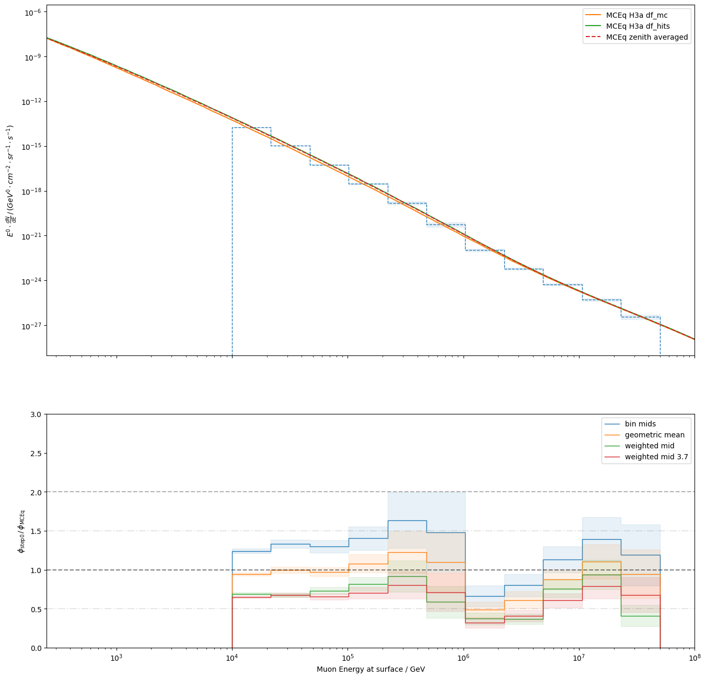
Old simulation
- averaged over all zenith angles

Slide 6
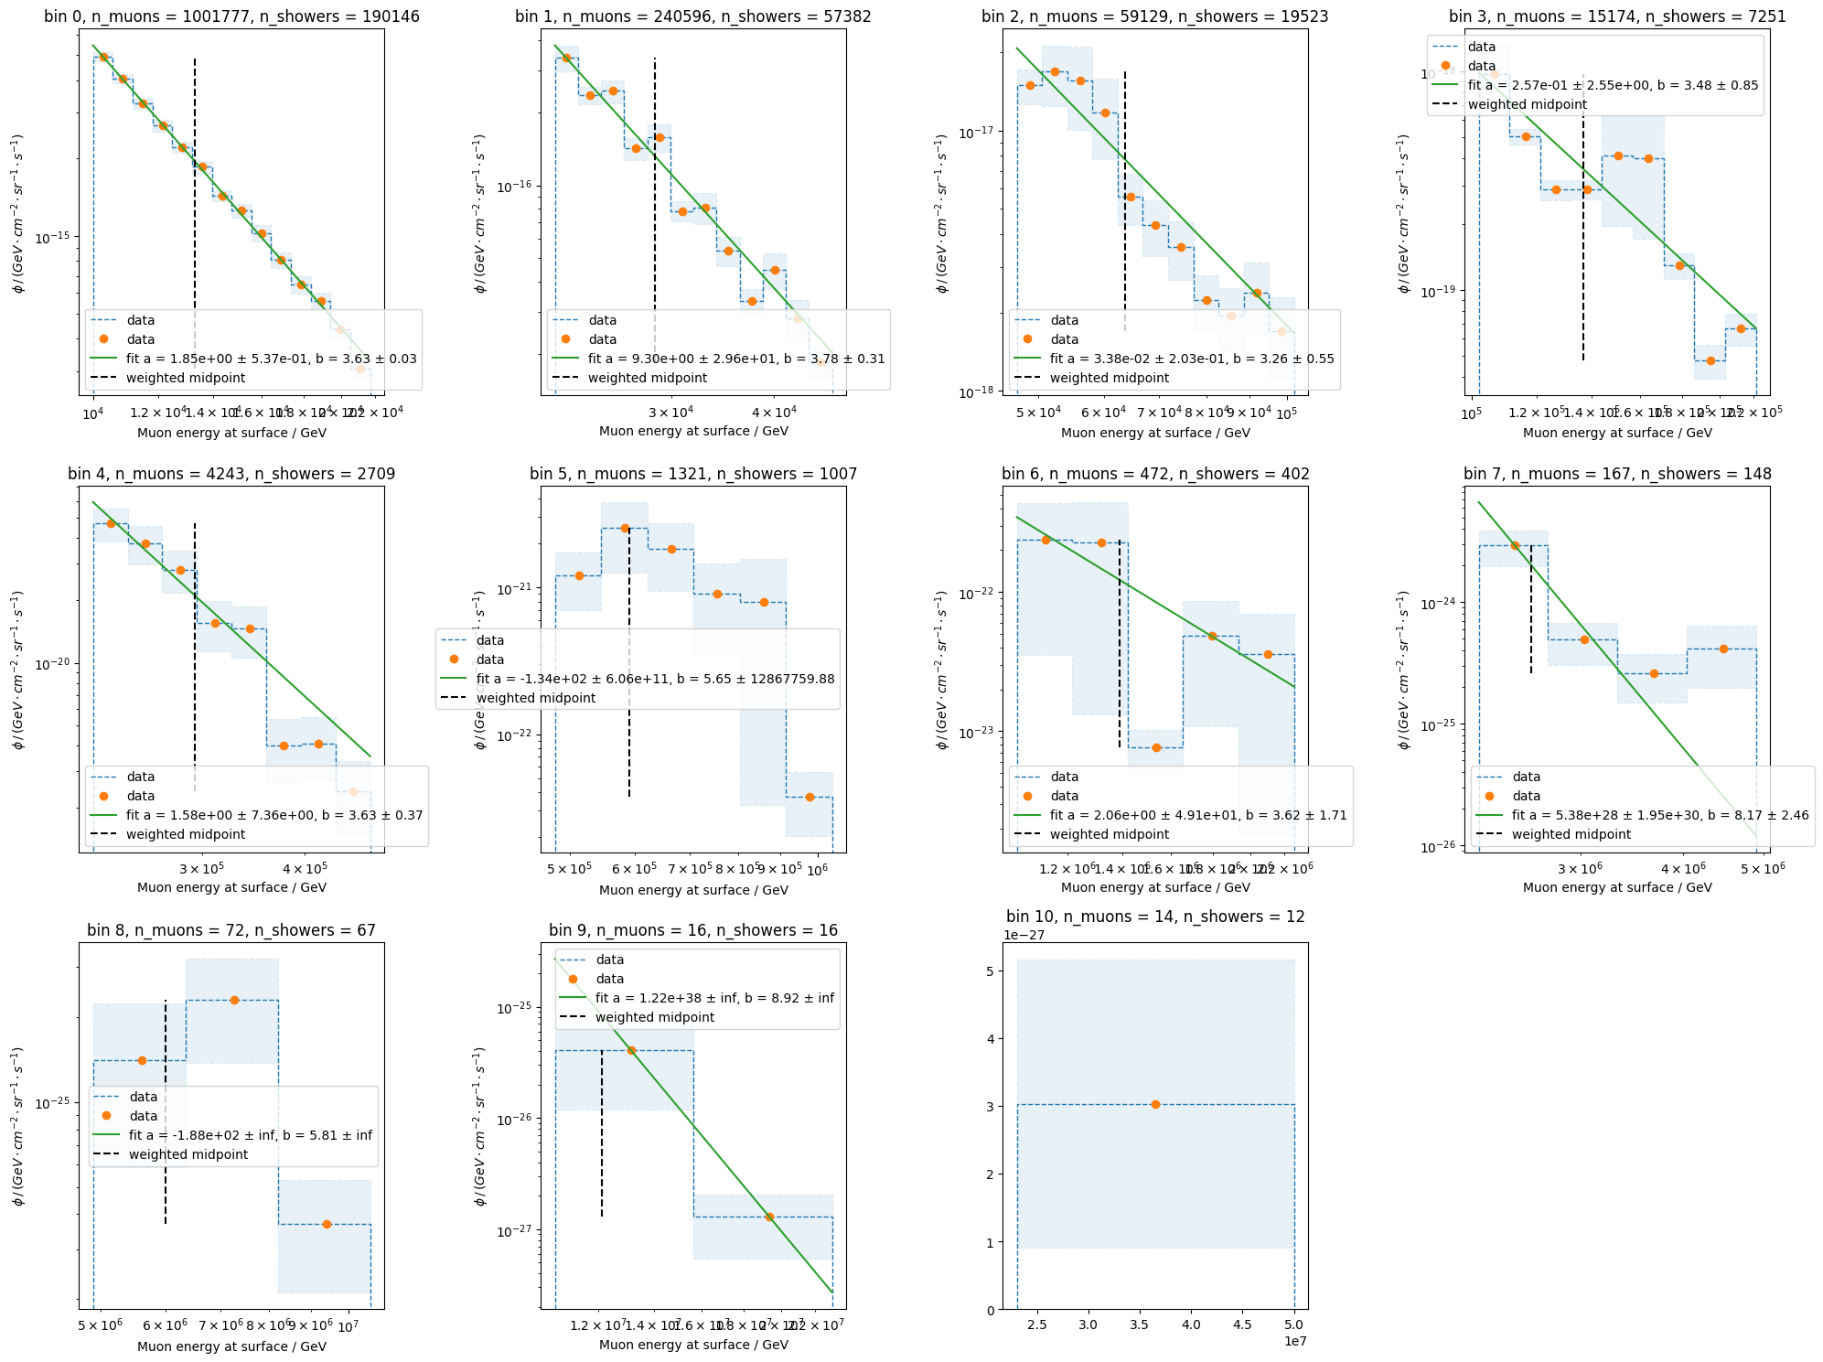
Fit spectral index of each bin – new simulation

Slide 7
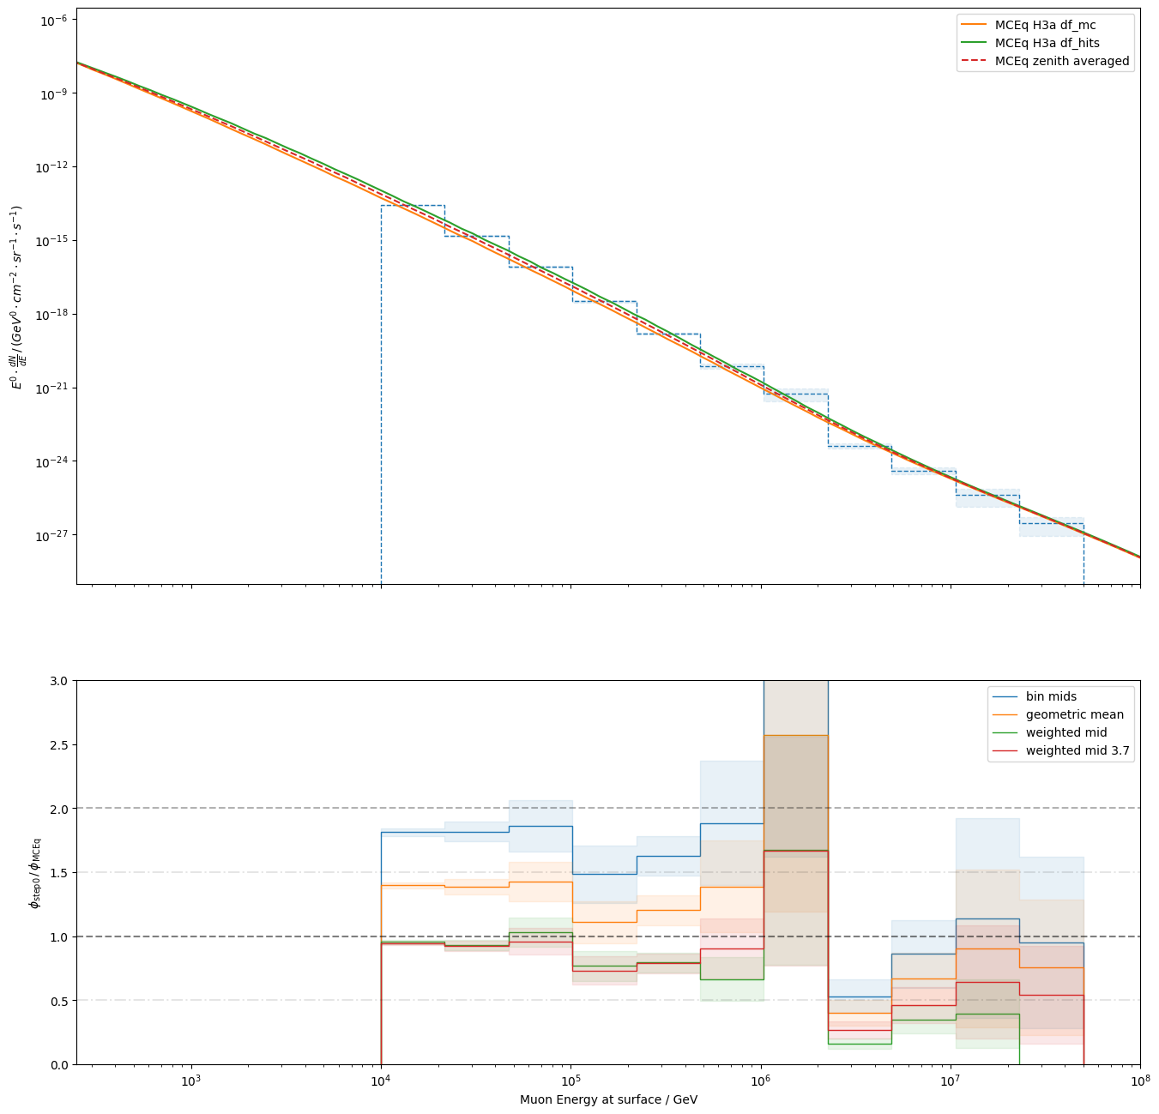
New simulation
- averaged over all zenith angles

Slide 8
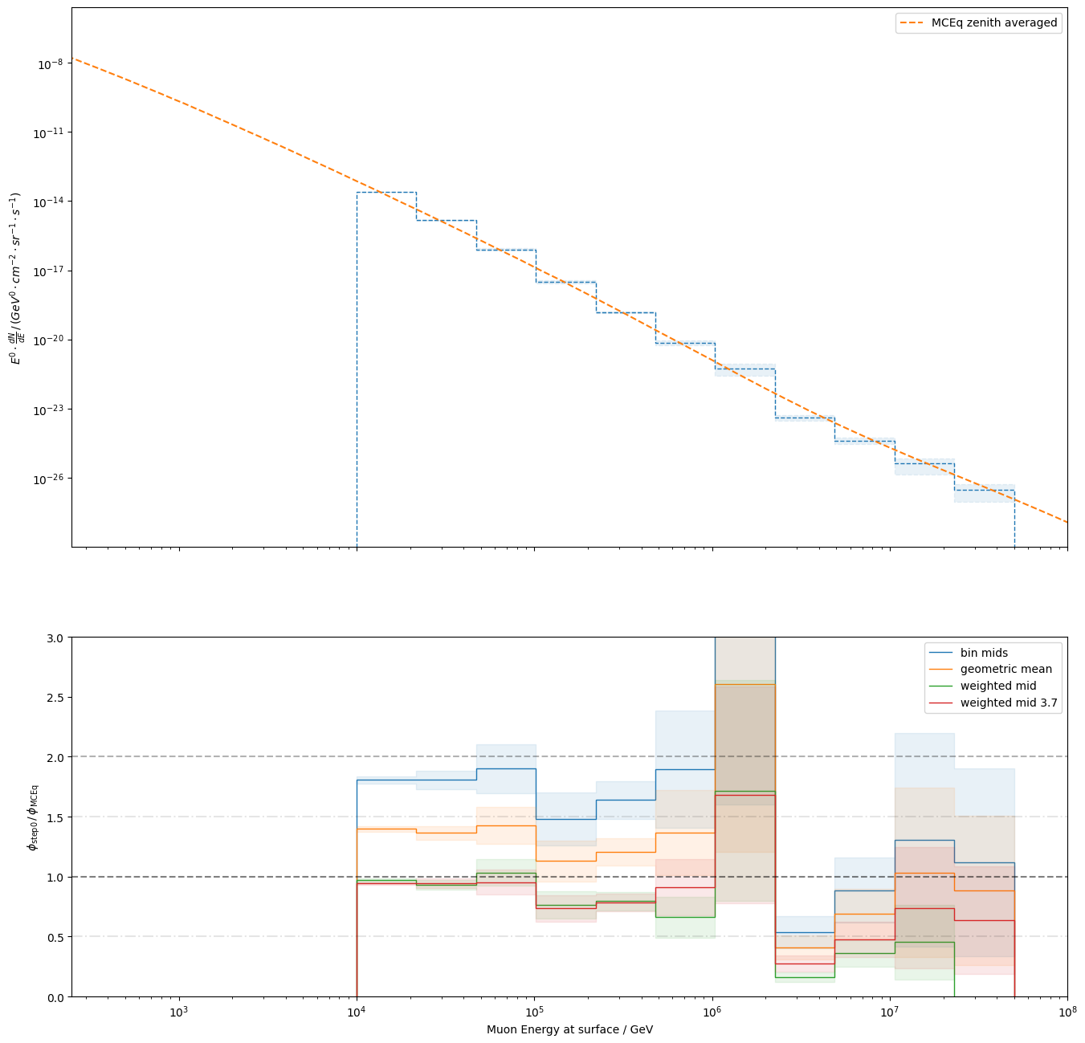
New simulation
using min and max zenith angle per energy bin

Slide 9
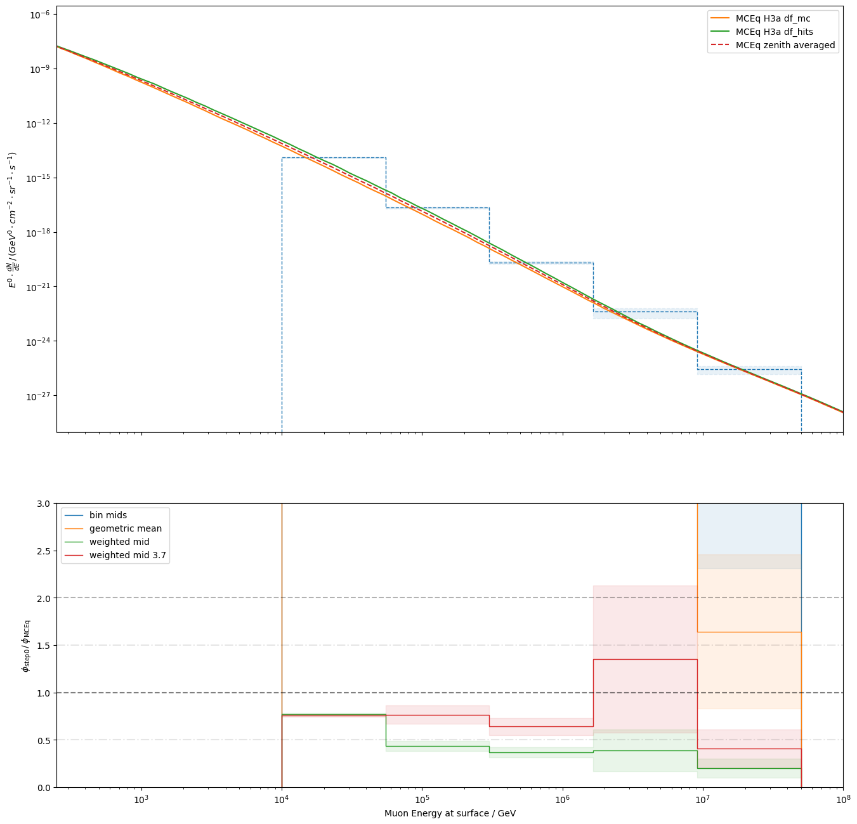
Test methods with very large binning – new simulation
red line: ~25% offset
In Karolin’s analysis there is also an offset of ~25% in her final plots

Slide 10
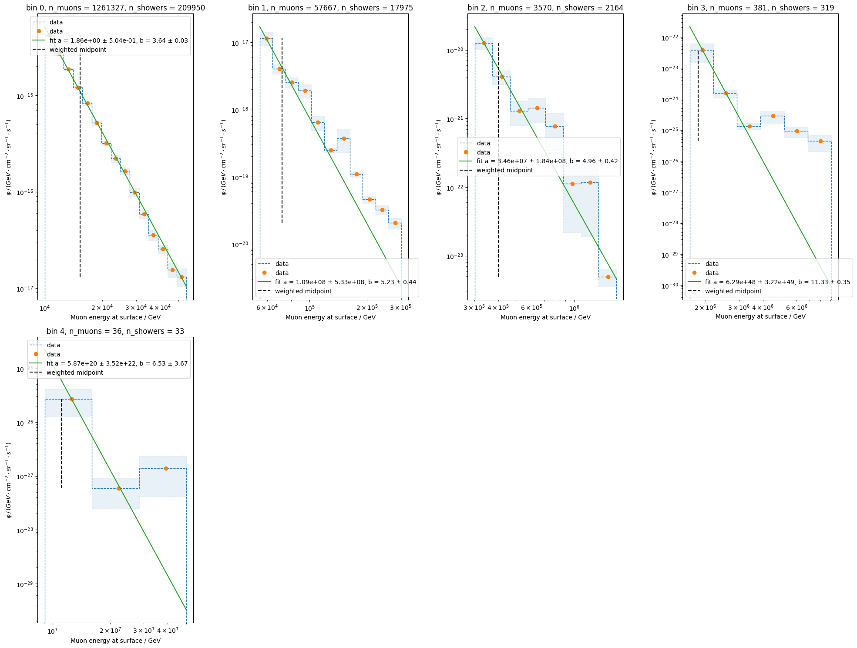
Fits for large binning – new simulation

Slide 11
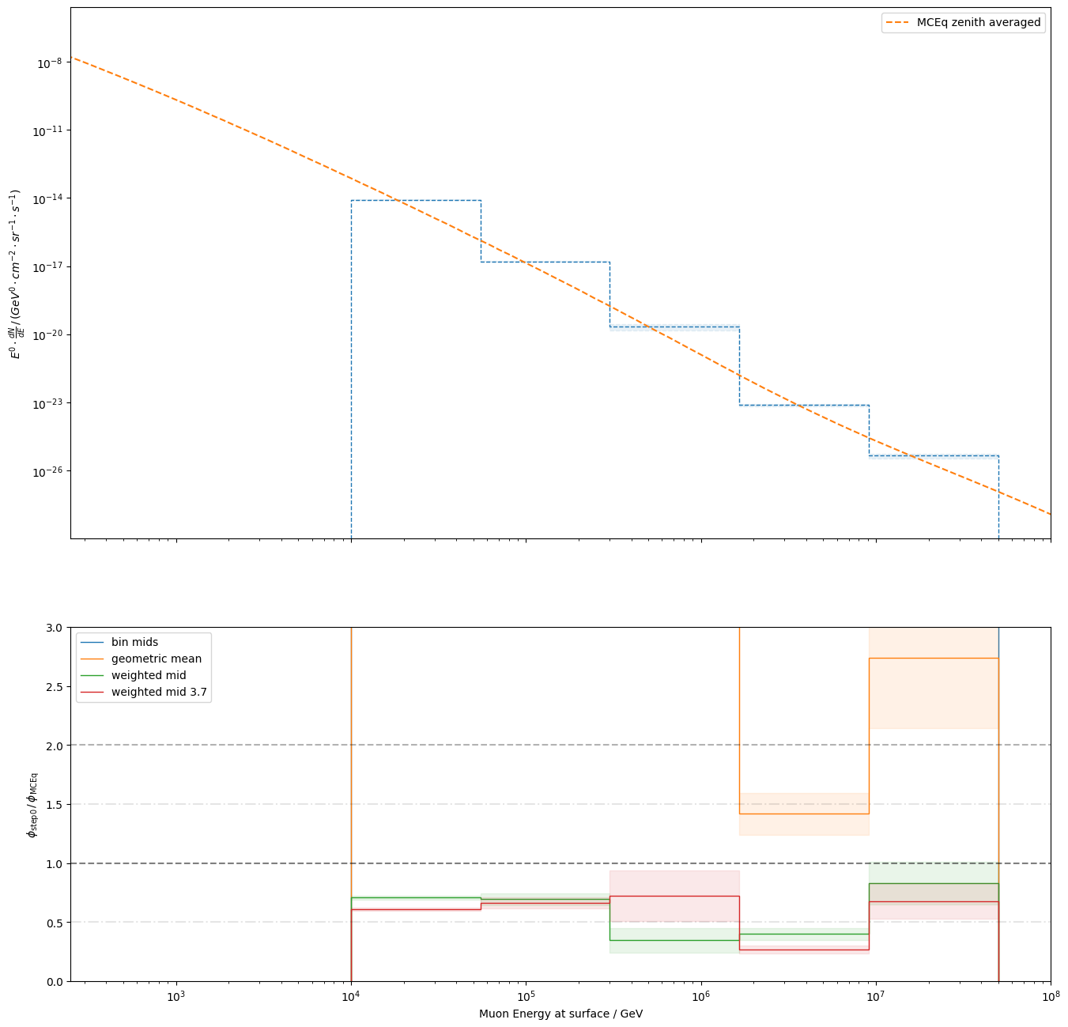
Test methods with very large binning – old simulation
red line: ~25% offset
In Karolin’s analysis there is also an offset of ~25% in her final plots

Slide 12
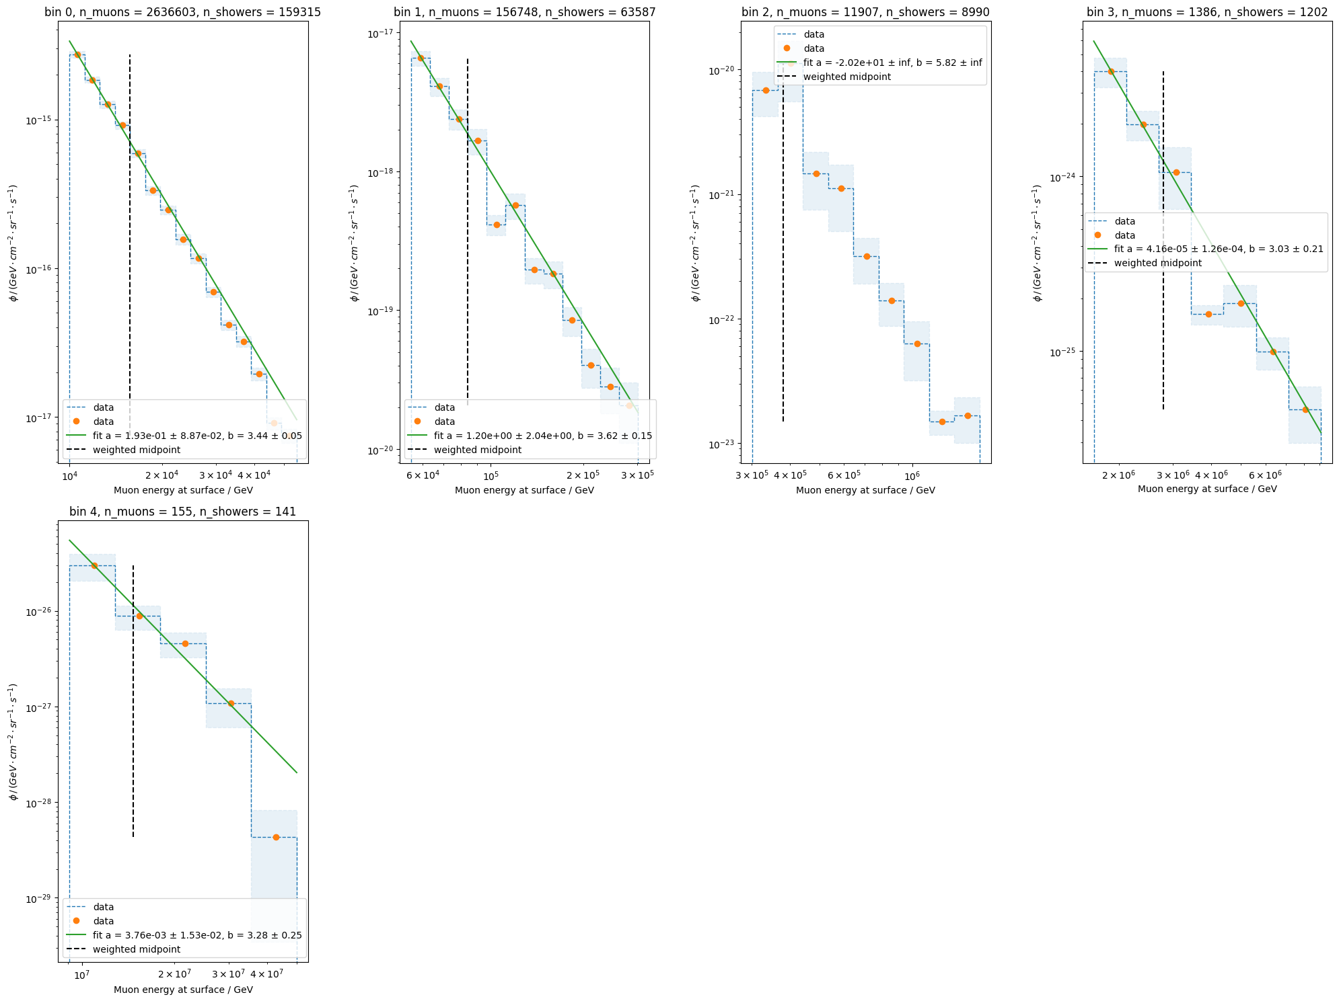
Test methods with very large binning – old simulation
red line: ~25% offset
In Karolin’s analysis there is also an offset of ~25% in her final plots

Slide 13
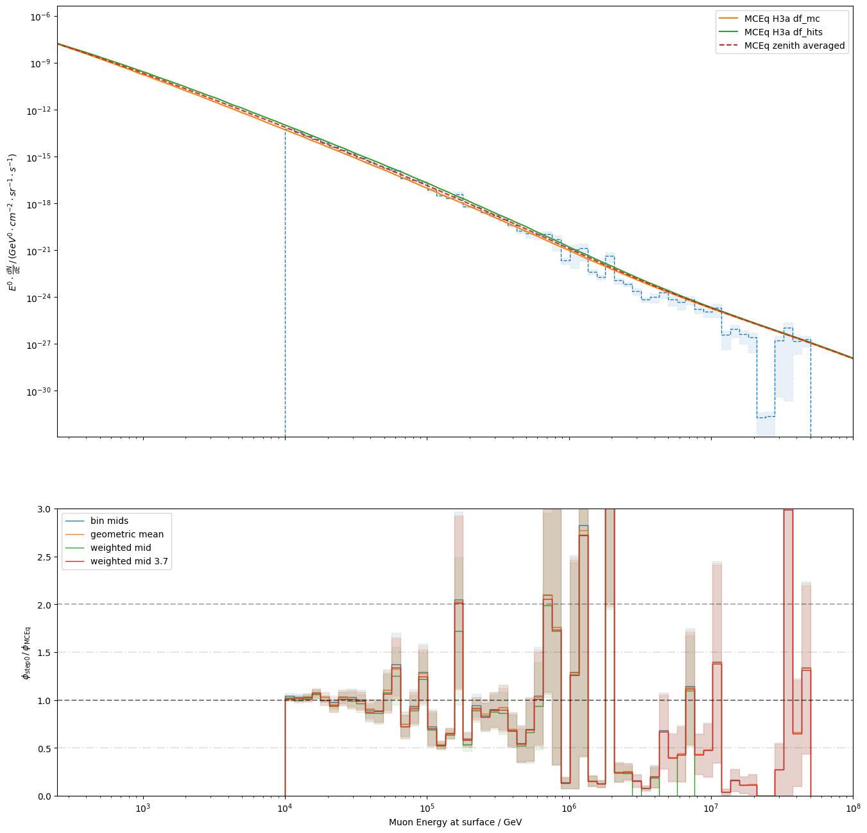
Fine binning – new simulation

Slide 14
Summary
Bin mids seems to be an on-going topic in Dortmund as well
Others sent a script for bin mids today → test their method
Maybe there is an offset of ~20% → talk again with Karo, what exactly did she observe
Use other method: instead of evaluating MCEq at a specific energy (bin mid) → integrate MCEq flux for the specific bin
Calculate an effective area with the current sample and method and test unfolding
Start “final” simulation (again)
Continue with the analysis / systematics
Continue on technical review
Proof-reading of Lars’ master’s thesis → atmospheric neutrinos
No news from Dennis → text working group leads today

