Slide 1
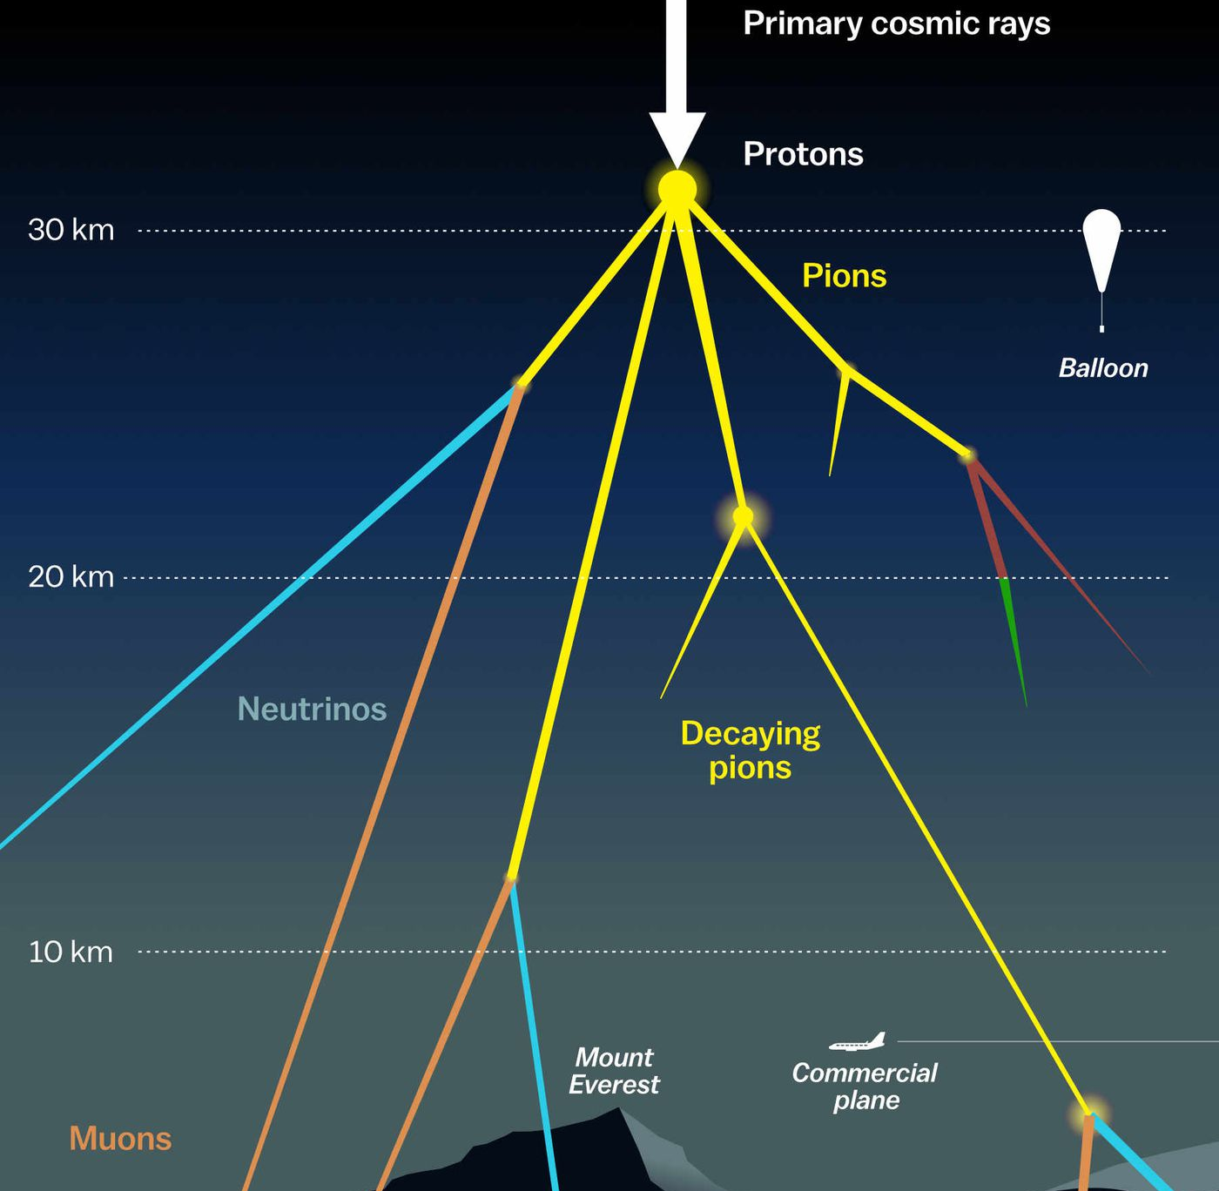

Muon flux at surface – MCEq vs. CORSIKA Pascal Gutjahr
July 18, 2024
Source: NASA

Slide 2
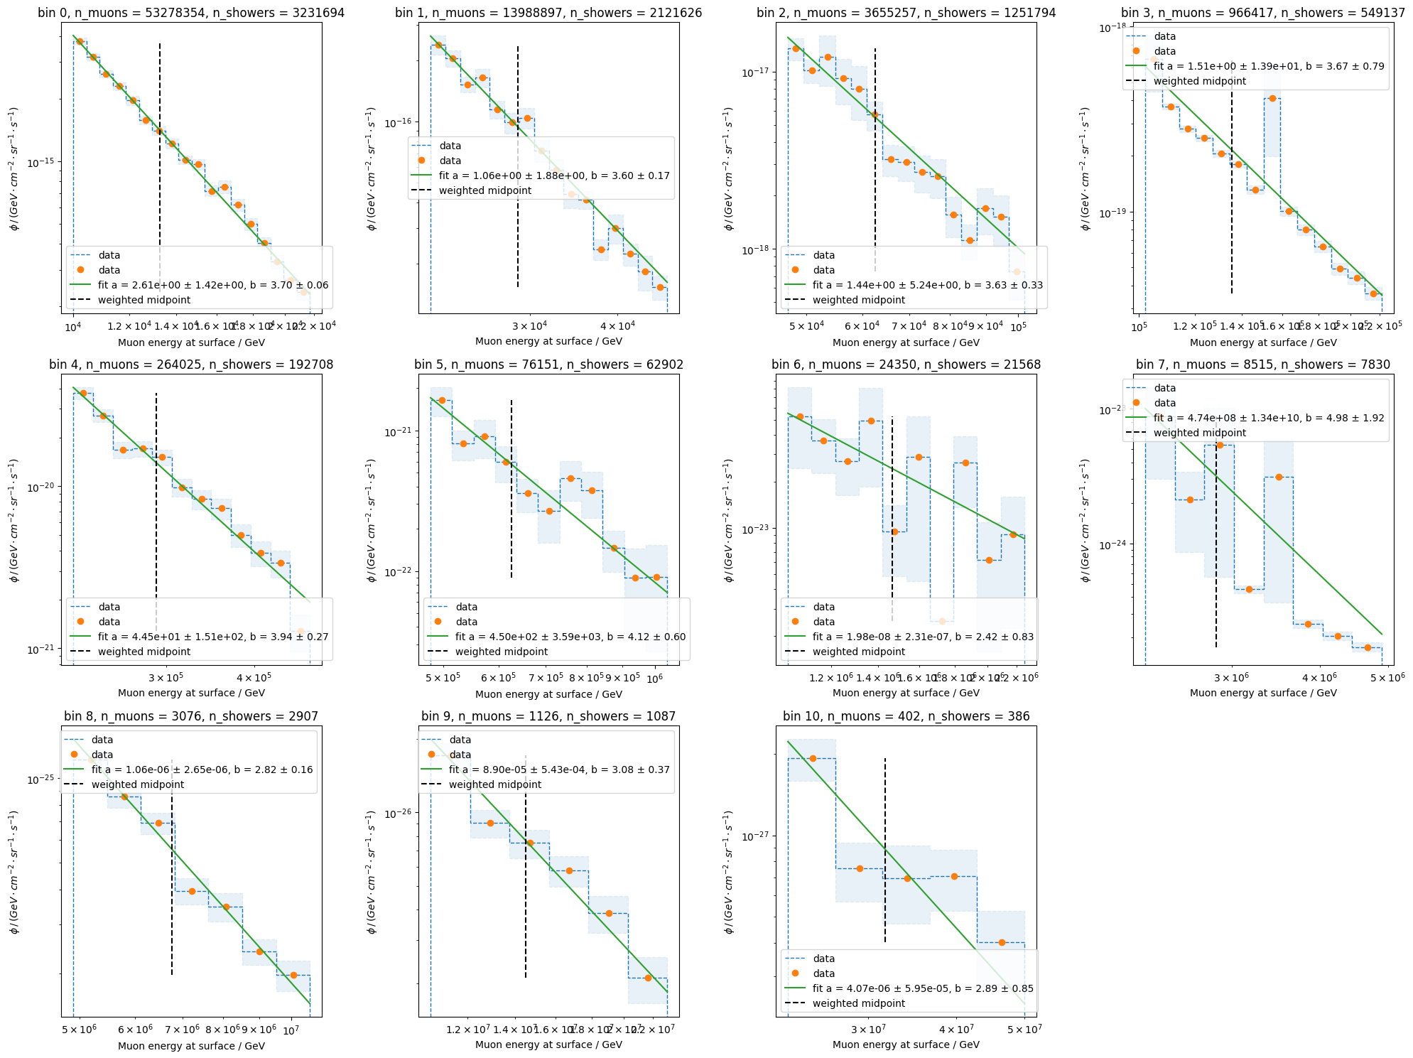
Fit spectral index per bin

Slide 3
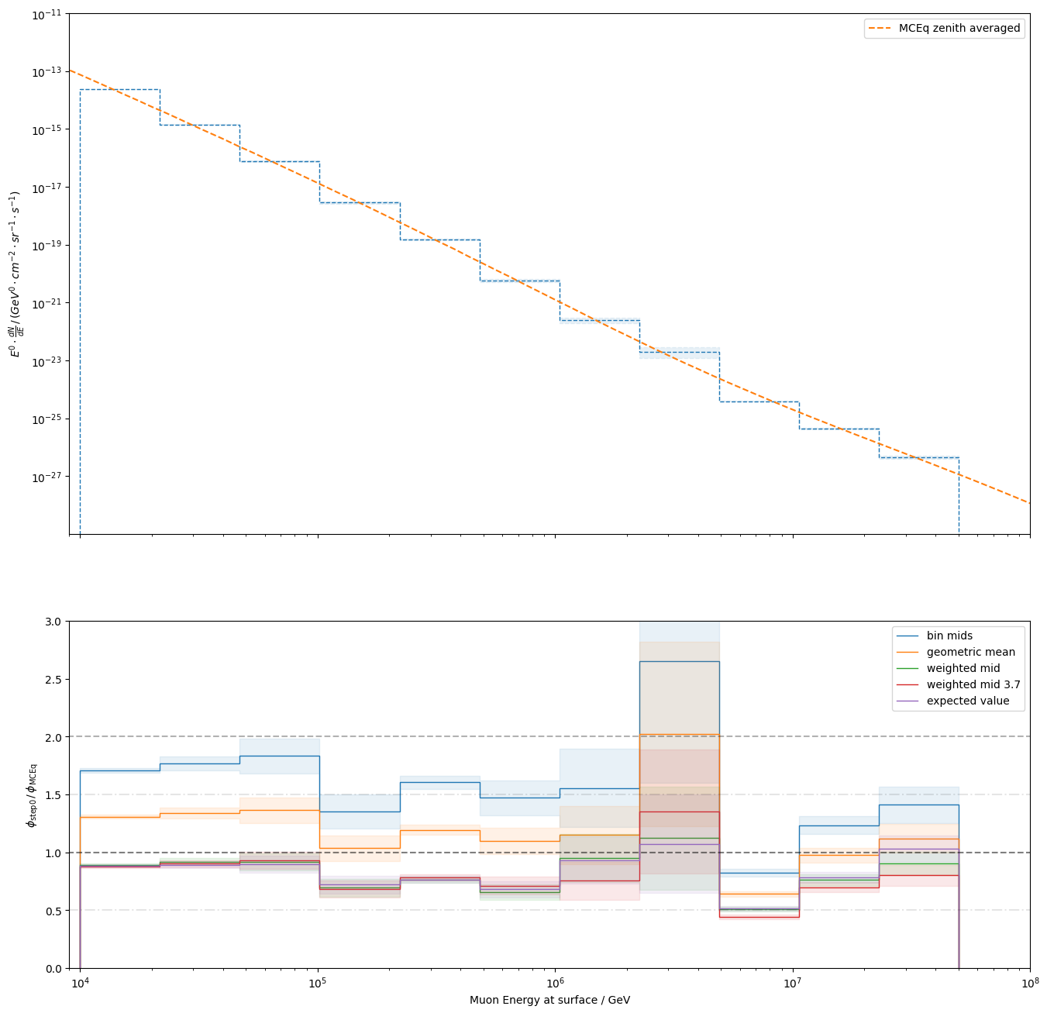
Check different bin ”mids”
fitted spectral index
fixed 3.7
COG (Karolin/Samuel)

Slide 4
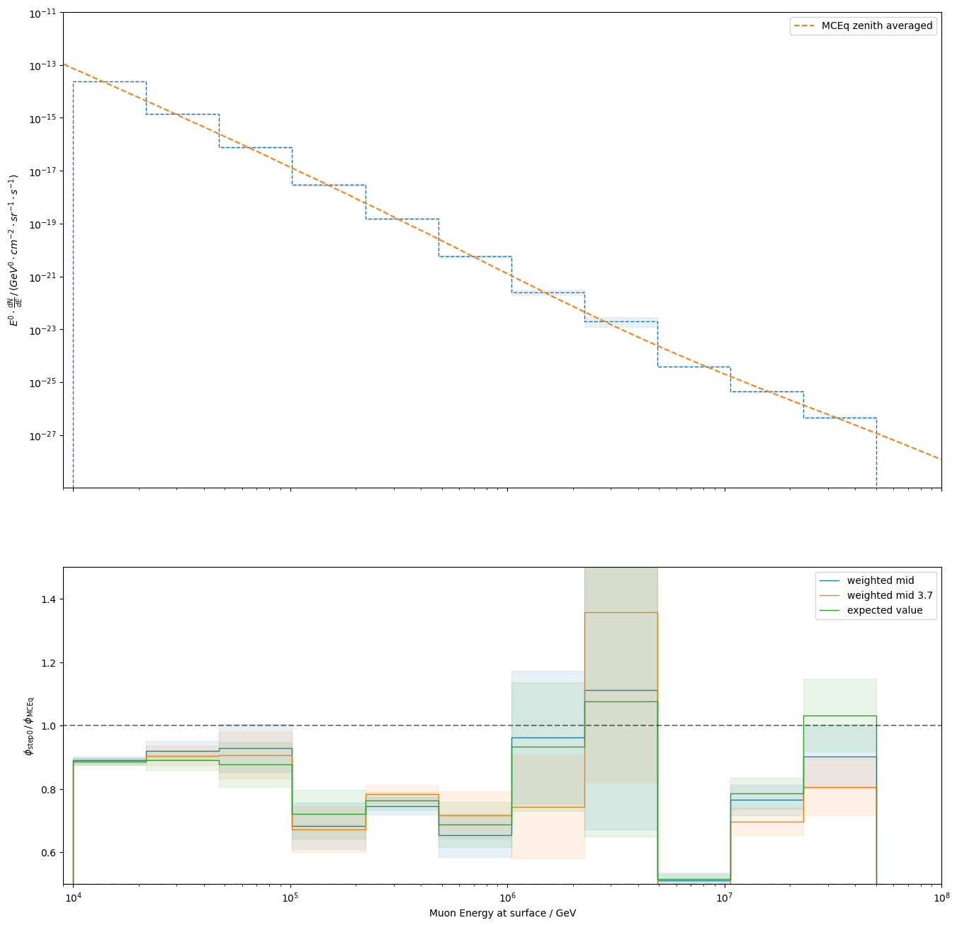
Zoom in
what happens here?

Slide 5
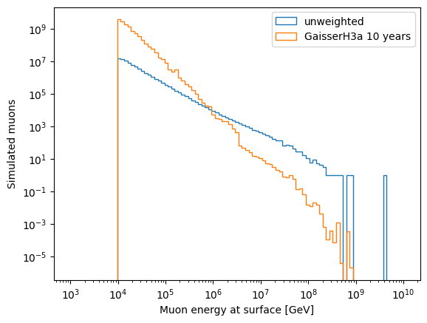
Muons at surface (check statistics)
missing statistics from very high-energetic showers??

Slide 6
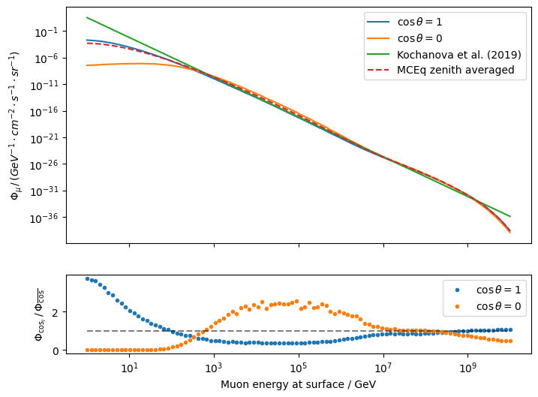
MCEq muon flux – zenith averaged

Slide 7
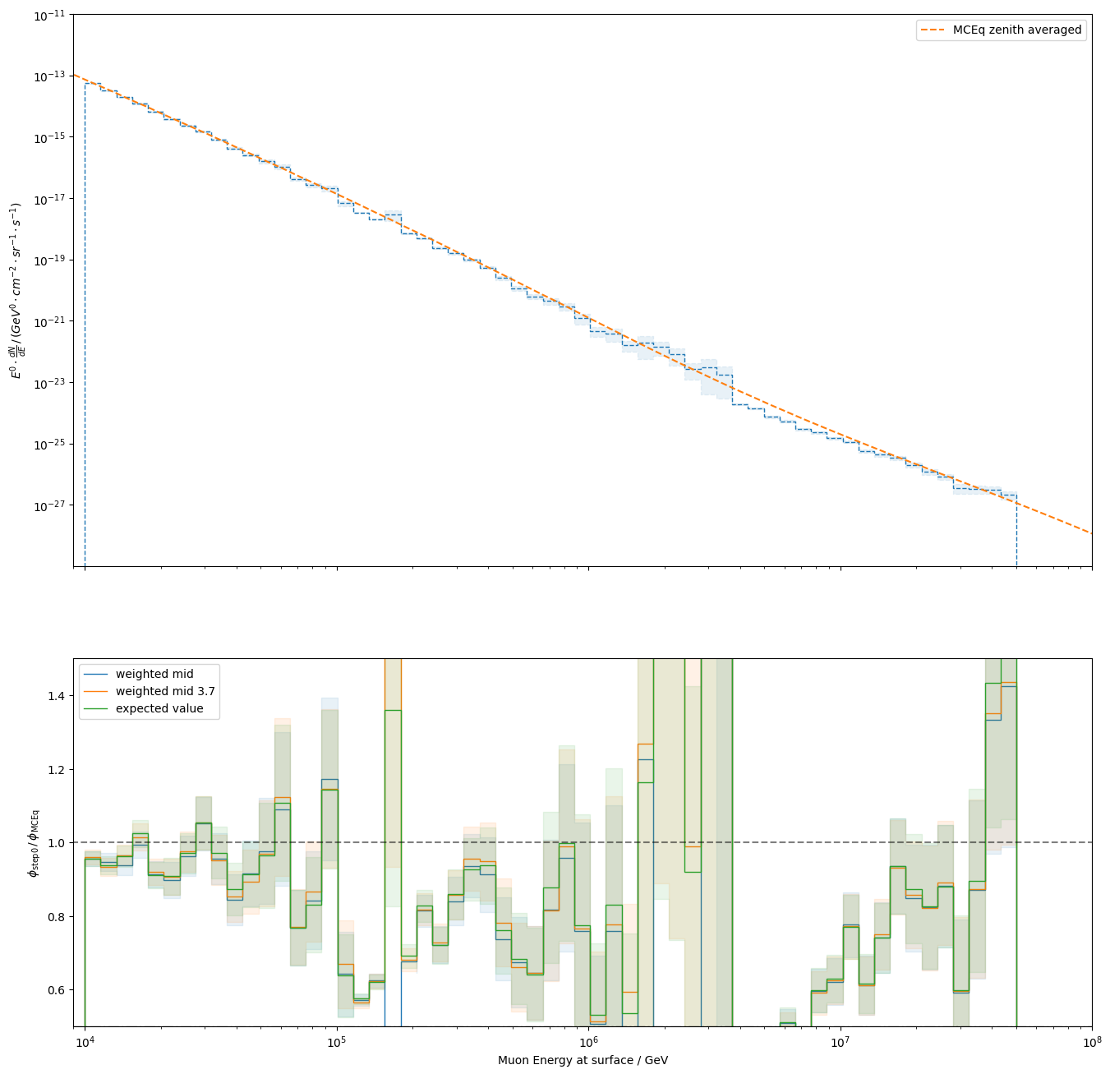
Check very small binning → less impact of bin “mids”

Slide 8
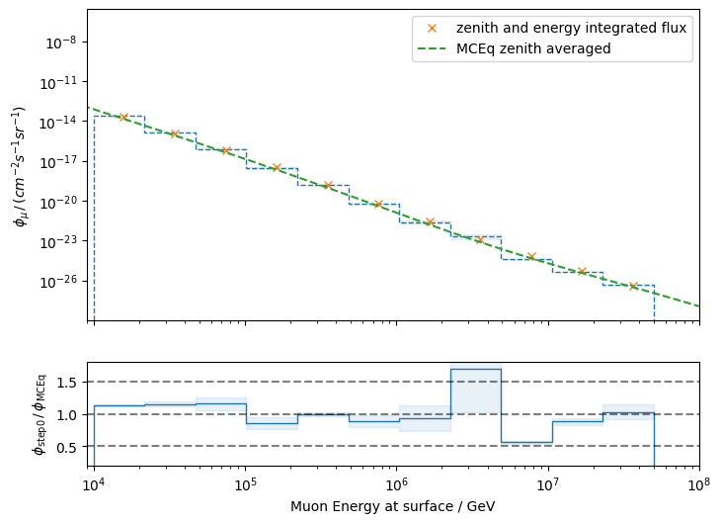
Integrate MCEq flux over energy → bin mids have no impact anymore
- energy integration is preliminary

Slide 9
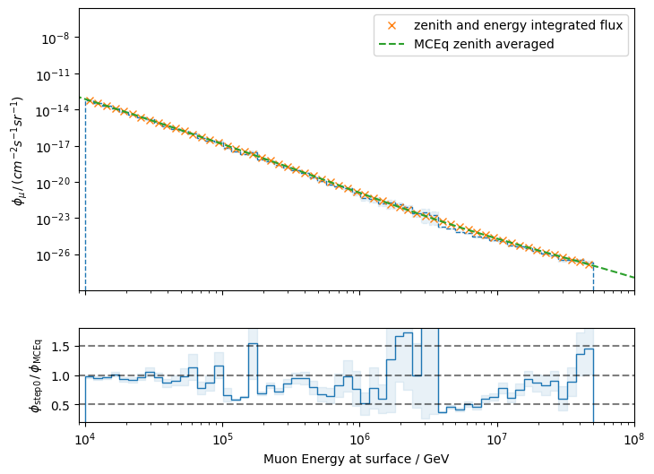
Integrate MCEq flux over energy → smaller bins
this dip is also visible on slide 5
→ missing phase space / events?
?
- energy integration is preliminary

