Slide 1
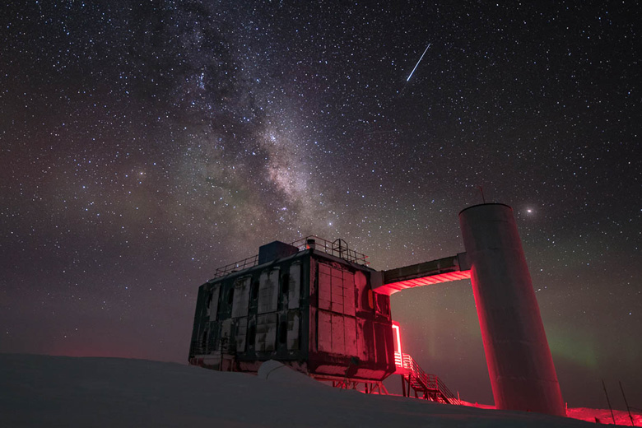
The IceCube Neutrino Observatory: The Perfect Muon Detector Unraveling Cosmic Secrets
Pascal Gutjahr
TU Dortmund University
pascal.gutjahr@tu-dortmund.de
LPC – Clermont-Ferrand
06.10.2023

Slide 2
IceCube Collaboration

Slide 3
Folie 5

Slide 4
Detector layout

Slide 5
Detection principle – cherenkov light

Slide 6
DOM

Slide 7
Detection medium - ice

Slide 8
Event types – mu, e, tau

Slide 9
Air shower - principle

Slide 10
More background

Slide 11
Seasonal variations

Slide 12
Earth as shield

Slide 13
muon deflections

Slide 14
NGC 1068

Slide 15
TXS

Slide 16
Galactic plane

Slide 17
muon puzzle - observation

Slide 18
Connection to LHC

Slide 19
possible solutions

Slide 20
prompt muons

