Slide 1
Prompt Muons
Goal: maximum likelihood fit using a poisson distribution in
energy and zenith

Slide 2
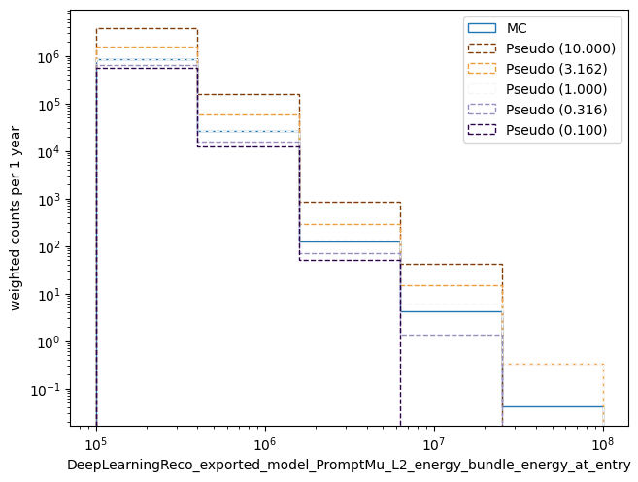
Create pseudo data
Sample events from MC as pseudo data
Use reconstructed bundle energy at entry point
Apply several prompt scalings

Slide 3
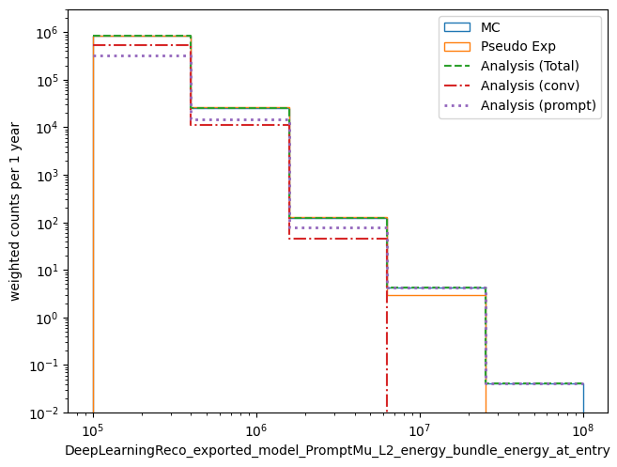
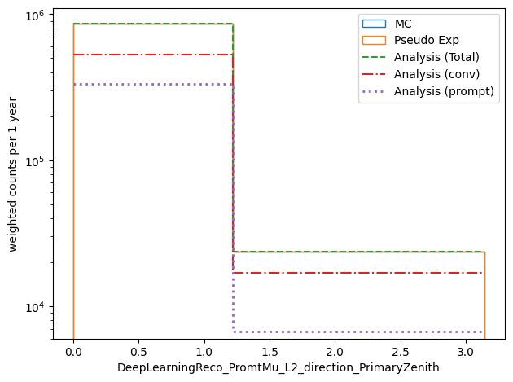
Check energy and zenith dsitribution

Slide 4
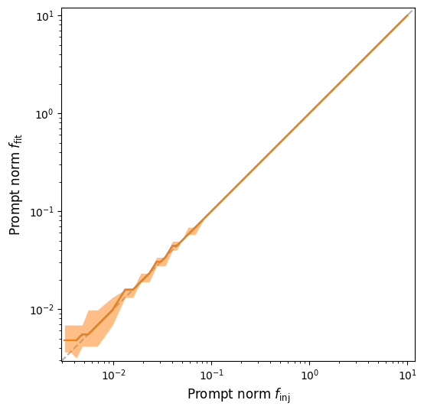
Check bias
Bias below f = 0.1 prompt
Looks promising

Slide 5
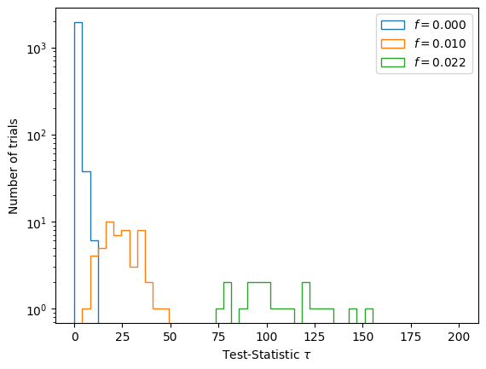
Test statistics
Seems like even f = 0.01 prompt can be measured
Only 20 trails per scaling

Slide 6
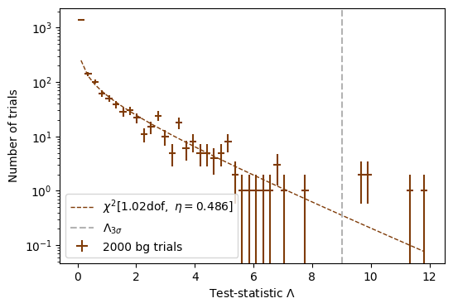
Check if test statistics follow Chi^2
Good agreement
At high test statistics: too less simulation data
More MC is needed
Discovery potential: f = 0.01

Slide 7
Next steps
Give an update in the cosmic ray call
Analyze different primary weighting
Check data-MC agreements
Analyze zenith-dependent data-MC (“zenith problem”)
Test different energy and zenith estimators (with Ben and Leander)
Test, how many years of data we need for this analysis –> estimate processing time
Check, in which phase space more MC data are needed
But, first of all:
Hand in PROPOSAL paper
Write ICRC muon deflection proceedings

