Slide 1
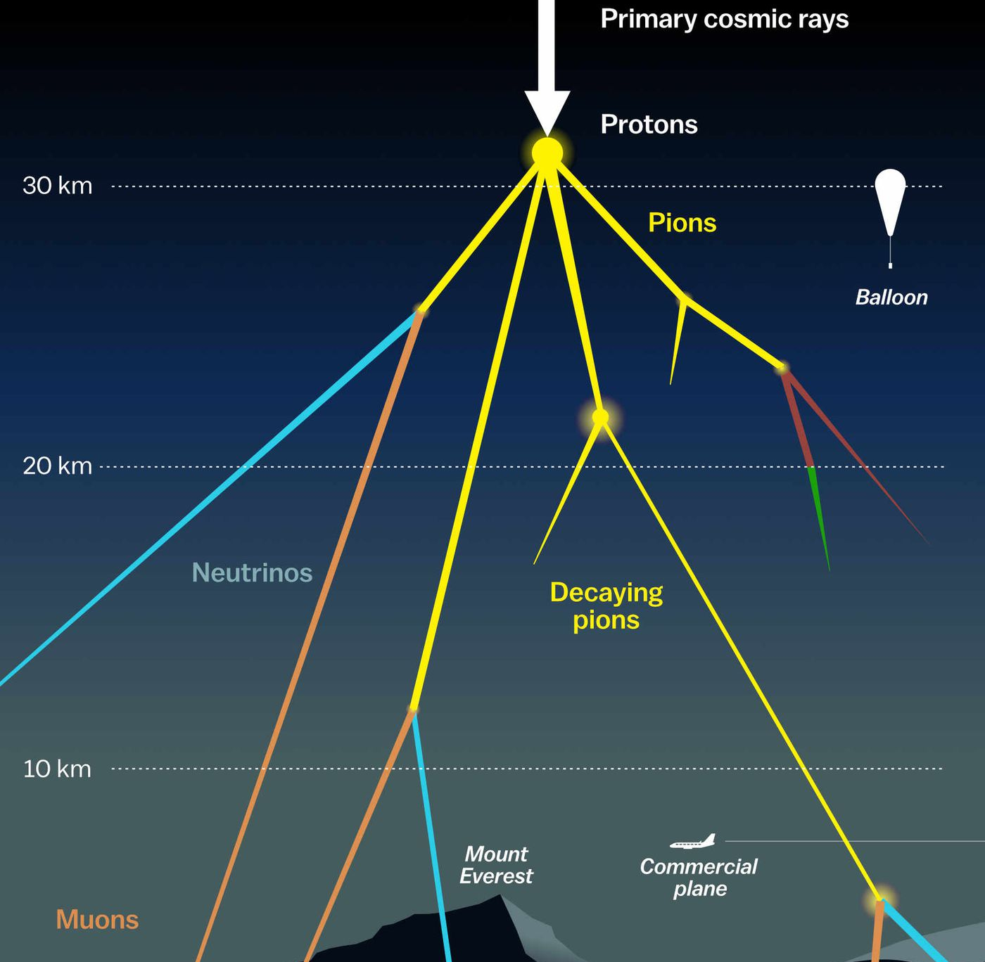

Prompt muons: unfolding Pascal Gutjahr
May 23, 2024
Source: NASA

Slide 2
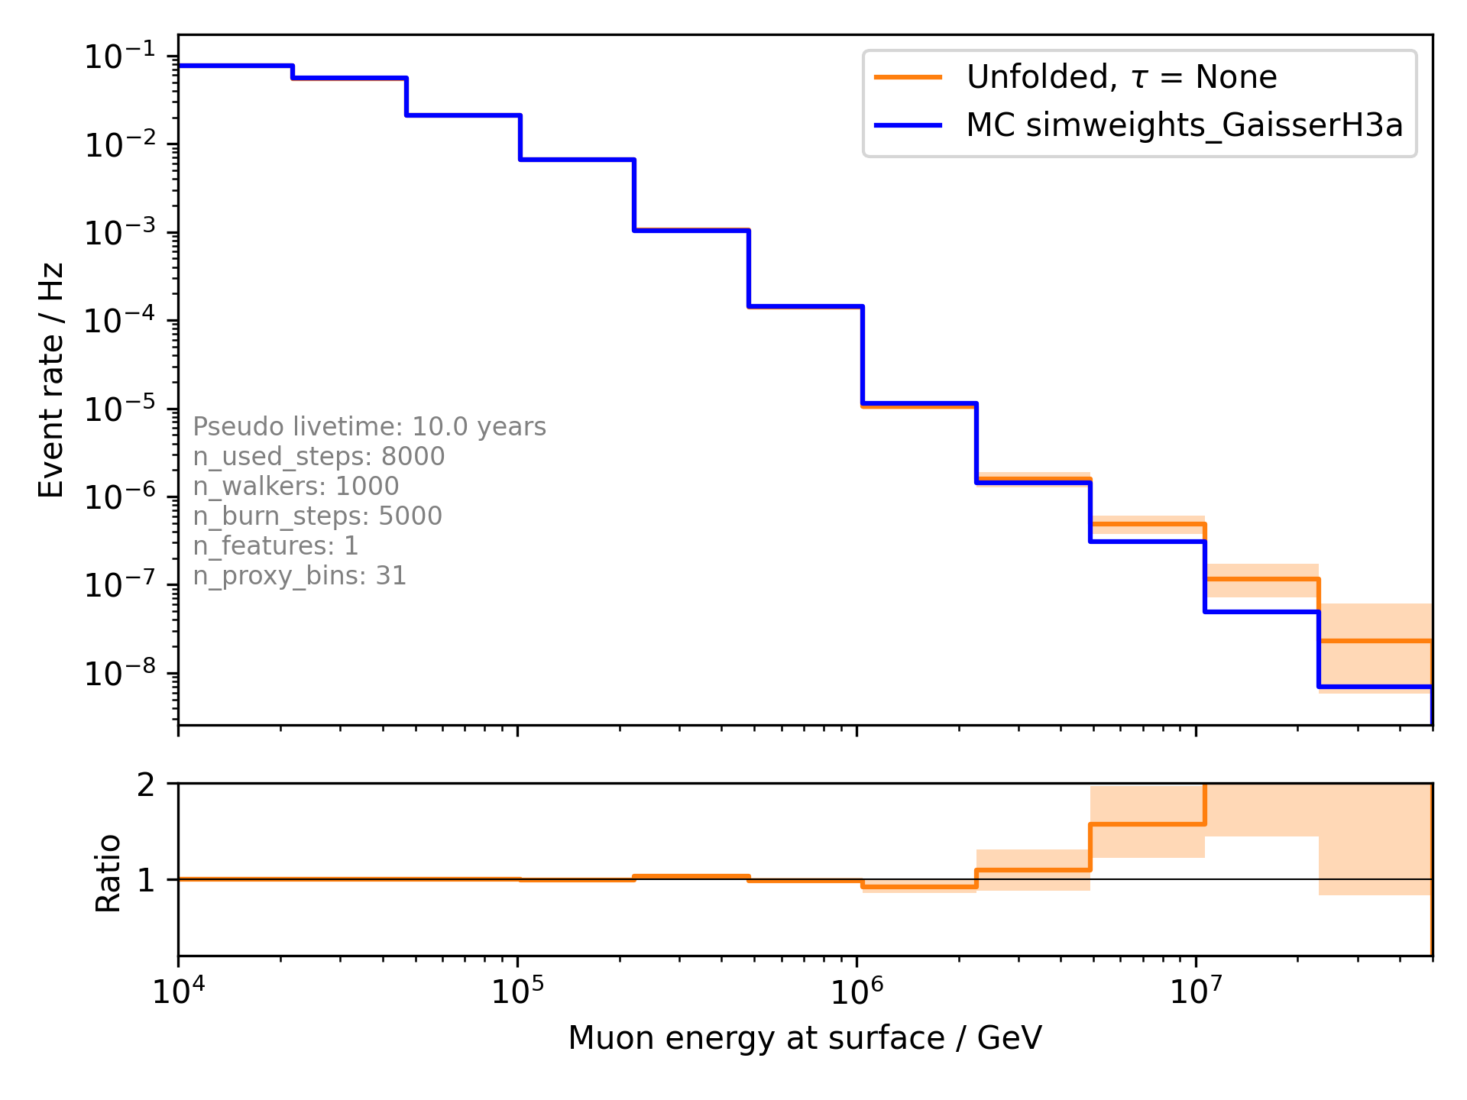
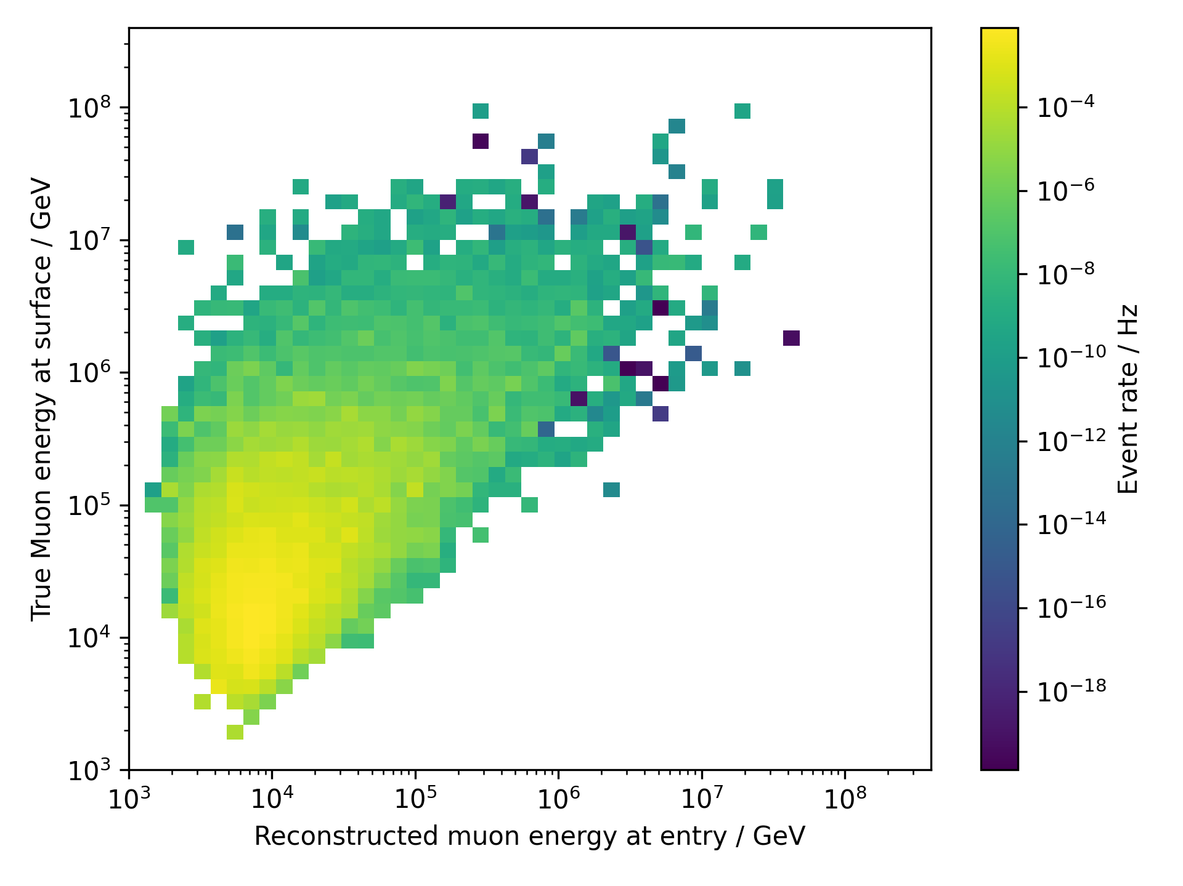
Unfold event rate
Proxy

Slide 3
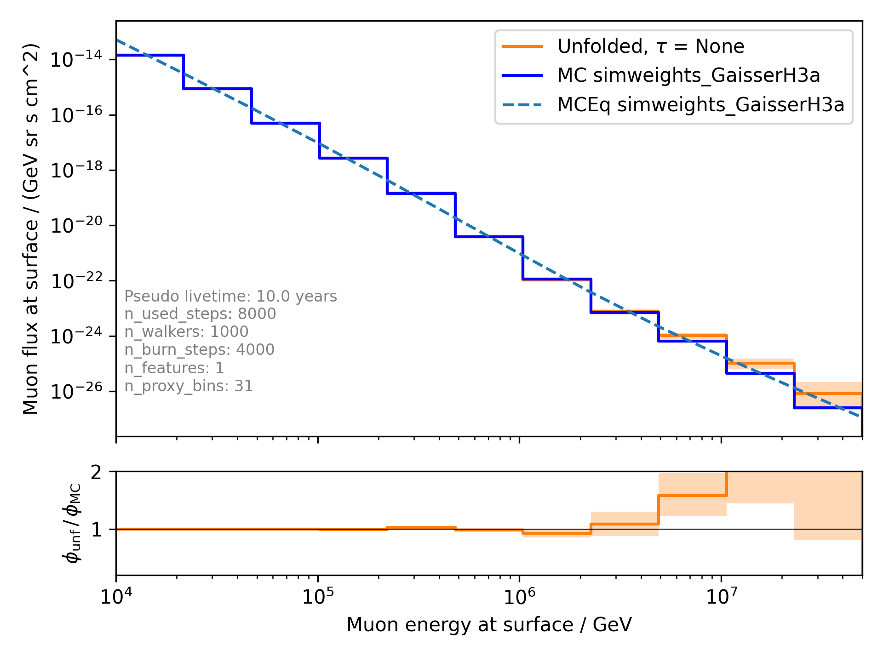
Unfold muon flux

Slide 4
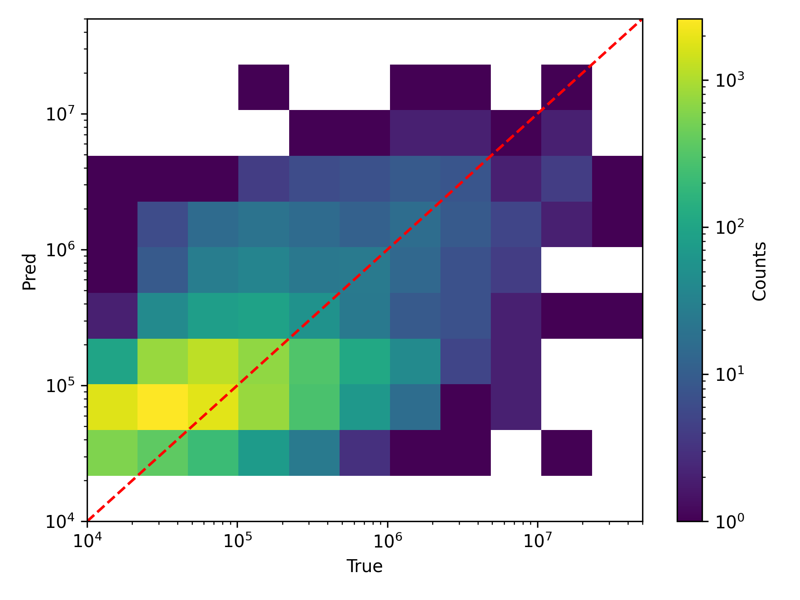
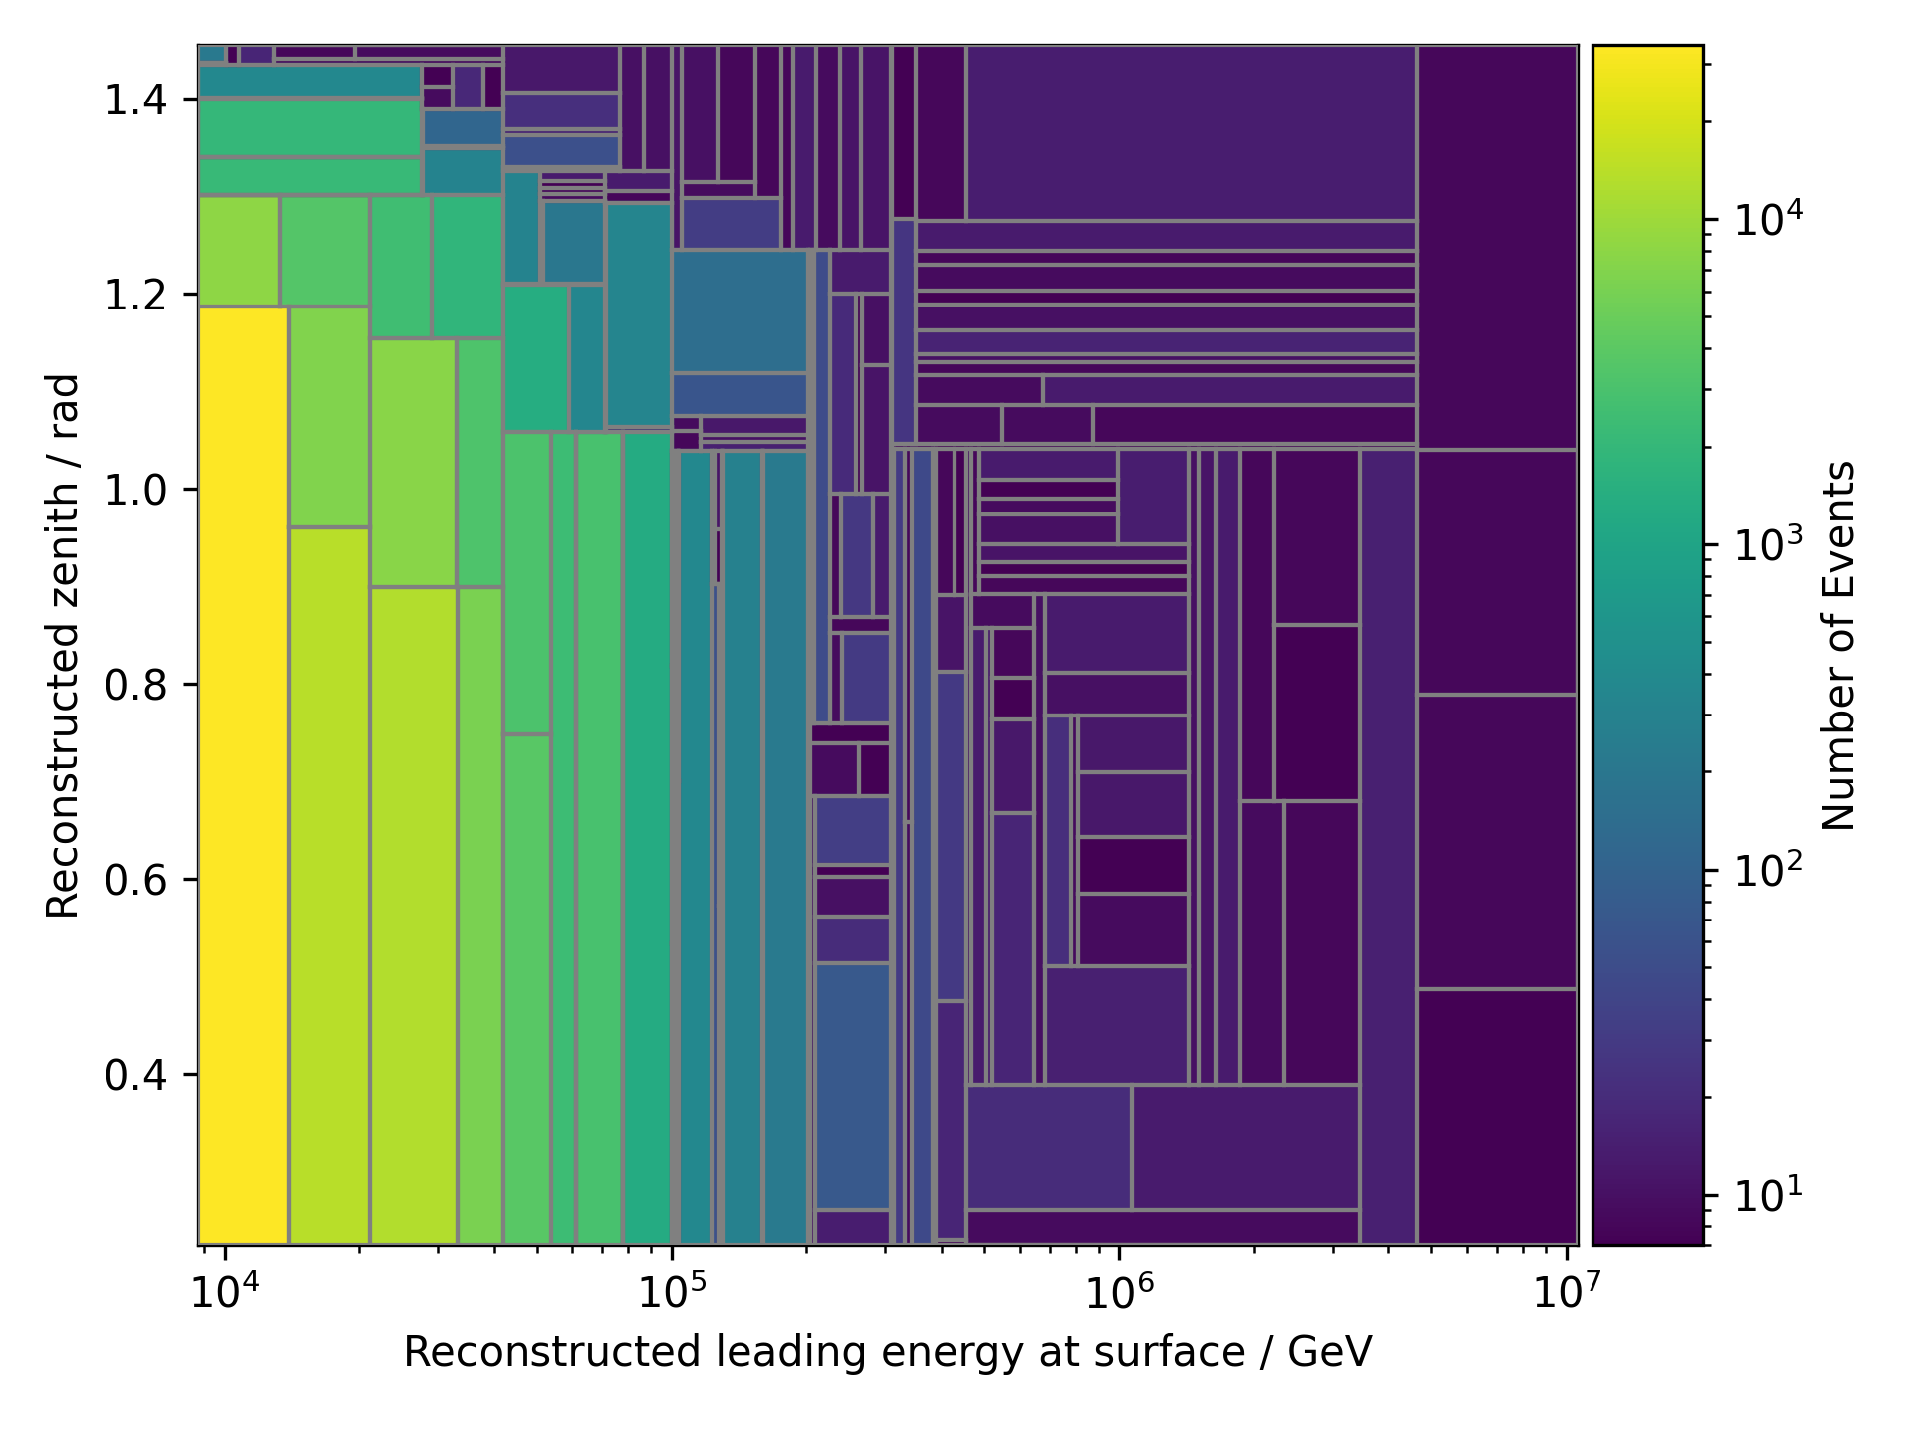
Tree binning – energy and zenith

Slide 5
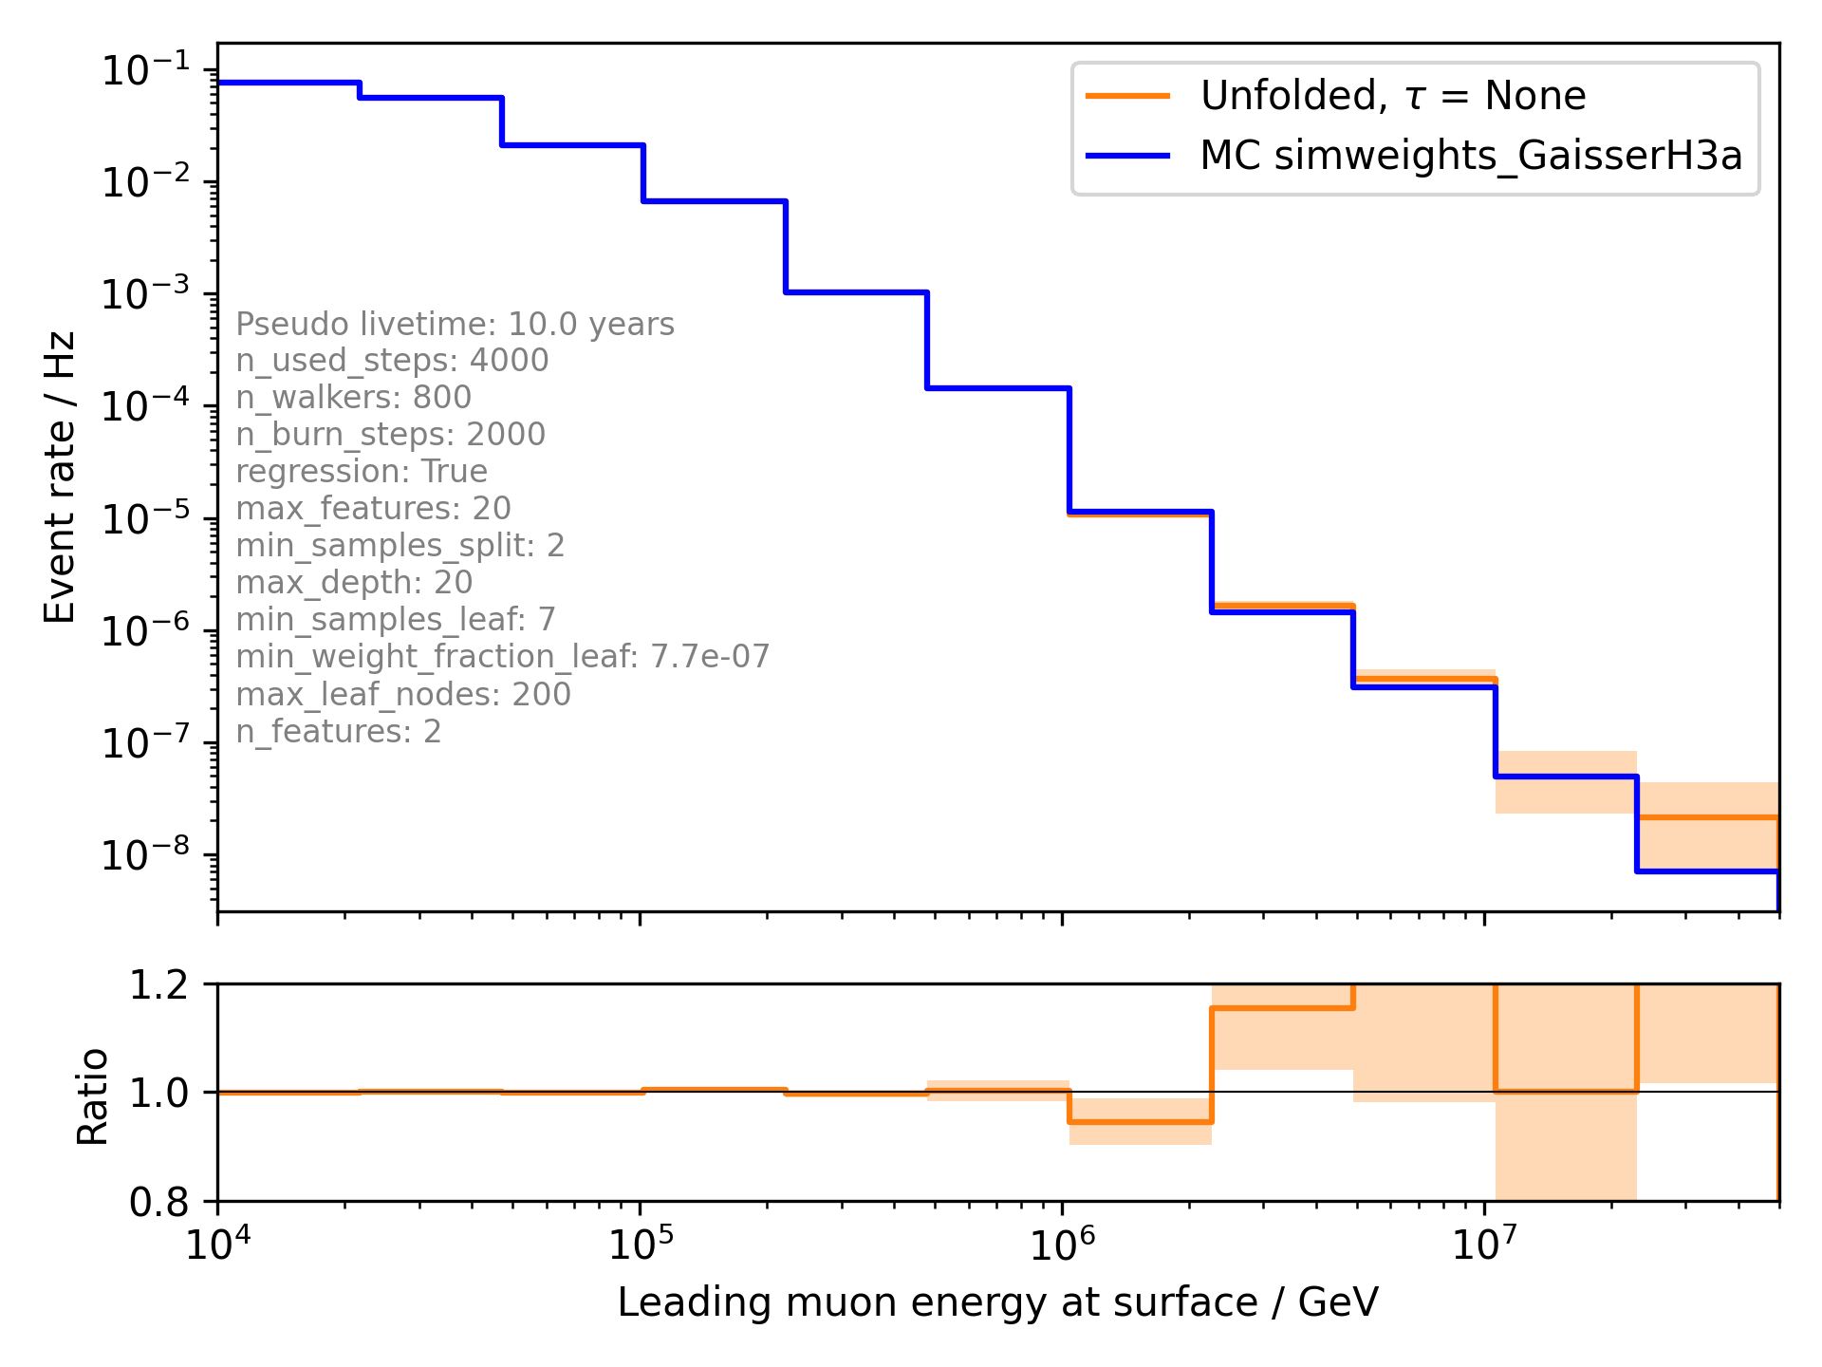
Unfold event rate with tree binning

Slide 6
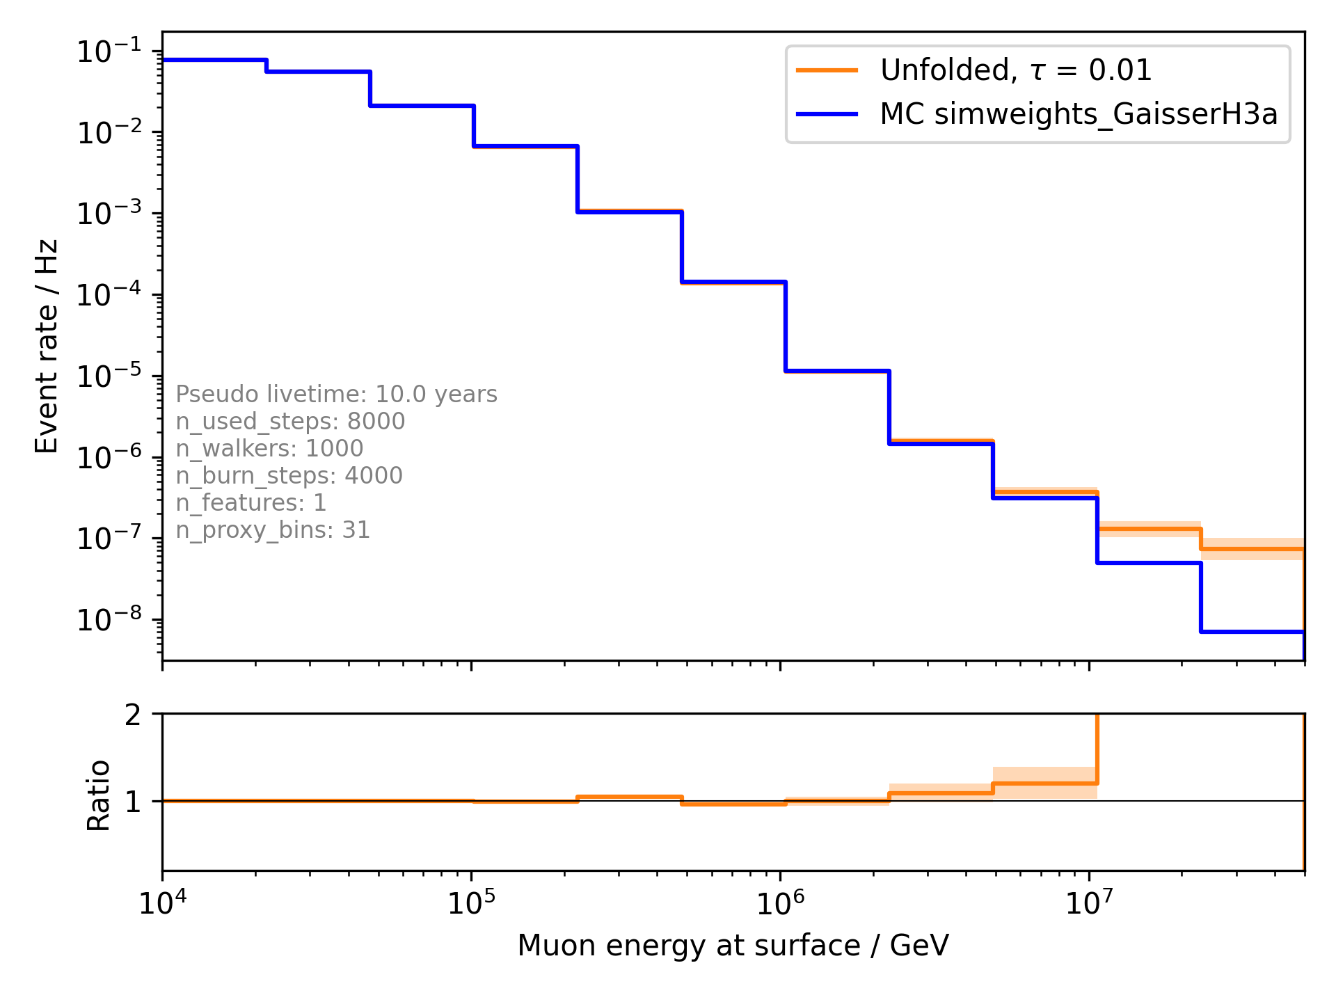
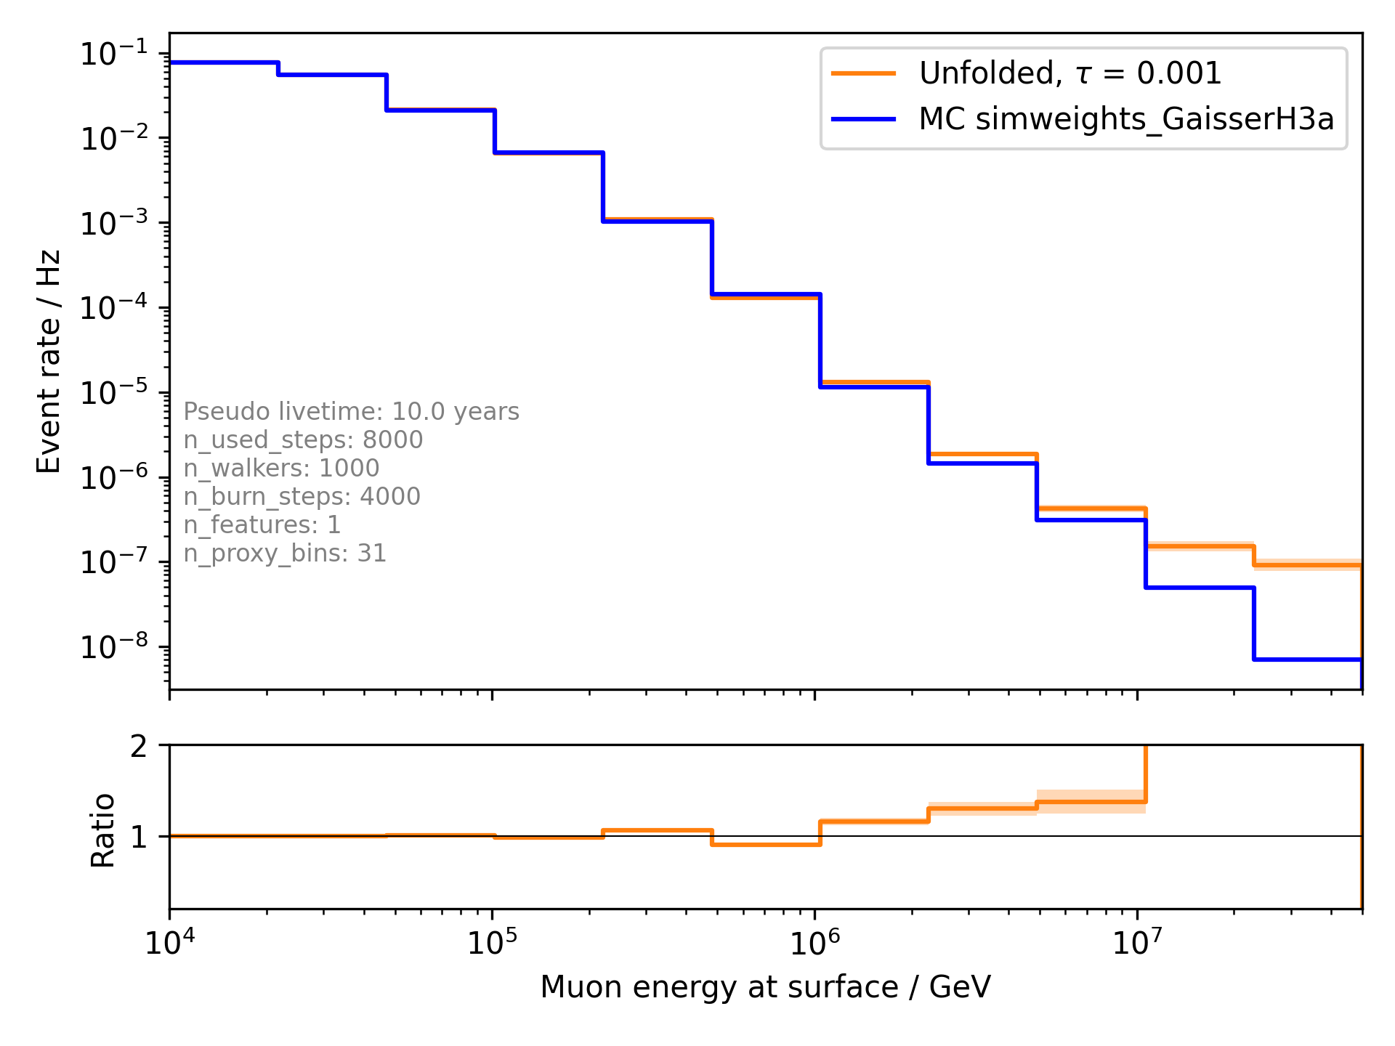
Test regularization (event rate, classical binning)

Slide 7
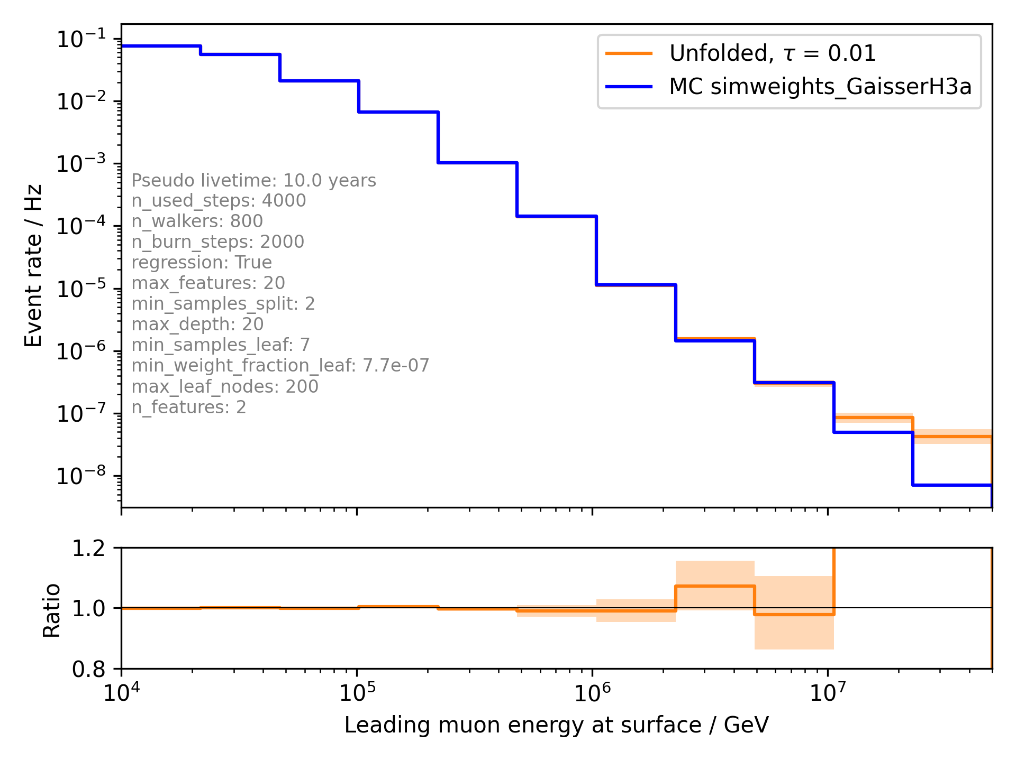
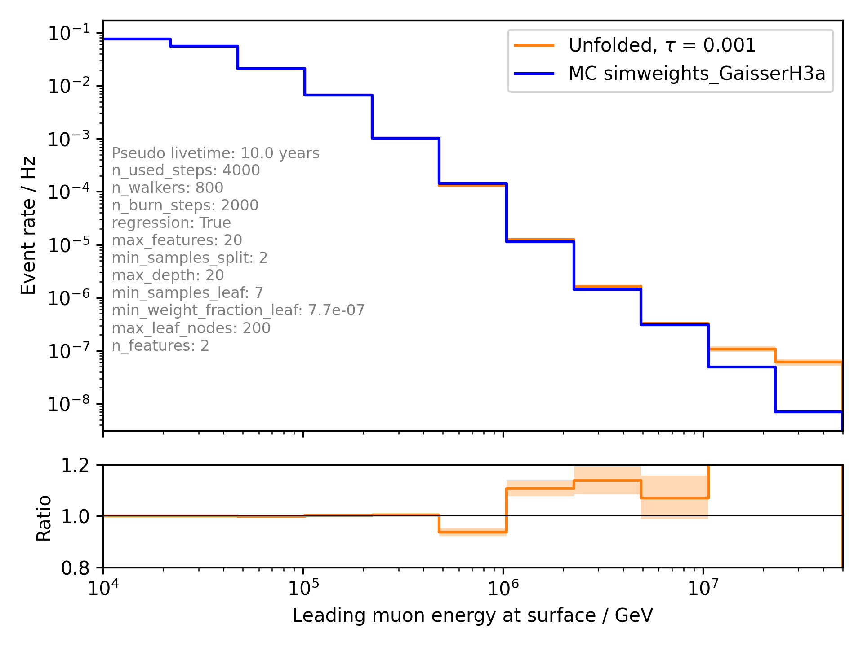
Test regularization (event rate, tree binning)

Slide 8
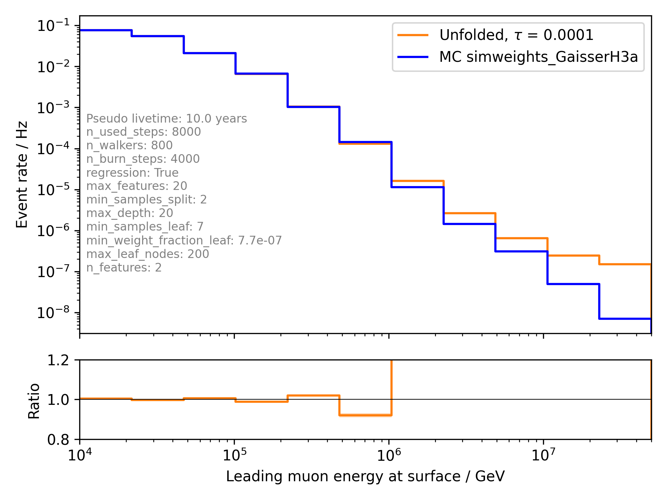
Test regularization (event rate, tree binning)

Slide 9
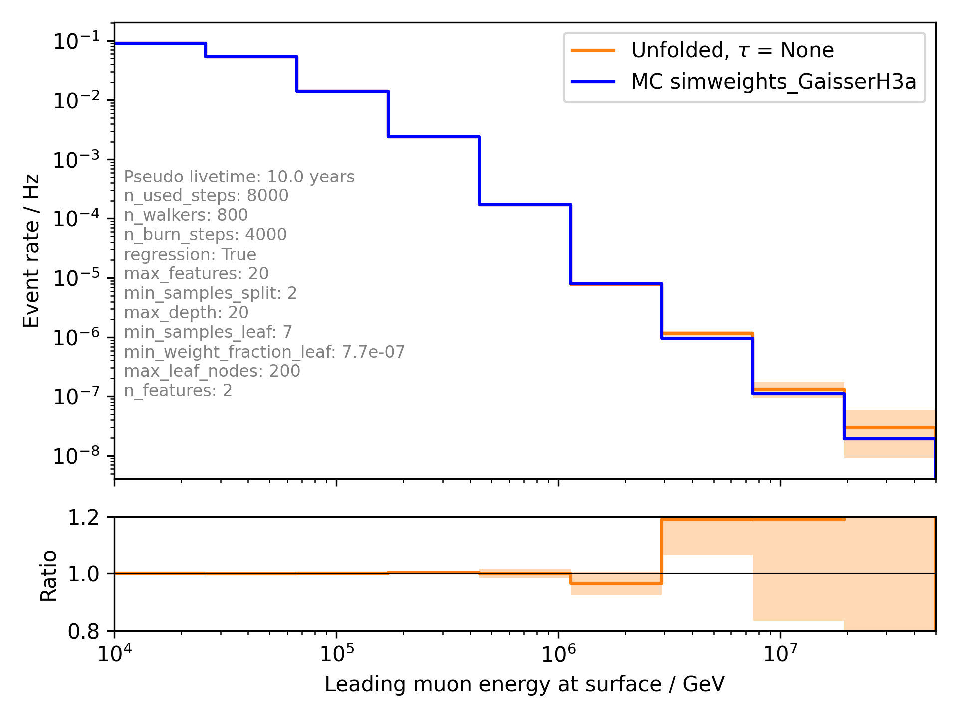
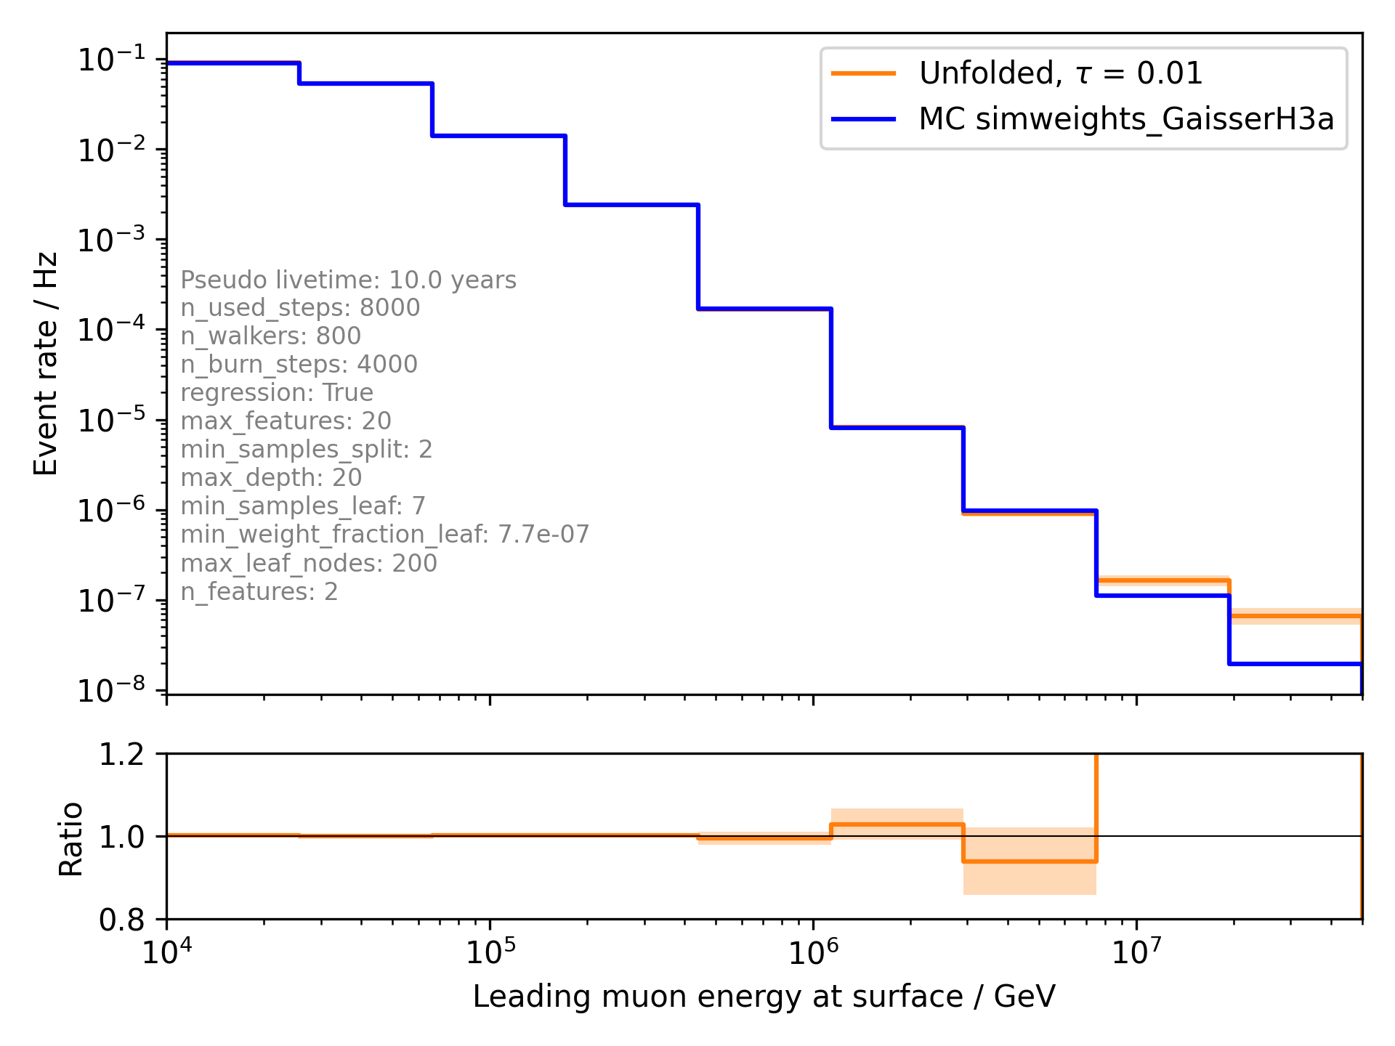
Two unfolding bins less

Slide 10
Questions
What is the correct way to choose the regularization parameter?
How do you define the unfolding bins?

