Slide 1
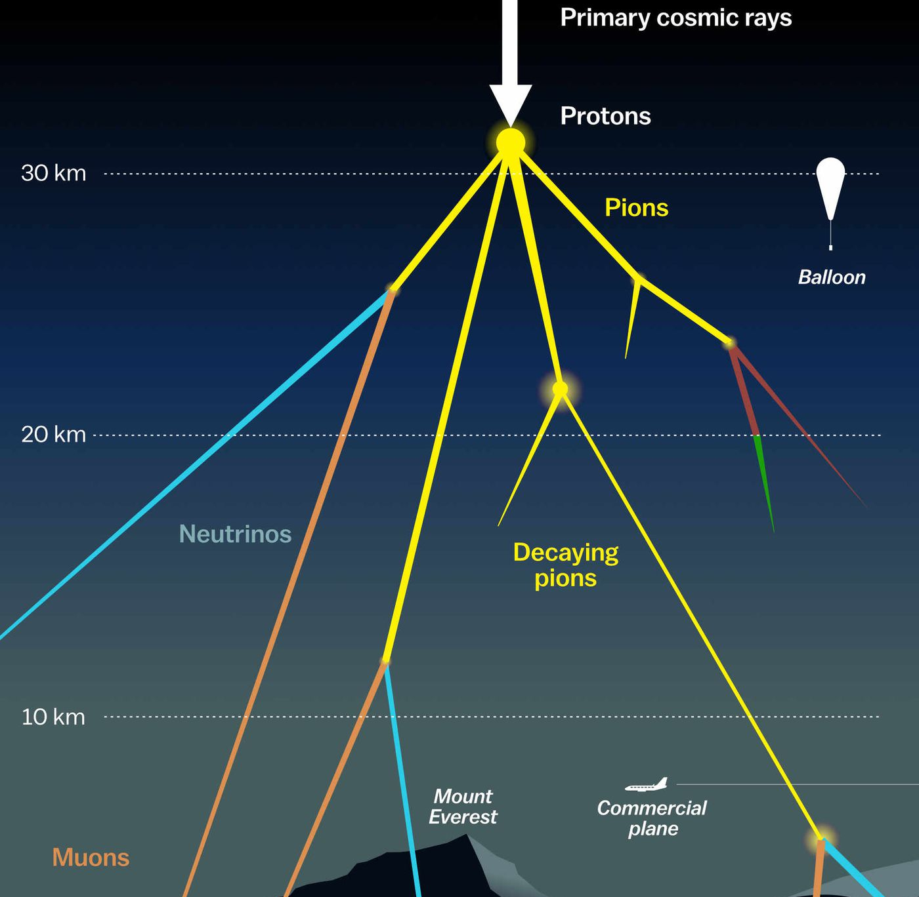

Measuring the prompt component of the atmospheric muon flux Pascal Gutjahr
June 6, 2024
Source: NASA

Slide 2
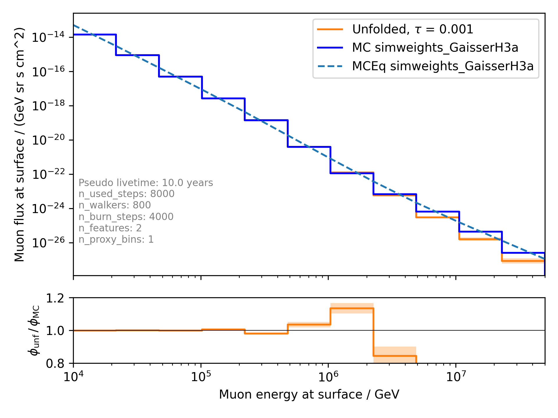
tau = 0.001

Slide 3
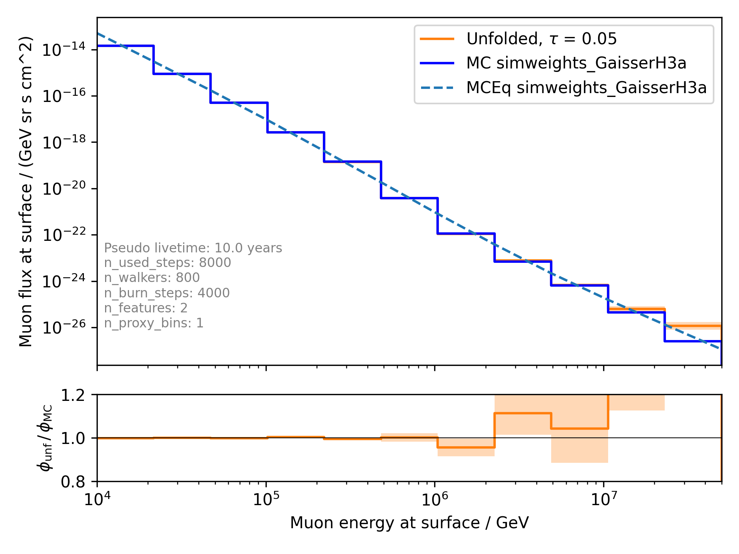
tau = 0.05

Slide 4
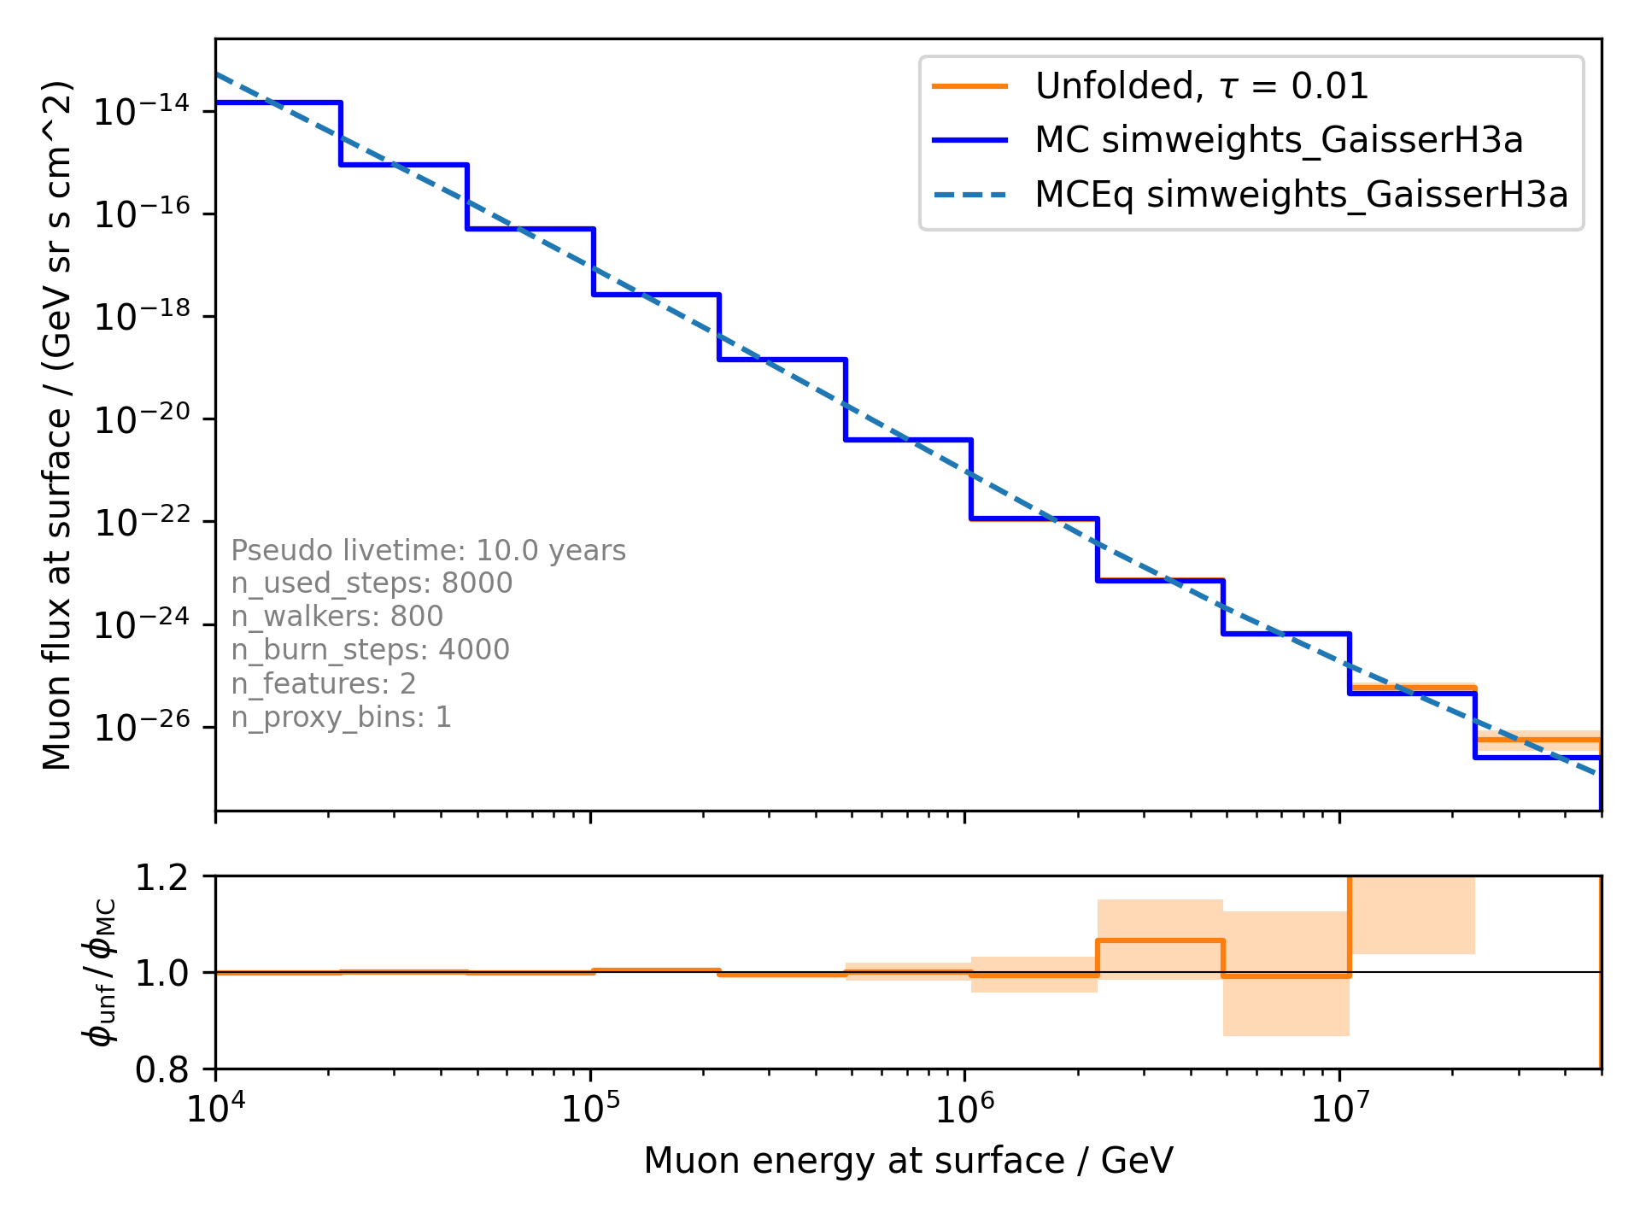
tau = 0.01

Slide 5
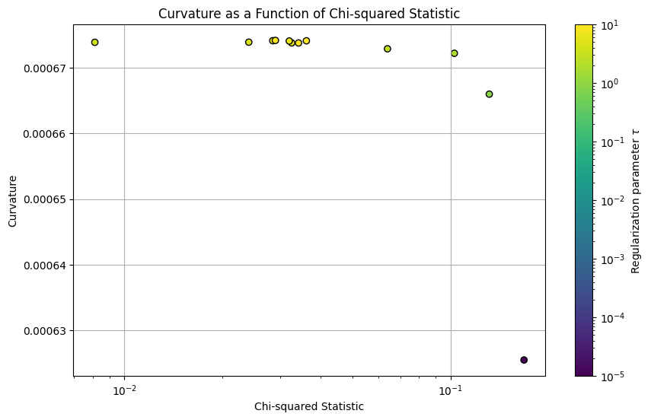
L-Curve

