Slide 1
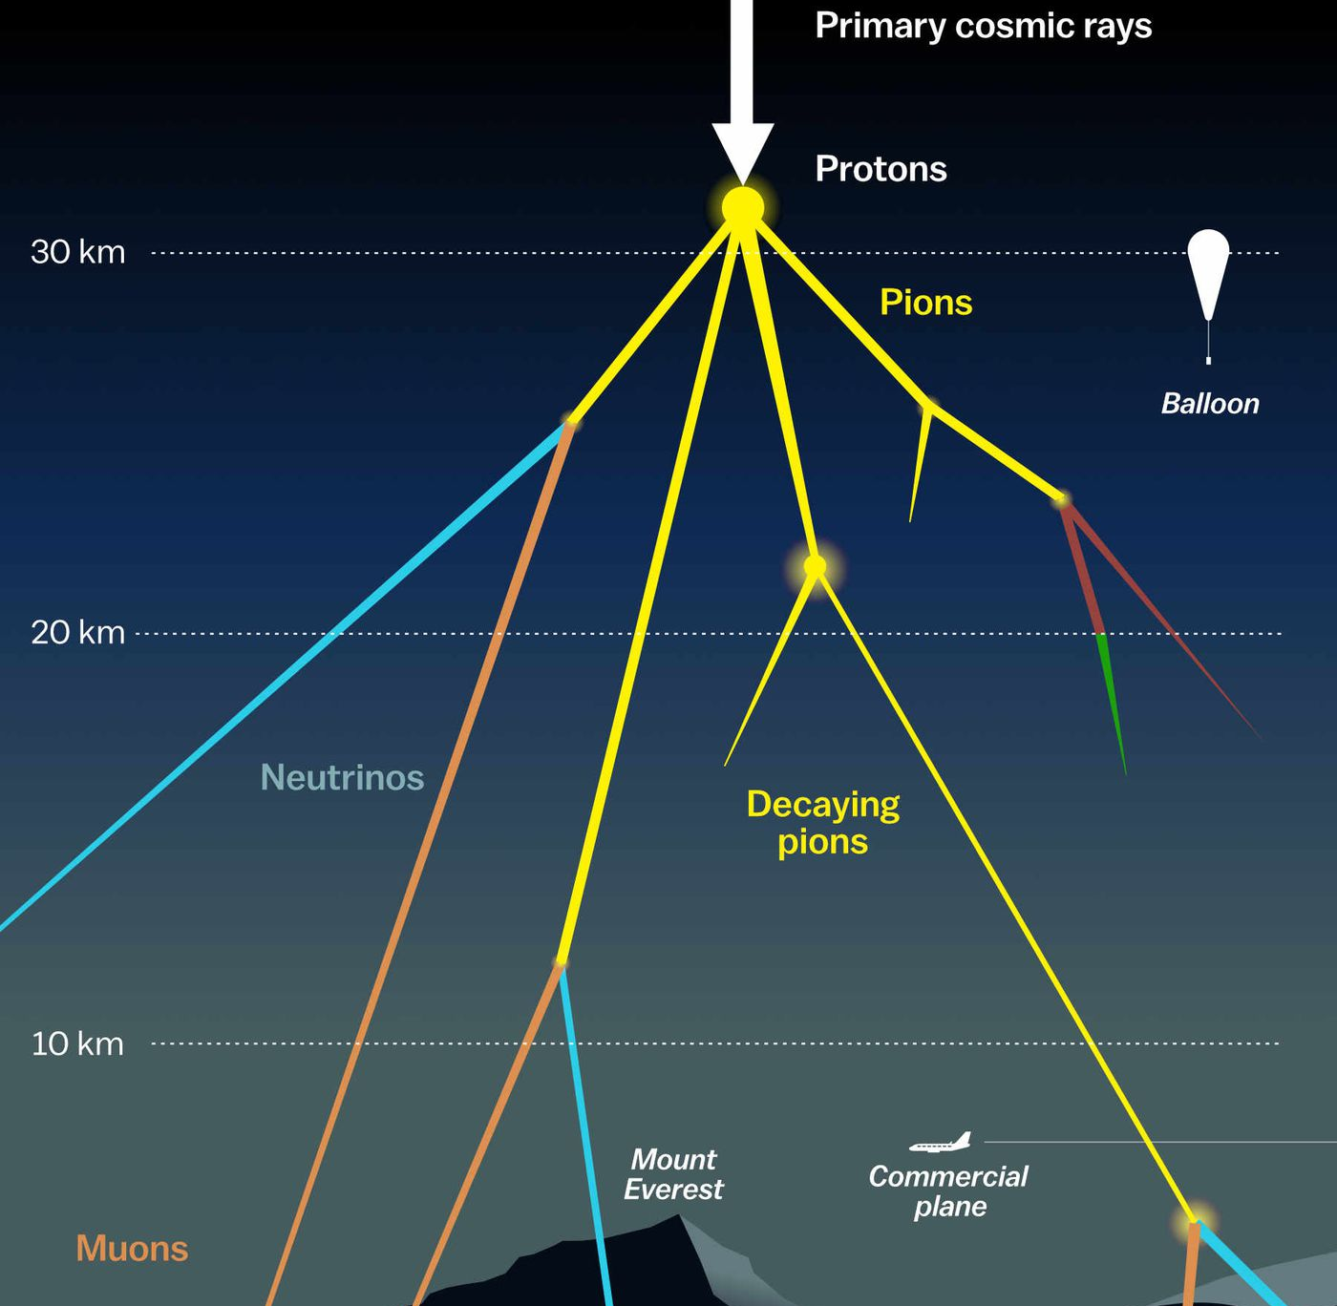

Measuring the prompt component of the atmospheric muon flux Pascal Gutjahr
June 20, 2024
Source: NASA

Slide 2
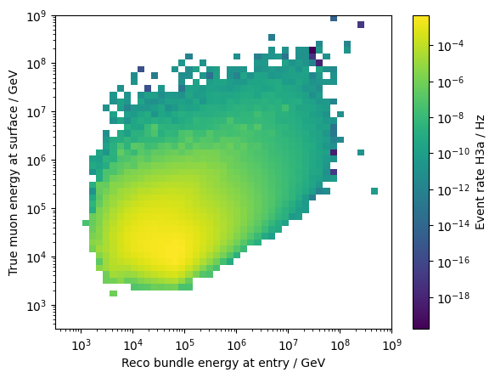
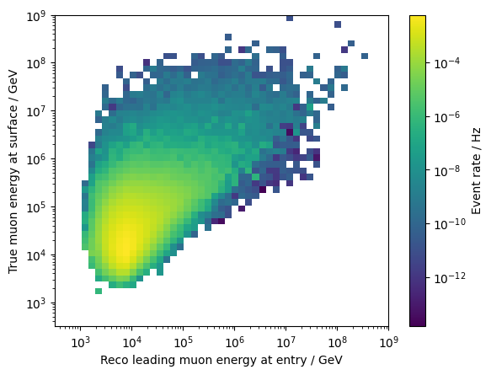
Proxy variables – v1110-rc1

Slide 3
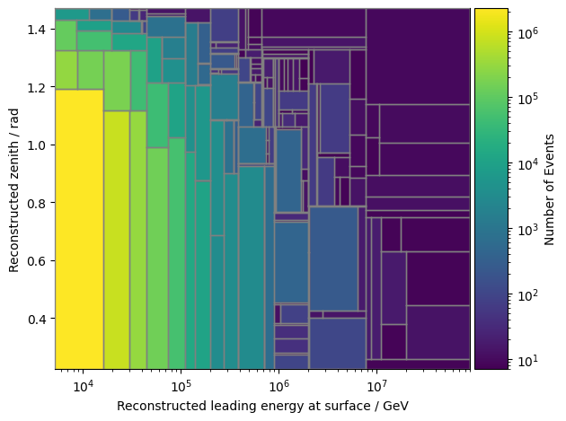
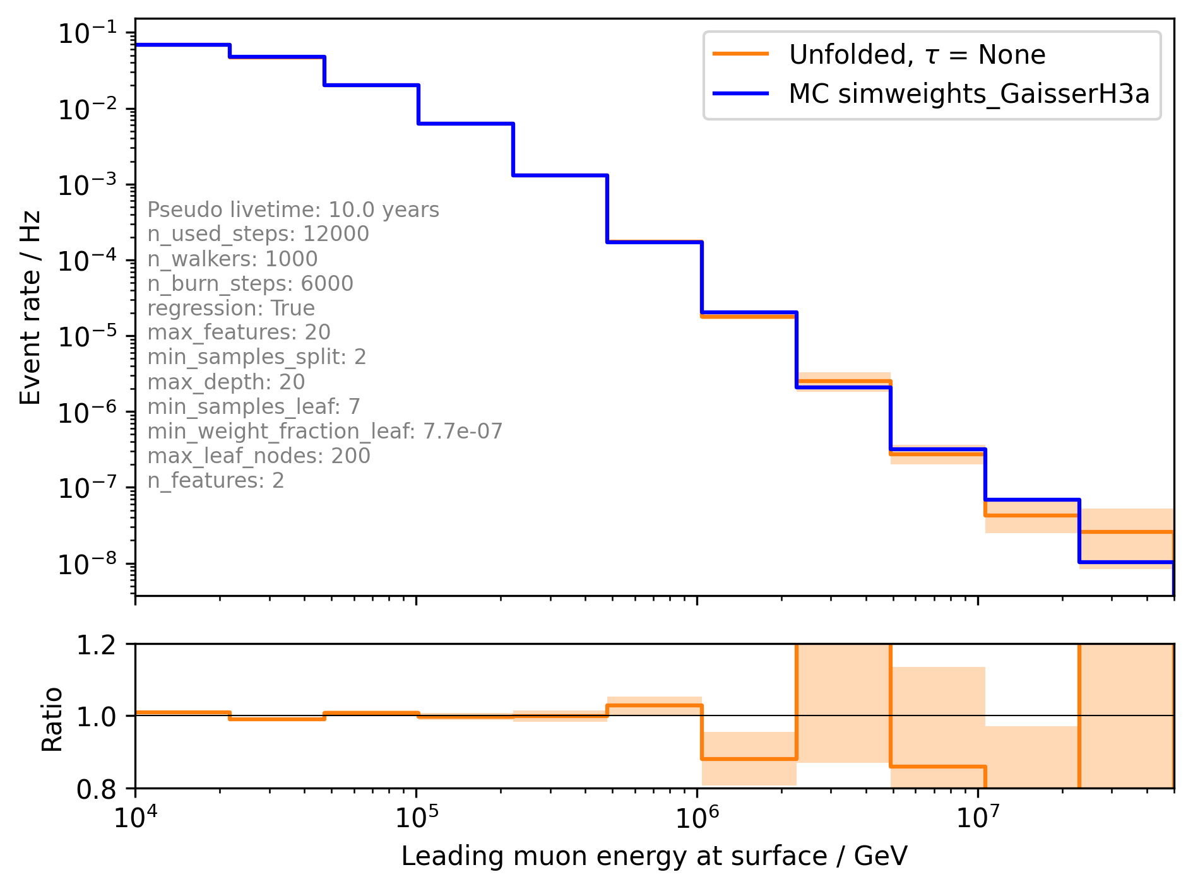
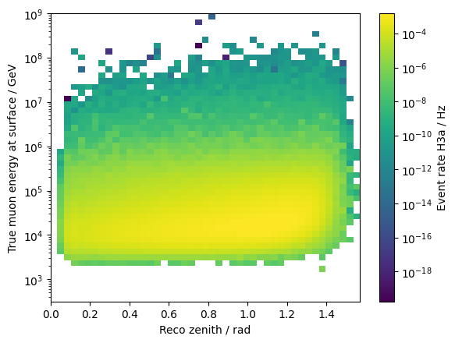
Unfolded event rate – v1110-rc1 (leading energy + zenith)

Slide 4
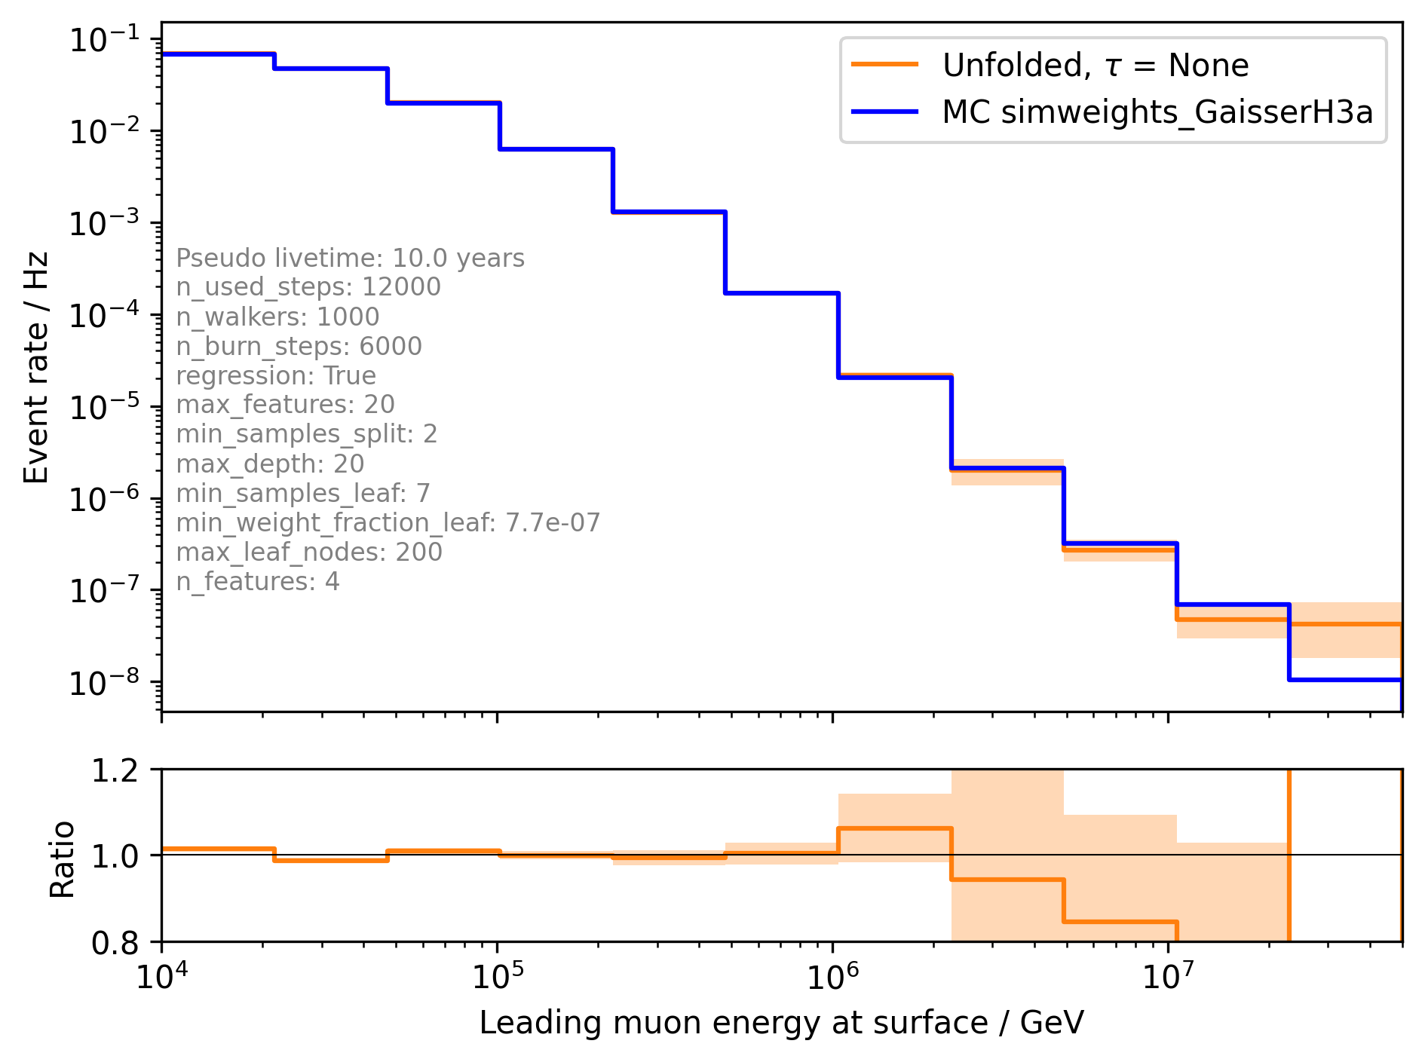
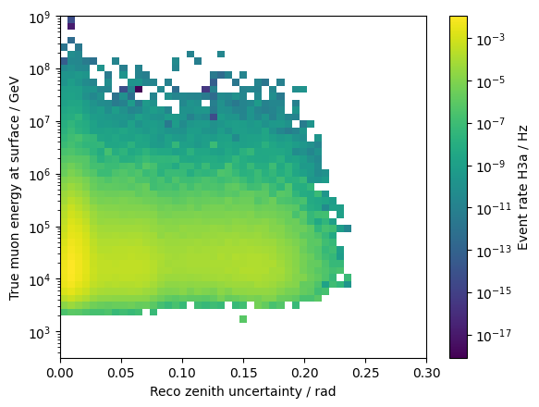
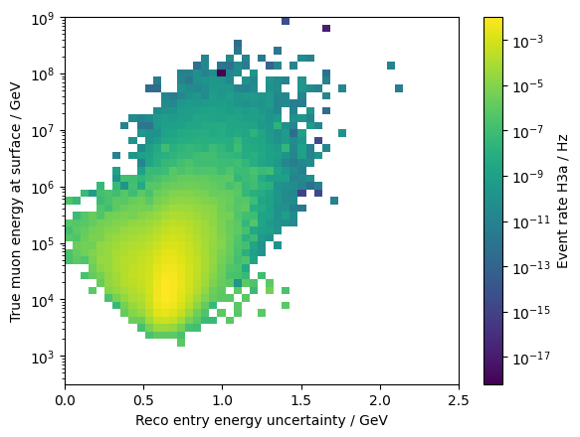
Unfolded event rate – v1110-rc1 (+ uncertainties)

Slide 5

Unfolded event rate – v1110-rc1 (+ bundly energy proxy)

Slide 6
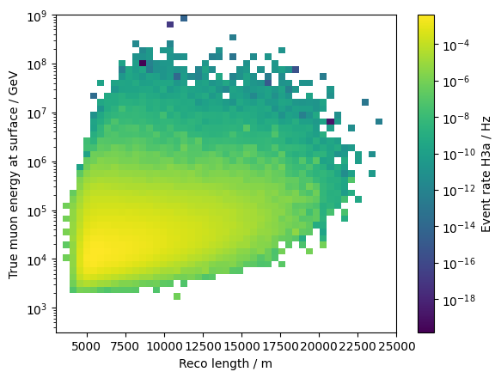
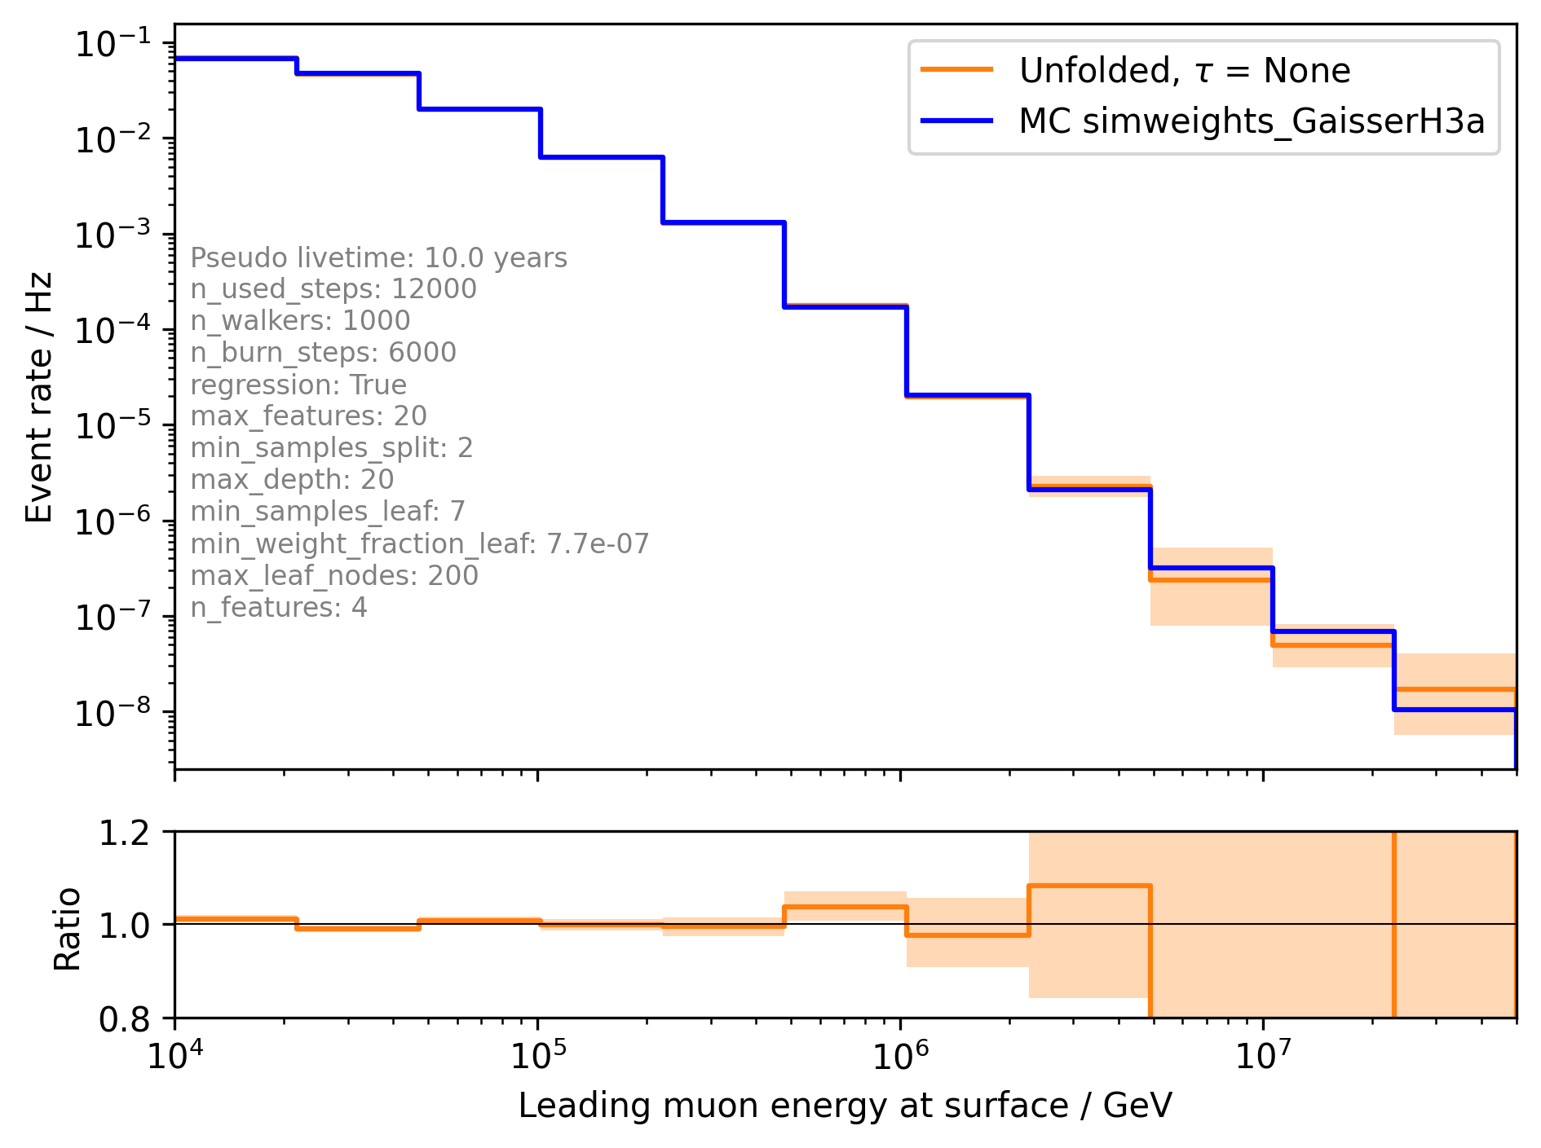
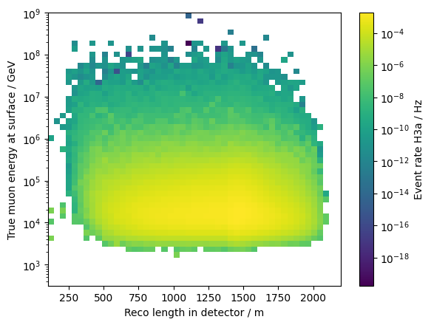
Unfolded event rate – v1110-rc1 (+ length and length in detector)

Slide 7
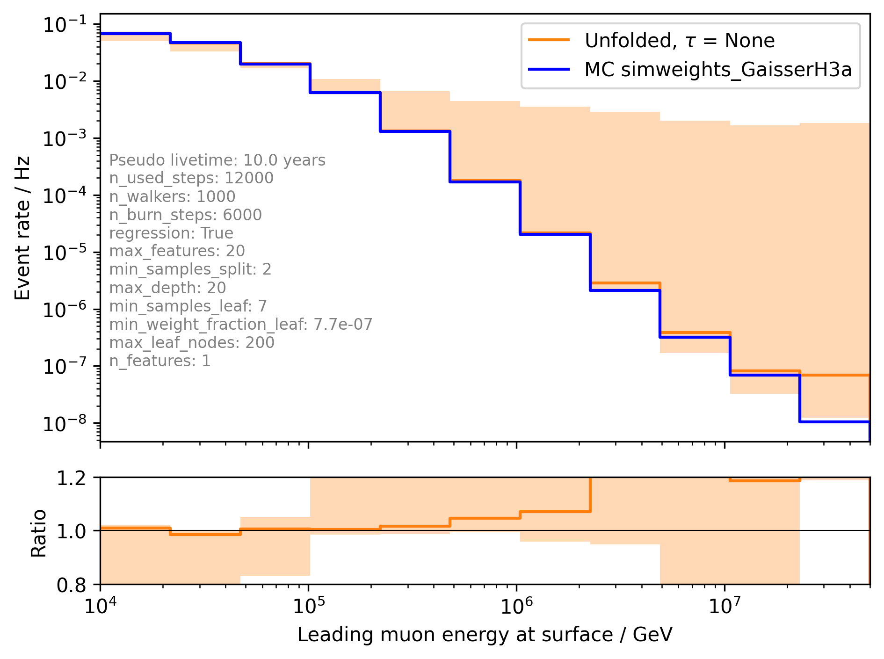
Unfolded event rate – v1110-rc1 (only leading energy)

Slide 8
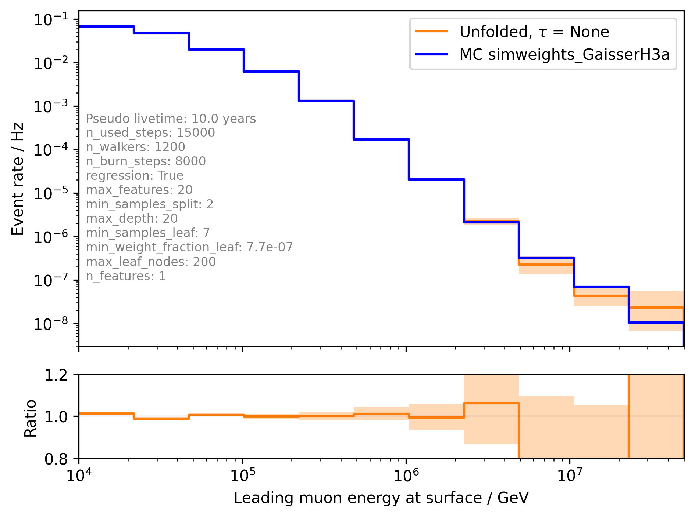

Unfolded event rate – v1110-rc1 (only leading energy) – more steps

Slide 9
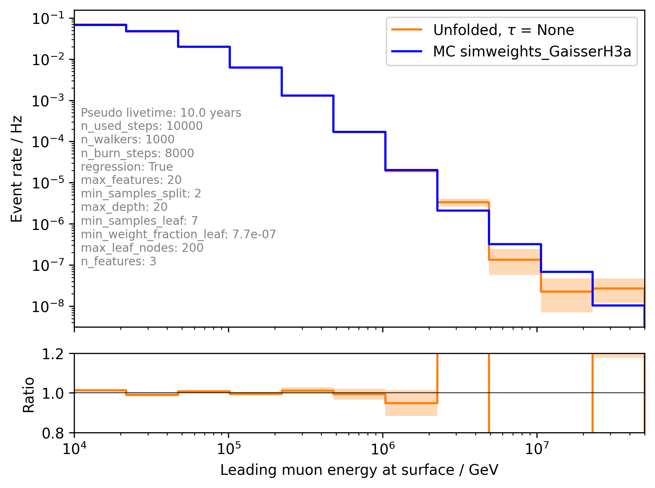
Unfolded event rate – v1110-rc1 (leading energy + uncertainty and length)

Slide 10
Effective Area
lower energy bound: 10 TeV

Slide 11
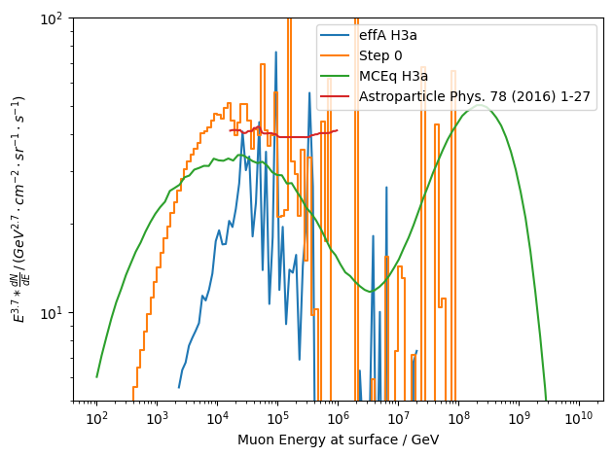
Muon flux at surface
cylinder r = 700m, l = 1400m

Slide 12
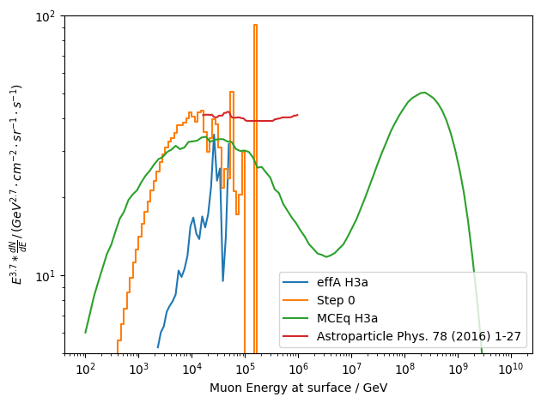
Muon flux at surface
load 22774 only
convex hull ext. 200m

Slide 13

Muon flux at surface
load 22774 only
cylinder r = 700m, l = 1400m
cylinder and convex hull have similar results
but where is the difference in MCEq coming from?

Slide 14
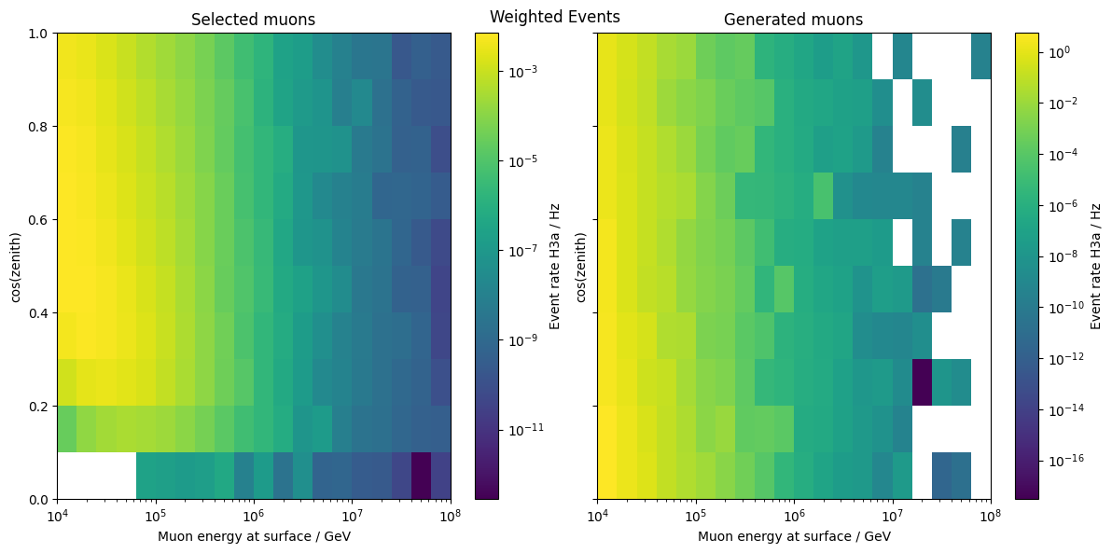
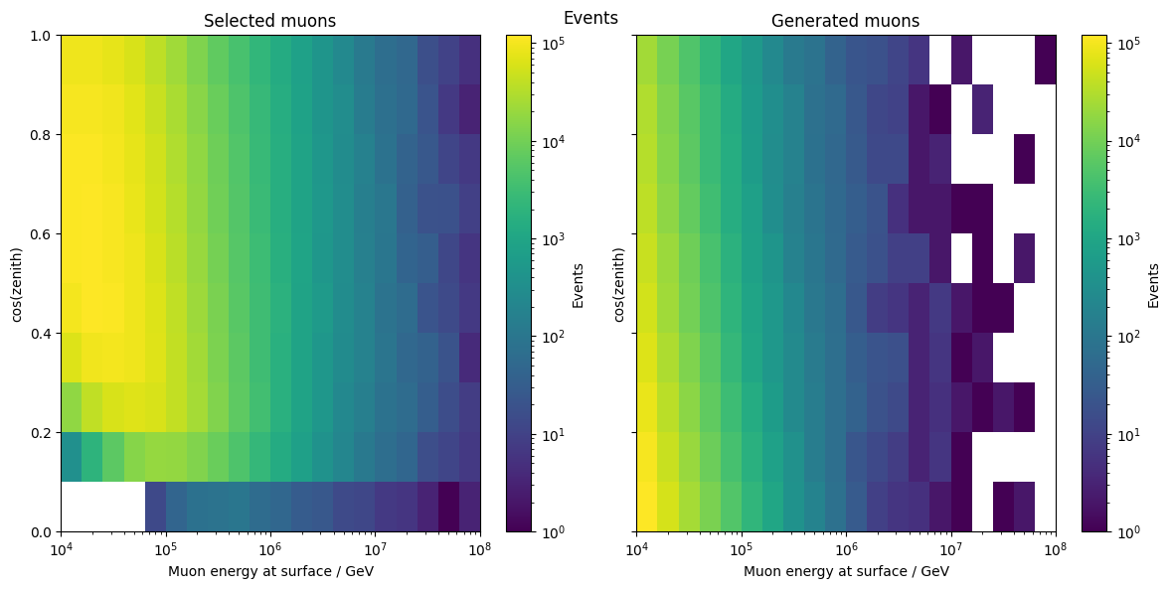
Check statistics
Weighted
Unweighted

