Slide 1
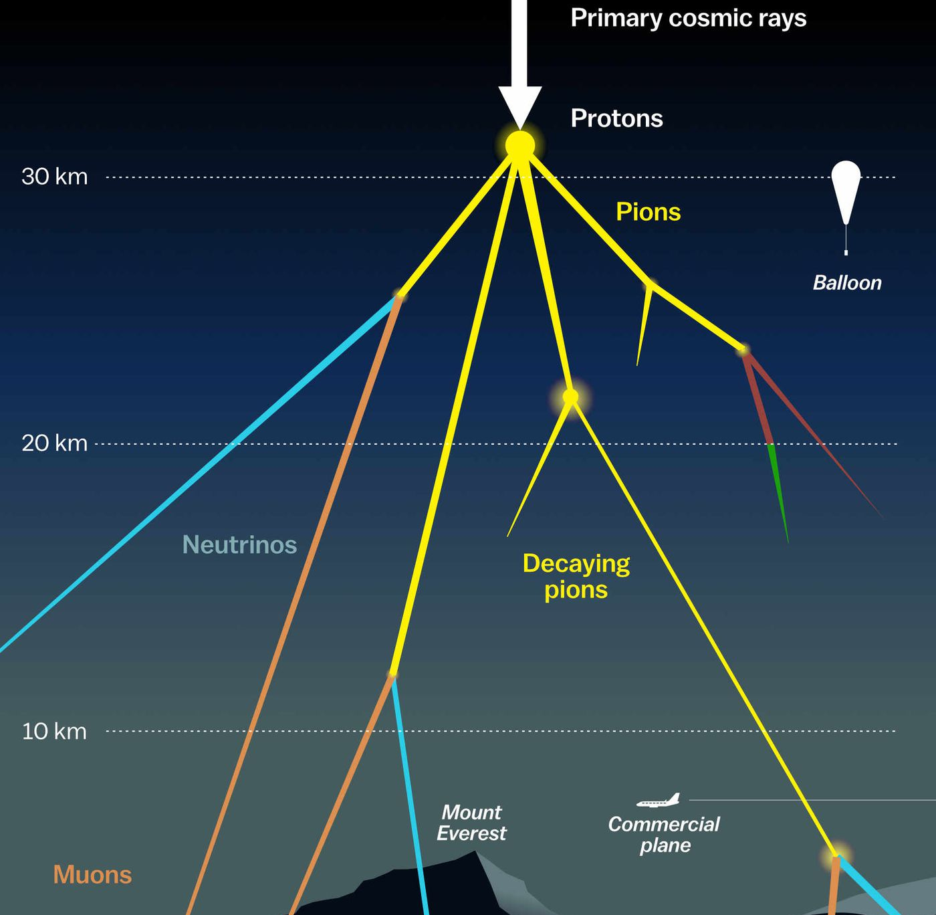

Measuring the prompt component of the atmospheric muon flux Pascal Gutjahr
July 5, 2024
Source: NASA

Slide 2
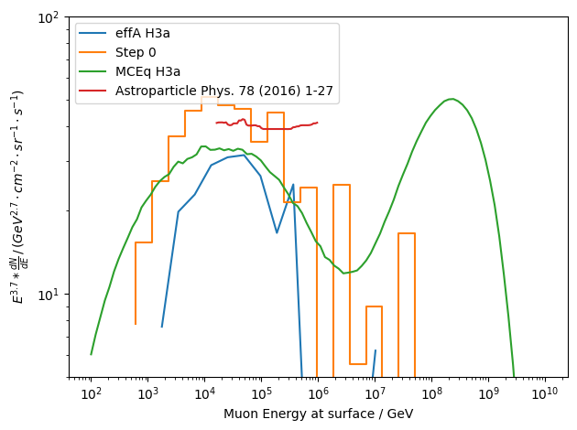
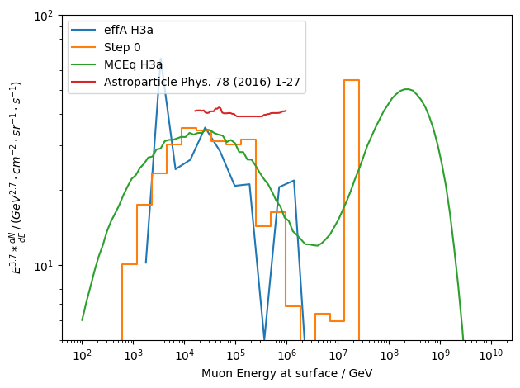
Muon flux at surface
new dataset
old dataset
considering all events at surface

Slide 3
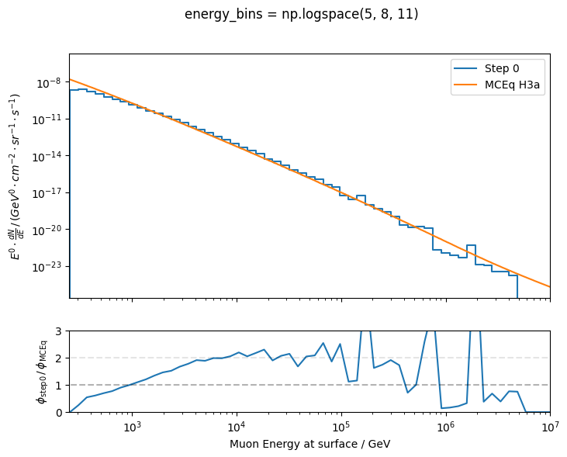
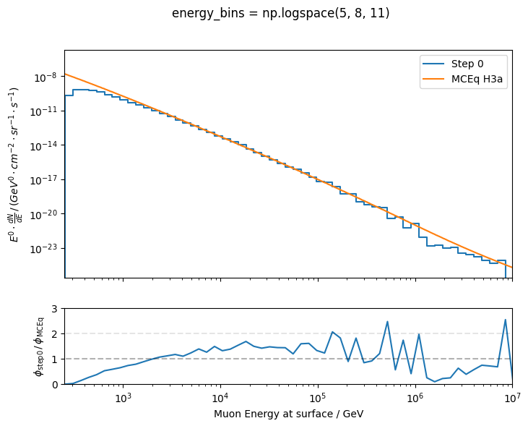
Muon flux at surface – ratio
new dataset
old dataset
statistics
missing statistics from high energies as well?
-> process all much more/all statistics

Slide 4
Misc
First draft of muon paper sent to Wolfgang
Technical review -> scripts do not work as documented -> they fix it for the second time
New master’s student needed a lot of supervision
Still waiting for Dennis’ review -> we are in contact, he has too many things to do…

