Slide 1
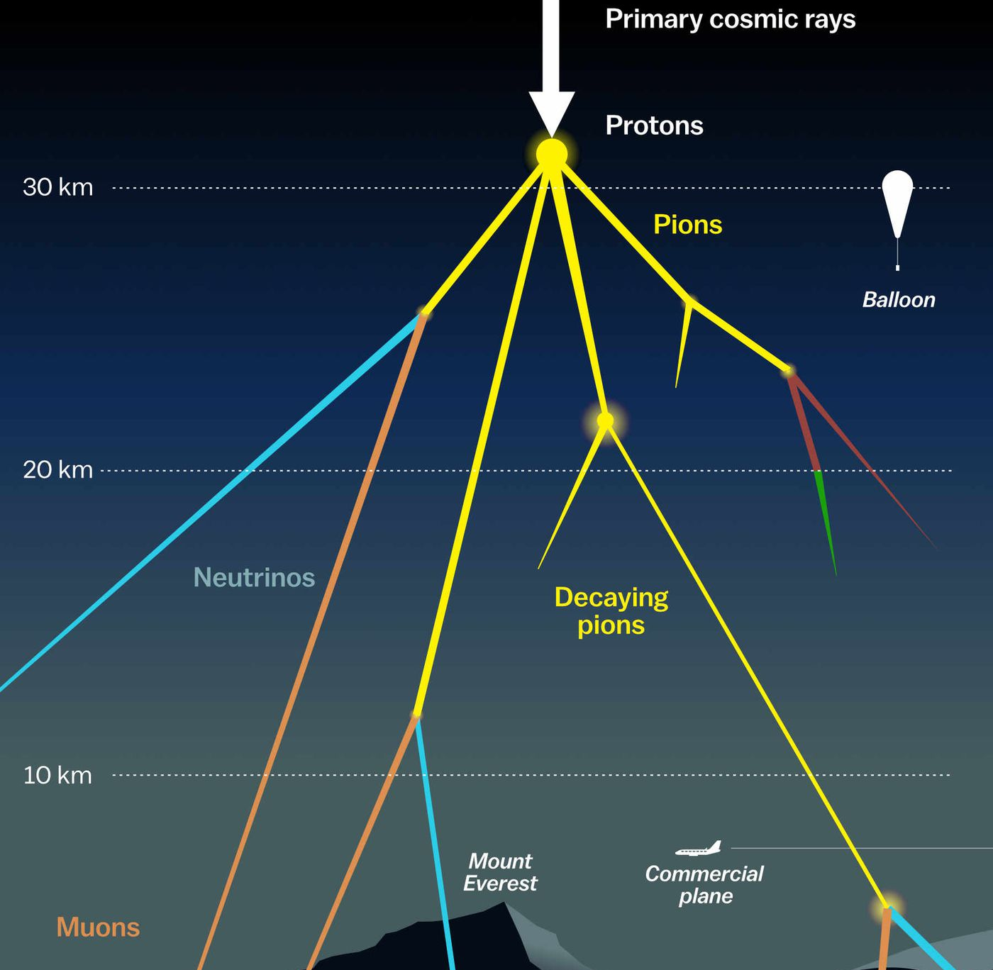

Measuring the prompt component of the atmospheric muon flux Pascal Gutjahr
July 9, 2024
Source: NASA

Slide 2
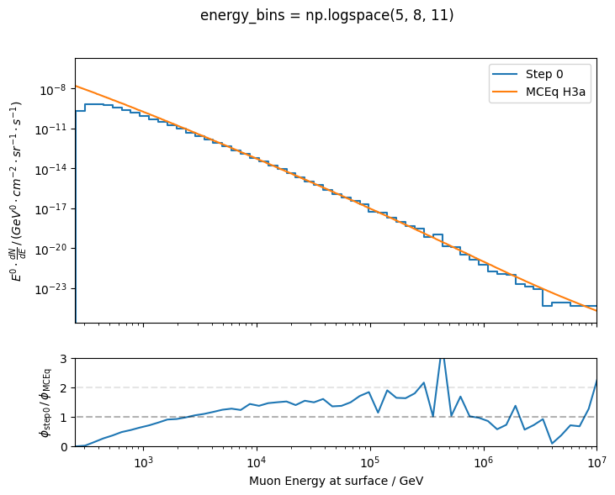
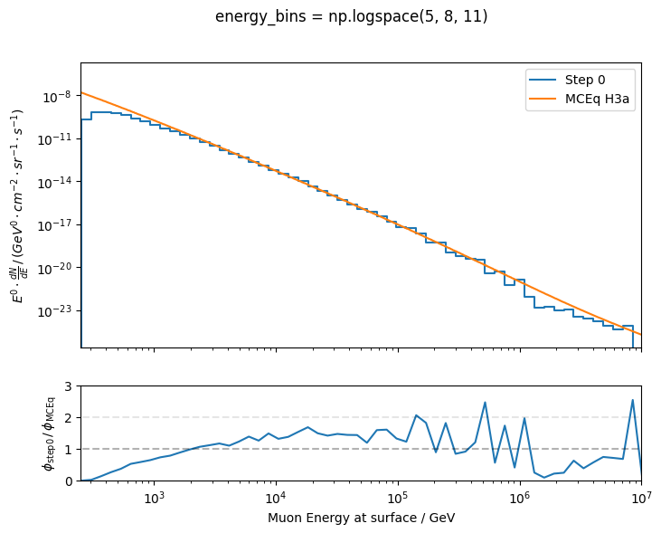
Muon flux at surface – old dataset
full high-energy statistics
plot from last week
statistics?

Slide 3
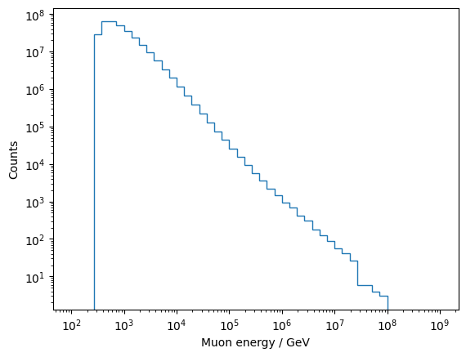
Muon flux at surface – old dataset
full high-energy statistics
statistics?
no enough high-energy showers simulated

