Slide 1
TherMOS: A Toolkit for Low Resolution Thermal Modeling
Dr. Pascal Schirmer

Slide 2
Version History
# | Version | Date | Comment | Editor | Lead
1 | v.1.0 | 15.05.2025 | Creating initial version. | Pascal Schirmer | Pascal Schirmer

Slide 3
Content
Short Introduction
Theoretical Background
Toolkit Overview
Exemplary Calculation
Advanced Functionalities
Outlook and Conclusion

Slide 4
A
Short Introduction

Slide 5
Aims and Goals
This MATLAB script/toolkit focuses on the reduction of high-order thermal models to more manageable lower-order models while preserving essential thermal dynamics. Thermal model order reduction is critical in simulations and real-time control applications where computational efficiency and accuracy are paramount. This process is typically necessary for systems with many thermal nodes, where full-scale modeling would be computationally prohibitive.

Slide 6
Dependencies
Used Hardware
Software
OS: WIN 10
CPU: AMD 3700X
RAM: 32 GB 3600 MHZ DDR4
ROM: 1 TB SSD
GPU: NVIDIA RTX 3700
The TherMOS Toolkit was implemented using Matlab R2023b and the following toolbox:
distrib_computing_toolbox
identification_toolbox
image_toolbox
matlab
neural_network_toolbox
optimization_toolbox
statistics_toolbox

Slide 7
Limitations and Known Issues
Numerical discrepancies for default implementation for calculating Gth and Cth matrices for 2D POD method
Thermal structure function has convergence issues (should currently not be used)
Deep learning does not support sequence-to-sequence learning

Slide 8
B
Theoretical Background

Slide 9
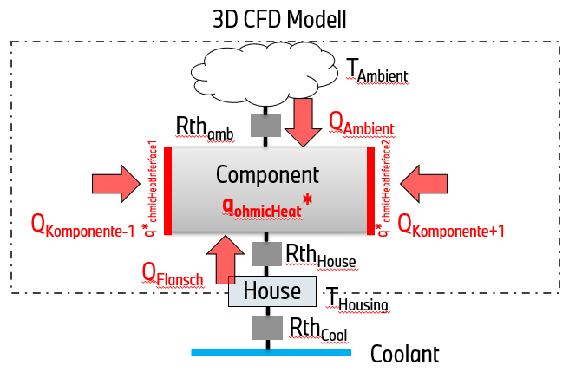

Physical Model
Literature:
Images:
Software:
Example:
Content:
Description
The generalized architecture that should be modelled using the ROMs is displayed below. It aims to represent a generalized component in a power electronic system that is dissipating losses, while having boundary conditions on system level. The following aspects are considered:
Internal heat generation ($q_{ohmicHeat}^{∗}$)
External heating due to nearby sources ($q_{ohmicHeatInt}^{∗})$
Heat flow to the ambient ($T_{amb}$)
Heat flow to the coolant ($T_{Coolant})$ over the housing ($T_{housing}$)
Therefore, the full order model consists next, to the geometry, of two independent reference temperatures and losses.

Slide 10
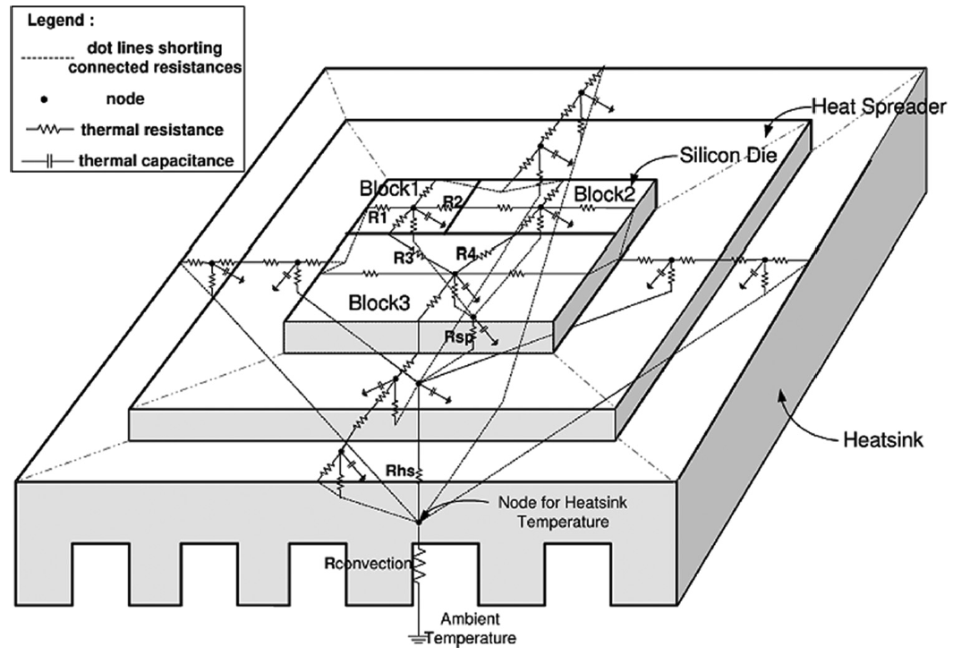

Reduced Order Model
Literature: [5,6]
Images:
Software:
Example:
Content:
Theory
The aim of a Reduced Order Model (ROM) is to reduced a complex geometrical physical model with high computational load using mathematical techniques. For example the temperature dependencies could then be modeled according to Fourier theory as a spatial temporal variable with infinite number of modes [2]:
$$T\left(x,y,t\right)=\sum_{i=1}^{∞}{θ_{i}\left(t\right)φ_{i}(x,y)}$$
where $T\left(x,y,t\right)$is the spatial temporal temperature constructed by an orthonormal set of spatial vectors $φ_{ }(x,y)$ and corresponding temporal modes $θ_{ }\left(t\right).$ The model coefficients are optimized to fulfil a minimum criteria, as:
$$\min_{φ_{i}(x,y)}\left\|T\left(x,y,t\right)−\hat{T}\left(x,y,t\right)\right\|$$

Slide 11
B1
1D Reduced order Models

Slide 12
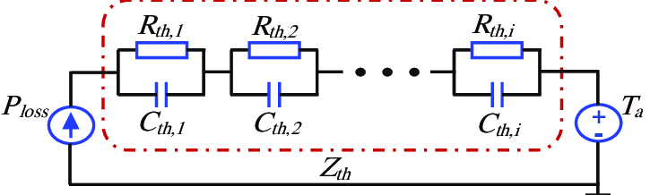
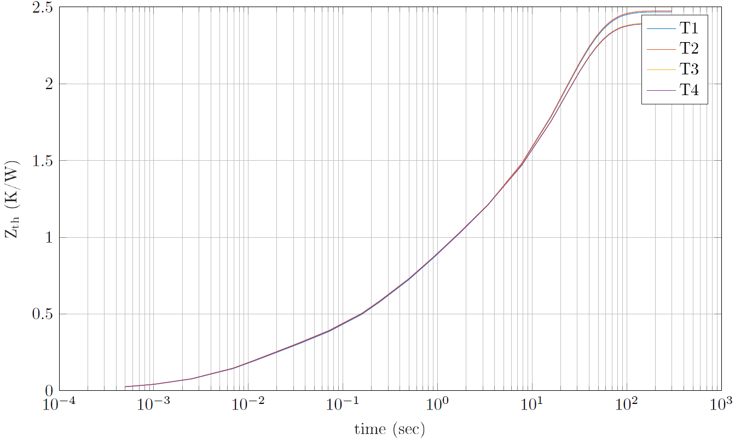


Foster- and Cauer-models (RC-Models)
Literature: [5,6]
Images:
Software:
Example:
Content:
Theory
Foster and Cauer models (RC-Models) are one of the easiest form to fit reduced order thermal models based on step responses. The equation for fitting can be found below:
$$Z_{th}(t)=\sum_{i=1}^{M}{R_{th}^{i}\left(1−exp\left(−\frac{t}{R_{th}^{i}C_{th}^{i}}\right)\right)}$$
where $Z_{th}$ is the fitted step-response for the $M^{th}$ order model, and $R_{th}^{i}/C_{th}^{i}$ are the $i^{th}$ element of the thermal resistance and thermal capacitance respectively. The dynamic time discrete temperature $T_{j}[k]$ can then be written as:
$$T_{j}\left[k\right]=\sum_{i=1}^{M}{\left(\frac{2τ_{i}−∆t}{2τ_{i}+∆t}T_{i}\left[k−1\right]+\frac{R_{th}^{i}∆t}{2τ_{i}+∆t}\left(p_{L}\left[k\right]+p_{L}[k−1]\right)\right)}$$
Example
Complex thermal resistance $Z_{th} \left(\frac{K}{W}\right)$for four different components with different thermal coupling.

Slide 13
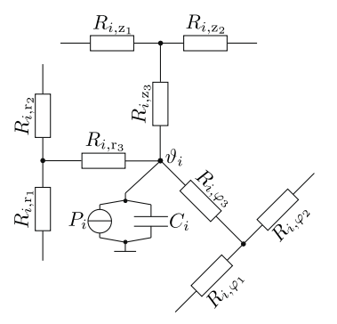


State-Space Models (SS-Models)
Literature: [7]
Images:
Software:
Example:
Content:
Theory
After carrying out all network simplifications by parallel and series connections of thermal resistors, each LPTN topology can be rewritten in the form of ordinary differential equations [3]:
$$C_{i}\frac{∂θ_{i}}{∂t}=P_{i}\left(t\right)+\sum_{j=1}^{n}{\frac{θ_{j}−θ_{i}}{R_{ij}^{th}}+\sum_{k=1}^{m}{\frac{θ_{ref,k}−θ_{i}}{R_{ik}^{th}}}}$$
where $R_{ij}^{th}$ are the internal nodes and $R_{ik}^{th}$ are the nodes to the reference temperature. Rearranging the above equations leads to the following state-space model:
$$\dot{x}\left(t\right)=Ax\left(t\right)+Bu\left(t\right)$$
$$y\left(t\right)=Cx(t)$$
where $x$ represents the nodal temperatures $θ$ and $u$ is the input vector consisting of power losses $P$ and the reference temperatures $θ_{ref}$.
Example
Assuming that parameters are constant during the sampling interval state-space models can be discretized:
$x\left[k+1\right]=Φx\left[k\right]+Hu[k]$ and $y\left[k\right]=Cx[k]$
$$Φ=e^{AT_{s}}$$
$$H=\int_{t_{k}}^{t_{k+1}}{e^{AT_{s}}}dτ_{s}B$$

Slide 14


Parameter varying Models
Literature: [5]
Images:
Software:
Example:
Content:
Approximation
For a digital implementation on embedded hardware, the LPTN state-space model has to be discretized. Assuming that the input and scheduling variables are constant during a sampling interval:
$x\left[k+1\right]=Φ(ζ(k))x\left[k\right]+H(ζ(k))u[k]$
$$y\left[k\right]=Cx[k]$$
$$Φ(ζ(k))=e^{A(ζ(k))T_{s}}$$
$H(ζ(k))=\int_{t_{k}}^{t_{k+1}}{e^{A{(ζ(k))T}_{s}}}dτ_{s}B$ $(ζ(k))$
Since $A,B$ are non-constant matrices they have to be updated, thus approximations like Euler are used:
$Φ\left(ζ\left(k\right)\right)≈I+T_{s}$ $A(ζ(k))$
$$H(ζ(k))≈T_{s}B (ζ(k))$$
Theory
Assuming that not all parameters are constant, the above models can be extended by a so-called scheduling variable $ζ(t)$, indicating that parameters are non-constant [5]:
$$C_{i}(ζ(t))\frac{∂θ_{i}}{∂t}=P_{i}\left(t\right)+\sum_{j=1}^{n}{\frac{θ_{j}−θ_{i}}{R_{ij}^{th}(ζ(t))}+\sum_{k=1}^{m}{\frac{θ_{ref,k}−θ_{i}}{R_{ik}^{th}(ζ\left(t\right))}}}$$
Rearranging the above equations leads to the following state-space model:
$$\dot{x}\left(t\right)=A(ζ(t))x\left(t\right)+B(ζ\left(t\right))u\left(t\right)$$
$$y\left(t\right)=Cx(t)$$

Slide 15



Feedback models
Theory
Often parameters are also sensitive to temperature, which leads to feedback models since the output influences the input of the model. For most cases it is sufficient to assume a linear relationship:
$$θ_{el}\left(θ\right)=\left[1+α\left(θ−θ_{0}\right)\right]θ_{el}\left(θ_{0}\right)$$
where $θ_{el}\left(θ\right)$ is a set of temperature dependent electrical parameters and $θ_{0}$ is the reference temperature. The input and output relationship can then be represented as indicated on the left. It must be noted that the feedback can lead to instable models.
Thermal Model
$$θ_{el}\left(θ\left(k\right)\right)$$
$$θ(k+1)$$
Parameter Update

Slide 16
B2
2D Reduced order Models

Slide 17
B3
Physics Informed models

Slide 18
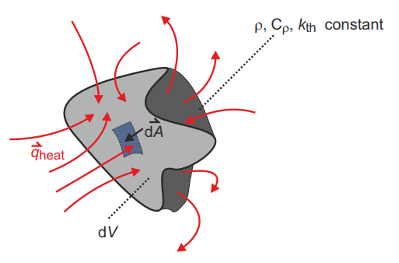

Physically motivated background: General
Literature: [8]
Images:
Software:
Example:
Content:
Theory
To model heat transfer between bodies, the definition of the energy balance is crucial.
$$E_{heat}=T∙c_{ρ}∙ρ∙V$$
where $E_{heat}$ is the energy, $T$ is the temperature, $c_{ρ}$ is the heat capacitance, $ρ$ is the density, and $V$ is the volume. The energy can only change due to a heat flux $Q_{heat}$ or internal heat generation $G_{heat}$.
$$\frac{∂E_{heat}}{∂t}=Q_{heat}+G_{heat}$$
Applying Fourier's law the above equations can be rewritten into the typical heat equation.
$$\frac{∂T}{∂t}−\frac{k_{th}}{c_{ρ}ρ}∇^{2}T=\frac{g_{heat}}{c_{ρ}ρ}$$
where $k_{th}$ is the thermal conductivity and $g_{heat}$ is the heat generation density.

Slide 19
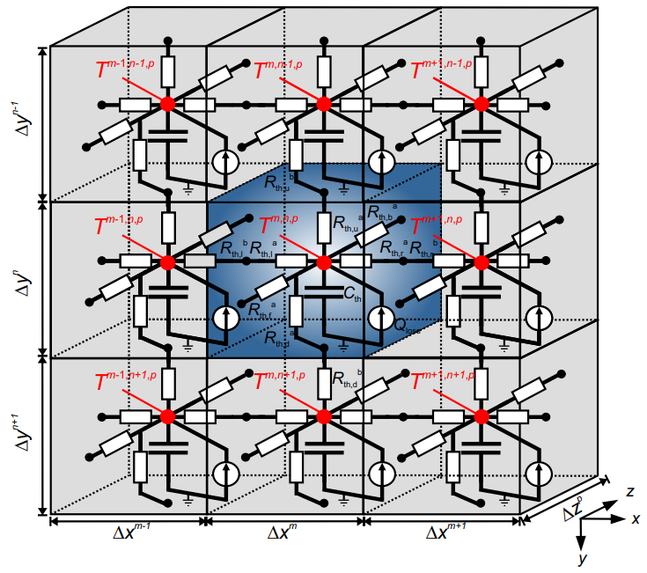
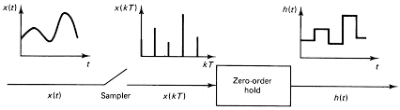


Physically motivated background: Discretization
Literature: [8]
Images:
Software:
Example:
Content:
Spatial Discretization
Applying spatial discretization the heat equation can be rewritten as:
$$C_{th}\frac{dT}{dt}=\sum{Q_{heat}+Q_{loss}}$$
$$Q_{heat}=\frac{T_{0}−T}{R_{th}}$$
where $Q_{heat}$ is the heat flow and $Q_{loss}$ are the internal losses.
Temporal Discretization
Using a thermal state-space model the results can be written as:
$$\frac{dT}{dt}=A∙T+B∙Q_{loss}$$
$$T\left(k+1\right)=A^{D}∙T+B^{D}∙Q_{loss}$$
For LTI systems and constant inputs $A^{D}, B^{D}$ can be written:
$$A^{D}=\exp\left(A∙T_{s}\right)and B^{D}=\int_{0}^{T_{s}}{B∙\exp\left(A∙τ\right)dτ}$$

Slide 20
C
Toolkit Overview

Slide 21
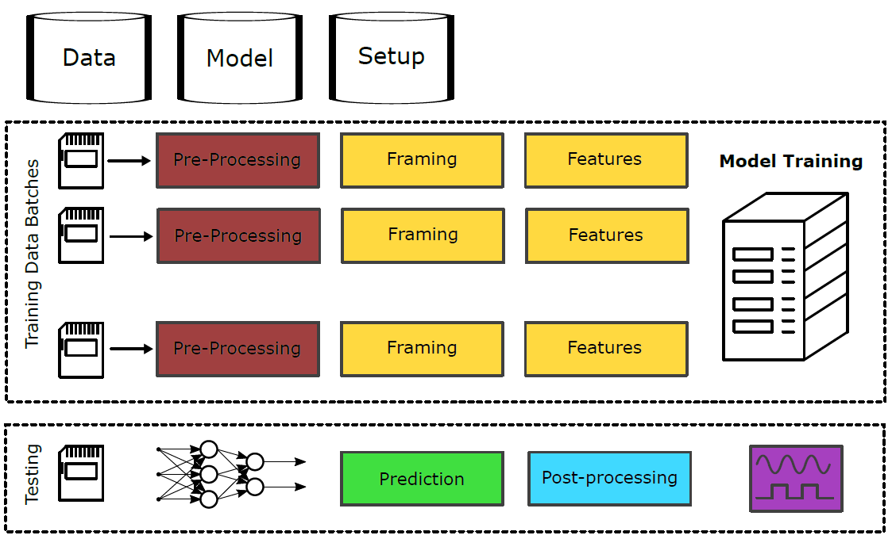
Toolkit Overview
Literature: -
Images: -
Software: TherMOS
Example: -
Content: Toolkit Description
Overview
Description
The toolkit implements model order reduction methods for 1D and 2D thermal problems
The main contribution of the toolkit is the implementation of the proper orthogonal decomposition (POD) using a Galerkin and a state space approach
1D Foster networks and state space systems provide reference setups for simple approaches commonly used in industry
Fundamentals of machine and deep learning are implemented as well

Slide 22
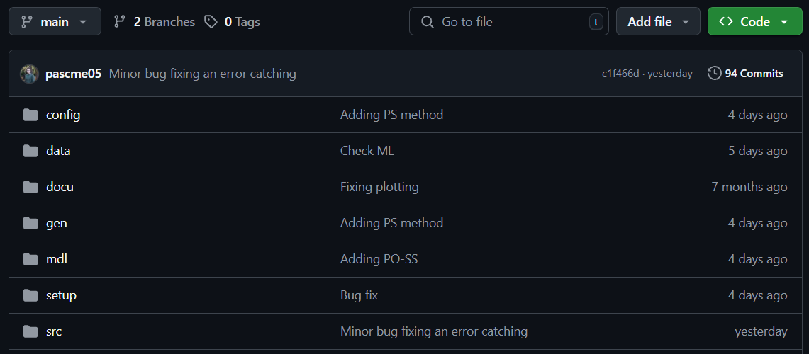
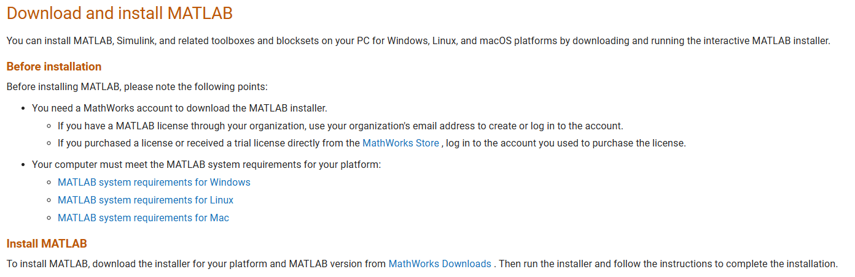
Installation and Usage
Literature: -
Images: -
Software: TherMOS
Example: -
Content: Toolkit Description
Step I:
Check out Github
Step II:
Install MATLAB
Step III:
Run start.Mat
To execute a new simulation three things are needed. First, a valid configuration file. Second, a training and testing dataset. Third a start script as provided in start.mat used for defining the configuration and the datasets.
Clone the latest version of the TherMOS Toolkit from Github: https://github.com/pascme05/TherMOS
Install Matlab R2023b or higher to ensure the toolkit to run smoothly.
https://de.mathworks.com/help/install/ug/install-products-with-internet-connection.html

Slide 23
Project Structure
Literature: -
Images: -
Software: TherMOS
Example: -
Content: Toolkit Description
TherMOS | Folder | Subfolder | Content
|-- | config |  | Contains the configuration files
|-- | data |  | Contains the datasets for training and testing
|-- | docu |  | Contains the documentation
|-- | gen |  | Contains code for generation of exemplary data
|-- | mdl |  | Contains trained models
|-- | results |  | Contains all results
|-- | setup |  | Contains preconfigured setup sheets
|-- | src |  | Contains source code implementation
 | |-- | data | Contains functions for loading data
 | |-- | dev | Contains functions for electrical calculation
 | |-- | general | Contains general and helper functions
 | |-- | model | Contains functions for reduced order models
 | |-- | numeric | Contains functions for numerical integration
 | |-- | plot | Contains functions for plotting

Slide 24
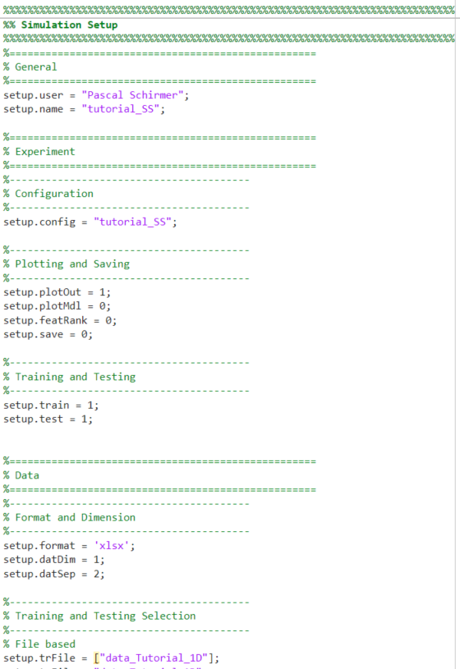
Setup File
Literature: -
Images: -
Software: TherMOS
Example: -
Content: Toolkit Description
Description
Experiment
Define training and testing
Define config file
Data Files
Define data formats
Define inputs and outputs
Models
Activate analytical 1D/2D models
Activate machine/deep learning

Slide 25
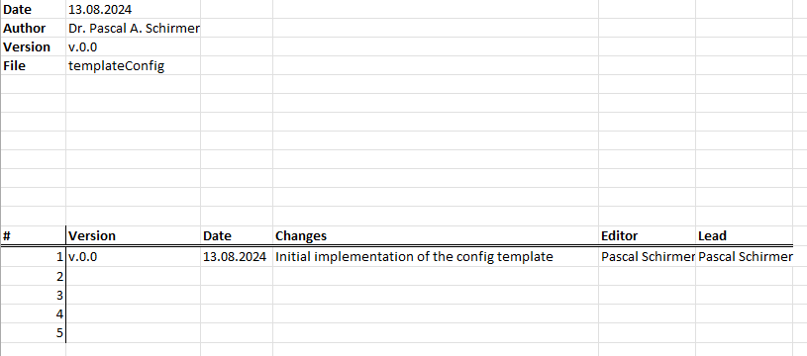
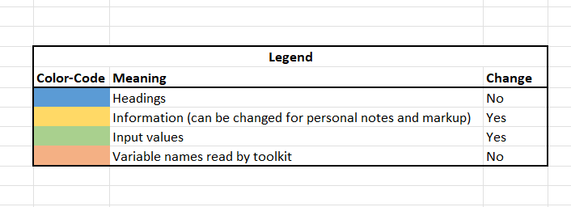
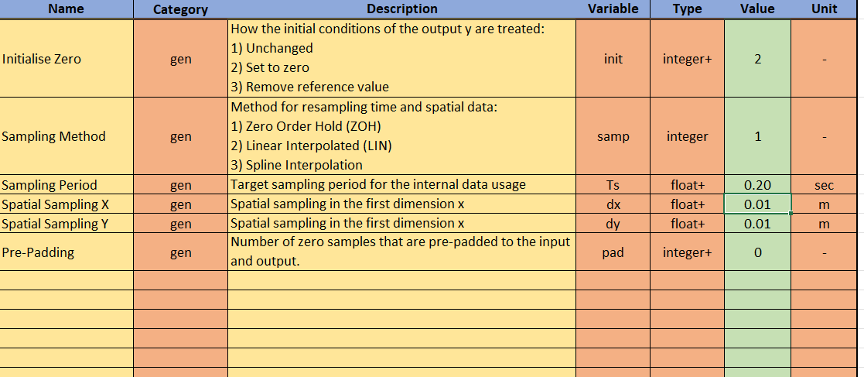
Configuration File
Literature: -
Images: -
Software: TherMOS
Example: -
Content: Toolkit Description
Change Log
All changes to the templated are logged here
New config files should be based on the default file
Legend
Colour coding to indicate which cell should be changed an which not
Colour code is valid throughout all worksheets
Settings
Four worksheets to adapt: experiment, data, models, and parameters
Each worksheet as drop downs a limits for the values

Slide 26
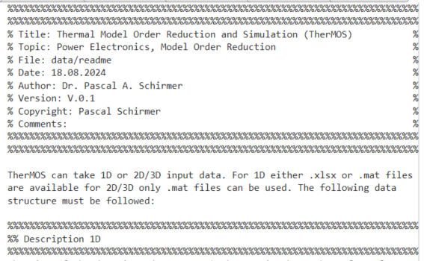
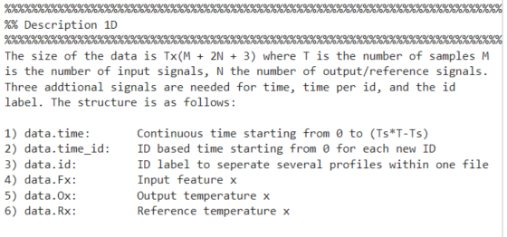
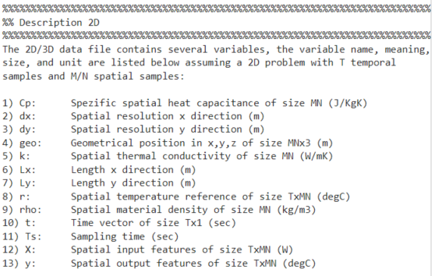
Data Files
Literature: -
Images: -
Software: TherMOS
Example: -
Content: Toolkit Description
Readme
General overview about the dataset structure
1D data description
2D data description
1D Matlab/Excel
1D timeseries can be defined in Excel or Matlab
The format uses T samples, for M inputs and N outputs
2D Matlab
2D spatial and temporal varying problems can be defined in Matlab only
The format uses T samples and MN spatial values

Slide 27
D
Exemplary Calculations

Slide 28
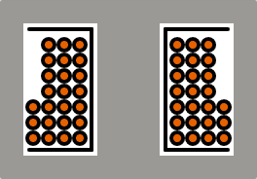
Problem Description: 1D Dataset
Literature:
Images:
Software:
Example:
Content:
Physical Problem
Dataset Description
Primary
Winding
The data contains heat up curves for a transformer with E core
Input: Losses for primary, secondary, and core
Output: Temperatures for primary, secondary, and core
The winding and the core are thermally coupled
The amount of coupling depends on the operating point
Three operating points are included (OP1-OP3)
Transformer
Core
Secondary
Winding

Slide 29

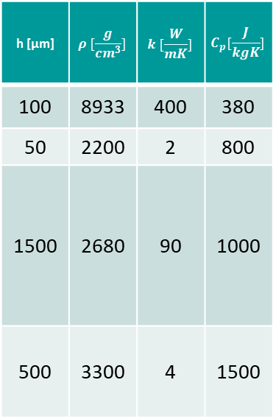

Problem Description: 2D Dataset
Literature:
Images:
Software:
Example:
Content:
Physical Problem
Dataset Description
h [µm] | $$ρ [\frac{g}{cm^{3}}]$$ | $$k [\frac{W}{mK}]$$ | $$C_{p}[\frac{J}{kgK}]$$
100 | 8933 | 400 | 380
50 | 2200 | 2 | 800
1500 | 2680 | 90 | 1000
500 | 3300 | 4 | 1500
$$P_{v}=20 W$$
The dataset contains thermal data from an insulated metal substrate board (IMS) [1]
Losses from two power semiconductor switches
Convective boundary at the bottom
Adiabatic on all other edges
The switches are coupled through the copper layer
The dominant heat flux is in direction of the cooling
Copper
Dielectric
Aluminium
Thermal Interface Material
$$h_{cool}=1000\frac{W}{m^{2}K}$$

Slide 30
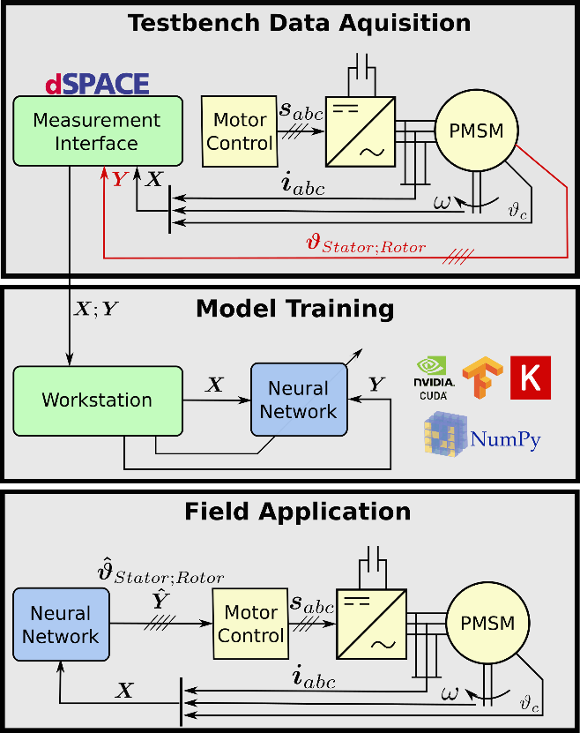
Problem Description: ML/DL Dataset
Literature:
Images:
Software:
Example:
Content:
Physical Problem
Dataset Description [2]
The dataset contains ~180 hrs of measured testbench data for an electric machine (PSM)
Input: Currents, Voltages, torque, speed, etc.
Output: Stator and Rotor temperatures
The dataset is cluster in IDs for splitting training, testing and validation
Dataset made publicly available from Paderborn University: [4]
[2,3]

Slide 31
D1
Analytical 1D Model order Reduction

Slide 32
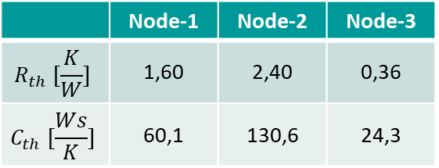
RC-Model: Training and Testing Results
Literature:
Images:
Software:
Example:
Content:
Settings & Parameters
Steady & Trans. Error Metric
Testing Data Plot
Fixed model order 3
Foster structure
Training OP1, Testing OP2
 | MAE | MSE | MAX
SS | 18,55 | 364,5 | 22,70
TR | 3,17 | 13,05 | 5,96
All | 17,32 | 336,3 | 22,70
 | Node-1 | Node-2 | Node-3
$$R_{th} [\frac{K}{W}]$$ | 1,60 | 2,40 | 0,36
$$C_{th} [\frac{Ws}{K}]$$ | 60,1 | 130,6 | 24,3

Slide 33
SS-Model: Training and Testing Results
Literature:
Images:
Software:
Example:
Content:
Settings & Parameters
Steady & Trans. Error Metric
Testing Data Plot
Training: OP1/3, Testing: OP2
Model Order: 2
Inputs: Primary, secondary, and core losses
Model form: Continuous
Noise modeling: off
Solver: linear
SS | MAE | MSE | MAX
Pri | 1,98 | 3,93 | 2,23
Sec | 2,05 | 4,33 | 3,06
Core | 1,35 | 2,62 | 2,53
TR | MAE | MSE | MAX
Pri | 2,06 | 4,80 | 2,71
Sec | 1,69 | 3,72 | 3,02
Core | 0,71 | 0,58 | 1,06

Slide 34
RC- and SS-Model Comparison
Literature:
Images:
Software:
Example:
Content:
Error Comparison Secondary (OP2)
Description &
Analysis
State Space system outperform RC networks for MAE, MSE, and MAX error
The losses in the transformer are coupled, thus primary, secondary and core losses mutually influence the temperature
RC networks cannot predict the temperature accurately due to the coupling
State Space models include the thermal coupling resistances and the power mapping inside their state space matrices
 | MAE | MSE | MAX
SS | 2,02 | 4,28 | 3,06
RC | 17,32 | 336,3 | 22,70

Slide 35
D2
Analytical 2D Model order Reduction

Slide 36
POD-Model: Training Spatial Modes
Literature:
Images:
Software:
Example:
Content:
Training based on one step response with 5 W losses (2,84E8 W/m³)
Using fixed number of POD modes equal to three
Using ode23s as stiff solver for Gth and Cth system
Using Gaussian Legendre Integration and Jacobi matrix for mesh correction

Slide 37
POD-Model: Testing Spatial Error X
Literature:
Images:
Software:
Example:
Content:
Both temperature and gradient are well captured
Largest temperature error at boundary interface
Largest gradient error at points of gradient changes

Slide 38
POD-Model: Testing Spatial Error Y
Literature:
Images:
Software:
Example:
Content:
Gradient is directly proportional to the heat conductance of the PCB materials
Temperature error increase in direction of the heat sources

Slide 39
POD-Model: Testing Temporal Error
Literature:
Images:
Software:
Example:
Content:
Temporal behaviour is captured well
Maximum error around 1,0 K
Steady state error around 0,2 K

Slide 40
D3
Deep Learning 1D Model order Reduction

Slide 41
DL-CNN: Training and Testing Results
Literature:
Images:
Software:
Example:
Content:
Settings & Parameters
Steady & Trans. Error Metric
Testing Data Plot
Normalisation X,y: off
Learning rate: 0,001
Batch: 1024
Input window: 600
Max Epochs: 100
Layer Structure
2x CNN ([5,64], [3,32])
1x DNN (32 nodes)
 | MAE | MSE | MAX
T_sw | 5,34 | 45,7 | 17,8
T_st | 3,48 | 49,9 | 11,6
T_so | 3,38 | 25,0 | 17,3
T_rm | 6,12 | 53,0 | 20,2
Avg | 4,58 | 35,9 | 20,2

Slide 42
DL-LSTM: Training and Testing Results
Literature:
Images:
Software:
Example:
Content:
Settings & Parameters
Steady & Trans. Error Metric
Testing Data Plot
Normalisation X,y: off
Learning rate: 0,001
Batch: 1024
Input window: 600
Max Epochs: 100
Layer Structure
1x LSTM (64 nodes)
1x DNN (64 nodes)
 | MAE | MSE | MAX
T_sw | 3,29 | 18,4 | 26,9
T_st | 2,23 | 9,37 | 22,4
T_so | 1,92 | 6,47 | 17,0
T_rm | 7,28 | 69,0 | 21,8
Avg | 3,68 | 25,8 | 26,9

Slide 43
DL-Model Comparison
Literature:
Images:
Software:
Example:
Content:
Error Comparison Stator Winding (ID60)
Description &
Analysis
LSTM outperforms CNN for MAE and MSE, but shows significantly higher MAX error
CNN generate smoothing effect through convolution
LSTM accurately models temporal behaviour
 | MAE | MSE | MAX
CNN | 5,34 | 45,7 | 17,8
LSTM | 3,29 | 18,4 | 26,9

Slide 44
E
Advanced functionalities

Slide 45
E1
Advanced functionalities: POD State Space Model

Slide 46
POD-SS Model
Literature:
Images:
Software:
Example:
Content:
Instead of calculating Cth and Gth matrices, a state space system is used to model the temporal dependencies
Improved transient modeling for low spatial and temporal resolution
Max error reduces from -1,0 K to -0,65 K

Slide 47
E2
Advanced functionalities: Deep Learning

Slide 48
Optimised Neural Network Architecture
Literature:
Images:
Software:
Example:
Content:
Error Comparison Stator Winding (ID60)
Description &
Analysis
Combining a CNN and LSTM based architecture to utilise temporal and spatial convolution characteristics
Significant further improvement for all error metric
 | MAE | MSE | MAX
CNN | 5,34 | 45,7 | 17,8
LSTM | 3,29 | 18,4 | 26,9
Opti | 2,80 | 13,4 | 13,5

Slide 49
Optimised Features and Neural Network Architecture
Literature:
Images:
Software:
Example:
Content:
Error Comparison Stator Winding (ID60)
Description &
Analysis
Adding additional input features, e.g. torque and rotational speed
Further improvement in all error metric
Lowest overall error
 | MAE | MSE | MAX
CNN | 5,34 | 45,7 | 17,8
LSTM | 3,29 | 18,4 | 26,9
Opti | 2,80 | 13,4 | 13,5
Opti2 | 2,37 | 9,43 | 10,2

Slide 50
F
Outlook and Conclusion

Slide 51
Development and Future Goals
As failure and mistakes are inextricably linked to human nature, the toolkit is obviously not perfect, thus suggestions and constructive feedback are always welcome. If you want to contribute to the TherMOS toolkit or spotted any mistake, please contact me via: p.schirmer@herts.ac.uk. The following aspects will be improved in future version:
3D input files for the Proper Orthogonal Decomposition (POD)
Physics Informed Neural Networks (PINNs) for 1D and 2D problems

Slide 52
G
References

Slide 53
Bibliography
[1] https://www.ventec-group.com/products/tec-thermal-thermal-management-ims/vt-4b3/datasheet/
[2] W. Kirchgässner, O. Wallscheid and J. Böcker, "Estimating Electric Motor Temperatures With Deep Residual Machine Learning," in IEEE Transactions on Power Electronics, vol. 36, no. 7, pp. 7480-7488, July 2021, doi: 10.1109/TPEL.2020.3045596
[3] https://github.com/upb-lea/deep-pmsm
[4] https://www.kaggle.com/datasets/wkirgsn/electric-motor-temperature
[5] Touzelbaev, Maxat N., et al. "High-efficiency transient temperature calculations for applications in dynamic thermal management of electronic devices." Journal of Electronic Packaging 135.3 (2013): 031001.
[6] Barabadi, Banafsheh, Satish Kumar, and Yogendra K. Joshi. "Transient heat conduction in on-chip interconnects using proper orthogonal decomposition method." Journal of Heat Transfer 139.7 (2017).
[7] O. Wallscheid, "Thermal Monitoring of Electric Motors: State-of-the-Art Review and Future Challenges," in IEEE Open Journal of Industry Applications, vol. 2, pp. 204-223, 2021, doi: 10.1109/OJIA.2021.3091870.
[8] van der Broeck, Christoph Henrik, Rik W. de Doncker, and Robert D. Lorenz. Methodology for thermal modeling, monitoring and control of power electronic modules. No. RWTH-2019-01370. Institut für Stromrichtertechnik und Elektrische Antriebe, 2019.

