Slide 1
Back So Soon: Analyzing the Invasion and Re-Emergence of DENV1 in Rio de Janeiro, Brazil from 1986-1990 Supplemental Figures
Rahul Subramanian, Victoria Romeo-Aznar, Edward Ionides, Claudia T. Codeço, and Mercedes Pascual
March 30, 2020

Slide 2
Supplemental Figure S1
Notes:
Supplemental Figure S1. Observed vs simulated cases from parameter combination for the stochastic SIR Cosine Model with No Immigration, fit to 2.5 years of DENV1 case data (fixed recovery rate). Log of observed monthly cases from April 1986 to June 1988 are shown in blue. Simulated cases were estimated from 100 simulations for each parameter combination within 2 log-likelihood units of the highest likelihood parameter combination (the MLE). Median values from 100 simulations from the MLE the are shown in red. The range of simulation medians across all parameter combinations within 2 log-likelihood units is shaded pink. The shaded blue region denotes the 95% quantile boundaries across all 100 simulations from the MLE. The shaded grey region denotes 95% quantile boundaries from all simulations (across all parameter combinations within 2 log-likelihood units of the MLE).

Slide 3
Supplemental Figure S2
Notes:
Supplemental Figure S2. Comparison of simulations from the MLE parameter combination for each fitted model with observed dengue case data. . Panels A and B of the figure compare simulations from the parameter combination with the highest likelihood (the MLE) with observed dengue case counts for each of 4 models. For each parameter combination, 100 independent stochastic simulations were conducted. Panel A shows cases on a standard scale, while Panel B is on a log scale. Panel C shows the proportion of susceptible individuals (susceptible population size divided by total population size) for the MLE. Panel D shows estimates of the reproductive number of the MLE, while Panel E shows the effective reproductive number (R_eff) for those simulations.
Note that since R_0 is a deterministic quantity, all simulations from a particular parameter combination will have the same R_0 value at a particular point in time (Panel D). However, process noise in the stochastic model can result in simulations from the same parameter combinations with different cases and proportions of susceptible individuals at a particular point in time and thus R_eff (panels A,B,C, and E). Measurement noise in the model can affect the number of observed cases (panels A and B) but does not affect the proportion susceptible (C) or R_eff (E).
The red line represents values for the median of 100 simulations from the MLE parameter combination, while the blue line (in panels A and B) represents observed dengue cases. The shaded grey region represents the 95% quantile for all simulations from the MLE parameter combination.

Slide 4
Supplemental Figure S3
Notes:
Supplemental Figure S3. Comparison of all examined parameter combinations within 2LL of MLE for each fitted model with observed dengue case data. Panels A and B of the figure compare simulations from all parameter combinations within 2 log-likelihood units of the parameter combination with the highest likelihood (the MLE) with observed dengue case counts for each of 4 models. For each parameter combination, 100 independent stochastic simulations were conducted. Panel A shows cases on a standard scale, while Panel B is on a log scale. Panel C shows the proportion of susceptible individuals (susceptible population size divided by total population size) for all parameter combinations within 2 log-likelihood units of the MLE. Panel D shows estimates of the reproductive number across all parameter combinations within 2lL of the MLE, while Panel E shows the effective reproductive number (R_eff) for those simulations.
Note that since R_0 is a deterministic quantity, all simulations from a particular parameter combination will have the same R_0 value at a particular point in time (Panel D). However, process noise in the stochastic model can result in simulations from the same parameter combinations with different cases and proportions of susceptible individuals at a particular point in time and thus R_eff (panels A,B,C, and E). Measurement noise in the model can affect the number of observed cases (panels A and B) but does not affect the proportion susceptible (C) or R_eff (E).
The red line represents values for the median of 100 simulations from the MLE parameter combination, while the blue line (in panels A and B) represents observed dengue cases. The shaded grey region represents the 95% quantile for all simulations pooled across all parameter combinations within 2LL of the MLE. The red region (Panels A-C and E) represents the range of median values (across 100 simulations) for each parameter combination within 2LL of the MLE. The blue region (Panels A-C and E) represents 95% quantiles for 100 simulations from the MLE parameter combination.

Slide 5
Supplemental Figure S4
Notes:
Supplemental Figure S4. Parameter Profiles for Initial Infected Size, Reporting Rate, and noise parameters for models with no immigration. For each profile, the parameter in question was held constant at particular values over a range, while other model parameters were optimized using the MIF algorithm. The profile shows the highest likelihood parameter combination for each fixed parameter value.
The red dot-dashed line indicates the likelihood value 2 log-likelihood units below the maximum likelihood across all parameter profiles. The blue dashed line indicates the likelihood value 2 log-likelihood units below the maximum likelihood for that particular parameter profile. The green dot-dashed line indicates the profile parameter value associated with the maximum likelihood parameter combination across all profiles. The orange dashed line indicates the profile parameter value associated with the maximum likelihood parameter combination for that parameter profile. The purple solid line denotes the likelihood value 2LL below the MLE parameter combination for profiles where the maximum likelihood parameter combination for that particular profile is also the overall maximum likelihood parameter combination across all profiles. The pink solid line denotes the profile parameter value in that situation.

Slide 6
Supplemental Figure S5
Notes:
Supplemental Figure S5. Parameter Profiles for Transmission Parameters (Beta_0, phi, and delta) for SIR Cosine Model with No Immigration. For each profile, the parameter in question was held constant at particular values over a range, while other model parameters were optimized using the MIF algorithm. The profile shows the highest likelihood parameter combination for each fixed parameter value.
The red dot-dashed line indicates the likelihood value 2 log-likelihood units below the maximum likelihood across all parameter profiles. The blue dashed line indicates the likelihood value 2 log-likelihood units below the maximum likelihood for that particular parameter profile. The green dot-dashed line indicates the profile parameter value associated with the maximum likelihood parameter combination across all profiles. The orange dashed line indicates the profile parameter value associated with the maximum likelihood parameter combination for that parameter profile. The purple solid line denotes the likelihood value 2LL below the MLE parameter combination for profiles where the maximum likelihood parameter combination for that particular profile is also the overall maximum likelihood parameter combination across all profiles. The pink solid line denotes the profile parameter value in that situation.

Slide 7
Supplemental Figure S6
Notes:
Supplemental Figure S6. Parameter Profiles for Transmission Parameters (b_1, b_1, and b_3) for SIR and SEIR Spline Models with No Immigration. For each profile, the parameter in question was held constant at particular values over a range, while other model parameters were optimized using the MIF algorithm. The profile shows the highest likelihood parameter combination for each fixed parameter value.
The red dot-dashed line indicates the likelihood value 2 log-likelihood units below the maximum likelihood across all parameter profiles. The blue dashed line indicates the likelihood value 2 log-likelihood units below the maximum likelihood for that particular parameter profile. The green dot-dashed line indicates the profile parameter value associated with the maximum likelihood parameter combination across all profiles. The orange dashed line indicates the profile parameter value associated with the maximum likelihood parameter combination for that parameter profile. The purple solid line denotes the likelihood value 2LL below the MLE parameter combination for profiles where the maximum likelihood parameter combination for that particular profile is also the overall maximum likelihood parameter combination across all profiles. The pink solid line denotes the profile parameter value in that situation.

Slide 8
Supplemental Figure S7
Notes:
Supplemental Figure S7. Parameter Profile for Initial Exposed Population (E_0) for SEIR Spline Model with No Immigration. For each profile, the parameter in question was held constant at particular values over a range, while other model parameters were optimized using the MIF algorithm. The profile shows the highest likelihood parameter combination for each fixed parameter value.
The red dot-dashed line indicates the likelihood value 2 log-likelihood units below the maximum likelihood across all parameter profiles. The blue dashed line indicates the likelihood value 2 log-likelihood units below the maximum likelihood for that particular parameter profile. The green dot-dashed line indicates the profile parameter value associated with the maximum likelihood parameter combination across all profiles. The orange dashed line indicates the profile parameter value associated with the maximum likelihood parameter combination for that parameter profile. The purple solid line denotes the likelihood value 2LL below the MLE parameter combination for profiles where the maximum likelihood parameter combination for that particular profile is also the overall maximum likelihood parameter combination across all profiles. The pink solid line denotes the profile parameter value in that situation.

Slide 9
Supplemental Figure S8
Notes:
Supplemental Figure S8: Profile of recovery rate gamma for SIR Cosine Model, and corresponding R_0 and reporting rate (rho) values for parameter combinations in that profile. . For the fits in earlier supplemental figures, the recovery rate gamma was fixed at the value indicated by the orange dotted line. As an additional test of sensitivity, the recovery rate was profiled.
For each profile, the parameter in question was held constant at particular values over a range, while other model parameters were optimized using the MIF algorithm. The profile shows the highest likelihood parameter combination for each fixed parameter value.
The red dot-dashed line indicates the likelihood value 2 log-likelihood units below the maximum likelihood across all parameter profiles. The blue dashed line indicates the likelihood value 2 log-likelihood units below the maximum likelihood for that particular parameter profile. The green dot-dashed line indicates the profile parameter value associated with the maximum likelihood parameter combination across all profiles. The orange dashed line indicates the profile parameter value associated with the maximum likelihood parameter combination for that parameter profile.
Panel A shows the profile of the recovery rate (gamma). Panels B and C show the reporting rate and R_0 values associated with each peak likelihood value on that profile.

Slide 10
Supplemental Figure S9
Notes:
Supplemental Figure S9: Expected number of skips from deterministic calculation given all combinations of R_0, delta, and reporting rate from each parameter combination of the gamma profile within 2LL of the original MLE. In Figure 3 panel A, expected numbers of deterministic skips were calculated for all parameter combinations within 2LL from the MLE in Model A_7, with R_0, delta, and rho values in Model A_7 mapped to the nearest corresponding values in the deterministic matrix. Parameter values from the profile of the recovery rate (gamma) in the sensitivity analysis shown in Supplemental Figure S8 were not included in the skip calculations for Figure 3. Here, we replicate those skip calculations for all parameter combinations from the gamma sensitivity analysis within 2LL of the original MLE.

Slide 11
Supplemental Figure S10
Notes:
Supplemental Figure S10: R_0 vs reporting rate (rho) for each parameter combination of the gamma profile of the SIR Cosine Model with No Immigration within 2LL of the original MLE. This figure compares the R_0 and reporting rate values for the parameter combinations from the gamma profile used for the deterministic skip calculations shown in Figure S11.

Slide 12
Supplemental Figure S11
Notes:
Supplemental Figure S11: Reporting rate (rho) vs process noise parameter (sigma_P) for each parameter combination of the gamma profile of the SIR Cosine Model with No Immigration within 2LL of the original MLE. This figure compares the process noise parameter and reporting rate values for the parameter combinations from the gamma profile used for the deterministic skip calculations shown in Figure S11.
Larger values of sigma_P denote larger magnitudes of process noise in model simulations.

Slide 13
Supplemental Figure S12
Notes:
Supplemental Figure S12: Average of filter means for the number of monthly cases (C) at each observed data point from 10 runs of the Sequential Monte Carlo algorithm pfilter run at MLE parameter combination ( in red) and at the parameter combination with the highest likelihood out of all parameter combination with the highest permissible amount of process noise (sigma_P = 1) shown in green. The observed cases are shown in blue for comparison. Only the third year of the fit (corresponding to the period from January 1988 through July 1988) is shown.

Slide 14
Supplemental Figure S13
Notes:
Supplemental Figure S13: Average of filter means for the number of monthly cases (C) at each observed data point from 10 runs of the Sequential Monte Carlo algorithm pfilter run at MLE parameter combination ( in red) and at the parameter combination with the highest likelihood out of all parameter combination with the highest permissible amount of process noise (sigma_P = 1) shown in green. The observed cases are shown in blue for comparison. Only the third year of the fit (corresponding to the period from January 1988 through July 1988) is shown. Shaded ribbons show the average of the filter mean +/- 2 times the standard deviation of the prediction (obtained by averaging the prediction variance over 10 pfilter runs and then taking the square root).

Slide 15
Supplemental Figure S14
Notes:
Supplemental Figure S14: Average of filter means for the number of monthly cases (C) at each observed data point from 10 runs of the Sequential Monte Carlo algorithm pfilter run at MLE parameter combination ( in red) and at the parameter combination with the highest likelihood out of all parameter combination with the highest permissible amount of process noise (sigma_P = 1) shown in green. The observed cases are shown in blue for comparison. Only the second year of the fit (corresponding to the period from January 1987 through December 1987) is shown. Shaded ribbons show the average of the filter mean +/- 2 times the standard deviation of the prediction (obtained by averaging the prediction variance over 10 pfilter runs and then taking the square root).
Larger values of sigma_P denote larger magnitudes of process noise in model simulations.

Slide 16
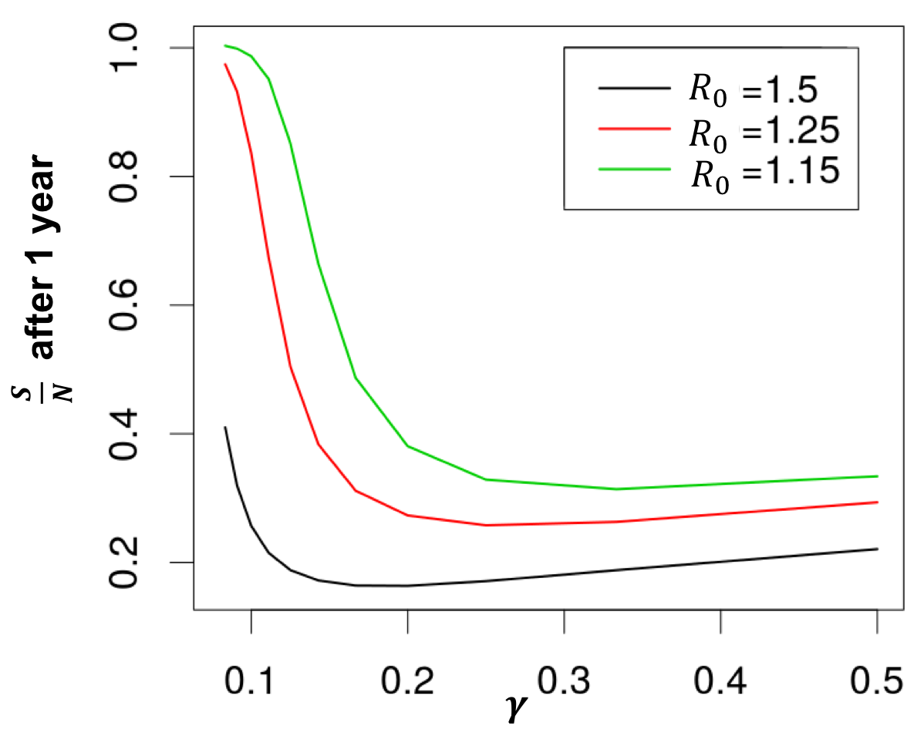
Supplemental Figure S15
Notes:
Supplemental Figure S15. Different combinations of $β_{0}$and $γ$ that yield the same $R_{0}$ value have different values of $\frac{S}{N}$ after 1 year. For example, suppose that we have the parameter combinations $δ=0.5, β_{0}=0.3, γ=0.2$ and $δ=0.5, β_{0}=0.15, γ=0.1$. While both parameter combinations give an $R_{0}$ of 1.5, the first yield an $\frac{S}{N}$ after one outbreak of around 20%, while the second gives an $\frac{S}{N}$ of approximately 40%. The plot shows values of $\frac{S}{N}$ as a function of $γ$ with $β_{0}$ modified to give different values of $R_{0}$. For all points in the plot, $δ=0.5,$I(t = 0) = 1, and $ω=\frac{2π}{365}.$

Slide 17
Supplemental Figure S16
Notes:
Supplemental Figure S16: Probability of stochastic epidemic in 1990 vs Process Noise Intensity ($σ_{P}$) under simulation from top 2LL parameter combinations of stochastic SIR Cosine Model. The fitted stochastic model was simulated forward in time from 1986-1990 with population growth. Daily pulse rates of 2,5,10,20, 50, and 100 infected individuals per day in January 1990 were used. Each parameter combination within 2 log-likelihood units of the MLE was simulated 100 times. The re-emergence probability was calculated by determining the number of simulations in which the susceptible population decreased in 1990. The plot shows re-emergence probability as a function of the process noise intensity $σ_{P}$. Each point represents a single parameter combination at a particular pulse rate. Points are colored by pulse rate. MLE parameter combination points are circled in red.

Slide 18
Supplemental Figure S17
Notes:
Supplemental Figure S17: Expected number of skips from deterministic calculation using parameter estimates from the fitted stochastic model (see Figures 3-4 and Methods). Expected numbers of deterministic skips were calculated for all parameter combinations within 2 log-likelihood units of the MLE of the stochastic model.R₀ δ and ρ values in this model from each combination were mapped to the nearest corresponding values in the deterministic matrix. Parameter values from the profile of the recovery rate (γ) in the sensitivity analysis shown in Supplemental Figure S8 were not included in the skip calculations (for the expected number of skips using those values, see Supplemental Figure S9). The expected number of skips was plotted as a function of R0. Each point represents one fitted parameter combination within 2 log-likelihood units of the MLE.

