Slide 1
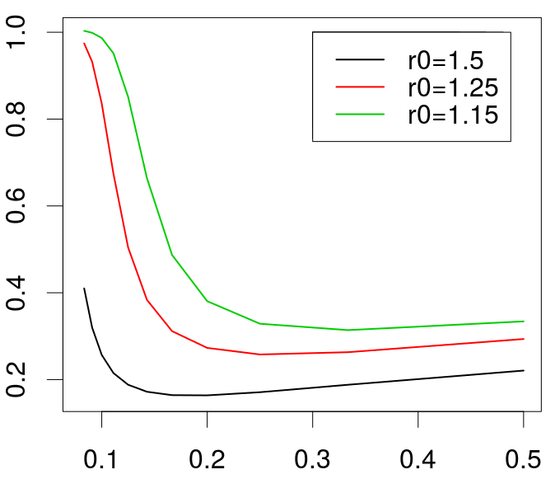





$$R_{0}$$
$$R_{0}$$
$$R_{0}$$
$\frac{S}{N}$ after 1 year
$$γ$$

