Slide 2
e-Service for RHD
RFP Ref. No: 35.01.0000.101.05.002.19.241
Issue Date: 03/10/2019
Ministry/Division: Ministry of Road Transport and Bridges
Presented by: Spectrum Engineering Consortium Ltd
Date: 28-Nov-2019

Slide 3
Spectrum Snapshot
Spectrum Engineering Consortium Ltd is
One of the leading IT System Integrators of Bangladesh
Inception in 1995, Incorporated in 1997
CMMI level 3, ISO -9001:2008 Certified
The founders and top management are from engineering and management background
200+ professionals trained & certified in technology and management
Served 800+ clients including Fortune 100 companies
Served Govt., Financial, Large Scale Enterprise, Telco etc.

Slide 4



































Proud to Serve
GOB
Financial
Telco
Multinational

Slide 5
Recent Achievement
Software and Services:
Interconnect Telco Billing for IGW and ICX Operators e.g. Digicon, Roots, TeleExchange, Paradise Telcom etc..
RHD MIS, RHD Tender Database
ROC for Robi Axiata, Grameen Phone
Audit Management System in Nepal and Bangladesh
Higher Education Management Information System, UGC
BANGLADESH Bank RTGS solution
Agent Banking solution for Agrani Bank
One the Largest ERP-EAM implementation for Partex Star Group.
One of the largest BI Solutions for NBR (Customs Department)
One Point Collection Center Solutions for SCB
VAT Management System for Nestlé, HeidelbergCement, Reckitt Benckiser, Tetra Pak, S C Johnson
Outsourcing:
Provided software outsourcing services for USA clients (successfully completed 40+projects) since 2006.

Slide 6
RHD existing Systems
Systems on Live | -
Organizational Database | Tender Database
Personnel Database System (PDS) | Schedule of Rates
Road Maintenance Management System (RMMS) | Contract Database
Bridge Maintenance Management System (BMMS) | Training Database
Central Management System (CMS) | Document Database
Project Monitoring System | Data Export-Import Tool
Finance and Budget Management Module | HDM Data Export Tool

Slide 7
Development of e-Service platform includes
Online system to manage measurement book (MB)
Online application portal system
to construct and maintain roads, bridges, culverts and Ferry
for establishing advertisements and billboards on the land of RHD
by public and permission granted by RHD for establishing CNG-filling and petrol pump stations and approaching road
Online auction management system
Online system to manage the public use of RHD equipment by rental service
Data collection, data correction/readiness, data entry and piloting
Training and capacity-building
Operation, maintenance

Slide 8
KEY TECHNICAL CHALLENGES
Scale
High Availability
High Speed Data Entry, Reporting
Integration with Local & National API (nid, e-filing,telco,bank)

Slide 9
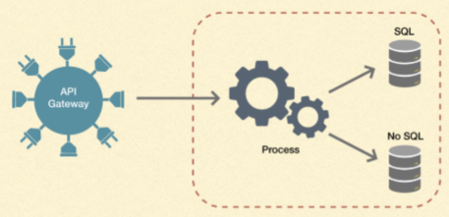
SYSTEM ARCHITECTURE
Micro-services highly recommended
So each service can be scaled independently
If a service is overloaded, other services continue to function

Slide 10
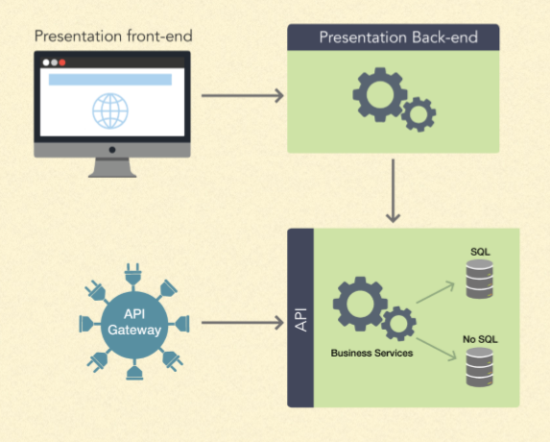
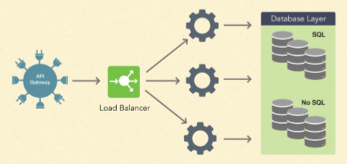
A TYPICAL MICRO SERVICE
SCALING

Slide 11
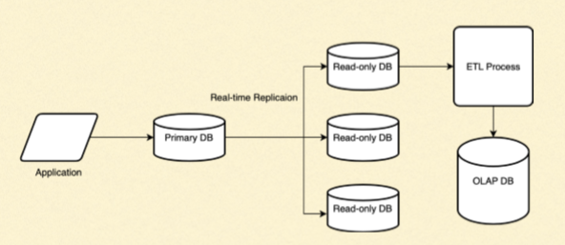
DB ARCHITECTURE
Primary DB → read-only replica databases
Read-only DB → OLAP database

Slide 12
SOLUTION TECHNOLOGIES
Database: RDBMS for Proﬁles, NoSQL for quickResponse
RDMS: PostgreSQL or MySQL
NoSQL: MongoDB
Queue: Apache Kafka
Language: Java 8+ and JavaScript ES6
Application frameworks: Spring (for Java), hapi (for JavaScript)
Runtime: OpenJDK, Node.js
Front-end: Angular, HTML5, CSS3

Slide 13
DEVELOPMENT TOOLS
Source control: git hosted on GitHub
Sprint planning and change tracking: Jira, openProject
Documentation: Google docs, sheets & slides
High level project management: Basecamp

Slide 14
DEVELOPMENT METHODOLOGY
Agile Scrum with Sprint Planning on Jira
Fully documented in Jira, including post deployment change tracking
Strict code review with Pull Requests on git repo
Continuous Integration & Continuous Delivery (CI/CD) -Jenkins
Docker container based deployment

Slide 15
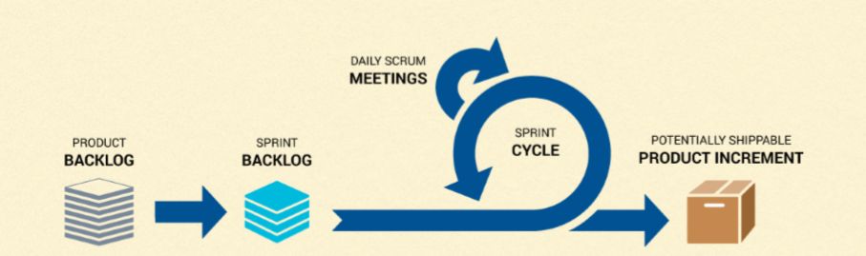
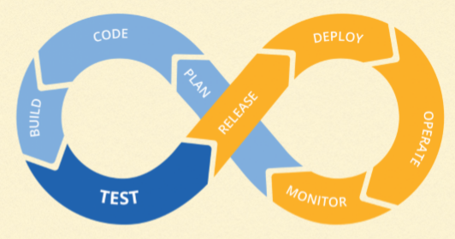
DEV PROCESS - SCRUM
CI/CD

Slide 16
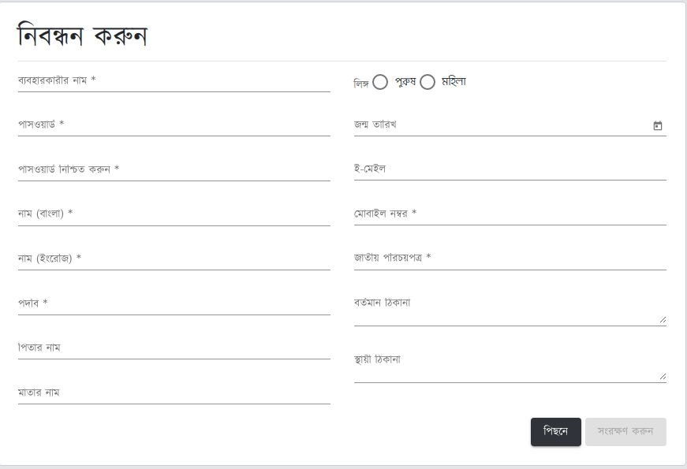
PoC DEVELOPMENT

Slide 17
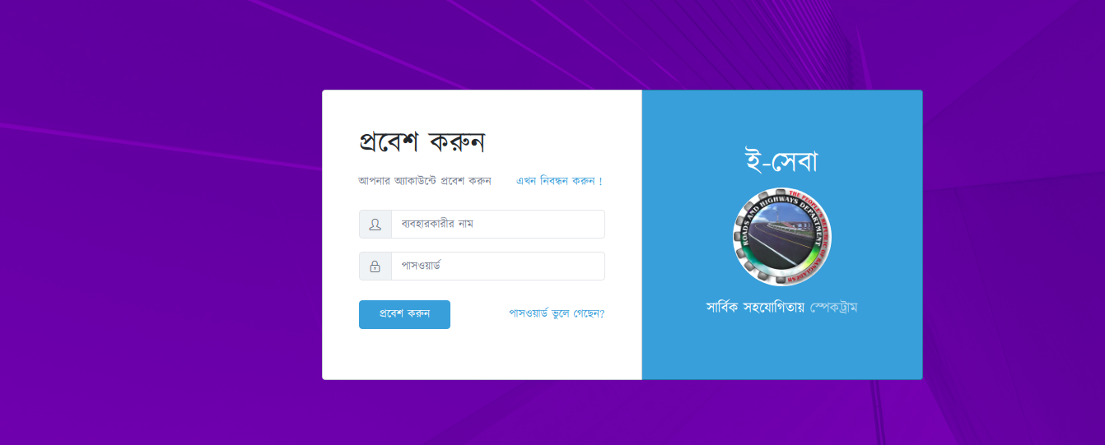
PoC DEVELOPMENT

Slide 18
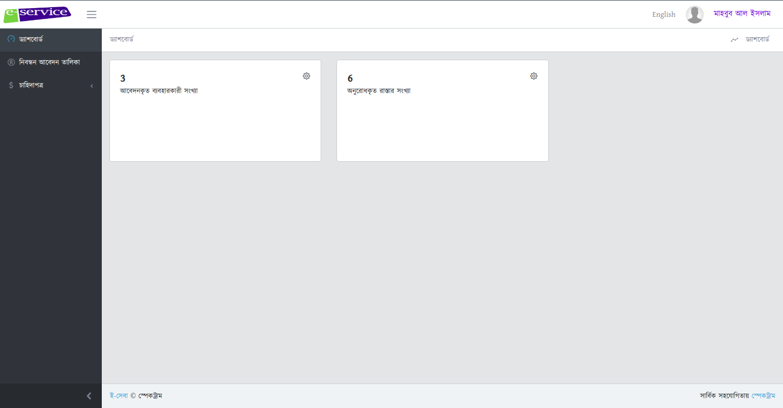
PoC DEVELOPMENT

Slide 19
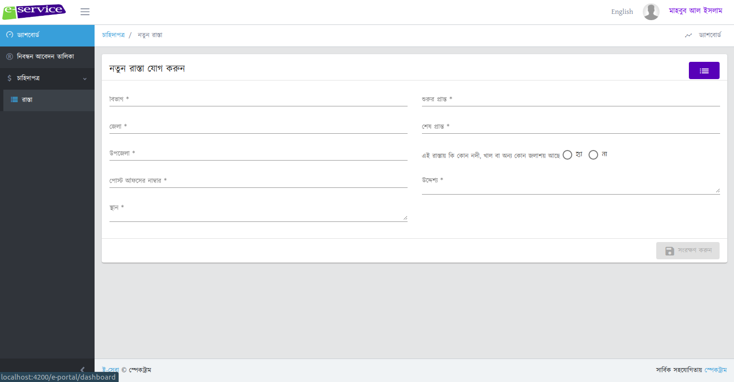
PoC DEVELOPMENT

Slide 20
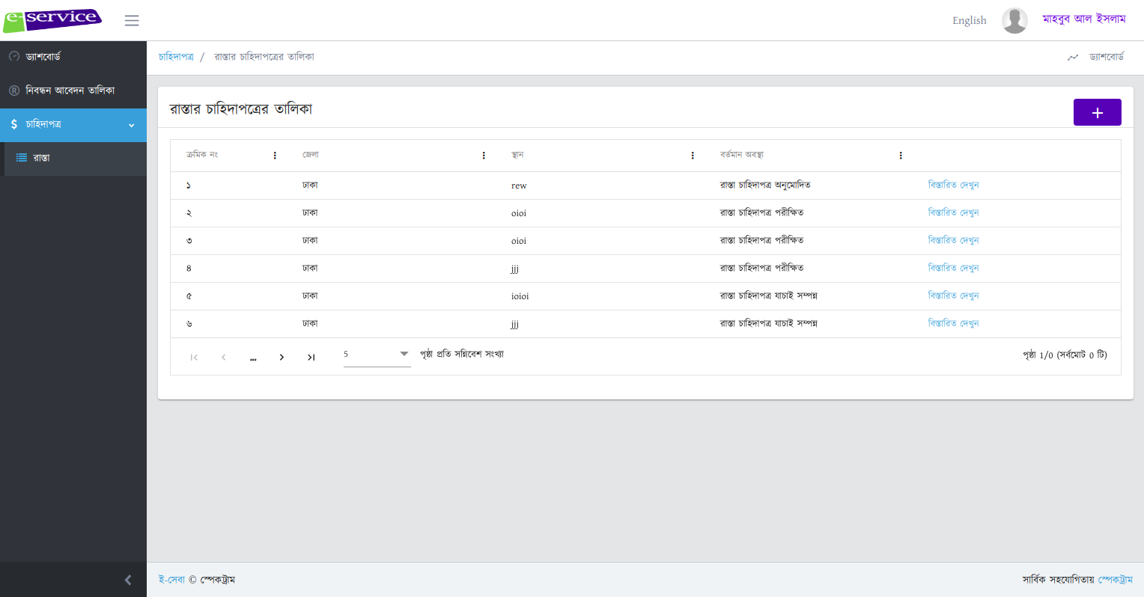
PoC DEVELOPMENT

Slide 21
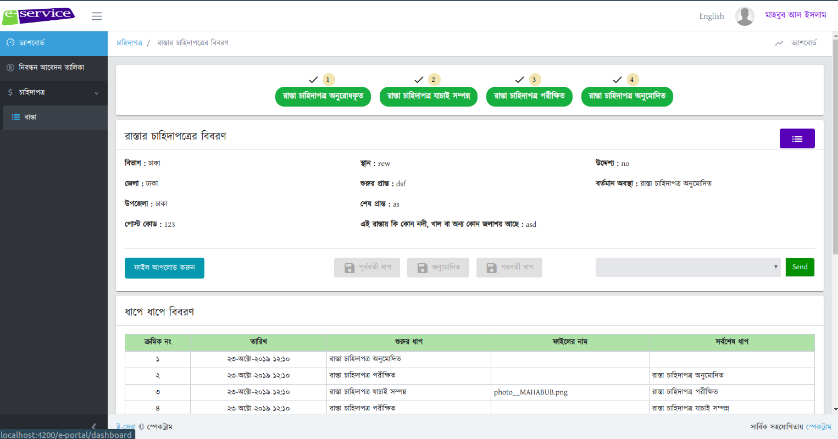
PoC DEVELOPMENT

Slide 22
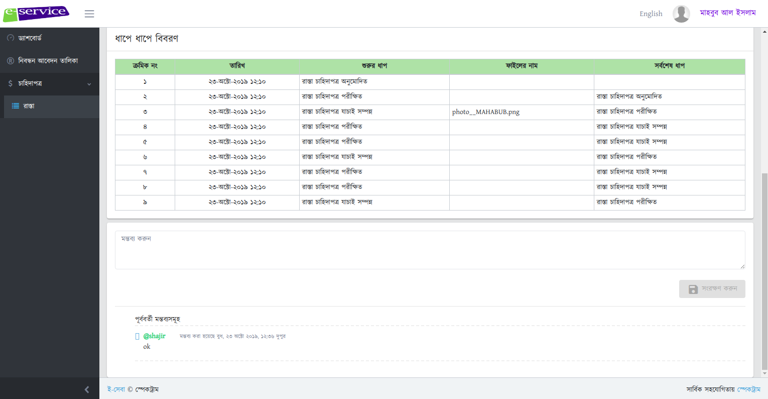
PoC DEVELOPMENT

