Slide 1
Development and delivery environment
using Docker

Slide 2
Presentation Agenda
Introduction to docker -
what, why etc.
Why we use Docker -
Benefits
How Docker Works
Installation and Configuration - DEV environment
Installing and Running Cellostics on Docker - DEV environment
Deploying Cellostics Docker Image (created from DEV) to Production
Modifying Cellostics in DEV and modifying Docker Image
Redeploying Docker Image in prod with modification
Building Microservices in Docker Image

Slide 3
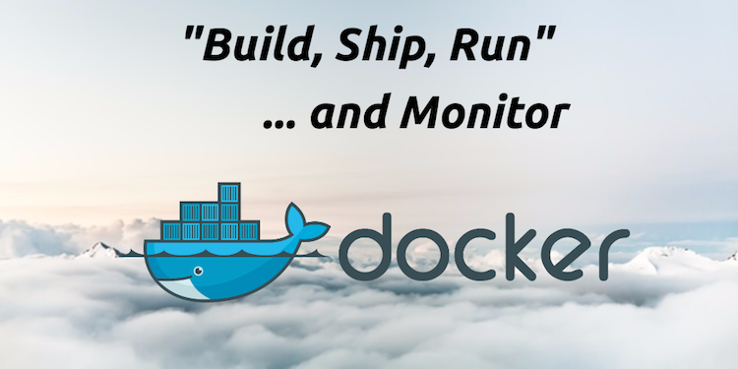
Introduction to Docker - what?
What is Docker
Open platform for developers and sysadmins to build, ship, and run distributed applications
It is a lightweight container platform and it is fast
Available on most linux distros
Also runs on windows and mac os
Can run thousands of containers

Slide 4
Introduction to docker why, what?
Traditional VM vs. Docker
uniVerge
Celloscope
Cellostics
uniVerge
Celloscope
Cellostics
Bins/Libs
Bins/Libs
Bins/Libs
RHEL
CentOS OS
Guest OS
Bins/Libs
Bins/Libs
Bins/Libs
Hypervisor
Docker Engine
Host OS
Linux Kernel/Host OS
Hardware
Hardware
VM
Docker
Notes:
The challenge

Slide 5
The issue with traditional VM’s
Many different stacks
Languages (Java, C#, Python, R)
Frameworks (Angular, River, Spring)
Databases (Postgres, Oracle, NoSQL)
Many different targets
Individual development environments
Pre-production, QA, staging ….
Production: on premises, cloud, hybrid
Deployment becomes very complex

Slide 6
Why Docker, its benefits
A Clean, Safe and portable runtime environment for Your App
No worries about missing dependencies, package and other pain points during subsequent developments.
Run each app in its own isolated container, accumulated with various versions and libraries and other dependencies for each app
Automate testing, integration, packaging, anything you can script.
Reduce/Eliminate concerns about compatibility on different platforms
Cheap, zero-penalty containers to deploy services. A VM without the overhead of VM. Instant replay and reset of image snapshot. That's the power of Docker
It’s Fast and lightweight
Minimal overhead/resource usage
Run thousands of containers
Easy to run your whole production stack locally

Slide 7
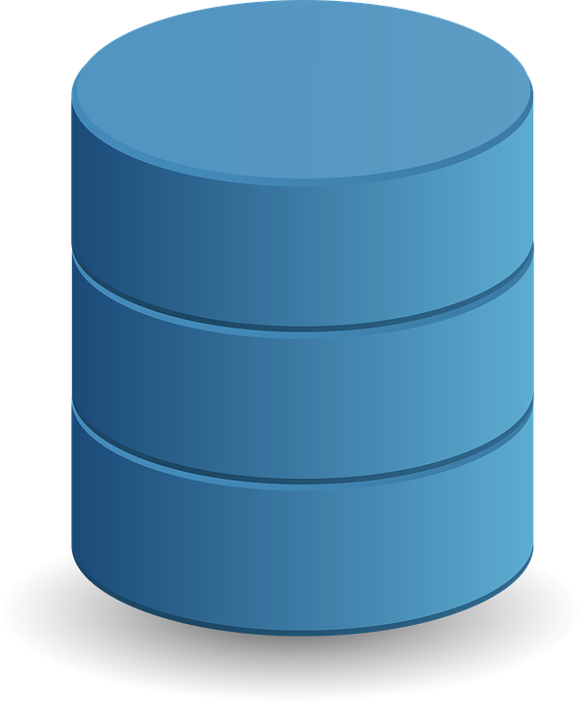
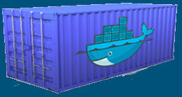
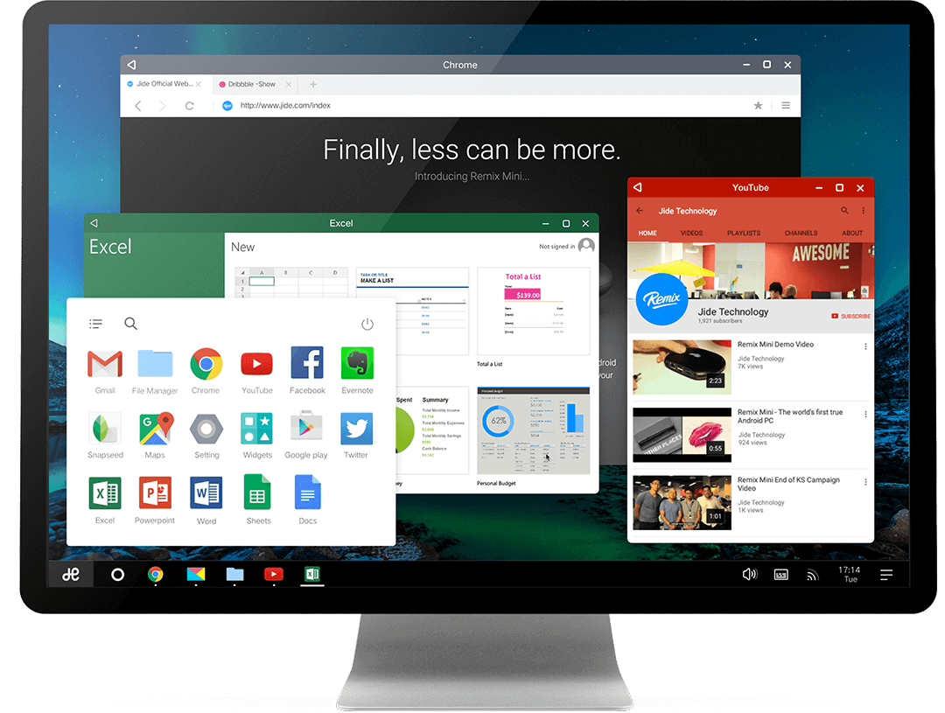

Introduction to docker why, what, etc ?
VM

Slide 8
How docker works
Isolated Application Platform
Contains everything needed to run your application
Based on images
Container
Image
Read Only Template used to create containers
Built by you or other Docker users
Stored in the Docker Hub or your local Registry
Container 1
Image 1
Docker Client
Container 2
Image 2
Container 3
Image 3
Host
Docker Registry

Slide 9


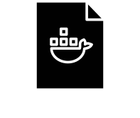
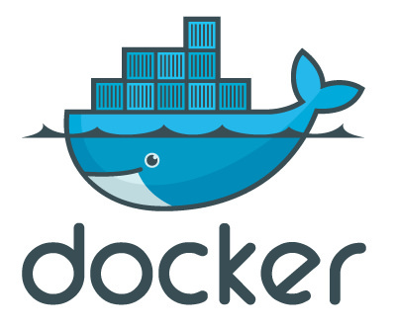
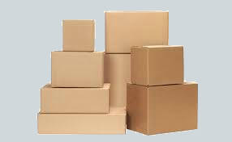
Installation and configuration
5 - Push
build
Images
1-Pull
4-Commit
Container
2-run
3 - Stop, Start, restart
Local Docker instance
Notes:
Docker workflow

Slide 10
Installation and configuration
1.Installing docker
> sudo apt-get install docker-engine # For Debian and Ubuntu
> sudo yum install docker-engine # For RHEL, CentOS, Fedora
2. Starting docker service
> sudo systemctl start docker
3.Verify docker is installed correctly by running
> sudo docker run --rm hello-world
4. Installing Docker Image
> docker pull image_name
> docker images # Will show existing images
> docker ps -l # Will show all running container

Slide 11
Installation and configuration
5. Showing Docker network
> docker network inspect network_name
6. Kill all running container
> docker kill $(docker ps -q)
7. Deleting unused docker container
> sudo docker rm ‘docker ps --no-trunc -aq’
8. Delete all stopped containers (including data-only containers)
> docker rm $(docker ps -a -q)
9. Delete all 'untagged/dangling' (<none>) images
> docker rmi $(docker images -q -f dangling=true)
> docker volume is -f dangling=true

Slide 12
Installation and configuration
10. For connecting docker postgres console
> docker exec -ti testcellostics_db_1 psql -h db -U postgres
> docker run -it --rm --link db_ap:postgres postgres psql -h postgres -U postgres
> docker run --name auth_data -e POSTGRES_PASSWORD=mysecret -d postgres
> docker run -it --rm --link db_ap:postgres postgres psql -h postgres -U postgres
11. Giving an image a new name
> sudo docker tag <oldname> <newname>

Slide 13
Installing and running Cellostics on Docker dev environment
Dockerfile
FROM python:3.5
ENV PYTHONUNBUFFERED 1
RUN mkdir /app
WORKDIR /app
ADD requirements.txt /app/
RUN pip install -r requirements.txt
ADD . /app/

Slide 14
Installing and running on Docker dev environment
docker-compose.yml
version: “2”
service
nginx:
image: "nginx:latest"
ports:
- "8080:8000"
volumes:
- "./src:/src"
- "./config/nginx:/etc/nginx/conf.d"
cellostics-server:
build: .
hostname: cellostics-server
command: bash -c "gunicorn project.wsgi:application -b 0.0.0.0:8000"
volumes:
- .:/app
ports:
- "8000:8000"
depends_on:
- db

Slide 15
Installing and running on Docker dev environment
Docker-compose.yml (contd.)
db:
image: postgres:9.5
hostname: db
environment:
- POSTGRES_USER=postgres
- POSTGRES_PASSWORD=postgres
- POSTGRES_DB=postgres

Slide 16
Deploying Cellostics Docker image(created from Dev) to prod
1. Push the images to the docker hub
> docker push username/imagename:tag
2. Pull the image from docker hub or other sources
> docker login username
> docker pull image_name:tag
> docker images
> docker run image_name:tag
3. Run from configuration file (the directory where docker compose file located)
> docker-compose up

Slide 17
Modifying and redeploying image in production environment
1. Run the docker image which will run as a container
> docker run -it image_name command_to_execute
2. Modified container will save as image
> docker commit container_name image_name
3. Redeploying modified Image and run as a container
> docker run image_id

Slide 18

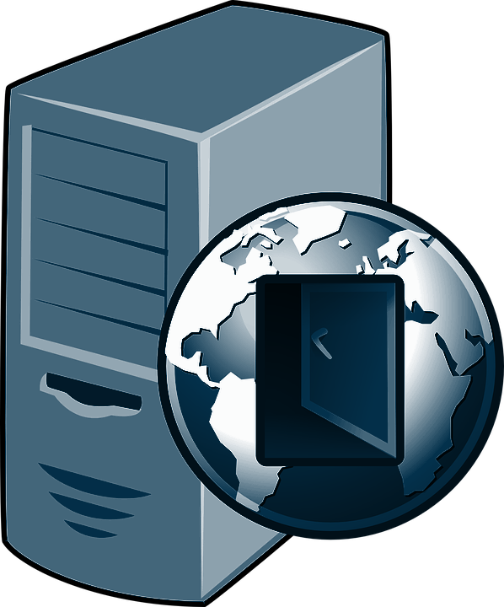
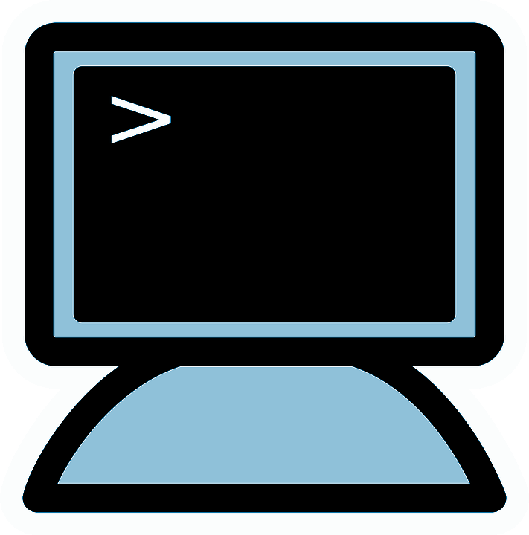
Building Microservice Application
Traditional Style Monolithic Architecture
UI
Backend
RDBMS
Other Service
User
Reverse Proxy
Application Server
Notes:
Docker workflow

Slide 19
Microservice Application using docker
Microservice Architecture
Container
Container
Web Front end
Log Server
DB
Container
Container
Map Service
Message client
Notes:
Docker workflow

Slide 20
Microservice Application using docker
Each Service can be developed and upgraded independently
Easier to developer for understand
If one service goes down, then the application should still run, although with the reduced functions
Application is easier to troubleshoot and maintain
The whole application doesn’t have to be committed to one technology dependent stack
Notes:
Docker workflow

Slide 21
Implementation
Create a Docker File
Create a Docker Compose File
Build Docker file
Docker Compose File Up
Restore data for Postgres docker container
Create image for Nginx
Docker Login
Docker Push
Docker Pull by other
Start nginx

Slide 22
Sources and references
http://slidedeck.io/lodelestra-edu/docker-slides
http://www.slideshare.net/dotCloud/why-docker
https://denibertovic.com/talks/supercharge-development-env-using-docker/#/12
https://docs.docker.com/engine/tutorials/dockerizing/
http://view.dckr.info:9090/#24
https://github.com/smancke/docker-intro

Slide 23
docker run -d -p 9000:9000 --privileged -v /var/run/docker.sock:/var/run/docker.sock uifd/ui-for-docker

Slide 24
Any Questions?

