Slide 1

Modern Backend Development
Chapter 1 — Introduction to Backend Development
Firebase • MongoDB • PHP • MySQL

Slide 2
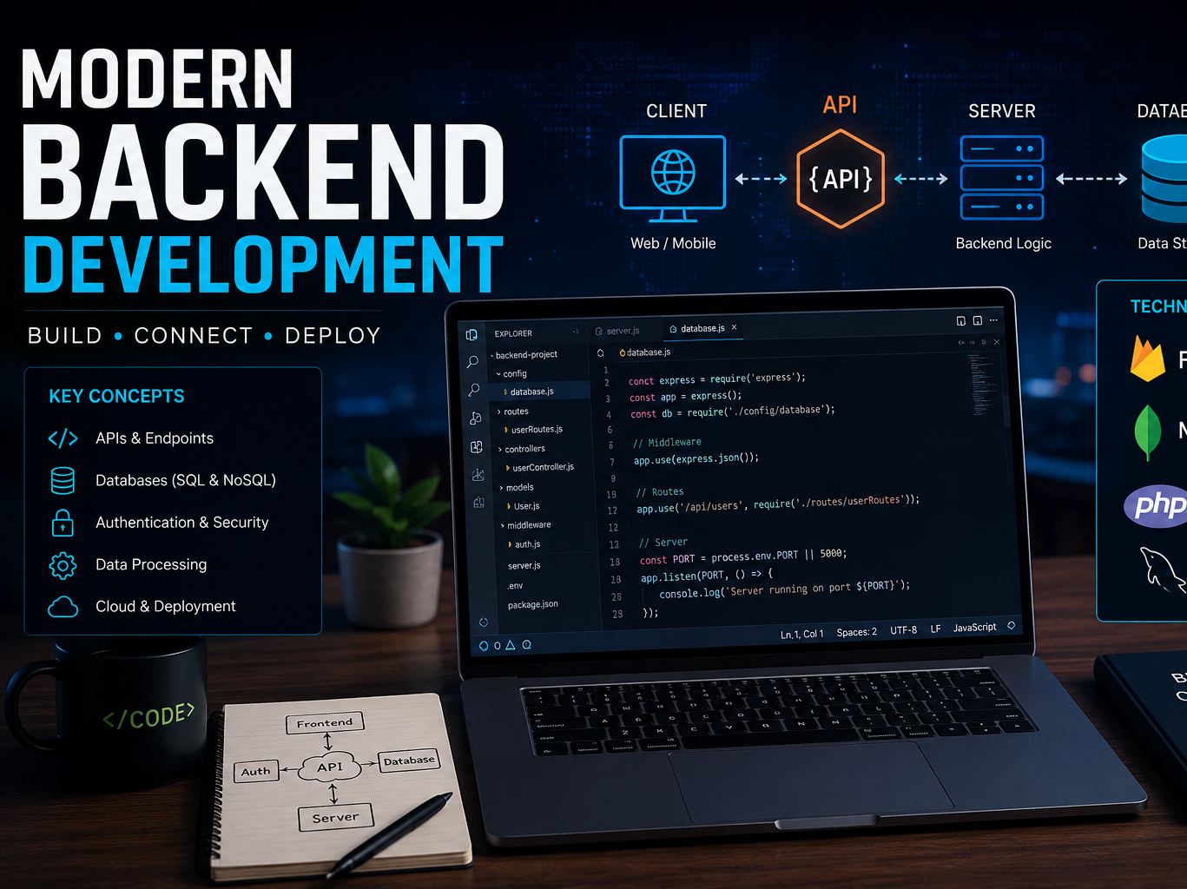

Slide 3
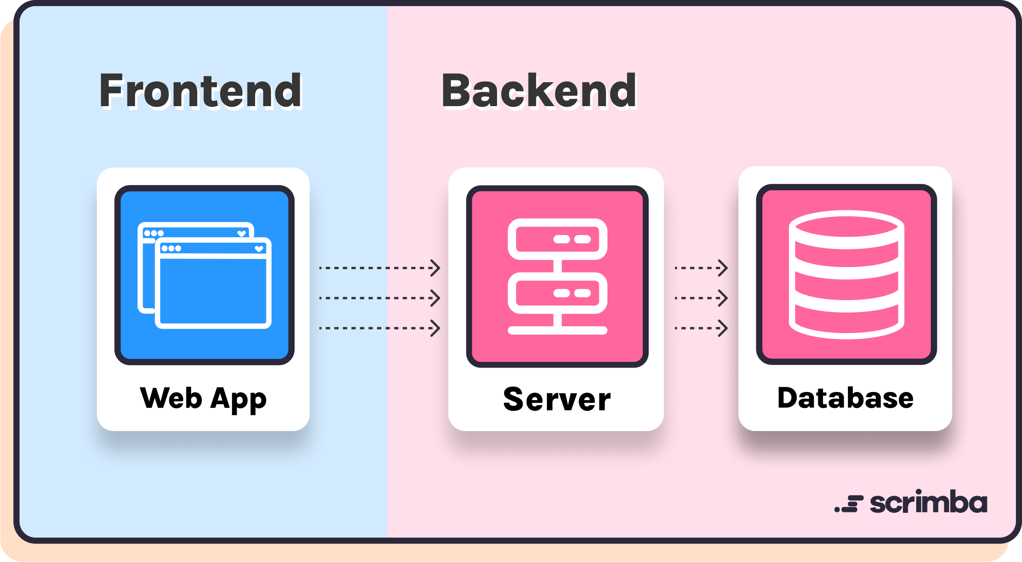

Slide 4
What is Backend?
• Hidden logic behind applications
• Handles data and authentication
• Connects frontend with database
• Processes requests and responses
Real Example:
Instagram stores accounts, posts, likes, and messages using backend systems.

Slide 5
Frontend vs Backend
Frontend:
• UI Design
• HTML, CSS, JavaScript
• What users see
Backend:
• Database
• APIs
• Authentication
• Business Logic

Slide 6
How Websites Work
Flow:
User → Frontend → Backend Server → Database
• User sends request
• Backend processes data
• Database stores/fetches information
• Response returns to user

Slide 7
Login System Flow
Step 1: User enters email & password
Step 2: Backend receives request
Step 3: Database verification
Step 4: Success or error response
Important:
Frontend never directly accesses database.

Slide 8
What is API?
API = Communication bridge
• Connects frontend and backend
• Transfers data using JSON
• Used in websites and mobile apps
Examples:
Instagram API
Weather API
Payment API

Slide 9

API Methods
GET → Fetch Data
POST → Send Data
PUT → Update Data
DELETE → Remove Data
These methods are used in REST APIs.

Slide 10
JSON Basics
Example JSON:
{
"name": "Arshad",
"course": "Backend"
}
• Key-value structure
• Lightweight data format
• Used in APIs and backend communication

Slide 11
SQL vs NoSQL
SQL:
• Tables and rows
• Structured data
• Example: MySQL
NoSQL:
• JSON documents
• Flexible structure
• Example: MongoDB, Firebase

Slide 12
MySQL Database Structure
• Tables
• Rows
• Columns
• Primary Keys
Best for:
Banking systems
Management systems
Structured applications

Slide 13
MongoDB Document Structure
• Collections
• Documents
• JSON storage
Best for:
Chat applications
Social media apps
Flexible backend systems

Slide 14
Backend Security
• Authentication
• Authorization
• Password protection
• Backend security layer
Backend protects database from unauthorized access.

Slide 15
Real-World Backend Examples
Instagram → User accounts & feeds
WhatsApp → Messaging system
Amazon → Orders & payments
YouTube → Videos & recommendations

Slide 16
Practical Session
Practical 1:
Create simple JSON response.
Practical 2:
Understand request and response cycle
Practical 3:
Observe APIs using browser inspect tools

Slide 17
Conclusion
Students learned:
• Backend fundamentals
• APIs
• JSON
• SQL vs NoSQL
• Client-server architecture
Next Chapter:
Firebase Backend Fundamentals

