Slide 1
ATKool: Next-Generation School Management

Slide 2
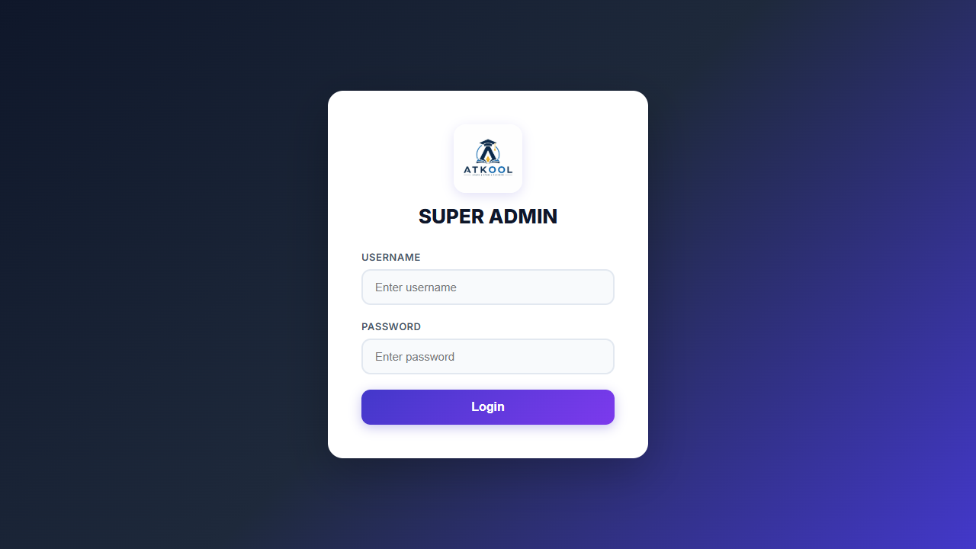
Super Admin Login

Slide 3
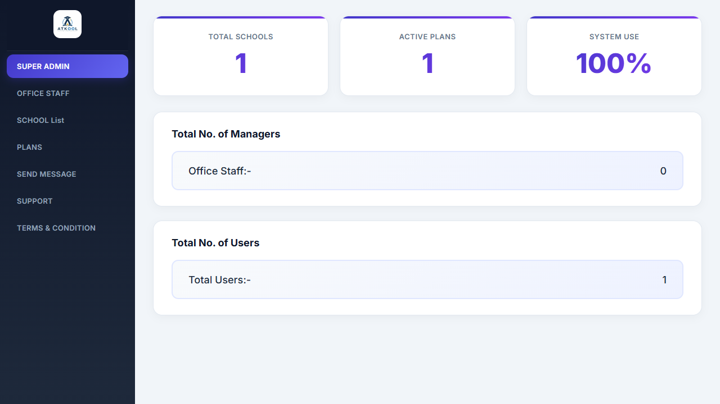
Super Admin Dashboard

Slide 4
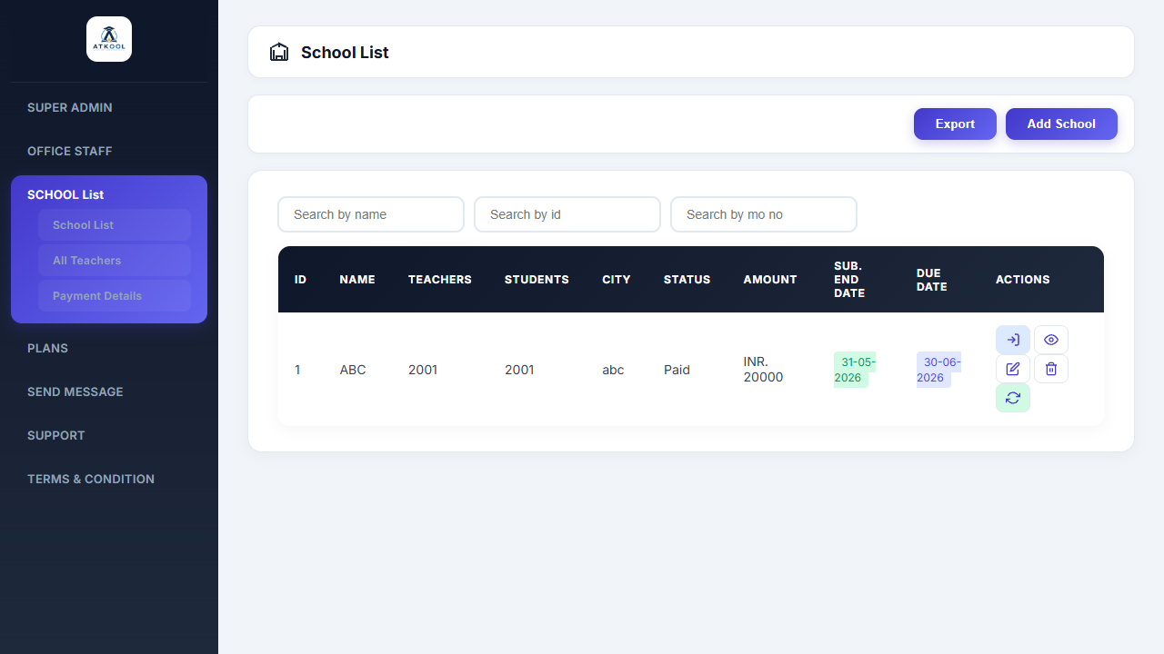
Schools Management

Slide 5
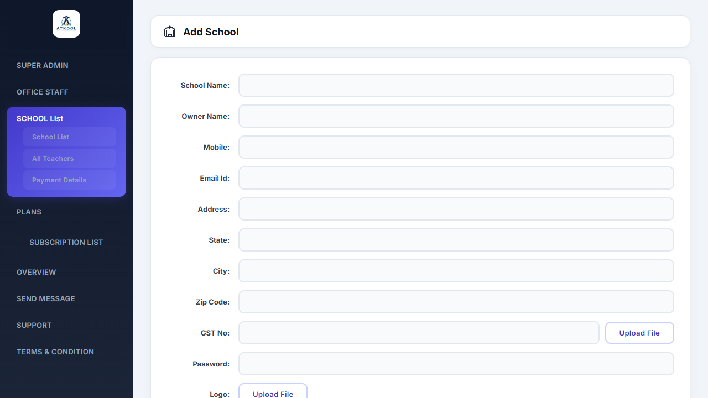
Creating a New School

Slide 6
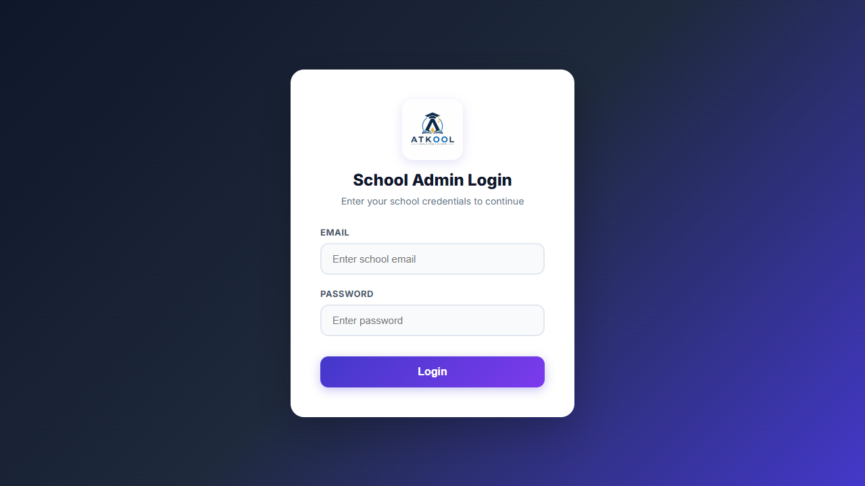
School Admin Login

