Slide 1

ATKool: Next-Generation School Management
Comprehensive, intuitive, and designed to empower educational institutions.

Slide 2
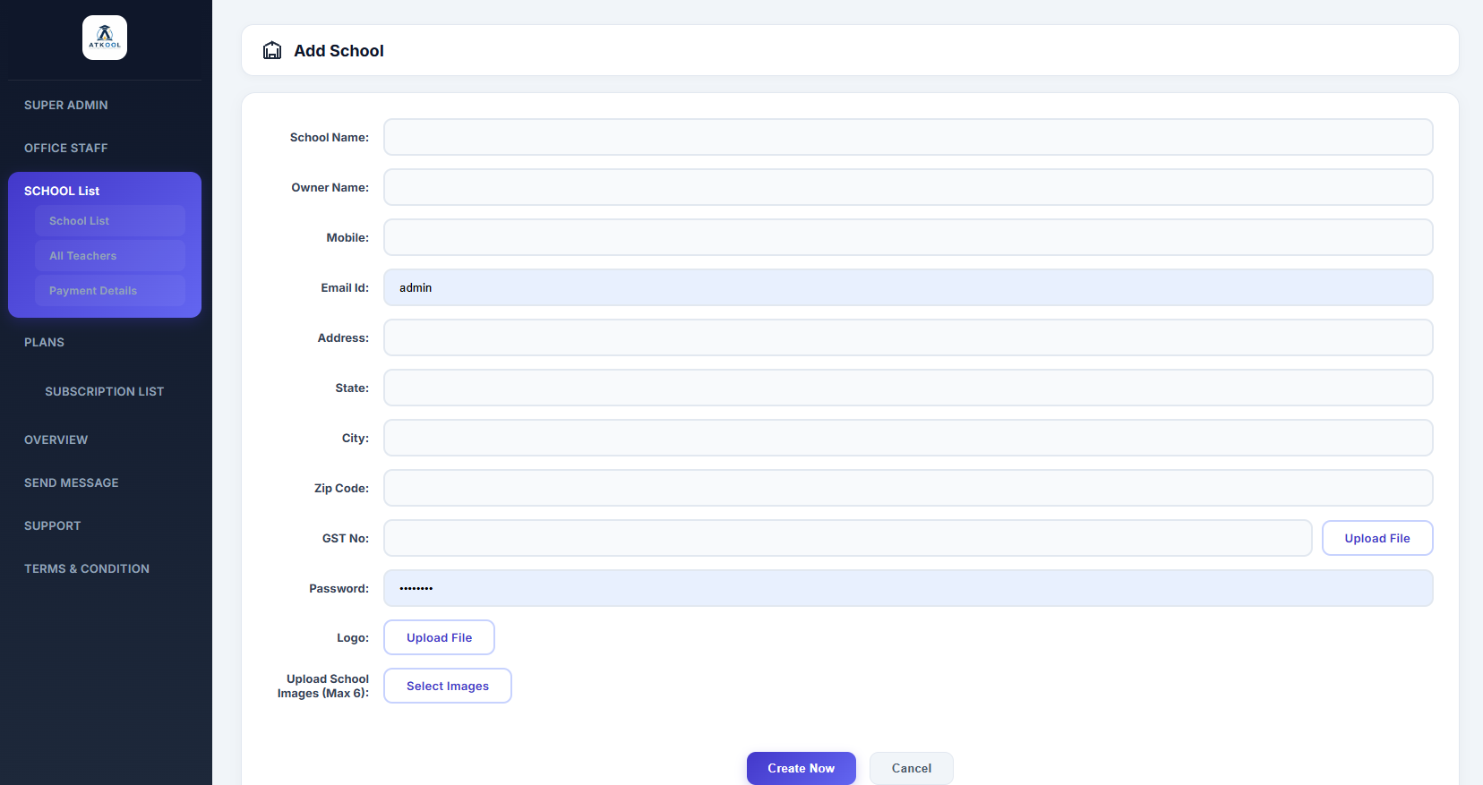
1. Super Admin Dashboard & School Creation
• Complete platform visibility and analytics. • Create new school instances with a few clicks. • Manage pricing plans and onboarding securely.

Slide 3
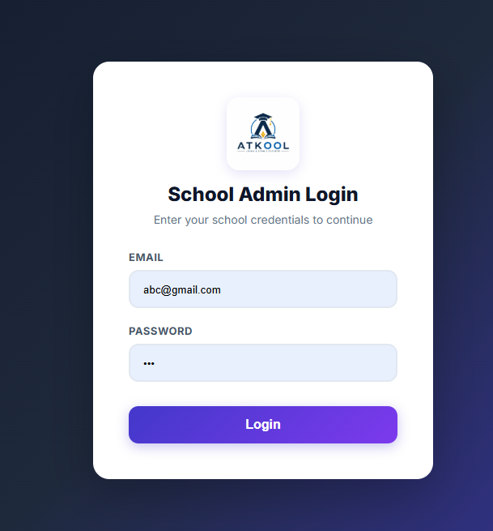
2. School Admin Login
• Secure entry for newly created schools. • School admins log in using provided credentials. • Beautiful, premium Royal Indigo interface.

Slide 4
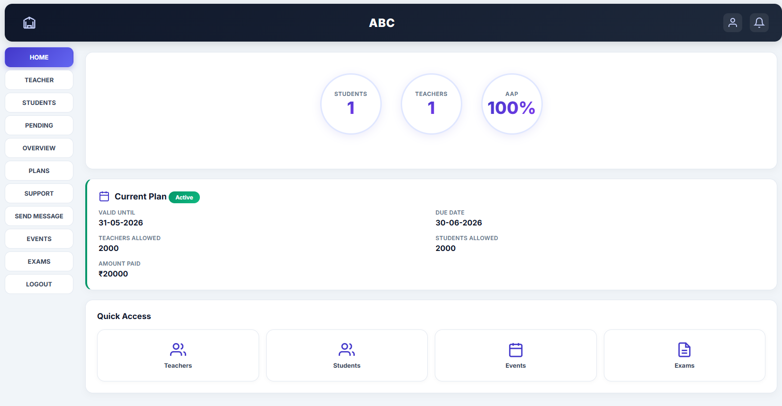
3. School Admin Dashboard
• High-level overview of daily operations. • Real-time stats: Students, Teachers, Pending Approvals. • Quick access links for rapid navigation.

Slide 5
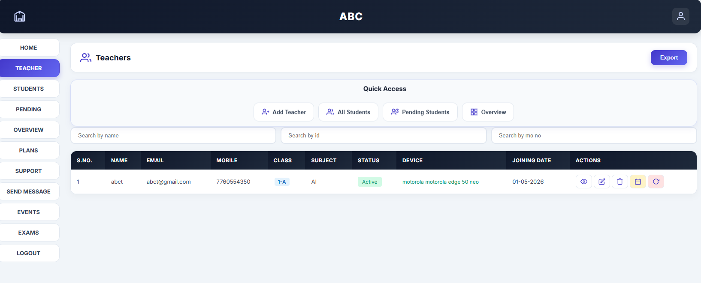
4. Managing People
Teachers & Students Module: • Directory listing with status indicators. • Add, edit, or approve pending requests easily. • Professional table designs with smooth interactions.

Slide 6
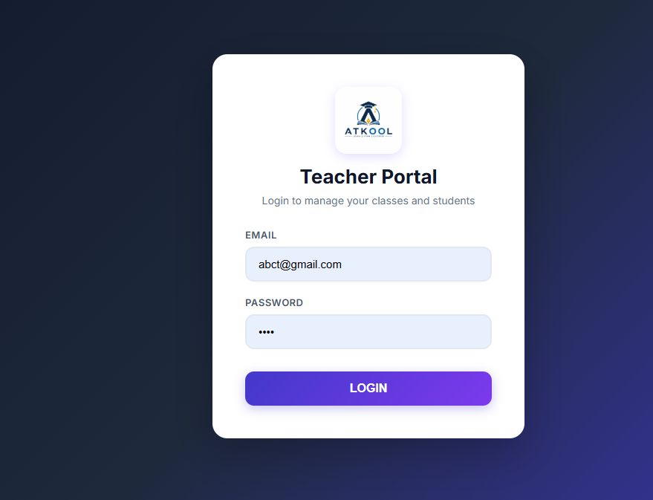
Teacher Portal

Slide 7
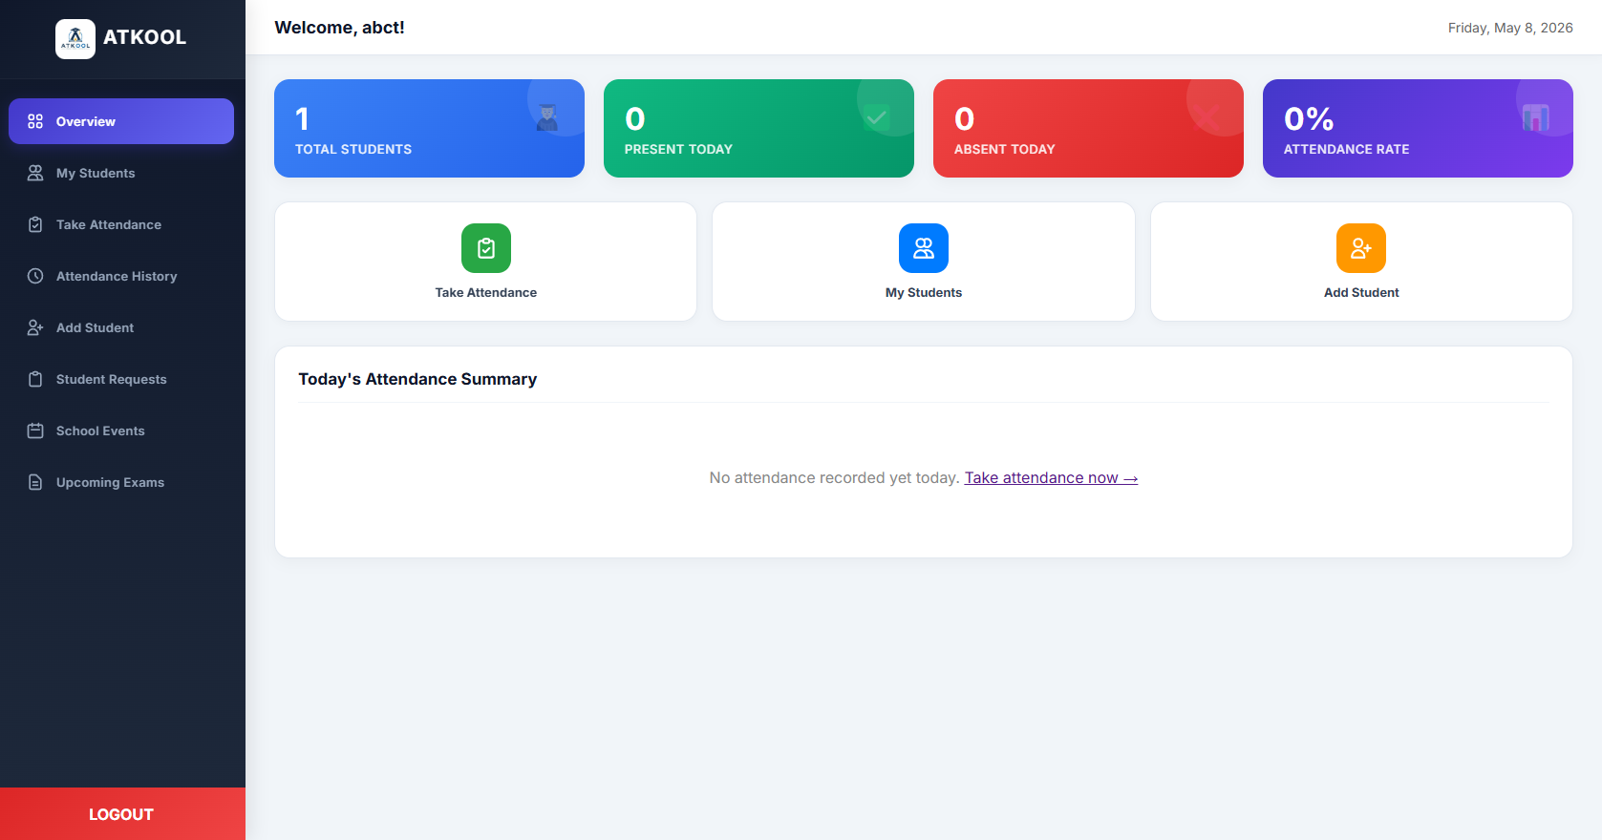
Teacher Portal

Slide 8
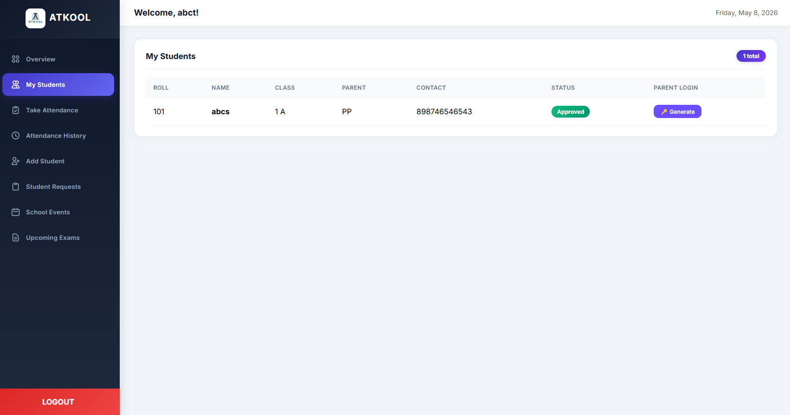

Slide 9
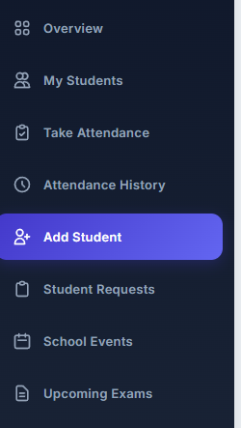

Slide 10
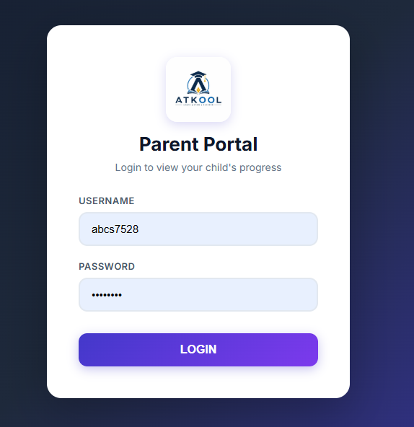
Parent Portal

Slide 11
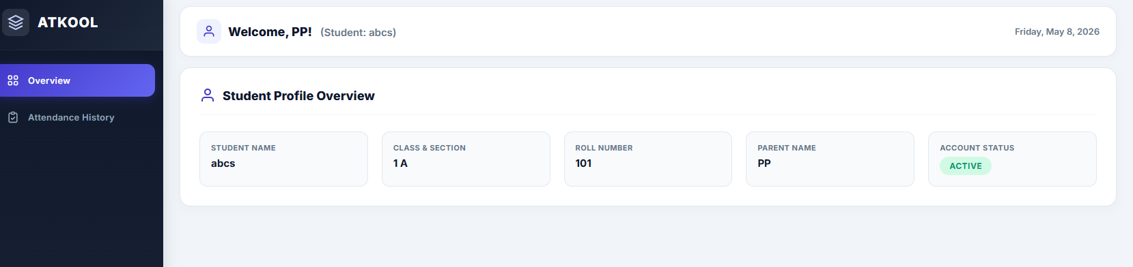
Parent Portal

Slide 12
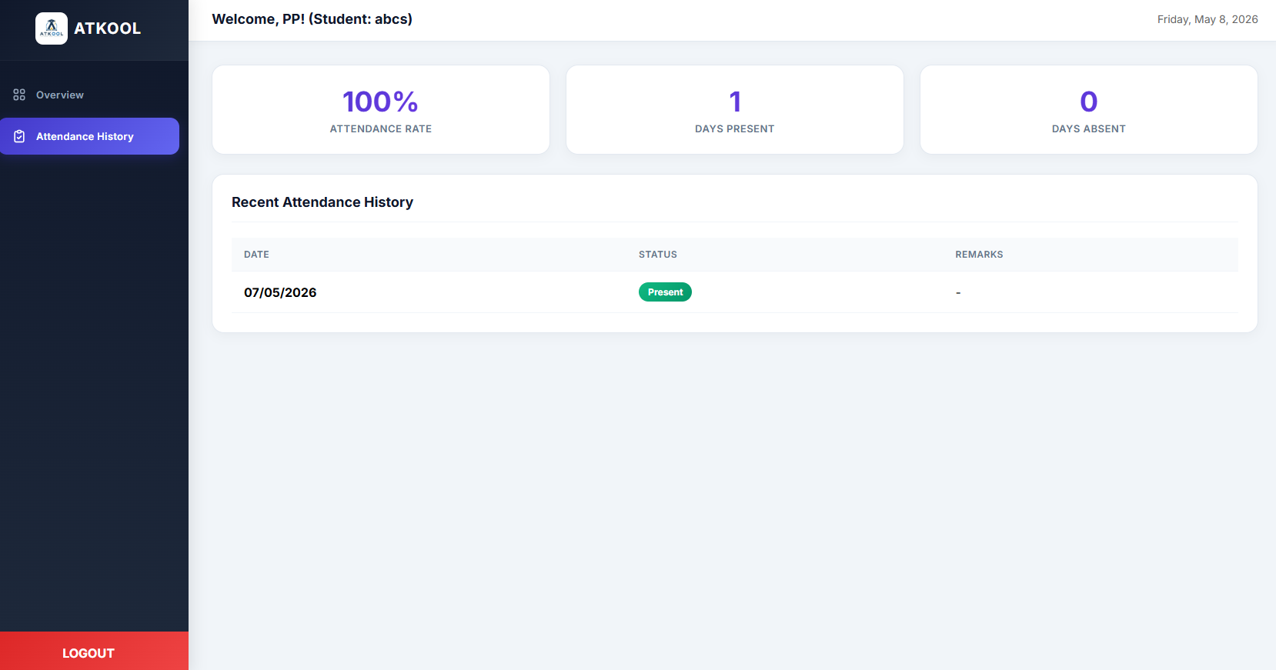
Parent Portal

