Slide 1
Smart Event Management System
(SHRESHTA)
A Real-Time Digital Transformation for Inter-Collegiate Fests
Guided by: Mrs. Neha J K
Presented by: Arshad Pasha

Slide 2
INDEX
1. Abstract
2. Introduction
3. Literature Review
4. System Architecture
5. Implementation Workflow
6. Operational Dashboards & Dashboards UI
7. Objectives of the Study
8. Results and Discussion
9. Conclusion
10. References

Slide 3
1. Abstract
The Problem:
Massive logistical hurdles—long queues, paper tracking, manual payment verification, and delayed certificates.
The Solution:
Developed "SHRESHTA 2026", a holistic cloud-based platform utilizing Next.js, Firebase NoSQL, and HTML5 Canvas.
Key Achievements:
Achieved 100% paperless lifecycle, sub-5-second QR verification times, and completely isolated real-time analytical dashboards.

Slide 4
2. Introduction
Legacy Workflow Limits:
Traditional academic events rely on physical ledgers and standalone Google Forms, creating massive data duplication and cross-checking friction.
The Digital Transformation:
Our proposed client-side hydrated web app acts as a 'Single Source of Truth'. It processes dynamic registrations based on rule-sets, securely handles strict UTR validation, and natively dispatches HTML certificates.

Slide 5
3. Literature Review
1. Traditional Barriers: Physical spreadsheets fail to support high-volume, real-time concurrent user loads.
2. Commercial Software: Platforms like Eventbrite lack agile customizability and demand high transactional fees unsuitable for colleges.
3. Academic Gap: While studies support QR verification (e.g. Kumar & Singh 2022), they are rarely fused with serverless micro-architectures for dynamic multi-event symposiums.

Slide 6
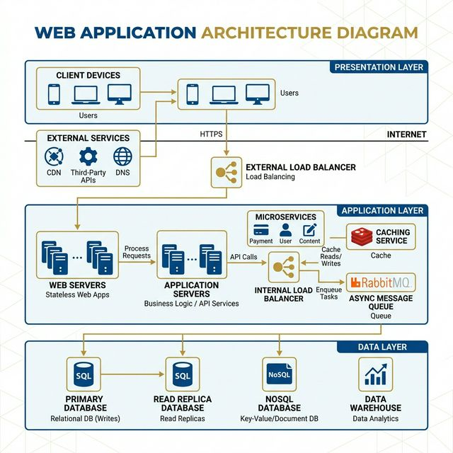
4. System Architecture

Slide 7
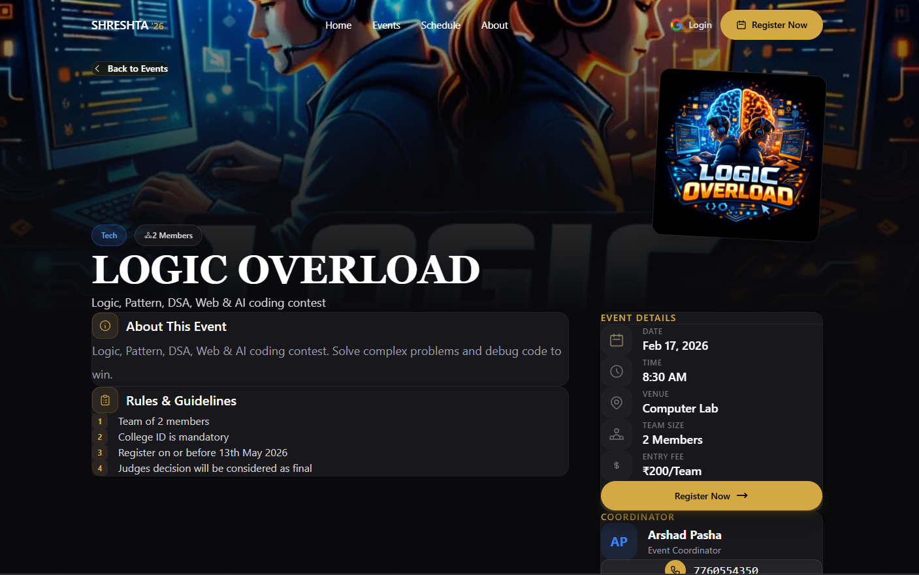
5. Implementation: Live Registration
Dynamic Data Intake:
- Captures Team Sizes based on event constraint logic. - Directly incorporates secure UPI QR and records the UTR ID immediately.

Slide 8
6. Real-Time Admin Dashboards
The interface uses Firebase Listeners. Calculations for 'Pending', 'Checked-in', and 'Total' aggregate instantaneously. Isolated Role Based Access Control (RBAC) ensures 0% data overlap among different faculties.

Slide 9
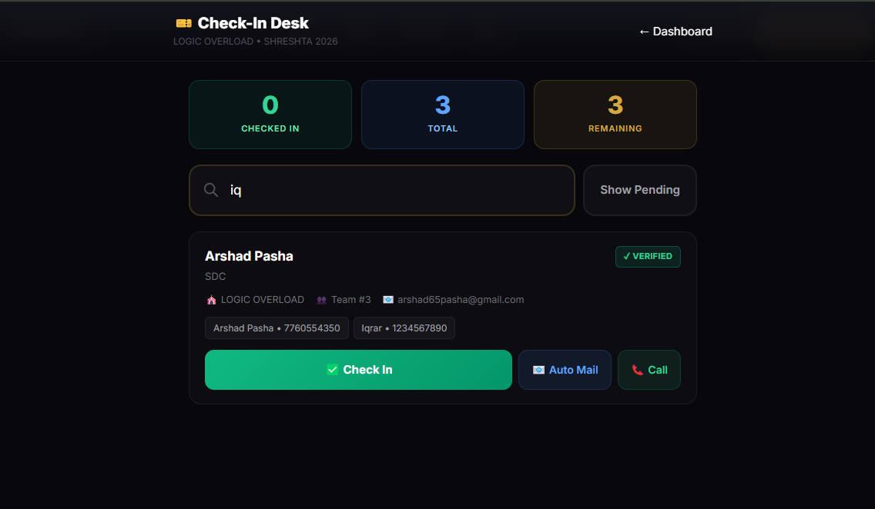
7. Sub-5-Second Check-in Algorithm
Fuzzy-Search Logistics:
- Volunteer staff can search by Phone, ID, or Name. - Direct integration allows instant 'Reminder Tracking' and One-Tap Check-ins.

Slide 10
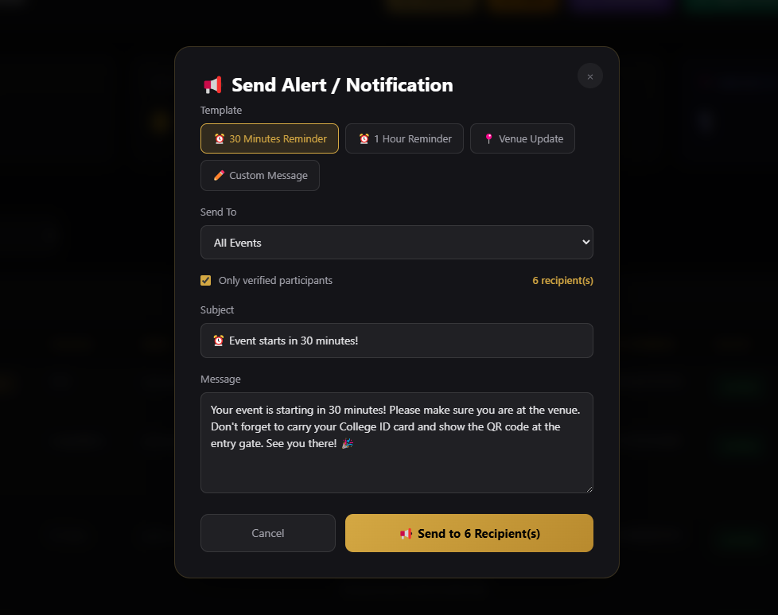
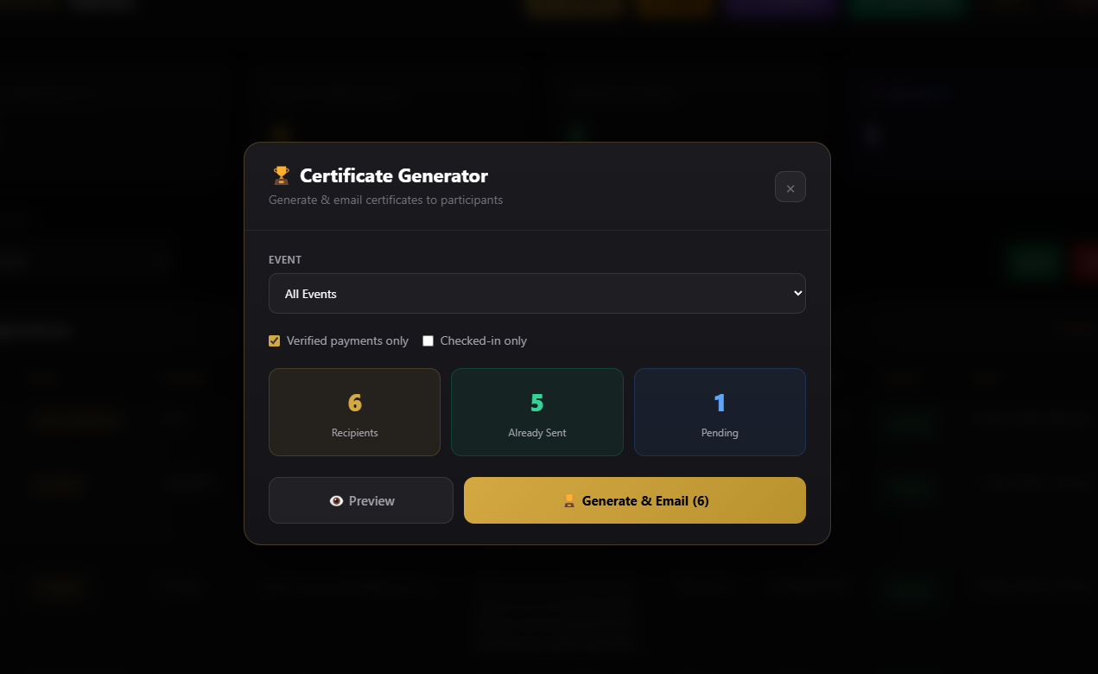
8. Zero-Touch Certificate Generation
HTML5 Canvas parses attendee names, events, and college variables dynamically over a blank JPEG template. The image is compressed and forwarded via the Resend API.

Slide 11
9. Results & Discussion
1. Scalability: Handled concurrent streams supporting 13 distinct macro-events.
2. Speed Matrix: Replaced a 45-second manual verification cycle with a sub-5-second unified desk system.
3. Complete Autocovarience: Dispatched hundreds of confirmation QR tickets and Canvas certificates via resilient API hook integration instantly.

Slide 12
10. Conclusion
The application unequivocally establishes that centralized, modular software can eradicate the intense friction present in multi-student coordination.
By prioritizing UI/UX across mobile-friendly paradigms, faculty gained absolute tracking oversight, while participants received a pristine, modern onboarding experience.

Slide 13
11. References
1. Next.js Routing Architecture (Vercel, 2026)
2. Real-Time Cloud Firestore Data Modeling (Google, 2026)
3. Role-Based Access Control Implementation Models (Sandhu et al., 1996)
4. Automating Transactional Emails via Serverless Executions (Resend API, 2026)
5. HTML5 Canvas: Pixel Graph Manipulation (MDN, 2026)

