Slide 1
Smart Event Management System
(SHRESHTA 2026)
A Real-Time Digital Transformation for Inter-Collegiate Fests
Paper Presentation by Author’s :
1. Mrs. Neha J K
(Assistant Professor )
2. Arshad Pasha
(Final Year BCA-’A’Sec )
Seshadripuram Degree College, Mysuru

Slide 2

INDEX
1. Abstract
2. Introduction
3. Literature Review
4. Research Methodology
5. Objectives of the Study
6. Result and Discussion
7. Conclusion
8. References

Slide 3
1. Abstract
The Solution: We developed SHRESHTA to completely digitalize and streamline workflows autonomously.
Key Methodologies: Next.js client-side rendering, Firebase Firestore (NoSQL), HTML5 Canvas templates, and strict RBAC.
Impact: Achieved a 100% paperless cycle, reduced check-in time to under 5 seconds, and provided real-time transparency.
The Problem: Hosting large-scale inter-collegiate fests involves massive logistical hurdles—long queues, paper tracking, manual verification, and delayed certificates.

Slide 4
2. Introduction
The Current Context: Event management heavily relies on legacy workflows like Excel sheets and cash-based counters causing duplicate entries and tedious financial verification.
Our Digital Transformation: By leveraging modern web technologies and Firebase Serverless computing, we built a centralized application acting as a single source of truth.

Slide 5

3. Literature Review
Traditional Methods: Simple forms provide a digital bridge but lack relational data constraints to block over-registration.
Commercial Architectures: Platforms like Eventbrite impose large fees and fail to accommodate academic needs like custom UTR tracking.
Smart Campuses: QR attendance proves barcode verification decreases queues by 80% (Kumar & Singh, 2022).
The Gap: A severe lack of lightweight, real-time academic solutions.

Slide 6
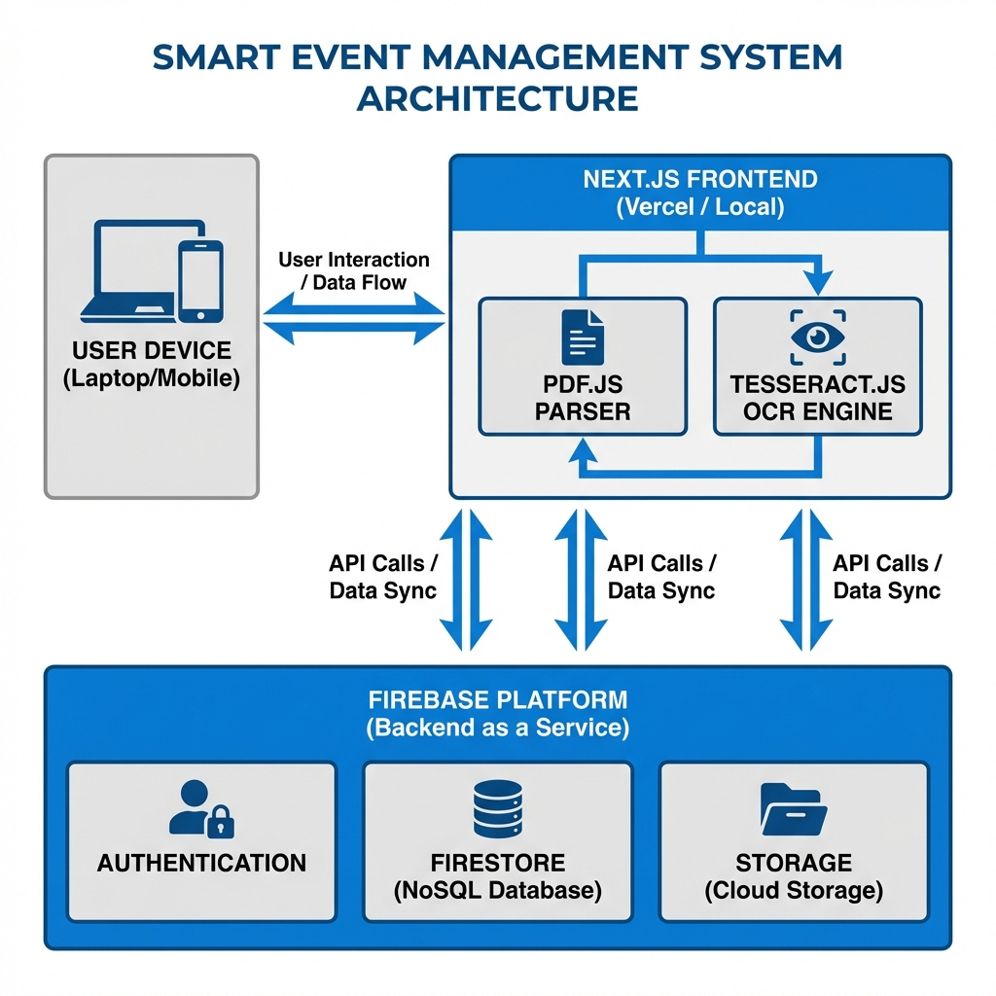
4. Research Methodology & Architecture
Built using Rapid Agile Development with a serverless macro-stack prioritizing real-time processing (Next.js 15, Firebase NoSQL, Tailwind CSS, Resend API).

Slide 7

5. Objectives of the Study
1. Eliminate Paper Trails: Store 100% of registrations on secured cloud.
2. Optimize Check-in Efficiency: Dramatically cut queue times.
3. Automate Validations: Establish a flawless digital payment (UTR) workflow.
4. Zero-Touch Rewards: Overlay names algorithmically for certificates.
5. Provide Real-Time Analytics via strict RBAC.

Slide 8
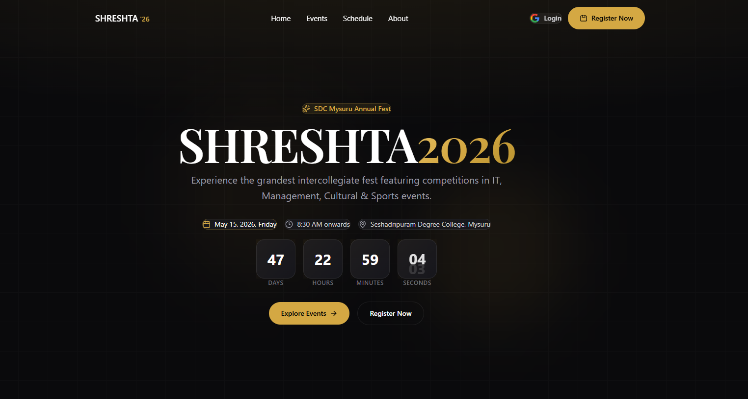
6. Result and Discussion (Overview)
Live Deployment Success:
The system successfully processed concurrent registrations for 13 distinct academic events.
Metric Precision: The real-time listener architecture completely obliterated manual counting—delivering live updates on Pendings and Check-ins.
0% Error Threshold: Isolated coordinator dashboards enforced absolute security, preventing data cross-contamination.

Slide 9
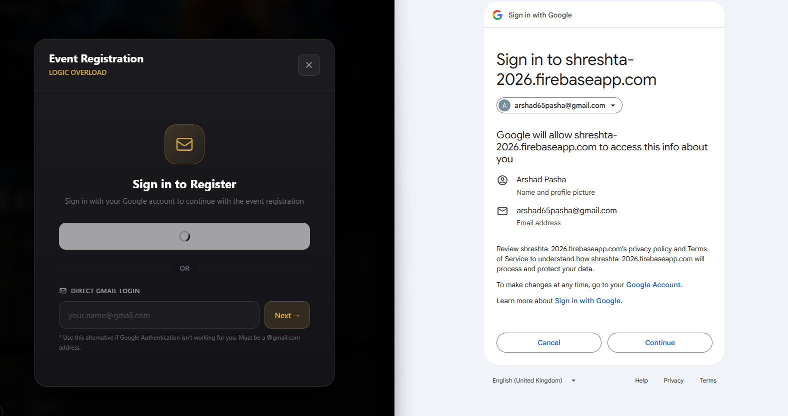
6.1 Result: Registration Automation
Dynamic Form Intake:
- UI dynamically mounts input rows based on event constraints.
- Captures 12-digit UTR immediately alongside a unified UPI QR.

Slide 10

6.2 Result: Real-Time Administration & RBAC
Master & Coordinator Dashboards scale synchronously without browser refreshes.
Individual faculty coordinators view an identical dashboard that is mathematically restricted to display only their unique event participants.

Slide 11
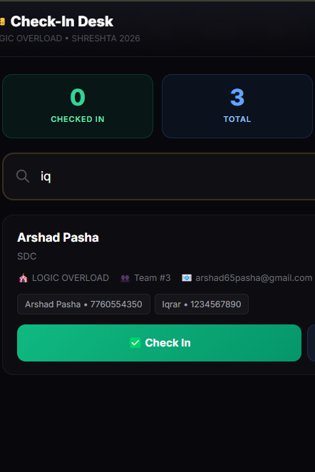
6.3 Result: Sub-5-Second Check-In Logistics
Fuzzy Global Search queried immense rosters instantly. Physical check-in shrunk from 45 seconds to under 5 seconds.

Slide 12
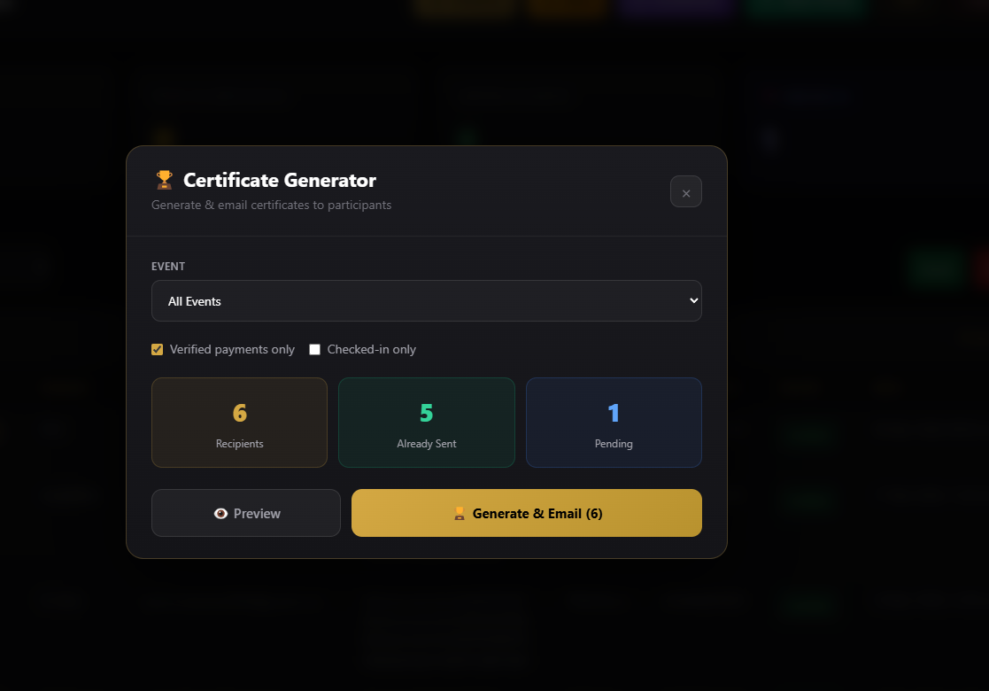
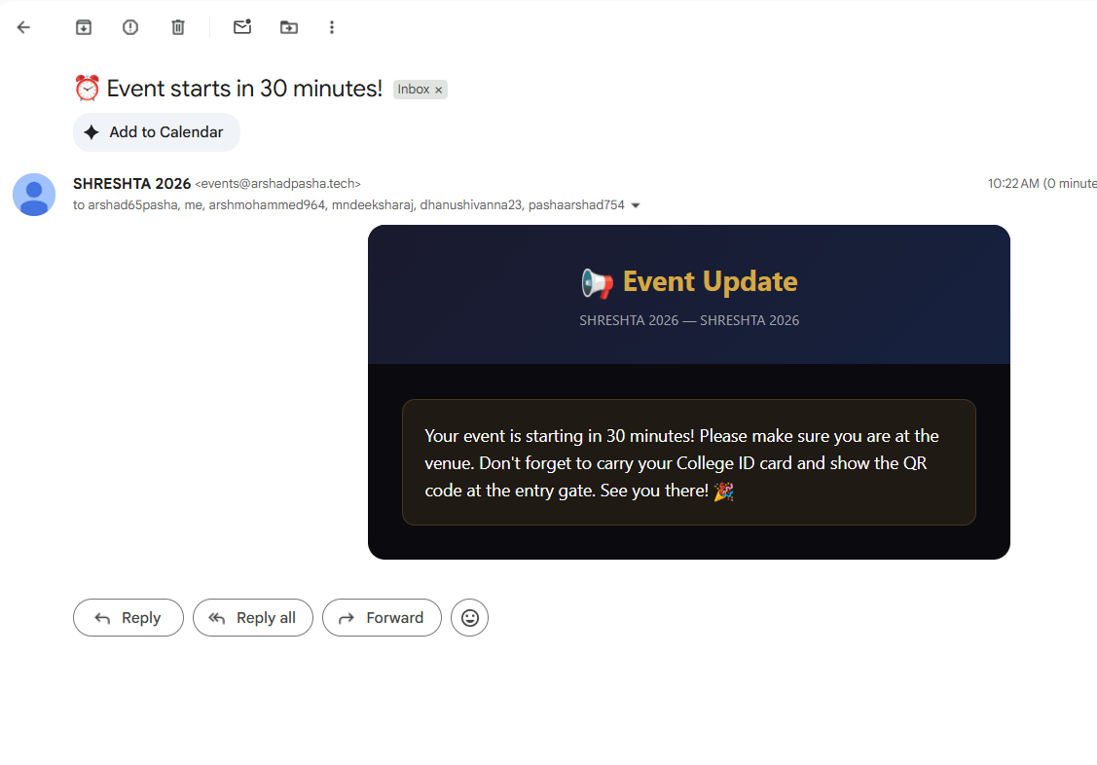
6.4 Result: Zero-Touch Automation Flow
Instant API Dispatch via Resend mails QR tickets securely. Canvas generates HD participation certificates flawlessly without human oversight.

Slide 13
7. Conclusion
The algorithm establishes definitively that high-friction physical event procedures can be entirely replaced by scalable micro-architectures.
Participants experienced frictionless onboarding.
Administrative faculty bypassed overlapping labor constraints.
The deployment stands as an infinitely reusable framework for future academic symposiums.

Slide 14
8. References
1. Vercel. (2026). Next.js Architecture Documentation.
2. Google. (2026). Cloud Firestore WebSocket Data Sync.
3. Sandhu, et al. (1996). Role-Based Access Control Models.
4. Kumar, R. (2022). QR Code Based Smart Attendance.
5. Resend. (2026). Serverless Email APIs.
6. MDN. (2026). Canvas API: Graphic Overlays.

