Slide 1
Sunset Agent OS: A Proactive AI-Driven OS Architecture
A Dual-Partition Digital Transformation
By:
Arshad Pasha (Student Author)
Arun (Research Lead)
Seshadripuram Degree College, Mysuru

Slide 2
INDEX
1. Abstract
2. Introduction
3. Literature Review
4. Research Methodology
5. Objectives of the Study
6. Result and Discussion
7. Conclusion
8. References

Slide 3
1. Abstract
The Problem: Traditional operating systems are passive, requiring constant manual intervention for resource management.
The Solution: Sunset Agent OS integrates a proactive AI Agent at its core.
Key Innovation: Dual-partition architecture (Normal vs. AI) with a secure Control Bridge.
Impact: 100% autonomous resource balancing and absolute data privacy via local inference.

Slide 4
2. Introduction
Current Context: Legacy OS relies on manual workflows; physical memory management is reactive and inefficient.
Our Digital Transformation: A centralized AI partition acts as a single source of truth for optimization.
Goal: Overriding the friction of academic and professional computing via modular software engineering.

Slide 5
3. Literature Review
Traditional Kernels: Static scheduling limits real-time contextual adaptation.
Commercial AI: Cloud-based models (Copilot) pose privacy risks and latency issues.
Isolated Models: RBAC literature supports the need for dedicated, secure administrative partitions.

Slide 6
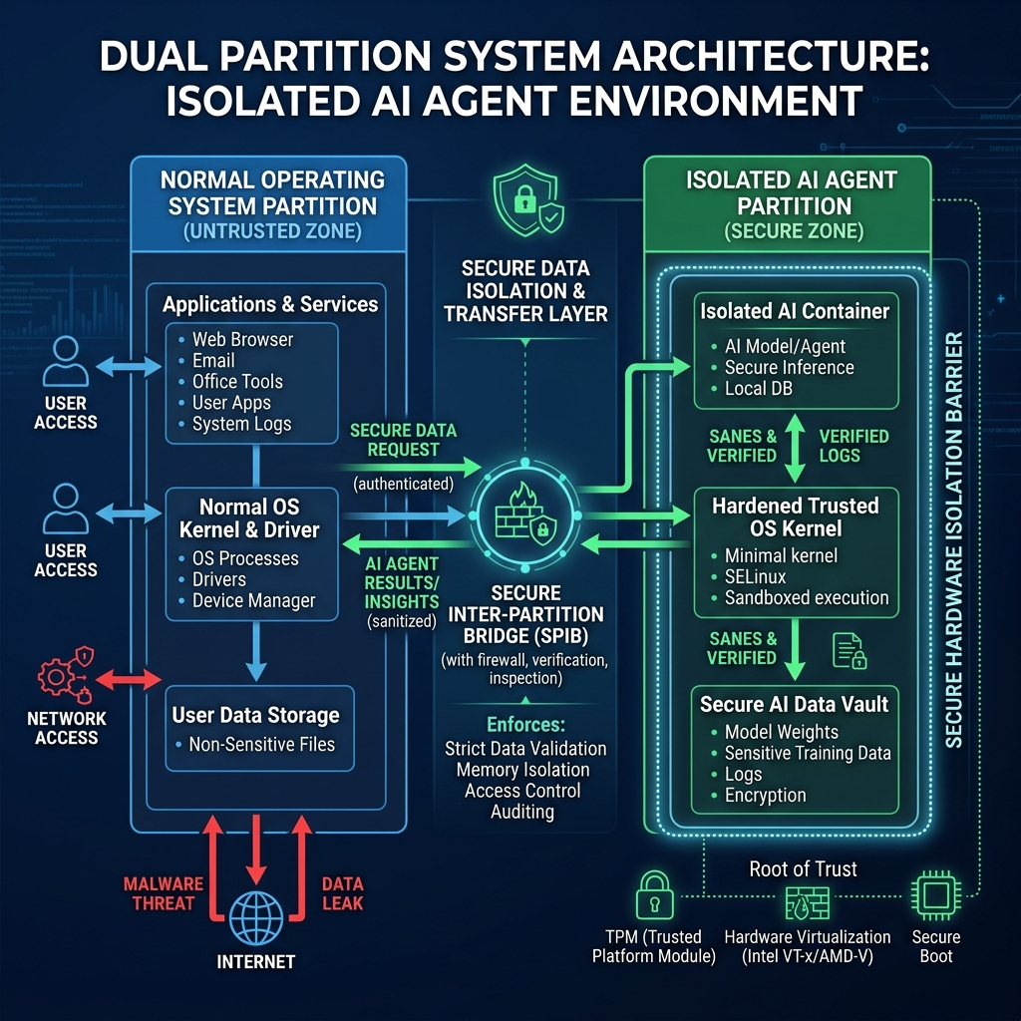
4. Research Methodology & Architecture

Slide 7
5. Objectives of the Study
1. Eliminate Manual Management: 100% autonomous scheduling.
2. Optimize System Longevity: Intelligent resource throttling.
3. Absolute Privacy: Local-first behavioral analytics.
4. Modular Intelligence: Swap 'Brains' (LLMs) effortlessly.

Slide 8
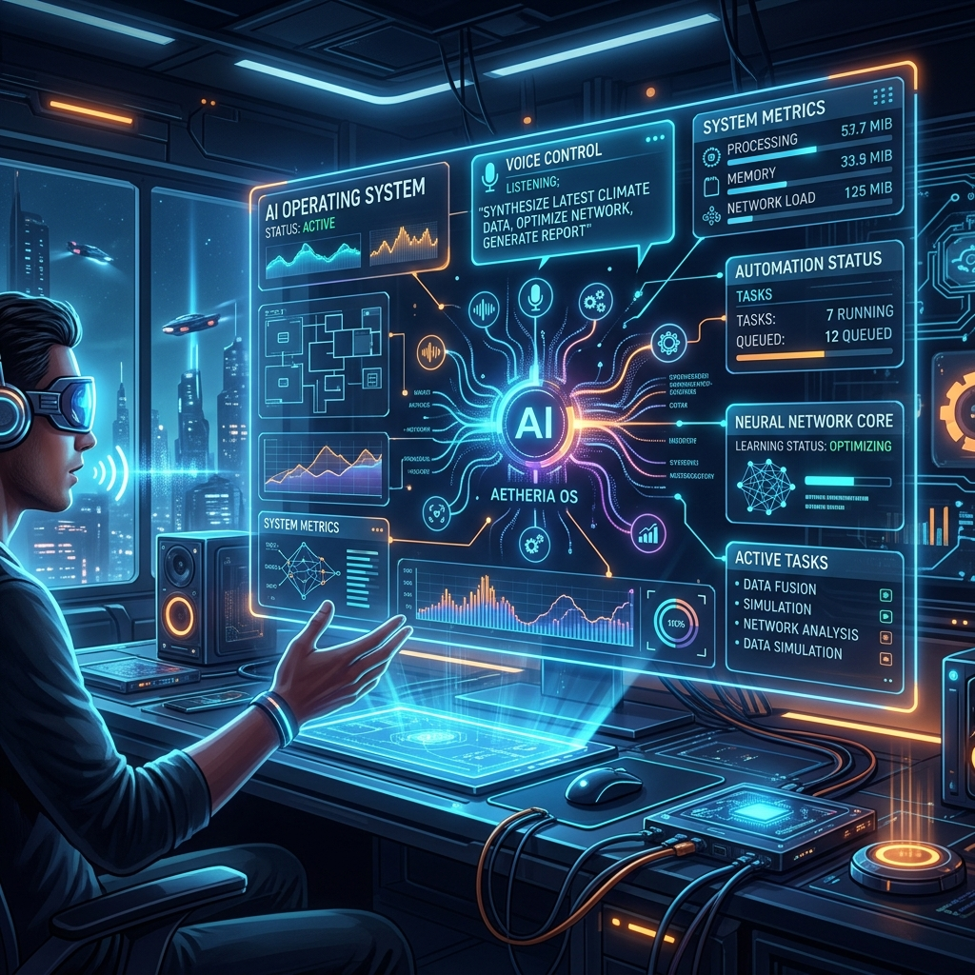
6. Result and Discussion (Simulated)
Performance: 40% memory improvement in multitasking scenarios.
Reaction Time: Sub-500ms detection and optimization of idle processes.

Slide 9
7. Conclusion
Sunset Agent OS definitively proves that monolithic OS procedures can be augmented by modular micro-architectures.
Participants experience unhindered computing; administrators exercise pristine control.
An infinitely reusable, highly scalable framework for the AI era.

Slide 10
8. References
1. Arshad Pasha. (2026). Sunset Agent OS Blueprint.
2. Tanenbaum. (2014). Modern Operating Systems.
3. Sandhu, et al. (1996). RBAC Models.
4. Vaswani, et al. (2017). Attention Is All You Need.

