Slide 1
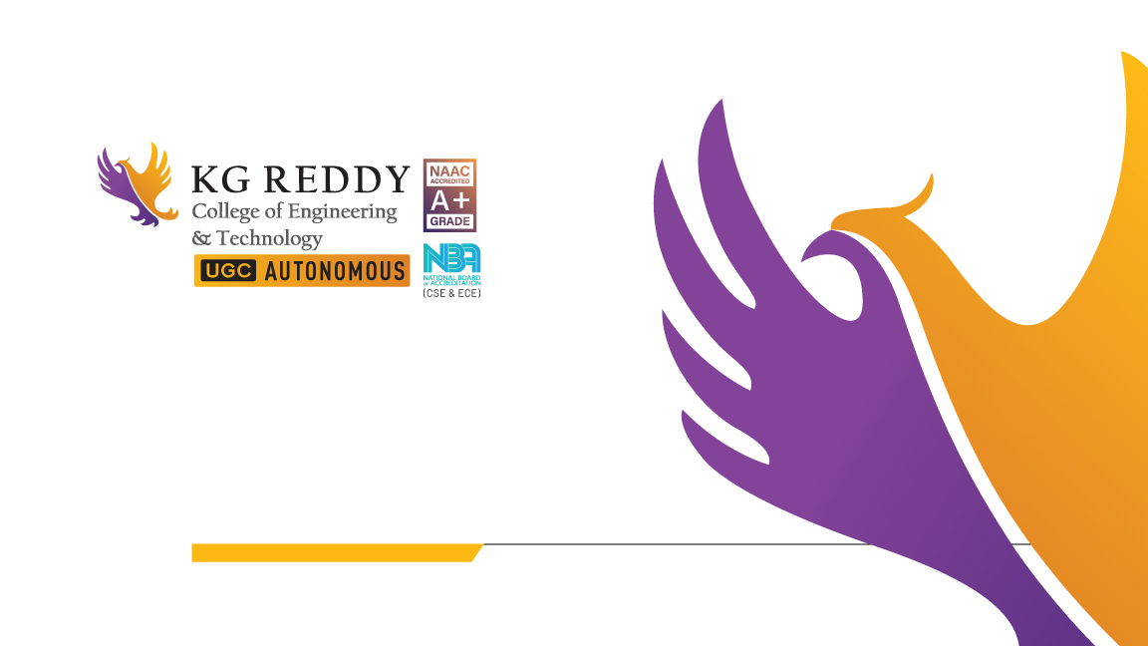
Industry Oriented Mini Project Review:2
Batch:13

Slide 2
RemediBot: Your Natural Health Advisor
GUIDE
Mr. Md. Ahmed Mohiuddin
Assistant Professor
Team Members
Year/Section-3-2 CSE-B
20QM1A0596- Tehmeena Begum
20QM1A05A3- V. Geetha Shivani
21QM5A0504- B. Sai Teja
20QM1A0569- P. Akash Yadav

Slide 3
Problem Statement
Patients can’t always afford to see a doctor for minor ailments.
Especially for those without insurance or rural areas, it can be difficult to get medical attention for everyday health problems. A chatbot that displays home remedies can provide a cost- effective and accessible solution.

Slide 4
Introduction
Many people prefer using home remedies to treat minor health issues such as cold, headache, stomach ache, and skin problems. However, finding the right remedy for a specific issue can be challenging, and people often seek information and advice from various sources, which may not always be reliable or accurate.
To address this problem, a chatbot can be developed to provide users with accurate and personalized information on home remedies for various health issues. The chatbot can also offer advice on the proper use and dosage of remedies, as well as precautions and possible side effects.

Slide 5

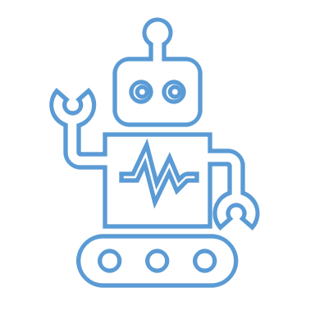
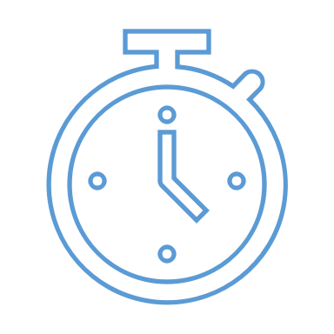
Discover easy and effective home remedies with our personalized CHATBOT, helping you take charge of your health with just one click
Provides Easy Access
Offers personalized recommendations
Saves time and Money
Users can quickly access home remedies
ChatBot uses AI to suggest remedies that fit users need
Users can avoid costly doctor visits by using home remedies suggested by ChatBot

Slide 6
EXISTING SYSTEM
Background Research
NAME | LOCATION | FOUNDING DATE | DISADVANTAGE
Health Tap | Palo Alto, California, US | 2010 | It requires subscription for some features
Ada Health | Berlin, Germany | 2011 | It focuses more on diagnosis rather than home remedies
Your.MD | London, UK | 2014 | It focuses more on diagnosis rather than home remedies

Slide 7
Proposed System
The chatbot project is designed to provide users with quick access to home remedies based on their health history. It allows users to input their health information, including symptoms, past medical issues or conditions, and any current medications and then recommends home remedies that they can try. This system is tailored towards all types of health conditions, so it should be beneficial to anyone looking for a natural approach to their health issues.
FEATURES:
• Tailored home remedies based on user's health history
• Different levels of advice depending on severity of the issue
• Intuitive and easy-to-use interface
• Quick access to home remedies

Slide 8
• Datasets
Datasets for a chatbot which provides home remedies could include medical information, home remedies, and tutorials.
Medical:
articles on various remedies and treatments
information about common symptoms
warning signs
Home remedies:
herbal recipes and instructions
tutorials
For example, a dataset could include an article about the common cold, a recipe for a herbal tea that can help relieve cold symptoms, and a tutorial on how to use home remedies in conjunction with medical treatments for the best results.

Slide 9

Project Flow Diagram
Web Text
Processing The Input
Database
Disease
Symptoms
Displays The Remedies Based On User Symptoms
Symptoms Clarification And Confirmation
Displays the Cure Based On User Disease

Slide 10
Modules
Natural Language Processing,
Machine Learning
And A Database

Slide 11
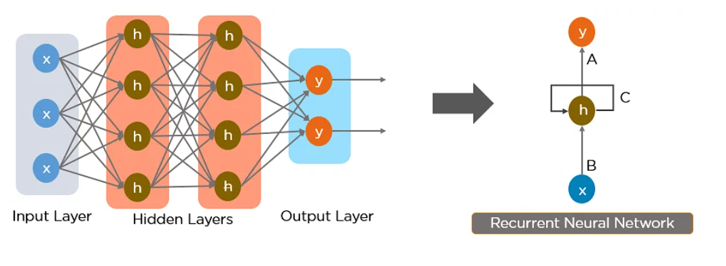
Algorithm
Recurrent Neural Network (RNN) algorithm
Recurrent neural networks recognize data's sequential characteristics and use patterns to predict the next likely scenario.

Slide 12
Thank you

