Slide 1
Tournament Scheduler
Muhammad Fahad Pasha, Riyan Ahmad, Ahmed Riaz, Muhammad Ali
Showntell Group 10

Slide 2
What is Tournament Scheduler?
Tournament scheduling is the process of systematically organizing matches or games among participants to ensure a smooth, balanced, and efficient competition.
IT Ensures:
Fair competition
Conflict-fRee Match-Making
Resource Optimization
Enhanced experience for all
Tournament Scheduler

Slide 3
let’s recall concepts
1. Combinatorics
Counting and arranging elements systematically.
analyze possible match schedules and permutations of teams
Tournament Scheduler

Slide 4
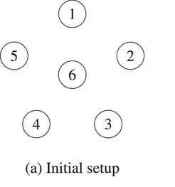


let’s recall concepts
2. Graph THEORY
Represents relationships using vertices (nodes) and edges (connections)
Models team matchups and connections between participants.
Tournament Scheduler

Slide 5
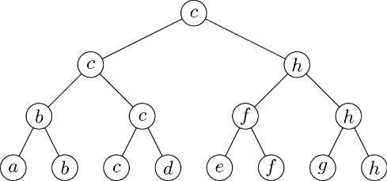
Different formats of tournaments
Single Elimination Tournament
The single elimination format is the easiest to organize. The name says it all, if a team loses one time they are out of the tournament.
A standard single elimination
system with i rounds Has n = 2^i
participants, and there will be
m = n - 1 matches conducted. For
3 rounds single elimination,
there would be 7 matches with
8 players.
Tournament Scheduler

Slide 6

Different formats of tournaments
Single Elimination Tournament
A single-elimination tournament with eight alternatives, where we assume that b≻a , c≻d , f≻e , h≻g , c≻b , h≻f , and c≻h ; all other dominance relations are arbitrary. Under this bracket, alternative c is the single-elimination winner
Tournament Scheduler

Slide 7
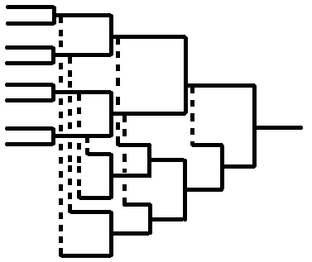
Different formats of tournaments
Double Elimination Tournament
Double elimination gives a second chance to the competitors. After one loss they are moved to the loser’s bracket and are eliminated after the second loss. This adds complexity to the tournament and keeps the competition balanced.
A classic double-elimination
tournament system for n = 2^i
participants (where 1 < i ∈ N) will
have m = 2n - 2 matches conducted.
Thus, we have 14 matches for 8
Players or teams.
Tournament Scheduler

Slide 8
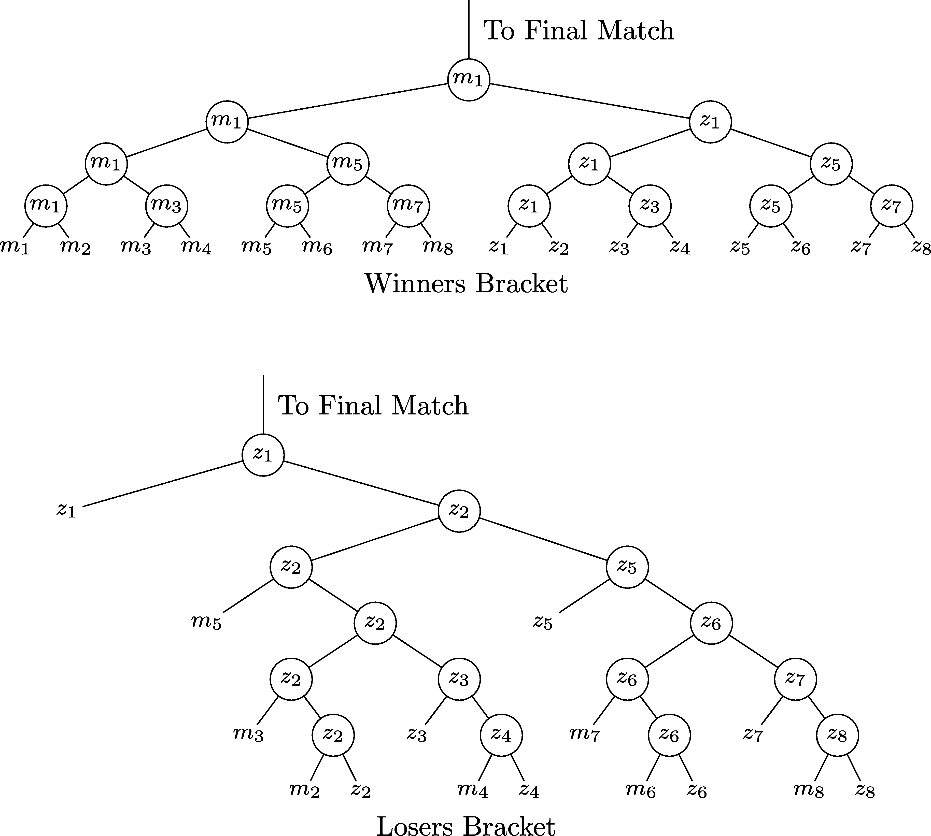
Different formats of tournaments
Double Elimination Tournament
Example of a winners bracket (above) and losers bracket (below) where each left-hand player wins each round in their respective (m and z) maximal sub-tournaments. The champion of the losers bracket plays the champion of the winners bracket in a final match.
Tournament Scheduler

Slide 9
Different formats of tournaments
Round-robin
A round robin tournament is a competition format where every participant competes against all others an equal number of times. It is commonly used in sports, esports, and other competitive events, offering fairness and comprehensive evaluation of participants.
If we have n numbers of competitors(teams),
Then the total number of game played by n teams in the context of round robin tournament is given by the formula:
Total Games = (n(n−1))/2
Tournament Scheduler

Slide 10
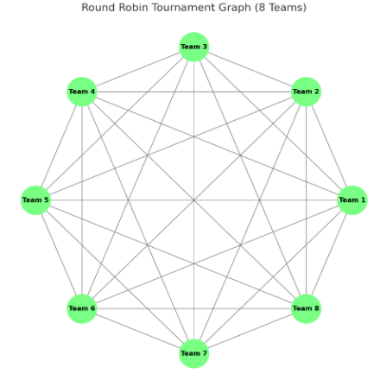
Different formats of tournaments
Round-robin
In a tournament with 8 teams, each team is represented by a node. To calculate the total number of matches, we use the combination formula 8C2, which gives us 28 edges. These 28 edges represent the 28 matches that will be played, ensuring that each team competes against every other team.
Tournament Scheduler

Slide 11



conclusion
Real world applications
Swiss System
Ladder
Group & knockout
Other formats
Thank you!
Any questions?
Tournament Scheduler

