Slide 1
Tournament Scheduler
Muhammad Fahad Pasha, Riyan Ahmad, Ahmed Riaz, Muhammad Ali
Showntell Group 10

Slide 2
What is Tournament Scheduler?
Tournament scheduling is the process of systematically organizing matches or games among participants to ensure a smooth, balanced, and efficient competition.
IT Ensures:
Fair competition
Conflict-fRee Match-Making
Resource Optimization
Enhanced experience for all
Tournament Scheduler

Slide 3
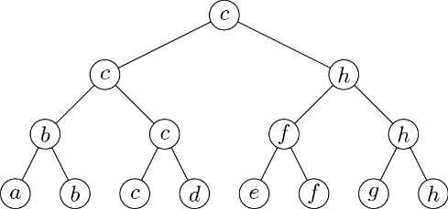
Different formats of tournaments
Single Elimination Tournament
The single elimination format is the easiest to organize. The name says it all, if a team loses one time they are out of the tournament.
A standard single elimination
system with i rounds Has n = 2^i
participants, and there will be
m = n - i matches conducted. For
8 players single elimination,
there would be 7 matches with
3 rounds.
Tournament Scheduler

Slide 4

Different formats of tournaments
Single Elimination Tournament
A single-elimination tournament with eight alternatives, where we assume that b≻a , c≻d , f≻e , h≻g , c≻b , h≻f , and c≻h ; all other dominance relations are arbitrary. Under this bracket, alternative c is the single-elimination winner
Tournament Scheduler

Slide 5
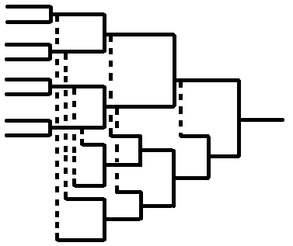
Different formats of tournaments
Double Elimination Tournament
Double elimination gives a second chance to the competitors. After one loss they are moved to the loser’s bracket and are eliminated after the second loss. This adds complexity to the tournament and keeps the competition balanced.
A classic double-elimination
tournament system for n = 2^i
participants (where 1 < i ∈ N) will
have m = 2n - 2 matches conducted.
Thus, we have m = 14 when n = 8.
Tournament Scheduler

