Slide 1
TripAdvisor: Online Booking app
Oleksandra Pashkevych May 2016

Slide 2

Agenda
About TripAdvisor
Smoke testing
Functional testing
- Positive
- Suitability
- Compatibility
Non-functional testing
- Usabiliti testing
- UI
L10n

Slide 3
About TripAdvisor
TripAdvisor is the world's largest travel site, enabling travelers to plan and book a trip.
TripAdvisor offers advice from millions of travelers and a wide variety of travel choices and planning features with seamless links to booking tools that check hundreds of websites to find the best hotel prices.
TripAdvisor branded sites make up the largest travel community in the world, reaching 340 million unique monthly visitors, and 350 million reviews and opinions covering more than 6.5 million accommodations, restaurants and attractions.
The sites operate in 48 markets worldwide.

Slide 4

Smoke testing
Task: Test online booking application — TripAdvisor.
Smoke Testing Procedure: quickly check the main application features:
Search for hotels, flights, vacations rentals and restaurants;
The ability to add items which you like to 'Saved Trip', ability to edit and review them.
Status: Passed.
Defects: None.

Slide 5
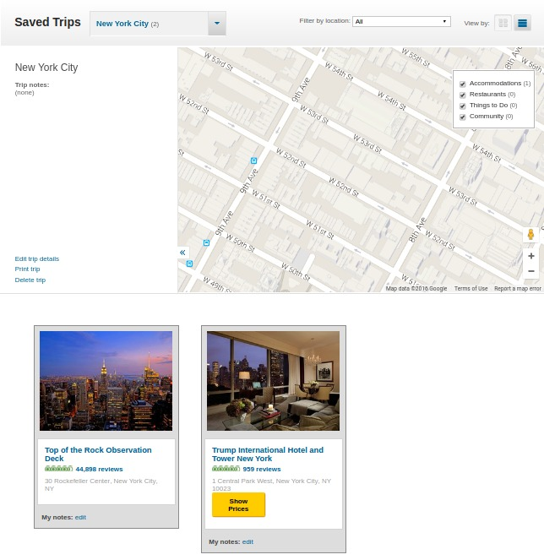
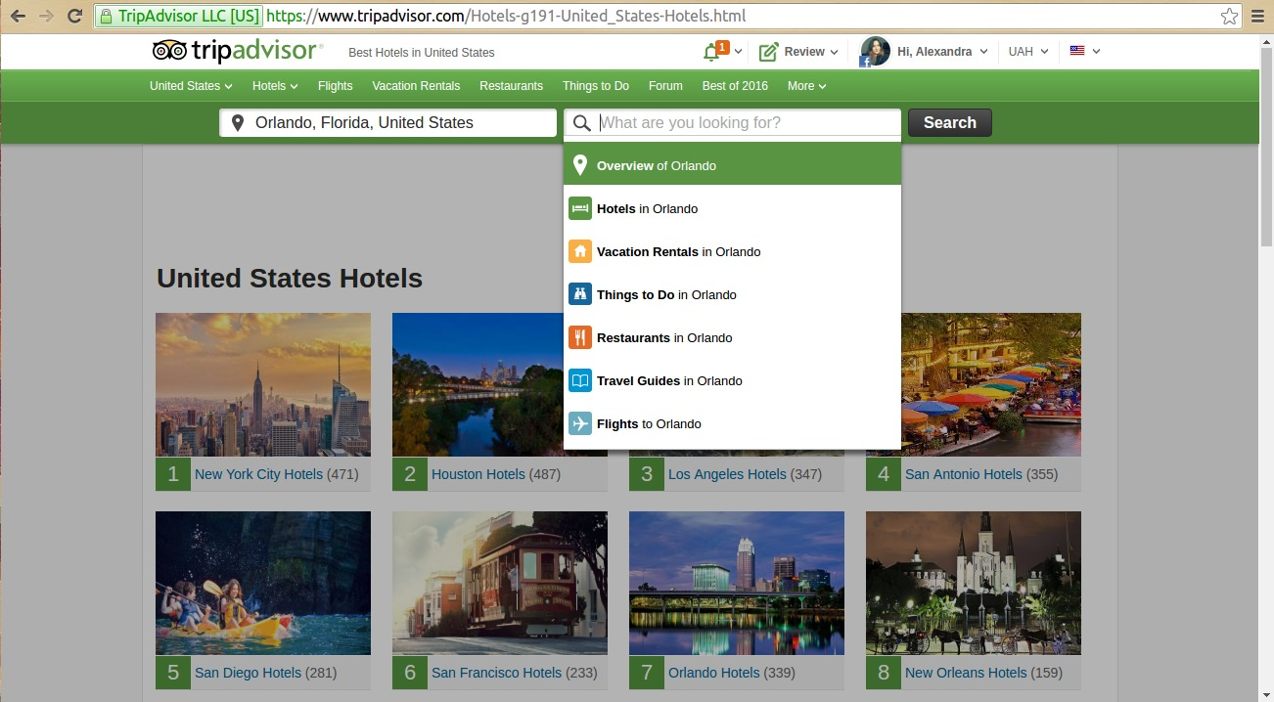
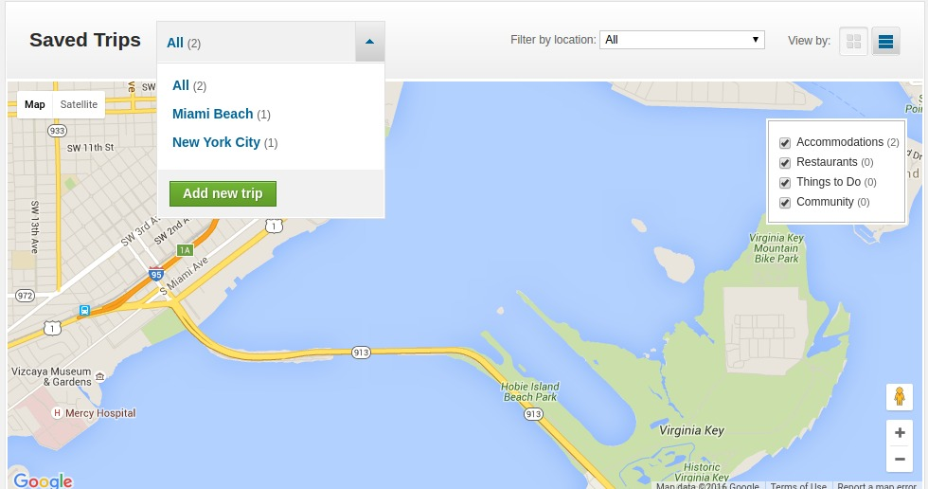

Smoke testing
4
1
3
3
2

Slide 6
Functional testing: Positive
Task: As a User I want to be able to Log in into the system with my Facebook account.
Positive Testing Procedure:
Open site: https://www.tripadvisor.com;
Press 'LOG IN' button;
Choose Continue with 'Facebook'.
Result: You are logged in, the avatar picture changed to your Facebook picture, you can see welcoming inscription 'Hi, <your facebook name>'. All actions for registered members as a post travel reviews, participate in discussion forums, email TripAdvisor content to themselves and others, access members-only newsletters and travel planning content, and enter surveys are avaliable to you now.
Status: Passed
Defects: None

Slide 7
Functional testing: Suitability
Task: As a User I want to see only list of restaurants which respond the criteria I chose.
Testing Procedure for checking suitability of application:
Choose a location in 'Where are you going?' text box(e.g. 'Rome, Lazio, Italy') and 'Restaurants' in 'What are you looking for?' text box;
Press 'Search' button or Enter;
In the 'Your Selections' area mark checkboxes which meet your desire(e.g Establishment Type: Restaurant; Reservations: Available Tonight; Cuisines & Dishes: Pizza; Meals: Dinner).
Result: Restaurants in the list respond the chosen criteria.
Status: Passed.
Defects: None.

Slide 8
Functional testing: Compatibility
Task: As a User I want to have the ability to search for, select, and book travel reservations(eg. hotels) with third-party suppliers(Booking, Agoda, Priceline, Kayak etc.) without leaving the TripAdvisor site experience.
Testing Procedure for checking compatibility of application: choose the hotel and dates for staying. After choosing, you will be propose to view the deals from third-party suppliers which are available for this hotel. Try to use any of that suppliers for booking this hotel(deals should be shown on the right side of the hotel link, in order to choose it, press 'View deal' yellow button near deal you want to review).
Result: After pressing the 'View deal' button, link to third-party supplier site is opened in other tab, you can perform actions which are availiable, according to terms of use for that site.
Status: Passed.
Defects: None.

Slide 9
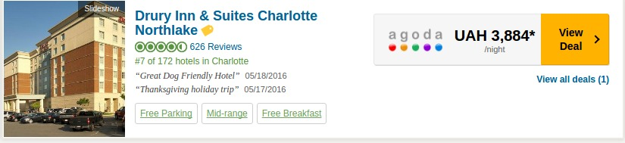
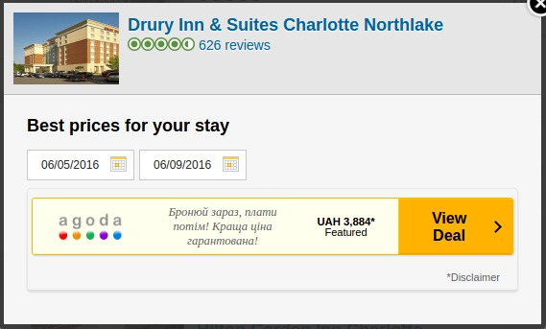
Functional testing: Compatibility

Slide 10
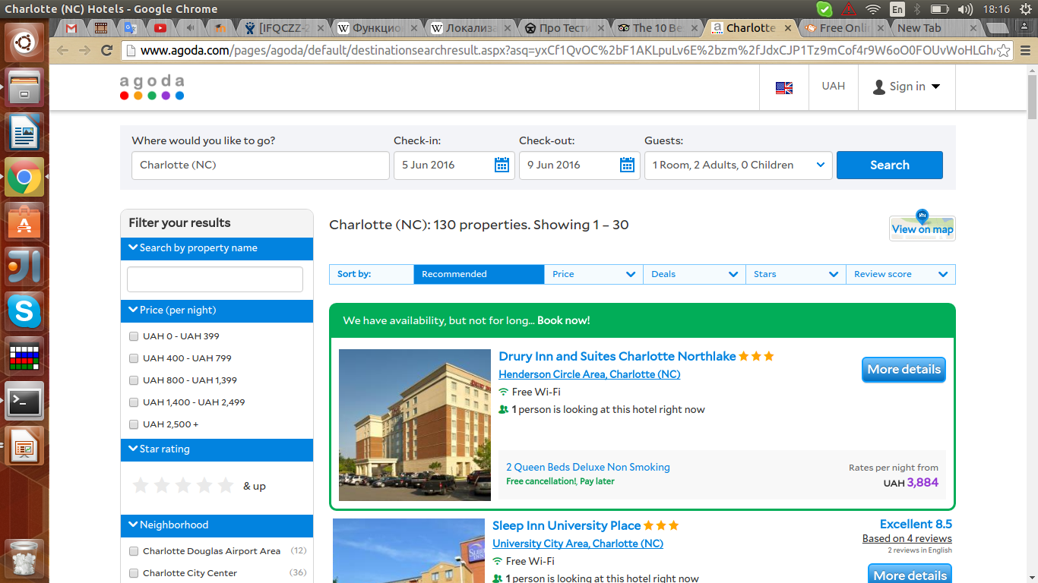
Functional testing: Compatibility

Slide 11

Non-functional testing: Usability
Task: As a User I want to be able to see a list of object, recently viewed by me.
Usability Testing Procedure: after viewing few hotels, restaurants, vacation rentals or other objects, check if reviewed items are shown on the main page in the 'You recently viewed...' list.
Result: Reviewed objects are shown on the main page in the 'You recently viewed...' list and at the bottom of the page where items you have seen are split into categories(see mock-ups at the next slide)
Status: Passed
Defects: None

Slide 12
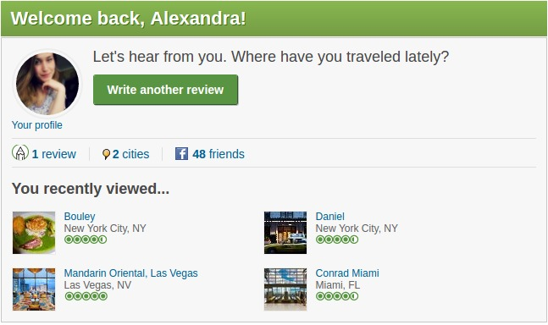
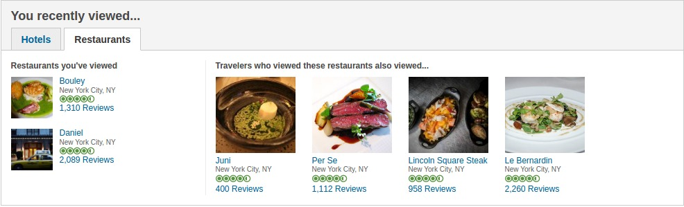

Slide 13
Non-functional testing: UI
Task: Verify whether links which you have visited became other color than unvisited.
UI Testing Procedure:
Open a main page: https://www.tripadvisor.com/;
Scroll down to the bottom of the page;
Choose any group of links which are avaliable(e.g. 'Quick links' or 'Hotels in popular destinations' etc.);
Press any from offered links;
Сome back to home page and see if proper link changed color.
Expected Result: Link which you have followed changed the color.
Actual Result: Link has the same color as unvisited references.
Status: Failed.
Defects: Visited link didn't change the color.

Slide 14
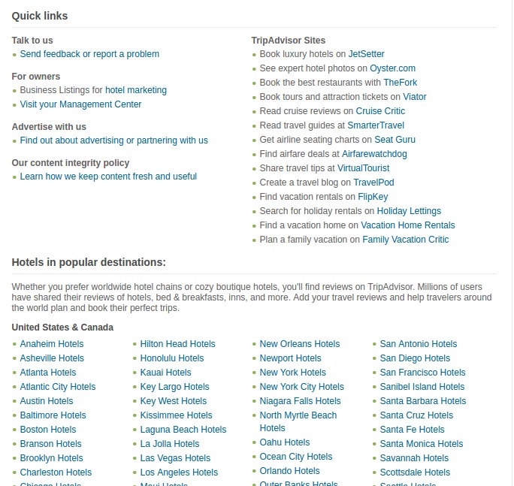
Non-functional testing: UI

Slide 15
Non-functional testing: UI vs L10n
Task: Verify if date format in fields which require calendar data, changes according to chosen locale.
UI vs L10n Testing Procedure:
Open a main page: https://www.tripadvisor.com/;
Choose US standard;
Choose date in field which needs a calendar data;
Change standard to Russian;
Choose date in field which needs a calendar data, see if date format has changed.
Result: Date format has changed according to chosen locale.
Status: Passed
UI Defect: Date format has changed according to chosen locale but tip into field specifies the wrong date format(the same as for US standard).

Slide 16
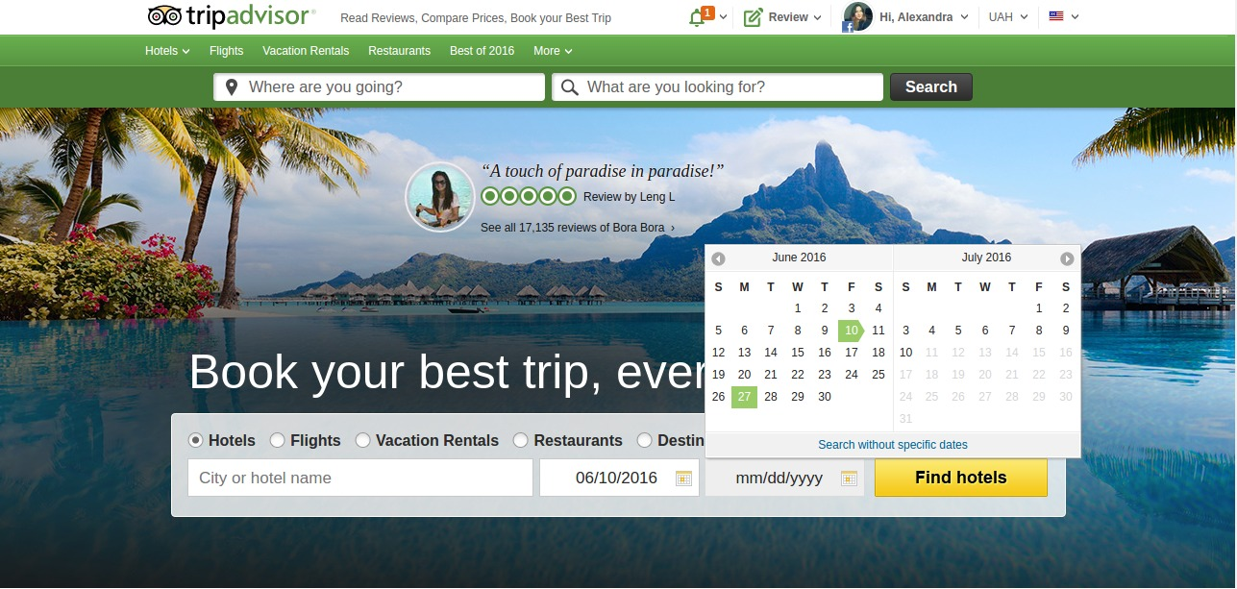
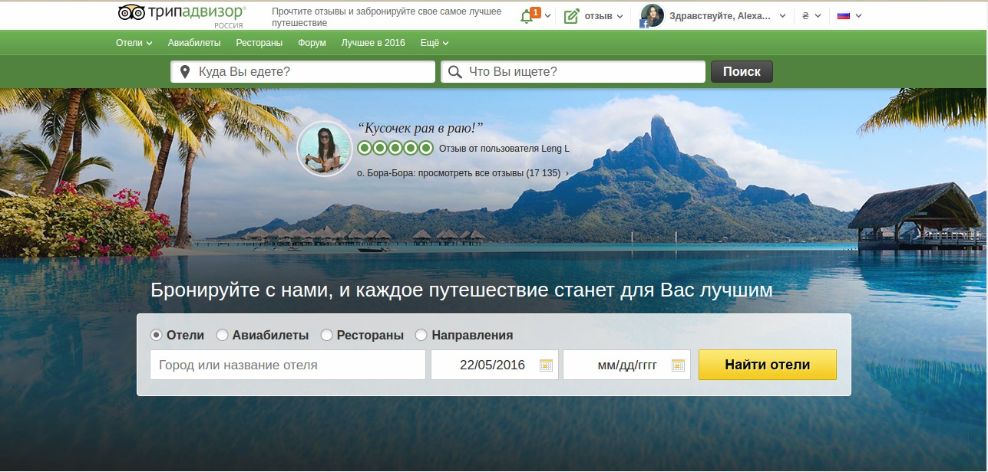

Slide 17
Thank you!

