Slide 1

PPT FOR MID-SEMESTER REVIEW – SEPTEMBER 2026
TITLE :- Library Management System — A Desktop Application in Java using Swing and SQLite
Div:- C Group No :- 3 Day:- Thursday Date:- 24/09/2026
Presented by
Project Guide
1) | Aarush Sangle | 22
2) | Pashmee Salunkhe | 17
3) | Rohan Rangapure | 13
4) | Sanchali Patil | 19
Dr. Priya Shelke
DEPARTMENT OF CSE-IOTCSBT
VISHWAKARMA INSTITUTE OF TECHNOLOGY, PUNE
Notes:
Fill in each member's PRN before the review.

Slide 2
Introduction and Objectives
What the system is
Objectives
A desktop application for running a small library — a school, college or community one. It keeps the catalogue of books and the list of members, and tracks who has what, when it is due back, and what is owed if it comes back late.
1
Maintain a searchable catalogue
Title, author, ISBN, category and shelf code, with copy counts.
2
Register members with borrowing limits
Each membership type carries its own limit, overridable per person.
Why it is needed
A paper register cannot tell you what is overdue today, cannot stop the last copy being lent twice, and cannot add up a fine. A librarian needs those answers in seconds, at the desk.
3
Issue, return and renew loans
Due dates worked out automatically; renewals allowed within limits.
Our approach
One Java application and one SQLite file. No server to set up, no account to create and no internet connection. The librarian runs one command and the window opens.
4
Calculate and settle overdue fines
Days late × the daily rate, charged or waived when the book comes back.
5
Keep every rule in one place
So that no screen, and no button, can bypass a rule by accident.
Course context: an Object-Oriented Programming project — the design is driven by classes, not by screens.
Department of CSE-IOTCSBT, Vishwakarma Institute of Technology, Pune-37
2

Slide 3
Technology Stack and Tools Used
Java 17+
language and runtime
1
external dependency
39
classes written
6,700+
lines of Java
Java 17
LANGUAGE
Records, enums and text blocks keep the model classes short. Runs on any machine with a JDK.
Swing
USER INTERFACE
Built into the JDK, so the window needs no extra library and no installer.
SQLite
DATABASE
The whole library is one file, library.db. No server, no configuration, no account.
JDBC + sqlite-jdbc 3.50.3.0
DATABASE DRIVER
The bridge from Java to SQLite — and the only external file in the project.
Git and GitHub
VERSION CONTROL
Full history of the work, with the code and its documentation kept together.
GitHub Actions
CONTINUOUS INTEGRATION
Builds and runs all 70 tests on every push — Windows and Linux.
Chosen so the project runs anywhere: download it, run one command, and the window opens — nothing to install and nothing to configure.
Department of CSE-IOTCSBT, Vishwakarma Institute of Technology, Pune-37
3

Slide 4
System Architecture
INTERFACE LAYER src/main/java/com/library/ui
Why it is split this way
Dashboard
Catalogue
Members
Circulation
Settings
The interface only draws screens. Every decision about what is allowed is taken in one class.
Each tab draws a screen and passes on what you typed. It never decides whether something is allowed.
A rule cannot be skipped from a button, because no button is able to write to the database itself.
asks
answers, or refuses with a reason
DATA LAYER db/LibraryDatabase.java
Owns every rule
Copy counts · borrowing limits · renewals · fines. Each change runs inside one transaction.
The rules can be tested without opening a window — 47 of the 70 tests run with no screen at all.
A new screen cannot invent a new rule; it can only ask for one that already exists.
SQL over JDBC
Swapping SQLite for another database would touch one class, not fifteen.
library.db — one SQLite file
books · members · loans · settings
Copy this one file and the whole library moves with it.
This separation is the main design idea of the project.
Department of CSE-IOTCSBT, Vishwakarma Institute of Technology, Pune-37
4

Slide 5
OOP Concepts Applied
Each concept is shown by the class in this project that actually uses it — not by a textbook example.
Encapsulation
LibraryDatabase
The Connection field is private. Nothing outside can touch the database directly; every change goes through a method that checks the rules first.
Abstraction
TabPanel · AppContext
TabPanel is abstract with an abstract refresh(). AppContext is an interface listing the four things a tab needs, so a tab never depends on the window.
Inheritance
5 tabs extend TabPanel
DashboardPanel, BooksPanel, MembersPanel, CirculationPanel and SettingsPanel all extend TabPanel. StatCard extends CardPanel.
private final Connection connection;
public abstract void refresh();
class BooksPanel extends TabPanel
Polymorphism
refresh() and overloading
Pressing F5 calls refresh() through one TabPanel reference and each tab runs its own version. listBooks() and renewLoan() are overloaded.
Composition
LibraryFrame · LoanView
LibraryFrame is built from its five panels and a Dialogs. LoanView wraps a Loan and adds the book title and borrower name a screen needs.
Generics and Enums
DataTable<T> · MembershipType
One DataTable<T> serves four tabs with different row types. MembershipType stores each type's borrowing limit beside its name.
for (TabPanel t : tabs) t.refresh();
record LoanView(Loan loan, ...)
class DataTable<T> extends JPanel
Department of CSE-IOTCSBT, Vishwakarma Institute of Technology, Pune-37
5

Slide 6
Class Design
«interface»
AppContext
implements
«JFrame»
LibraryFrame
Reading the design
TabPanel is the shape of a tab: every screen must supply refresh(). That one method lets F5 reload all five at once.
builds the five tabs
«abstract»
TabPanel
refresh() is abstract — every tab must reload itself
AppContext is an interface, so a tab never depends on the real window — which is how 23 tests drive the screens with no display.
The model classes are Java records: immutable, with no database connection, so they cannot save themselves.
DashboardPanel
BooksPanel
MembersPanel
CirculationPanel
SettingsPanel
Five tabs, one shape — the window treats them identically
LoanView wraps a Loan and adds the book title and borrower name, fetched in one JOIN rather than one query per row.
LibraryDatabase
Owns every rule · hands back model objects · throws LibraryException
LibraryDatabase is the only class that holds a connection — the single door to the data.
«record»
Book
11 fields
«record»
Member
10 fields
«record»
Loan
9 fields
«record»
LoanView
wraps a Loan
Immutable model classes — they hold data, not a connection
Department of CSE-IOTCSBT, Vishwakarma Institute of Technology, Pune-37
6

Slide 7
Database Design
BOOKS
id PK
title, author
isbn UNIQUE
category, shelf
total_copies
available_copies
MEMBERS
id PK
member_code UNIQUE
name, email, phone
membership_type
active
max_books
Design decisions
Two real things — books and members. Lending is many-to-many, resolved through loans.
A loan carries its own data (out, due, returned, fine), so it is a table, not just a link.
1 : many
1 : many
return_date empty means the book is still out. That single test drives the dashboard, the overdue list and the delete block.
SETTINGS
key PK
value
LOANS
id PK
book_id FK
member_id FK
issue_date, due_date
return_date
renewals
fine, fine_paid
available_copies is stored and moved by one on each issue and return — guarded by a CHECK constraint and a transaction.
settings is key–value, so a new setting is a new row rather than a change to the schema.
A loan is the relationship between a book and a member, made into a table of its own
Five indexes cover the searches the app runs constantly.
Department of CSE-IOTCSBT, Vishwakarma Institute of Technology, Pune-37
7

Slide 8
Features and Business Rules
Rules the system enforces
How a fine is worked out
Every one is checked in the data layer, so no screen can get around them.
days late × daily rate
A copy must be on the shelf.
Own three copies, all three out — the next person waits.
One copy per person per title.
The same member cannot hold two copies of one book.
WORKED EXAMPLE
Borrowed 1 October
Due back 15 October (14-day loan)
Returned 18 October → 3 days late
Fine = 3 × ₹2.00 = ₹6.00
Everyone has a limit.
Student 3 · Teacher 6 · Staff 5 · Public 2, overridable per member.
Overdue books block new loans.
Nothing new until what is late is sorted out.
Inactive members cannot borrow.
Suspend someone without deleting their history.
At the counter
While a book is out and late the fine keeps growing, and shows on the dashboard. It is only written down when the return is accepted — and at that moment it can be charged or waived.
Loan length and daily rate are set on the Settings tab.
A loan may be renewed twice.
And only while it is not already overdue.
Nothing in use can be deleted.
A book or member with an open loan stays put.
Every change is one transaction.
Copy counts can never drift out of step with the loans.
Department of CSE-IOTCSBT, Vishwakarma Institute of Technology, Pune-37
8

Slide 9
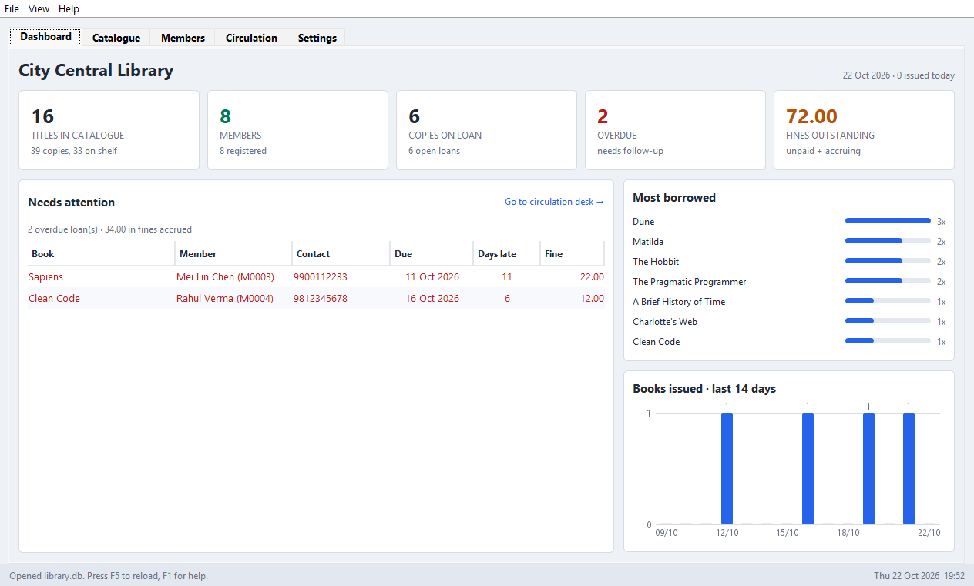
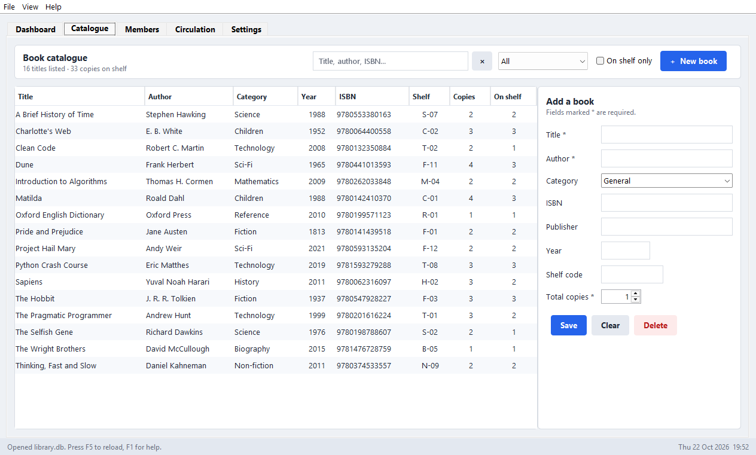
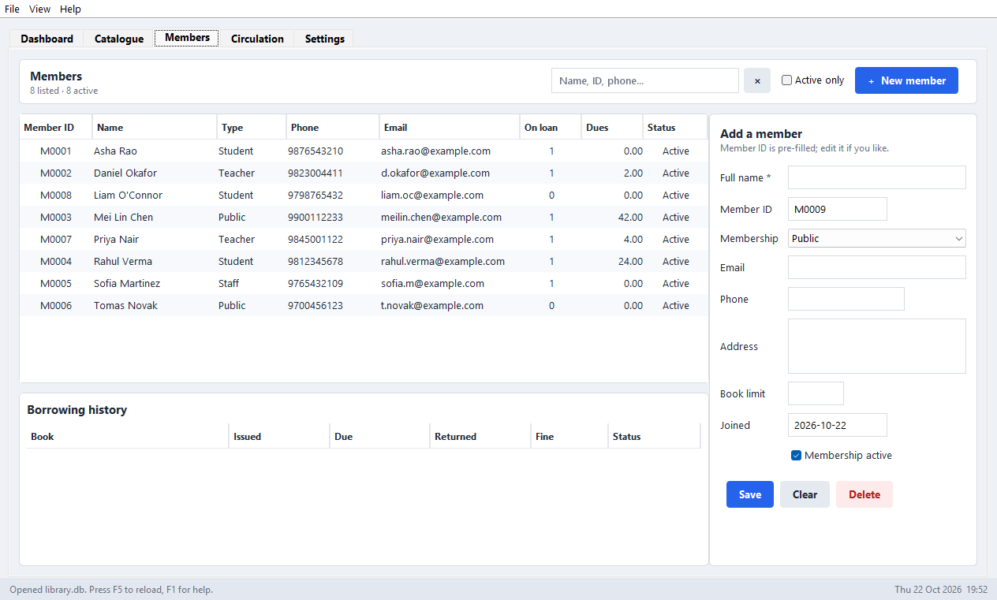
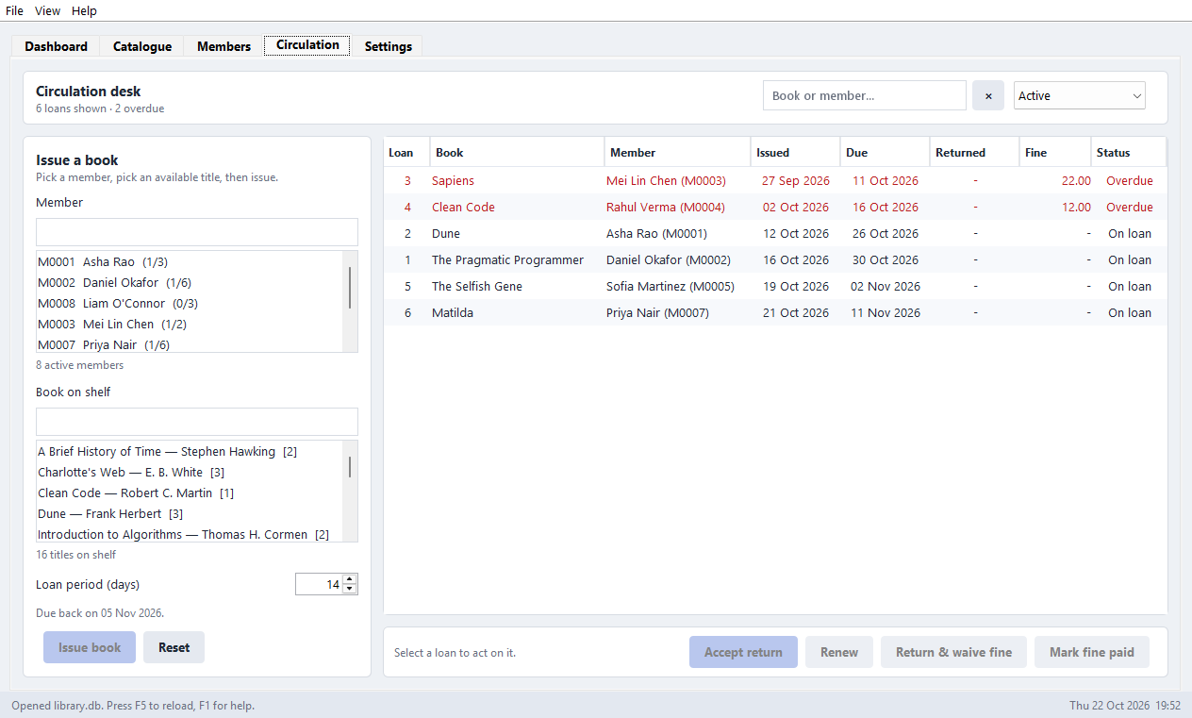
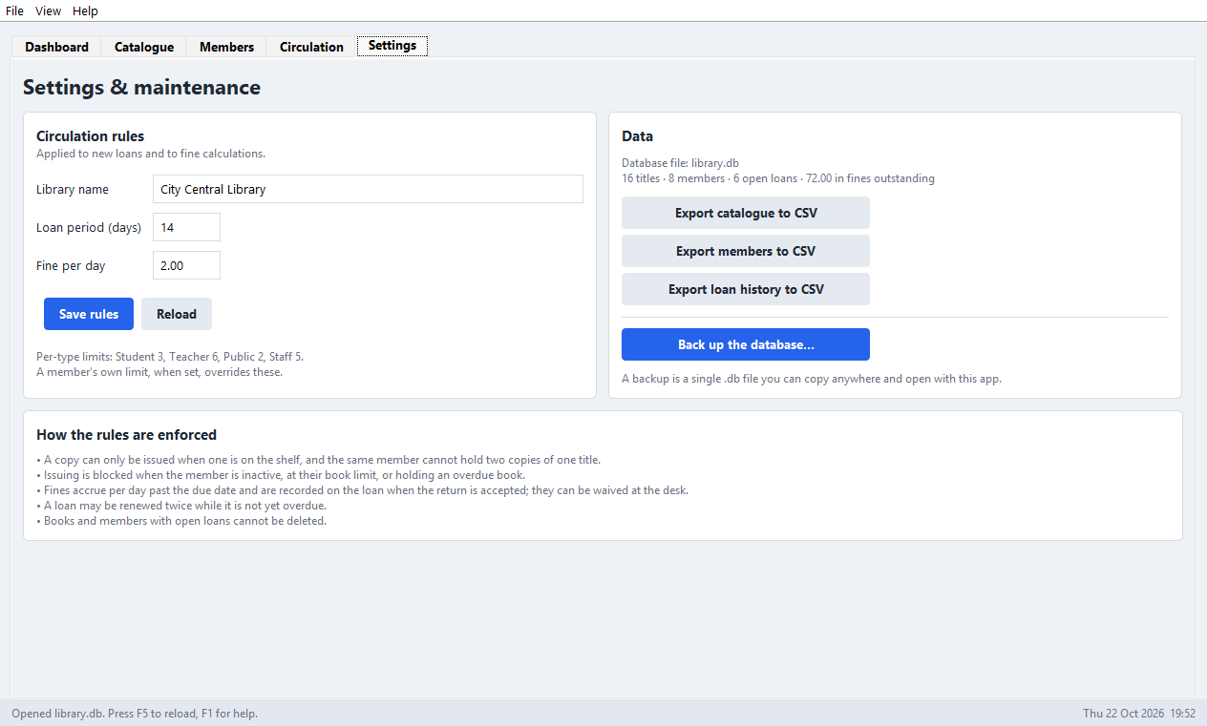
Application Screenshots
Catalogue — search, filter and edit books
Members — limits, dues and full history
Dashboard — counts, fines outstanding, and a red list of what is overdue
Circulation — issue, return, renew, settle
Settings — rules, CSV export and backup
Five tabs, one window. Ctrl+1…5 jumps between tabs · Ctrl+F searches · F5 reloads · overdue rows are red, out-of-stock titles orange.
Department of CSE-IOTCSBT, Vishwakarma Institute of Technology, Pune-37
9

Slide 10
Testing, Results and Conclusion
70
tests, all passing
47
rule and database tests
23
interface tests
2 × 2
operating systems × JDKs in CI
What the tests prove
Conclusion
Fines are worked out correctly, including at the day boundaries.
A complete, working library system in about 6,700 lines of Java, with one external dependency and no server to run.
Keeping the rules apart from the screens is what makes it both testable and safe to extend — the lesson the project set out to demonstrate.
Copy counts stay right after every issue, return and renewal.
A book that is on loan cannot be deleted.
Data is still there after closing and reopening the file.
Future scope
Reservations and a waiting list for titles that are all out.
The real screens are driven and checked — adding a book, catching a bad email, issuing, returning, waiving a fine.
Barcode scanning at the circulation desk.
Every push is built and tested automatically: Windows with JDK 21, and Linux with JDK 17 — the oldest version the project supports.
Shared access for more than one librarian at a time.
Automatic email or SMS reminders before a book falls due.
Department of CSE-IOTCSBT, Vishwakarma Institute of Technology, Pune-37
10

