Slide 1
Art & literature
9 класс

Slide 2

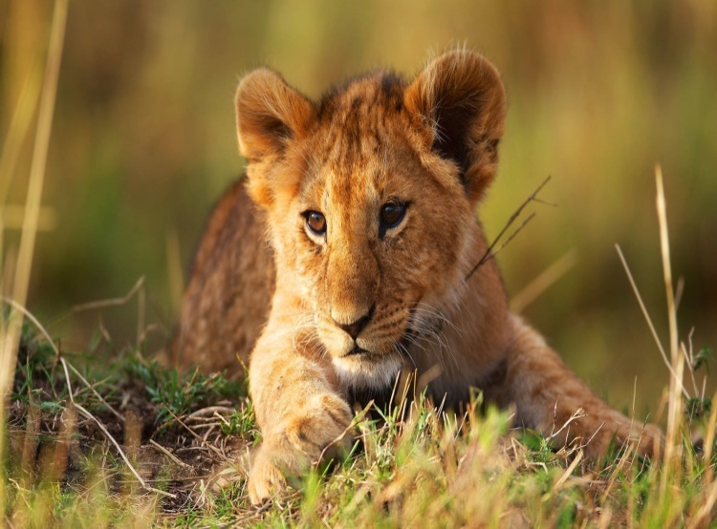
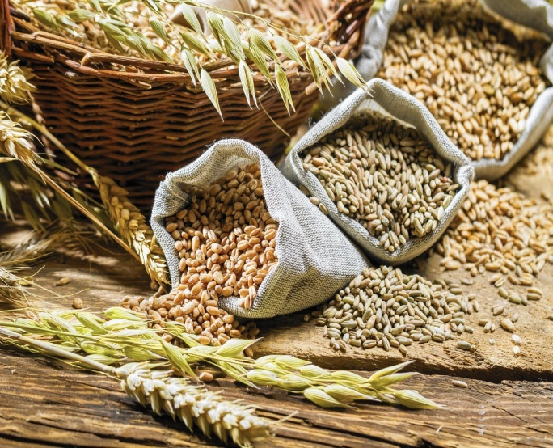
Remain…
1) Anonymous
2) Animal
3) Grains

Slide 3
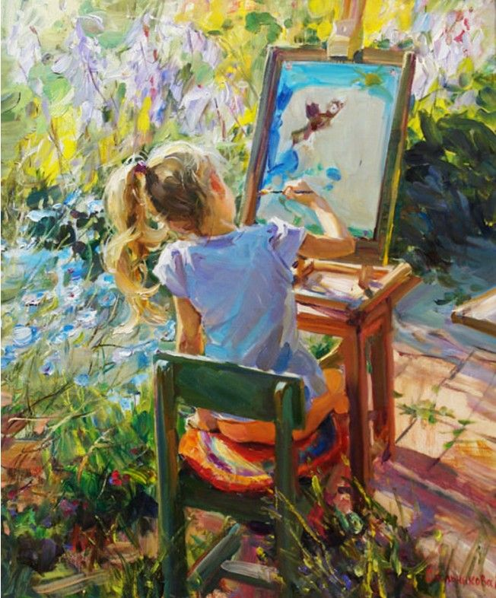
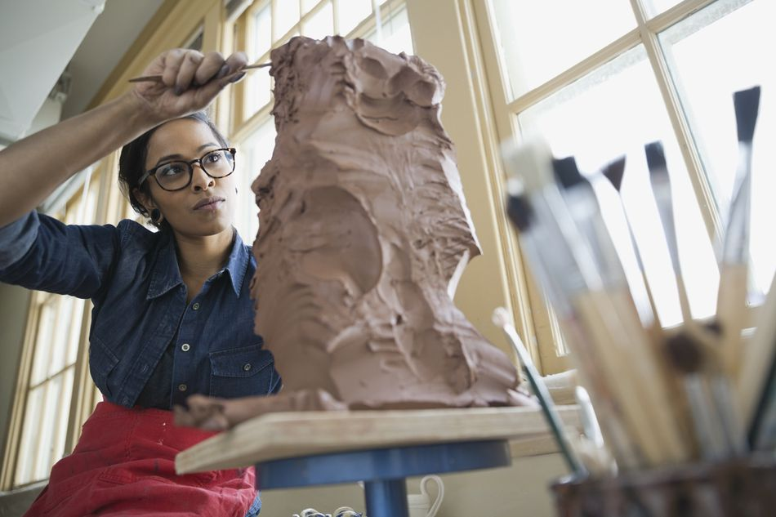
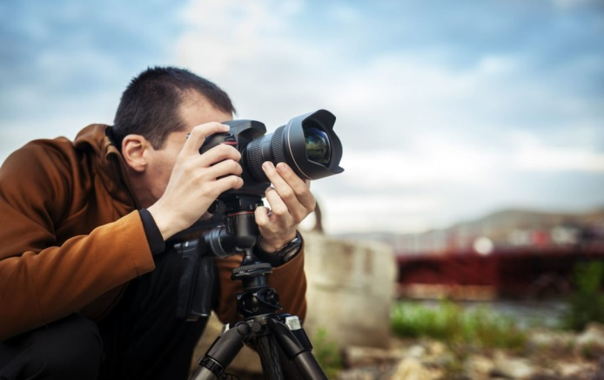
Painting - Painter
Sculpture - ?
Photography - ?

Slide 4
Adjective/ Adverb | Comparative | Superlative
Young | ? | Youngest
Late) | Later | ?
? | Bigger | Biggest

Slide 5
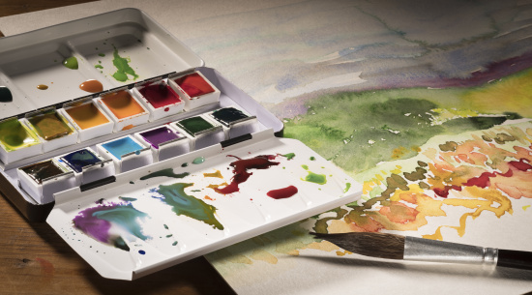
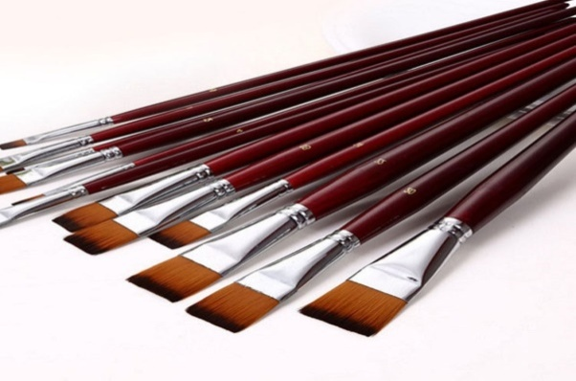
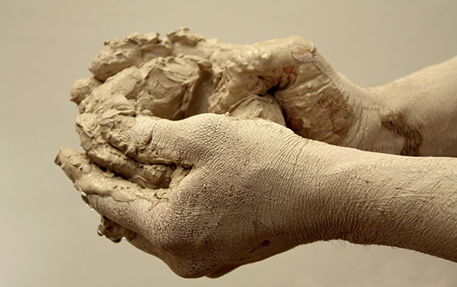
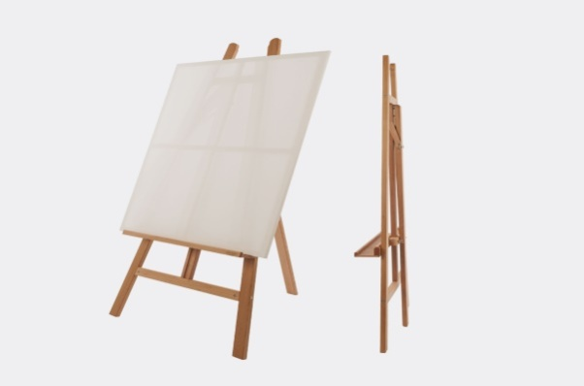
Which material or equipment does not belong to the art of painting?
Watercolours
Paintbrush
Clay
Easel

Slide 6
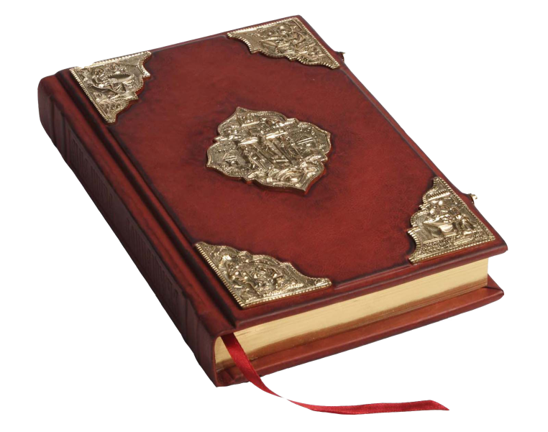
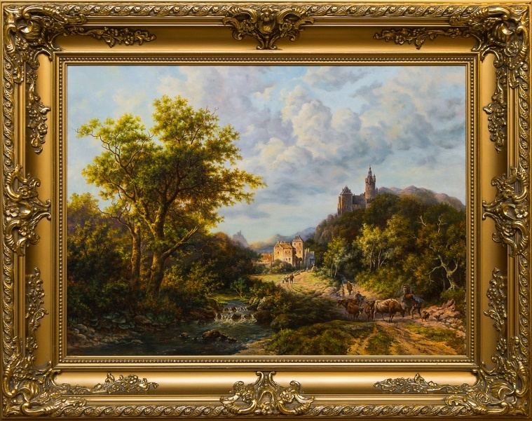
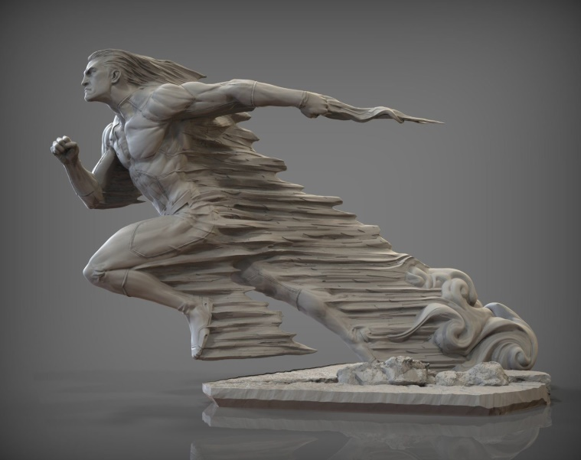
People create this during inspiration, but after that the subject has to go through the printing house.
book
picture
sculpture

Slide 7

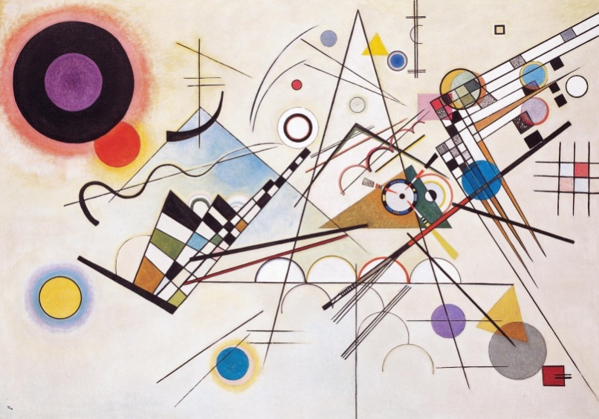
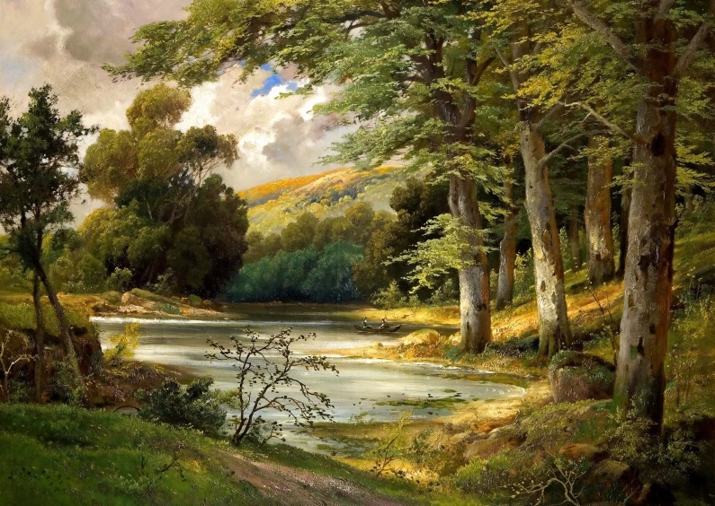
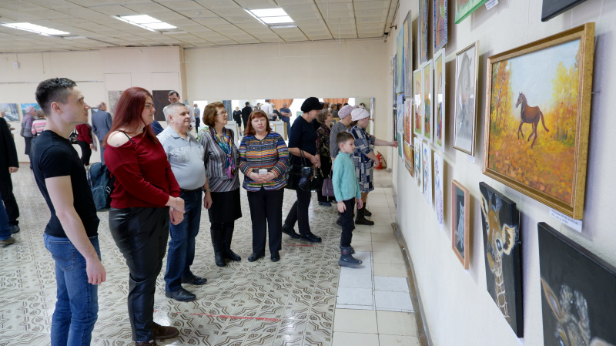
Aest?etics
Abstr?ct art
Lands?ape
Sh?w

Slide 8
What other word refers to the general theme of these words?
1) tune
2) сomposer
3) сonductor
4) beat
Disco
Piece
Scale
Seascape

