Slide 2
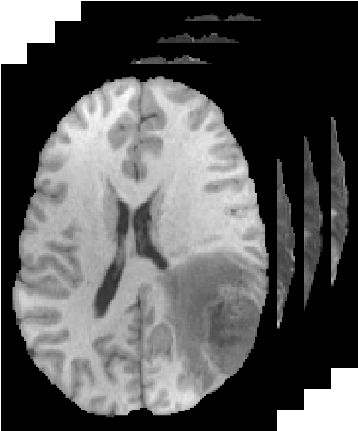
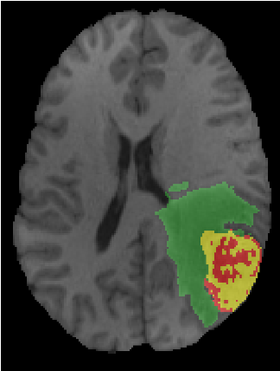


$$× L$$
Conv (stride = 2)
Subblock
Encoder Block 1
Decoder Block 3
Encoder Block 2
Decoder Block 2
Encoder Block 3
Decoder Block 1
$$× M$$
Encoder Block 4
Decoder Block 1
C
Subblock
Bridge Block
TConv (stride = 2)

Slide 3
Encoder Block 1
Decoder Block 3
Encoder Block 2
Decoder Block 2
Encoder Block 3
Decoder Block 1
Encoder Block 4
Decoder Block 1
Bridge Block
$$× L$$
$$× M$$
Conv (stride = 2)
Subblock
C
Subblock
TConv (stride = 2)

Slide 4
Stem Block
Head Block
Decoder Block 4
MLP
Encoder Block 1
Concatenate
Upsampling
Norm
Downsamping
Decoder Block 3
Encoder Block 2
Concatenate
Multi-Head Attention
Upsampling
Downsamping
Decoder Block 2
Norm
Encoder Block 3
Concatenate
Upsampling
Downsamping
Decoder Block 1
Encoder Block 4
Concatenate
Upsampling
Downsamping
Bridge Block

Slide 5
Stem Block
Encoder Block 1
Downsamping
Encoder Block 2
Downsamping
Encoder Block 3
Downsamping
Encoder Block 4
Downsamping
Bridge Block
Head Block
Decoder Block 4
Concatenate
Upsampling
Decoder Block 3
Concatenate
Upsampling
Decoder Block 2
Concatenate
Upsampling
Decoder Block 1
Concatenate
Upsampling
Norm
Multi-Head Factorizer
MLP
Norm
Factorizer Block

Slide 6


Stem Block
Encoder Block 1
Encoder Block 2
Encoder Block 3
Encoder Block 4
Bridge Block
Decoder Block 1
Decoder Block 2
Decoder Block 3
Decoder Block 4
Head Block
$$× L$$
$$× M$$
MLP
Downsample
(stride = 2)
Subblock
Upsample
(stride = 2)
Subblock
Norm
MHSA
C
Norm

Slide 7
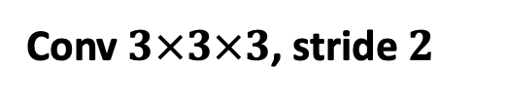

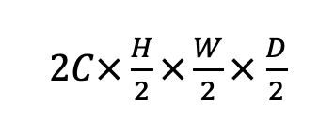
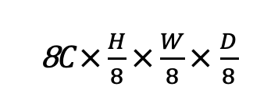
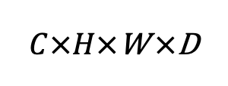
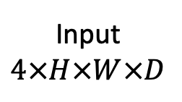
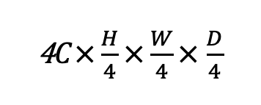
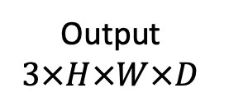

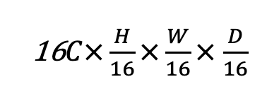
Input
$$4×H×W×D$$
$C×H×$W $×$D
Decoder Block 4
Head Block
Concatenate
Upsample
Output
$$3×H×W×D$$
Downsample
$2C×\frac{H}{2}×\frac{W}{2}×$ $\frac{D}{2}$
Decoder Block 3
Head Block
Encoder Block 2
Concatenate
Upsample
Downsample
4$C×\frac{H}{4}×\frac{W}{4}×$ $\frac{D}{4}$
Decoder Block 2
Head Block
Encoder Block 3
Concatenate
Upsample
Downsample
8$C×\frac{H}{8}×\frac{W}{8}×$ $\frac{D}{8}$
Decoder Block 1
Stem Block
Conv $3×3×3$
Encoder Block 4
Concatenate
Head Block
Conv $1×1×1$
Upsample
Downsample
Conv $3×3×3$, stride $2$
Downsample
16$C×\frac{H}{16}×\frac{W}{16}×$ $\frac{D}{16}$
Upsample
Transposed Conv $3×3×3$, stride $2$
Bridge Block

Slide 8
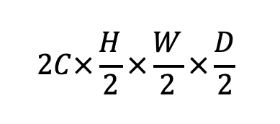
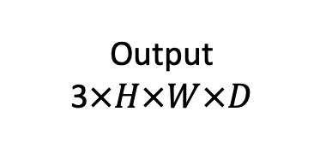
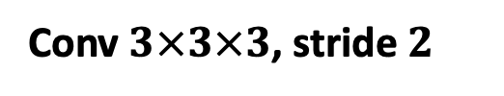
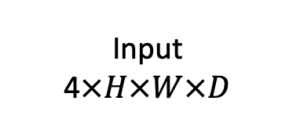
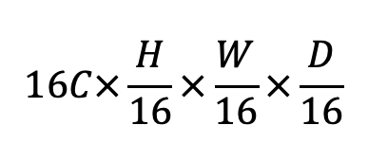
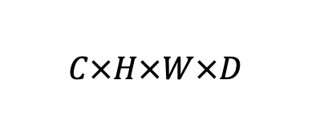


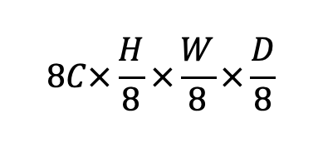
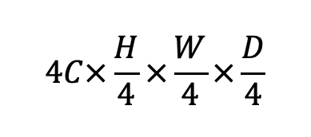
Stem Block
$$C×H×W×D$$
Factorizer Block
Head Block
Factorizer Block
Concatenate
$$\text{Output}$$
$$\text{3}×H×W×D$$
$$\text{Input}$$
$$\text{4}×H×W×D$$
Upsample
Downsample
$$2C×\frac{H}{2}×\frac{W}{2}×\frac{D}{2}$$
Factorizer Block
Head Block
Factorizer Block
Concatenate
Upsample
Downsample
$$4C×\frac{H}{4}×\frac{W}{4}×\frac{D}{4}$$
Factorizer Block
Head Block
Factorizer Block
Concatenate
Upsample
Downsample
$$8C×\frac{H}{8}×\frac{W}{8}×\frac{D}{8}$$
Factorizer Block
Factorizer Block
Concatenate
Stem Block
Conv $3×3×3$
Positional Embedding
Upsample
Head Block
Pointwise Conv
∼
$$16C×\frac{H}{16}×\frac{W}{16}×\frac{D}{16}$$
Downsample
Conv $3×3×3$, stride $2$
Downsample
+
Factorizer Block
Upsample
Transposed Conv $3×3×3$, stride $2$

Slide 9
T1
T1gd
T2
FLAIR
GT

Slide 10
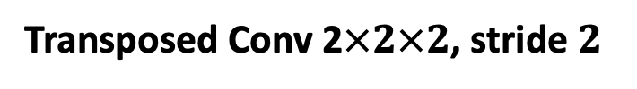
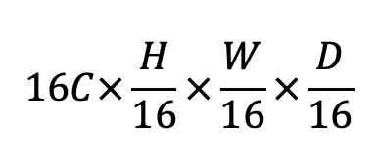

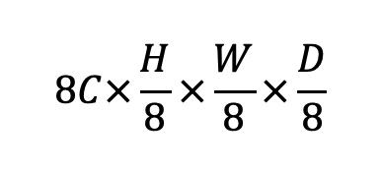

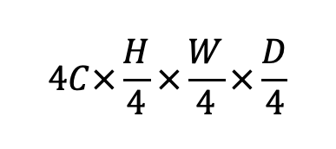
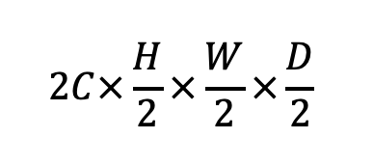
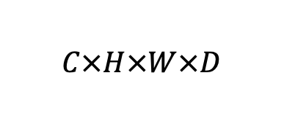
Stem Block
$$C×H×W×D$$
Swin Factorizer Block
Head Block
Swin Factorizer Block
Concatenate
$$\text{Output}$$
$$\text{3}×H×W×D$$
$$\text{Input}$$
$$\text{4}×H×W×D$$
Upsample
Downsample
$$2C×\frac{H}{2}×\frac{W}{2}×\frac{D}{2}$$
Swin Factorizer Block
Head Block
Swin Factorizer Block
Concatenate
Upsample
Downsample
$$4C×\frac{H}{4}×\frac{W}{4}×\frac{D}{4}$$
Swin Factorizer Block
Head Block
Swin Factorizer Block
Concatenate
Upsample
Downsample
$$8C×\frac{H}{8}×\frac{W}{8}×\frac{D}{8}$$
Swin Factorizer Block
Swin Factorizer Block
Concatenate
Stem Block
Conv $3×3×3$
Positional Embedding
Upsample
Head Block
Pointwise Conv
∼
$$16C×\frac{H}{16}×\frac{W}{16}×\frac{D}{16}$$
Downsample
Conv 2$×2×2$, stride $2$
Downsample
+
Swin Factorizer Block
Upsample
Transposed Conv 2$×2×2$, stride $2$

Slide 11
MLP
Poinwise Conv
Dematricize
Concatenate
Layer Norm
NMF
Unfold
ReLU
Swin
Wrapped NMF
Matricize
Layer Norm
Poinwise Conv

Slide 12
Output
Regular Patches
Unfold
Input
Concatenate
SW Patches
Unfold

Slide 14
Local Matricize
Pixel
Channel
Regular Patches
Unfold
Concatenate
Batch
Input
Unfold
SW Patches

Slide 15
Pixel
Channel
Non-overapping Patches
Unfold
Batch
Input

Slide 16
Pixel
Channel
Unfold
Input
Batch

Slide 17
Channel
Channel
Position
Input
Position
Output
Input
Fold
Norm
Unfold
Output
MHSA
MLP
Norm

Slide 18
Linear
Query
Attention Map
Softmax
Input
Linear
Key
Transpose
Linear
Output
Linear
Value

Slide 19
Linear
Query
Input
Linear
Key
Factorization
Linear
Output
Linear
Value

Slide 20
Output
Linear
Attention Map
Nonparametric Regression
Softmax
Transpose
Query
Key
Value
Linear
Linear
Linear
Input

Slide 21
Channel
Position
$$X$$
Query
Linear
Attention Map
Softmax
Key
Transpose
$$Y$$
Linear
Output
Value
Linear
Nonparametric Regression

Slide 22
Output
Linear
Factorization
Query
Key
Value
Linear
Linear
Linear
Input

Slide 23


$$X$$
Linear
Matrix Factorization
Linear
$$Y$$

Slide 24




$$X$$
Linear
Linear
Linear
$$Q$$
$$K$$
$$V$$
Joint Matrix Factorization
Linear
$$Y$$

