Slide 1
ENTERPRISE AI ENGINEERING
WITH PALANTIR AIP
Program Walkthrough & Live Demo
Prepared & Presented by Rajesh Pasham
Intelligence Works COE • Enterprise Palantir Foundry & AIP Consulting

Slide 2





Today's Walkthrough
A quick, practical tour of the program you'll be sending your team into
Alignment Recap
How the curriculum answers each of your three feedback points
Program Architecture
The Insurance Claims Lifecycle that runs through all 8 weeks
Sample Deep Dives
A look at the AIP Copilot and Multi-Agent architectures your team will build
The Capstone
One integrated Enterprise Insurance AI Operations Platform
Business Value & Next Steps
KPIs this program moves, and how we kick off
Enterprise AI Engineering with Palantir AIP
2

Slide 3

You Asked. The Curriculum Already Delivers.
Your team's alignment feedback, mapped directly to what's built into the program
Compress Basic Ingestion
80% AIP & Advanced Focus
Data Engineers → AI/Ontology Engineers
Standard Foundry/data ingestion is fully compressed into Week 1 only — Week 1 opens directly on Ontology-first design and governance.
7 of 8 weeks (Weeks 2–8) are AIP-dedicated: LLM Copilots, Actions/writeback, multi-agent systems, MLOps, and OSDK extensibility.
Every week maps to a named engineering role — from Ontology Engineer to Enterprise AI Solution Architect — not front-end UI work.
Enterprise AI Engineering with Palantir AIP
3

Slide 4
Program at a Glance
8
80%+
10 hrs
1
Weeks
AIP-Focused Content
Per Week, Per Participant
Integrated Capstone Platform
Delivery Rhythm — Every Week
• Day 1–2 — Instructor-led Theory + Live Architecture Demo (2 hrs)
• Day 3 — Self-paced Case Study Development
• Day 4 — Batch-wise Mentoring / Design Reviews (4 hrs)
• Day 5 — Architecture Review, Code Review & Feedback (4 hrs)
Enterprise AI Engineering with Palantir AIP
4

Slide 5
Program Through-Line: The Insurance Claims Lifecycle
One continuous, realistic lifecycle — each week contributes the AIP capability needed for that stage
Claims Intake / OCR / Classification
Week 4
Coverage Validation
Week 3
Fraud Detection / Medical Verification
Week 5
Adjuster Recommendation
Weeks 2 & 5
Settlement & Guidewire Update
Weeks 3 & 7
Enterprise AI Engineering with Palantir AIP
5

Slide 6
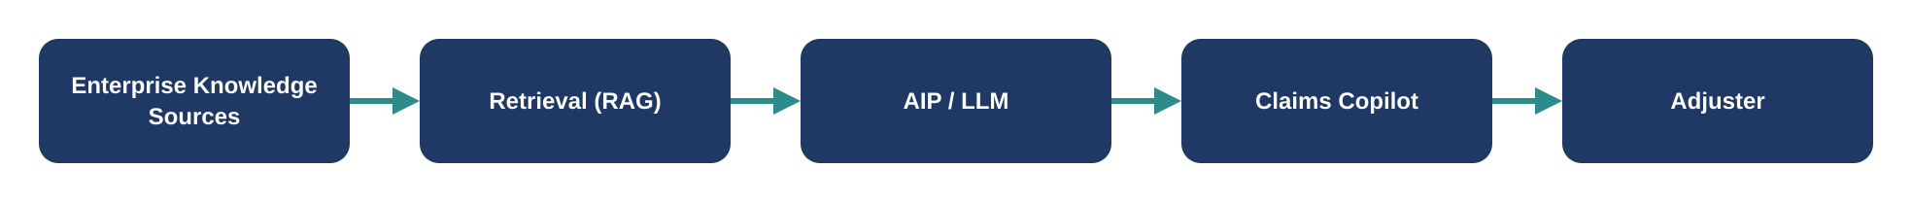
Deep Dive — Week 2: Insurance Claims Copilot
Objective: a production-ready Copilot that retrieves enterprise knowledge and integrates with the Ontology
What Your Team Builds
Palantir Components Used
• RAG-based retrieval grounded in enterprise knowledge
• AIP Assist
• Prompt & context engineering for insurance scenarios
• AIP Logic
• Direct integration with the Week 1 Ontology
• AIP Agent Studio
• Ontology
Enterprise AI Engineering with Palantir AIP
6

Slide 7
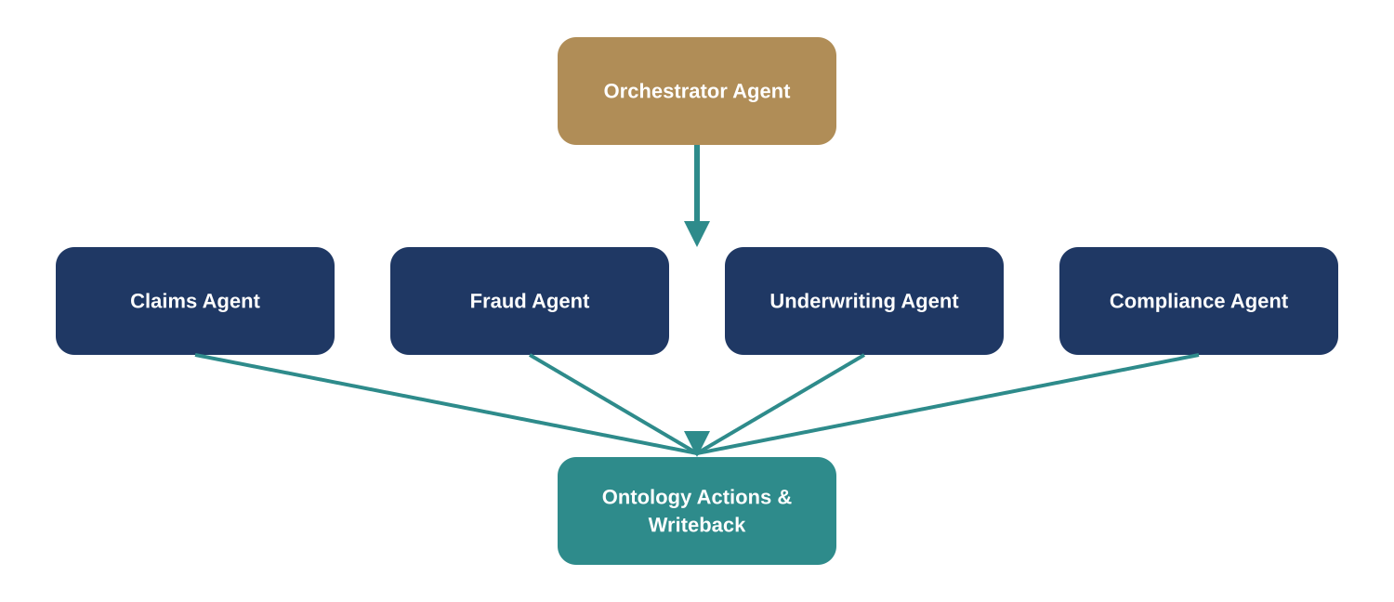
Deep Dive — Week 5: Multi-Agent Insurance Workflow
Objective: orchestrate specialized agents that collaborate and write back to the Ontology
Insurance Agents
Enterprise Patterns
• Claims Agent
• Event-driven triggers
• Fraud Agent
• Microservices-style isolation
• Underwriting Agent
• Ontology Actions writeback
• Compliance Agent
Enterprise AI Engineering with Palantir AIP
7

Slide 8
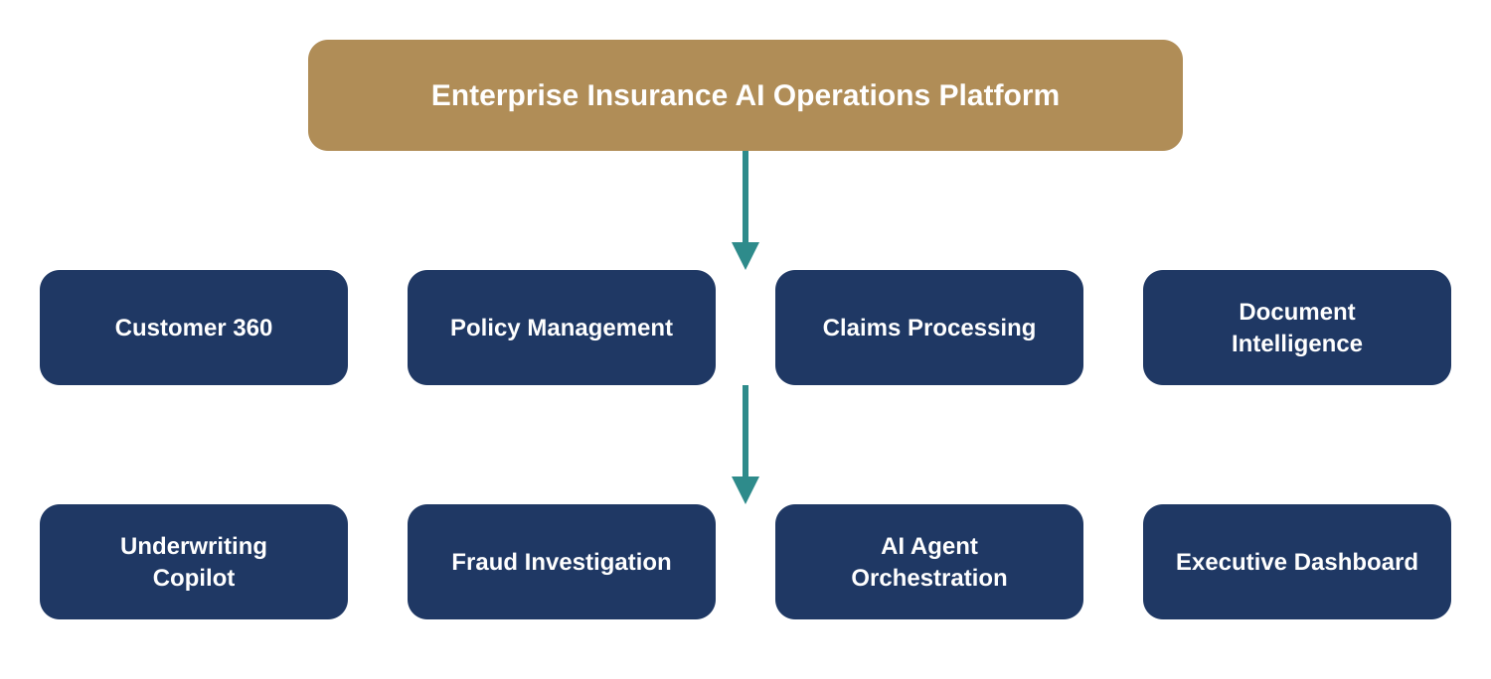
The Capstone: One Integrated Platform
Every team hardens and integrates the same platform they've been building since Week 1 — not a menu of disconnected options
Enterprise AI Engineering with Palantir AIP
8

Slide 9
The Engineering Progression
Each week builds a specific, named capability
W1
Ontology Engineer
W2
Copilot Developer
W3
Workflow Automation Engineer
W4
Document Intelligence Engineer
W5
AI Agent Engineer
W6
LLMOps Engineer
W7
OSDK Full Stack Developer
W8
Enterprise AI Solution Architect
Enterprise AI Engineering with Palantir AIP
9

Slide 10







Mapped Directly to Palantir Capabilities
Every week names the specific platform components participants use — not generic topics
Foundry & Ontology Manager
AIP Assist
AIP Logic, Actions & Automate
Agent Studio
Contour & Document Processing
OSDK & Developer Console
AIP Evals & Observability
Access Control (RBAC/ABAC)
Enterprise AI Engineering with Palantir AIP
10

Slide 11
Tied to the Metrics That Matter
The capstone platform is designed to move real business KPIs, not just demonstrate technical completeness
Claims Processing Time
Fraud Detection Accuracy
Straight Through Processing (STP)
Claim Leakage
Average Settlement Time
Policy Renewal Rate
Customer Satisfaction
Operational Cost Reduction
Enterprise AI Engineering with Palantir AIP
11

Slide 12
Progress Is Measurable Every Week
A consistent weekly scorecard, plus a dedicated capstone evaluation — not just a final grade
Weekly Scorecard
Final Capstone Criteria
Architecture
20%
Solution Architecture
20%
AI Design
20%
Ontology / AI Workflow Design
30%
Implementation
30%
Multi-Agent & Writeback
25%
Documentation
10%
Security, MLOps & Production Support
20%
Presentation
20%
Executive Presentation
5%
Enterprise AI Engineering with Palantir AIP
12

Slide 13


Next Steps
Confirm Kickoff Date
Align on a Week 1 start date and cohort batch groupings
Finalize Use Case Pool
Confirm the 5–10 real use cases from the illustrative pool with participants
Confirm Data & Access
Data provisioning and anonymization approach ready before Week 2
Begin Week 1
Accelerated Foundry, Ontology & Enterprise Governance
Rajesh Pasham | Intelligence Works COE | +91 85489 84640 | linkedin.com/in/rajeshpasham
Enterprise AI Engineering with Palantir AIP
13

