Slide 1
Agenda
MVC model discussion
Architecture Overview
Salliter Current Status[Front end, API, DataPlatform,AWS]
Technology Selection

Slide 2
MVC model discussion

Slide 3
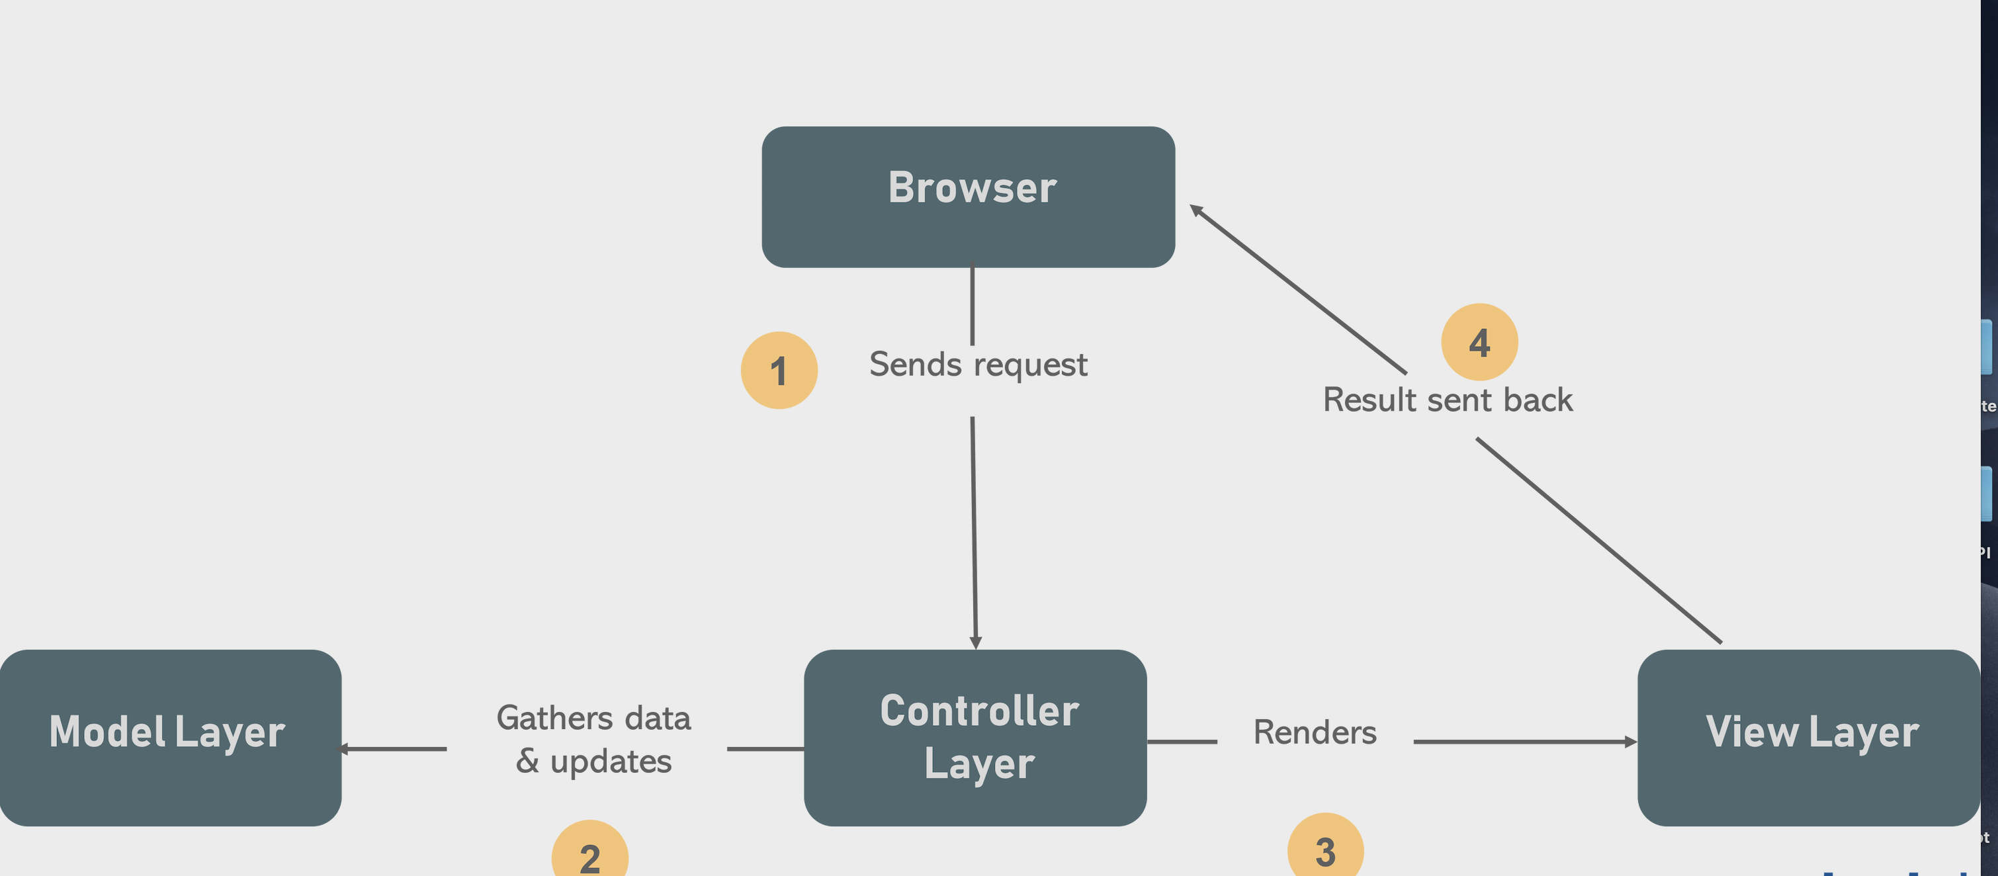

Slide 4
Architecture Overview

Slide 5
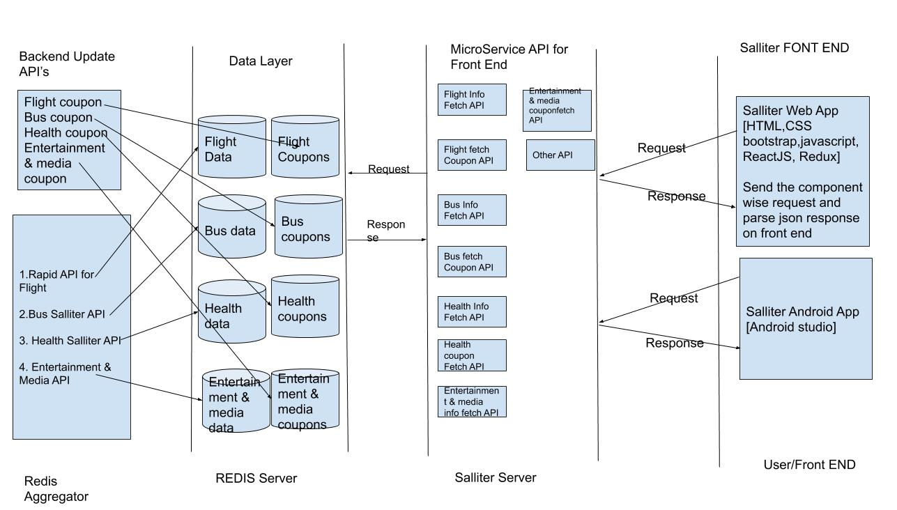

Slide 6
Salliter Current Status

Slide 7
Technology used in Salliter and what we have currently?
Architecture -> Monolithic Arch
Server -> Flask
Front -> HTML,CSS,Js
Backend/API -> Python/Flask
Dataplatform -> Python
DataStorage -> Redis
Cloud/Hosting -> AWS
Code management -> Github
Work flow Management -> Trello

Slide 8
Technology Selection

Slide 9
Technology Selection
Architecture -> Micro Service Arch with MVC Model
View Layer -> ReactJs and ReactNative
Controller Layer -> Springboot
Model Layer (DataPlatform/ML) -> Python /Go
DataStorage ->Redis
Server -> NodeJS
Cloud/Hosting-> AWS
Code management -> Github
Build Management -> Locally
Docker Image Artifactory -> Github repo
Work Flow Management -> Trello

