Slide 1
Agenda
Finalising Salliter Architecture [MVC model]
Discussion on selection of Technology wrt to MVC Arch
Discussion on Task Assignment
Update on AWS Account

Slide 2
Architecture Overview

Slide 3
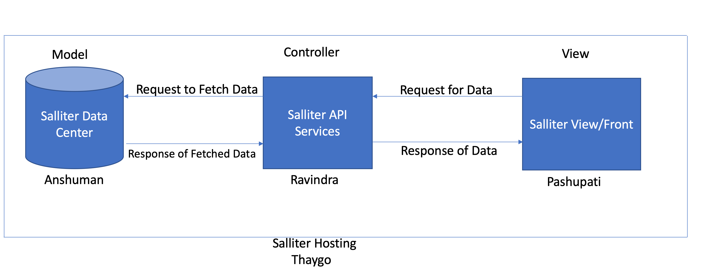

Slide 4
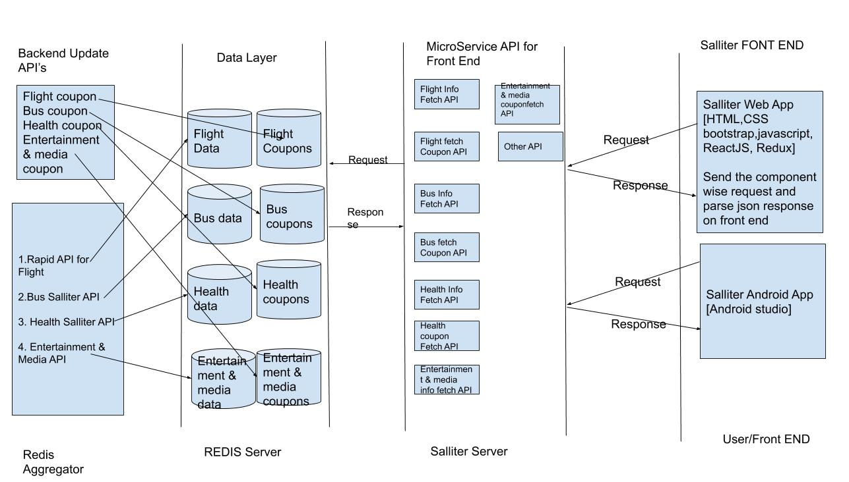

Slide 5
Technology Selection

Slide 6
Technology Selection
Architecture -> Micro Service Arch with MVC Model
View Layer -> ReactJs and ReactNative
Controller Layer -> Springboot
Model Layer (DataPlatform/ML) -> Python /Go
DataStorage ->Redis
Server -> NodeJS
Cloud/Hosting-> Docker, Kubernates, AWS
Code management -> Github
Build Management -> Locally
Docker Image Artifactory -> Github repo
Work Flow Management -> Trello

Slide 7
Discussion on Task Assignment
Lets follow Agile way of working
- sprint wise [1 week]
- Start with Planning of task to meet goal
- Fix Target/Goal per week based on bandwidth
- Use Trello
- Discuss about Progress / Updates

