Slide 1
LECTURE-12 &13
Modern Cryptography,
Stream Cipher and Block Cipher, Data Encryption Standard (DES)

Slide 2
Introduction
Truly random - is defined as exhibiting ``true'' randomness, such as the time between ``tics'' from a Geiger counter exposed to a radioactive element
Pseudorandom - is defined as having the appearance of randomness, but nevertheless exhibiting a specific, repeatable pattern.
numbers calculated by a computer through a deterministic process, cannot, by definition, be random

Slide 3
Introduction
Usage
  Almost all network security protocols rely on the randomness of certain parameters
    Nonce - used to avoid replay
    session key
    Unique parameters in digital signatures
  Monte Carlo Simulations -
    is a mathematical technique for numerically solving differential equations. Randomly generates scenarios for collecting statistics.

Slide 4
(Desirable) Properties of Pseudorandom Numbers
  Uncorrelated Sequences - The sequences of random numbers should be serially uncorrelated
  Long Period - The generator should be of long period (ideally, the generator should not repeat; practically, the repetition should occur only after the generation of a very large set of random numbers).
  Uniformity - The sequence of random numbers should be uniform, and unbiased. That is, equal fractions of random numbers should fall into equal ``areas'' in space. Eg. if random numbers on [0,1) are to be generated, it would be poor practice were more than half to fall into [0, 0.1), presuming the sample size is sufficiently large.
  Efficiency - The generator should be efficient. Low overhead for massively parallel computations.

Slide 5
STREAM AND BLOCK CIPHERS
The literature divides the symmetric ciphers into two broad categories: Stream ciphers and block ciphers. Although the definitions are normally applied to modern ciphers, this categorization also applies to traditional ciphers.
Stream Ciphers: The encryption and decryption takes place bit by bit or byte by byte or some small fixed length of bits with a simple XORing mechanism.
Block Ciphers: The encryptions and décryptions takes place on a fixed size of block of plain message in several rounds.
Combination: The cipher system make use of both mechanism

Slide 6
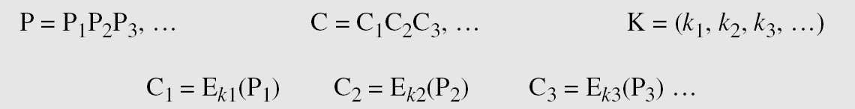
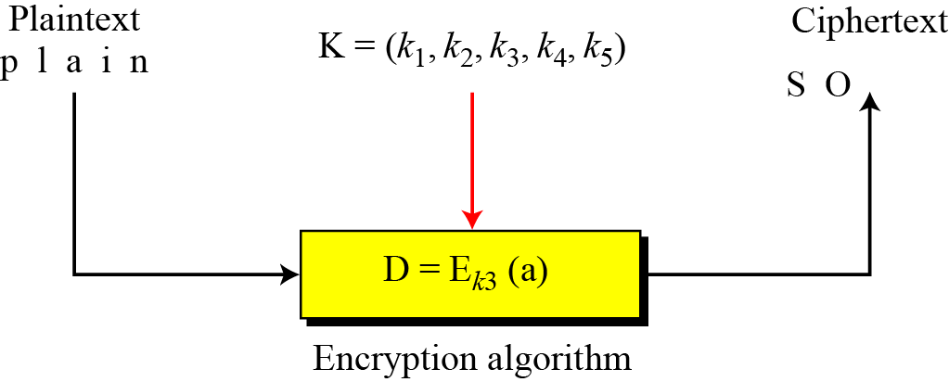
Stream Ciphers
Call the plaintext stream P, the ciphertext stream C, and the key stream K.
Stream cipher

Slide 7


ELECTRONIC CIPHERS Vs COMPUTER BASED SECURITY
The basic formulae remains same for encryption,
C _{i} = P_{i} Z_{i} ,
but here, P_{i} {0,1}
C _{i} {0,1}
Addition modulo 2 : XOR
Z _{i} {0,1}
This transformation makes the life easy because all plain message can be
converted into BINNARY DIGITS using ASCII code or any other coding
scheme, and
Z_{i} can be generated independently by random number generator.
C_{i} can be obtained by simply XOR it.
Reverse process for Decryption is again simple:-
P_{i} = C _{i} Z _{i}

Slide 8
ENCIPHERING :-(OTP)
MESSAGE :- NEELIMA
PLAIN BITS P_{i} :- 1001110 , 1000101 , 1000101 , 1001100 ,
1001001, 1001101 , 1000001
KEY BITS Z _{i} :- 0101101 , 1100101 , 0110011 , 0110110 ,
0100101, 0100110 , 1110011
CIPHER BITS C _{i} :- 1100011 , 0100000 , 1110110 , 1111010 ,
1101100, 1101011 , 0110010
DISGUISED MESSAGE :- c b v z l k 2
DECIPHERING :-
CIPHER’S MESSAGE :- c b v z l k 2
CIPHER BITS C _{i} :- 1100011 , 0100000 , 1110110 , 1111010 ,
1101100, 1101011 , 0110010
KEY BITS Z _{i} :- 0101101 , 1100101 , 0110011 , 0110110 ,
0100101, 0100110 , 1110011
PLAIN BITS P_{i}:- 1001110 , 1000101 , 1000101 , 1001100 ,
1001001, 1001101 , 1000001
PLAIN MESSAGE :- NEELIMA

Slide 9
History: DATA ENCRYPTION STANDARD
In 1973, NIST published a request for proposals for a national symmetric-key cryptosystem. A proposal from IBM, a modification of a project called Lucifer, was accepted as DES. DES was published in the Federal Register in March 1975 as a draft of the Federal Information Processing Standard (FIPS).

Slide 10
Objectives
❏ To review a short history of DES
❏ To define the basic structure of DES
❏ To describe the details of building elements of DES
❏ To describe the round keys generation process
❏ To analyze DES/ Discuss the variation of DES

Slide 11

Overview
DES is a block cipher, as shown in Figure
Figure: Encryption and decryption with DES

Slide 12
DES STRUCTURE
The encryption process is made of two permutations (P-boxes), which we call initial and final permutations, and sixteen Feistel rounds.
Topics discussed in this section:
Initial and Final Permutations Rounds
Cipher and Reverse Cipher
Examples

Slide 13

Continue
General structure of DES

Slide 14

Initial and Final Permutations
Initial and final permutation steps in DES

Slide 15

Continued
Note
The initial and final permutations are straight P-boxes that are inverses
of each other.
They have no cryptography significance in DES.

Slide 16

Rounds
DES uses 16 rounds. Each round of DES is a Feistel cipher.
A round in DES
(encryption site)

Slide 17

Continued
DES Function
The heart of DES is the DES function. The DES function applies a 48-bit key to the rightmost 32 bits to produce a 32-bit output.
DES function

Slide 18

Continue
Expansion P-box
Since R_{I−1} is a 32-bit input and K_{I} is a 48-bit key, we first need to expand R_{I−1} to 48 bits.
Expansion permutation

Slide 19
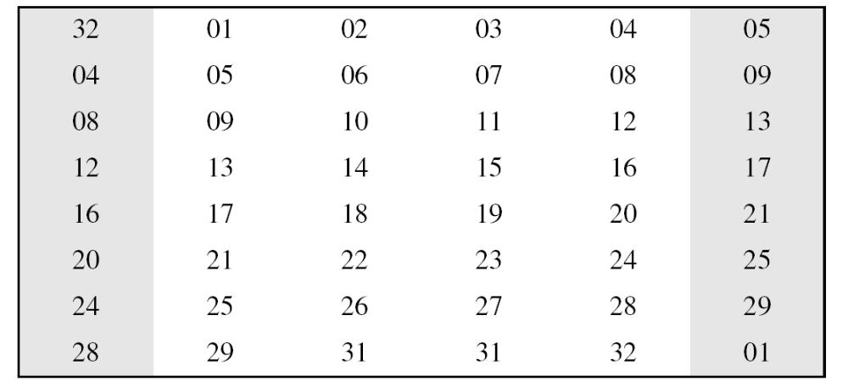
Continue
Although the relationship between the input and output can be defined mathematically, DES uses earlier given table to define this P-box.
Expansion P-box table

Slide 20
Continue
Whitener (XOR)
After the expansion permutation, DES uses the XOR operation on the expanded right section and the round key. Note that both the right section and the key are 48-bits in length. Also note that the round key is used only in this operation.

Slide 21

Continue
S-Boxes
The S-boxes do the real mixing (confusion). DES uses 8 S-boxes, each with a 6-bit input and a 4-bit output.
S-boxes

Slide 22

Continue
S-box rule

Slide 23

Continue
Table shows the permutation for S-box 1. For the rest of the boxes see the textbook.
S-box 1

Slide 24
Continued
Example
The input to S-box 1 is 100011. What is the output?
Solution
If we write the first and the sixth bits together, we get 11 in binary, which is 3 in decimal. The remaining bits are 0001 in binary, which is 1 in decimal. We look for the value in row 3, column 1, in (S-box 1). The result is 12 in decimal, which in binary is 1100. So the input 100011 yields the output 1100.

Slide 25
Continued
Example
The input to S-box 8 is 000000. What is the output?
Solution
If we write the first and the sixth bits together, we get 00 in binary, which is 0 in decimal. The remaining bits are 0000 in binary, which is 0 in decimal. We look for the value in row 0, column 0, in Table (S-box 8). The result is 14 in decimal, which is 1101 in binary. So the input 000000 yields the output 1101.

Slide 26
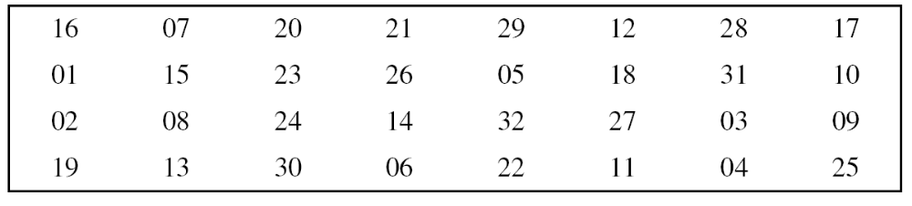
Continue
Straight Permutation
Straight permutation table

Slide 27
Cipher and Reverse Cipher
Using mixers and swappers, we can create the cipher and reverse cipher, each having 16 rounds.
First Approach
To achieve this goal, one approach is to make the last round (round 16) different from the others; it has only a mixer and no swapper.
Note
In the first approach, there is no swapper in the last round.

Slide 28

Continued
DES cipher and reverse cipher for the first approach

Slide 29
Continued
Alternative Approach
We can make all 16 rounds the same by including one swapper to the 16th round and add an extra swapper after that (two swappers cancel the effect of each other).
Key Generation
The round-key generator creates sixteen 48-bit keys out of a 56-bit cipher key.

Slide 30

Continued
Key generation

Slide 31
DES ANALYSIS
Critics have used a strong magnifier to analyze DES. Tests have been done to measure the strength of some desired properties in a block cipher.
Topics discussed in this section:
Properties
Design Criteria
DES Weaknesses

Slide 32
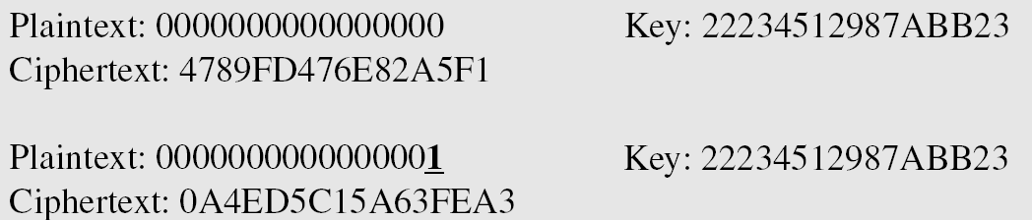
Properties
Two desired properties of a block cipher are the avalanche effect and the completeness.
Example
To check the avalanche effect in DES, let us encrypt two plaintext blocks (with the same key) that differ only in one bit and observe the differences in the number of bits in each round.

Slide 33
Continued
Example
Continued
Although the two plaintext blocks differ only in the rightmost bit, the ciphertext blocks differ in 29 bits. This means that changing approximately 1.5 percent of the plaintext creates a
change of approximately 45 percent in the ciphertext.
Table Number of bit differences for Example

Slide 34
Continued
Completeness effect
Completeness effect means that each bit of the ciphertext needs to depend on many bits on the plaintext.

Slide 35
Design Criteria
S-Boxes
The design provides confusion and diffusion of bits from each round to the next.
Confusion refers to making the correlation between the key and the ciphertext as complex and intricate as possible; diffusion refers to the property that the redundancy in the statistics of the plaintext is “dissipated” in the statistics of the ciphertext.
P-Boxes
They provide diffusion of bits.
Number of Rounds
DES uses sixteen rounds of Feistel ciphers. the ciphertext is thoroughly a random function of plaintext and ciphertext.

Slide 36
Properties
Two desired properties of a block cipher are the avalanche effect and the completeness.
Example
To check the avalanche effect in DES, let us encrypt two plaintext blocks (with the same key) that differ only in one bit and observe the differences in the number of bits in each round.

Slide 37
Multiple DES
The major criticism of DES regards its key length. Fortunately DES is not a group. This means that we can use double or triple DES to increase the key size.
1. Double DES
2. Triple DES

Slide 38
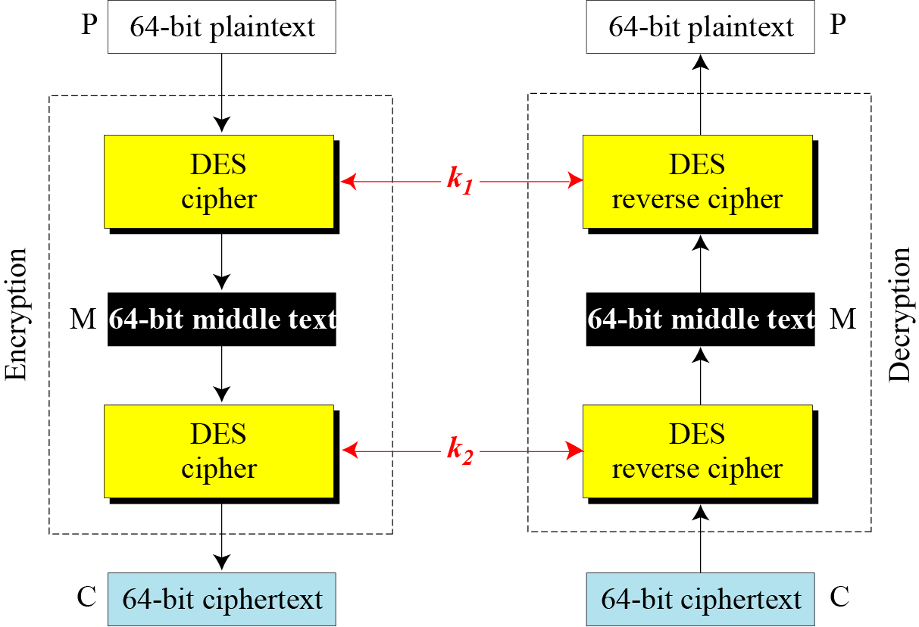
Double DES

Slide 39
Attacks on Double DES
Meet-in-the-Middle Attack
However, using a known-plaintext attack called meet-in-the-middle attack proves that double DES improves this vulnerability slightly (to 2⁵⁷ tests), but not tremendously (to 2¹¹²).

Slide 40
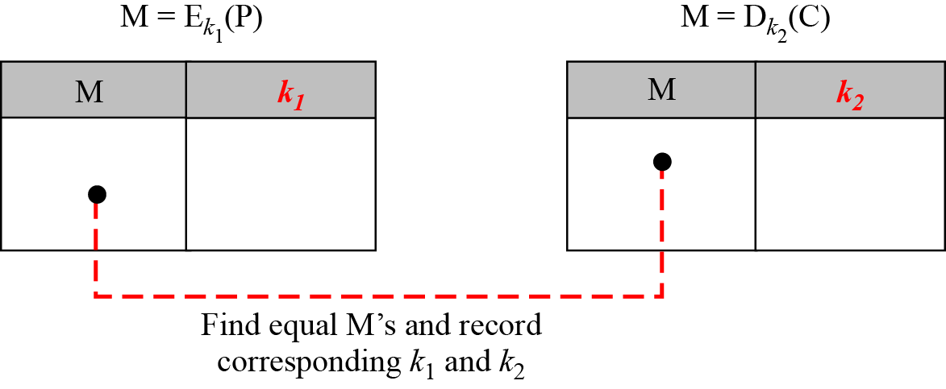
Continued
Tables for meet-in-the-middle attack

Slide 41
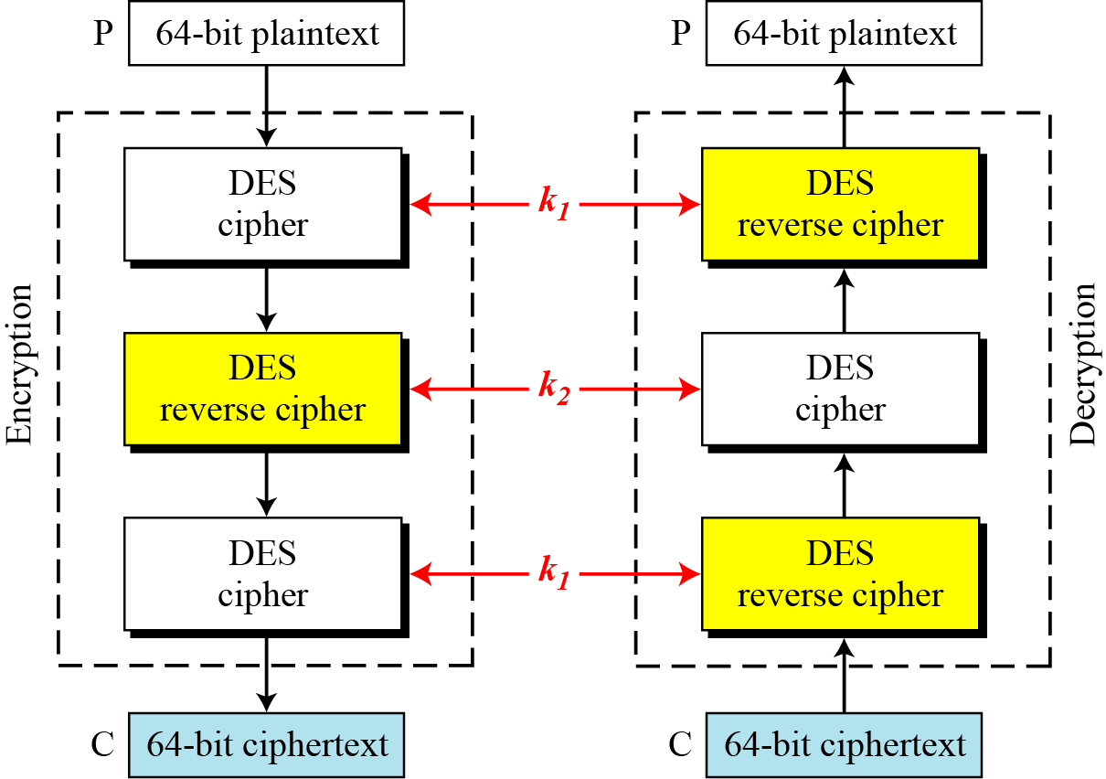
Triple DES
Figure Triple DES with two keys

Slide 42
Continuous
Triple DES with Three Keys
The possibility of known-plaintext attacks on triple DES with two keys has enticed some applications to use triple DES with three keys. Triple DES with three keys is used by many applications such as PGP .

Slide 43
Security of DES
DES, as the first important block cipher, has gone through much scrutiny. Among the attempted attacks, three are of interest: brute-force, differential cryptanalysis, and linear cryptanalysis.
Brute-Force Attack
DES can be broken using 2⁵⁵ encryptions.
Differential Cryptanalysis
It has been revealed that the designers of DES already knew about this type of attack and designed S-boxes and chose 16 as the number of rounds to make DES specifically resistant to this type of attack.

Slide 44
Linear Cryptanalysis
Linear cryptanalysis is newer than differential cryptanalysis. DES is more vulnerable to linear cryptanalysis than to differential cryptanalysis. S-boxes are not very resistant to linear cryptanalysis. It has been shown that DES can be broken using 2⁴³ pairs of known plaintexts. However, from the practical point of view, finding so many pairs is very unlikely.

