Slide 1
Lecture_PKC_14
Asymmetric-Key
Cryptography
10.<number>

Slide 2
Objectives
Difference: symmetric-key and asymmetric-key
Trapdoor one-way functions and their
use in asymmetric-key cryptosystems
Knapsack cryptosystem as one of
the first ideas in asymmetric-key cryptography
Discuss the RSA cryptosystem
Discuss the ElGamal cryptosystem
Discuss the elliptic curve cryptosystem
10.<number>

Slide 3

INTRODUCTION
Symmetric and asymmetric-key cryptography will exist in parallel and continue to serve the community. We actually believe that they are complements of each other; the advantages of one can compensate for the disadvantages of the other.
Note
Symmetric-key cryptography is based on sharing secrecy;
Asymmetric-key cryptography is based on personal secrecy.
10.<number>

Slide 4
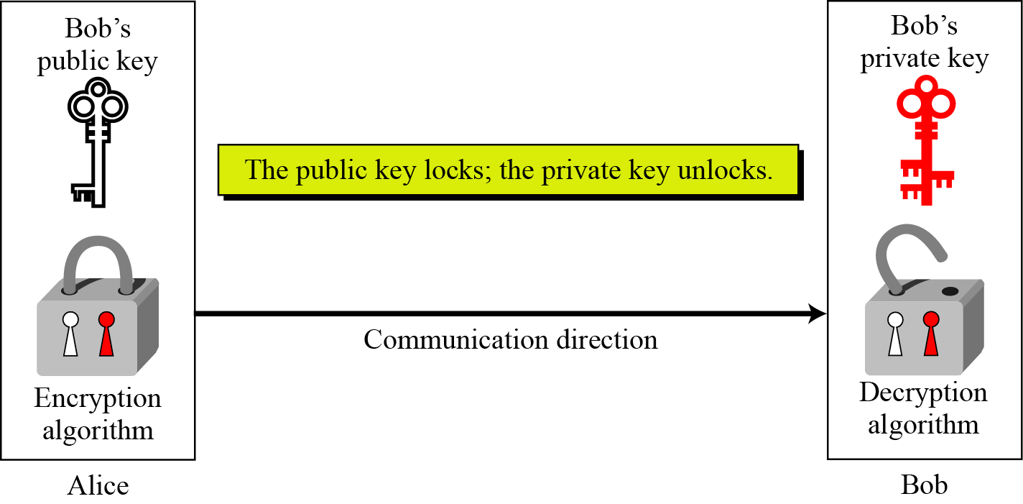
Keys
Asymmetric key cryptography uses two separate keys: one private and one public.
Locking and unlocking in asymmetric-key cryptosystem
10.<number>

Slide 5
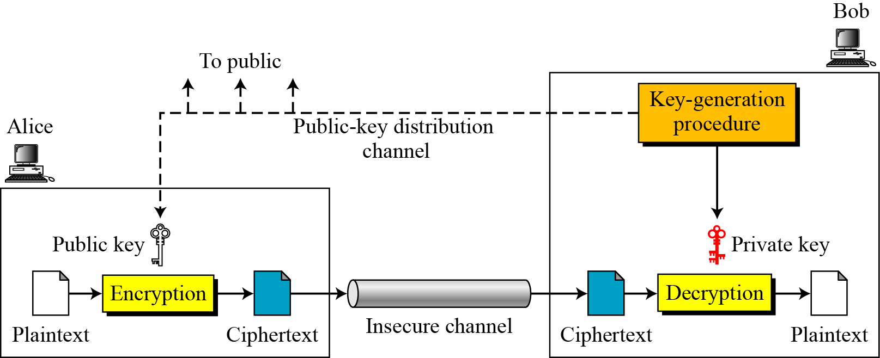
General Idea
General idea of asymmetric-key cryptosystem
10.<number>

Slide 6
Continued
Plaintext/Ciphertext
Unlike in symmetric-key cryptography, plaintext and ciphertext are treated as integers in asymmetric-key cryptography.
Encryption/Decryption
C = f (K_{public} , P) P = g(K_{private} , C)
10.<number>

Slide 7
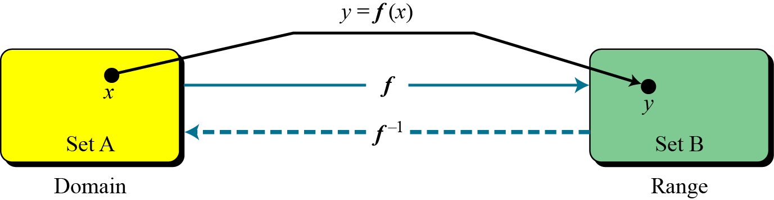
Trapdoor One-Way Function
The main idea behind asymmetric-key cryptography is the concept of the trapdoor one-way function.
Functions
A function as rule mapping a domain to a range
10.<number>

Slide 8
Continued
One-Way Function (OWF)
1. f is easy to compute.
2. f ⁻¹ is difficult to compute.
Trapdoor One-Way Function (TOWF)
3. Given y and a trapdoor, x can be
computed easily.
10.<number>

Slide 9
Continued
Example
When n is large, n = p × q is a one-way function. Given p and q , it is always easy to calculate n ; given n, it is very difficult to compute p and q. This is the factorization problem.
Example
When n is large, the function y = x^{k} mod n is a trapdoor one-way function. Given x, k, and n, it is easy to calculate y. Given y, k, and n, it is very difficult to calculate x. This is the discrete logarithm problem. However, if we know the trapdoor, k′ such that k × k ′ = 1 mod φ(n), we can use x = y^{k′} mod n to find x.
10.<number>

Slide 10
Knapsack Cryptosystem
Definition
a = [a₁, a₂, …, a_{k} ] and x = [x₁, x₂, …, x_{k}].
Given a and x, it is easy to calculate s. However, given s and a it is difficult to find x.
Superincreasing Tuple
a_{i} ≥ a₁ + a₂ + … + a_{i−1}
10.<number>

Slide 11
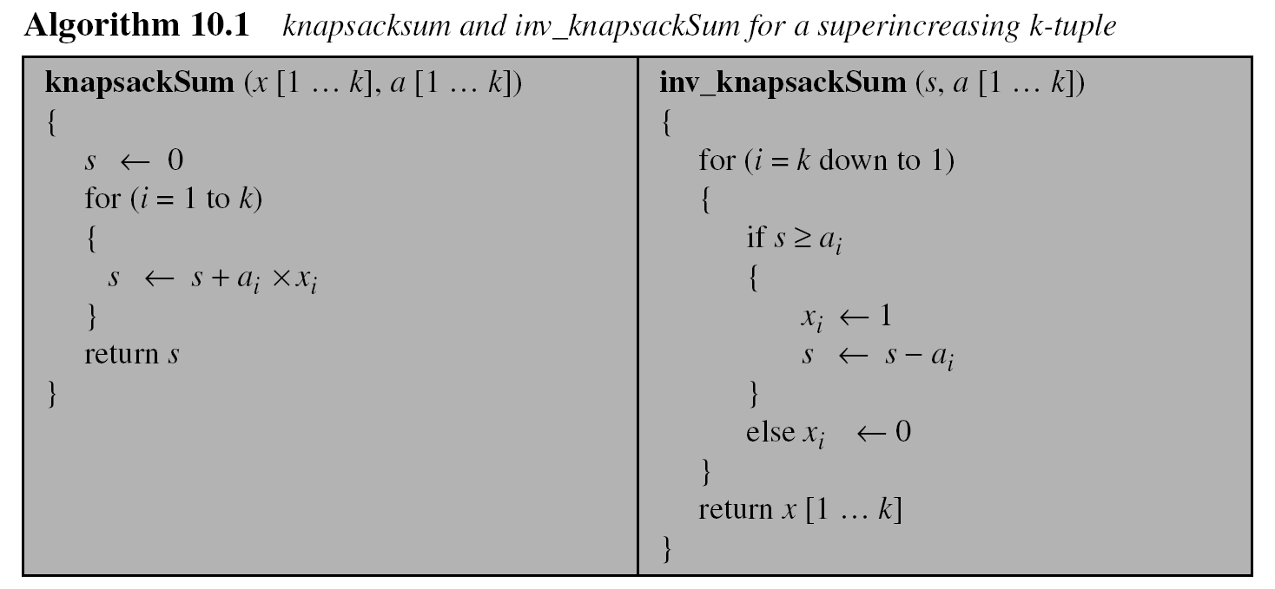
Continued
10.<number>

Slide 12
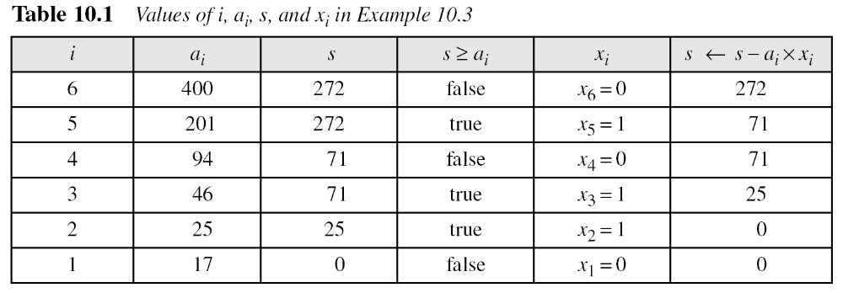
Continued
Example
As a very trivial example, assume that a = [17, 25, 46, 94, 201,400] and s = 272 are given. Table shows how the tuple x is found using inv_knapsackSum routine in Algorithm. In this case x = [0, 1, 1, 0, 1, 0], which means that 25, 46, and 201 are in the knapsack.
10.<number>

Slide 13
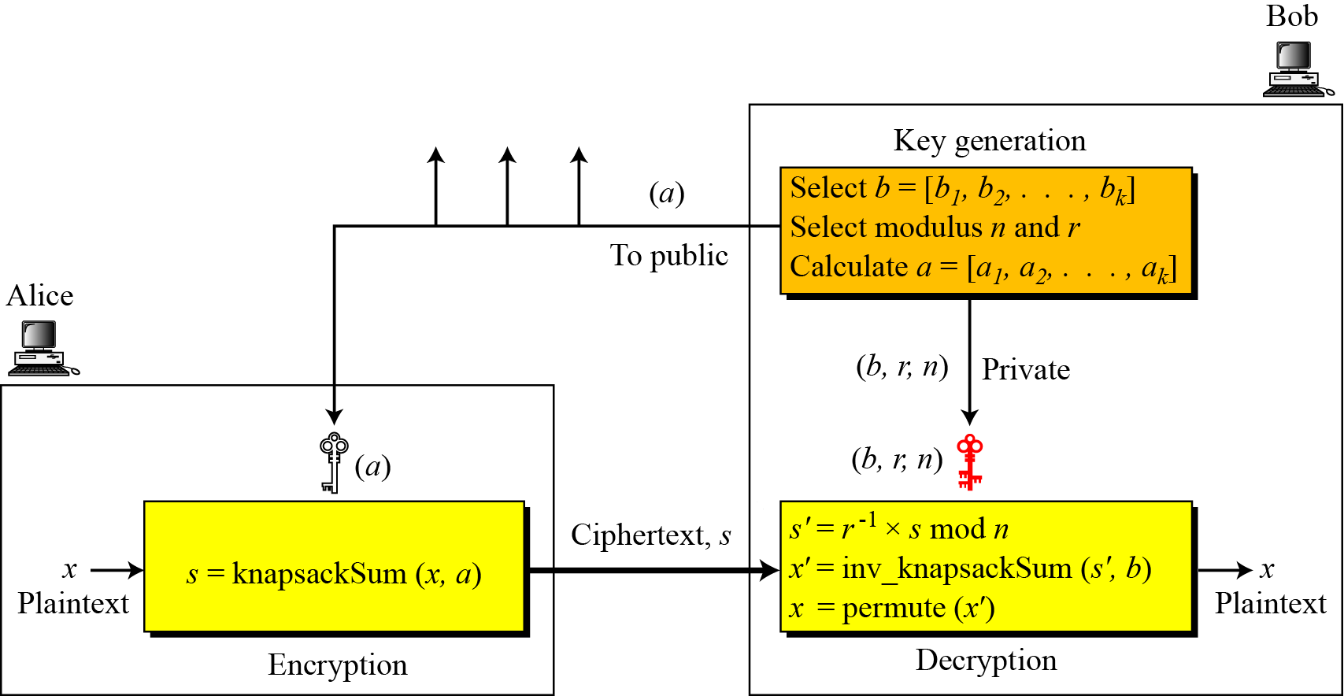
Continued
Secret Communication with Knapsacks.
Secret communication with knapsack cryptosystem
10.<number>

Slide 14
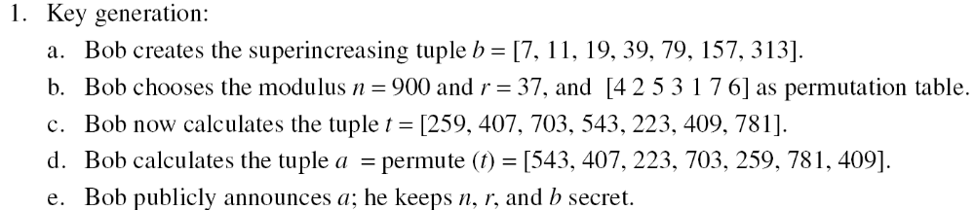
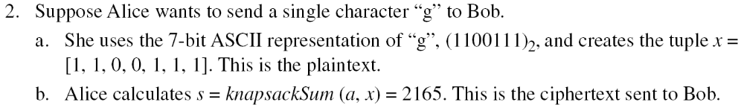
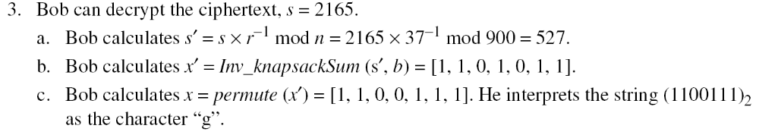
Continued
Example
This is a trivial (very insecure) example just to show the procedure.
10.<number>

Slide 15
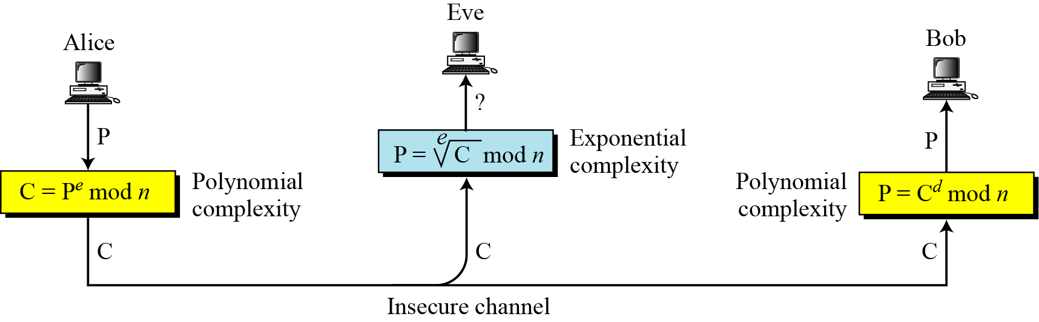
Introduction RSA
Complexity of operations in RSA
10.<number>

Slide 16
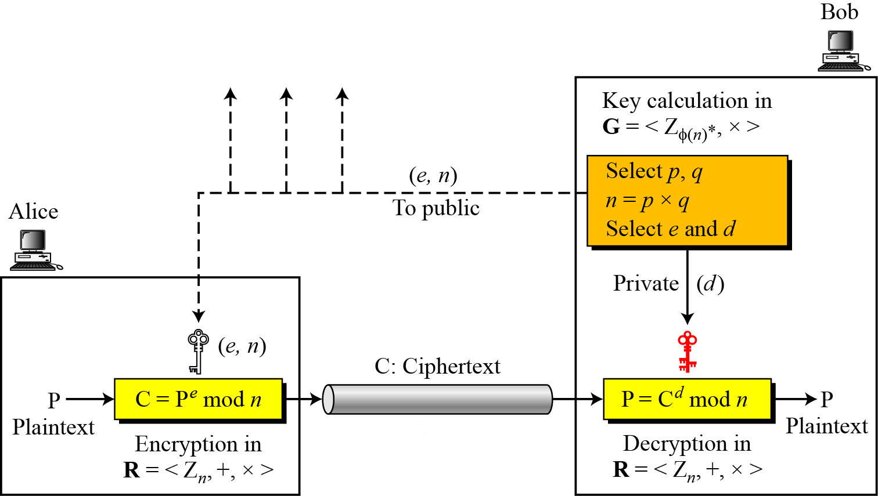
Procedure
Encryption, decryption, and key generation in RSA
10.<number>

Slide 17
Continued
Two Algebraic Structures
R = <Z_{n} , +, × >
Encryption/Decryption Ring:
Key-Generation Group:
G = <Z _{φ(n)}∗, × >
10.<number>

Slide 18
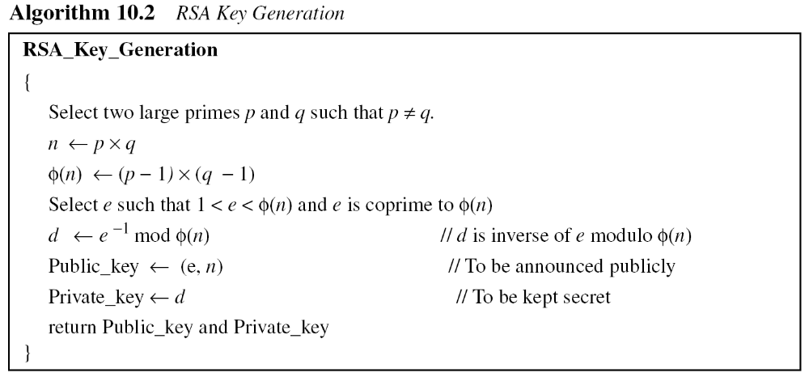
Continued
10.<number>

Slide 19
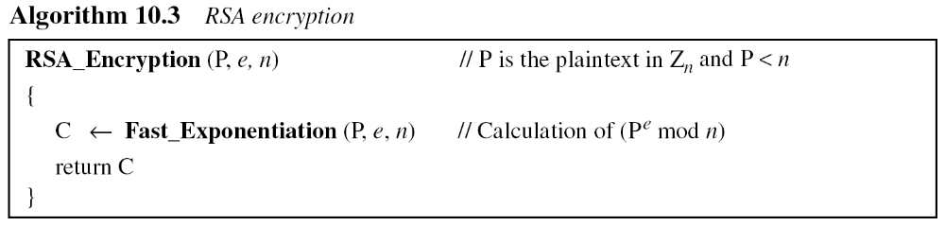
Continued
Encryption
10.<number>

Slide 20
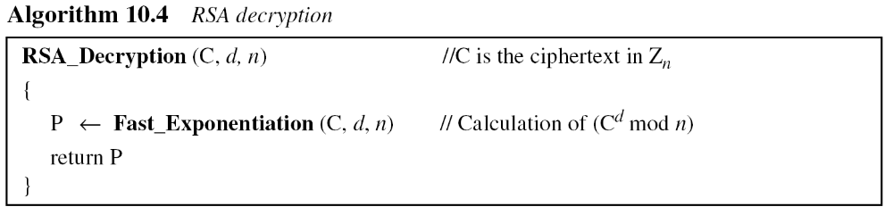
Continued
Decryption
10.<number>

Slide 21
Some Trivial Examples
Example
Bob chooses 7 and 11 as p and q and calculates n = 77. The value of φ(n) = (7 − 1)(11 − 1) or 60. Now he chooses two exponents, e and d, from Z₆₀∗. If he chooses e to be 13, then d is 37. Note that e × d mod 60 = 1 (they are inverses of each Now imagine that Alice wants to send the plaintext 5 to Bob. She uses the public exponent 13 to encrypt 5.
Bob receives the ciphertext 26 and uses the private key 37 to decipher the ciphertext:
10.<number>

Slide 22
Some Trivial Examples
Example
Now assume that another person, John, wants to send a message to Bob. John can use the same public key announced by Bob (probably on his website), 13; John’s plaintext is 63. John calculates the following:
Bob receives the ciphertext 28 and uses his private key 37 to decipher the ciphertext:
10.<number>

Slide 23
Some Trivial Examples
Example 10. 7
Jennifer creates a pair of keys for herself. She chooses p = 397 and q = 401. She calculates
n = 159197. She then calculates φ(n) = 158400. She then chooses e = 343 and d = 12007. Show how Ted can send a message to Jennifer if he knows e and n.
Suppose Ted wants to send the message “NO” to Jennifer. He changes each character to a number (from 00 to 25), with each character coded as two digits. He then concatenates the two coded characters and gets a four-digit number. The plaintext is 1314. Figure 10.7 shows the process.
10.<number>

Slide 24
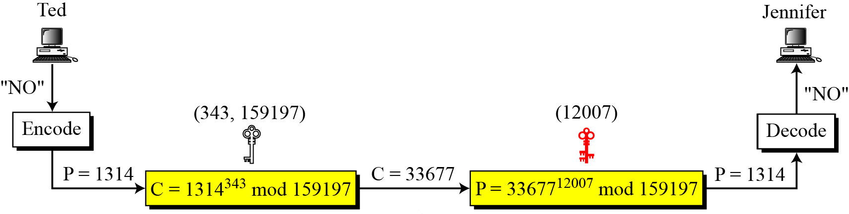
Continued
Encryption and decryption: Example
10.<number>

