Slide 1
Mtech_16_Cryptographic Tools

Slide 2
Cryptography Tools
Public Key Infrastructure (PKI): integrated system of software, encryption methodologies, protocols, legal agreements, and third-party services enabling users to communicate securely
PKI systems based on public key cryptosystems; include digital certificates and certificate authorities (CAs)
Notes:
Cryptography Tools
Public Key Infrastructure (PKI) is an integrated system of software, encryption methodologies, protocols, legal agreements, and third-party services that enables users to communicate securely.
PKI systems are based on public key cryptosystems and include digital certificates and certificate authorities (CAs).

Slide 3
Cryptography Tools (continued)
PKI protects information assets in several ways:
  Authentication
  Integrity
  Privacy
  Authorization
  Nonrepudiation
Notes:
PKI protects information assets in several ways:
Authentication. Digital certificates in a PKI system permit parties to validate the identity of other of the parties in an Internet transaction.
Integrity. A digital certificate demonstrates that the content signed by the certificate has not been altered while being moved from server to client.
Privacy. Digital certificates keep information from being intercepted during transmission over the Internet.
Authorization. Digital certificates issued in a PKI environment can replace user IDs and passwords, enhance security, and reduce some of the overhead required for authorization processes and controlling access privileges.
Nonrepudiation. Digital certificates can validate actions, making it less likely that customers or partners can later repudiate a digitally signed transaction.

Slide 4
Digital Signatures
Encrypted messages that can be mathematically proven to be authentic
Created in response to rising need to verify information transferred using electronic systems
Asymmetric encryption processes used to create digital signatures
Notes:
Digital Signatures
An interesting thing happens when the asymmetric process is reversed, that is the private key is used to encrypt a short message.
The public key can be used to decrypt it, and the fact that the message was sent by the organization that owns the private key cannot be refuted.
This is known as non-repudiation, which is the foundation of digital signatures.
Digital Signatures are encrypted messages that are independently verified by a central facility (registry) as authentic.

Slide 5
Digital Certificates
Electronic document containing key value and identifying information about entity that controls key
Digital signature attached to certificate’s container file to certify file is from entity it claims to be from
Notes:
Digital Certificates and Certificate Authorities
As alluded to earlier, a digital certificate is an electronic document, similar to a digital signature, attacked to a file certifying that this file is from the organization it claims to be from and has not been modified from the originating format.
A Certificate Authority is an agency that manages the issuance of certificates and serves as the electronic notary public to verify their worth and integrity.

Slide 6
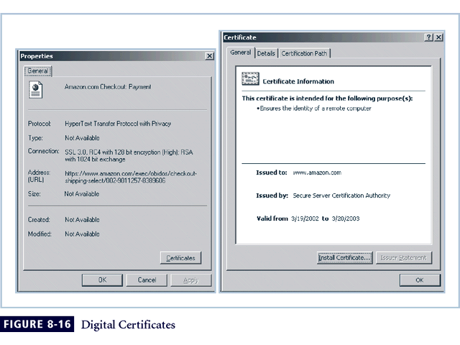
Figure 8-5 Digital Signatures

Slide 7
Hybrid Cryptography Systems
Except with digital certificates, pure asymmetric key encryption not widely used
Asymmetric encryption more often used with symmetric key encryption, creating hybrid system
Diffie-Hellman Key Exchange method: most common hybrid system; provided foundation for subsequent developments in public key encryption
Notes:
Hybrid Systems
In practice asymmetric key encryption is not widely used except in the area of certificates. Instead, it is more often used in conjunction with symmetric key encryption creating a hybrid system.
The current process is based on the Diffie-Hellman Key Exchange method, which is a way to exchange private keys without exposure to any third parties using public key encryption.
With this method asymmetric encryption is used as a method to exchange symmetric keys, so that two organizations can conduct quick, efficient, secure communications based on symmetric encryption.
Diffie-Hellman provided the foundation for subsequent developments in public key encryption.

Slide 8
Steganography
Process of hiding information; in use for a long time
Most popular modern version hides information within files appearing to contain digital pictures or other images
Some applications hide messages in .bmp, .wav, .mp3, and .au files, as well as in unused space on CDs and DVDs
Notes:
Steganography
Steganography is a process of hiding information and has been in use for a long time.
The word “steganography” is derived from the Greek words steganos meaning “covered” and graphein meaning “to write.”
The most popular modern version of steganography involves hiding information within files that appear to contain digital pictures or other images.
Most computer graphics standards use a combination of three color values (red, blue, and green (RGB)) to represent a picture element, or pixel.
Each of the three color values usually requires an 8-bit code for that color’s intensity (e.g., 00000000 for no red and 11111111 for maximum red).
This inability to perceive difference on part of humans provides the steganographer with one bit per color (or three bits per pixel) to use for encoding data into an image file.
Some applications are capable of hiding messages in .bmp, .wav, .mp3, and .au files, as well as in unused storage space on CDs and DVDs.

Slide 9
Protocols for Secure Communications
Secure Socket Layer (SSL) protocol: uses public key encryption to secure channel over public Internet
Secure Hypertext Transfer Protocol (S-HTTP): extended version of Hypertext Transfer Protocol; provides for encryption of individual messages between client and server across Internet
S-HTTP is the application of SSL over HTTP; allows encryption of information passing between computers through protected and secure virtual connection
Notes:
Securing the Web
Secure Electronic Transactions (SET) was developed by MasterCard and Visa in 1997 to provide protection from electronic payment fraud.
SET works by encrypting the credit card transfers with DES for encryption and RSA for key exchange, much as other algorithms do.
SET provides the security for both Internet-based credit card transactions and the encryption of swipe systems of those credit cards in retail stores.
Secure Socket Layer was developed by Netscape in 1994 to provide security in online electronic commerce transactions.
It uses a number of algorithms, but mainly relies on RSA for key transfer and IDEA, DES or 3DES for encrypted symmetric key-based data transfer.
Secure Hypertext Transfer Protocol (SHTTP) is an encrypted solution to the unsecured version of HTTP.
It provides an alternative to the aforementioned protocols and can provide secure e-commerce transactions as well as encrypted Web pages for secure data transfer over the Web, using a number of different algorithms.
Secure Shell (SSH) provides security over remote access connections using tunneling. It provides authentication services between a client and server.
IP Security (IPSec) is the cryptographic authentication and encryption product of the IETF’s IP Protocol Security Working Group, defined in RFC 1825, 1826 and 1827.
IP Security (IPSec) is used to create Virtual Private Networks (VPNs) and is an open framework for security development within the TCP/IP family of protocol standards.

Slide 10
Protocols for Secure Communications (continued)
Securing E-mail with S/MIME, PEM, and PGP
  Secure Multipurpose Internet Mail Extensions (S/MIME): builds on Multipurpose Internet Mail Extensions (MIME) encoding format by adding encryption and authentication
  Privacy Enhanced Mail (PEM): proposed as standard to function with public key cryptosystems; uses 3DES symmetric key encryption
  Pretty Good Privacy (PGP): uses IDEA Cipher for message encoding
Notes:
Securing E-mail
A number of encryption cryptosystems have been adapted in an attempt to inject some degree of security into e-mail, a notoriously unsecured medium.
S/MIME builds on the Multipurpose Internet Mail Extensions (MIME) encoding format by adding encryption and authentication through digital signatures based on public key cryptosystems.
Securing E-mail
Privacy Enhanced Mail (PEM) was proposed by the Internet Engineering Task Force (IETF) as a standard to function with the public key cryptosystems.
PEM uses 3DES symmetric key encryption and RSA for key exchanges and digital signatures.
Pretty Good Privacy (PGP) was developed by Phil Zimmerman and uses the IDEA Cipher, a 128-bit symmetric key block encryption algorithm with 64 bit blocks for message encoding.
IDEA performs 8 rounds on 16 bit sub-blocks using algebraic calculations.
PGP also uses RSA for symmetric key exchange and for digital signatures.

Slide 11
Protocols for Secure Communications (continued)
Securing Web transactions with SET, SSL, and S-HTTP
  Secure Electronic Transactions (SET): developed by MasterCard and VISA in 1997 to provide protection from electronic payment fraud
  Uses DES to encrypt credit card information transfers
  Provides security for both Internet-based credit card transactions and credit card swipe systems in retail stores
Notes:
Securing Web Transactions with SET, SSL, and S-HTTP
Just as PGP, PEM, and S/MIME work to secure e-mail operations, a number of related protocols work to secure Web browsers, especially at electronic commerce sites.
Among these are Secure Electronic Transactions (SET), Secure Socket Layer (SSL), Secure Hypertext Transfer Protocol (S-HTTP), Secure Shell (SSH-2), and IP Security (IPSec).
Secure Electronic Transactions (SET) was developed by MasterCard and VISA in 1997 to provide protection from electronic payment fraud.
SET uses DES to encrypt credit card information transfers and RSA for key exchange. SET provides the security for both Internet-based credit card transactions and credit card swipe systems in retail stores.

Slide 12
Protocols for Secure Communications (continued)
Securing TCP/IP with IPSec
  Internet Protocol Security (IPSec): open source protocol to secure communications across any IP-based network
  IPSec designed to protect data integrity, user confidentiality, and authenticity at IP packet level
Notes:
IPSec
IPSec combines several different cryptosystems including:
Diffie-Hellman key exchange for deriving key material between peers on a public network
Public key cryptography for signing the Diffie-Hellman exchanges to guarantee the identity of the two parties
Bulk encryption algorithms, such as DES, for encrypting the data
Digital certificates signed by a certificate authority to act as digital ID cards.
IPSec includes:
1) the IP Security Protocol itself, which defines the information to add to an IP packet, as well as how to encrypt packet data; and
2) the Internet Key Exchange, which uses asymmetric-based key exchange and negotiates the security associations.

Slide 13
Protocols for Secure Communications (continued)
  IPSec combines several different cryptosystems: Diffie-Hellman; public key cryptography; bulk encryption algorithms; digital certificates
  In IPSec, IP layer security obtained by use of application header (AH) protocol or encapsulating security payload (ESP) protocol

Slide 14
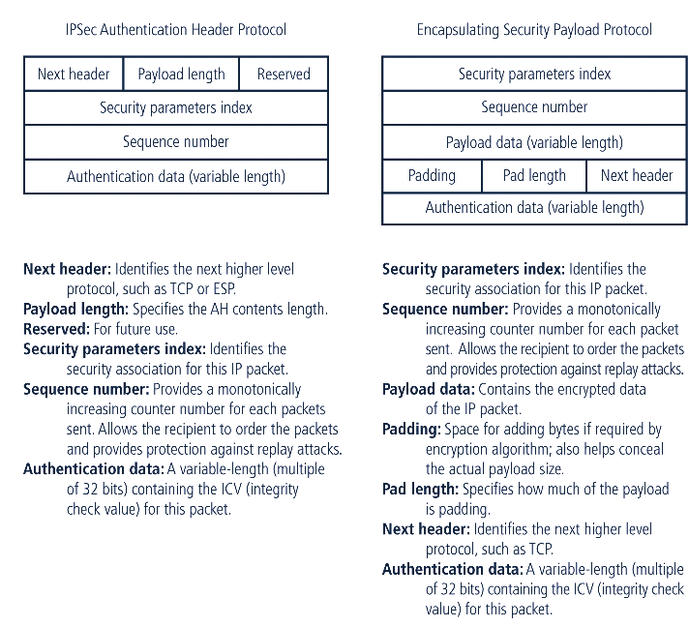
IPSec Headers

Slide 15
Protocols for Secure Communications (continued)
Securing TCP/IP with PGP
  Pretty Good Privacy (PGP): hybrid cryptosystem designed in 1991 by Phil Zimmermann
  Combined best available cryptographic algorithms to become open source de facto standard for encryption and authentication of e-mail and file storage applications
Notes:
PGP
Pretty Good Privacy (PGP) is a hybrid cryptosystem originally designed in 1991 by Phil Zimmermann.
PGP combined some of the best available cryptographic algorithms to become the open source de facto standard for encryption and authentication of e-mail and file storage applications.
Both freeware and low-cost commercial versions of PGP are available for a wide variety of platforms.
The PGP security solution provides six services: authentication by digital signatures, message encryption, compression, e-mail compatibility, segmentation, and key management.

Slide 16
Protocols for Secure Communications (continued
  Freeware and low-cost commercial PGP versions are available for many platforms
  PGP security solution provides six services: authentication by digital signatures; message encryption; compression; e-mail compatibility; segmentation; key management

Slide 17
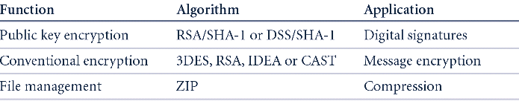
PGP Function

Slide 18
Attacks on Cryptosystems
Attempts to gain unauthorized access to secure communications have typically used brute force attacks (ciphertext attacks)
Attacker may alternatively conduct known-plaintext attack or selected-plaintext attach schemes
Notes:
Attacks on Cryptosystems
Historically, attempts to gain unauthorized access to secure communications have used brute force attacks.
Ciphertext attacks involve a hacker searching for a common text structure, wording, or syntax in the encrypted message that can enable him or her to calculate the number of each type of letter used in the message.
Frequency analysis can be used along with published frequency of occurrence patterns of various languages and can allow an experienced attacker to crack almost any code quickly if the individual has a large enough sample of the encoded text.
To protect against this, modern algorithms attempt to remove the repetitive and predictable sequences of characters from the ciphertext.
Occasionally, an attacker may obtain duplicate texts, one in ciphertext and one in plaintext, which enable the individual to reverse-engineer the encryption algorithm in a known-plaintext attack scheme.
Alternatively, an attacker may conduct a selected-plaintext attack by sending the potential victim a specific text that they are sure the victim will forward on to others.

Slide 19
Man-in-the-Middle Attack
Designed to intercept transmission of public key or insert known key structure in place of requested public key
From victims’ perspective, encrypted communication appears to be occurring normally, but in fact attacker receives each encrypted message, decodes, encrypts, and sends to originally intended recipient
Establishment of public keys with digital signatures can prevent traditional man-in-the-middle attack
Notes:
Man-in-the-Middle Attack
A man-in-the-middle attack is designed to intercept the transmission of a public key or even to insert a known key structure in place of the requested public key.
From the perspective of the victims of such attacks, their encrypted communication appears to be occurring normally, but in fact the attacker is receiving each encrypted message and decoding it and then encrypting and sending it to the originally intended recipient.
Establishment of public keys with digital signatures can prevent the traditional man-in-the-middle attack, as the attacker cannot duplicate the signatures.

Slide 20
Correlation Attacks
Collection of brute-force methods that attempt to deduce statistical relationships between structure of unknown key and ciphertext
Differential and linear cryptanalysis have been used to mount successful attacks
Only defense is selection of strong cryptosystems, thorough key management, and strict adherence to best practices of cryptography in frequency of changing keys
Notes:
Correlation Attacks
Correlation attacks are a collection of brute-force methods that attempt to deduce statistical relationships between the structure of the unknown key and the ciphertext that is the output of the cryptosystem.
Differential and linear cryptanalysis, both of which are advanced methods of breaking codes have been used to mount successful attacks on block cipher encryptions such as DES.
The only defense against this kind of attack is the selection of strong cryptosystems that have stood the test of time, thorough key management, and strict adherence to the best practices of cryptography in the frequency of changing keys.

Slide 21
Dictionary Attacks
Attacker encrypts every word in a dictionary using same cryptosystem used by target
Dictionary attacks can be successful when the ciphertext consists of relatively few characters (e.g., usernames, passwords)
Notes:
Dictionary Attacks
In a dictionary attack, the attacker encrypts every word in a dictionary using the same cryptosystem as used by the target.
Dictionary attacks can be successful when the ciphertext consists of relatively few characters, as for example files which contain encrypted usernames and passwords.
After a match is located, the attacker has essentially identified a potential valid password for the system under attack.

Slide 22
Timing Attacks
Attacker eavesdrops during victim’s session; uses statistical analysis of user’s typing patterns and inter-keystroke timings to discern sensitive session information
Can be used to gain information about encryption key and possibly cryptosystem in use
Once encryption successfully broken, attacker may launch a replay attack (an attempt to resubmit recording of deciphered authentication to gain entry into secure source
Notes:
Timing Attacks
In a timing attack, the attacker eavesdrops during the victim’s session and uses statistical analysis of the user’s typing patterns and inter-keystroke timings to discern sensitive session information.
While timing analysis may not directly result in the decryption of sensitive data, it can be used to gain information about the encryption key and perhaps the cryptosystem in use.
Once the attacker has successfully broken an encryption, he or she may launch a replay attack, which is an attempt to resubmit a recording of the deciphered authentication to gain entry into a secure source.

Slide 23
Defending From Attacks
No matter how sophisticated encryption and cryptosystems have become, if key is discovered, message can be determined
Key management is not so much management of technology but rather management of people
Notes:
Defending From Attacks
No matter how sophisticated encryption and cryptosystems have become, however, they have retained the same flaw that the first systems contained thousands of years ago: If you discover the key, you can determine the message.
Thus, key management is not so much the management of technology but rather the management of people.

Slide 24
Summary
Cryptography and encryption provide sophisticated approach to security
  Many security-related tools use embedded encryption technologies
  Encryption converts a message into a form that is unreadable by the unauthorized
Many tools are available and can be classified as symmetric or asymmetric, each having advantages and special capabilities
Strength of encryption tool dependent on key size but even more dependent on following good management practices
Cryptography is used to secure most aspects of Internet and Web uses that require it, drawing on extensive set of protocols and tools designed for that purpose
Cryptosystems are subject to attack in many ways

