Slide 1
Lecture: 17&18:Flooding Attack

Slide 2
Introduction
When a denial of service (DoS) attack occurs, a computer or a network user is unable to access resources like e-mail and the Internet.
An attack can be directed at an operating system or at the network.

Slide 3
DDoS Attack
DDoS is short or Distributed Denial of Service.
DDoS is a type of DOS attack where multiple compromised systems, which are often infected with a Trojan,
are used to target a single system causing a Denial of Service (DoS) attack.
Victims of a DDoS attack consist of both the end targeted system and all systems maliciously used and controlled by the hacker in the distributed attack.

Slide 4
How DDoS Attacks Work
In a DDoS attack, the incoming traffic flooding the victim originates from many different sources – potentially hundreds of thousands or more.
This effectively makes it impossible to stop the attack simply by blocking a single IP address
it is very difficult to distinguish legitimate user traffic from attack traffic when spread across so many points of origin.

Slide 5
Difference Between DoS and DDos Attacks
The DoS attack typically uses one computer and one Internet connection to flood a targeted system or resource.
The DDoS attack uses multiple computers and Internet connections to flood the targeted resource.
DDoS attacks are often global attacks, distributed via botnets .

Slide 6
Types of DDoS Attacks
Traffic attacks: Traffic flooding attacks send a huge volume of TCP, UDP and ICMP packets to the target. Legitimate requests get lost and these attacks may be accompanied by malware exploitation.
Bandwidth attacks: This DDos attack overloads the target with massive amounts of junk data. This results in a loss of network bandwidth and equipment resources and can lead to a complete denial of service.
Application attacks: Application-layer data messages can deplete resources in the application layer, leaving the target's system services unavailable.

Slide 7
Types of DoS attacks
Ping Flood Attack (Internet Control Message Protocol ICMP echo)
SYN Flood Attack (DoS attack)
DDoS Attack (Distributed SYN Flood)
UDP Flood Attacks
Smurf Attack
DNS name server Attack
Land Attack
Ping of Death Attack
Fragmentation / Teardrop Attack
Connection Spoofing
Bounce Scanning
Stealth Communication

Slide 8
What is a “Spoofed Packet”?
Packets sent by an attacker such that the true source is not authentic
  Media Access Control: MAC spoofing
  IP packet spoofing
  Email spoofing
This is not same as routing attacks
  These cause packets to be redirected
    e.g. DNS cache poisoning; router table attacks; ARP spoofing

Slide 9
Significance of “Spoofed Packets” in DoS attacks
Spoofed packets are a part of many attacks
  SYN Flood Attack
  Smurf Attack
  Connection Spoofing
  Bounce Scanning
  Stealth Communication

Slide 10
IP/TCP Header Review
IP Header Format
version
header
length
TOS
total length
identification
flags
fragment offset
TTL
protocol
header checksum
20 bytes
source IP address
destination IP address
options (if any)
data

Slide 11
IP/TCP Header Review
TCP Header Format
source port number
destination port number
sequence number
acknowledgement number
20 bytes
header
length
reserved
U
R
G
A
C
K
P
S
H
R
S
T
S
Y
N
F
I
N
window size
TCP checksum
urgent pointer
options (if any)
data (if any)

Slide 12
SYN Flood Attack
TCP Handshake Review
  client
    sends SYN packet to server
    waits for SYN-ACK from server
  server
    responds with SYN-ACK packet
    waits for ACK packet from client
  client
    sends ACK to server
SYN
SYN-ACK
ACK

Slide 13
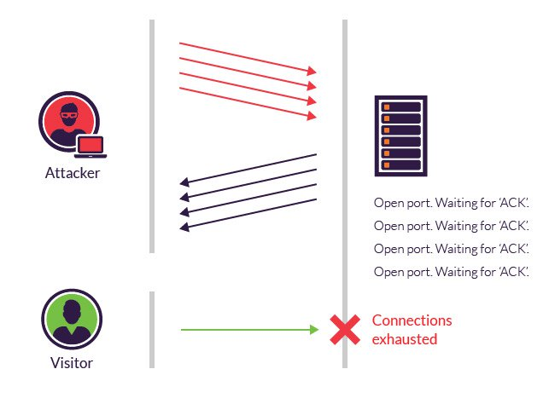

Slide 14
SYN Flood Attack
Attacker causes TCP buffer to be exhausted with half-open connections
No reply from target needed, so source may be spoofed.
Claimed source must not be an active host.
TCP Buffers
169.237.5.23
168.150.241.155
169.237.7.114
Half-open connection; Waiting for ACK
Completed handshake; connection open
empty
buffer

Slide 15
SYN Flood Attack
Attacker causes TCP buffer to be exhausted with half-open connections
No reply from target needed, so source may be spoofed.
Claimed source must not be an active host.
TCP Buffers
128.120.254.1
128.120.254.2
128.120.254.3
128.120.254.4
128.120.254.5
128.120.254.6
128.120.254.7
128.120.254.8
128.120.254.9
128.120.254.10
128.120.254.11
128.120.254.12
128.120.254.13
128.120.254.14
169.237.7.114
128.120.254.15
Half-open connection; Waiting for ACK
Completed handshake; connection open
empty
buffer

Slide 16
When a client and server establish a normal TCP “three-way handshake,” the exchange looks like this:
Client requests connection by sending SYN (synchronize) message to the server.
Server acknowledges by sending SYN-ACK (synchronize-acknowledge) message back to the client.
Client responds with an ACK (acknowledge) message, and the connection is established.
In a SYN flood attack, the attacker sends repeated SYN packets to every port on the targeted server, often using a fake IP address. The server, unaware of the attack, receives multiple, apparently legitimate requests to establish communication. It responds to each attempt with a SYN-ACK packet from each open port.
The malicious client either does not send the expected ACK, or—if the IP address is spoofed—never receives the SYN-ACK in the first place. Either way, the server under attack will wait for acknowledgement of its SYN-ACK packet for some time.

Slide 17
During this time, the server cannot close down the connection by sending an RST packet, and the connection stays open. Before the connection can time out, another SYN packet will arrive. This leaves an increasingly large number of connections half-open – and indeed SYN flood attacks are also referred to as “half-open” attacks. Eventually, as the server’s connection overflow tables fill, service to legitimate clients will be denied, and the server may even malfunction or crash
While the “classic” SYN flood described above tries to exhaust network ports, SYN packets can also be used in DDoS attacks that try to clog your pipes with fake packets to achieve network saturation. The type of packet is not important. Still, SYN packets are often used because they are the least likely to be rejected by default.

Slide 18
METHODS OF MITIGATION
Micro blocks—administrators can allocate a micro-record (as few as 16 bytes) in the server memory for each incoming SYN request instead of a complete connection object.
SYN cookies—using cryptographic hashing, the server sends its SYN-ACK response with a sequence number (seqno) that is constructed from the client IP address, port number, and possibly other unique identifying information. When the client responds, this hash is included in the ACK packet. The server verifies the ACK, and only then allocates memory for the connection.
RST cookies—for the first request from a given client, the server intentionally sends an invalid SYN-ACK. This should result in the client generating an RST packet, which tells the server something is wrong. If this is received, the server knows the request is legitimate, logs the client, and accepts subsequent incoming connections from it.
Stack tweaking—administrators can tweak TCP stacks to mitigate the effect of SYN floods. This can either involve reducing the timeout until a stack frees memory allocated to a connection, or selectively dropping incoming connections.

Slide 19
RST or FIN Flood
Generally speaking, to close a TCP-SYN session, there should be an exchange of RST or FIN packets between the client and the host. During an RST / FIN Flood attack, the victim server is bombarded with fake RST or FIN packets that have no connection to any of the sessions stored in the server’s database. The victim server has to waste lots of system resources (RAM, processor, etc.) to compare the incoming packets with the current transmissions, which results in server productivity loss and its partial unavailability.
One of the protection measures is limiting the number of FIN / RST requests that can be processed per unit time. Please take into account that you are running the risk of losing users with the same IP address if you impose these limits; many internet providers use their own network address translation NAT and send requests from many users via the same IP-address

Slide 20
PING FLOOD (ICMP FLOOD)
Ping flood, also known as ICMP flood, is a common Denial of Service (DoS) attack in which an attacker takes down a victim’s computer by overwhelming it with ICMP echo requests, also known as pings.
The attack involves flooding the victim’s network with request packets, knowing that the network will respond with an equal number of reply packets. Additional methods for bringing down a target with ICMP requests include the use of custom tools or code, such as hping and scapy.
This strains both the incoming and outgoing channels of the network, consuming significant bandwidth and resulting in a denial of service.

Slide 21
Smurf Attack
In this attack, spoofed IP packets containing ICMP Echo-Request with a source address equal to that of the attacked system and a broadcast destination address are sent to the intermediate network.
Sending a ICMP Echo Request to a broadcast address triggers all hosts included in the network to respond with an ICMP response packet, thus creating a large mass of packets which are routed to the victim's spoofed address.

Slide 22
Smurf Attack (contd.)
ICMP echo (spoofed source address of victim)
Sent to IP broadcast address
ICMP echo reply
ICMP = Internet Control
Message Protocol
INTERNET
1 SYN
PERPETRATOR
VICTIM
Simultaneous10,000 SYN/ACKs - VICTIM IS DEAD
INNOCENT
REFLECTOR SITES
BANDWIDTH MULTIPLICATION:
A T1 (1.54 Mbps) can easily
yield 100 MBbps of attack
SOURCE: CISCO

Slide 23
DNS FLOOD
DNS flood is a type of Distributed Denial of Service (DDoS) attack in which the attacker targets one or more Domain Name System (DNS) servers belonging to a given zone, attempting to hamper resolution of resource records of that zone and its sub-zones.
DNS servers are the “roadmap” of the Internet, helping requestors find the servers they seek. A DNS zone is a distinct portion of the domain name space in the Domain Name System (DNS). For each zone, administrative responsibility is delegated to a single server cluster.
In a DNS flood attack the offender tries to overbear a given DNS server (or servers) with apparently valid traffic, overwhelming server resources and impeding the servers’ ability to direct legitimate requests to zone resources.

Slide 24
DNS Flood
DNS flood attacks should be clearly differentiated from DNS amplification attacks. DNS amplification is an asymmetrical DDoS attack in which the attacker sends out a small look-up query with spoofed target IP, making the spoofed target the recipient of much larger DNS responses. With these attacks, the attacker’s goal is to saturate the network by continuously exhausting bandwidth capacity.
DNS floods are symmetrical DDoS attacks. These attacks attempt to exhaust server-side assets (e.g., memory or CPU) with a flood of UDP requests, generated by scripts running on several compromised botnet machines.
A DNS flood attack is considered a variant of the UDP flood attack, since DNS servers rely on the UDP protocol for name resolution, and is a Layer 7 attack. With UDP-based queries (unlike TCP queries), a full circuit is never established, and thus spoofing is more easily accomplished.

Slide 25
DNS Flood
To attack a DNS server with a DNS flood, the attacker runs a script , generally from multiple servers. These scripts send malformed packets from spoofed IP addresses. Since Layer 7 attacks like DNS flood require no response to be effective, the attacker can send packets that are neither accurate nor even correctly formatted.
The attacker can spoof all packet information, including source IP and make it appear that the attack is coming from multiple sources. Randomized packet data also helps offenders to avoid common DDoS protection mechanisms, while also like IP filtering (e.g., using Linux IPtables) completely useless.
Another common type of DNS flood attack is DNS NXDOMAIN flood attack, in which the attacker floods the DNS server with requests for records that are nonexistent or invalid. The DNS server expends all its resources looking for these records, its cache fills with bad requests, and it eventually has no resources to serve legitimate requests.

Slide 26
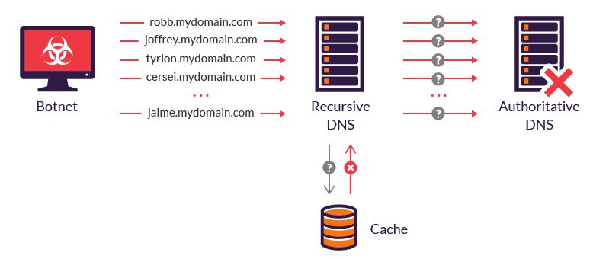
A botnet (short for “robot network”) is a network of computers infected by malware that are under the control of a single attacking party, known as the “bot-herder.” Each individual machine under the control of the bot-herder is known as a bot.

Slide 27
Summary of attack methods
 | Attack packets | Reply packets
Smurf | ICMP echo queries to broadcast address | ICMP echo replies
SYN flooding | TCP SYN packets | TCP SYN ACK packets
RST flooding | TCP packets to closed ports | TCP RST packets
ICMP flooding | ICMP queries UDP packets to closed ports IP packets with low TTL | ICMP replies Port unreachable Time exceeded
DNS reply flooding | DNS queries (recursive) to DNS servers | DNS replies

Slide 28
Detection Methods
Routing-based
Active
  Proactive
  Reactive
Passive

Slide 29
Routing-based Method
For a given network topology certain source IP addresses should never be seen
  Internal addresses arriving on external interface
  External addresses arriving on internal interface
  IANA non-routable addresses on external interface
  Other special addresses
External NIC
Internal NIC

Slide 30
Special Addresses
0.0.0.0/8 - Historical Broadcast
10.0.0.0/8 - RFC 1918 Private Network
127.0.0.0/8 - Loopback
169.254.0.0/16 - Link Local Networks
172.16.0.0/12 - RFC 1918 Private Network
192.0.2.0/24 - TEST-NET
192.168.0.0/16 - RFC 1918 Private Network
240.0.0.0/5 - Class E Reserved
248.0.0.0/5 - Unallocated
255.255.255.255/32 - Broadcast

Slide 31
Routing-based Methods
Most commonly used method
  firewalls, filtering routers
Relies on knowledge of network topology and routing specs.
Primarily used at organizational border.
Cannot detect many examples of spoofing
  Externally spoofed external addresses
  Internally spoofed internal addresses

Slide 32
Proactive methods
Looks for behavior that would not occur if client actually processed packet from client.
Method: change in IP stack behavior
Can observe suspicious activity
Examples –
  TCP window games
  SYN-Cookies (block with out detection)

Slide 33
TCP Window Games
Modified TCP Handshake
  client
    sends SYN packet and ACK number to server
    waits for SYN-ACK from server w/ matching ACK number
  server
    responds with SYN-ACK packet w/ initial “random” sequence number
    Sets window size to zero
    waits for ACK packet from client with matching sequence number
  client
    sends ACK to server with matching sequence number, but no data
    Waits for ACK with window > 0
    After receiving larger window, client sends data.
Spoofer will not see 0-len window and will send data without waiting.
SYN
ack-number
SYN-ACK
seq-number, ack-number
window = 0
ACK
seq_number, ack-number
(no data)
ACK
seq-number, ack-number
window = 4096
ACK
seq_number, ack-number
w/ data

Slide 34
SYN-Cookies
Modified TCP Handshake
Example of “stateless” handshake
  client
    sends SYN packet and ACK number to server
    waits for SYN-ACK from server with matching ACK number
  server
    responds with SYN-ACK packet with initial SYN-cookie sequence number
    Sequence number is cryptographically generated value based on client address, port, and time.
    No TCP buffers are allocated
  client
    sends ACK to server with matching sequence number
  server
    If ACK is to an unopened socket, server validates returned sequence number as SYN-cookie
    If value is reasonable, a buffer is allocated and socket is opened.
    .
Spoofed packets will not consume TCP buffers
SYN
ack-number
SYN-ACK
seq-number as SYN-cookie,
ack-number
NO BUFFER ALLOCATED
ACK
seq_number
ack-number+data
SYN-ACK
seq-number, ack-number
TCP BUFFER ALLOCATED

Slide 35
Reactive methods
When a suspicious packet is received, a probe of the source is conducted to verify if the packet was spoofed
May use same techniques as proactive methods
Example probes
  Is TTL appropriate?
  Is ID appropriate?
  Is host up?
  Change window size

Slide 36
Passive Methods
Learn expected values for observed packets
When an anomalous packet is received, treat it as suspicious
Example values –
  Expected TTL
  Expected client port
  Expected client OS idiosyncrasies

Slide 37
Conclusion
Spoofed-packets used in many different attacks
Spoofed-packets can be detected by a number of methods
High predictability in TTL and ID allow use of passive and active methods

