Slide 1
Information Security
CSE 632
Network Security (1)
CS526
Topic 18: Network Security

Slide 2
Network Protocols Stack
Application protocol
Application
Application
Transport
TCP protocol
Transport
Network
IP protocol
IP
IP protocol
Network
Link
Data Link
Network Access
Data Link
Link
CS526
Topic 18: Network Security

Slide 3
Types of Addresses in Internet
Media Access Control (MAC) addresses in the network access layer
  Associated w/ network interface card (NIC)
  48 bits or 64 bits
IP addresses for the network layer
  32 bits for IPv4, and 128 bits for IPv6
  E.g., 128.3.23.3
IP addresses + ports for the transport layer
  E.g., 128.3.23.3:80
Domain names for the application/human layer
  E.g., www.purdue.edu
CS526
Topic 18: Network Security

Slide 4
Routing and Translation of Addresses
Translation between IP addresses and MAC addresses
  Address Resolution Protocol (ARP) for IPv4
  Neighbor Discovery Protocol (NDP) for IPv6
Routing with IP addresses
  TCP, UDP, IP for routing packets, connections
  Border Gateway Protocol for routing table updates
Translation between IP addresses and domain names
  Domain Name System (DNS)
CS526
Topic 18: Network Security

Slide 5
Threats in Networking
Confidentiality
  e.g. Packet sniffing
Integrity
  e.g. Session hijacking
Availability
  e.g. Denial of service attacks
Common
  e.g. Address translation poisoning attacks
  e.g. Routing attacks
CS526
Topic 18: Network Security

Slide 6
Concrete Security Problems
ARP is not authenticated
  APR spoofing (or ARP poisoning)
Network packets pass by untrusted hosts
  Packet sniffing
TCP state can be easy to guess
  TCP spoofing attack
Open access
  Vulnerable to DoS attacks
DNS is not authenticated
  DNS poisoning attacks
CS526
Topic 18: Network Security

Slide 7
Address Resolution Protocol (ARP)
Primarily used to translate IP addresses to Ethernet MAC addresses
  The device drive for Ethernet NIC needs to do this to send a packet
Also used for IP over other LAN technologies, e.g. IEEE 802.11
Each host maintains a table of IP to MAC addresses
Message types:
  ARP request
  ARP reply
  ARP announcement
CS526
Topic 18: Network Security
Notes:
An internet packet contains an IP address. After it reaches the local network, one needs to know which host should receive it.

Slide 8
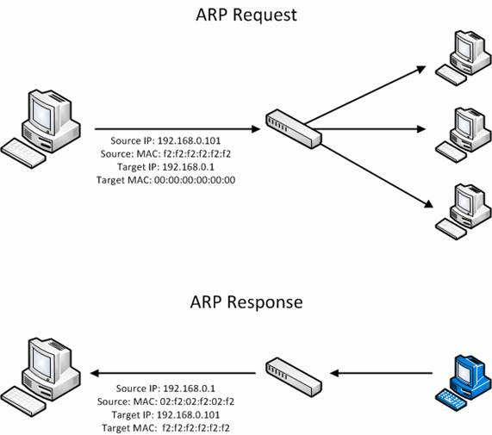
http://www.windowsecurity.com
CS526
Topic 18: Network Security
Notes:
The request is broadcasted (FF:FF:..FF) means broadcasting. This means that the source address 192.168.0.1 wants to know the MAC address of 192.168.0.3.
The reply says “I am 192.168.0.3”, and my MAC address is …

Slide 9
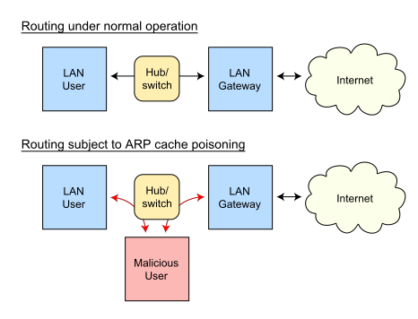
ARP Spoofing (ARP Poisoning)
Send fake or 'spoofed', ARP messages to an Ethernet LAN.
  To have other machines associate IP addresses with the attacker’s MAC
Legitimate use
  redirect a user to a registration page before allow usage of the network.
  Implementing redundancy and fault tolerance
CS526
Topic 18: Network Security
Notes:
DHCP snooping is used when DHCP protocol is used to assign IP addresses to hosts on a LAN.

Slide 10
ARP Spoofing (ARP Poisoning) - 2
Defenses
  static ARP table
  DHCP Certification (use access control to ensure that hosts only use the IP addresses assigned to them, and that only authorized DHCP servers are accessible).
  detection: Arpwatch (sending email when updates occur),
CS526
Topic 18: Network Security

Slide 11



IP Routing
Meg
Office gateway
Packet
Source
121.42.33.12
Tom
Destination
132.14.11.51
121.42.33.12
Sequence
5
132.14.11.1
ISP
132.14.11.51
121.42.33.1
Internet routing uses numeric IP address
Typical route uses several hops
CS526
Topic 18: Network Security

Slide 12
Packet Sniffing
Promiscuous Network Interface Card reads all packets
  Read all unencrypted data (e.g., “ngrep”)
  ftp, telnet send passwords in clear!
Eve
Network
Alice
Bob
Prevention: Encryption (IPSEC, TLS)
CS526
Topic 18: Network Security

Slide 13
User Datagram Protocol
IP provides routing
  IP address gets datagram to a specific machine
UDP separates traffic by port (16-bit number)
  Destination port number gets UDP datagram to particular application process, e.g., 128.3.23.3:53
  Source port number provides return address
Minimal guarantees
  No acknowledgment
  No flow control
  No message continuation
CS526
Topic 18: Network Security

Slide 14
Transmission Control Protocol
Connection-oriented, preserves order
  Sender
    Break data into packets
    Attach sequence numbers
  Receiver
    Acknowledge receipt; lost packets are resent
    Reassemble packets in correct order
Book
Mail each page
Reassemble book
1
19
1
5
1
CS526
Topic 18: Network Security

Slide 15
TCP Sequence Numbers
Sequence number (32 bits) – has a dual role:
  If the SYN flag is set, then this is the initial sequence number. The sequence number of the actual first data byte is this sequence number plus 1.
  If the SYN flag is clear, then this is the accumulated sequence number of the first data byte of this packet for the current session.
Acknowledgment number (32 bits) –
  If the ACK flag is set then this the next sequence number that the receiver is expecting.
  This acknowledges receipt of all prior bytes (if any).
CS526
Topic 18: Network Security
Notes:
The first ACK sent by each end acknowledges the other end's initial sequence number itself, but no data.

Slide 16
TCP Handshake
C
S
SYN (seq=x)
Listening
Store data
SYN ACK (ack=x+1 seq=y)
Wait
ACK (ack=y+1,seq=x+1)
Connected
CS526
Topic 18: Network Security

Slide 17
TCP sequence prediction attack
Predict the sequence number used to identify the packets in a TCP connection, and then counterfeit packets.
Adversary: do not have full control over the network, but can inject packets with fake source IP addresses
  E.g., control a computer on the local network
TCP sequence numbers are used for authenticating packets
Initial seq# needs high degree of unpredictability
  If attacker knows initial seq # and amount of traffic sent, can estimate likely current values
  Some implementations are vulnerable
CS526
Topic 18: Network Security
Notes:
Why care about TCP sequence predictions? If the adversary controls the network, the adversary can read all sequence numbers.
Deals with more realistic adversary model:

Slide 18
Blind TCP Session Hijacking
Server A
A, B trusted connection
  Send packets with predictable seq numbers
E impersonates B to A
  Opens connection to A to get initial seq number
  DoS B’s queue
  Sends packets to A that resemble B’s transmission
  E cannot receive, but may execute commands on A
E
B
Attack can be blocked if E is outside firewall.
CS526
Topic 18: Network Security

Slide 19
Risks from Session Hijacking
Inject data into an unencrypted server-to-server traffic, such as an e-mail exchange, DNS zone transfers, etc.
Inject data into an unencrypted client-to-server traffic, such as ftp file downloads, http responses.
Spoof IP addresses, which are often used for preliminary checks on firewalls or at the service level.
Carry out MITM attacks on weak cryptographic protocols.
  often result in warnings to users that get ignored
Denial of service attacks, such as resetting the connection.
CS526
Topic 18: Network Security

Slide 20
DoS vulnerability caused by session hijacking
Suppose attacker can guess seq. number for an existing connection:
  Attacker can send Reset packet to
  close connection. Results in DoS.
  Naively, success prob. is 1/2³² (32-bit seq. #’s).
  Most systems allow for a large window of
  acceptable seq. #’s
    Much higher success probability.
Attack is most effective against long lived connections, e.g. BGP.
CS526
Topic 18: Network Security

Slide 21
Categories of Denial-of-service Attacks
 | Stopping services | Exhausting resources
Locally | Process killing Process crashing System reconfiguration | Spawning processes to fill the process table Filling up the whole file system Saturate comm bandwidth
Remotely | Malformed packets to crash buggy services | Packet floods (Smurf, SYN flood, DDoS, etc)
CS526
Topic 18: Network Security

Slide 22
SYN Flooding
C
S
SYN_{C1}
Listening
SYN_{C2}
Store data
SYN_{C3}
SYN_{C4}
SYN_{C5}
CS526
Topic 18: Network Security

Slide 23
SYN Flooding
Attacker sends many connection requests
  Spoofed source addresses
Victim allocates resources for each request
  Connection requests exist until timeout
  Old implementations have a small and fixed bound on half-open connections
Resources exhausted ⇒ requests rejected
No more effective than other channel capacity-based attack today
CS526
Topic 18: Network Security

Slide 24

Smurf DoS Attack
1 ICMP Echo Req
Src: Dos Target
Dest: brdct addr
3 ICMP Echo Reply
Dest: Dos Target
Send ping request to broadcast addr (ICMP Echo Req)
Lots of responses:
  Every host on target network generates a ping reply (ICMP Echo Reply) to victim
  Ping reply stream can overload victim
gateway
DoS
Target
DoS
Source
Prevention: reject external packets to broadcast address
CS526
Topic 18: Network Security

Slide 25
Internet Control Message Protocol
Provides feedback about network operation
  Error reporting
  Reachability testing
  Congestion Control
Example message types
  Destination unreachable
  Time-to-live exceeded
  Parameter problem
  Redirect to better gateway
  Echo/echo reply - reachability test
CS526
Topic 18: Network Security

Slide 26
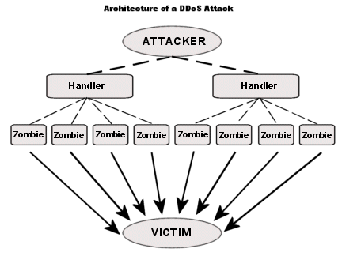
Distributed DoS (DDoS)
CS526
Topic 18: Network Security

Slide 27
Hiding DDoS Attacks
Reflection
  Find big sites with lots of resources, send packets with spoofed source address, response to victim
    PING => PING response
    SYN => SYN-ACK
Pulsing zombie floods
  each zombie active briefly, then goes dormant;
  zombies taking turns attacking
  making tracing difficult
CS526
Topic 18: Network Security

Slide 28
Cryptographic network protection
Solutions above the transport layer
  Examples: SSL and SSH
  Protect against session hijacking and injected data
  Do not protect against denial-of-service attacks caused by spoofed packets
Solutions at network layer
  Use cryptographically random ISNs [RFC 1948]
  More generally: IPsec
  Can protect against
    session hijacking and injection of data.
    denial-of-service attacks using session resets.
CS526
Topic 18: Network Security

Slide 29

Readings for This Lecture
Optional Reading
  Steve Bellovin: A Look Back at “Security Problems in the TCP/IP Protocol Suite”
CS526
Topic 18: Network Security

Slide 30

Coming Attractions …
DNS Security
CS526
Topic 18: Network Security

Slide 31
What is a session?
Definition from FOLDOC
  A lasting connection between a user (or user agent i.e. browser) and a server usually involving the exchange of many requests
Typically maintained by the server
  Includes a data store or a table to store user state and other user specific information
  Includes an index to the table (aka session key or session-id)
  Created on first request or after an authentication process
  Session-id exchanged between browser and server on every request.
Different ways to exchange session-ids
  URL Rewriting
  Hidden Form fields
  Cookies (most common)
Hijacking
  Stealing of this session-id and using it to impersonate and access data
  Passive attack difficult to detect

Slide 32
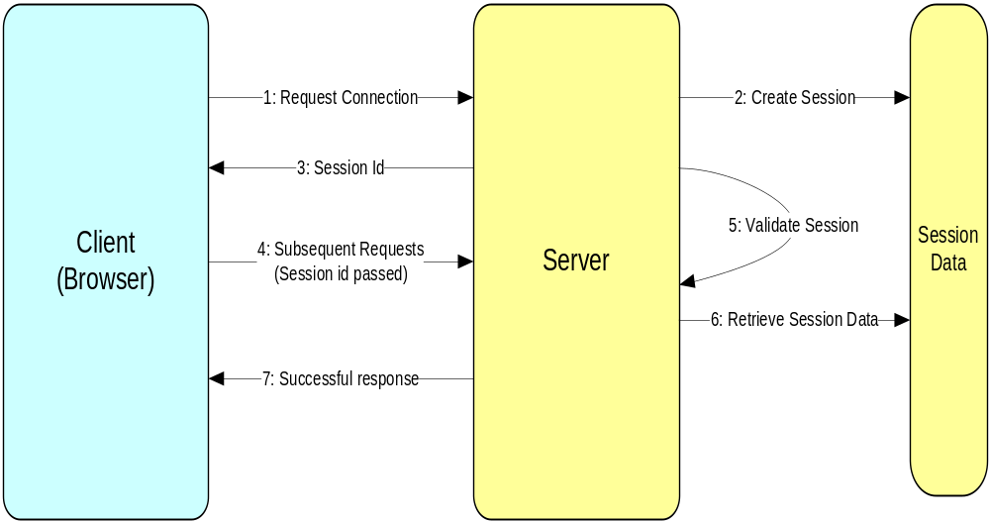
Typical Session

Slide 33
Attack Methods
Guessing Session Id
  shorter length, predictable
Session Fixing
  predictable, session created before authenticated
Security Vulnerabilities in Hops
  trusting private networks, vulnerabilites in web servers, etc
Session Sniffing (typical on non SSL sessions)
  same subnet as client or server
Man in the Middle Attack (SSL)
  ARP Poisoning, DNS Spoofing
Cross Site Scripting (XSS)
  User trusting source, application vulnerability

Slide 34
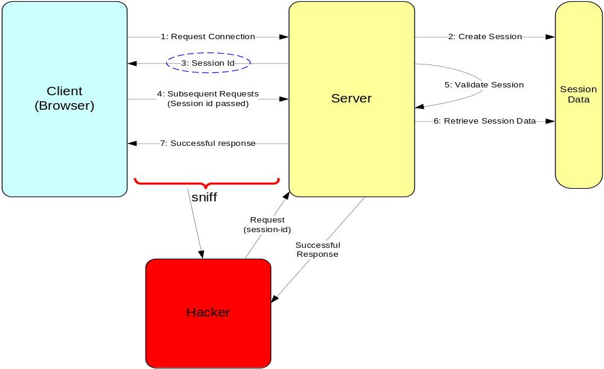
Session Sniffing

Slide 35
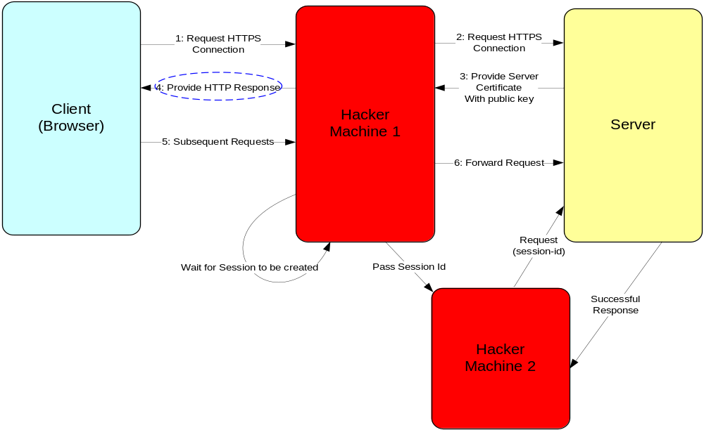
Man in the Middle Attack

Slide 36

Cross Site Scripting (XSS)
Hacker inserts a rogue script to a trusted site.
Common in social / community sites.

